Slide 1


Genesis 3
The Fall of Man

Slide 2

GENESIS STRUCTURE
  Beginning of the Human race (Gen. 1‒11)
  Beginning of the Hebrew race (Gen. 12‒50)

Slide 3

GENESIS STRUCTURE
  Genesis 1-11 (four events)
  Creation (1-2)
  Fall (3-5)
  Flood (6-9)
  National dispersion (10-11)

Slide 4

Contradictory Account of Creation?
Genesis 1 – Overview of the whole creation
Genesis 2 – Details surrounding the creation of the garden, the first man, and his activities on day 6

Slide 5
GENESIS STRUCTURE
  Genesis 1-11 (four events)
  Creation (1-2)
  Fall (3-5)
  Flood (6-9)
  National dispersion (10-11)

Slide 6
GENESIS 3: THE FALL OF MAN
“This chapter is the pivot on which the whole Bible turns”
-W. H. Griffith Thomas

Slide 7

Genesis Structure
  3:1-5 Temptation by the serpent
  3:6 Sin of Adam and Eve
  3:7-13 Results of the sin
  3:14-19 Imposition of divine judgments
  3:20-24 God’s provision in spite of the sin

Slide 8
Genesis Structure
  3:1-5 Temptation by the serpent
  3:6 Sin of Adam and Eve
  3:7-13 Results of the sin
  3:14-19 Imposition of divine judgments
  3:20-24 God’s provision in spite of the sin

Slide 9
Satan’s Tactics (2 Cor 2:11)
  Adds to God’s Word (3:1; 2:16-17)
  Challenges God’s goodness (3:1; 2:16-17)
  Subtracts from God’s Word (3:4; 2:17)
  Offers wisdom without submission to God (3:5; Prov 1:7)

Slide 10

Adam and Eve’s Mistakes (Eph 6:10-20)
  Subtracting from God’s Word (3:2; 2:16)
  Adding to God’s Word (3:3; 2:17)
  Doubting God’s goodness (3:2-3; 2:16-17)
  Initial break down in male headship (2:4-7, 16-17, 18-25)

Slide 11
Genesis Structure
  3:1-5 Temptation by the serpent
  3:6 Sin of Adam and Eve
  3:7-13 Results of the sin
  3:14-19 Imposition of divine judgments
  3:20-24 God’s provision in spite of the sin

Slide 12
Sin of Adam and Eve (3:6)
  Three avenues of temptation (1 John 2:16)
  Lust of the flesh
  Lust of the eye
  Pride of life
  Break down in male headship (1 Tim 2:13; Gen 2:23)

Slide 13
Genesis Structure
  3:1-5 Temptation by the serpent
  3:6 Sin of Adam and Eve
  3:7-13 Results of the sin
  3:14-19 Imposition of divine judgments
  3:20-24 God’s provision in spite of the sin

Slide 14
Results of the Sin
(3:7-13)
  Religion (3:7)
  Broken fellowship (3:8-10)
  “Buck passing” (3:11-13)
  Reversal creation hierarchy (3:11-13)

Slide 15
Results of the Sin
(3:7-13)
  Religion (3:7)
  Broken fellowship (3:8-10)
  “Buck passing” (3:11-13)
  Reversal creation hierarchy (3:11-13)

Slide 16
Results of the Sin
(3:7-13)
  Religion (3:7)
  Broken fellowship (3:8-10)
  “Buck passing” (3:11-13)
  Reversal creation hierarchy (3:11-13)

Slide 17
Results of the Sin
(3:7-13)
  Religion (3:7)
  Broken fellowship (3:8-10)
  “Buck passing” (3:11-13)
  Reversal creation hierarchy (3:11-13)

Slide 18
Results of the Sin
(3:7-13)
  Religion (3:7)
  Broken fellowship (3:8-10)
  “Buck passing” (3:11-13)
  Reversal creation hierarchy (3:11-13)

Slide 19

Genesis 1:26-28
²⁶ Then God said, “Let Us make man in Our image, according to Our likeness; and let them rule over the fish of the sea and over the birds of the sky and over the cattle and over all the earth, and over every creeping thing that creeps on the earth.” ²⁷ God created man in His own image, in the image of God He created him; male and female He created them. ²⁸ God blessed them; and God said to them, “Be fruitful and multiply, and fill the earth, and subdue it; and rule over the fish of the sea and over the birds of the sky and over every living thing that moves on the earth.”

Slide 20
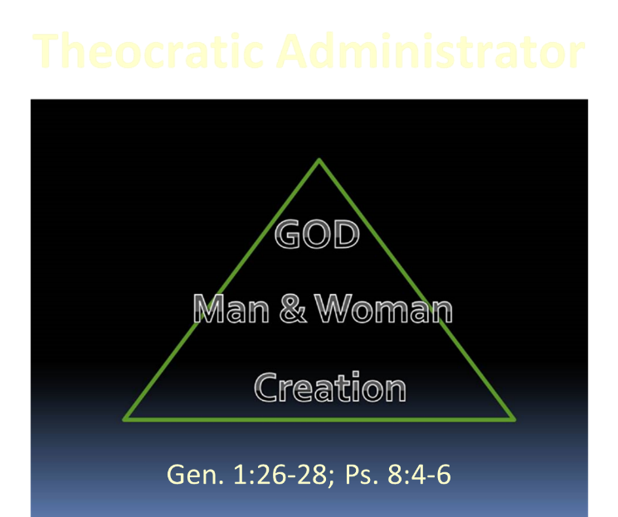

Slide 21

Names & Titles Demonstrating Satan’s Post-Fall, Earthly Authority
(Job 1:7; 2:2; Luke 4:5-8; Rom. 8:19-22)
Prince of this world (John 12:31; 14:30; 16:11)
God of this age (2 Cor. 4:4)
Prince and power of the air (Eph. 2:2)
Who the believer wrestles with (Eph. 6:12)
Roaring lion (1 Pet. 5:8)
Whole world lies in his power (1 John 5:19)

Slide 22


Slide 23
Results of the Sin
(3:7-13)
  Religion (3:7)
  Broken fellowship (3:8-10)
  “Buck passing” (3:11-13)
  Reversal creation hierarchy (3:11-13)

Slide 24
Genesis Structure
  3:1-5 Temptation by the serpent
  3:6 Sin of Adam and Eve
  3:7-13 Results of the sin
  3:14-19 Imposition of divine judgments
  3:20-24 God’s provision in spite of the sin

Slide 25
Divine Judgments
(3:14-19)
  Serpent (3:14-15)
  Woman (3:16)
  Man (3:17-19)

Slide 26
Divine Judgments
(3:14-19)
  Serpent (3:14-15)
  Woman (3:16)
  Man (3:17-19)

Slide 27
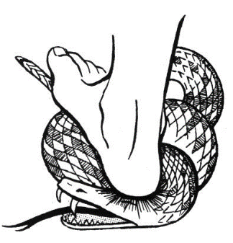
Serpent
(3:14-15)
  Serpent’s body (3:14)
  Protoevangelium (3:15)

Slide 28
Serpent
(3:14-15)
  Serpent’s body (3:14)
  Protoevangelium (3:15)

Slide 29

Romans 8:19-22
¹⁹ For the anxious longing of the creation waits eagerly for the revealing of the sons of God. ²⁰ For the creation was subjected to futility, not willingly, but because of Him who subjected it, in hope ²¹ that the creation itself also will be set free from its slavery to corruption into the freedom of the glory of the children of God. ²² For we know that the whole creation groans and suffers the pains of childbirth together until now.

Slide 30
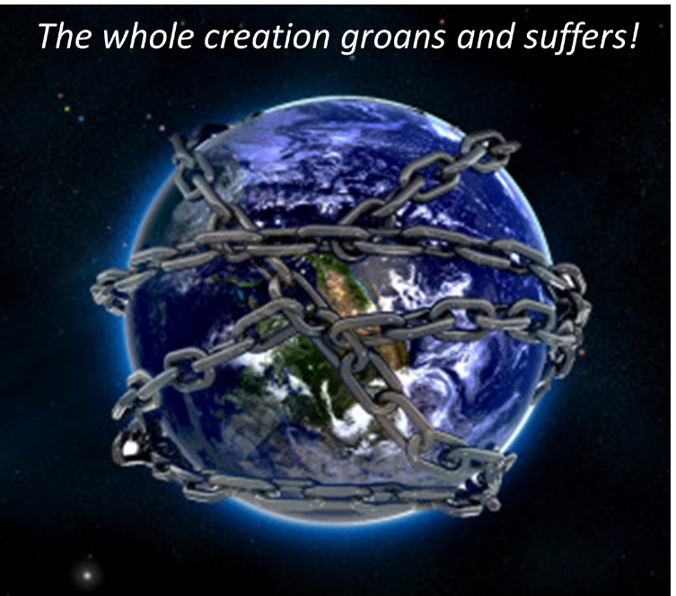

Slide 31
Serpent
(3:14-15)
  Serpent’s body (3:14)
  Protoevangelium (3:15)

Slide 32


Genesis 3:15
“And I will put enmity Between you and the woman, And between your seed and her seed; He shall bruise you on the head, And you shall bruise him on the heel.”

Slide 33
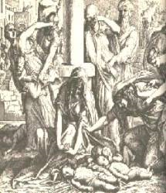
Satanic Attempts to Stop Messiah
  Cain; Gen. 4, 1 Jn. 3:12
  Pharaoh; Ex. 1
  Athaliah;2 Chron. 22
  Haman; Esther
  Herod; Mt.2;Rev 12:4
  Matt 4:5-7

Slide 34
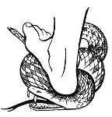
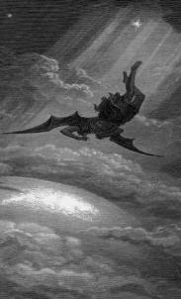
Satan’s Progressive Defeat
  Initial eviction from heaven (Isa 14:12-15; Ezek 28:12-17)
  Eden (Gen 3:15)
  Pre-diluvian world (1 Pet 3:19-20)
  Cross (John 12:31; 16:11; Col 2:15; Heb 2:14; 1 John 3:8)
  Mid point of the Tribulation (Rev 12:9)
  Beginning of millennium (Rev 20:2-3)
  End of millennium (Rev 20:10)

Slide 35
Genesis 3:15
“And I will put enmity Between you and the woman, And between your seed and her seed; He shall bruise you on the head, And you shall bruise him on the heel.”

Slide 36
Genesis 3:15
“And I will put enmity Between you and the woman, And between your seed and her seed; He shall bruise you on the head, And you shall bruise him on the heel.”

Slide 37
Divine Judgments
(3:14-19)
  Serpent (3:14-15)
  Woman (3:16)
  Man (3:17-19)

Slide 38
Woman
(3:16)
  Painful child birth (3:16a)
  Relational conflict (3:16b)

Slide 39
Woman
(3:16)
  Painful child birth (3:16a)
  Relational conflict (3:16b)

Slide 40
Genesis 1:26-28
²⁶ Then God said, “Let Us make man in Our image, according to Our likeness; and let them rule over the fish of the sea and over the birds of the sky and over the cattle and over all the earth, and over every creeping thing that creeps on the earth.” ²⁷ God created man in His own image, in the image of God He created him; male and female He created them. ²⁸ God blessed them; and God said to them, “Be fruitful and multiply, and fill the earth, and subdue it; and rule over the fish of the sea and over the birds of the sky and over every living thing that moves on the earth.”

Slide 41
Woman
(3:16)
  Painful child birth (3:16a)
  Relational conflict (3:16b)

Slide 42

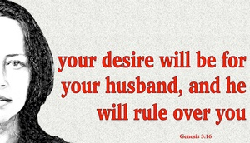
Genesis 3:16
“To the woman He said, ‘I will greatly multiply Your pain in childbirth, In pain you will bring forth children; Yet your desire [TESHUQAH] will be for your husband, And he will rule over you.’”

Slide 43

Song of Solomon 7:10
“I am my beloved’s, and his desire [TESHUQAH] is for me.”

Slide 44
Parallel Between Genesis 3:16 & 4:7
Genesis 3:16
“your desire [TESHUQAH] will be for your husband, and he will rule over you.”
Genesis 4:7
“its [sin] desire [TESHUQAH] is for you, but you must master it.”
Susan T. Foh, “What is the Woman’s Desire?”, The Westminster Theological Journal 37 (1974-75), 376-83.

Slide 45
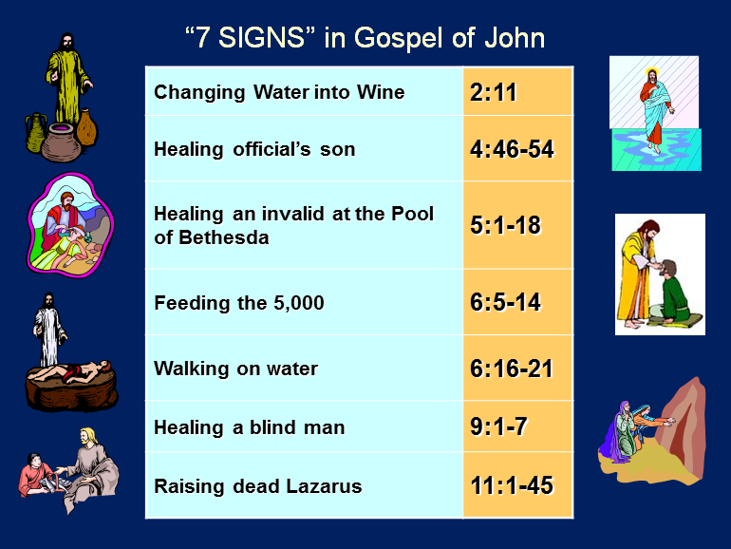

Slide 46


1 Corinthians 7:28
“But if you marry, you have not sinned; and if a virgin marries, she has not sinned. Yet such will have trouble in this life, and I am trying to spare you.”

Slide 47

Proverbs 21:9, 19; 25:24
“⁹ It is better to live in a corner of a roof
Than in a house shared with a contentious woman… ¹⁹ It is better to live in a desert land
Than with a contentious and vexing woman... ^{25:24} It is better to live in a corner of the roof
Than in a house shared with a contentious woman.”

Slide 48
Divine Judgments
(3:14-19)
  Serpent (3:14-15)
  Woman (3:16)
  Man (3:17-19)

Slide 49
Man
(3:17-19)
  Painful labor (3:17-19a)
  Death (3:19b)

Slide 50
Man
(3:17-19)
  Painful labor (3:17-19a)
  Death (3:19b)

Slide 51
Genesis 3:17-19
¹⁷ Then to Adam He said, “Because you have listened to the voice of your wife, and have eaten from the tree about which I commanded you, saying, ‘You shall not eat from it’; Cursed is the ground because of you; In toil you will eat of it All the days of your life. ¹⁸ “Both thorns and thistles it shall grow for you; And you will eat the plants of the field; ¹⁹ By the sweat of your face You will eat bread...”

Slide 52

Genesis 3:19
“By the sweat of your face You will eat bread, Till you return to the ground, Because from it you were taken; For you are dust, And to dust you shall return.”

Slide 53
Man
(3:17-19)
  Painful labor (3:17-19a)
  Death (3:19b)

Slide 54
Genesis 3:19
“By the sweat of your face You will eat bread, Till you return to the ground, Because from it you were taken; For you are dust, And to dust you shall return.”

Slide 55
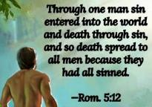
Genesis 2:16-17
“¹⁶ The Lord God commanded the man, saying, ‘From any tree of the garden you may eat freely; ¹⁷ but from the tree of the knowledge of good and evil you shall not eat, for in the day that you eat from it you will surely die (muwth).’”

Slide 56

1 Corinthians 15:21-22
“²¹ For since by a man came death, by a man also came the resurrection of the dead. ²² For as in Adam all die, so also in Christ all will be made alive.”

Slide 57

Romans 5:12
“Therefore, just as through one man sin entered into the world, and death through sin, and so death spread to all men, because all sinned—.”

Slide 58

2 Cor. 4:16
Therefore we do not lose heart, but though our outer man is decaying, yet our inner man is being renewed day by day.

Slide 60
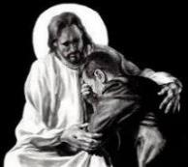
Revelation 21:4
“and He will wipe away every tear from their eyes; and there will no longer be any death; there will no longer be any mourning, or crying, or pain; the first things have passed away.”

Slide 61
Genesis Structure
  3:1-5 Temptation by the serpent
  3:6 Sin of Adam and Eve
  3:7-13 Results of the sin
  3:14-19 Imposition of divine judgments
  3:20-24 God’s provision in spite of the sin

Slide 62
God’s Provision
(3:20-24)
  Continuation of the race (3:20)
  Forgiveness (3:21, 7)
  Expulsion of Adam and Eve from Eden (3:22-24)

Slide 63
God’s Provision
(3:20-24)
  Continuation of the race (3:20)
  Forgiveness (3:21, 7)
  Expulsion of Adam and Eve from Eden (3:22-24)

Slide 64
Genesis 3:19
“By the sweat of your face You will eat bread, Till you return to the ground, Because from it you were taken; For you are dust, And to dust you shall return.”

Slide 65

Acts 17:26
“and He made from one man every nation of mankind to live on all the face of the earth, having determined their appointed times and the boundaries of their habitation.” (Italics added)

Slide 66
God’s Provision
(3:20-24)
  Continuation of the race (3:20)
  Forgiveness (3:21, 7)
  Expulsion of Adam and Eve from Eden (3:22-24)

Slide 67
God’s Provision
(3:20-24)
  Continuation of the race (3:20)
  Forgiveness (3:21, 7)
  Expulsion of Adam and Eve from Eden (3:22-24)

Slide 68
Genesis 1:26-28
²⁶ Then God said, “Let Us make man in Our image, according to Our likeness; and let them rule over the fish of the sea and over the birds of the sky and over the cattle and over all the earth, and over every creeping thing that creeps on the earth.” ²⁷ God created man in His own image, in the image of God He created him; male and female He created them. ²⁸ God blessed them; and God said to them, “Be fruitful and multiply, and fill the earth, and subdue it; and rule over the fish of the sea and over the birds of the sky and over every living thing that moves on the earth.”

Slide 69
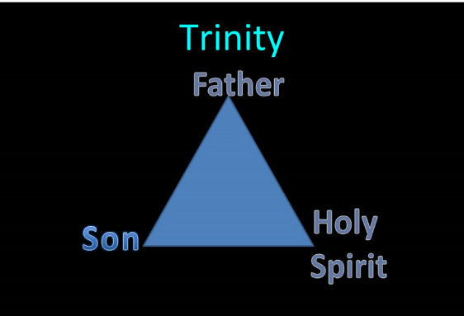
TRINITARIANISM IN GENESIS
  Gen 1:26
  Gen 3:22
  Gen 11:7
  Isa 6:8

Slide 70
THE DIVINE INSTITUTIONS
Conscience (Gen. 3:22)
Marriage and family (Gen. 1:26-28; 2:18-25)
Labor (Gen. 2:15; 3:19)
Government (Gen. 9:6)
Nationalism (Gen. 11:1-9)

Slide 71
THE DIVINE INSTITUTIONS
Conscience (Gen. 3:22)
Marriage and family (Gen. 1:26-28; 2:18-25)
Labor (Gen. 2:15; 3:19)
Government (Gen. 9:6)
Nationalism (Gen. 11:1-9)

Slide 72
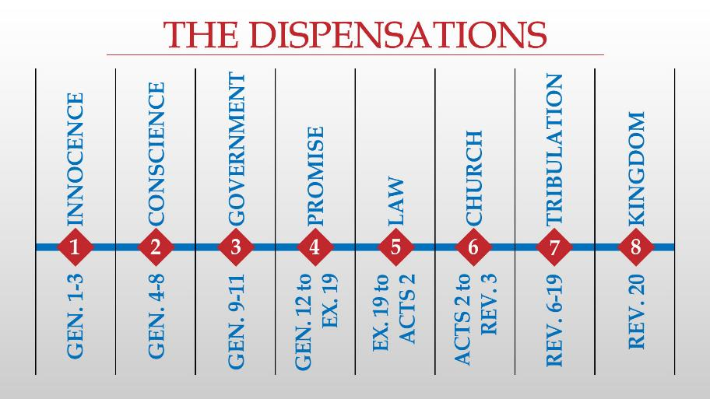

Slide 73
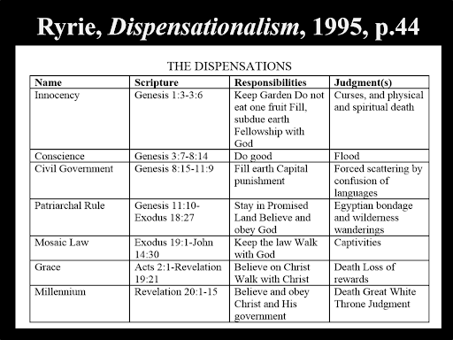

Slide 74
Conclusion

Slide 75
Genesis Structure Review
  3:1-5 Temptation by the serpent
  3:6 Sin of Adam and Eve
  3:7-13 Results of the sin
  3:14-19 Imposition of divine judgments
  3:20-24 God’s provision in spite of the sin

Slide 76

“The Lord bless you and keep you; the Lord make his face shine on you and be gracious to you; the Lord turn his face toward you and give you peace.” (NIV)

