Slide 1
PRACTICAL RIGHTEOUSNESS
Dr. Andy Woods
Senior Pastor – Sugar Land Bible Church
President – Chafer Theological Seminary

Slide 2
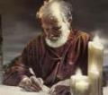
Answering Eleven Questions
Who wrote it? – James
What do we know about the author? – Christ’s ½ Brother
Who was the audience? – Believing Jews in the Diaspora
Where was if written from? – Jerusalem
When was the book written? – A.D. 44‒47
What was the book’s occasion? – Practical righteousness
What is the book’s purpose? – Achieving practical righteousness
What is the book about? – Practical righteousness
What is the book’s theme? – Daily living
What makes the book different? – Practicality
How is the book organized? – Faith and Wisdom

Slide 3
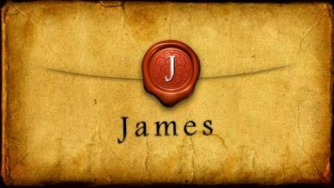
JAMES STRUCTURE
Faith (James 1:1‒3:12)
Wisdom (James 3:13‒5:20)

Slide 4
JAMES STRUCTURE
Faith (James 1:1‒3:12)
Wisdom (James 3:13‒5:20)

Slide 5
JAMES STRUCTURE
Faith (1:1–3:12)
Trials (1:2-18)
Obedience to the Word (1:19-27)
Favoritism (2:1-13)
Faith manifesting works (2:14-26)
Tongue (3:1-12)

Slide 6
JAMES STRUCTURE
Faith (1:1–3:12)
Trials (1:2-18)
Obedience to the Word (1:19-27)
Favoritism (2:1-13)
Faith manifesting works (2:14-26)
Tongue (3:1-12)

Slide 7
James 1:2-18
Trials – Jas 1:2-18
Rejoicing during trials – Jas 1:2-12
Command not to charge God with temptation – Jas 1:13-18

Slide 8
JAMES STRUCTURE
Faith (1:1–3:12)
Trials (1:2-18)
Obedience to the Word (1:19-27)
Favoritism (2:1-13)
Faith manifesting works (2:14-26)
Tongue (3:1-12)

Slide 9
Faith Obeys God (James 1:19-27)
Need for Slowness in Speaking & Anger (1:19-20)
Need for Obedience to God’s Word (1:21-25)
Need for True Religion (1:26-27)

Slide 10
Faith Obeys God (James 1:19-27)
Need for Slowness in Speaking & Anger (1:19-20)
Need for Obedience to God’s Word (1:21-25)
Need for True Religion (1:26-27)

Slide 11
Faith Obeys God (James 1:19-27)
Need for Slowness in Speaking & Anger (1:19-20)
Need for Obedience to God’s Word (1:21-25)
Need for True Religion (1:26-27)

Slide 12
II. Need for Obedience to God’s Word (Jas 1:21-25)
Reception of the Word (21)
Doers of the Word (22-25)

Slide 13
II. Need for Obedience to God’s Word (Jas 1:21-25)
Reception of the Word (21)
Doers of the Word (22-25)

Slide 14
Reception of God’s Word (Jas 1:21)
Removal (21a)
Reception (21b)
Result (21c)

Slide 15
II. Need for Obedience to God’s Word (Jas 1:21-25)
Reception of the Word (21)
Doers of the Word (22-25)

Slide 16
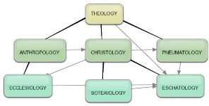
Areas of Systematic Theology
Prolegomena – Introduction
Bibliology – Study of the Bible
Theology – Study of God
Christology – Study of Christ
Pneumatology – Study of the Holy Spirit
Anthropology – Study of Man
Hamartiology – Study of sin
Soteriology – Study of salvation
Angelology – Study of angels
Ecclesiology – Study of the Church
Eschatology – Study of the end

Slide 17
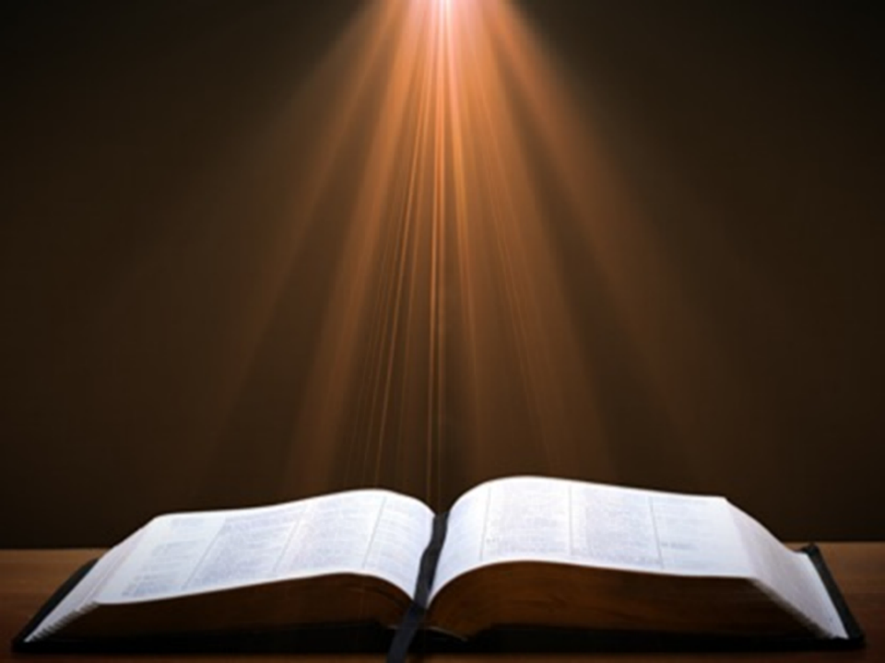
Ezra 7:10
“For Ezra had firmly resolved to study the Law of the Lord and to practice it, and to teach His statutes and ordinances in Israel.”

Slide 18
Faith Obeys God (James 1:19-27)
Need for Slowness in Speaking & Anger (1:19-20)
Need for Obedience to God’s Word (1:21-25)
Need for True Religion (1:26-27)

Slide 19
III. Need for True Religion (Jas 1:26-27)
What True Religion Is Not (26)
What True Religion Is (27)

Slide 20
III. Need for True Religion (Jas 1:26-27)
What True Religion Is Not (26)
What True Religion Is (27)

Slide 21
Three Tenses of Salvation
Phase | Justification | Sanctification | Glorification
Tense | Past | Present | Future
Saved from sin’s: | Penalty | Power | Presence
Scripture | Eph 2:8-9; Titus 3:5 | Philip 2:12 | Rom 5:10
Nature | Single | Dual | Single

Slide 22
Three Tenses of Salvation
Phase | Justification | Sanctification | Glorification
Tense | Past | Present | Future
Saved from sin’s: | Penalty | Power | Presence
Scripture | Eph 2:8-9; Titus 3:5 | Philip 2:12 | Rom 5:10
Nature | Single | Dual | Single

Slide 23
III. Need for True Religion (Jas 1:26-27)
What True Religion Is Not (26)
What True Religion Is (27)

Slide 24
Thomas Jefferson
"My views ... are the result of a life of inquiry and reflection, and very different from the anti-Christian system imputed to me by those who know nothing of my opinions. To the corruptions of Christianity, I am, indeed, opposed; but not to the genuine precepts of Jesus Himself. I am a Christian in the only sense in which He wished any one to be; sincerely attached to his doctrines in preference to all others...His system of morals...if filled up in the style and spirit of the rich fragments He left us, would be the most perfect and sublime that has ever been taught by man...”
On April 21, 1803, Jefferson wrote to Dr. Benjamin Rush, also a signer of the Declaration

Slide 25
Thomas Jefferson
“His moral doctrines...were more pure and perfect than those of the most correct of the philosophers...gathering all into one family under the bonds of love, charity, peace, common wants and common aids. A development of this head will evince the peculiar superiority of the system of Jesus over all others. The precepts of philosophy, and of the Hebrew code, laid hold of actions only. He pushed his scrutinies into the heart of man; erected his tribunal in the region of his thoughts, and purified the waters at the fountain head.”
On April 21, 1803, Jefferson wrote to Dr. Benjamin Rush, also a signer of the Declaration

Slide 26
What True Religion Is (Jas 1:27)
Ministering to Widows & Orphans (27a)
Moral purity (27b)

Slide 27
What True Religion Is (Jas 1:27)
Ministering to Widows & Orphans (27a)
Moral purity (27b)

Slide 28
Deuteronomy 28:49-50
“⁴⁹ The Lord will bring a nation against you from afar, from the end of the earth, as the eagle swoops down, a nation whose language you shall not understand, ⁵⁰ a nation of fierce countenance who will have no respect for the old, nor show favor to the young.”

Slide 29
What True Religion Is (Jas 1:27)
Ministering to Widows & Orphans (27a)
Moral purity (27b)

Slide 30
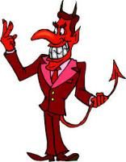
Names & Titles Demonstrating Satan’s Post-Fall, Earthly Authority (Job 1:7; 2:2; Luke 4:5-8; Rom. 8:19-22)
Prince of this world (John 12:31; 14:30; 16:11)
God of this age (2 Cor. 4:4)
Prince and power of the air (Eph. 2:2)
Who the believer wrestles with (Eph. 6:12)
Roaring lion (1 Pet. 5:8)
Whole world lies in his power (1 John 5:19)

Slide 31
CONCLUSION

Slide 32
JAMES STRUCTURE
Faith (1:1–3:12)
Trials (1:2-18)
Obedience to the Word (1:19-27)
Favoritism (2:1-13)
Faith manifesting works (2:14-26)
Tongue (3:1-12)

Slide 33
Faith Obeys God (James 1:19-27)
Need for Slowness in Speaking & Anger (1:19-20)
Need for Obedience to God’s Word (1:21-25)
Need for True Religion (1:26-27)

Slide 34
JAMES STRUCTURE
Faith (1:1–3:12)
Trials (1:2-18)
Obedience to the Word (1:19-27)
Favoritism (2:1-13)
Faith manifesting works (2:14-26)
Tongue (3:1-12)

