Slide 1


THE RAPTURE
What and When? – Part 25
Andrew Marshall Woods, Th.M., JD., PhD.
Sr. Pastor, Sugar Land Bible Church

Slide 2

What is the Rapture?
An important doctrine
Distinct from the Second Advent
Catching away of all living believers (1 Thess 4:17)
Reunion (1 Thess 4:14-16)
Resurrection (1 Cor 15:50-54)
Exemption from death (1 Cor 15:51, 54-56)
Instantaneous (1 Cor 15:52)
Mystery (1 Cor 15:51)
Imminent (1 Cor 15:51; 1 Thess 4:15)
Traditional doctrine now being recovered

Slide 3
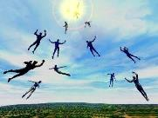
When Will the Rapture Take Place Relative to the Tribulation Period?
Pre-tribulation rapture theory
Mid-tribulation rapture theory
Post-tribulation rapture theory
Pre-wrath rapture theory
Partial rapture theory

Slide 4


Slide 5
When is the Rapture?
7 Arguments Favoring the Pre-Tribulation View
Tribulation's purpose concerns Israel (Jer 30:7; Dan 9:24)
No biblical reference to the church on earth during the Tribulation period (Rev 4-22)
Church is promised an exemption from divine wrath (1 Thess 1:10; 5:9; Rom 5:9; Rev 3:10; 6:17)
Rapture is imminent (1 Cor 15:51; 1 Thess 4:15)
Rapture is a comfort (1 Thess 4:18)
Antichrist cannot come to power until the restrainer is removed (2 Thess 2:6-7)
Symbolic parallels (2 Peter 2:5-9)

Slide 6
Strengthening the Pre-Tribulation Case
John 14:1-4
Revelation 3:10
First Thessalonians 4‒5
Second Thessalonians 2:3a
Matthew 24‒25

Slide 7
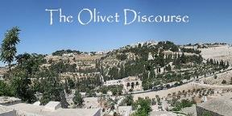
Preview of Matthew 24–25
The problem
The larger context
The immediate context (23:37-39)
The Disciples’ questions (24:1-3)
The Tribulation’s first half (24:4-14)
The Tribulation’s mid-point (24:15-20)
The Tribulation’s second half (24:21-22)
The Second Advent (24:23-31)
Eight parabolic exhortations (24:32‒25:46)

Slide 8
Preview of Matthew 24–25
The problem
The larger context
The immediate context (23:37-39)
The Disciples’ questions (24:1-3)
The Tribulation’s first half (24:4-14)
The Tribulation’s mid-point (24:15-20)
The Tribulation’s second half (24:21-22)
The Second Advent (24:23-31)
Eight parabolic exhortations (24:32‒25:46)

Slide 9
THE RAPTURE IN MATTHEW 24
Note the order of events:
        ²⁹ There are days of tribulation
        ³⁰ The whole world sees Jesus return
        ³¹ The elect are gathered to Him
        ⁴⁰⁻⁴¹ The rapture reiterated
How do Pre-Tribulation theorists explain the Rapture occurring before the apocalypse and before the Second Coming? Jesus says exactly the opposite in simple, unmistakable language.
Are there two Raptures - one before this that Jesus mysteriously didn't describe and then this one, which He did? Why would He leave one out? Or is there only one, but when he discusses it He jumbles up the order of events? Why would He do that?

Slide 10
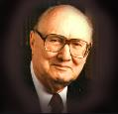
John F. Walvoord
"Christ's Olivet Discourse on the End of the Age - Part I," Bibliotheca Sacra 128/#510 (April 1971), p. 116..
“In Matthew 24–Matthew 25 the expositor should, therefore, understand that the program of God for the end of the age has in view the period ending with the second coming of Christ to the earth and the establishment of His earthly Kingdom, not the church age specifically ending with the rapture. Both the questions of the disciples and the answers of Christ are therefore, keyed to the Jewish expectation based on Old Testament prophecy, and the program of God for the earth in general rather than the church as the body of Christ.”

Slide 11
Preview of Matthew 24–25
The problem
The larger context
The immediate context (23:37-39)
The Disciples’ questions (24:1-3)
The Tribulation’s first half (24:4-14)
The Tribulation’s mid-point (24:15-20)
The Tribulation’s second half (24:21-22)
The Second Advent (24:23-31)
Eight parabolic exhortations (24:32‒25:46)

Slide 12
Matthew’s Purposes
To explain that Jesus in whom they had believed was the long-awaited Jewish Messiah
To explain why the kingdom had been postponed despite the fact that the king had arrived
To explain the interim program of God during the kingdom’s absence

Slide 13
Preview of Matthew 24–25
The problem
The larger context
The immediate context (23:37-39)
The Disciples’ questions (24:1-3)
The Tribulation’s first half (24:4-14)
The Tribulation’s mid-point (24:15-20)
The Tribulation’s second half (24:21-22)
The Second Advent (24:23-31)
Eight parabolic exhortations (24:32‒25:46)

Slide 14

Matthew 23:37-39
³⁷ “Jerusalem, Jerusalem, who kills the prophets and stones those who are sent to her! How often I wanted to gather [episynagō] your children together, the way a hen gathers [episynagō] her chicks under her wings, and you were unwilling. ³⁸ Behold, your house is being left to you desolate! ³⁹ For I say to you, from now on you will not see Me until you say, ‘Blessed is He who comes in the name of the Lord!’”

Slide 15
Preview of Matthew 24–25
The problem
The larger context
The immediate context (23:37-39)
The Disciples’ questions (24:1-3)
The Tribulation’s first half (24:4-14)
The Tribulation’s mid-point (24:15-20)
The Tribulation’s second half (24:21-22)
The Second Advent (24:23-31)
Eight parabolic exhortations (24:32‒25:46)

Slide 16
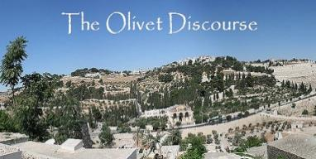
Matthew 24:3
“³ As He was sitting on the Mount of Olives, the disciples came to Him privately, saying, ‘Tell us, when will these things happen, and what will be the sign of Your coming, and of the end of the age?’”

Slide 17
Preview of Matthew 24–25
The problem
The larger context
The immediate context (23:37-39)
The Disciples’ questions (24:1-3)
The Tribulation’s first half (24:4-14)
The Tribulation’s mid-point (24:15-20)
The Tribulation’s second half (24:21-22)
The Second Advent (24:23-31)
Eight parabolic exhortations (24:32‒25:46)

Slide 18
Matt 24 / Rev 6 Parallels
Prediction | Birth pangs (Matt 24) | Seal judgments (Rev 6)
1. False Christ | 24:5 | 6:2
2. War | 24:6 | 6:3-4
3. Famine | 24:7 | 6:5-6
4. Death | 24:6-7 | 6:7-8
5. Martyrs | 24:9-13 | 6:9-11
6. Earthquakes | 24:7 | 6:12-17
7. Evangelism | 24:14 | 7:1-9

Slide 19


Matthew 24:14
“This gospel of the kingdom (Israel’s national gospel) shall be preached in the whole world as a testimony to all the nations, and then the end will come.”

Slide 20
Preview of Matthew 24–25
The problem
The larger context
The immediate context (23:37-39)
The Disciples’ questions (24:1-3)
The Tribulation’s first half (24:4-14)
The Tribulation’s mid-point (24:15-20)
The Tribulation’s second half (24:21-22)
The Second Advent (24:23-31)
Eight parabolic exhortations (24:32‒25:46)

Slide 21


Slide 22

HANUKKAH
The Maccabean revolt
December 25th 165 BC : the temple is liberated and rededicated
1 & 2 Maccabees
The miracle of the lamp oil
Hanukkah “Feast of Dedication” (festival of lights).
Christmas / Jewish Holiday
John 10:22-24

Slide 23
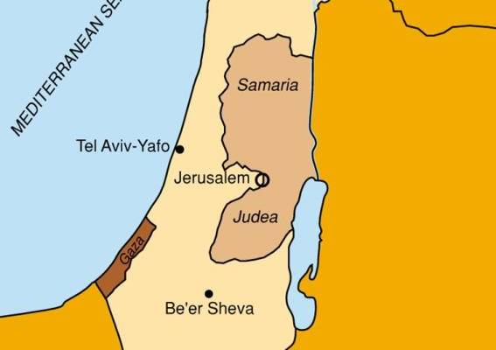

Slide 24

Matthew 24:15-16, 20
“¹⁵ Therefore when you see the abomination of desolation which was spoken of through Daniel the prophet, standing in the holy place (let the reader understand) ¹⁶ then those who are in Judea must flee to the mountains…²⁰ But pray that your flight will not be in the winter, or on a Sabbath.”

Slide 25
Preview of Matthew 24–25
The problem
The larger context
The immediate context (23:37-39)
The Disciples’ questions (24:1-3)
The Tribulation’s first half (24:4-14)
The Tribulation’s mid-point (24:15-20)
The Tribulation’s second half (24:21-22)
The Second Advent (24:23-31)
Eight parabolic exhortations (24:32‒25:46)

Slide 26

Isaiah 13:12
“I will make mortal man scarcer than pure gold and mankind than the gold of Ophir.”

Slide 27
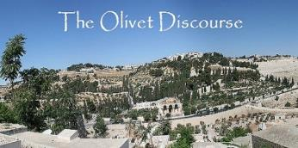
Matthew 24:21-22
“²¹ For then there will be a great tribulation, such as has not occurred since the beginning of the world until now, nor ever will. ²² Unless those days had been cut short, no life would have been saved; but for the sake of the elect those days will be cut short.”

Slide 28
Deuteronomy 7:7
⁷ “The LORD did not set His love on you nor choose you because you were more in number than any of the peoples, for you were the fewest of all peoples.”

Slide 29
Preview of Matthew 24–25
The problem
The larger context
The immediate context (23:37-39)
The Disciples’ questions (24:1-3)
The Tribulation’s first half (24:4-14)
The Tribulation’s mid-point (24:15-20)
The Tribulation’s second half (24:21-22)
The Second Advent (24:23-31)
Eight parabolic exhortations (24:32‒25:46)

Slide 31

VII. The Second Advent
(Matthew 24:23-31)
False returns of Christ (24:23-26)
The true return of Christ (24:27-31)

Slide 32
VII. The Second Advent
(Matthew 24:23-31)
False returns of Christ (24:23-26)
The true return of Christ (24:27-31)

Slide 33


2 Thessalonians 2:9
“that is, the one whose coming is in accord with the activity of Satan, with all power and signs and false wonders.”

Slide 34
Antichrist’s Satanic Miracles (2 Thessalonians 2:9)
MIRACLE | GREEK | CHRIST’S MINISTRY
Powers | Dynamis | Matt. 11:20
Signs | Semēion | John 20:30
Wonders | Teras | Acts 2:22

Slide 35

Satanic/Demonic Miracles
Exod. 7–8
Deut. 13:1-3
Job 1:12-19; 2:7-8
1 Sam. 28?
Matt. 7:21-23; 24:24
Acts 8:9; 16:16
Gal. 1:6-9
2 Thess. 2:9
Rev. 13:3, 13, 15; 16:13-14

Slide 36
VII. The Second Advent
(Matthew 24:23-31)
False returns of Christ (24:23-26)
The true return of Christ (24:27-31)

Slide 37
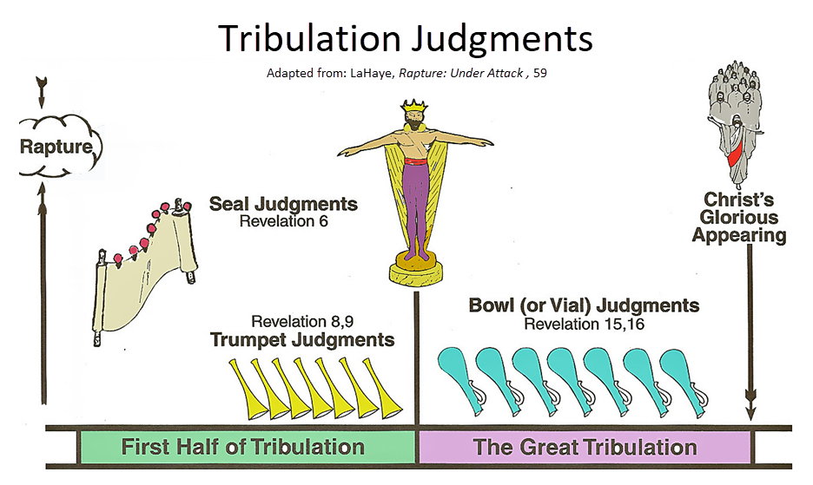

Slide 38


Seven Bowls
(Revelation 16)
1st Bowl (16:1-2) – Boils
2nd Bowl (16:3) – Sea becomes blood
3rd Bowl (16:4-7) – Freshwater destroyed
4th Bowl (16:8-9) – Sun scorches man
5th Bowl (16:10-11) – Darkness
6th Bowl (16:13-16) – Euphrates dried
7th Bowl (16:17-21) – Greatest earthquake

Slide 39
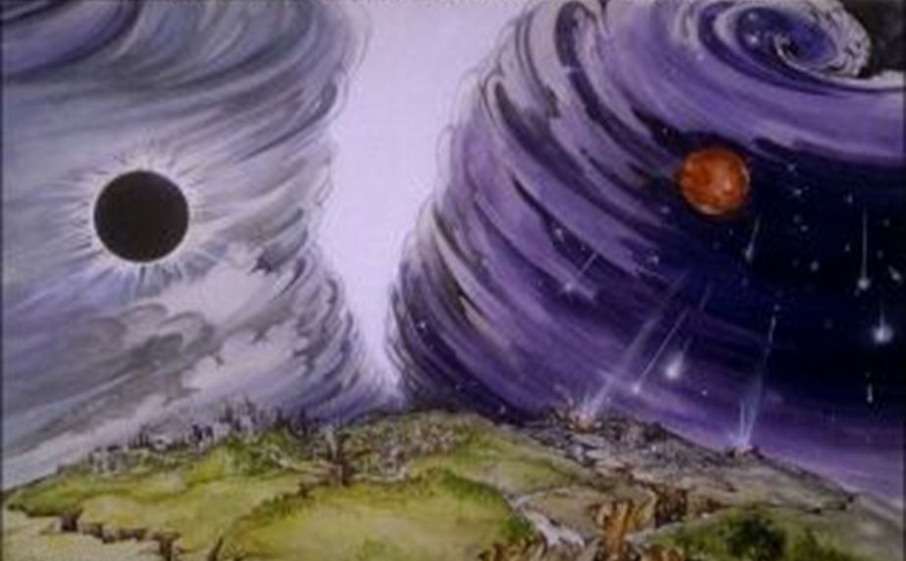
Isaiah 13/Matthew 24 Connection
Isaiah 13:10; Matthew 24:29
Isaiah 13:12; Matthew 24:21-22

Slide 40
Matthew 24:30
“And then the sign of the Son of Man will appear in the sky, and then all the tribes of the earth will mourn, and they will see the SON OF MAN COMING ON THE CLOUDS OF THE SKY with power and great glory.”

Slide 41
Matthew 24:30
“And then the sign of the Son of Man will appear in the sky, and then all the tribes of the earth will mourn, and they will see the SON OF MAN COMING ON THE CLOUDS OF THE SKY with power and great glory.”

Slide 42
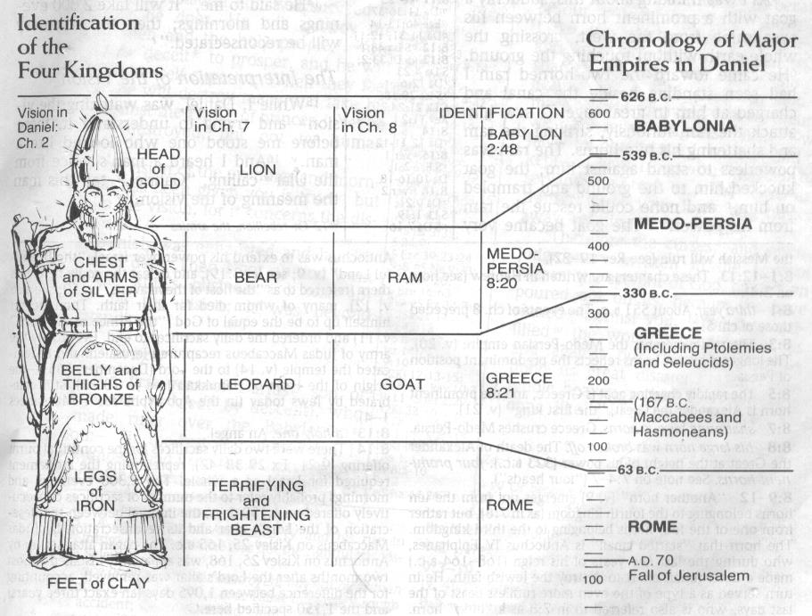

Slide 43
Matthew 24:30
“And then the sign of the Son of Man will appear in the sky, and then all the tribes of the earth will mourn, and they will see the SON OF MAN COMING ON THE CLOUDS OF THE SKY with power and great glory.”

Slide 44
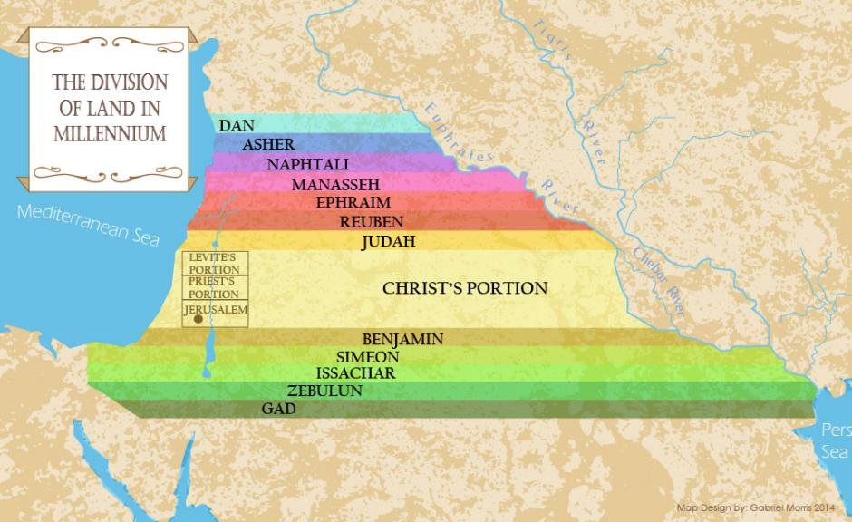

Slide 45
Matthew 24:31
“And He will send forth His angels with a great trumpet and they will gather together [episynagō] His elect from the four winds, from one end of the sky to the other.”

Slide 46

1 Thessalonians 4:13-18
¹³ "But we do not want you to be uninformed, brethren, about those who are asleep, so that you will not grieve as do the rest who have no hope. ¹⁴ For if we believe that Jesus died and rose again, even so God will bring with Him those who have fallen asleep in Jesus. ¹⁵ For this we say to you by the word of the Lord, that we who are alive and remain until the coming of the Lord, will not precede those who . . .

Slide 47
1 Thessalonians 4:13-18
. . . have fallen asleep. ¹⁶ For the Lord Himself will descend from heaven with a shout, with the voice of the archangel and with the trumpet of God, and the dead in Christ will rise first. ¹⁷ Then we who are alive and remain will be caught up together with them in the clouds to meet the Lord in the air, and so we shall always be with the Lord. ¹⁸ Therefore comfort one another with these words."

Slide 48
John A. Sproule
"An Exegetical Defense of Pretribulationalism" (Th.D. diss., Grace Theological Seminary, 1981), 53.
“Where does Paul mention the darkening of the sun (Matt. 24:29), the moon not giving its light (Matt. 24:29), the stars falling from the sky (Matt. 24:29), the powers of the heavens being shaken (Matt. 24:29), all the tribes of the earth mourning (Matt. 24:30), all the world seeing the coming of the Son of Man (Matt. 24:30), or God sending forth angels (Matt.24:31)?”

Slide 49
Paul D. Feinberg
"Response: Paul D. Feinberg," in The Rapture: Pre-, Mid-, or Posttribulational, ed. Richard R. Reiter (Grand Rapids: Zondervan, 1984), 225.
“Notice what happens when you examine both passages carefully. In Matthew the Son of Man comes on the clouds, while in 1 Thessalonians 4 the ascending believers are in them. In Matthew the angels gather the elect; in 1 Thessalonians the Lord Himself (note the emphasis) gathers the believers. Thessalonians only speaks of the voice of the archangel. In the Olivet Discourse nothing is said about a resurrection, while in the latter text it is the central point. In the two passages the differences in what will take place prior to the appearance of Christ is striking. Moreover, the order of ascent is absent from Matthew in spite of the fact that it is the central part of the epistle.”

Slide 50

Isaiah 27:13
“It will come about also in that day that a great trumpet will be blown, and those who were perishing in the land of Assyria and who were scattered in the land of Egypt will come and worship the Lord in the holy mountain at Jerusalem.”

Slide 51
Matthew 24:31
“And He will send forth His angels with a great trumpet and they will gather together [episynagō] His elect from the four winds, from one end of the sky to the other.”

Slide 52
Isaiah 11:11-12
Then it will happen on that day that the Lord Will again recover the second time with His hand The remnant of His people, who will remain, From Assyria, Egypt, Pathros, Cush, Elam, Shinar, Hamath, And from the islands of the sea.¹² And He will lift up a standard for the nations And assemble the banished ones of Israel, And will gather the dispersed of Judah From the four corners of the earth.

Slide 53
Matthew 24:31
“And He will send forth His angels with a great trumpet and they will gather together [episynagō] His elect from the four winds, from one end of the sky to the other.”

Slide 54
Matthew 23:37-39
³⁷ “Jerusalem, Jerusalem, who kills the prophets and stones those who are sent to her! How often I wanted to gather [episynagō] your children together, the way a hen gathers [episynagō] her chicks under her wings, and you were unwilling. ³⁸ Behold, your house is being left to you desolate! ³⁹ For I say to you, from now on you will not see Me until you say, ‘Blessed is He who comes in the name of the Lord!’”

Slide 55
Preview of Matthew 24–25
The problem
The larger context
The immediate context (23:37-39)
The Disciples’ questions (24:1-3)
The Tribulation’s first half (24:4-14)
The Tribulation’s mid-point (24:15-20)
The Tribulation’s second half (24:21-22)
The Second Advent (24:23-31)
Eight parabolic exhortations (24:32‒25:46)

Slide 56
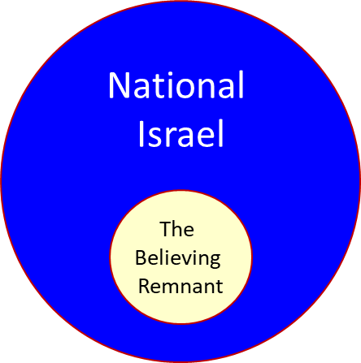

Slide 57
Zechariah 13:8-9
⁸“It will come about in all the land,” Declares the Lord, “That two parts in it will be cut off and perish; But the third will be left in it. ⁹“And I will bring the third part through the fire, Refine them as silver is refined, And test them as gold is tested. They will call on My name, And I will answer them; I will say, ‘They are My people,’ And they will say, ‘The Lord is my God.’ ”

Slide 58
Ezekiel 20:33-38
³³ “As I live,” declares the Lord God, “surely with a mighty hand and with an outstretched arm and with wrath poured out, I shall be king over you. ³⁴ I will bring you out from the peoples and gather you from the lands where you are scattered, with a mighty hand and with an outstretched arm and with wrath poured out; ³⁵ and I will bring you into the wilderness of the peoples, and there I will enter into judgment . . .

Slide 59
Ezekiel 20:33-38
…with you face to face. ³⁶ As I entered into judgment with your fathers in the wilderness of the land of Egypt, so I will enter into judgment with you,” declares the Lord God. ³⁷ “I will make you pass under the rod, and I will bring you into the bond of the covenant; ³⁸ and I will purge from you the rebels and those who transgress against Me; I will bring them out of the land where they sojourn, but they will not enter the land of Israel. Thus you will know that I am the Lord.

Slide 60

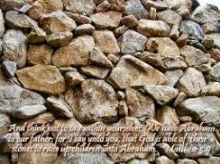
Matthew 3:9
“and do not suppose that you can say to yourselves, ‘We have Abraham for our father’; for I say to you that from these stones God is able to raise up children to Abraham.”

Slide 61
Romans 2:28-29
“²⁸ For he is not a Jew who is one outwardly, nor is circumcision that which is outward in the flesh. ²⁹ But he is a Jew who is one inwardly; and circumcision is that which is of the heart, by the Spirit, not by the letter; and his praise is not from men, but from God.”

Slide 62
Romans 9:6
“But it is not as though the word of God has failed. For they are not all Israel who are descended from Israel.”

Slide 63

Revelation 2:9
“I know your tribulation and your poverty (but you are rich), and the blasphemy by those who say they are Jews and are not, but are a synagogue of Satan.”

Slide 64
Discontinuity Between Israel & the Church
 | ISRAEL | CHURCH
Governing principle | Law | NT
Relation to HS | Selective, temporary, subsequent | Universal, permanent, at moment of salvation
Farewell address | Olivet Discourse | Upper Room Discourse
Designation | First Born Son | Bride of Christ
Revealed in OT | Yes | No
Evangelism | Come & See | Go & Proclaim
Blessings | Earthly | Heavenly
Composition | Believers & Unbelievers | Believers Only

Slide 65
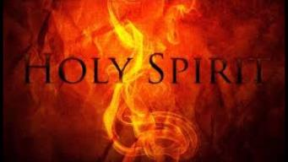
1 Corinthians 12:13
“For by one Spirit we were all baptized into one body, whether Jews or Greeks, whether slaves or free, and we were all made to drink of one Spirit.”

Slide 66
1 Corinthians 3:1-3 (NKJV)
¹ And I, brethren, could not speak to you as to spiritual people but as to carnal, as to babes in Christ. ² I fed you with milk and not with solid food; for until now you were not able to receive it, and even now you are still not able; ³ for you are still carnal. For where there are envy, strife, and divisions among you, are you not carnal and behaving like mere men?

Slide 67

Notes:
Ray Steadman – “1st Californians”
Unbelievers vs Categories of Believers
Unbelievers – ψυχικός psuchikós; Natural, pertaining to the natural as distinguished from the spiritual
Spiritual Believers – πνευματικός pneumatikós; of persons who are spiritual, enlightened by the Holy Spirit
Infant Believers – σάρκινος sárkinos; with propensities of the flesh unto sin; νήπιος nḗpios; an infant, child, baby without any definite limitation of age. (This relates to immaturity and lack of instruction)
Carnal Believers – σαρκικός sarkikós; tendency to satisfy the flesh, implying sinfulness, sinful propensity, carnal (This relates to disobedience and open rebellion)

Slide 68
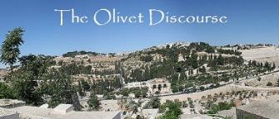
VIII. Eight Parabolic Exhortations
(Matthew 24:32–25:46)
The fig tree (24:32-35)
The days of Noah (24:36-39)
The comparison of two men & women (24:40-41)
The householder (24:42-44)
The wise servant (24:45-51)
The wise virgins (25:1-13)
The talents (25:14-30)
The sheep & goat judgment (25:31-46)

Slide 69
VIII. Eight Parabolic Exhortations
(Matthew 24:32–25:46)
The fig tree (24:32-35)
The days of Noah (24:36-39)
The comparison of two men & women (24:40-41)
The householder (24:42-44)
The wise servant (24:45-51)
The wise virgins (25:1-13)
The talents (25:14-30)
The sheep & goat judgment (25:31-46)

Slide 71
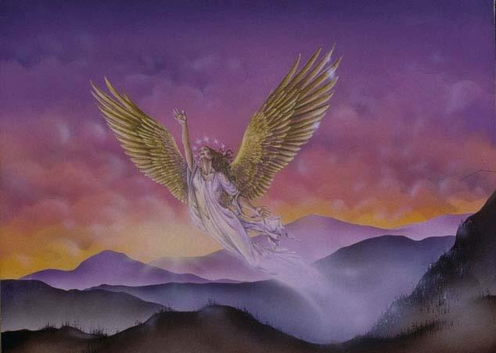
CONNECTING
REV 12 & ANTI-SEMITISM
DANIEL’S 70th WEEK (7 years)
Israel flees
3 ½ years
1260 days

Slide 72
VIII. Eight Parabolic Exhortations
(Matthew 24:32–25:46)
The fig tree (24:32-35)
The days of Noah (24:36-39)
The comparison of two men & women (24:40-41)
The householder (24:42-44)
The wise servant (24:45-51)
The wise virgins (25:1-13)
The talents (25:14-30)
The sheep & goat judgment (25:31-46)

Slide 73
VIII. Eight Parabolic Exhortations
(Matthew 24:32–25:46)
The fig tree (24:32-35)
The days of Noah (24:36-39)
The comparison of two men & women (24:40-41)
The householder (24:42-44)
The wise servant (24:45-51)
The wise virgins (25:1-13)
The talents (25:14-30)
The sheep & goat judgment (25:31-46)

Slide 74

Matthew 24:36-41
³⁶ “But of that day and hour no one knows, not even the angels of heaven, nor the Son, but the Father alone. ³⁷ For the coming of the Son of Man will be just like the days of Noah. ³⁸ For as in those days before the flood they were eating and drinking, marrying and giving in marriage, until the day that Noah entered the ark, ³⁹ and they did not understand until the flood came and took them all away; so will the coming of the Son of Man be. ⁴⁰ Then there will be two men in the field; one will be taken and one will be left. ⁴¹ Two women will be grinding at the mill; one will be taken and one will be left.”

Slide 75
C. The Comparison of Two Men and Women
Matthew 24:40-41
No rapture reasons
  Preceding context
  Days of Noah chronology
  Son of Man
  Other Matthean judgments
  Lukan parallel passage

Slide 76
C. The Comparison of Two Men and Women
Matthew 24:40-41
No rapture reasons
  Preceding context
  Days of Noah chronology
  Son of Man
  Other Matthean judgments
  Lukan parallel passage

Slide 77
C. The Comparison of Two Men and Women
Matthew 24:40-41
No rapture reasons
  Preceding context
  Days of Noah chronology
  Son of Man
  Other Matthean judgments
  Lukan parallel passage

Slide 78
Matthew 24:36-41
³⁶ “But of that day and hour no one knows, not even the angels of heaven, nor the Son, but the Father alone. ³⁷ For the coming of the Son of Man will be just like the days of Noah. ³⁸ For as in those days before the flood they were eating and drinking, marrying and giving in marriage, until the day that Noah entered the ark, ³⁹ and they did not understand until the flood came and took them all away; so will the coming of the Son of Man be. ⁴⁰ Then there will be two men in the field; one will be taken and one will be left. ⁴¹ Two women will be grinding at the mill; one will be taken and one will be left.”

Slide 79

Dr. John Walvoord
Matthew: Thy Kingdom Come (Chicago: Moody, 1974), 193.
“According to Matthew 24:40-41, ‘Then there will be two men in the field; one will be taken and one will be left. Two women will be grinding at the mill; one will be taken and one will be left.’ Because at the rapture, believers will be taken out of the world, some have confused this with the rapture of the church. Here, however, the situation is the reverse. The one who is left, is left to enter the kingdom; the one who is taken, is taken in judgment. This is in keeping with the illustration of the time of Noah when the ones taken away are the unbelievers.”

Slide 80
C. The Comparison of Two Men and Women
Matthew 24:40-41
No rapture reasons
  Preceding context
  Days of Noah chronology
  Son of Man
  Other Matthean judgments
  Lukan parallel passage

Slide 81
Matthew 24:36-41
³⁶ “But of that day and hour no one knows, not even the angels of heaven, nor the Son, but the Father alone. ³⁷ For the coming of the Son of Man will be just like the days of Noah. ³⁸ For as in those days before the flood they were eating and drinking, marrying and giving in marriage, until the day that Noah entered the ark, ³⁹ and they did not understand until the flood came and took them all away; so will the coming of the Son of Man be. ⁴⁰ Then there will be two men in the field; one will be taken and one will be left. ⁴¹ Two women will be grinding at the mill; one will be taken and one will be left.”

Slide 83
C. The Comparison of Two Men and Women
Matthew 24:40-41
No rapture reasons
  Preceding context
  Days of Noah chronology
  Son of Man
  Other Matthean judgments
  Lukan parallel passage

Slide 84
C. The Comparison of Two Men and Women
Matthew 24:40-41
No rapture reasons
  Preceding context
  Days of Noah chronology
  Son of Man
  Other Matthean judgments
  Lukan parallel passage

Slide 85
Luke 17:34-37
³⁴ “I tell you, on that night there will be two in one bed; one will be taken and the other will be left. ³⁵ “There will be two women grinding at the same place; one will be taken and the other will be left. ³⁶ “Two men will be in the field; one will be taken and the other will be left.” ³⁷ And answering they said to Him, “Where, Lord?” And He said to them, “Where the body is, there also the vultures will be gathered.”

Slide 86
C. The Comparison of Two Men and Women
Matthew 24:40-41
Pro-rapture reasons
  From airō to paralambanō
  Day or hour can be known in the Tribulation
  Normal life activities at the end of the Tribulation
  Peri De (“Now Concerning”) construction

Slide 87
C. The Comparison of Two Men and Women
Matthew 24:40-41
Pro-rapture reasons
  From airō to paralambanō
  Day or hour can be known in the Tribulation
  Normal life activities at the end of the Tribulation
  Peri De (“Now Concerning”) construction

Slide 88
Matthew 24:36-41
³⁶ “But of that day and hour no one knows, not even the angels of heaven, nor the Son, but the Father alone. ³⁷ For the coming of the Son of Man will be just like the days of Noah. ³⁸ For as in those days before the flood they were eating and drinking, marrying and giving in marriage, until the day that Noah entered the ark, ³⁹ and they did not understand until the flood came and took (airō) them all away; so will the coming of the Son of Man be. ⁴⁰ Then there will be two men in the field; one will be taken (paralambanō) and one will be left. ⁴¹ “Two women will be grinding at the mill; one will be taken (paralambanō) and one will be left.”

Slide 89

John 14:1–4
¹ “Do not let your heart be troubled; believe in God, believe also in Me. ² “In My Father’s house are many dwelling places; if it were not so, I would have told you; for I go to prepare a place for you. ³ “If I go and prepare a place for you, I will come again and receive you (paralambanō) to Myself, that where I am, there you may be also. ⁴ “And you know the way where I am going.”

Slide 90

Arnold G. Fruchtenbaum
Yeshua: The Life of Messiah from a Messianic Jewish Perspective, 4 vols., vol. 3 (San Antonio, TX: Ariel Ministries, 2017), 365.
“The phrase translated as taken away is not a technical term and could be used in more than one way in the same context. Furthermore, while the same word is used in the English translation, it is not in Greek. Verse 39 contains the verb airō (“to raise,“ “take up,“ “to lift“) and verse 40 the verb is paralambanō (“to receive from“), suggesting that the verses might be dealing with two separate concepts.”

Slide 91
C. The Comparison of Two Men and Women
Matthew 24:40-41
Pro-rapture reasons
  From airō to paralambanō
  Day or hour can be known in the Tribulation
  Normal life activities at the end of the Tribulation
  Peri De (“Now Concerning”) construction

Slide 92
Matthew 24:36-41
³⁶ “But of that day and hour no one knows, not even the angels of heaven, nor the Son, but the Father alone. ³⁷ For the coming of the Son of Man will be just like the days of Noah. ³⁸ For as in those days before the flood they were eating and drinking, marrying and giving in marriage, until the day that Noah entered the ark, ³⁹ and they did not understand until the flood came and took them all away; so will the coming of the Son of Man be. ⁴⁰ Then there will be two men in the field; one will be taken and one will be left. ⁴¹ “Two women will be grinding at the mill; one will be taken and one will be left.”

Slide 94
Arnold G. Fruchtenbaum
Yeshua: The Life of Messiah from a Messianic Jewish Perspective, 4 vols., vol. 3 (San Antonio, TX: Ariel Ministries, 2017), 365-66.
“No one will ever know the timing of the rapture. Yeshua noted that the angels of heaven do not know when it will occur (Matt. 24:36). Not even the Son in His humanity knew the timing. Only God the father knows when the believers will be taken up to meet their Messiah in the air. This will always be true of the rapture. The second coming, on the other hand, will occur exactly seven years after the beginning of the seven-year covenant and 42 months, or 1260 days, after the abomination of desolation. Once the tribulation begins, the second coming can be accurately calculated, so the passage above must be dealing with the rapture and not the second coming.”

Slide 95


Slide 96

Genesis 6:1-4
“¹ Now it came about, when men began to multiply on the face of the land, and daughters were born to them, ² that the sons of God saw that the daughters of men were beautiful; and they took wives for themselves, whomever they chose. ³ Then the Lord said, ‘My Spirit shall not strive with man forever, because he also is flesh; nevertheless his days shall be one hundred and twenty years.’ . . .

Slide 97
C. The Comparison of Two Men and Women
Matthew 24:40-41
Pro-rapture reasons
  From airō to paralambanō
  Day or hour can be known in the Tribulation
  Normal life activities at the end of the Tribulation
  Peri De (“Now Concerning”) construction

Slide 98
Matthew 24:36-41
³⁶ “But of that day and hour no one knows, not even the angels of heaven, nor the Son, but the Father alone. ³⁷ For the coming of the Son of Man will be just like the days of Noah. ³⁸ For as in those days before the flood they were eating and drinking, marrying and giving in marriage, until the day that Noah entered the ark, ³⁹ and they did not understand until the flood came and took them all away; so will the coming of the Son of Man be. ⁴⁰ Then there will be two men in the field; one will be taken and one will be left. ⁴¹ “Two women will be grinding at the mill; one will be taken and one will be left.”

Slide 99
Luke 17:26-30
²⁶ “And just as it happened in the days of Noah, so it will be also in the days of the Son of Man: ²⁷ they were eating, they were drinking, they were marrying, they were being given in marriage, until the day that Noah entered the ark, and the flood came and destroyed them all. ²⁸ “It was the same as happened in the days of Lot: they were eating, they were drinking, they were buying, they were selling, they were planting, they were building; ²⁹ but on the day that Lot went out from Sodom it rained fire and brimstone from heaven and destroyed them all. ³⁰ “It will be just the same on the day that the Son of Man is revealed.”

Slide 101
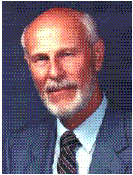
Dave Hunt
Dave Hunt, How Close Are We? Compelling Evidence for the Soon Return of Christ (Eugene, OR: Harvest House, 1993), 210-11.
“﻿When Christ says, ‘As it was in the days of Noah and Lot,’ it is absolutely certain that He is not describing conditions that will prevail at the time of the Second Coming. Therefore, these must be the conditions which will prevail just prior to the Rapture at a different time—and, obviously, before the devastation of the tribulation period.”

Slide 102
Arnold G. Fruchtenbaum
Yeshua: The Life of Messiah from a Messianic Jewish Perspective, 4 vols., vol. 3 (San Antonio, TX: Ariel Ministries, 2017), 366.
“The rapture will occur when conditions on earth are normal and people are eating and drinking, marrying and giving in marriage (Matt. 24:38). These are common activities in human society. Marrying and giving in marriage are necessary to propagate life; eating and drinking are essential to sustain it. During the time of Noah, life was normal when suddenly the flood came and took the people away. The rapture will occur in the same manner: so shall be the coming of the Son of Man (Matt. 24:39). Nothing spectacular will forewarn people that the believers are about to be taken up. However, things . . .

Slide 103
Arnold G. Fruchtenbaum
Yeshua: The Life of Messiah from a Messianic Jewish Perspective, 4 vols., vol. 3 (San Antonio, TX: Ariel Ministries, 2017), 366.
. . .will be abnormal at the time of the second coming. Nearly three-quarters of the earth will be destroyed in seven long years of tribulation. A blackness paired with tremendous tidal waves, anarchy, confusion, and perplexity will envelop the world. The Olivet Discourse shows that conditions will be abnormal at the time of the second coming, and so it is better to interpret this passage as referring to the rapture.”

Slide 104

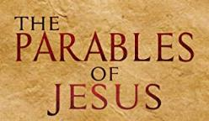
Matthew 24:32-33
³² “Now learn the parable from the fig tree: when its branch has already become tender and puts forth its leaves, you know that summer is near; ³³ so, you too, when you see all these things, recognize that He is near, right at the door.”

Slide 105
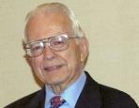

Dr. Roy B. Zuck
Basic Bible Interpretation, p. 215-16.
“﻿Usually a parable, like a sermon illustration, is teaching a single truth. When Jesus explained a number of His parables, He usually…stated one spiritual truth. For example when the man found his one lost sheep, he rejoiced, and Jesus said this illustrates the truth that there is rejoicing in heaven when a sinner repents (Luke 15:7)...He gave one simple spiritual lesson, and made no attempt to see any spiritual significance to the vineyard, the denarius, or the sixth hour, the ninth hour, or the eleventh hour, nor the vineyard foreman…To hunt for meanings in every detail in the parables is to turn them into allegories.”

Slide 106
C. The Comparison of Two Men and Women
Matthew 24:40-41
Pro-rapture reasons
  From airō to paralambanō
  Day or hour can be known in the Tribulation
  Normal life activities at the end of the Tribulation
  Peri De (“Now Concerning”) construction

Slide 107

Matthew 24:36
“But (peri de) of that day and hour no one knows, not even the angels of heaven, nor the Son, but the Father alone.”

Slide 108
Arnold G. Fruchtenbaum
Yeshua: The Life of Messiah from a Messianic Jewish Perspective, 4 vols., vol. 3 (San Antonio, TX: Ariel Ministries, 2017), 365.
“Matthew began the passage with the word but (Matt. 24:36). In the Greek language, there is more than one way of saying but. Here, the English word is a translation of two Greek words, peri de, meaning ‘now concerning.’ As Greek grammar books show, this construction denotes a contrast and often introduces a new subject. Paul uses the formula frequently in his writings when presenting a new topic (eg. 1 Cor. 7:1, 25; 8:1; 12:1; 16:1, 12; 1 Thess. 4:9; 5:1; etc.). In the context of Matthew 24, Yeshua had been talking about one topic (the second coming), then introduced a new subject (the rapture)...In the passage above, He introduced the new topic by using the peri de construction.”

Slide 109
VIII. Eight Parabolic Exhortations
(Matthew 24:32–25:46)
The fig tree (24:32-35)
The days of Noah (24:36-39)
The comparison of two men & women (24:40-41)
The householder (24:42-44)
The wise servant (24:45-51)
The wise virgins (25:1-13)
The talents (25:14-30)
The sheep & goat judgment (25:31-46)

Slide 110
VIII. Eight Parabolic Exhortations
(Matthew 24:32–25:46)
The fig tree (24:32-35)
The days of Noah (24:36-39)
The comparison of two men & women (24:40-41)
The householder (24:42-44)
The wise servant (24:45-51)
The wise virgins (25:1-13)
The talents (25:14-30)
The sheep & goat judgment (25:31-46)

Slide 111
VIII. Eight Parabolic Exhortations
(Matthew 24:32–25:46)
The fig tree (24:32-35)
The days of Noah (24:36-39)
The comparison of two men & women (24:40-41)
The householder (24:42-44)
The wise servant (24:45-51)
The wise virgins (25:1-13)
The talents (25:14-30)
The sheep & goat judgment (25:31-46)

Slide 112
VIII. Eight Parabolic Exhortations
(Matthew 24:32–25:46)
The fig tree (24:32-35)
The days of Noah (24:36-39)
The comparison of two men & women (24:40-41)
The householder (24:42-44)
The wise servant (24:45-51)
The wise virgins (25:1-13)
The talents (25:14-30)
The sheep & goat judgment (25:31-46)

Slide 113

F. Partial Rapture of the Church?
(Matthew 25:1-13)
Chapter division & preceding context
Demoted from bride to maidens
Bride? Body? In Christ?
Translation? Resurrection?
Bridegroom comes to the earth

Slide 114
F. Partial Rapture of the Church?
(Matthew 25:1-13)
Chapter division & preceding context
Demoted from bride to maidens
Bride? Body? In Christ?
Translation? Resurrection?
Bridegroom comes to the earth

Slide 115
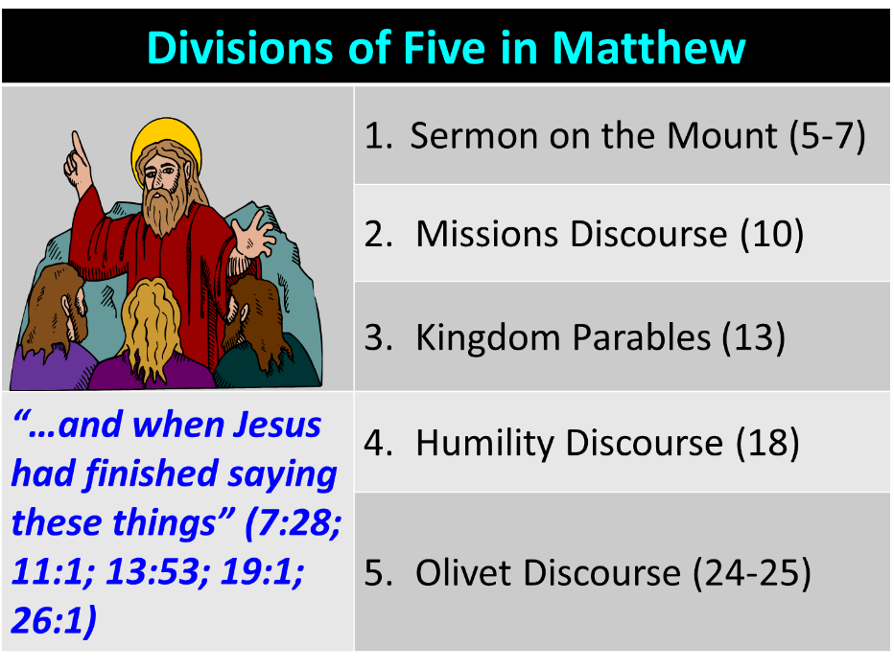

Slide 116
F. Partial Rapture of the Church?
(Matthew 25:1-13)
Chapter division & preceding context
Demoted from bride to maidens
Bride? Body? In Christ?
Translation? Resurrection?
Bridegroom comes to the earth

Slide 117
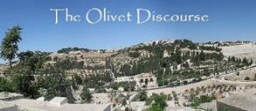
F. Partial Rapture of the Church?
(Matthew 25:1-13)
All asleep (vs. 5)
Rapture for all Christians (1 Cor. 15:51)
End of the Inter-Advent Age
Consistency with the other Parables
Dispensationally misapplied passage

Slide 118
F. Partial Rapture of the Church?
(Matthew 25:1-13)
All asleep (vs. 5)
Rapture for all Christians (1 Cor. 15:51)
End of the Inter-Advent Age
Consistency with the other Parables
Dispensationally misapplied passage

Slide 119
1 Corinthians 12:13
“For by one Spirit we were all baptized into one body, whether Jews or Greeks, whether slaves or free, and we were all made to drink of one Spirit.”

Slide 120
F. Partial Rapture of the Church?
(Matthew 25:1-13)
All asleep (vs. 5)
Rapture for all Christians (1 Cor. 15:51)
End of the Inter-Advent Age
Consistency with the other Parables
Dispensationally misapplied passage

Slide 121
VIII. Eight Parabolic Exhortations
(Matthew 24:32–25:46)
The fig tree (24:32-35)
The days of Noah (24:36-39)
The comparison of two men & women (24:40-41)
The householder (24:42-44)
The wise servant (24:45-51)
The wise virgins (25:1-13)
The talents (25:14-30)
The sheep & goat judgment (25:31-46)

Slide 122
VIII. Eight Parabolic Exhortations
(Matthew 24:32–25:46)
The fig tree (24:32-35)
The days of Noah (24:36-39)
The comparison of two men & women (24:40-41)
The householder (24:42-44)
The wise servant (24:45-51)
The wise virgins (25:1-13)
The talents (25:14-30)
The sheep & goat judgment (25:31-46)

Slide 123
CONNECTING
REV 12 & ANTI-SEMITISM
DANIEL’S 70th WEEK (7 years)
Israel flees
3 ½ years
1260 days

Slide 124
Scripture’s Four Judgments
Name | Sheep and Goat | Judgment of the Jews | Bema Seat | Great White Throne
Scripture | Matt 25:31-46 | Ezek 20:33-44 | 1 Cor 3:10-15 | Rev 20:11-15
Place | Earth, Jerusalem | Earth, wilderness | Heaven | Earth
Audience | Gentile Tribulation survivors | Jewish Tribulation survivors | Church Age believers | All unsaved
When | After Tribulation | After Tribulation | After rapture | After Millennium
Purpose | Saved Gentiles enter kingdom | Saved Jews enter kingdom | Reward believers | Degree of punishment in hell
Evaluation | Treatment of Christ’s brethren | Passing under shepherd’s rod | Works taken through fire | Not in the book; judged by books

Slide 125
Conclusion

Slide 126
VIII. Eight Parabolic Exhortations
(Matthew 24:32–25:46)
The fig tree (24:32-35)
The days of Noah (24:36-39)
The comparison of two men & women (24:40-41)
The householder (24:42-44)
The wise servant (24:45-51)
The wise virgins (25:1-13)
The talents (25:14-30)
The sheep & goat judgment (25:31-46)

Slide 127
Preview of Matthew 24–25
The problem
The larger context
The immediate context (23:37-39)
The Disciples’ questions (24:1-3)
The Tribulation’s first half (24:4-14)
The Tribulation’s mid-point (24:15-20)
The Tribulation’s second half (24:21-22)
The Second Advent (24:23-31)
Eight parabolic exhortations (24:32‒25:46)

