Slide 1
PRACTICAL RIGHTEOUSNESS
Dr. Andy Woods
Senior Pastor – Sugar Land Bible Church
President – Chafer Theological Seminary

Slide 2
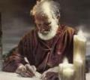
Answering Eleven Questions
Who wrote it? – James
What do we know about the author? – Christ’s ½ Brother
Who was the audience? – Believing Jews in the Diaspora
Where was if written from? – Jerusalem
When was the book written? – A.D. 44‒47
What was the book’s occasion? – Practical righteousness
What is the book’s purpose? – Achieving practical righteousness
What is the book about? – Practical righteousness
What is the book’s theme? – Daily living
What makes the book different? – Practicality
How is the book organized? – Faith and Wisdom

Slide 3
JAMES STRUCTURE
Faith (James 1:1‒3:12)
Wisdom (James 3:13‒5:20)

Slide 4
JAMES STRUCTURE
Faith (James 1:1‒3:12)
Wisdom (James 3:13‒5:20)

Slide 5
JAMES STRUCTURE
Faith (1:1–3:12)
Trials (1:2-18)
Obedience to the Word (1:19-27)
Favoritism (2:1-13)
Faith manifesting works (2:14-26)
Tongue (3:1-12)

Slide 6
JAMES STRUCTURE
Faith (1:1–3:12)
Trials (1:2-18)
Obedience to the Word (1:19-27)
Favoritism (2:1-13)
Faith manifesting works (2:14-26)
Tongue (3:1-12)

Slide 7
James 1:12-18
Trials – Jas 1:2-18
Rejoicing during trials – Jas 1:2-12
Command not to charge God with temptation – Jas 1:13-18

Slide 8
JAMES STRUCTURE
Faith (1:1–3:12)
Trials (1:2-18)
Obedience to the Word (1:19-27)
Favoritism (2:1-13)
Faith manifesting works (2:14-26)
Tongue (3:1-12)

Slide 9
Faith Obeys God (James 1:19-27)
Need for Slowness in Speaking & Anger (1:19-20)
Need for Obedience to God’s Word (1:21-25)
Need for True Religion (1:26-27)

Slide 10
Faith Obeys God (James 1:19-27)
Need for Slowness in Speaking & Anger (1:19-20)
Need for Obedience to God’s Word (1:21-25)
Need for True Religion (1:26-27)

Slide 11
I. Need for Slowness & Anger (Jas 1:19-20)
Slowness in Speech (19a)
Slowness in Anger (19b-20)

Slide 12
I. Need for Slowness & Anger (Jas 1:19-20)
Slowness in Speech (19a)
Slowness in Anger (19b-20)

Slide 13
I. Need for Slowness & Anger (Jas 1:19-20)
Slowness in Speech (19a)
Slowness in Anger (19b-20)

Slide 14
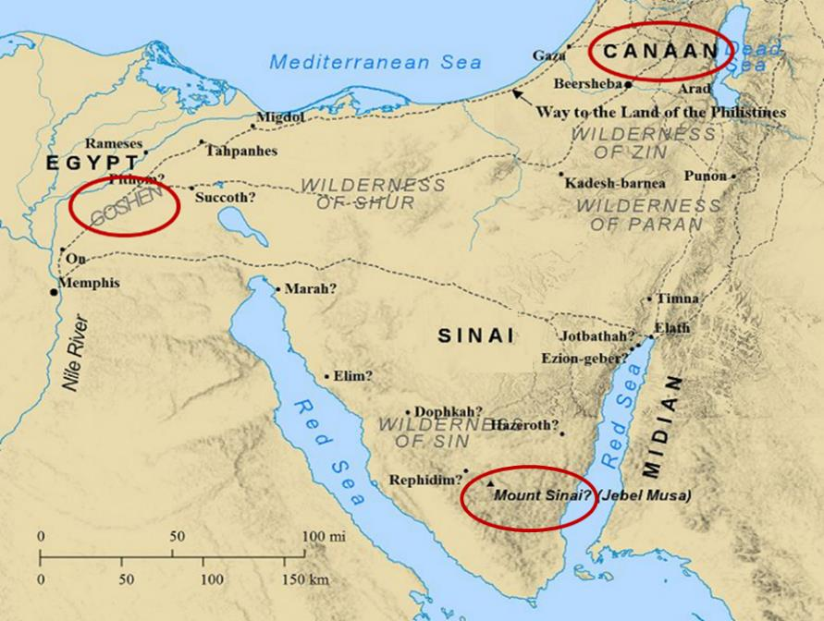

Slide 15
Galatians 5:19-21
¹⁹ Now the deeds of the flesh are evident, which are: immorality, impurity, sensuality, ²⁰ idolatry, sorcery, enmities, strife, jealousy, outbursts of anger, disputes, dissensions, factions, ²¹ envying, drunkenness, carousing, and things like these, of which I forewarn you, just as I have forewarned you, that those who practice such things will not inherit the kingdom of God.

Slide 16
Faith Obeys God (James 1:19-27)
Need for Slowness in Speaking & Anger (1:19-20)
Need for Obedience to God’s Word (1:21-25)
Need for True Religion (1:26-27)

Slide 17
II. Need for Obedience to God’s Word (Jas 1:21-25)
Reception of the Word (21)
Doers of the Word (22-25)

Slide 18
II. Need for Obedience to God’s Word (Jas 1:21-25)
Reception of the Word (21)
Doers of the Word (22-25)

Slide 19
Reception of God’s Word (Jas 1:21)
Removal (21a)
Reception (21b)
Result (21c)

Slide 20
Reception of God’s Word (Jas 1:21)
Removal (21a)
Reception (21b)
Result (21c)

Slide 21
Reception of God’s Word (Jas 1:21)
Removal (21a)
Reception (21b)
Result (21c)

Slide 22
Reception of God’s Word (Jas 1:21)
Removal (21a)
Reception (21b)
Result (21c)

Slide 23
Three Tenses of Salvation
Phase | Justification | Sanctification | Glorification
Tense | Past | Present | Future
Saved from sin’s: | Penalty | Power | Presence
Scripture | Eph 2:8-9; Titus 3:5 | Philip 2:12 | Rom 5:10
Nature | Single | Dual | Single

Slide 24
Three Tenses of Salvation
Phase | Justification | Sanctification | Glorification
Tense | Past | Present | Future
Saved from sin’s: | Penalty | Power | Presence
Scripture | Eph 2:8-9; Titus 3:5 | Philip 2:12 | Rom 5:10
Nature | Single | Dual | Single

Slide 25
II. Need for Obedience to God’s Word (Jas 1:21-25)
Reception of the Word (21)
Doers of the Word (22-25)

Slide 26
Faith Obeys God (James 1:19-27)
Need for Slowness in Speaking & Anger (1:19-20)
Need for Obedience to God’s Word (1:21-25)
Need for True Religion (1:26-27)

Slide 27
III. Need for True Religion (Jas 1:26-27)
What True Religion Is Not (26)
What True Religion Is (27)

Slide 28
III. Need for True Religion (Jas 1:26-27)
What True Religion Is Not (26)
What True Religion Is (27)

Slide 29
III. Need for True Religion (Jas 1:26-27)
What True Religion Is Not (26)
What True Religion Is (27)

Slide 30
What True Religion Is (Jas 1:27)
Ministering to Widows & Orphans (27a)
Moral purity (27b)

Slide 31
What True Religion Is (Jas 1:27)
Ministering to Widows & Orphans (27a)
Moral purity (27b)

Slide 32
Deuteronomy 28:49-50
“⁴⁹ The Lord will bring a nation against you from afar, from the end of the earth, as the eagle swoops down, a nation whose language you shall not understand, ⁵⁰ a nation of fierce countenance who will have no respect for the old, nor show favor to the young.”

Slide 33
What True Religion Is (Jas 1:27)
Ministering to Widows & Orphans (27a)
Moral purity (27b)

Slide 34
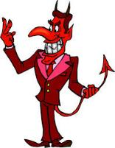
Names & Titles Demonstrating Satan’s Post-Fall, Earthly Authority (Job 1:7; 2:2; Luke 4:5-8; Rom. 8:19-22)
Prince of this world (John 12:31; 14:30; 16:11)
God of this age (2 Cor. 4:4)
Prince and power of the air (Eph. 2:2)
Who the believer wrestles with (Eph. 6:12)
Roaring lion (1 Pet. 5:8)
Whole world lies in his power (1 John 5:19)

Slide 35
CONCLUSION

Slide 36
JAMES STRUCTURE
Faith (1:1–3:12)
Trials (1:2-18)
Obedience to the Word (1:19-27)
Favoritism (2:1-13)
Faith manifesting works (2:14-26)
Tongue (3:1-12)

Slide 37
Faith Obeys God (James 1:19-27)
Need for Slowness in Speaking & Anger (1:19-20)
Need for Obedience to God’s Word (1:21-25)
Need for True Religion (1:26-27)

Slide 38
JAMES STRUCTURE
Faith (1:1–3:12)
Trials (1:2-18)
Obedience to the Word (1:19-27)
Favoritism (2:1-13)
Faith manifesting works (2:14-26)
Tongue (3:1-12)

