Slide 1


Genesis 3
The Fall of Man

Slide 2

GENESIS STRUCTURE
  Beginning of the Human race (Gen. 1‒11)
  Beginning of the Hebrew race (Gen. 12‒50)

Slide 3

GENESIS STRUCTURE
  Genesis 1-11 (four events)
  Creation (1-2)
  Fall (3-5)
  Flood (6-9)
  National dispersion (10-11)

Slide 4

Contradictory Account of Creation?
Genesis 1 – Overview of the whole creation
Genesis 2 – Details surrounding the creation of the garden, the first man, and his activities on day 6

Slide 5
GENESIS STRUCTURE
  Genesis 1-11 (four events)
  Creation (1-2)
  Fall (3-5)
  Flood (6-9)
  National dispersion (10-11)

Slide 6
GENESIS 3: THE FALL OF MAN
“This chapter is the pivot on which the whole Bible turns”
-W. H. Griffith Thomas

Slide 7

Genesis Structure
  3:1-5 Temptation by the serpent
  3:6 Sin of Adam and Eve
  3:7-13 Results of the sin
  3:14-19 Imposition of divine judgments
  3:20-24 God’s provision in spite of the sin

Slide 8
Genesis Structure
  3:1-5 Temptation by the serpent
  3:6 Sin of Adam and Eve
  3:7-13 Results of the sin
  3:14-19 Imposition of divine judgments
  3:20-24 God’s provision in spite of the sin

Slide 9
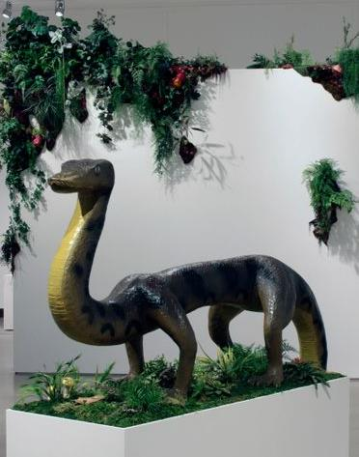
Genesis 3:1-5
  Serpent’s identity? (Rev 12:9; 20:2)
  Crafty?
  Why did Satan take the form of a serpent?

Slide 10
Genesis 3:1-5
  Serpent’s identity? (Rev 12:9; 20:2)
  Crafty?
  Why did Satan take the form of a serpent?

Slide 11
Genesis 3:1-5
  Serpent’s identity? (Rev 12:9; 20:2)
  Crafty?
  Why did Satan take the form of a serpent?

Slide 12

Ezekiel 28:14, 16
¹⁴ “You were the anointed cherub who covers, And I placed you there. You were on the holy mountain of God; You walked in the midst of the stones of fire... ¹⁶ By the abundance of your trade You were internally filled with violence, And you sinned; Therefore I have cast you as profane From the mountain of God. And I have destroyed you, O covering cherub, From the midst of the stones of fire.”

Slide 13
Genesis 3:1-5
  Serpent’s identity? (Rev 12:9; 20:2)
  Crafty?
  Why did Satan take the form of a serpent?

Slide 14
Genesis 1:26-28
²⁶ Then God said, “Let Us make man in Our image, according to Our likeness; and let them rule over the fish of the sea and over the birds of the sky and over the cattle and over all the earth, and over every creeping thing that creeps on the earth.” ²⁷ God created man in His own image, in the image of God He created him; male and female He created them. ²⁸ God blessed them; and God said to them, “Be fruitful and multiply, and fill the earth, and subdue it; and rule over the fish of the sea and over the birds of the sky and over every living thing that moves on the earth.”

Slide 15
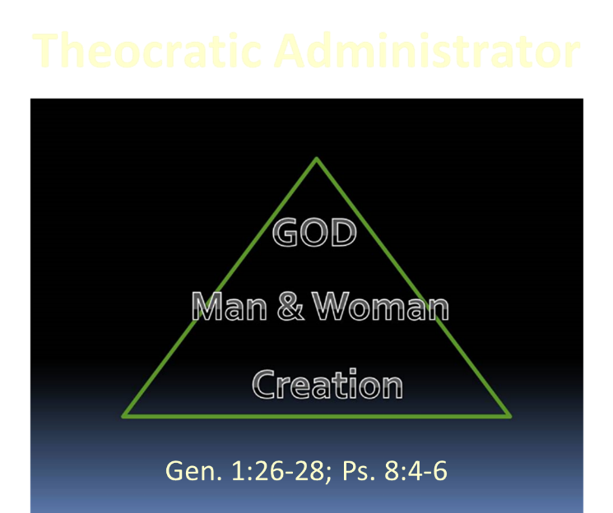

Slide 16

Names & Titles Demonstrating Satan’s Post-Fall, Earthly Authority
(Job 1:7; 2:2; Luke 4:5-8; Rom. 8:19-22)
Prince of this world (John 12:31; 14:30; 16:11)
God of this age (2 Cor. 4:4)
Prince and power of the air (Eph. 2:2)
Who the believer wrestles with (Eph. 6:12)
Roaring lion (1 Pet. 5:8)
Whole world lies in his power (1 John 5:19)

Slide 17
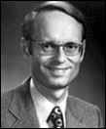
Charles Ryrie
Basic Theology. Page 511
“Why is an earthly kingdom necessary? Did He not receive His inheritance when He was raised and exalted in heaven? Is not His present rule His inheritance? Why does there need to be an earthly kingdom? Because He must be triumphant in the same arena where His was seemingly defeated. His rejection by the rulers of this world was on this earth (1 Cor. 2:8). His exaltation must also be on this earth. And so it shall be when He comes again to rule this world in righteousness. He has waited long for His inheritance; soon He shall receive it.”

Slide 18
Satan’s Tactics (2 Cor 2:11)
  Adds to God’s Word (3:1; 2:16-17)
  Challenges God’s goodness (3:1; 2:16-17)
  Subtracts from God’s Word (3:4; 2:17)
  Offers wisdom without submission to God (3:5; Prov 1:7)

Slide 19


Ecclesiastes 1:9
“That which has been is that which will be, And that which has been done is that which will be done. So there is nothing new under the sun.”

Slide 20
Satan’s Tactics (2 Cor 2:11)
  Adds to God’s Word (3:1; 2:16-17)
  Challenges God’s goodness (3:1; 2:16-17)
  Subtracts from God’s Word (3:4; 2:17)
  Offers wisdom without submission to God (3:5; Prov 1:7)

Slide 21
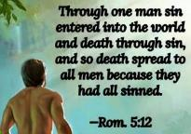
Genesis 2:16-17
“¹⁶ The Lord God commanded the man, saying, ‘From any tree of the garden you may eat freely; ¹⁷ but from the tree of the knowledge of good and evil you shall not eat, for in the day that you eat from it you will surely die (muwth).’”

Slide 22
Satan’s Tactics (2 Cor 2:11)
  Adds to God’s Word (3:1; 2:16-17)
  Challenges God’s goodness (3:1; 2:16-17)
  Subtracts from God’s Word (3:4; 2:17)
  Offers wisdom without submission to God (3:5; Prov 1:7)

Slide 23
Genesis 2:16-17
“¹⁶ The Lord God commanded the man, saying, ‘From any tree of the garden you may eat freely; ¹⁷ but from the tree of the knowledge of good and evil you shall not eat, for in the day that you eat from it you will surely die (muwth).’”

Slide 24
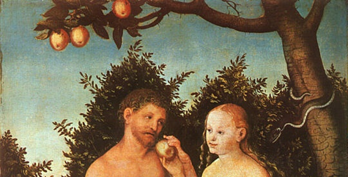
Adam and Eve’s Mistakes (Eph 6:10-20)
  Subtracting from God’s Word (3:2; 2:16)
  Adding to God’s Word (3:3; 2:17)
  Doubting God’s goodness (3:2-3; 2:16-17)
  Initial break down in male headship (2:4-7, 16-17, 18-25)

Slide 25
Adam and Eve’s Mistakes (Eph 6:10-20)
  Subtracting from God’s Word (3:2; 2:16)
  Adding to God’s Word (3:3; 2:17)
  Doubting God’s goodness (3:2-3; 2:16-17)
  Initial break down in male headship (2:4-7, 16-17, 18-25)

Slide 26
Genesis 2:16-17
“¹⁶ The Lord God commanded the man, saying, ‘From any tree of the garden you may eat freely; ¹⁷ but from the tree of the knowledge of good and evil you shall not eat, for in the day that you eat from it you will surely die (muwth).’”

Slide 27
Adam and Eve’s Mistakes (Eph 6:10-20)
  Subtracting from God’s Word (3:2; 2:16)
  Adding to God’s Word (3:3; 2:17)
  Doubting God’s goodness (3:2-3; 2:16-17)
  Initial break down in male headship (2:4-7, 16-17, 18-25)

Slide 28
Genesis 2:16-17
“¹⁶ The Lord God commanded the man, saying, ‘From any tree of the garden you may eat freely; ¹⁷ but from the tree of the knowledge of good and evil you shall not eat, for in the day that you eat from it you will surely die (muwth).’”

Slide 29
Adam and Eve’s Mistakes (Eph 6:10-20)
  Subtracting from God’s Word (3:2; 2:16)
  Adding to God’s Word (3:3; 2:17)
  Doubting God’s goodness (3:2-3; 2:16-17)
  Initial break down in male headship (2:4-7, 16-17, 18-25)

Slide 30
Genesis 2:16-17
“¹⁶ The Lord God commanded the man, saying, ‘From any tree of the garden you may eat freely; ¹⁷ but from the tree of the knowledge of good and evil you shall not eat, for in the day that you eat from it you will surely die (muwth).’”

Slide 31
Adam and Eve’s Mistakes (Eph 6:10-20)
  Subtracting from God’s Word (3:2; 2:16)
  Adding to God’s Word (3:3; 2:17)
  Doubting God’s goodness (3:2-3; 2:16-17)
  Initial break down in male headship (2:4-7, 16-17, 18-25)

Slide 32
Satan’s Tactics (2 Cor 2:11)
  Adds to God’s Word (3:1; 2:16-17)
  Challenges God’s goodness (3:1; 2:16-17)
  Subtracts from God’s Word (3:4; 2:17)
  Offers wisdom without submission to God (3:5; Prov 1:7)

Slide 33
Genesis 2:16-17
“¹⁶ The Lord God commanded the man, saying, ‘From any tree of the garden you may eat freely; ¹⁷ but from the tree of the knowledge of good and evil you shall not eat, for in the day that you eat from it you will surely die (muwth).’”

Slide 34
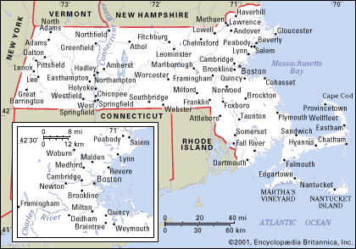
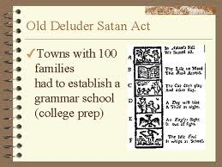
Old Satan Deluder Law: 1642 Massachusetts
“It being one chief project of that old deluder, Satan, to keep men from the knowledge of the Scriptures, as in former time…It is therefore ordered…that after the Lord hath increased the settlement…they shall…appoint one within their town, to teach all such children to read…they shall set up a grammar school to instruct youths…”
Church of the Holy Trinity v. U.S., 143 U.S. 457, 467 (1892)

Slide 35

Works – Present
  Snatches God’s Word (Luke 8:12)
  Rules world (1 John 5:19)
  Blinds the mind (2 Cor 4:4)
  Sends false ministers (2 Cor 11:14-15)
  Sends false gospels (2 Cor 11:3-4)
  Sows unbelievers among believers (Matt 13:38-39)
  Performs miracles (2 Thess 2:9)
  Promotes immorality (Eph 2:1-3)
  Opposes God’s people (Eph 6:11-12)

Slide 36
Satan’s Tactics (2 Cor 2:11)
  Adds to God’s Word (3:1; 2:16-17)
  Challenges God’s goodness (3:1; 2:16-17)
  Subtracts from God’s Word (3:4; 2:17)
  Offers wisdom without submission to God (3:5; Prov 1:7)

Slide 37
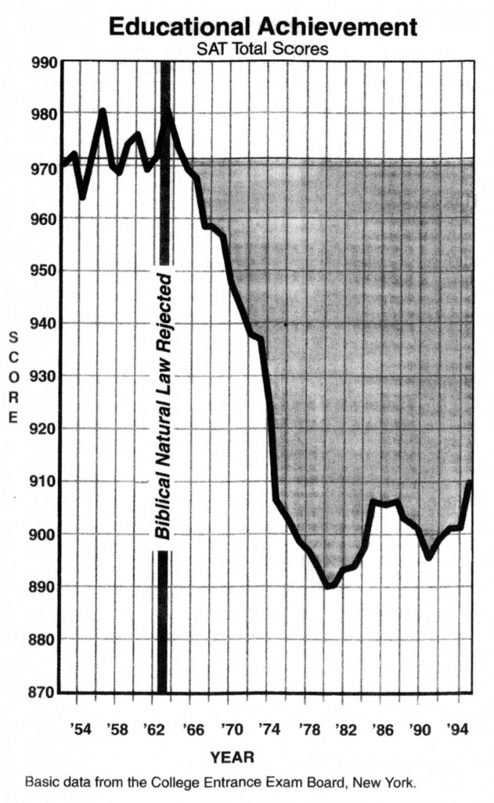
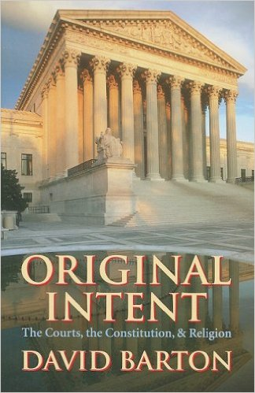
David Barton, Original Intent, p. 245

Slide 38

Original State and First Sin (cont’d)
Isaiah 14:12-15
  5 “I will” statements
    Ascend to heaven (13)
    Raise my throne above the stars of God (13)
    Sit enthroned on the Mt. of the Assembly (13)
    Ascend above the tops of the clouds (14)
    Make myself like the Most High (14)

Slide 39

Isaiah 14:14
“I will ascend above the heights of the clouds; I will make myself like the Most High.”

Slide 40
Satan’s Tactics (2 Cor 2:11)
  Adds to God’s Word (3:1; 2:16-17)
  Challenges God’s goodness (3:1; 2:16-17)
  Subtracts from God’s Word (3:4; 2:17)
  Offers wisdom without submission to God (3:5; Prov 1:7)

Slide 41
Genesis Structure
  3:1-5 Temptation by the serpent
  3:6 Sin of Adam and Eve
  3:7-13 Results of the sin
  3:14-19 Imposition of divine judgments
  3:20-24 God’s provision in spite of the sin

Slide 42
Sin of Adam and Eve (3:6)
  Three avenues of temptation (1 John 2:16)
  Lust of the flesh
  Lust of the eye
  Pride of life
  Break down in male headship (1 Tim 2:13; Gen 2:23)

Slide 43
Sin of Adam and Eve (3:6)
  Three avenues of temptation (1 John 2:16)
  Lust of the flesh
  Lust of the eye
  Pride of life
  Break down in male headship (1 Tim 2:13; Gen 2:23)

Slide 44
Sin of Adam and Eve (3:6)
  Three avenues of temptation (1 John 2:16)
  Lust of the flesh
  Lust of the eye
  Pride of life
  Break down in male headship (1 Tim 2:13; Gen 2:23)

Slide 45

Evangelical Feminism
A theological movement within the evangelical church that seeks to abolish all gender role distinctions within marriage and the church

Slide 46

Male Headship Before the Fall
  Adam created first – Gen. 2:4-7, 18-25; 1 Tim 2:13
  Adam named Eve – Gen. 1:10; 2:19-20, 23; 3:20
  God held Adam accountable – Gen. 3:9; Rom. 5:12

Slide 47
Male Headship Before the Fall
  Adam created first – Gen. 2:4-7, 18-25; 1 Tim 2:13
  Adam named Eve – Gen. 1:10; 2:19-20, 23; 3:20
  God held Adam accountable – Gen. 3:9; Rom. 5:12

Slide 48
Male Headship Before the Fall
  Adam created first – Gen. 2:4-7, 18-25; 1 Tim 2:13
  Adam named Eve – Gen. 1:10; 2:19-20, 23; 3:20
  God held Adam accountable – Gen. 3:9; Rom. 5:12

Slide 49
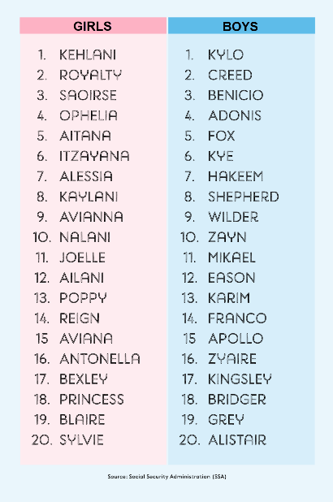
Biblical Significance of Naming
Genesis 1:8
Numbers 32:37-38
2 Kings 23:24
2 Kings 24:17
Daniel 1:6-7
Fruchtenbaum, Genesis, 84

Slide 50
Male Headship Before the Fall
  Adam created first – Gen. 2:4-7, 18-25; 1 Tim 2:13
  Adam named Eve – Gen. 1:10; 2:19-20, 23; 3:20
  God held Adam accountable – Gen. 3:9; Rom. 5:12

Slide 51

Romans 5:12
“Therefore, just as through one man sin entered into the world, and death through sin, and so death spread to all men, because all sinned—.”

Slide 52
Genesis 1:26-28
²⁶ Then God said, “Let Us make man in Our image, according to Our likeness; and let them rule over the fish of the sea and over the birds of the sky and over the cattle and over all the earth, and over every creeping thing that creeps on the earth.” ²⁷ God created man in His own image, in the image of God He created him; male and female He created them. ²⁸ God blessed them; and God said to them, “Be fruitful and multiply, and fill the earth, and subdue it; and rule over the fish of the sea and over the birds of the sky and over every living thing that moves on the earth.”

Slide 53

Woman created from man’s side…not his foot
  Helper and not slave (Gen 2:18)
  To complete what is lacking in man
  “Helper” (ezer) also used of God (Exod 18:4; Deut 33:7; 1 Sam 7:12)
  Same essence as Adam (2:24)
  Both sexes retain the image of God (Gen 1:27-28)
  Both sexes are co-rulers (Gen 1:26-28)
  Trinitarian analogy
  No feminism or chauvinism

Slide 54

1 Peter 3:7
“You husbands in the same way, live with your wives in an understanding way, as with someone weaker, since she is a woman; and show her honor as a fellow heir of the grace of life, so that your prayers will not be hindered.”

Slide 55
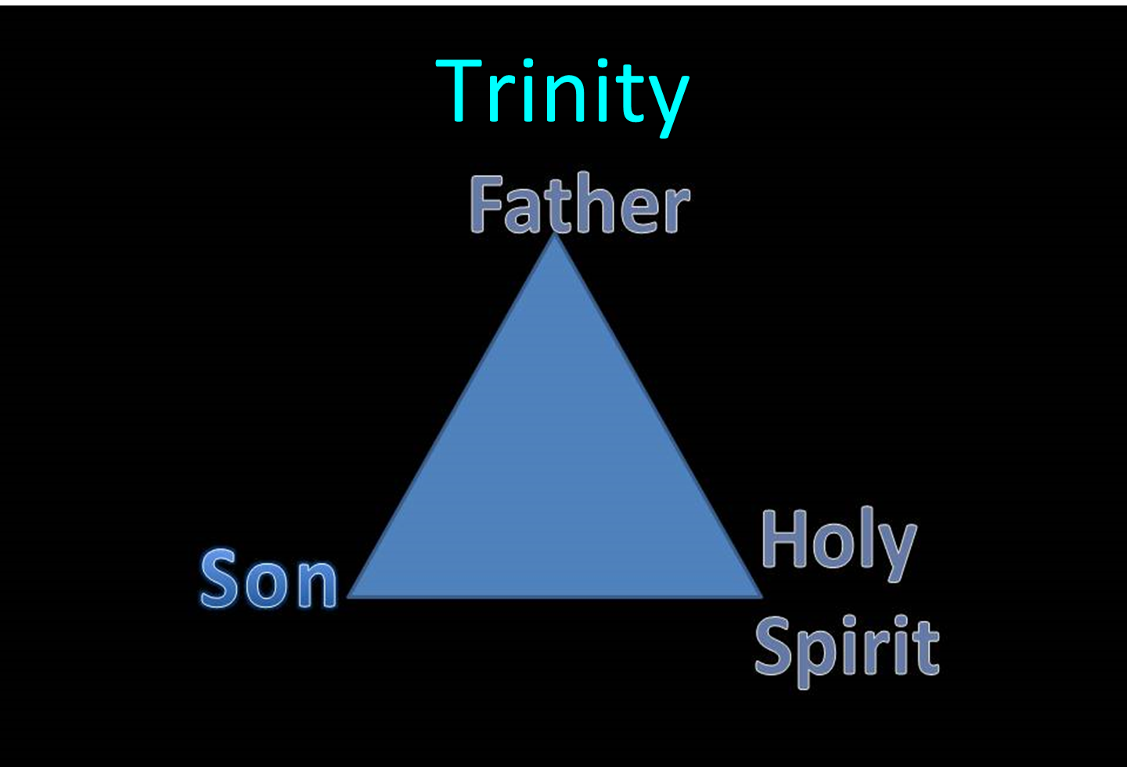

Slide 56
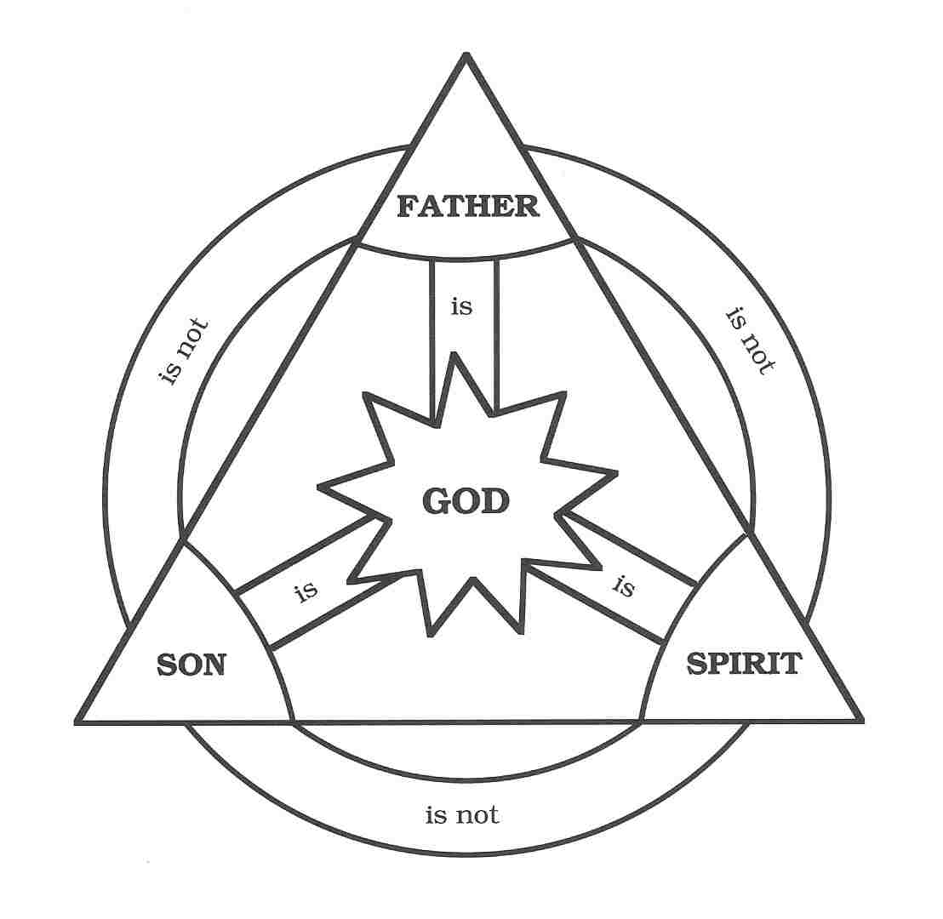

Slide 57
Genesis Structure
  3:1-5 Temptation by the serpent
  3:6 Sin of Adam and Eve
  3:7-13 Results of the sin
  3:14-19 Imposition of divine judgments
  3:20-24 God’s provision in spite of the sin

Slide 58
Results of the Sin
(3:7-13)
  Religion (3:7)
  Broken fellowship (3:8-10)
  “Buck passing” (3:11-13)
  Reversal creation hierarchy (3:11-13)

Slide 59
Results of the Sin
(3:7-13)
  Religion (3:7)
  Broken fellowship (3:8-10)
  “Buck passing” (3:11-13)
  Reversal creation hierarchy (3:11-13)

Slide 60
Results of the Sin
(3:7-13)
  Religion (3:7)
  Broken fellowship (3:8-10)
  “Buck passing” (3:11-13)
  Reversal creation hierarchy (3:11-13)

Slide 61
Results of the Sin
(3:7-13)
  Religion (3:7)
  Broken fellowship (3:8-10)
  “Buck passing” (3:11-13)
  Reversal creation hierarchy (3:11-13)

Slide 62
Results of the Sin
(3:7-13)
  Religion (3:7)
  Broken fellowship (3:8-10)
  “Buck passing” (3:11-13)
  Reversal creation hierarchy (3:11-13)

Slide 63
Genesis 1:26-28
²⁶ Then God said, “Let Us make man in Our image, according to Our likeness; and let them rule over the fish of the sea and over the birds of the sky and over the cattle and over all the earth, and over every creeping thing that creeps on the earth.” ²⁷ God created man in His own image, in the image of God He created him; male and female He created them. ²⁸ God blessed them; and God said to them, “Be fruitful and multiply, and fill the earth, and subdue it; and rule over the fish of the sea and over the birds of the sky and over every living thing that moves on the earth.”

Slide 65


Slide 66
Genesis Structure
  3:1-5 Temptation by the serpent
  3:6 Sin of Adam and Eve
  3:7-13 Results of the sin
  3:14-19 Imposition of divine judgments
  3:20-24 God’s provision in spite of the sin

Slide 67
Divine Judgments
(3:14-19)
  Serpent (3:14-15)
  Woman (3:16)
  Man (3:17-19)

Slide 68
Divine Judgments
(3:14-19)
  Serpent (3:14-15)
  Woman (3:16)
  Man (3:17-19)

Slide 69
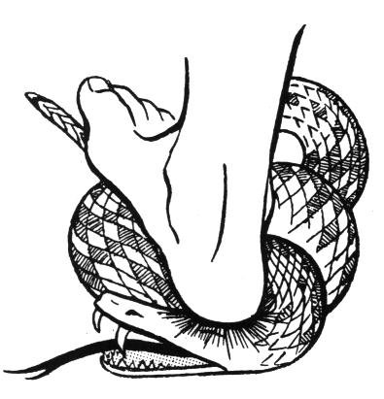
Serpent
(3:14-15)
  Serpent’s body (3:14)
  Protoevangelium (3:15)

Slide 70
Serpent
(3:14-15)
  Serpent’s body (3:14)
  Protoevangelium (3:15)

Slide 71
Romans 8:19-22
¹⁹ For the anxious longing of the creation waits eagerly for the revealing of the sons of God. ²⁰ For the creation was subjected to futility, not willingly, but because of Him who subjected it, in hope ²¹ that the creation itself also will be set free from its slavery to corruption into the freedom of the glory of the children of God. ²² For we know that the whole creation groans and suffers the pains of childbirth together until now.

Slide 72
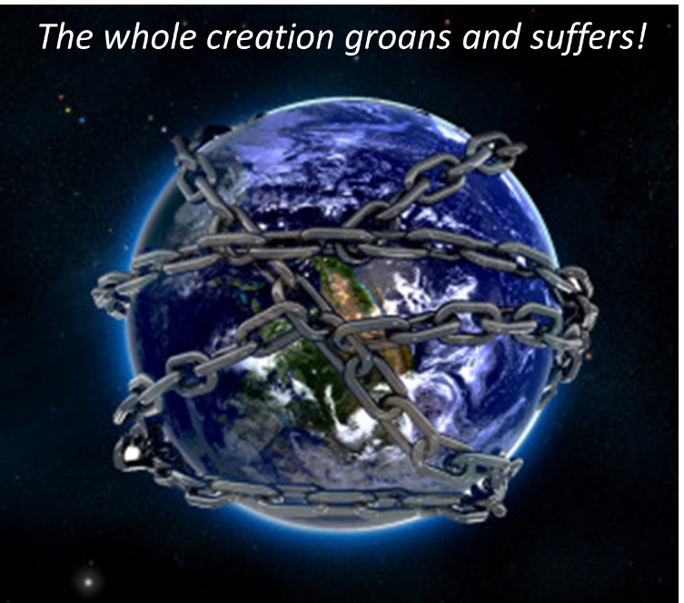

Slide 73
Serpent
(3:14-15)
  Serpent’s body (3:14)
  Protoevangelium (3:15)

Slide 74
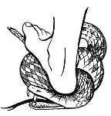

Satan’s Progressive Defeat
  Initial eviction from heaven (Isa 14:12-15; Ezek 28:12-17)
  Eden (Gen 3:15)
  Pre-diluvian world (1 Pet 3:19-20)
  Cross (John 12:31; 16:11; Col 2:15; Heb 2:14; 1 John 3:8)
  Mid point of the Tribulation (Rev 12:9)
  Beginning of millennium (Rev 20:2-3)
  End of millennium (Rev 20:10)

Slide 75
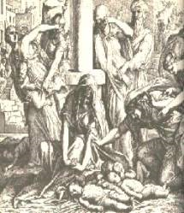
Satanic Attempts to Stop Messiah
  Cain; Gen. 4, 1 Jn. 3:12
  Pharaoh; Ex. 1
  Athaliah;2 Chron. 22
  Haman; Esther
  Herod; Mt.2;Rev 12:4
  Matt 4:5-7

Slide 76
Divine Judgments
(3:14-19)
  Serpent (3:14-15)
  Woman (3:16)
  Man (3:17-19)

Slide 77
Woman
(3:16)
  Painful child birth (3:16a)
  Relational conflict (3:16b)

Slide 78
Woman
(3:16)
  Painful child birth (3:16a)
  Relational conflict (3:16b)

Slide 79
Genesis 1:26-28
²⁶ Then God said, “Let Us make man in Our image, according to Our likeness; and let them rule over the fish of the sea and over the birds of the sky and over the cattle and over all the earth, and over every creeping thing that creeps on the earth.” ²⁷ God created man in His own image, in the image of God He created him; male and female He created them. ²⁸ God blessed them; and God said to them, “Be fruitful and multiply, and fill the earth, and subdue it; and rule over the fish of the sea and over the birds of the sky and over every living thing that moves on the earth.”

Slide 80
Woman
(3:16)
  Painful child birth (3:16a)
  Relational conflict (3:16b)

Slide 81

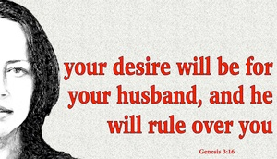
Genesis 3:16
¹⁶ “To the woman He said, ‘I will greatly multiply Your pain in childbirth, In pain you will bring forth children; Yet your desire [TESHUQAH] will be for your husband, And he will rule over you.’”

Slide 82

Song of Solomon 7:10
¹⁰ “I am my beloved’s, and his desire [TESHUQAH] is for me.”

Slide 83
Parallel Between Genesis 3:16 & 4:7
Genesis 3:16
“your desire [TESHUQAH] will be for your husband, and he will rule over you.”
Genesis 4:7
“its [sin] desire [TESHUQAH] is for you, but you must master it.”
Susan T. Foh, “What is the Woman’s Desire?”, The Westminster Theological Journal 37 (1974-75), 376-83.

Slide 84
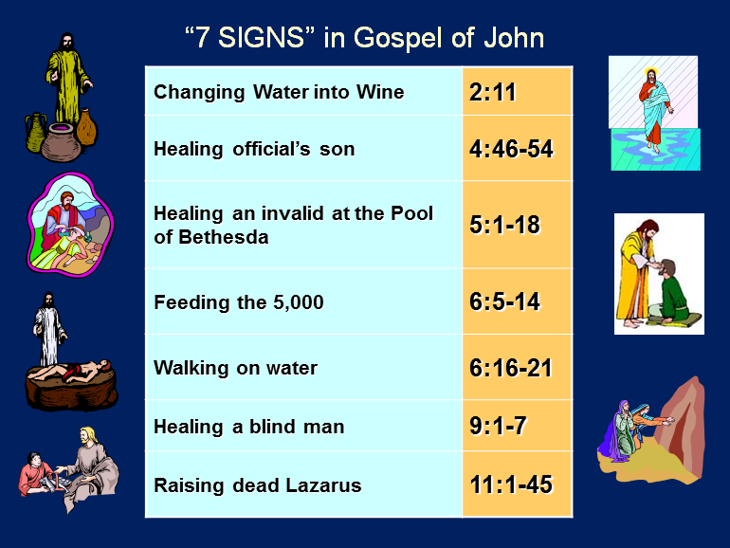

Slide 85


1 Corinthians 7:28
“But if you marry, you have not sinned; and if a virgin marries, she has not sinned. Yet such will have trouble in this life, and I am trying to spare you.”

Slide 86
Proverbs 21:9, 19; 25:24
“⁹ It is better to live in a corner of a roof
Than in a house shared with a contentious woman… ¹⁹ It is better to live in a desert land
Than with a contentious and vexing woman... ²⁴ It is better to live in a corner of the roof
Than in a house shared with a contentious woman.”

Slide 87
Divine Judgments
(3:14-19)
  Serpent (3:14-15)
  Woman (3:16)
  Man (3:17-19)

Slide 88
Man
(3:17-19)
  Painful labor (3:17-19a)
  Death (3:19b)

Slide 89
Man
(3:17-19)
  Painful labor (3:17-19a)
  Death (3:19b)

Slide 90
Genesis 3:17-19
¹⁷ Then to Adam He said, “Because you have listened to the voice of your wife, and have eaten from the tree about which I commanded you, saying, ‘You shall not eat from it’; Cursed is the ground because of you; In toil you will eat of it All the days of your life. ¹⁸ “Both thorns and thistles it shall grow for you; And you will eat the plants of the field; ¹⁹ By the sweat of your face You will eat bread...”

Slide 91

Genesis 3:19
“By the sweat of your face You will eat bread, Till you return to the ground, Because from it you were taken; For you are dust, And to dust you shall return.”

Slide 92
Man
(3:17-19)
  Painful labor (3:17-19a)
  Death (3:19b)

Slide 93
Genesis 3:19
“By the sweat of your face You will eat bread, Till you return to the ground, Because from it you were taken; For you are dust, And to dust you shall return.”

Slide 94
Genesis 2:16-17
“¹⁶ The Lord God commanded the man, saying, ‘From any tree of the garden you may eat freely; ¹⁷ but from the tree of the knowledge of good and evil you shall not eat, for in the day that you eat from it you will surely die (muwth).’”

Slide 95

1 Corinthians 15:21-22
“²¹ For since by a man came death, by a man also came the resurrection of the dead. ²² For as in Adam all die, so also in Christ all will be made alive.”

Slide 96
Romans 5:12
“Therefore, just as through one man sin entered into the world, and death through sin, and so death spread to all men, because all sinned—.”

Slide 97
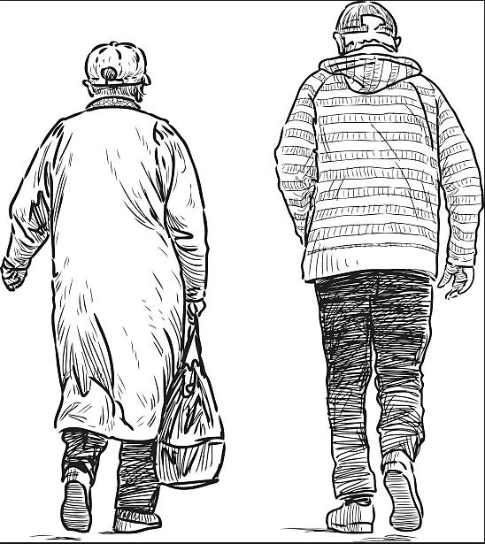
2 Cor. 4:16
¹⁶ Therefore we do not lose heart, but though our outer man is decaying, yet our inner man is being renewed day by day.

Slide 99
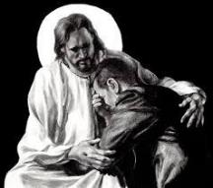
Revelation 21:4
“and He will wipe away every tear from their eyes; and there will no longer be any death; there will no longer be any mourning, or crying, or pain; the first things have passed away.”

Slide 100
Genesis Structure
  3:1-5 Temptation by the serpent
  3:6 Sin of Adam and Eve
  3:7-13 Results of the sin
  3:14-19 Imposition of divine judgments
  3:20-24 God’s provision in spite of the sin

Slide 101
God’s Provision
(3:20-24)
  Continuation of the race (3:20)
  Forgiveness (3:21, 7)
  Expulsion of Adam and Eve from Eden (3:22-24)

Slide 102
God’s Provision
(3:20-24)
  Continuation of the race (3:20)
  Forgiveness (3:21, 7)
  Expulsion of Adam and Eve from Eden (3:22-24)

Slide 103
Genesis 3:19
“By the sweat of your face You will eat bread, Till you return to the ground, Because from it you were taken; For you are dust, And to dust you shall return.”

Slide 104

Acts 17:26
“and He made from one man every nation of mankind to live on all the face of the earth, having determined their appointed times and the boundaries of their habitation.” (Italics added)
104

Slide 105
God’s Provision
(3:20-24)
  Continuation of the race (3:20)
  Forgiveness (3:21, 7)
  Expulsion of Adam and Eve from Eden (3:22-24)

Slide 106
God’s Provision
(3:20-24)
  Continuation of the race (3:20)
  Forgiveness (3:21, 7)
  Expulsion of Adam and Eve from Eden (3:22-24)

Slide 107
Genesis 1:26-28
²⁶ Then God said, “Let Us make man in Our image, according to Our likeness; and let them rule over the fish of the sea and over the birds of the sky and over the cattle and over all the earth, and over every creeping thing that creeps on the earth.” ²⁷ God created man in His own image, in the image of God He created him; male and female He created them. ²⁸ God blessed them; and God said to them, “Be fruitful and multiply, and fill the earth, and subdue it; and rule over the fish of the sea and over the birds of the sky and over every living thing that moves on the earth.”

Slide 108

Trinitarianism in Genesis
  Gen 1:26
  Gen 3:22
  Gen 11:7
  Isa 6:8

Slide 109
The Divine Institutions
Conscience (Gen. 3:22)
Marriage and family (Gen. 1:26-28; 2:18-25)
Labor (Gen. 2:15; 3:19)
Government (Gen. 9:6)
Nationalism (Gen. 11:1-9)

Slide 110
The Divine Institutions
Conscience (Gen. 3:22)
Marriage and family (Gen. 1:26-28; 2:18-25)
Labor (Gen. 2:15; 3:19)
Government (Gen. 9:6)
Nationalism (Gen. 11:1-9)

Slide 111
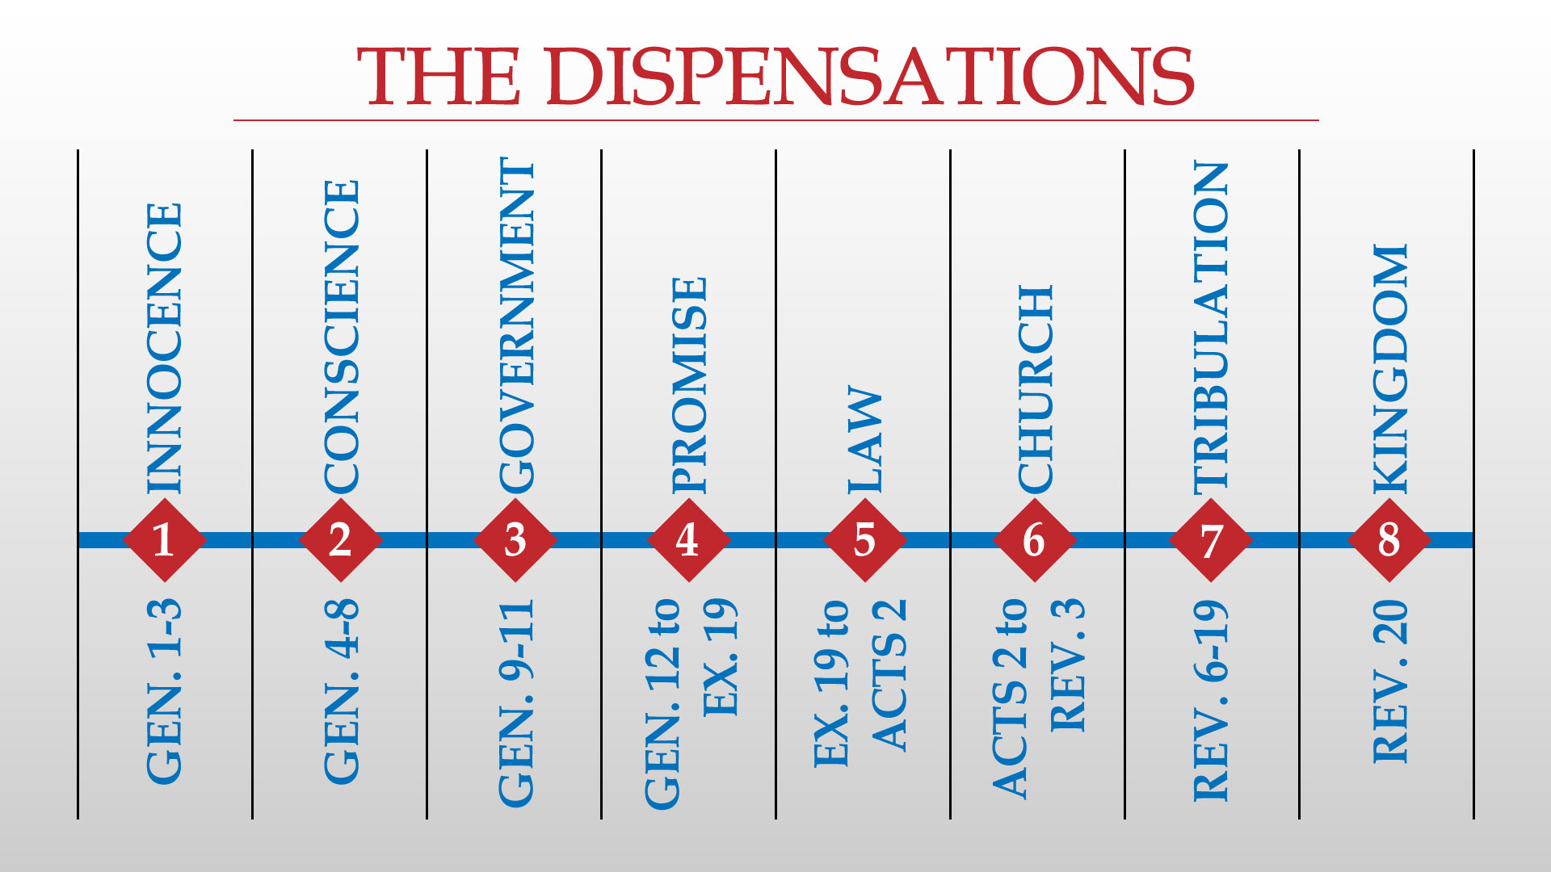

Slide 112
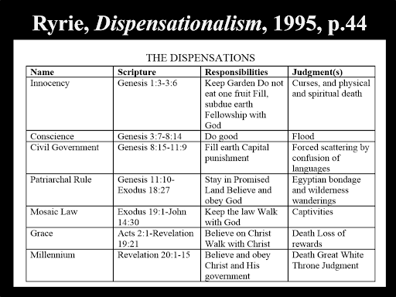

Slide 113
Conclusion

Slide 114
Genesis Structure Review
  3:1-5 Temptation by the serpent
  3:6 Sin of Adam and Eve
  3:7-13 Results of the sin
  3:14-19 Imposition of divine judgments
  3:20-24 God’s provision in spite of the sin

Slide 115

“The Lord bless you and keep you; the Lord make his face shine on you and be gracious to you; the Lord turn his face toward you and give you peace.” (NIV)

