Slide 1
PRACTICAL RIGHTEOUSNESS
Dr. Andy Woods
Senior Pastor – Sugar Land Bible Church
President – Chafer Theological Seminary

Slide 2
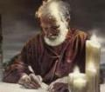
Answering Eleven Questions
Who wrote it? – James
What do we know about the author? – Christ’s ½ Brother
Who was the audience? – Believing Jews in the Diaspora
Where was if written from? – Jerusalem
When was the book written? – A.D. 44‒47
What was the book’s occasion? – Practical righteousness
What is the book’s purpose? – Achieving practical righteousness
What is the book about? – Practical righteousness
What is the book’s theme? – Daily living
What makes the book different? – Practicality
How is the book organized? – Faith and Wisdom

Slide 3
James 1:1
Salutation – Jas 1:1
Writer – Jas 1:1a
Audience – Jas 1:1b

Slide 4
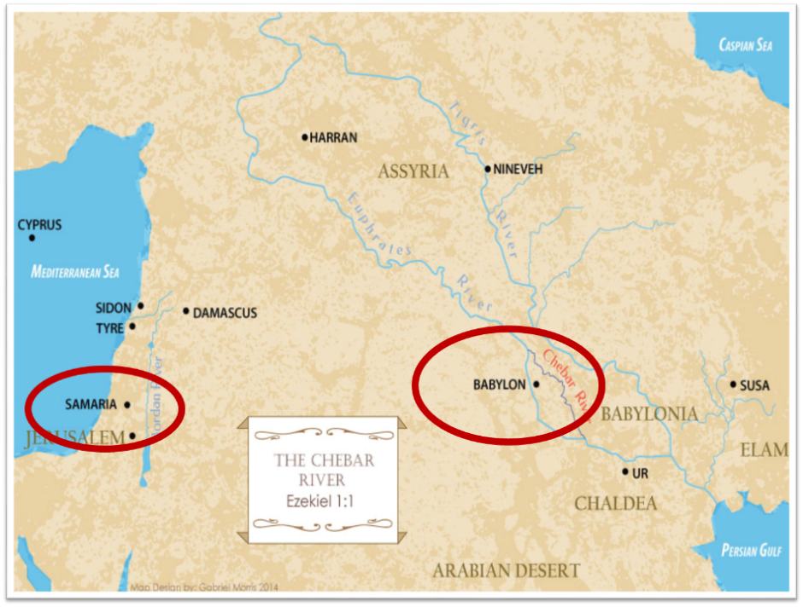

Slide 5
JAMES STRUCTURE
Faith (James 1:1‒3:12)
Wisdom (James 3:13‒5:20)

Slide 6
JAMES STRUCTURE
Faith (James 1:1‒3:12)
Wisdom (James 3:13‒5:20)

Slide 7
JAMES STRUCTURE
Faith (1:1–3:12)
Trials (1:2-18)
Obedience to the Word (1:19-27)
Favoritism (2:1-13)
Faith manifesting works (2:14-26)
Tongue (3:1-12)

Slide 8
JAMES STRUCTURE
Faith (1:1–3:12)
Trials (1:2-18)
Obedience to the Word (1:19-27)
Favoritism (2:1-13)
Faith manifesting works (2:14-26)
Tongue (3:1-12)

Slide 9
James 1:12-18
Trials – Jas 1:2-18
Rejoicing during trials – Jas 1:2-12
Command not to charge God with temptation – Jas 1:13-18

Slide 10
James 1:12-18
Trials – Jas 1:2-18
Rejoicing during trials – Jas 1:2-12
Command not to charge God with temptation – Jas 1:13-18

Slide 11
Why Rejoice During Trials? (Jas 1:2-12)
Trials produce patience & maturity (1:2-8)
Trials produce intimacy & dependence upon God (1:9-11)
Believers will be rewarded for enduring trials (1:12)

Slide 12
James 1:12-18
Trials – Jas 1:2-18
Rejoicing during trials – Jas 1:2-12
Command not to charge God with temptation – Jas 1:13-18

Slide 13
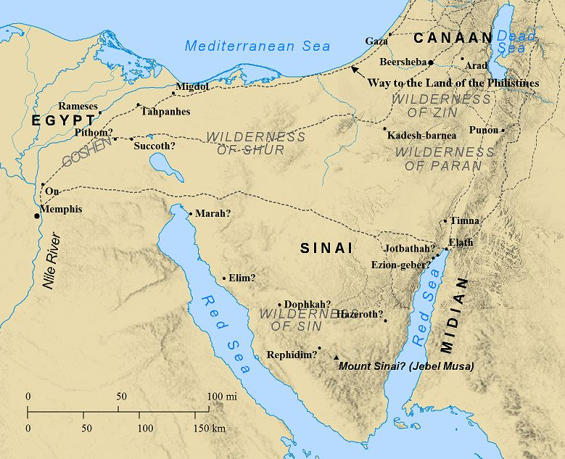

Slide 14
Reasons Why Blaming God is Wrong (Jas 1:13-18)
Temptation cannot emanate from God (1:13b)
Temptation comes from man’s fallen nature (1:14-15)
God is the giver of good gifts (1:16-18)

Slide 15
Reasons Why Blaming God is Wrong (Jas 1:13-18)
Temptation cannot emanate from God (1:13b)
Temptation comes from man’s fallen nature (1:14-15)
God is the giver of good gifts (1:16-18)

Slide 16
Reasons Why Blaming God is Wrong (Jas 1:13-18)
Temptation cannot emanate from God (1:13b)
Temptation comes from man’s fallen nature (1:14-15)
God is the giver of good gifts (1:16-18)

Slide 17
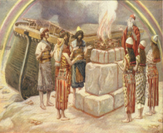
Genesis 8:21
The Lord smelled the soothing aroma; and the Lord said to Himself, “I will never again curse the ground on account of man, for the intent of man’s heart is evil from his youth; and I will never again destroy every living thing, as I have done.[emphasis mine].

Slide 18
Jeremiah 17:9
“The heart is more deceitful than all else And is desperately sick; Who can understand it?.”

Slide 19
Mark 7:20-23
“²⁰ And He was saying, ‘That which proceeds out of the man, that is what defiles the man. ²¹ For from within, out of the heart of men, proceed the evil thoughts, fornications, thefts, murders, adulteries, ²² deeds of coveting and wickedness, as well as deceit, sensuality, envy, slander, pride and foolishness. ²³ All these evil things proceed from within and defile the man.’”

Slide 21
Revelation 20:1-3
“¹ Then I saw an angel coming down from heaven, holding the key of the abyss and a great chain in his hand. ² And he laid hold of the dragon, the serpent of old, who is the devil and Satan, and bound him for a thousand years; ³ and he threw him into the abyss, and shut it and sealed it over him, so that he would not deceive the nations any longer, until the thousand years were completed; after these things he must be released for a short time.”

Slide 22
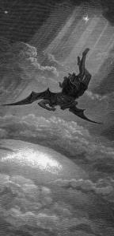
Satan’s Progressive Defeat
Initial eviction from heaven (Isa 14:12-15; Ezek 28:12-17)
Eden (Gen 3:15)
Pre-diluvian world (1 Pet 3:19-20)
Cross (John 12:31; 16:11; Col 2:15; Heb 2:14; 1 John 3:8)
Mid point of the Tribulation (Rev 12:9)
Beginning of millennium (Rev 20:2-3)
End of millennium (Rev 20:10)

Slide 23
Zechariah 14:16-18
“Then it will come about that any who are left of all the nations that went against Jerusalem will go up from year to year to worship the King, the Lord of hosts, and to celebrate the Feast of Booths. ¹⁷ And it will be that whichever of the families of the earth does not go up to Jerusalem to worship the King, the Lord of hosts, there will be no rain on them. ¹⁸ If the family of Egypt does not go up or enter, then no rain will fall on them; it will be the plague with which the Lord smites the nations who do not go up to celebrate the Feast of Booths.”

Slide 24
Revelation 20:7-9
“⁷ When the thousand years are completed, Satan will be released from his prison, ⁸ and will come out to deceive the nations which are in the four corners of the earth, Gog and Magog, to gather them together for the war; the number of them is like the sand of the seashore. ⁹ And they came up on the broad plain of the earth and surrounded the camp of the saints and the beloved city, and fire came down from heaven and devoured them.”

Slide 25
Reasons Why Blaming God is Wrong (Jas 1:13-18)
Temptation cannot emanate from God (1:13b)
Temptation comes from man’s fallen nature (1:14-15)
God is the giver of good gifts (1:16-18)

Slide 26
Benjamin Franklin
June 28, 1787; quoted by Albert Henry Smyth, ed., The Writings of Benjamin Franklin (New York: The Macmillan Company, 1905-7), IX:600-1.
“In this situation of this assembly, groping, as it were, in the dark to find political truth, and scarce able to distinguish it when presented to us, how has it happened, Sir, that we have not hitherto once thought of humbly applying to the Father of Lights to illuminate our understandings? In the beginning of the contest with Britain, when we were sensible of danger, we had daily prayers in this room for the divine protection. Our prayers, Sir, were heard-and they were graciously answered...”

Slide 27
Benjamin Franklin
June 28, 1787; quoted by Albert Henry Smyth, ed., The Writings of Benjamin Franklin (New York: The Macmillan Company, 1905-7), IX:600-1.
“I have lived, Sir, a long time; and the longer I live, the more convincing proofs I see of this truth, that God governs in the affairs of men. And if a sparrow cannot fall to the ground without his notice, is it probable that an empire can rise without his aid? We have been assured, Sir, in the sacred writings that ‘except the Lord build the house, they labor in vain that build it.’”

Slide 28
Benjamin Franklin
June 28, 1787; quoted by Albert Henry Smyth, ed., The Writings of Benjamin Franklin (New York: The Macmillan Company, 1905-7), IX:600-1.
“I firmly believe this; and I also believe that, without his concurring aid, we shall succeed in this political building no better than the builders of Babel.... I therefore beg leave to move that, henceforth, prayers imploring the assistance of heaven and its blessings on our deliberations be held in this assembly every morning before we proceed to business, and that one or more of the clergy of this city be requested to officiate in that service.”

Slide 29
CONCLUSION

Slide 30
James 1:12-18
Trials – Jas 1:2-18
Rejoicing during trials – Jas 1:2-12
Command not to charge God with temptation – Jas 1:13-18

Slide 31
Reasons Why Blaming God is Wrong (Jas 1:13-18)
Temptation cannot emanate from God (1:13b)
Temptation comes from man’s fallen nature (1:14-15)
God is the giver of good gifts (1:16-18)

Slide 32
JAMES STRUCTURE
Faith (1:1–3:12)
Trials (1:2-18)
Obedience to the Word (1:19-27)
Favoritism (2:1-13)
Faith manifesting works (2:14-26)
Tongue (3:1-12)

