Slide 1
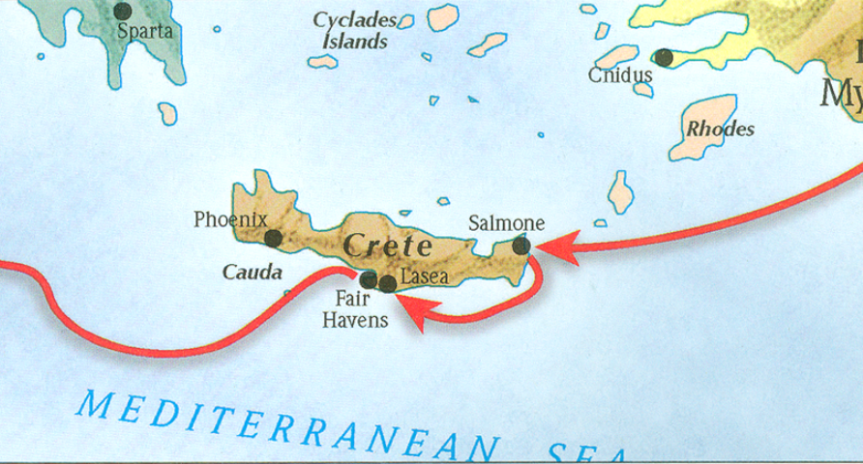
The book of Titus
Worthy of the Gospel

Slide 2
Outline of Titus
Salutation (1-5a)
Assignor (1:1-3)
Assignee (1:4)
Assignment (1:5)
Assignment Explained (1:5-3:11)
Appoint Elders (1:5b-16)
Addressing Doctrinal Issues (2:1-3:11)
Conclusion (3:12-15)
Requests (3:12-14)
Greetings (3:15a-b)
Benediction (3:15c)
Outline adapted from Titus Argument, Article by Andy Woods, 2007.

Slide 3
Outline of Titus
Salutation (1-5a)
Assignor (1:1-3)
Assignee (1:4)
Assignment (1:5)
Assignment Explained (1:5-3:11)
Appoint Elders (1:5b-16)
Addressing Doctrinal Issues (2:1-3:11)
Conclusion (3:12-15)
Requests (3:12-14)
Greetings (3:15a-b)
Benediction (3:15c)
Outline adapted from Titus Argument, Article by Andy Woods, 2007.

Slide 4
II. Assignment Explained (1:5-3:11)
Appoint Leaders (1:5b-16)
Personal Qualifications of Elders (1:6-8)
Marital relationships (1:6a)
Familial relationships (1:6b)
Interpersonal relationship (1:7-8)
Doctrinal Qualifications of Elders (1:9)
Outline adapted from Titus Argument, Article by Andy Woods, 2007.

Slide 5
The Book of Titus
“The Qualifications of Elders”

Slide 6
Titus 1:6
“…namely, if any man is above reproach, the husband of one wife, having children who believe, not accused of dissipation or rebellion.”

Slide 7
Titus 1:6
“…namely, if any man is above reproach, the husband of one wife, having children who believe, not accused of dissipation or rebellion.”

Slide 8
Titus 1:6
“…namely, if any man is above reproach, the husband of one wife, having children who believe, not accused of dissipation or rebellion.”

Slide 9
Titus 1:6
“…namely, if any man is above reproach, the husband of one wife, having children who believe, not accused of dissipation or rebellion.”

Slide 10
Proverbs 23:13
“13 Do not hold back discipline from the child, although you strike him with the rod, he will not die. 14 You shall strike him with the rod and rescue his soul from Sheol..”

Slide 11
Proverbs 22:15
“Foolishness is bound up in the heart of a child; The rod of discipline will remove it far from him.”

Slide 12
Proverbs 29:15
“The rod and reproof gives wisdom, But a child who gets his own way brings shame to his mother.”

Slide 13
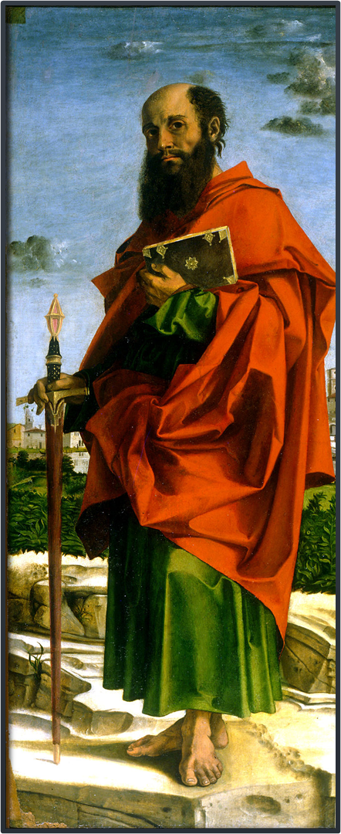
1 Timothy 3:4-5
“He must be one who manages his own household well, keeping his children under control with all dignity 5 (but if a man does not know how to manage his own household, how will he take care of the church of God?)…”

Slide 14
Titus 2:1-5
“1 But as for you, speak the things which are fitting for sound doctrine. 2 Older men are to be temperate, dignified, sensible, sound in faith, in love, in perseverance. 3 Older women likewise are to be reverent in their behavior, not malicious gossips nor enslaved to much wine, teaching what is good, 4 so that they may encourage the young women to love their husbands, to love their children, 5 to be sensible, pure, workers at home, kind, being subject to their own husbands, so that the word of God will not be dishonored.”

Slide 15
1 Timothy 3:4-5
“He must be one who manages his own household well, keeping his children under control with all dignity 5 (but if a man does not know how to manage his own household, how will he take care of the church of God?)…”

Slide 16
Ephesians 2:19-22
“19 So then you are no longer strangers and aliens, but you are fellow citizens with the saints, and are of God’s household, 20 having been built on the foundation of the apostles and prophets, Christ Jesus Himself being the corner stone in whom the whole building, being fitted together, is growing into a holy temple in the Lord, 22 in whom you also are being built together into a dwelling of God in the Spirit.”

Slide 17
Titus 1:7
“For the overseer must be above reproach as God’s steward, not self-willed, not quick-tempered, not addicted to wine, not pugnacious, not fond of sordid gain…”

Slide 18
Titus 1:7
“For the overseer must be above reproach as God’s steward, not self-willed, not quick-tempered, not addicted to wine, not pugnacious, not fond of sordid gain…”

Slide 19
Titus 1:7
“For the overseer must be above reproach as God’s steward, not self-willed, not quick-tempered, not addicted to wine, not pugnacious, not fond of sordid gain…”

Slide 20
James 1:20
“…the anger of man does not achieve the righteousness of God.”

Slide 21
Proverbs 29:22
“An angry man stirs up strife, and a hot-tempered man abounds in transgression.”

Slide 22
Psalm 103:8
The LORD is compassionate, and gracious, and slow to anger, abounding in love.”

Slide 23
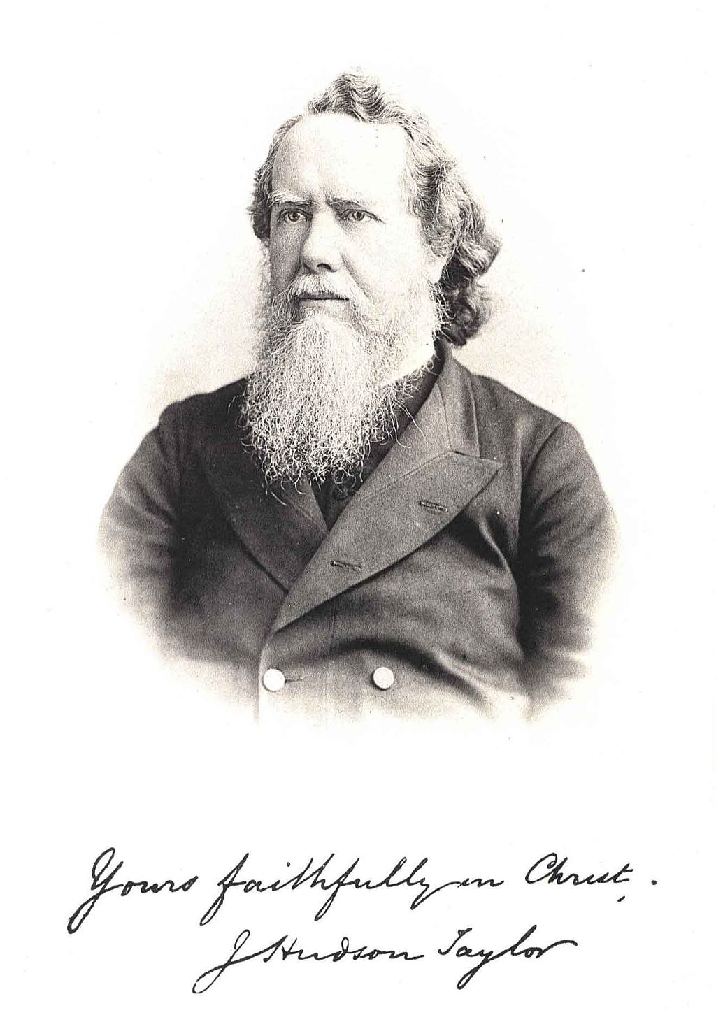
Hudson Taylor:
“My greatest temptation is to lose my temper over the slackness and inefficiency so disappointing in those on whom I depended. It is no use to lose my temper – only kindness. But oh, it is such a trial.”

Slide 24
Colossians 3:8
“But now you also, put them all aside: anger, wrath, malice, slander, and abusive speech from your mouth.”

Slide 25
Titus 1:7
“For the overseer must be above reproach as God’s steward, not self-willed, not quick-tempered, not addicted to wine, not pugnacious, not fond of sordid gain…”

Slide 26
Proverbs 20:1
“Wine is a mocker, strong drink a brawler, And whoever is intoxicated by it is not wise.”

Slide 27
Isaiah 5:11
“Woe to those who rise early in the morning that they may pursue strong drink, Who stay up late in the evening that wine may inflame them.”

Slide 28
Titus 1:7
“For the overseer must be above reproach as God’s steward, not self-willed, not quick-tempered, not addicted to wine, not pugnacious, not fond of sordid gain…”

Slide 29
Titus 1:8
“but hospitable, loving what is good, sensible, just, devout, self-controlled…”

Slide 30
Biblical Eldership
“For an elder to be inhospitable is a poor example of Christians love and care for others. The shepherd elder is to give himself lovingly and sacrificially for the care of the flock. This cannot be done at a distance – with a smile and a handshake on Sunday morning or through a superficial visit. Giving oneself to the care of Gods people means sharing one’s life and home with others. An open home is a sign of an open heart and a loving, sacrificial, serving spirit. A lack of hospitality is a sign of selfish, lifeless, loveless Christianity…[what] may seem like a small thing, hospitality has an enormous, lasting impact on people…In mysterious ways, God works through the guest-host relationship to encourage and instruct His people”

Slide 31
Titus 1:8
“but hospitable, loving what is good, sensible, just, devout, self-controlled…”

Slide 32
Titus 1:8
“but hospitable, loving what is good, sensible, just, devout, self-controlled…”

Slide 33
Titus 1:8
“but hospitable, loving what is good, sensible, just, devout, self-controlled…”

Slide 34
Titus 1:8
“but hospitable, loving what is good, sensible, just, devout, self-controlled…”

Slide 35
Proverbs 25:28
“Like a city that is broken into and without walls, is a man who has no control over his spirit.”

Slide 36
Titus 1:8
“but hospitable, loving what is good, sensible, just, devout, self-controlled…”

Slide 37
Titus 1:9
“…holding fast the faithful word which is in accordance with the teaching, so that he will be able both to exhort in sound doctrine and to refute those who contradict.”

Slide 38
1 Timothy 1:18-19
“This command I entrust to you, Timothy, my son, in accordance with the prophecies previously made concerning you, that by them you fight the good fight, keeping faith and a good conscience, which some have rejected and suffered shipwreck in regard to their faith.”

Slide 39
Titus 1:9
“…holding fast the faithful word which is in accordance with the teaching, so that he will be able both to exhort in sound doctrine and to refute those who contradict.”

Slide 40
1 Timothy 4:1-2
“But the Spirit explicitly says that in later times some will fall away from the faith, paying attention to deceitful spirits and doctrines of demons, 2 by means of the hypocrisy of liars seared in their own conscience as with a branding iron.”

Slide 41
Titus 1:9
“…holding fast the faithful word which is in accordance with the teaching, so that he will be able both to exhort in sound doctrine and to refute those who contradict.”

Slide 42
1 Peter 5:1-4
“Therefore, I exhort the elders among you, as your fellow elder and witness of the sufferings of Christ, and a partaker also of the glory that is to be revealed, 2 shepherd the flock of God among you, exercising oversight not under compulsion, but voluntarily, according to the will of God; and not for sordid gain, but with eagerness; 3 nor yet as lording it over those allotted to your charge, but proving to be examples to the flock. 4 And when the Chief Shepherd appears, you will receive the unfading crown of glory.”

Slide 43
II. Assignment Explained (1:5-3:11)
Appoint Leaders (1:5b-16)
Personal Qualifications of Elders (1:6-8)
Marital relationships (1:6a)
Familial relationships (1:6b)
Interpersonal relationship (1:7-8)
Doctrinal Qualifications of Elders (1:9)
Outline adapted from Titus Argument, Article by Andy Woods, 2007.

Slide 44
The book of Titus
Worthy of the Gospel

