Slide 1
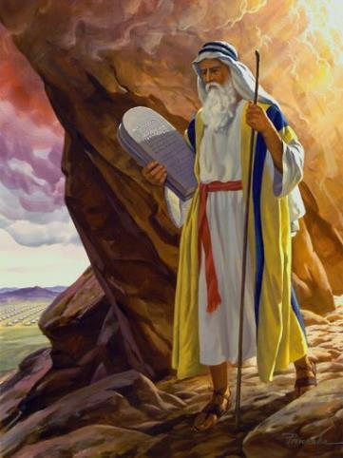
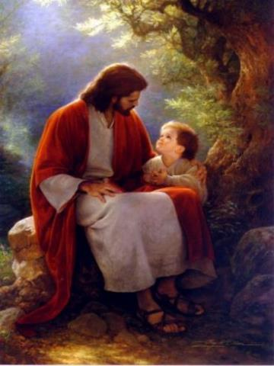
Law and Grace: An Overview Jim McGowan, Th.D. Sugar Land Bible Church 10-18-2020
…but grace and truth were realized through Jesus Christ - John 1:17
For the Law was given through Moses…
Special thanks to Dr. Vern Peterman for access to his insights and resources.

Slide 2
Session 26 Outline
Review
Purpose, Aim, and Objective
Session 25
Beatitudes and Blessings – Matthew 5:3-10
General Information
Observations, Comparisons & Contrasts
Concluding Observations

Slide 3
OUR PURPOSE, AIM AND OBJECTIVE
Law and Grace
…is to Compare and Contrast Law and Grace so as to properly understand these two important themes and how they are related to the life of the New Testament Believer.

Slide 4
C. I. SCOFIELD, D. D.
The Grace of God, The Fundamentals Vol. 3, Chapter VII, p. 98
We have, most of us, been reared and now live under the influence of Galatianism. Protestant theology, alas, is for the most part, thoroughly Galatianized, in that neither law nor grace are given their distinct and separated places, as in the counsels of God, but are mingled together in one incoherent system.
The law is no longer, as in the Divine intent, a ministration of death (2 Cor. 3:7), of cursing (Gal. 3:10), of conviction (Rom. 3:19), because we are taught that we must try to keep it, and that by Divine help we may.
Nor, on the other hand, does grace bring us blessed deliverance from the dominion of sin, for we are kept under the law as a rule of life despite the plain declaration, “Sin shall not have dominion over you: for ye are not under the law, but under grace” (Rom. 6:14). (emphasis mine)

Slide 5
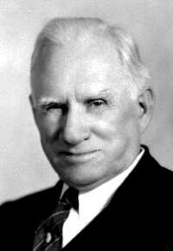
William R. Newell
Romans Verse-by-Verse (p. 274).
Grand Rapids, MI: Christian Classics Ethereal Library.
It is because Reformed theology has kept us Gentiles under the Law,—if not as a means of righteousness, then as “a rule of life,” that all the trouble has arisen. The Law is no more a rule of life than it is a means of righteousness. Walking in the Spirit has now taken the place of walking by ordinances. God has another principle under which He has put his saints: “Ye are not under law, but, under grace! (Rom. 6:14)” (italics mine)
PDF Download Here: https://archive.org/details/Romans_Verse_By_Verse-NewellWR

Slide 6
Henry Ironside
The Continual Burnt Offering: Daily Meditations on the Word of God (p. 265). Neptune, NJ: Loizeaux Brothers.
In Romans 7 we have a man renewed by the Spirit of God, but struggling under law, hoping thereby to subdue or find deliverance from the power of the old Adamic nature. In chapter 8 we have God’s way of deliverance through the death and resurrection of Christ with which the believer is identified before God. The chapter begins with “no condemnation” and ends with “no separation.” All who are in Christ Jesus are accepted in the Beloved and as free from every charge of guilt as He is Himself. He paid our penalty on the cross. Now we are linked up with Him in resurrection, not under law but under grace.

Slide 7
Session 26 Outline
Review
Purpose, Aim, and Objective
Session 25
Beatitudes and Blessings – Matthew 5:3-10
General Information
Observations, Comparisons & Contrasts
Concluding Observations

Slide 8
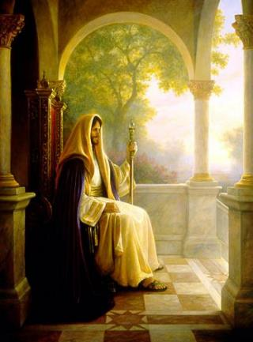
Matthew’s Purposes
Law and Grace: Session 25 Review The SOM – Matthew 5:1–8:1 (Luke 6:17–49)
To explain that Jesus, in whom, they (Jewish believers) had believed was the long-awaited Jewish Messiah.
To explain why the Kingdom had been postponed despite the fact that the King had arrived
To explain the interim program of God during the kingdom’s absence

Slide 9
Matthew & the Kingdom
Law and Grace: Session 25 Review The SOM – Matthew 5:1–8:1 (Luke 6:17–49)
Kingdom offered
Kingdom rejected
Kingdom postponed
Kingdom ultimately accepted
Interim program

Slide 10
Matthew’s Message
Law and Grace: Session 25 Review The SOM – Matthew 5:1–8:1 (Luke 6:17–49)
Jesus is the predicted Jewish king who ushered in an interim program by building the sons of the kingdom into the church in between Israel’s past rejection and future acceptance of her king

Slide 11
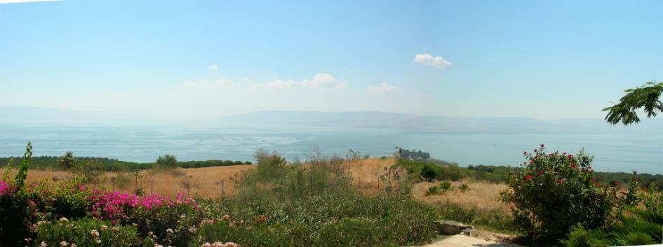
Law and Grace: Session 25 Review The SOM – Matthew 5:1–8:1 (Luke 6:17–49)
The Sermon on the Mount

Slide 12
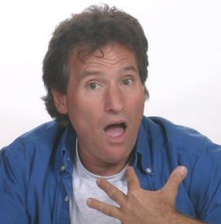
How did Christ intend for us to view the Sermon on the Mount?
Law and Grace: Session 25 Review The SOM – Matthew 5:1–8:1 (Luke 6:17–49)
Some look upon the Sermon on Mount as entirely, directly, applicable to us in the Church now, but it was spoken to the Jews in the land of Israel who were all under the Law of Moses.
What? Jesus didn’t say that to me?

Slide 13
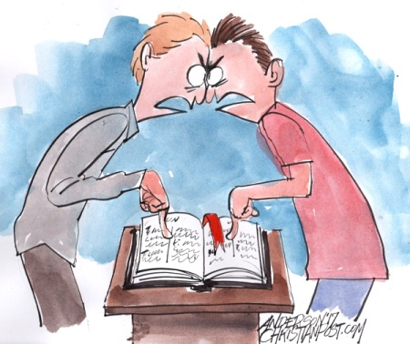
How did Christ intend for us to view the Sermon on the Mount?
Law and Grace: Session 25 Review The SOM – Matthew 5:1–8:1 (Luke 6:17–49)

Slide 14
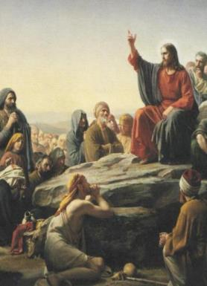
How did Christ intend for us to view the Sermon on the Mount?
Law and Grace: Session 25 Review The SOM – Matthew 5:1–8:1 (Luke 6:17–49)
The Sermon on the Mount is primarily and directly addressed to the Jews of Jesus’ day given after:
intense interest in the person of Jesus was stirred up – was He the Messiah?
the selection of the Twelve Disciples.
several conflicts with the Pharisees regarding Pharisaic Judaism and the Pharisaic interpretation of the Mosaic Law.

Slide 15
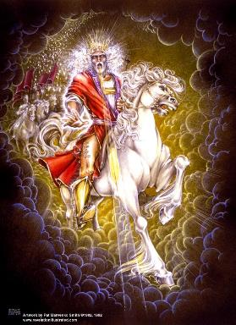
How did Christ intend for us to view the Sermon on the Mount?
Law and Grace: Session 25 Review The SOM – Matthew 5:1–8:1 (Luke 6:17–49)
The question being raised among the Jewish masses was, “What kind of righteousness is necessary for entering into the Kingdom?” Was it “Pharisaic righteousness – mere external conformity” or was it the righteousness that the OT prophets and Jesus taught?

Slide 16
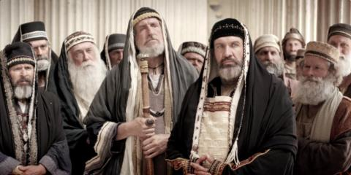
Matthew 5:20
“For I say to you that unless your righteousness surpasses that of the scribes and Pharisees, you will not enter the kingdom of heaven.

Slide 17
How did Christ intend for us to view the Sermon on the Mount?
Law and Grace: Session 25 Review The SOM – Matthew 5:1–8:1 (Luke 6:17–49)
The sermon was designed to lead [the Jewish] multitude away from a false concept of righteousness to a true concept of righteousness; from a false hope of entrance into the kingdom to a sure foundation for entrance into Messiah’s kingdom…the Sermon on the Mount in its historical setting was Christ’s instruction to that generation to which He was offering Himself as Saviour and Sovereign…
Pentecost, J. D. (1995). Thy Kingdom Come: Tracing God’s Kingdom Program and Covenant Promises throughout History (pp. 205–206). Grand Rapids, MI: Kregel Publications.

Slide 18
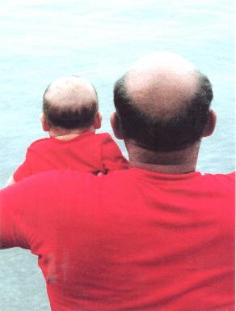
Comparison & Contrast: Intro
Law and Grace: Session 25 Review The SOM – Matthew 5:1–8:1 (Luke 6:17–49)
Knowing that we’ll find some things that are the same between ourselves and the Israelites who believe, and some that are different, we compare what is similar and contrast what is different.
Like Father like son…

Slide 19
Comparison & Contrast: Intro
Law and Grace: Session 25 Review The SOM – Matthew 5:1–8:1 (Luke 6:17–49)
An important tool in our understanding what Jesus intended to convey will be to define words that are the same for Israel and the church, but have different meanings, such as the word ‘blessed’.
Israel can be blessed in earthly ways, in the land, if they obey the Law of Moses, but cursed in or from the land, and made subject to God’s wrath if they disobey the Law of Moses (Deut. 28:1-14).
We in the Body of Christ are blessed in the heavenly places in Christ regardless of what we do or don’t do and are also promised never to be subject to God’s wrath (Eph. 1:3; Rom. 5:9).

Slide 20
Law and Grace: Session 25 Review The SOM – Matthew 5:1–8:1 (Luke 6:17–49)

Slide 21
Session 26 Outline
Review
Purpose, Aim, and Objective
Session 25
Beatitudes and Blessings – Matthew 5:3-10
General Information
Observations, Comparisons & Contrasts
Concluding Observations

Slide 22
Matthew 5:3–10
³ “Blessed are the poor in spirit, for theirs is the kingdom of heaven. ⁴ “Blessed are those who mourn, for they shall be comforted. ⁵ “Blessed are the gentle, for they shall inherit the earth. ⁶ “Blessed are those who hunger and thirst for righteousness, for they shall be satisfied. ⁷ “Blessed are the merciful, for they shall receive mercy. ⁸ “Blessed are the pure in heart, for they shall see God. ⁹ “Blessed are the peacemakers, for they shall be called sons of God. ¹⁰ “Blessed are those who have been persecuted for the sake of righteousness, for theirs is the kingdom of heaven.

Slide 23
³ Blessed are the poor in spirit, for theirs is the kingdom of heaven. ⁴ Blessed are those who mourn, for they shall be comforted. ⁵ Blessed are the gentle, for they shall inherit the earth. ⁶ Blessed are those who hunger and thirst for righteousness, for they shall be satisfied. ⁷ Blessed are the merciful, for they shall receive mercy. ⁸ Blessed are the pure in heart, for they shall see God. ⁹ Blessed are the peacemakers, for they shall be called sons of God. ¹⁰Blessed are those who have been persecuted for the sake of righteousness, for theirs is the kingdom of heaven.
THE INCLUSIO IN MATTHEW 5:3-10
Inclusi – What?

Slide 24
The Lexham Glossary of Theology states, “An Inclusio is a literary device that repeats words or themes at the beginning and end of a section. The repetition brackets the section. The Bible makes frequent use of inclusios to structure both long and short sections of text.”
Law and Grace: Session 26 The SOM – Matthew 5:1–8:1 (Luke 6:17–49)
INCLUSIO
Mangum, D. (2014). The Lexham Glossary of Theology. Bellingham, WA: Lexham Press.

Slide 25
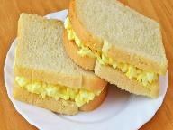
The Believers Church Bible Commentary states, that an ‘Inclusio’ is “A literary device in which a section’s opening and closing are identical or at least similar. An inclusio by definition ties the end to the beginning; it recapitulates. One might think of an inclusio as a sandwich: material is placed between identical phrases. The effect of such a device is to give unity and emphasis to the passage.”
Law and Grace: Session 26 The SOM – Matthew 5:1–8:1 (Luke 6:17–49)
INCLUSIO
The Believers Church Bible Commentary; Martens, E. A. (1986). Jeremiah (p. 3). Scottdale, PA: Herald Press.

Slide 26
³ Blessed are the poor in spirit, for theirs is the kingdom of heaven. ⁴ Blessed are those who mourn, for they shall be comforted. ⁵ Blessed are the gentle, for they shall inherit the earth. ⁶ Blessed are those who hunger and thirst for righteousness, for they shall be satisfied. ⁷ Blessed are the merciful, for they shall receive mercy. ⁸ Blessed are the pure in heart, for they shall see God. ⁹ Blessed are the peacemakers, for they shall be called sons of God. ¹⁰ Blessed are those who have been persecuted for the sake of righteousness, for theirs is the kingdom of heaven.
THE INCLUSIO IN MATTHEW 5:3-10

Slide 27
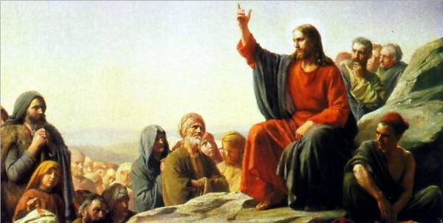
‘Blessed are’ followed by some condition of the heart or outward expression, followed by ‘for’ [meaning because], followed by some form of kingdom fulfillment or resolution.
Law and Grace: Session 26 The SOM – Matthew 5:1–8:1 (Luke 6:17–49)
THE GENERAL FORM OF THE BEATITUDES IS:

Slide 28
‘Blessing’ throughout these verses is conditioned upon the state of the heart and not merely on an outward conformity to the Law of Moses as emphasized by the Pharisees.
Law and Grace: Session 26 The SOM – Matthew 5:1–8:1 (Luke 6:17–49)
THE GENERAL FORM OF THE BEATITUDES IS:

Slide 29
Law and Grace: Session 26 The SOM – Matthew 5:1–8:1 (Luke 6:17–49)
THERE’S BLESSED, AND THEN THERE’S BLESSED!
The word ‘beatitudes’ is from the Latin word (beatus) that means ‘blessed, happy, blissful’. A few different Greek words are translated as ‘blessed’ in the New Testament.
In the Sermon on the Mount, the word is μακάριος (makários).
In Ephesians 1:3 the word is εὐλογητός (eulogētós) also in the Septuagint version (LXX) of Deu. 28.

Slide 30
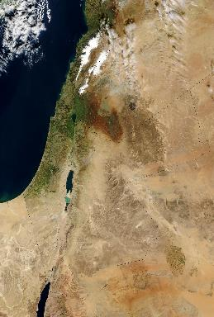
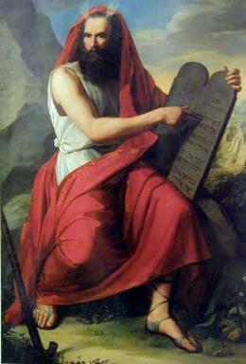
Law and Grace: Session 26 The SOM – Matthew 5:1–8:1 (Luke 6:17–49)
THERE’S BLESSED, AND THEN THERE’S BLESSED!
The Israelites were blessed if they obeyed all the Law of Moses, and cursed if they disobeyed one law.
These conditional blessings were in earthly ways in the land of Israel.

Slide 31
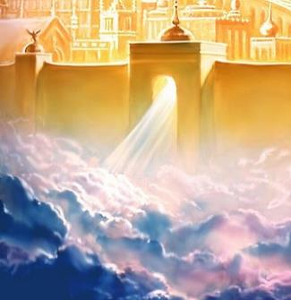
Law and Grace: Session 26 The SOM – Matthew 5:1–8:1 (Luke 6:17–49)
THERE’S BLESSED, AND THEN THERE’S BLESSED!
We are not blessed conditionally (no ‘if’), and our blessings are spiritual, and all in the heavenlies in Christ (Eph. 1:3).
Ephesians 1:3
Blessed be the God and Father of our Lord Jesus Christ, who has blessed us with every spiritual blessing in the heavenly places in Christ,

Slide 32
Law and Grace: Session 26 The SOM – Matthew 5:1–8:1 (Luke 6:17–49)
THERE’S BLESSED, AND THEN THERE’S BLESSED!
All of the ‘blessed’ statements in Matthew 5 are contingent upon the heart condition of the Jew.

Slide 33
³ Blessed are the poor in spirit, for theirs is the kingdom of heaven. ⁴ Blessed are those who mourn, for they shall be comforted. ⁵ Blessed are the gentle, for they shall inherit the earth. ⁶ Blessed are those who hunger and thirst for righteousness, for they shall be satisfied. ⁷ Blessed are the merciful, for they shall receive mercy. ⁸ Blessed are the pure in heart, for they shall see God. ⁹ Blessed are the peacemakers, for they shall be called sons of God. ¹⁰ Blessed are those who have been persecuted for the sake of righteousness, for theirs is the kingdom of heaven.
THE INCLUSIO IN MATTHEW 5:3-10

Slide 34
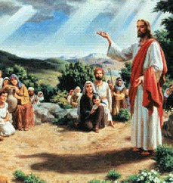
Poor in spirit
Law and Grace: Session 26 The SOM – Matthew 5:1–8:1 (Luke 6:17–49)
Verse 3 introduces the first of several paradoxes in the Beatitudes. The paradox is illustrated by a deficiency which then becomes the basis for blessing.

Slide 35
Poor in spirit
Law and Grace: Session 26 The SOM – Matthew 5:1–8:1 (Luke 6:17–49)
The individual Jew who is poor in spirit is the one who realizes that he is greatly lacking in spiritual assets of his own. He doesn’t’ have what it takes, he needs the Lord.
The individual Jew who recognizes that he is poor in spirit understands that he must look to God to meet the deepest needs of his heart and that the ultimate provision for that physically and spiritually, will be realized in the Kingdom.

Slide 36
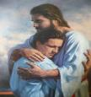
³ Blessed are the poor in spirit, for theirs is the kingdom of heaven. ⁴ Blessed are those who mourn, for they shall be comforted. ⁵ Blessed are the gentle, for they shall inherit the earth. ⁶ Blessed are those who hunger and thirst for righteousness, for they shall be satisfied. ⁷ Blessed are the merciful, for they shall receive mercy. ⁸ Blessed are the pure in heart, for they shall see God. ⁹ Blessed are the peacemakers, for they shall be called sons of God. ¹⁰ Blessed are those who have been persecuted for the sake of righteousness, for theirs is the kingdom of heaven.
THE INCLUSIO IN MATTHEW 5:3-10

Slide 37
Isaiah 61:1–3
¹ The Spirit of the Lord God is upon me, Because the Lord has anointed me To bring good news to the afflicted; He has sent me to bind up the brokenhearted, To proclaim liberty to captives And freedom to prisoners; ² To proclaim the favorable year of the Lord And the day of vengeance of our God; To comfort all who mourn, ³ To grant those who mourn in Zion, Giving them a garland instead of ashes, The oil of gladness instead of mourning, The mantle of praise instead of a spirit of fainting. So they will be called oaks of righteousness, The planting of the Lord, that He may be glorified.

Slide 38
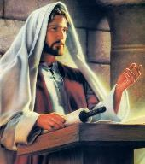
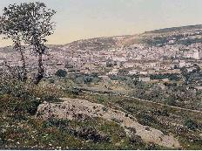
Law and Grace: Session 26 The SOM – Matthew 5:1–8:1 (Luke 6:17–49)
Christ’s 1st and 2nd Comings in Isaiah 61:1-3
Isaiah 61:1–3
First Coming
¹ The Spirit of the Lord God is upon me, Because the Lord has anointed me To bring good news to the afflicted; He has sent me to bind up the brokenhearted, To proclaim liberty to captives And freedom to prisoners; ² To proclaim the favorable year of the Lord… (cf. Luke 4:14-21)
Christ read these words in the synagogue in Nazareth.

Slide 39
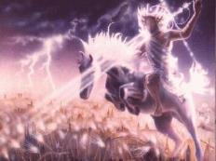
Law and Grace: Session 26 The SOM – Matthew 5:1–8:1 (Luke 6:17–49)
Christ’s 1st and 2nd Comings in Isaiah 61:1-3
Isaiah 61:1–3
Second Coming
…[To proclaim] the day of vengeance of our God; To comfort all who mourn, ³ To grant those who mourn in Zion, Giving them a garland instead of ashes, The oil of gladness instead of mourning, The mantle of praise instead of a spirit of fainting. So they will be called oaks of righteousness, The planting of the Lord, that He may be glorified.
But Christ did not read these words about His 2nd Coming!

Slide 40
³ Blessed are the poor in spirit, for theirs is the kingdom of heaven. ⁴ Blessed are those who mourn, for they shall be comforted. ⁵ Blessed are the gentle, for they shall inherit the earth. ⁶ Blessed are those who hunger and thirst for righteousness, for they shall be satisfied. ⁷ Blessed are the merciful, for they shall receive mercy. ⁸ Blessed are the pure in heart, for they shall see God. ⁹ Blessed are the peacemakers, for they shall be called sons of God. ¹⁰ Blessed are those who have been persecuted for the sake of righteousness, for theirs is the kingdom of heaven.
THE INCLUSIO IN MATTHEW 5:3-10

Slide 41
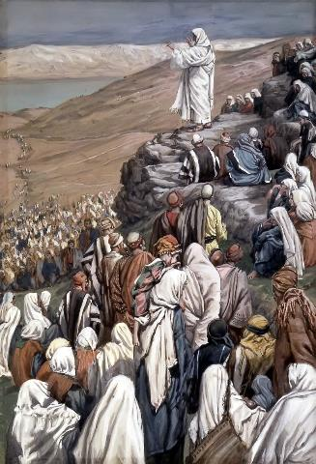
Law and Grace: Session 26 The SOM – Matthew 5:1–8:1 (Luke 6:17–49)
Gentle
This word ‘gentle’ (KJV: meek) is from the same root as the word ‘gentleness’ that is listed among the fruit of the Spirit (Gal. 5:22-23).
The Israelites whose heart condition reflects ‘a soothing disposition’, ‘free from malice and vengefulness’, will inherit the earth, primarily the land of Israel in the Millennial Kingdom.

Slide 42
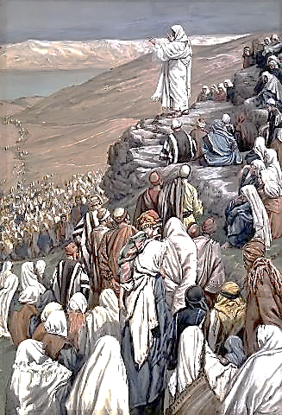
Law and Grace: Session 26 The SOM – Matthew 5:1–8:1 (Luke 6:17–49)
Gentle
What about believers, do we have an inheritance? Yes, but, our inheritance isn’t Israel or the land Israel.
The inheritance of those in the Body of Christ is ‘in Christ’ (Eph. 1:3-14; Col. 1:12; 3:24; 1 Pet. 1:4).
During the Millennial Kingdom, it will still be ‘in Christ’ Who will be in the land, ruling & reigning on David’s throne!

Slide 43
³ Blessed are the poor in spirit, for theirs is the kingdom of heaven. ⁴ Blessed are those who mourn, for they shall be comforted. ⁵ Blessed are the gentle, for they shall inherit the earth. ⁶ Blessed are those who hunger and thirst for righteousness, for they shall be satisfied. ⁷ Blessed are the merciful, for they shall receive mercy. ⁸ Blessed are the pure in heart, for they shall see God. ⁹ Blessed are the peacemakers, for they shall be called sons of God. ¹⁰ Blessed are those who have been persecuted for the sake of righteousness, for theirs is the kingdom of heaven.
THE INCLUSIO IN MATTHEW 5:3-10

Slide 44
Isaiah 61:10-11
¹⁰ I will rejoice greatly in the Lord, my soul will exult in my God; for He has clothed me with garments of salvation, He has wrapped me with a robe of righteousness, as a bridegroom decks himself with a garland, and as a bride adorns herself with her jewels. ¹¹ For as the earth brings forth its sprouts, and as a garden causes the things sown in it to spring up, so the Lord God will cause righteousness and praise to spring up before all the nations [Gentiles]. (cf. Isa. 62:1-2)

Slide 45
Isaiah 62:1–2
¹ For Zion’s sake I will not keep silent, And for Jerusalem’s sake I will not keep quiet, Until her righteousness goes forth like brightness, And her salvation like a torch that is burning. ² The nations will see your righteousness, And all kings your glory; And you will be called by a new name Which the mouth of the Lord will designate.

Slide 46
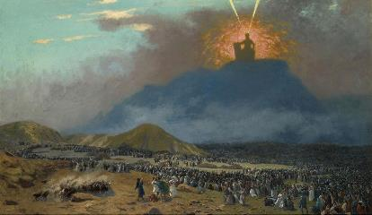
What do you mean by ‘righteousness’?
Law and Grace: Session 26 The SOM – Matthew 5:1–8:1 (Luke 6:17–49)
For the Jews, righteousness was initially understood as *“to live consistently with a divine standard” i.e., the Mosaic Law as originally given at Mt. Sinai. This divine standard was to be lived out before God and before others, all to God’s glory alone (cf. Matt. 5:16).
* Fruchtenbaum, A. G. (1983). The Messianic Bible Study Collection (Vol. 94, p. 8). Tustin, CA: Ariel Ministries.

Slide 47
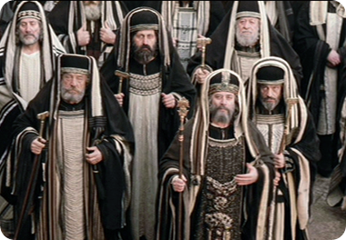
What do you mean by ‘righteousness’?
Law and Grace: Session 26 The SOM – Matthew 5:1–8:1 (Luke 6:17–49)
The Pharisaic interpretation of the Mosaic Law added traditions in an effort to ‘ensure external piety’. (Matt. 6:1) Jesus referred to the Pharisaic interpretation as a ‘heaven burden’ (Matt. 23:4; Lu. 11:46) and the Apostles referred to it as an unbearable yoke (Acts 15:10).

Slide 48
What do you mean by ‘righteousness’?
Law and Grace: Session 26 The SOM – Matthew 5:1–8:1 (Luke 6:17–49)
But for us who are in the Body of Christ, our righteousness is in our position in Christ, Who is our righteousness, and we are declared righteous by faith in Him, which is all from grace.

Slide 49
Hungering and Thirsting
Law and Grace: Session 26 The SOM – Matthew 5:1–8:1 (Luke 6:17–49)
We know that it was impossible for mere men to keep the Law of Moses because the Law made no provision for the empowerment desperately needed by men to do so. Therefore, finding ultimate satisfaction through the Law of Moses can’t be what Matthew is eluding to in Matt. 5:6.

Slide 50
Hungering and Thirsting
Law and Grace: Session 26 The SOM – Matthew 5:1–8:1 (Luke 6:17–49)
Matthew is describing Kingdom conditions and indicates that in the Millennial Kingdom those Jews who hunger and thirst for righteousness (i.e. a spiritual appetite) will be fully satisfied with that righteousness.

Slide 51
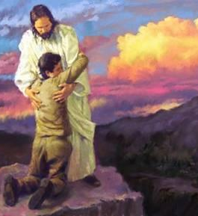
Hungering and Thirsting
Law and Grace: Session 26 The SOM – Matthew 5:1–8:1 (Luke 6:17–49)
For us who are in the Body of Christ, we are to long for the pure milk of the word of God that by it we may grow (1 Pet. 2:2), growing in the grace and in the knowledge of Christ (2 Pet. 3:18).

Slide 52
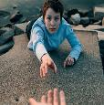
³ Blessed are the poor in spirit, for theirs is the kingdom of heaven. ⁴ Blessed are those who mourn, for they shall be comforted. ⁵ Blessed are the gentle, for they shall inherit the earth. ⁶ Blessed are those who hunger and thirst for righteousness, for they shall be satisfied. ⁷ Blessed are the merciful, for they shall receive mercy. ⁸ Blessed are the pure in heart, for they shall see God. ⁹ Blessed are the peacemakers, for they shall be called sons of God. ¹⁰ Blessed are those who have been persecuted for the sake of righteousness, for theirs is the kingdom of heaven.
THE INCLUSIO IN MATTHEW 5:3-10

Slide 53
Law and Grace: Session 26 The SOM – Matthew 5:1–8:1 (Luke 6:17–49)
The merciful obtain mercy
The merciful ones obtaining mercy is very similar to the principle of the Law that says that the ones who forgive are forgiven by God (Matt. 6:12-15).

Slide 54
Law and Grace: Session 26 The SOM – Matthew 5:1–8:1 (Luke 6:17–49)
The merciful obtain mercy
But, under grace, mercy is not conditional. In fact, mercy in life is an expression of God’s very own infinite, eternal character, in which He is rich [wealthy] toward those who are ‘in Christ’.

Slide 55
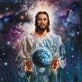
³ Blessed are the poor in spirit, for theirs is the kingdom of heaven. ⁴ Blessed are those who mourn, for they shall be comforted. ⁵ Blessed are the gentle, for they shall inherit the earth. ⁶ Blessed are those who hunger and thirst for righteousness, for they shall be satisfied. ⁷ Blessed are the merciful, for they shall receive mercy. ⁸ Blessed are the pure in heart, for they shall see God. ⁹ Blessed are the peacemakers, for they shall be called sons of God. ¹⁰ Blessed are those who have been persecuted for the sake of righteousness, for theirs is the kingdom of heaven.
THE INCLUSIO IN MATTHEW 5:3-10

Slide 56
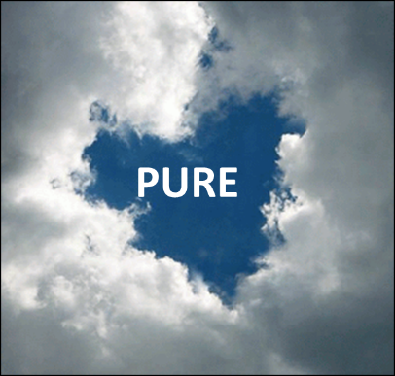
Pure in heart
Law and Grace: Session 26 The SOM – Matthew 5:1–8:1 (Luke 6:17–49)
The Israelites who would seek to remain pure, as defined by the Law of Moses and by Jesus, in contrast to the Pharisaic interpretation of the Law of Moses, are the ones who will see not only the Kingdom, but God! (2 Sam. 22:22-27; cf. Psa. 18:21-26)

Slide 57
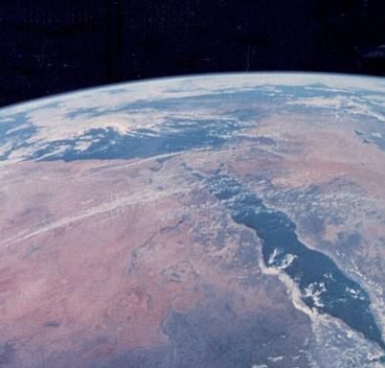
Pure in heart
Law and Grace: Session 26 The SOM – Matthew 5:1–8:1 (Luke 6:17–49)
Jesus, the Messiah, in His 2nd coming, will indeed be God dwelling on earth.

Slide 58
Pure in heart
Law and Grace: Session 26 The SOM – Matthew 5:1–8:1 (Luke 6:17–49)
We in the church have a positional purity of heart in Christ, and are to pursue purity based on our position – in Christ!

Slide 59
Shall see God
Law and Grace: Session 26 The SOM – Matthew 5:1–8:1 (Luke 6:17–49)
Christ told the Israelites that if they had a pure heart, they would see God in the kingdom, and Christ’s true deity.

Slide 60
Shall see God
Law and Grace: Session 26 The SOM – Matthew 5:1–8:1 (Luke 6:17–49)
But we are called to behold Christ through His word, and so be transformed by the Holy Spirit (2 Cor. 3:18).
And we are called to look unto Jesus, the author & perfecter of faith (Hebrews 12:2).

Slide 61
³ Blessed are the poor in spirit, for theirs is the kingdom of heaven. ⁴ Blessed are those who mourn, for they shall be comforted. ⁵ Blessed are the gentle, for they shall inherit the earth. ⁶ Blessed are those who hunger and thirst for righteousness, for they shall be satisfied. ⁷ Blessed are the merciful, for they shall receive mercy. ⁸ Blessed are the pure in heart, for they shall see God. ⁹ Blessed are the peacemakers, for they shall be called sons of God. ¹⁰ Blessed are those who have been persecuted for the sake of righteousness, for theirs is the kingdom of heaven.
THE INCLUSIO IN MATTHEW 5:3-10

Slide 62
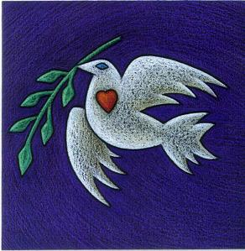
Law and Grace: Session 26 The SOM – Matthew 5:1–8:1 (Luke 6:17–49)
Peacemakers
Now does this mean that Jesus intended that the Israelites should go about negotiating peace settlements among warring factions?

Slide 63
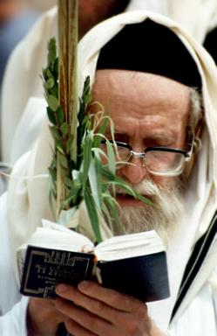
Law and Grace: Session 26 The SOM – Matthew 5:1–8:1 (Luke 6:17–49)
Peacemakers
Prov. 3:27-30 advises Israelites to avoid needless fighting with other Israelites, and in Matt. 5:22-25 we’ll see Jesus urging resolution.
So, pursuing peace is something that in fact, the Israelites are to do.

Slide 64
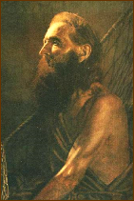
James 3:17-18
¹⁷ But the wisdom from above is first pure, then peaceable, gentle, reasonable, full of mercy and good fruits, unwavering, without hypocrisy. ¹⁸ And the seed whose fruit is righteousness is sown in peace by those who make peace.

Slide 65
Called sons of God
Law and Grace: Session 26 The SOM – Matthew 5:1–8:1 (Luke 6:17–49)
When we see the term ‘son of’ or ‘child of’ in the Bible the meaning is ‘like in character or close in relationship’ – perhaps both.
1 John 3:10
By this the children of God and the children of the devil are obvious…

Slide 66
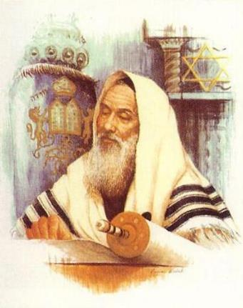
Called sons of God
Law and Grace: Session 26 The SOM – Matthew 5:1–8:1 (Luke 6:17–49)
The Jews were to be intentional, practiced, and observable, peacemakers in order to demonstrate that they were ‘like in character’ or ‘close in relationship’ to God, which would result in they’re being called ‘sons of God’ by those observing them.

Slide 67
Galatians 3:26
“For you are all sons of God through faith in Christ Jesus.”

Slide 68
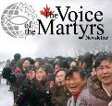
³ BLESSED ARE the poor in spirit, FOR THEIRS IS THE KINGDOM OF HEAVEN. ⁴ Blessed are those who mourn, for they shall be comforted. ⁵ Blessed are the gentle, for they shall inherit the earth. ⁶ Blessed are those who hunger and thirst for righteousness, for they shall be satisfied. ⁷ Blessed are the merciful, for they shall receive mercy. ⁸ Blessed are the pure in heart, for they shall see God. ⁹ Blessed are the peacemakers, for they shall be called sons of God. ¹⁰ BLESSED ARE those who have been persecuted for the sake of righteousness, FOR THEIRS IS THE KINGDOM OF HEAVEN.
THE INCLUSIO IN MATTHEW 5:3-10

Slide 69
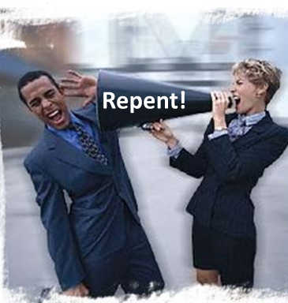
Persecuted for the sake of righteousness
Law and Grace: Session 26 The SOM – Matthew 5:1–8:1 (Luke 6:17–49)
Now it’s pretty easy to get ‘persecuted’ for being obnoxious or being an irritant.
But that is not what Jesus is talking about here.

Slide 70
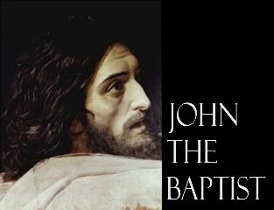
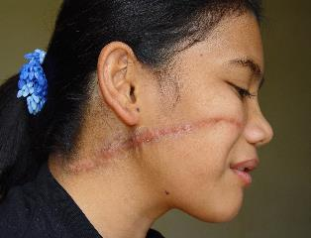
Persecuted for the sake of righteousness
Law and Grace: Session 26 The SOM – Matthew 5:1–8:1 (Luke 6:17–49)
Israelites before the start of the Coming Kingdom (i.e. John the Baptist), and Church saints before the Rapture can both be persecuted.
But being persecuted has its ultimate payoff: Israelites in the Kingdom, and Church saints rewarded in heaven.

Slide 71
Session 26 Outline
Review
Purpose, Aim, and Objective
Session 25
Beatitudes and Blessings – Matthew 5:3-10
General Information
Observations, Comparisons & Contrasts
Concluding Observations

Slide 72
The Inclusio in Matthew 5:3-10 | Comparison & Contrast
3 Blessed are the poor in spirit, for theirs is the kingdom of heaven. | Philippians 4:23; Philemon 25
4 Blessed are those who mourn, for they shall be comforted. | John 14:16; 26; 15:26; 16:7
5 Blessed are the gentle, for they shall inherit the earth. | Galatians 5:22,23
6 Blessed are those who hunger and thirst for righteousness, shall be satisfied. | 1 Peter 2:2; Romans 10:4
7 Blessed are the merciful, for they shall receive mercy. | Ephesians 2:4-7
8 Blessed are the pure in heart, for they shall see God. | 2 Corinthians 3:18; Hebrews 12:2
9 Blessed are the peacemakers, for they shall be called sons of God. | Galatians 5:22-23
10 Blessed are those who have been persecuted for the sake of righteousness, for theirs is the kingdom of heaven. | 2 Timothy 3:12

Slide 73
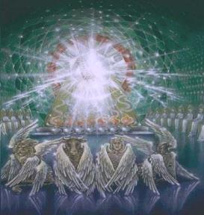
Comparison & Contrast: Summary
Law and Grace: Session 26 The SOM – Matthew 5:1–8:1 (Luke 6:17–49)
We find that there are similarities between the Beatitudes in Matthew’s Jewish oriented Gospel and what is revealed to the Church elsewhere, because it is the same God who ultimately authored both the Old & New Testaments and,
because there is a common human need among the Jews and the Church.

Slide 74
Comparison & Contrast: Summary
Law and Grace: Session 26 The SOM – Matthew 5:1–8:1 (Luke 6:17–49)
Where we find that there is a difference between the Beatitudes and what is revealed to us in the church, it is because God has carried out a different means of expressing Himself and meeting needs.

Slide 75
Law and Grace: An Overview Jim McGowan, Th.D. Sugar Land Bible Church 10-18-2020
…but grace and truth were realized through Jesus Christ - John 1:17
For the Law was given through Moses…
Special thanks to Dr. Vern Peterman for access to his insights and resources.

Slide 76
ADDENDUM SLIDES

Slide 77
Law and Grace: Session 26 The SOM – Matthew 5:1–8:1 (Luke 6:17–49)
The Inclusio in Matthew 5:3-10 | Comparison & Contrast
3 Blessed are the poor in spirit, for theirs is the kingdom of heaven. | Philippians 4:23; Philemon 25
Philippians 4:23
“The grace of the Lord Jesus Christ be with your spirit.”
Philemon 25
“The grace of the Lord Jesus Christ be with your spirit.” (cf. Gal. 6:18; 2 Tim. 4:22)

Slide 78
Law and Grace: Session 26 The SOM – Matthew 5:1–8:1 (Luke 6:17–49)
The Inclusio in Matthew 5:3-10 | Comparison & Contrast
4 Blessed are those who mourn, for they shall be comforted. | John 14:16; 26; 15:26; 16:7
John 14:16 (KJV)
And I will pray the Father, and He shall give you another Comforter, that He may abide with you for ever

Slide 79
Law and Grace: Session 26 The SOM – Matthew 5:1–8:1 (Luke 6:17–49)
The Inclusio in Matthew 5:3-10 | Comparison & Contrast
5 Blessed are the gentle, for they shall inherit the earth. | Galatians 5:22,23
Galatians 5:22-23
²² But the fruit of the Spirit is love, joy, peace, patience, kindness, goodness, faithfulness, ²³ gentleness, self-control; against such things there is no law.

Slide 80
Law and Grace: Session 26 The SOM – Matthew 5:1–8:1 (Luke 6:17–49)
The Inclusio in Matthew 5:3-10 | Comparison & Contrast
6 Blessed are those who hunger and thirst for righteousness, shall be satisfied. | 1 Peter 2:2; Romans 10:4
1 Peter 2:2
…like newborn babies, long for the pure milk of the word, so that by it you may grow in respect to salvation…
Romans 10:4
For Christ is the end of the law for righteousness to everyone who believes.

Slide 81
Law and Grace: Session 26 The SOM – Matthew 5:1–8:1 (Luke 6:17–49)
The Inclusio in Matthew 5:3-10 | Comparison & Contrast
7 Blessed are the merciful, for they shall receive mercy. | Ephesians 2:4-7
Ephesians 2:4-7
⁴ But God, being rich in mercy, because of His great love with which He loved us, ⁵ even when we were dead in our transgressions, made us alive together with Christ ( by grace you have been saved), ⁶ and raised us up with Him, and seated us with Him in the heavenly places in Christ Jesus, ⁷ so that in the ages to come He might show the surpassing riches of His grace in kindness toward us in Christ Jesus.

Slide 82
Law and Grace: Session 26 The SOM – Matthew 5:1–8:1 (Luke 6:17–49)
The Inclusio in Matthew 5:3-10 | Comparison & Contrast
8 Blessed are the pure in heart, for they shall see God. | 2 Corinthians 3:18; Hebrews 12:2
2 Corinthians 3:18
But we all, with unveiled face, beholding as in a mirror the glory of the Lord, are being transformed into the same image from glory to glory, just as from the Lord, the Spirit.
Hebrews 12:2
…fixing our eyes on Jesus…

Slide 83
Law and Grace: Session 26 The SOM – Matthew 5:1–8:1 (Luke 6:17–49)
The Inclusio in Matthew 5:3-10 | Comparison & Contrast
9 Blessed are the peacemakers, for they shall be called sons of God. | Galatians 5:22-23
Galatians 5:22-23
²² But the fruit of the Spirit is love, joy, peace, patience, kindness, goodness, faithfulness, ²³ gentleness, self-control; against such things there is no law.

Slide 84
Law and Grace: Session 26 The SOM – Matthew 5:1–8:1 (Luke 6:17–49)
The Inclusio in Matthew 5:3-10 | Comparison & Contrast
10 Blessed are those who have been persecuted for the sake of righteousness, for theirs is the kingdom of heaven. | 2 Timothy 3:12
2 Timothy 3:12
Indeed, all who desire to live godly in Christ Jesus will be persecuted.

