Slide 1


Genesis 2:4-25
Creation of the Anthropos

Slide 2

GENESIS STRUCTURE
  Beginning of the Human race (Gen. 1‒11)
  Beginning of the Hebrew race (Gen. 12‒50)

Slide 3

GENESIS STRUCTURE
  Genesis 1-11 (four events)
  Creation (1-2)
  Fall (3-5)
  Flood (6-9)
  National dispersion (10-11)

Slide 4

Contradictory Account of Creation?
Genesis 1 – Overview of the whole creation
Genesis 2 – Details surrounding the creation of the garden, the first man, and his activities on day 6

Slide 5

Genesis 2 Outline
Genesis 2:4-7 – Creation of man
Genesis 2:8-14 – Man placed in the Garden of Eden
Genesis 2:15-17 – Man’s responsibilities in the Garden of Eden
Genesis 2:18-25 – First marriage

Slide 6
Genesis 2 Outline
Genesis 2:4-7 – Creation of man
Genesis 2:8-14 – Man placed in the Garden of Eden
Genesis 2:15-17 – Man’s responsibilities in the Garden of Eden
Genesis 2:18-25 – First marriage

Slide 7
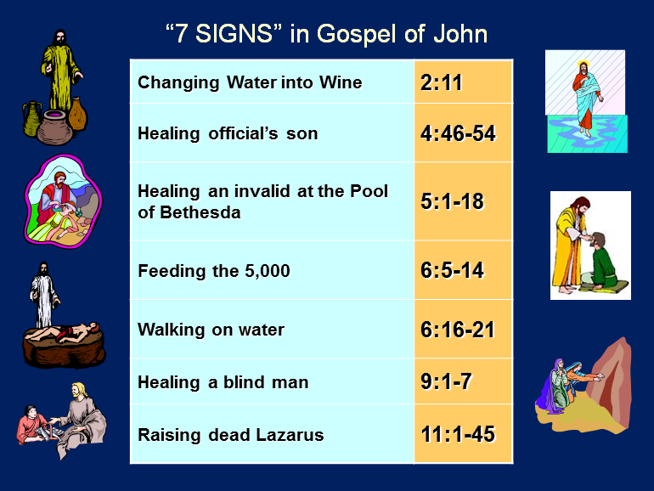

Slide 8
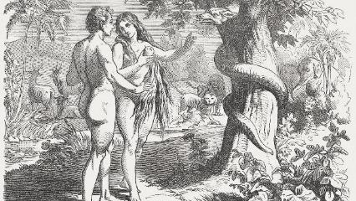
First Marriage
(Gen 2:18-25)
  Problem identified (Gen. 2:18)
  Problem recognized (Gen. 2:19-20)
  Problem solved (Gen. 2:21-25)

Slide 9
First Marriage
(Gen 2:18-25)
  Problem identified (Gen. 2:18)
  Problem recognized (Gen. 2:19-20)
  Problem solved (Gen. 2:21-25)

Slide 10
First Marriage
(Gen 2:18-25)
  Something not good (Gen 1:31; 2:18) – Man’s incompleteness resolved
  Genesis 2:18-20
  Naming all of the animals in one day?
    beasts of the field (2:20) vs. beasts of the earth (1:25)
    animals brought to him
    Adam’s mind, uniformitarian presupposition
    marriage context

Slide 11
First Marriage
(Gen 2:18-25)
  Something not good (Gen 1:31; 2:18) – Man’s incompleteness resolved
  Genesis 2:18-20
  Naming all of the animals in one day?
    beasts of the field (2:20) vs. beasts of the earth (1:25)
    animals brought to him
    Adam’s mind, uniformitarian presupposition
    marriage context

Slide 12


Genesis 1:31
“God saw all that He had made, and behold, it was very good. And there was evening and there was morning, the sixth day.”

Slide 13
First Marriage
(Gen 2:18-25)
  Problem identified (Gen. 2:18)
  Problem recognized (Gen. 2:19-20)
  Problem solved (Gen. 2:21-25)

Slide 14
First Marriage
(Gen 2:18-25)
  Something not good (Gen 1:31; 2:18) – Man’s incompleteness resolved
  Genesis 2:18-20
  Naming all of the animals in one day?
    beasts of the field (2:20) vs. beasts of the earth (1:25)
    animals brought to him
    Adam’s mind, uniformitarian presupposition
    marriage context

Slide 15
First Marriage
(Gen 2:18-25)
  Something not good (Gen 1:31; 2:18) – Man’s incompleteness resolved
  Genesis 2:18-20
  Naming all of the animals in one day?
    beasts of the field (2:20) vs. beasts of the earth (1:25)
    animals brought to him
    Adam’s mind, uniformitarian presupposition
    marriage context

Slide 16
First Marriage
(Gen 2:18-25)
  Something not good (Gen 1:31; 2:18) – Man’s incompleteness resolved
  Genesis 2:18-20
  Naming all of the animals in one day?
    beasts of the field (2:20) vs. beasts of the earth (1:25)
    animals brought to him
    Adam’s mind, uniformitarian presupposition
    marriage context

Slide 17
First Marriage
(Gen 2:18-25)
  Something not good (Gen 1:31; 2:18) – Man’s incompleteness resolved
  Genesis 2:18-20
  Naming all of the animals in one day?
    beasts of the field (2:20) vs. beasts of the earth (1:25)
    animals brought to him
    Adam’s mind, uniformitarian presupposition
    marriage context

Slide 18
First Marriage
(Gen 2:18-25)
  Something not good (Gen 1:31; 2:18) – Man’s incompleteness resolved
  Genesis 2:18-20
  Naming all of the animals in one day?
    beasts of the field (2:20) vs. beasts of the earth (1:25)
    animals brought to him
    Adam’s mind, uniformitarian presupposition
    marriage context

Slide 19
First Marriage
(Gen 2:18-25)
  Something not good (Gen 1:31; 2:18) – Man’s incompleteness resolved
  Genesis 2:18-20
  Naming all of the animals in one day?
    beasts of the field (2:20) vs. beasts of the earth (1:25)
    animals brought to him
    Adam’s mind, uniformitarian presupposition
    marriage context

Slide 20
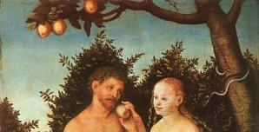
Day Six Activities
  God created the livestock, beasts of the earth, & everything that creeps on the earth
  God created Adam
  God planted the garden
  God talked to Adam
  God brought certain animals to Adam
  Adam named these animals
  God created Eve
Mark Van Bebber and Paul S. Taylor, Creation and Time: A Report on the Progressive Creationist Book by Hugh Ross (Gilbert, AZ: Eden Communications, 1994), 82

Slide 21
First Marriage
(Gen 2:18-25)
  Problem identified (Gen. 2:18)
  Problem recognized (Gen. 2:19-20)
  Problem solved (Gen. 2:21-25)

Slide 22
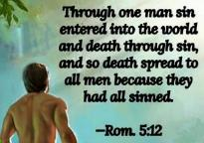
1 Thessalonians 5:23
“²³ Now may the God of peace Himself sanctify you entirely; and may your spirit and soul and body be preserved complete, without blame at the coming of our Lord Jesus Christ.”

Slide 23

Evangelical Feminism
A theological movement within the evangelical church that seeks to abolish all gender role distinctions within marriage and the church

Slide 24

Male headship
Genesis 2:21-23
Order – 1 Tim 2:11-13; transcends post-fall culture
Adam named Eve (Gen 2:23; 1:5)

Slide 25
Male headship
Genesis 2:21-23
Order – 1 Tim 2:11-13; transcends post-fall culture
Adam named Eve (Gen 2:23; 1:5)

Slide 26
Male headship
Genesis 2:21-23
Order – 1 Tim 2:11-13; transcends post-fall culture
Adam named Eve (Gen 2:23; 1:5)

Slide 27
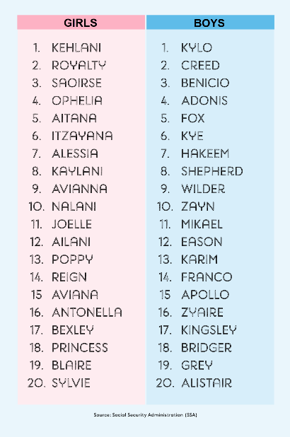
Biblical Significance of Naming
Genesis 1:8
Numbers 32:37-38
2 Kings 23:24
2 Kings 24:17
Daniel 1:6-7
Fruchtenbaum, Genesis, 84

Slide 28

Woman created from man’s side…not his foot
To complete what is lacking in man
Helper and not slave (Gen 2:18)
  “Helper” (ezer) also used of God (Exod 18:4; Deut 33:7; 1 Sam 7:12)
  Same essence as Adam (2:23)
  Both sexes retain the image of God (Gen 1:27-28)
  Both sexes are co-rulers (Gen 1:26-28)
  Trinitarian analogy
  No feminism or chauvinism

Slide 29
Woman created from man’s side…not his foot
To complete what is lacking in man
Helper and not slave (Gen 2:18)
  “Helper” (ezer) also used of God (Exod 18:4; Deut 33:7; 1 Sam 7:12)
  Same essence as Adam (2:23)
  Both sexes retain the image of God (Gen 1:27-28)
  Both sexes are co-rulers (Gen 1:26-28)
  Trinitarian analogy
  No feminism or chauvinism

Slide 30
Woman created from man’s side…not his foot
To complete what is lacking in man
Helper and not slave (Gen 2:18)
  “Helper” (ezer) also used of God (Exod 18:4; Deut 33:7; 1 Sam 7:12)
  Same essence as Adam (2:23)
  Both sexes retain the image of God (Gen 1:27-28)
  Both sexes are co-rulers (Gen 1:26-28)
  Trinitarian analogy
  No feminism or chauvinism

Slide 31
Woman created from man’s side…not his foot
To complete what is lacking in man
Helper and not slave (Gen 2:18)
  “Helper” (ezer) also used of God (Exod 18:4; Deut 33:7; 1 Sam 7:12)
  Same essence as Adam (2:23)
  Both sexes retain the image of God (Gen 1:27-28)
  Both sexes are co-rulers (Gen 1:26-28)
  Trinitarian analogy
  No feminism or chauvinism

Slide 32
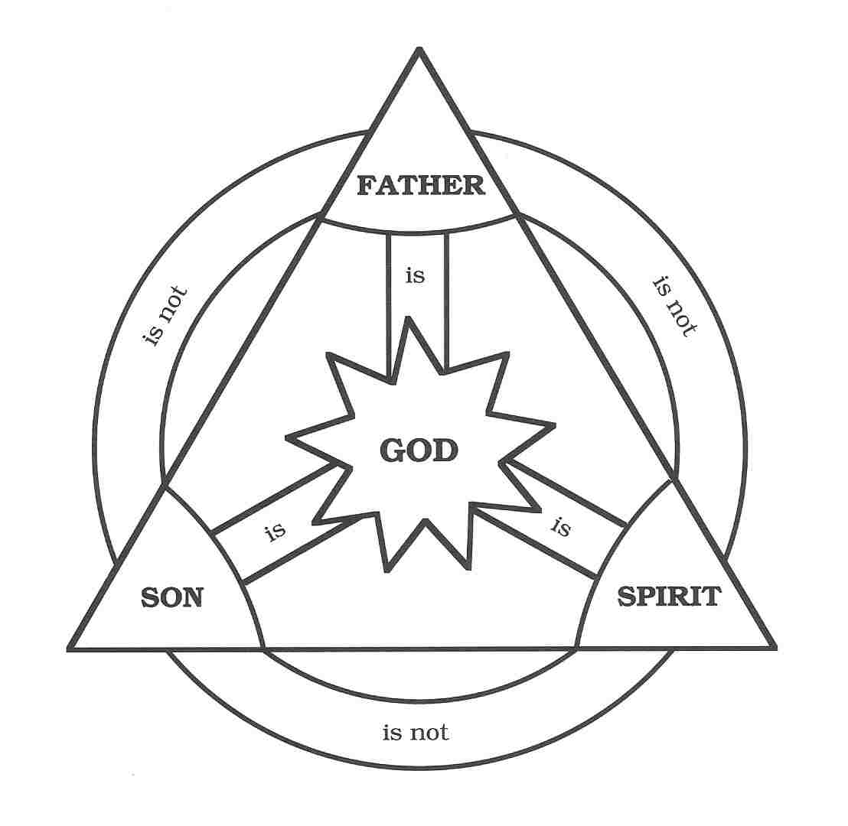

Slide 33

John 16:7-11
“⁷ But I tell you the truth, it is to your advantage that I go away; for if I do not go away, the Helper [paraklētos] will not come to you; but if I go, I will send Him to you. ⁸ And He, when He comes, will convict the world concerning sin and righteousness and judgment; ⁹ concerning sin, because they do not believe in Me; ¹⁰ and concerning righteousness, because I go to the Father and you no longer see Me; ¹¹ and concerning judgment, because the ruler of this world has been judged.”

Slide 34
Woman created from man’s side…not his foot
To complete what is lacking in man
Helper and not slave (Gen 2:18)
  “Helper” (ezer) also used of God (Exod 18:4; Deut 33:7; 1 Sam 7:12)
  Same essence as Adam (2:23)
  Both sexes retain the image of God (Gen 1:27-28)
  Both sexes are co-rulers (Gen 1:26-28)
  Trinitarian analogy
  No feminism or chauvinism

Slide 35
Woman created from man’s side…not his foot
To complete what is lacking in man
Helper and not slave (Gen 2:18)
  “Helper” (ezer) also used of God (Exod 18:4; Deut 33:7; 1 Sam 7:12)
  Same essence as Adam (2:23)
  Both sexes retain the image of God (Gen 1:27-28)
  Both sexes are co-rulers (Gen 1:26-28)
  Trinitarian analogy
  No feminism or chauvinism

Slide 36
Genesis 1:26-28
²⁶ Then God said, “Let Us make man in Our image, according to Our likeness; and let them rule over the fish of the sea and over the birds of the sky and over the cattle and over all the earth, and over every creeping thing that creeps on the earth.” ²⁷ God created man in His own image, in the image of God He created him; male and female He created them. ²⁸ God blessed them; and God said to them, “Be fruitful and multiply, and fill the earth, and subdue it; and rule over the fish of the sea and over the birds of the sky and over every living thing that moves on the earth.”

Slide 37
Woman created from man’s side…not his foot
To complete what is lacking in man
Helper and not slave (Gen 2:18)
  “Helper” (ezer) also used of God (Exod 18:4; Deut 33:7; 1 Sam 7:12)
  Same essence as Adam (2:23)
  Both sexes retain the image of God (Gen 1:27-28)
  Both sexes are co-rulers (Gen 1:26-28)
  Trinitarian analogy
  No feminism or chauvinism

Slide 38
Genesis 1:26-28
²⁶ Then God said, “Let Us make man in Our image, according to Our likeness; and let them rule over the fish of the sea and over the birds of the sky and over the cattle and over all the earth, and over every creeping thing that creeps on the earth.” ²⁷ God created man in His own image, in the image of God He created him; male and female He created them. ²⁸ God blessed them; and God said to them, “Be fruitful and multiply, and fill the earth, and subdue it; and rule over the fish of the sea and over the birds of the sky and over every living thing that moves on the earth.”

Slide 39
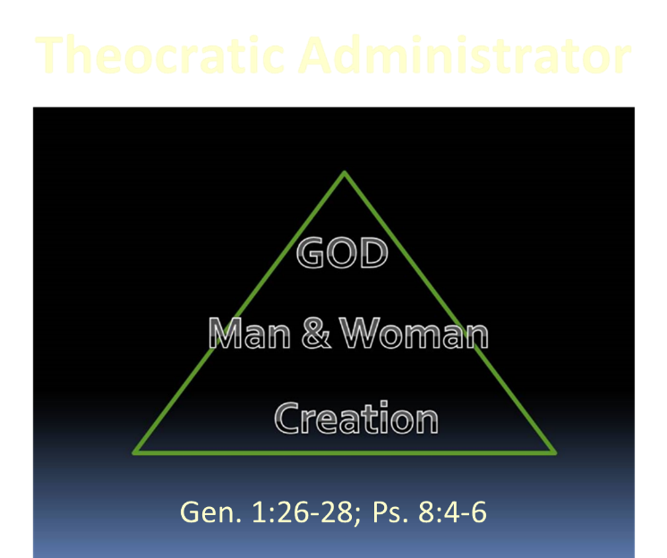

Slide 40
Woman created from man’s side…not his foot
To complete what is lacking in man
Helper and not slave (Gen 2:18)
  “Helper” (ezer) also used of God (Exod 18:4; Deut 33:7; 1 Sam 7:12)
  Same essence as Adam (2:23)
  Both sexes retain the image of God (Gen 1:27-28)
  Both sexes are co-rulers (Gen 1:26-28)
  Trinitarian analogy
  No feminism or chauvinism

Slide 42
Woman created from man’s side…not his foot
To complete what is lacking in man
Helper and not slave (Gen 2:18)
  “Helper” (ezer) also used of God (Exod 18:4; Deut 33:7; 1 Sam 7:12)
  Same essence as Adam (2:23)
  Both sexes retain the image of God (Gen 1:27-28)
  Both sexes are co-rulers (Gen 1:26-28)
  Trinitarian analogy
  No feminism or chauvinism

Slide 43
Genesis 2:24-25
Genesis 2:24
  New relational priority in order for the marriage to work (Matt 19:6)
Genesis 2:25
  Transition to the next chapter; like Gen. 1:31

Slide 44
Genesis 2:24-25
Genesis 2:24
  New relational priority in order for the marriage to work (Matt 19:6)
Genesis 2:25
  Transition to the next chapter; like Gen. 1:31

Slide 45

Matthew 19:3-6
³ Some Pharisees came to Jesus, testing Him and asking, “Is it lawful for a man to divorce his wife for any reason at all?” ⁴ And He answered and said, “Have you not read that He who created them from the beginning made them male and female, ⁵ and said, ‘For this reason a man shall leave his father and mother and be joined to his wife, and the two shall become one flesh’? ⁶ “So they are no longer two, but one flesh. What therefore God has joined together, let no man separate.”

Slide 46
Genesis 2:24-25
Genesis 2:24
  New relational priority in order for the marriage to work (Matt 19:6)
Genesis 2:25
  Transition to the next chapter; like Gen. 1:31

Slide 47
Genesis 1:31
“God saw all that He had made, and behold, it was very good. And there was evening and there was morning, the sixth day.”

Slide 48
Conclusion

Slide 49
Genesis 2 Outline
Genesis 2:4-7 – Creation of man
Genesis 2:8-14 – Man placed in the Garden of Eden
Genesis 2:15-17 – Man’s responsibilities in the Garden of Eden
Genesis 2:18-25 – First marriage

Slide 50
Genesis 1–2 Summation
  Perfect environment
  Man and Woman
  as pinnacle of creation
  theocratic administrators

Slide 51
GENESIS STRUCTURE
  Genesis 1-11 (four events)
  Creation (1-2)
  Fall (3-5)
  Flood (6-9)
  National dispersion (10-11)

Slide 52

“The Lord bless you and keep you; the Lord make his face shine on you and be gracious to you; the Lord turn his face toward you and give you peace.” (NIV)

