Slide 1
PRACTICAL RIGHTEOUSNESS
Dr. Andy Woods
Senior Pastor – Sugar Land Bible Church
President – Chafer Theological Seminary

Slide 2
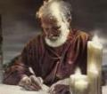
Answering Eleven Questions
Who wrote it? – James
What do we know about the author? – Christ’s ½ Brother
Who was the audience? – Believing Jews in the Diaspora
Where was if written from? – Jerusalem
When was the book written? – A.D. 44‒47
What was the book’s occasion? – Practical righteousness
What is the book’s purpose? – Achieving practical righteousness
What is the book about? – Practical righteousness
What is the book’s theme? – Daily living
What makes the book different? – Practicality
How is the book organized? – Faith and Wisdom

Slide 3
James 1:1
Salutation – Jas 1:1
Writer – Jas 1:1a
Audience – Jas 1:1b

Slide 4
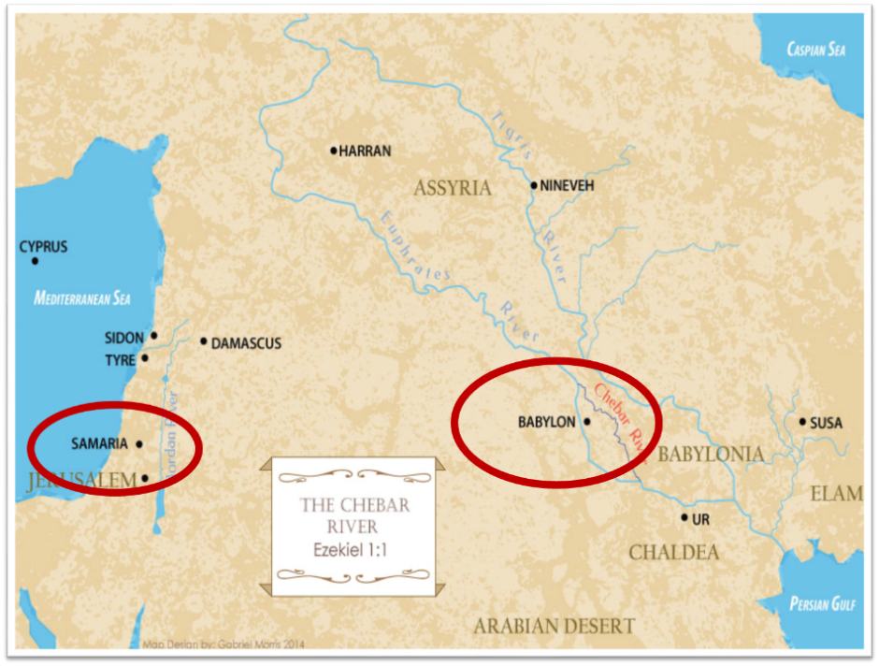

Slide 5
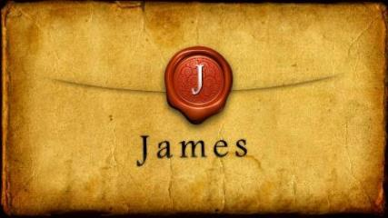
JAMES STRUCTURE
Faith (James 1:1‒3:12)
Wisdom (James 3:13‒5:20)

Slide 6
JAMES STRUCTURE
Faith (James 1:1‒3:12)
Wisdom (James 3:13‒5:20)

Slide 7
JAMES STRUCTURE
Faith (1:1–3:12)
Trials (1:2-18)
Obedience to the Word (1:19-27)
Favoritism (2:1-13)
Faith manifesting works (2:14-26)
Tongue (3:1-12)

Slide 8
JAMES STRUCTURE
Faith (1:1–3:12)
Trials (1:2-18)
Obedience to the Word (1:19-27)
Favoritism (2:1-13)
Faith manifesting works (2:14-26)
Tongue (3:1-12)

Slide 9
James 1:12-18
Trials – Jas 1:2-18
Rejoicing during trials – Jas 1:2-12
Command not to charge God with temptation – Jas 1:13-18

Slide 10
James 1:12-18
Trials – Jas 1:2-18
Rejoicing during trials – Jas 1:2-12
Command not to charge God with temptation – Jas 1:13-18

Slide 11
Why Rejoice During Trials? (Jas 1:2-12)
Trials produce patience & maturity (1:2-8)
Trials produce intimacy & dependence upon God (1:9-11)
Believers will be rewarded for enduring trials (1:12)

Slide 12
Why Rejoice During Trials? (Jas 1:2-12)
Trials produce patience & maturity (1:2-8)
Trials produce intimacy & dependence upon God (1:9-11)
Believers will be rewarded for enduring trials (1:12)

Slide 13
Why Rejoice During Trials? (Jas 1:2-12)
Trials produce patience & maturity (1:2-8)
Trials produce intimacy & dependence upon God (1:9-11)
Believers will be rewarded for enduring trials (1:12)

Slide 14
Why Rejoice During Trials? (Jas 1:2-12)
Trials produce patience & maturity (1:2-8)
Trials produce intimacy & dependence upon God (1:9-11)
Believers will be rewarded for enduring trials (1:12)

Slide 15
Scripture’s Five Crowns (Rev 4:10: 3:11; 2 John 8)
SCRIPTURE | CROWN | PURPOSE
1 Cor. 9:24-27 | Incorruptible | Gaining mastery over the flesh
1 Thess. 2:19-20 | Rejoicing | Soul winning
Jas. 1:12; Rev. 2:10 | Life | Enduring trials
1 Pet. 5:2-4 | Glory | Shepherding God’s people
2 Tim. 4:8 | Righteousness | Longing for His appearing

Slide 16
James 1:12-18
Trials – Jas 1:2-18
Rejoicing during trials – Jas 1:2-12
Command not to charge God with temptation – Jas 1:13-18

Slide 17
Reasons Why Blaming God is Wrong (Jas 1:13-18)
Temptation cannot emanate from God (1:13b)
Temptation comes from man’s fallen nature (1:14-15)
God is the giver of good gifts (1:16-18)

Slide 18
Reasons Why Blaming God is Wrong (Jas 1:13-18)
Temptation cannot emanate from God (1:13b)
Temptation comes from man’s fallen nature (1:14-15)
God is the giver of good gifts (1:16-18)

Slide 19
Reasons Why Blaming God is Wrong (Jas 1:13-18)
Temptation cannot emanate from God (1:13b)
Temptation comes from man’s fallen nature (1:14-15)
God is the giver of good gifts (1:16-18)

Slide 20
Zechariah 14:16-18
“Then it will come about that any who are left of all the nations that went against Jerusalem will go up from year to year to worship the King, the Lord of hosts, and to celebrate the Feast of Booths. ¹⁷ And it will be that whichever of the families of the earth does not go up to Jerusalem to worship the King, the Lord of hosts, there will be no rain on them. ¹⁸ If the family of Egypt does not go up or enter, then no rain will fall on them; it will be the plague with which the Lord smites the nations who do not go up to celebrate the Feast of Booths.”

Slide 21
Revelation 20:7-9
“⁷ When the thousand years are completed, Satan will be released from his prison, ⁸ and will come out to deceive the nations which are in the four corners of the earth, Gog and Magog, to gather them together for the war; the number of them is like the sand of the seashore. ⁹ And they came up on the broad plain of the earth and surrounded the camp of the saints and the beloved city, and fire came down from heaven and devoured them.”

Slide 22
Reasons Why Blaming God is Wrong (Jas 1:13-18)
Temptation cannot emanate from God (1:13b)
Temptation comes from man’s fallen nature (1:14-15)
God is the giver of good gifts (1:16-18)

Slide 23
Benjamin Franklin
June 28, 1787; quoted by Albert Henry Smyth, ed., The Writings of Benjamin Franklin (New York: The Macmillan Company, 1905-7), IX:600-1.
“In this situation of this assembly, groping, as it were, in the dark to find political truth, and scarce able to distinguish it when presented to us, how has it happened, Sir, that we have not hitherto once thought of humbly applying to the Father of Lights to illuminate our understandings? In the beginning of the contest with Britain, when we were sensible of danger, we had daily prayers in this room for the divine protection. Our prayers, Sir, were heard-and they were graciously answered...”

Slide 24
Benjamin Franklin
June 28, 1787; quoted by Albert Henry Smyth, ed., The Writings of Benjamin Franklin (New York: The Macmillan Company, 1905-7), IX:600-1.
“I have lived, Sir, a long time; and the longer I live, the more convincing proofs I see of this truth, that God governs in the affairs of men. And if a sparrow cannot fall to the ground without his notice, is it probable that an empire can rise without his aid? We have been assured, Sir, in the sacred writings that ‘except the Lord build the house, they labor in vain that build it.’”

Slide 25
Benjamin Franklin
June 28, 1787; quoted by Albert Henry Smyth, ed., The Writings of Benjamin Franklin (New York: The Macmillan Company, 1905-7), IX:600-1.
“I firmly believe this; and I also believe that, without his concurring aid, we shall succeed in this political building no better than the builders of Babel.... I therefore beg leave to move that, henceforth, prayers imploring the assistance of heaven and its blessings on our deliberations be held in this assembly every morning before we proceed to business, and that one or more of the clergy of this city be requested to officiate in that service.”

Slide 26
CONCLUSION

Slide 27
James 1:12-18
Trials – Jas 1:2-18
Rejoicing during trials – Jas 1:2-12
Command not to charge God with temptation – Jas 1:13-18

Slide 28
JAMES STRUCTURE
Faith (1:1–3:12)
Trials (1:2-18)
Obedience to the Word (1:19-27)
Favoritism (2:1-13)
Faith manifesting works (2:14-26)
Tongue (3:1-12)

