Slide 1


Genesis 2:4-25
Creation of the Anthropos

Slide 2

GENESIS STRUCTURE
  Beginning of the Human race (Gen. 1‒11)
  Beginning of the Hebrew race (Gen. 12‒50)

Slide 3

GENESIS STRUCTURE
  Genesis 1-11 (four events)
  Creation (1-2)
  Fall (3-5)
  Flood (6-9)
  National dispersion (10-11)

Slide 4

Contradictory Account of Creation?
Genesis 1 – Overview of the whole creation
Genesis 2 – Details surrounding the creation of the garden, the first man, and his activities on day 6

Slide 5

Genesis 2 Outline
Genesis 2:4-7 – Creation of man
Genesis 2:8-14 – Man placed in the Garden of Eden
Genesis 2:15-17 – Man’s responsibilities in the Garden of Eden
Genesis 2:18-25 – First marriage

Slide 6
Genesis 2 Outline
Genesis 2:4-7 – Creation of man
Genesis 2:8-14 – Man placed in the Garden of Eden
Genesis 2:15-17 – Man’s responsibilities in the Garden of Eden
Genesis 2:18-25 – First marriage

Slide 7
Genesis 2:4-7
“These are the generations of” (Toledoth)
From the ground – pride (Gen 1:27) and humility
Breath of life – man’s value and why redemption is necessary
“Lives” (Gen 2:7) – Trichotomous man (1 Thess. 5:23)
  Body – physical, cardiovascular, muscular, etc…
  Soul – personality, intellect, emotions, volition
  Spirit – relates to God (John 4:23-24; 1 Cor. 2:10-16)

Slide 8
Genesis 2 Outline
Genesis 2:4-7 – Creation of man
Genesis 2:8-14 – Man placed in the Garden of Eden
Genesis 2:15-17 – Man’s responsibilities in the Garden of Eden
Genesis 2:18-25 – First marriage

Slide 9
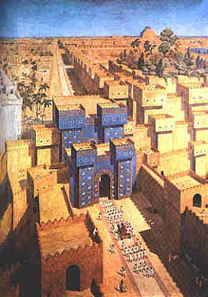
East = Babylon
Genesis 2:8
Genesis 11:2
Matthew 2:2

Slide 10


Slide 11

Daniel 1:1-2
“¹ In the third year of the reign of Jehoiakim king of Judah, Nebuchadnezzar king of Babylon came to Jerusalem and besieged it.² The Lord gave Jehoiakim king of Judah into his hand, along with some of the vessels of the house of God; and he brought them to the land of Shinar, to the house of his god, and he brought the vessels into the treasury of his god.”

Slide 12


Slide 13

Zechariah 5:5-11
⁹ Then I lifted up my eyes and looked, and there two women were coming out with the wind in their wings; and they had wings like the wings of a stork, and they lifted up the ephah between the earth and the heavens. ¹⁰ I said to the angel who was speaking with me, “Where are they taking the ephah?” ¹¹ Then he said to me, “To build a temple for her in the land of Shinar; and when it is prepared, she will be set there on her own pedestal.”

Slide 14
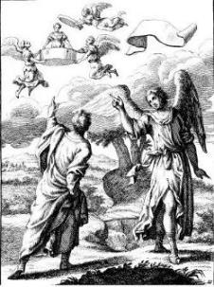
Zechariah 5:5-11
Woman (wickedness)
Ephah (commerce)
House (Temple-2 Sam 7; religion)
Shinar (Gen 10:10; 11:2; Dan 1:2)

Slide 15

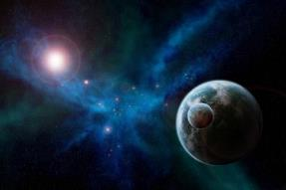
Genesis 1:31
“God saw all that He had made, and behold, it was very good. And there was evening and there was morning, the sixth day.”

Slide 16
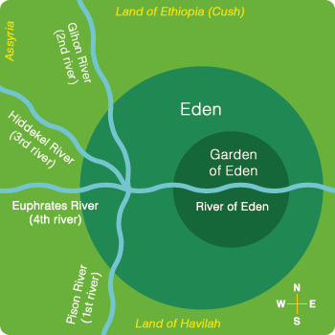
Description of the Garden of Eden
(Gen 2:8-14)
Two trees (Gen 2:9)
Four rivers: Pishon, Gihon, Tigris, Euphrates

Slide 17
Description of the Garden of Eden
(Gen 2:8-14)
Two trees (Gen 2:9)
Four rivers: Pishon, Gihon, Tigris, Euphrates

Slide 18
Genesis 1:26-28
²⁶ Then God said, “Let Us make man in Our image, according to Our likeness; and let them rule over the fish of the sea and over the birds of the sky and over the cattle and over all the earth, and over every creeping thing that creeps on the earth.” ²⁷ God created man in His own image, in the image of God He created him; male and female He created them. ²⁸ God blessed them; and God said to them, “Be fruitful and multiply, and fill the earth, and subdue it; and rule over the fish of the sea and over the birds of the sky and over every living thing that moves on the earth.”

Slide 19
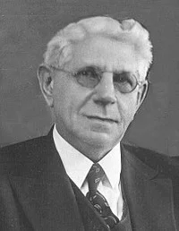
The Father of Determinism
"Predestination does not form an important subject of discussion in history until the time of Augustine. Earlier Church Fathers allude to it, but do not as yet seem to have a very clear conception of it. On the whole they regard it as the prescience of God with reference to human deeds, on the basis of which He determines their future destiny.”
Louis Berkhof, Systematic Theology: With a Complete Textual Index, 4th and rev. ed. (Grand Rapids: Eerdman's, 1932; reprint, Grand Rapids: Baker, 1996), 109.

Slide 20
Description of the Garden of Eden
(Gen 2:8-14)
Two trees (Gen 2:9)
Four rivers: Pishon, Gihon, Tigris, Euphrates

Slide 21
Local Flood?
(Gen 2:8-14)
All four rivers had a common source
Pishon and Gihon?
Local flood? Features of post flood world given names familiar to those who survived the flood (Ex: York/New York)

Slide 22
Local Flood?
(Gen 2:8-14)
All four rivers had a common source
Pishon and Gihon?
Local flood? Features of post flood world given names familiar to those who survived the flood (Ex: York/New York)

Slide 24
Local Flood?
(Gen 2:8-14)
All four rivers had a common source
Pishon and Gihon?
Local flood? Features of post flood world given names familiar to those who survived the flood (Ex: York/New York)

Slide 25
Genesis 1:31
“God saw all that He had made, and behold, it was very good. And there was evening and there was morning, the sixth day.”

Slide 26
Daniel 2:37-38
You, O king, are the king of kings, to whom the God of heaven has given the kingdom, the power, the strength and the glory; ³⁸ and wherever the sons of men dwell, or the beasts of the field, or the birds of the sky, He has given them into your hand and has caused you to rule over them all. You are the head of gold.

Slide 27


Statue
&
Stone

Slide 28


Slide 29
Eden = Probationary Environment
EDEN (GENESIS 1-2) | ETERNAL STATE (REV 21-22)
Division of light and darkness 1:4 | No night 21:25
Division of land and sea 1:10 | No sea 21:1
Sun and moon 1:16 | No sun and moon 21:23
Garden 2:8-9 | City (21:2)
River flowing out of Eden 2:10 | River flowing from throne 22:1
Gold in the land 2:12 | Gold in the city 21:21
Tree of life in the middle of the garden 2:9 | Tree of life throughout the city 22:2
Bdellium and onyx stone 2:12 | All manner of stones 21:19
God walking in the garden 3:8 | God dwelling with His people 21:3
Henry Morris, Genesis Record, p.33

Slide 30

Notes:
And the streets are made of what? Gold. When a man heard he was about to die, he desperately gathered up his life’s greatest accumulation—gold bars. When he did finally enter heaven, toting the heaven load, one angel poked another angel in the ribs. He said, “Hey, look, that guy brought pavement!”

Slide 31
Local Flood?
(Gen 2:8-14)
All four rivers had a common source
Pishon and Gihon?
Local flood? Features of post flood world given names familiar to those who survived the flood (Ex: York/New York)

Slide 33
Local Flood?
(Gen 2:8-14)
All four rivers had a common source
Pishon and Gihon?
Local flood? Features of post flood world given names familiar to those who survived the flood (Ex: York/New York)

Slide 34
Genesis 2 Outline
Genesis 2:4-7 – Creation of man
Genesis 2:8-14 – Man placed in the Garden of Eden
Genesis 2:15-17 – Man’s responsibilities in the Garden of Eden
Genesis 2:18-25 – First marriage

Slide 35

Man’s Duties in Eden
(Gen 2:15-17)
Theocratic administration
Cultivate and keep the garden – both labor and procreation (Gen 1:28) are pre fall institutions

Slide 36
Man’s Duties in Eden
(Gen 2:15-17)
Theocratic administration
Cultivate and keep the garden – both labor and procreation (Gen 1:28) are pre fall institutions

Slide 37
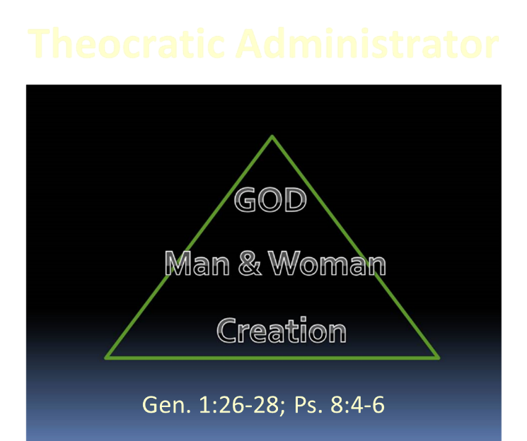

Slide 38
Genesis 1:26-28
²⁶ Then God said, “Let Us make man in Our image, according to Our likeness; and let them rule over the fish of the sea and over the birds of the sky and over the cattle and over all the earth, and over every creeping thing that creeps on the earth.” ²⁷ God created man in His own image, in the image of God He created him; male and female He created them. ²⁸ God blessed them; and God said to them, “Be fruitful and multiply, and fill the earth, and subdue it; and rule over the fish of the sea and over the birds of the sky and over every living thing that moves on the earth.”

Slide 39
Man’s Duties in Eden
(Gen 2:15-17)
Theocratic administration
Cultivate and keep the garden – both labor and procreation (Gen 1:28) are pre fall institutions

Slide 40

Genesis 3:19
“By the sweat of your face You will eat bread, Till you return to the ground, Because from it you were taken; For you are dust, And to dust you shall return.”

Slide 42
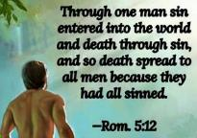
Genesis 2:16-17
“¹⁶ The Lord God commanded the man, saying, ‘From any tree of the garden you may eat freely; ¹⁷ but from the tree of the knowledge of good and evil you shall not eat, for in the day that you eat from it you will surely die (muwth).’”

Slide 43

“Do not eat from the Tree of Knowledge”
(Gen 2:17)
  Free will
  Physical death: 791x, Gen 3:19
  Humanity’s dependency upon special revelation even in the pr-fall world (Gen. 2:9)
  Deuteronomy 30:15
  Gen 2:17 and the Day Age theory?
  Gen. 1 creation days-yom with ordinal modifier and “evening and morning”
  yom + prep = “when” (1 Kgs. 2:37)

Slide 44
“Do not eat from the Tree of Knowledge”
(Gen 2:17)
  Free will
  Physical death: 791x, Gen 3:19
  Humanity’s dependency upon special revelation even in the pr-fall world (Gen. 2:9)
  Deuteronomy 30:15
  Gen 2:17 and the Day Age theory?
  Gen. 1 creation days-yom with ordinal modifier and “evening and morning”
  yom + prep = “when” (1 Kgs. 2:37)

Slide 45
Genesis 1:26-28
²⁶ Then God said, “Let Us make man in Our image, according to Our likeness; and let them rule over the fish of the sea and over the birds of the sky and over the cattle and over all the earth, and over every creeping thing that creeps on the earth.” ²⁷ God created man in His own image, in the image of God He created him; male and female He created them. ²⁸ God blessed them; and God said to them, “Be fruitful and multiply, and fill the earth, and subdue it; and rule over the fish of the sea and over the birds of the sky and over every living thing that moves on the earth.”

Slide 46
The Father of Determinism
"Predestination does not form an important subject of discussion in history until the time of Augustine. Earlier Church Fathers allude to it, but do not as yet seem to have a very clear conception of it. On the whole they regard it as the prescience of God with reference to human deeds, on the basis of which He determines their future destiny.”
Louis Berkhof, Systematic Theology: With a Complete Textual Index, 4th and rev. ed. (Grand Rapids: Eerdman's, 1932; reprint, Grand Rapids: Baker, 1996), 109.

Slide 47
“Do not eat from the Tree of Knowledge”
(Gen 2:17)
  Free will
  Physical death: 791x, Gen 3:19
  Humanity’s dependency upon special revelation even in the pr-fall world (Gen. 2:9)
  Deuteronomy 30:15
  Gen 2:17 and the Day Age theory?
  Gen. 1 creation days-yom with ordinal modifier and “evening and morning”
  yom + prep = “when” (1 Kgs. 2:37)

Slide 48
Genesis 3:19
“By the sweat of your face You will eat bread, Till you return to the ground, Because from it you were taken; For you are dust, And to dust you shall return.”

Slide 49

1 Corinthians 15:21-22
“²¹ For since by a man came death, by a man also came the resurrection of the dead. ²² For as in Adam all die, so also in Christ all will be made alive.”

Slide 50

Romans 5:12
“Therefore, just as through one man sin entered into the world, and death through sin, and so death spread to all men, because all sinned—.”

Slide 51

Genesis 1:29-30
“²⁹ Then God said, ‘Behold, I have given you every plant yielding seed that is on the surface of all the earth, and every tree which has fruit yielding seed; it shall be food for you; ³⁰ and to every beast of the earth and to every bird of the sky and to every thing that moves on the earth which has life, I have given every green plant for food’; and it was so.”

Slide 52
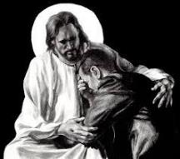
Revelation 21:4
“and He will wipe away every tear from their eyes; and there will no longer be any death; there will no longer be any mourning, or crying, or pain; the first things have passed away.”

Slide 54
1 Thessalonians 5:23
“²³ Now may the God of peace Himself sanctify you entirely; and may your spirit and soul and body be preserved complete, without blame at the coming of our Lord Jesus Christ.”

Slide 55
“Do not eat from the Tree of Knowledge”
(Gen 2:17)
  Free will
  Physical death: 791x, Gen 3:19
  Humanity’s dependency upon special revelation even in the pr-fall world (Gen. 2:9)
  Deuteronomy 30:15
  Gen 2:17 and the Day Age theory?
  Gen. 1 creation days-yom with ordinal modifier and “evening and morning”
  yom + prep = “when” (1 Kgs. 2:37)

Slide 56
General vs. Special Revelation
 | GENERAL | SPECIAL
EXAMPLES | Nature, conscience (Rom 1–2) | Incarnation, Scripture, miracles
AVAILABILITY | All | Some
ACCOMPLISHMENT | Accountability (Rom 1) | Salvation (Acts 4:12; 2 Tim 3:15)
FORM | Non-written | Written
QUALITY | Natural | Supernatural, miraculous

Slide 57
Louis Berkhof
Introductory volume to Systematic Theology
(Grand Rapids, Eerdmans, 1946), 60, 96.
“Since the entrance of sin into the world, man can gather true knowledge about God from his general revelation only if he studies it in light of Scripture, in which the elements of God’s original self-revelation, which were obscured and perverted by the blight of sin, are republished, corrected, and interpreted… Some are inclined to speak of God’s revelation as a second source; but this is hardly correct in view of the fact that nature can come into consideration here only as interpreted in the light of Scripture.”

Slide 58
“Do not eat from the Tree of Knowledge”
(Gen 2:17)
  Free will
  Physical death: 791x, Gen 3:19
  Humanity’s dependency upon special revelation even in the pr-fall world (Gen. 2:9)
  Deuteronomy 30:15
  Gen 2:17 and the Day Age theory?
  Gen. 1 creation days-yom with ordinal modifier and “evening and morning”
  yom + prep = “when” (1 Kgs. 2:37)

Slide 59
The Father of Determinism
"Predestination does not form an important subject of discussion in history until the time of Augustine. Earlier Church Fathers allude to it, but do not as yet seem to have a very clear conception of it. On the whole they regard it as the prescience of God with reference to human deeds, on the basis of which He determines their future destiny.”
Louis Berkhof, Systematic Theology: With a Complete Textual Index, 4th and rev. ed. (Grand Rapids: Eerdman's, 1932; reprint, Grand Rapids: Baker, 1996), 109.

Slide 60
“Do not eat from the Tree of Knowledge”
(Gen 2:17)
  Free will
  Physical death: 791x, Gen 3:19
  Humanity’s dependency upon special revelation even in the pr-fall world (Gen. 2:9)
  Deuteronomy 30:15
  Gen 2:17 and the Day Age theory?
  Gen. 1 creation days-yom with ordinal modifier and “evening and morning”
  yom + prep = “when” (1 Kgs. 2:37)

Slide 61
Genesis 2:16-17
“¹⁶ The Lord God commanded the man, saying, ‘From any tree of the garden you may eat freely; ¹⁷ but from the tree of the knowledge of good and evil you shall not eat, for in the day that you eat from it you will surely die (muwth).’”

Slide 62
“Do not eat from the Tree of Knowledge”
(Gen 2:17)
  Free will
  Physical death: 791x, Gen 3:19
  Humanity’s dependency upon special revelation even in the pr-fall world (Gen. 2:9)
  Deuteronomy 30:15
  Gen 2:17 and the Day Age theory?
  Gen. 1 creation days-yom with ordinal modifier and “evening and morning”
  yom + prep = “when” (1 Kgs. 2:37)

Slide 63
“Do not eat from the Tree of Knowledge”
(Gen 2:17)
  Free will
  Physical death: 791x, Gen 3:19
  Humanity’s dependency upon special revelation even in the pr-fall world (Gen. 2:9)
  Deuteronomy 30:15
  Gen 2:17 and the Day Age theory?
  Gen. 1 creation days-yom with ordinal modifier and “evening and morning”
  yom + prep = “when” (1 Kgs. 2:37)

Slide 64
Genesis 2:17; 1 Kings 2:37 (NET)
“but you must not eat from the tree of the knowledge of good and evil, for when [yom + in] you eat from it you will surely die.”
“If [yom + in] you ever do leave and cross the Kidron Valley, know for sure that you will certainly die! You will be responsible for your own death.”

Slide 65
1 Thessalonians 5:23
“²³ Now may the God of peace Himself sanctify you entirely; and may your spirit and soul and body be preserved complete, without blame at the coming of our Lord Jesus Christ.”

Slide 66
Genesis 2 Outline
Genesis 2:4-7 – Creation of man
Genesis 2:8-14 – Man placed in the Garden of Eden
Genesis 2:15-17 – Man’s responsibilities in the Garden of Eden
Genesis 2:18-25 – First marriage

Slide 67
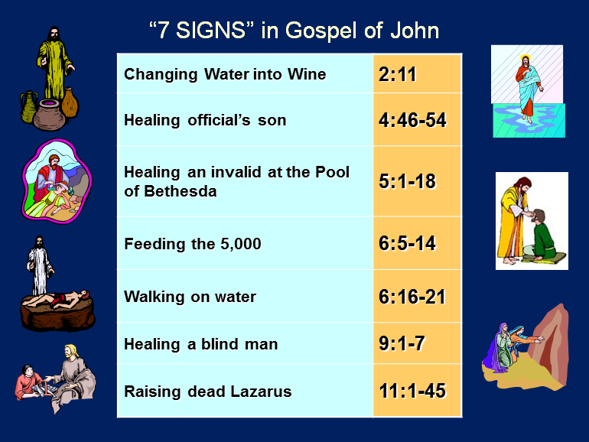

Slide 68
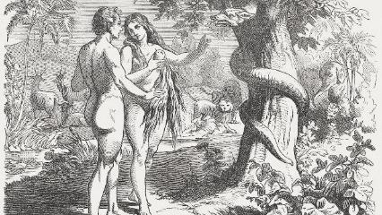
First Marriage
(Gen 2:18-25)
  Problem identified (Gen. 2:18)
  Problem recognized (Gen. 2:19-20)
  Problem solved (Gen. 2:21-25)

Slide 69
First Marriage
(Gen 2:18-25)
  Problem identified (Gen. 2:18)
  Problem recognized (Gen. 2:19-20)
  Problem solved (Gen. 2:21-25)

Slide 70
First Marriage
(Gen 2:18-25)
  Something not good (Gen 1:31; 2:18) – Man’s incompleteness resolved
  Genesis 2:18-20
  Naming all of the animals in one day?
    beasts of the field (2:20) vs. beasts of the earth (1:25)
    animals brought to him
    Adam’s mind, uniformitarian presupposition
    marriage context

Slide 71
First Marriage
(Gen 2:18-25)
  Something not good (Gen 1:31; 2:18) – Man’s incompleteness resolved
  Genesis 2:18-20
  Naming all of the animals in one day?
    beasts of the field (2:20) vs. beasts of the earth (1:25)
    animals brought to him
    Adam’s mind, uniformitarian presupposition
    marriage context

Slide 72
Genesis 1:31
“God saw all that He had made, and behold, it was very good. And there was evening and there was morning, the sixth day.”

Slide 73
First Marriage
(Gen 2:18-25)
  Problem identified (Gen. 2:18)
  Problem recognized (Gen. 2:19-20)
  Problem solved (Gen. 2:21-25)

Slide 74
First Marriage
(Gen 2:18-25)
  Something not good (Gen 1:31; 2:18) – Man’s incompleteness resolved
  Genesis 2:18-20
  Naming all of the animals in one day?
    beasts of the field (2:20) vs. beasts of the earth (1:25)
    animals brought to him
    Adam’s mind, uniformitarian presupposition
    marriage context

Slide 75
First Marriage
(Gen 2:18-25)
  Something not good (Gen 1:31; 2:18) – Man’s incompleteness resolved
  Genesis 2:18-20
  Naming all of the animals in one day?
    beasts of the field (2:20) vs. beasts of the earth (1:25)
    animals brought to him
    Adam’s mind, uniformitarian presupposition
    marriage context

Slide 76
First Marriage
(Gen 2:18-25)
  Something not good (Gen 1:31; 2:18) – Man’s incompleteness resolved
  Genesis 2:18-20
  Naming all of the animals in one day?
    beasts of the field (2:20) vs. beasts of the earth (1:25)
    animals brought to him
    Adam’s mind, uniformitarian presupposition
    marriage context

Slide 77
First Marriage
(Gen 2:18-25)
  Something not good (Gen 1:31; 2:18) – Man’s incompleteness resolved
  Genesis 2:18-20
  Naming all of the animals in one day?
    beasts of the field (2:20) vs. beasts of the earth (1:25)
    animals brought to him
    Adam’s mind, uniformitarian presupposition
    marriage context

Slide 78
First Marriage
(Gen 2:18-25)
  Something not good (Gen 1:31; 2:18) – Man’s incompleteness resolved
  Genesis 2:18-20
  Naming all of the animals in one day?
    beasts of the field (2:20) vs. beasts of the earth (1:25)
    animals brought to him
    Adam’s mind, uniformitarian presupposition
    marriage context

Slide 79
First Marriage
(Gen 2:18-25)
  Something not good (Gen 1:31; 2:18) – Man’s incompleteness resolved
  Genesis 2:18-20
  Naming all of the animals in one day?
    beasts of the field (2:20) vs. beasts of the earth (1:25)
    animals brought to him
    Adam’s mind, uniformitarian presupposition
    marriage context

Slide 80
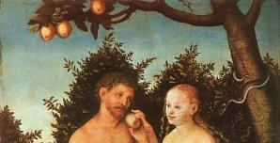
Day Six Activities
  God created the livestock, beasts of the earth, & everything that creeps on the earth
  God created Adam
  God planted the garden
  God talked to Adam
  God brought certain animals to Adam
  Adam named these animals
  God created Eve
Mark Van Bebber and Paul S. Taylor, Creation and Time: A Report on the Progressive Creationist Book by Hugh Ross (Gilbert, AZ: Eden Communications, 1994), 82

Slide 81
First Marriage
(Gen 2:18-25)
  Problem identified (Gen. 2:18)
  Problem recognized (Gen. 2:19-20)
  Problem solved (Gen. 2:21-25)

Slide 82

Evangelical Feminism
A theological movement within the evangelical church that seeks to abolish all gender role distinctions within marriage and the church

Slide 83

Male headship
Genesis 2:21-23
Order – 1 Tim 2:11-13; transcends post-fall culture
Adam named Eve (Gen 2:23; 1:5)

Slide 84
Male headship
Genesis 2:21-23
Order – 1 Tim 2:11-13; transcends post-fall culture
Adam named Eve (Gen 2:23; 1:5)

Slide 85
Male headship
Genesis 2:21-23
Order – 1 Tim 2:11-13; transcends post-fall culture
Adam named Eve (Gen 2:23; 1:5)

Slide 86
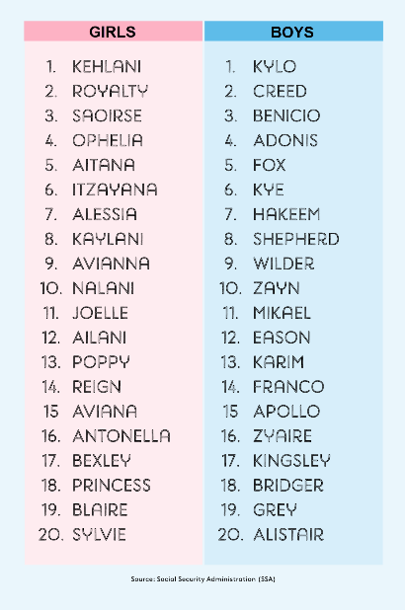
Biblical Significance of Naming
Genesis 1:8
Numbers 32:37-38
2 Kings 23:24
2 Kings 24:17
Daniel 1:6-7
Fruchtenbaum, Genesis, 84

Slide 87

Woman created from man’s side…not his foot
To complete what is lacking in man
Helper and not slave (Gen 2:18)
  “Helper” (ezer) also used of God (Exod 18:4; Deut 33:7; 1 Sam 7:12)
  Same essence as Adam (2:23)
  Both sexes retain the image of God (Gen 1:27-28)
  Both sexes are co-rulers (Gen 1:26-28)
  Trinitarian analogy
  No feminism or chauvinism

Slide 88
Woman created from man’s side…not his foot
To complete what is lacking in man
Helper and not slave (Gen 2:18)
  “Helper” (ezer) also used of God (Exod 18:4; Deut 33:7; 1 Sam 7:12)
  Same essence as Adam (2:23)
  Both sexes retain the image of God (Gen 1:27-28)
  Both sexes are co-rulers (Gen 1:26-28)
  Trinitarian analogy
  No feminism or chauvinism

Slide 89
Woman created from man’s side…not his foot
To complete what is lacking in man
Helper and not slave (Gen 2:18)
  “Helper” (ezer) also used of God (Exod 18:4; Deut 33:7; 1 Sam 7:12)
  Same essence as Adam (2:23)
  Both sexes retain the image of God (Gen 1:27-28)
  Both sexes are co-rulers (Gen 1:26-28)
  Trinitarian analogy
  No feminism or chauvinism

Slide 90
Woman created from man’s side…not his foot
To complete what is lacking in man
Helper and not slave (Gen 2:18)
  “Helper” (ezer) also used of God (Exod 18:4; Deut 33:7; 1 Sam 7:12)
  Same essence as Adam (2:23)
  Both sexes retain the image of God (Gen 1:27-28)
  Both sexes are co-rulers (Gen 1:26-28)
  Trinitarian analogy
  No feminism or chauvinism

Slide 91
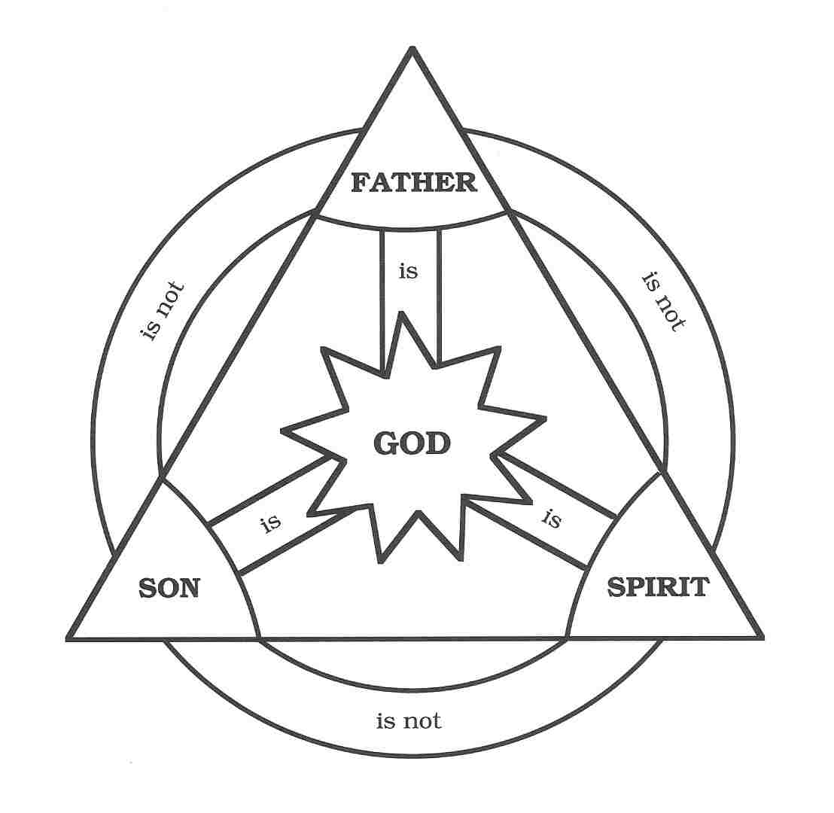

Slide 92

John 16:7-11
“⁷ But I tell you the truth, it is to your advantage that I go away; for if I do not go away, the Helper [paraklētos] will not come to you; but if I go, I will send Him to you. ⁸ And He, when He comes, will convict the world concerning sin and righteousness and judgment; ⁹ concerning sin, because they do not believe in Me; ¹⁰ and concerning righteousness, because I go to the Father and you no longer see Me; ¹¹ and concerning judgment, because the ruler of this world has been judged.”

Slide 93
Woman created from man’s side…not his foot
To complete what is lacking in man
Helper and not slave (Gen 2:18)
  “Helper” (ezer) also used of God (Exod 18:4; Deut 33:7; 1 Sam 7:12)
  Same essence as Adam (2:23)
  Both sexes retain the image of God (Gen 1:27-28)
  Both sexes are co-rulers (Gen 1:26-28)
  Trinitarian analogy
  No feminism or chauvinism

Slide 94
Woman created from man’s side…not his foot
To complete what is lacking in man
Helper and not slave (Gen 2:18)
  “Helper” (ezer) also used of God (Exod 18:4; Deut 33:7; 1 Sam 7:12)
  Same essence as Adam (2:23)
  Both sexes retain the image of God (Gen 1:27-28)
  Both sexes are co-rulers (Gen 1:26-28)
  Trinitarian analogy
  No feminism or chauvinism

Slide 95
Genesis 1:26-28
²⁶ Then God said, “Let Us make man in Our image, according to Our likeness; and let them rule over the fish of the sea and over the birds of the sky and over the cattle and over all the earth, and over every creeping thing that creeps on the earth.” ²⁷ God created man in His own image, in the image of God He created him; male and female He created them. ²⁸ God blessed them; and God said to them, “Be fruitful and multiply, and fill the earth, and subdue it; and rule over the fish of the sea and over the birds of the sky and over every living thing that moves on the earth.”

Slide 96
Woman created from man’s side…not his foot
To complete what is lacking in man
Helper and not slave (Gen 2:18)
  “Helper” (ezer) also used of God (Exod 18:4; Deut 33:7; 1 Sam 7:12)
  Same essence as Adam (2:23)
  Both sexes retain the image of God (Gen 1:27-28)
  Both sexes are co-rulers (Gen 1:26-28)
  Trinitarian analogy
  No feminism or chauvinism

Slide 97
Genesis 1:26-28
²⁶ Then God said, “Let Us make man in Our image, according to Our likeness; and let them rule over the fish of the sea and over the birds of the sky and over the cattle and over all the earth, and over every creeping thing that creeps on the earth.” ²⁷ God created man in His own image, in the image of God He created him; male and female He created them. ²⁸ God blessed them; and God said to them, “Be fruitful and multiply, and fill the earth, and subdue it; and rule over the fish of the sea and over the birds of the sky and over every living thing that moves on the earth.”

Slide 99
Woman created from man’s side…not his foot
To complete what is lacking in man
Helper and not slave (Gen 2:18)
  “Helper” (ezer) also used of God (Exod 18:4; Deut 33:7; 1 Sam 7:12)
  Same essence as Adam (2:23)
  Both sexes retain the image of God (Gen 1:27-28)
  Both sexes are co-rulers (Gen 1:26-28)
  Trinitarian analogy
  No feminism or chauvinism

Slide 101
Woman created from man’s side…not his foot
To complete what is lacking in man
Helper and not slave (Gen 2:18)
  “Helper” (ezer) also used of God (Exod 18:4; Deut 33:7; 1 Sam 7:12)
  Same essence as Adam (2:23)
  Both sexes retain the image of God (Gen 1:27-28)
  Both sexes are co-rulers (Gen 1:26-28)
  Trinitarian analogy
  No feminism or chauvinism

Slide 102
Genesis 2:24-25
Genesis 2:24
  New relational priority in order for the marriage to work (Matt 19:6)
Genesis 2:25
  Transition to the next chapter; like Gen. 1:31

Slide 103
Genesis 2:24-25
Genesis 2:24
  New relational priority in order for the marriage to work (Matt 19:6)
Genesis 2:25
  Transition to the next chapter; like Gen. 1:31

Slide 104

Matthew 19:3-6
³ Some Pharisees came to Jesus, testing Him and asking, “Is it lawful for a man to divorce his wife for any reason at all?” ⁴ And He answered and said, “Have you not read that He who created them from the beginning made them male and female, ⁵ and said, ‘For this reason a man shall leave his father and mother and be joined to his wife, and the two shall become one flesh’? ⁶ “So they are no longer two, but one flesh. What therefore God has joined together, let no man separate.”

Slide 105
Genesis 2:24-25
Genesis 2:24
  New relational priority in order for the marriage to work (Matt 19:6)
Genesis 2:25
  Transition to the next chapter; like Gen. 1:31

Slide 106
Genesis 1:31
“God saw all that He had made, and behold, it was very good. And there was evening and there was morning, the sixth day.”

Slide 107
Conclusion

Slide 108
Genesis 2 Outline
Genesis 2:4-7 – Creation of man
Genesis 2:8-14 – Man placed in the Garden of Eden
Genesis 2:15-17 – Man’s responsibilities in the Garden of Eden
Genesis 2:18-25 – First marriage

Slide 109
Genesis 1–2 Summation
  Perfect environment
  Man and Woman
  as pinnacle of creation
  theocratic administrators

Slide 110
GENESIS STRUCTURE
  Genesis 1-11 (four events)
  Creation (1-2)
  Fall (3-5)
  Flood (6-9)
  National dispersion (10-11)

Slide 111

“The Lord bless you and keep you; the Lord make his face shine on you and be gracious to you; the Lord turn his face toward you and give you peace.” (NIV)

