Slide 1


Genesis 2:4-25
Creation of the Anthropos

Slide 2

GENESIS STRUCTURE
  Beginning of the Human race (Gen. 1‒11)
  Beginning of the Hebrew race (Gen. 12‒50)

Slide 3

GENESIS STRUCTURE
  Genesis 1-11 (four events)
  Creation (1-2)
  Fall (3-5)
  Flood (6-9)
  National dispersion (10-11)

Slide 4

Contradictory Account of Creation?
Genesis 1 – Overview of the whole creation
Genesis 2 – Details surrounding the creation of the garden, the first man, and his activities on day 6

Slide 5
Contradictory Account of Creation?
Genesis 1 – Overview of the whole creation
Genesis 2 – Details surrounding the creation of the garden, the first man, and his activities on day 6

Slide 6
Genesis 1:1–2:3 Outline
Original creation on the first day (Gen 1:1)
Original creation in its unfilled and unformed state (Gen 1:2)
Creation week (Gen 1:3–2:3): “And God said,” “good”
  First day 1:3-5
  Second day 1:6-8
  Third day 1:9-13
  Fourth day 1:14-19
  Fifth day 1:20-23
  Sixth day 1:24-31
  Seventh day 2:1-3

Slide 7
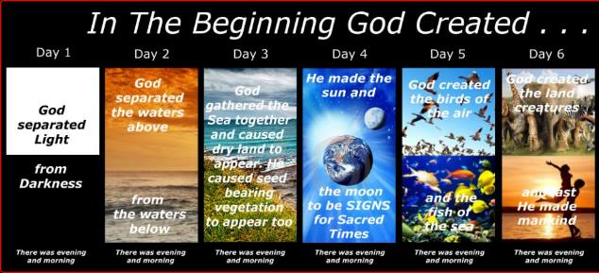
Shaping and Populating (Gen 1:1)
Day 1: | Light | Day 4: | Luminaries
Day 2: | Water, sky | Day 5: | Sea animals, birds
Day 3: | Land, vegetation | Day 6: | Land animals, man

Slide 8
Contradictory Account of Creation?
Genesis 1 – Overview of the whole creation
Genesis 2 – Details surrounding the creation of the garden, the first man, and his activities on day 6

Slide 9
Comparison of Genesis 1 and 2
Genesis 1 | Genesis 2
Creator God | Covenant keeper God
Elohim | Yahweh
Powerful God | Personal God
God of the Universe | God of man
Climaxes with man | Climaxes with marriage
Six days of creation | Sixth day of creation
Wilkinson and Boa, Talk Thru the Bible, pg, 530.

Slide 10

AUTHORSHIP
Charles Darwin
Karl Marx
Julius Wellhausen
John Dewey
Sigmund Freud
John Maynard Keynes
Soren Kierkegaard

Slide 11
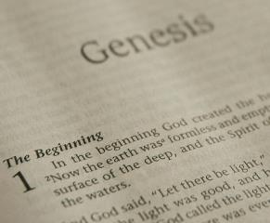
DOCUMENTARY HYPOTHESIS
J – Yahwist (850 B.C.)
E – Elohist (750 B.C.)
D – Deuteronomist (621 B.C.)
P – Priestly code (525 B.C.)

Slide 12

Textual Contradictions Explained
Beasts created before (Gen 1:24-25) vs. between (Gen 2:19) Adam and Eve? “Had formed” in 2:19
Plants and herbs created on day three (1:12) vs. had not been created yet (2:5) on day 6? Cultivated plants in 2:5
Trees created on day three (1:12) vs. had not been created yet (2:9) on day 6? Garden trees

Slide 13
Textual Contradictions Explained
Beasts created before (Gen 1:24-25) vs. between (Gen 2:19) Adam and Eve? “Had formed” in 2:19
Plants and herbs created on day three (1:12) vs. had not been created yet (2:5) on day 6? Cultivated plants in 2:5
Trees created on day three (1:12) vs. had not been created yet (2:9) on day 6? Garden trees

Slide 14
Textual Contradictions Explained
Beasts created before (Gen 1:24-25) vs. between (Gen 2:19) Adam and Eve? “Had formed” in 2:19
Plants and herbs created on day three (1:12) vs. had not been created yet (2:5) on day 6? Cultivated plants in 2:5
Trees created on day three (1:12) vs. had not been created yet (2:9) on day 6? Garden trees

Slide 15
Textual Contradictions Explained
Beasts created before (Gen 1:24-25) vs. between (Gen 2:19) Adam and Eve? “Had formed” in 2:19
Plants and herbs created on day three (1:12) vs. had not been created yet (2:5) on day 6? Cultivated plants in 2:5
Trees created on day three (1:12) vs. had not been created yet (2:9) on day 6? Garden trees

Slide 16

Matthew 19:3-6
³ Some Pharisees came to Jesus, testing Him and asking, “Is it lawful for a man to divorce his wife for any reason at all?” ⁴ And He answered and said, “Have you not read that He who created them from the beginning made them male and female, ⁵ and said, ‘For this reason a man shall leave his father and mother and be joined to his wife, and the two shall become one flesh’? ⁶ “So they are no longer two, but one flesh. What therefore God has joined together, let no man separate.”

Slide 17
Genesis 1:27
God created man in His own image, in the image of God He created him; male and female He created them.
Genesis 2:24
For this reason a man shall leave his father and his mother, and be joined to his wife; and they shall become one flesh.

Slide 18
Genesis 2 Outline
Genesis 2:4-7 – Creation of man
Genesis 2:8-14 – Man placed in the Garden of Eden
Genesis 2:15-17 – Man’s responsibilities in the Garden of Eden
Genesis 2:18-25 – First marriage

Slide 19
Genesis 2 Outline
Genesis 2:4-7 – Creation of man
Genesis 2:8-14 – Man placed in the Garden of Eden
Genesis 2:15-17 – Man’s responsibilities in the Garden of Eden
Genesis 2:18-25 – First marriage

Slide 20
Genesis 2:4-7
“These are the generations of” (Toledoth)
From the ground – pride (Gen 1:27) and humility
Breath of life – man’s value and why redemption is necessary
“Lives” (Gen 2:7) – Trichotomous man (1 Thess. 5:23)
  Body – physical, cardiovascular, muscular, etc…
  Soul – personality, intellect, emotions, volition
  Spirit – relates to God (John 4:23-24; 1 Cor. 2:10-16)

Slide 21
Genesis 2:4-7
“These are the generations of” (Toledoth)
From the ground – pride (Gen 1:27) and humility
Breath of life – man’s value and why redemption is necessary
“Lives” (Gen 2:7) – Trichotomous man (1 Thess. 5:23)
  Body – physical, cardiovascular, muscular, etc…
  Soul – personality, intellect, emotions, volition
  Spirit – relates to God (John 4:23-24; 1 Cor. 2:10-16)

Slide 22
Toledoth
“And These Are the Generations of…”
Introduction to the generations (1:1–2:3)
Generations of the heaven and earth (2:4–4:26)
Generations of Adam (5:1–6:8)
Generations of Noah (6:9–9:29)
Generations of the sons of Noah (10:1–11:9)
Generations of Shem (11:10–26)
Generations of Terah (11:27–25:11)
Generations of Ishmael (25:12-18)
Generations of Isaac (25:19–35:29)
Generations of Esau (36:1–37:1)
Generations of Jacob (37:2–50:26)

Slide 23
Toledoth
“And These Are the Generations of…”
Introduction to the generations (1:1–2:3)
Generations of the heaven and earth (2:4–4:26)
Generations of Adam (5:1–6:8)
Generations of Noah (6:9–9:29)
Generations of the sons of Noah (10:1–11:9)
Generations of Shem (11:10–26)
Generations of Terah (11:27–25:11)
Generations of Ishmael (25:12-18)
Generations of Isaac (25:19–35:29)
Generations of Esau (36:1–37:1)
Generations of Jacob (37:2–50:26)

Slide 24
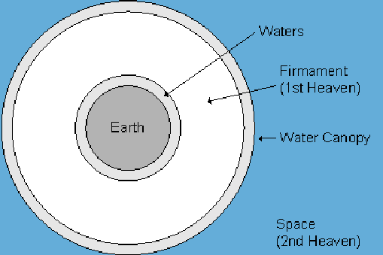

Slide 25


Slide 26
Day 2 Canopy Theory
(Gen 1:6-8)
Implied – Gen. 1:6-7; Ps. 148:4
Explains
  Long life spans of early man – Gen. 5:5, 27
  Strange beasts – (Gen. 1:24-25; Job 40‒41)
  Where the flood waters came from – (Gen. 2:5-6)
  Why man’s post-flood life span cut short – (Gen. 11:24-25)

Slide 27

Genesis 6:1-3
“¹ Now it came about, when men began to multiply on the face of the land, and daughters were born to them, ² that the sons of God saw that the daughters of men were beautiful; and they took wives for themselves, whomever they chose. ³ Then the Lord said, “My Spirit shall not strive with man forever, because he also is flesh; nevertheless his days shall be one hundred and twenty years.”

Slide 28
Genesis 2:4-7
“These are the generations of” (Toledoth)
From the ground – pride (Gen 1:27) and humility
Breath of life – man’s value and why redemption is necessary
“Lives” (Gen 2:7) – Trichotomous man (1 Thess. 5:23)
  Body – physical, cardiovascular, muscular, etc…
  Soul – personality, intellect, emotions, volition
  Spirit – relates to God (John 4:23-24; 1 Cor. 2:10-16)

Slide 29

Genesis 1:26-28
²⁶ Then God said, “Let Us make man in Our image, according to Our likeness; and let them rule over the fish of the sea and over the birds of the sky and over the cattle and over all the earth, and over every creeping thing that creeps on the earth.” ²⁷ God created man in His own image, in the image of God He created him; male and female He created them. ²⁸ God blessed them; and God said to them, “Be fruitful and multiply, and fill the earth, and subdue it; and rule over the fish of the sea and over the birds of the sky and over every living thing that moves on the earth.”

Slide 30

Genesis 3:19
“By the sweat of your face You will eat bread, Till you return to the ground, Because from it you were taken; For you are dust, And to dust you shall return.”

Slide 31
Genesis 2:4-7
“These are the generations of” (Toledoth)
From the ground – pride (Gen 1:27) and humility
Breath of life – man’s value and why redemption is necessary
“Lives” (Gen 2:7) – Trichotomous man (1 Thess. 5:23)
  Body – physical, cardiovascular, muscular, etc…
  Soul – personality, intellect, emotions, volition
  Spirit – relates to God (John 4:23-24; 1 Cor. 2:10-16)

Slide 32
Genesis 2:4-7
“These are the generations of” (Toledoth)
From the ground – pride (Gen 1:27) and humility
Breath of life – man’s value and why redemption is necessary
“Lives” (Gen 2:7) – Trichotomous man (1 Thess. 5:23)
  Body – physical, cardiovascular, muscular, etc…
  Soul – personality, intellect, emotions, volition
  Spirit – relates to God (John 4:23-24; 1 Cor. 2:10-16)

Slide 33


Steven Waterhouse
Not by Bread Alone (Amarillo, TX: Westcliff, 2007), 77.
“The literal translation of Gen. 2:7 teaches that ‘God breathed into Adam the breath of lives’ (plural).”

Slide 34
Genesis 2:4-7
“These are the generations of” (Toledoth)
From the ground – pride (Gen 1:27) and humility
Breath of life – man’s value and why redemption is necessary
“Lives” (Gen 2:7) – Trichotomous man (1 Thess. 5:23)
  Body – physical, cardiovascular, muscular, etc…
  Soul – personality, intellect, emotions, volition
  Spirit – relates to God (John 4:23-24; 1 Cor. 2:10-16)

Slide 35
Genesis 2:4-7
“These are the generations of” (Toledoth)
From the ground – pride (Gen 1:27) and humility
Breath of life – man’s value and why redemption is necessary
“Lives” (Gen 2:7) – Trichotomous man (1 Thess. 5:23)
  Body – physical, cardiovascular, muscular, etc…
  Soul – personality, intellect, emotions, volition
  Spirit – relates to God (John 4:23-24; 1 Cor. 2:10-16)

Slide 36
Genesis 2:4-7
“These are the generations of” (Toledoth)
From the ground – pride (Gen 1:27) and humility
Breath of life – man’s value and why redemption is necessary
“Lives” (Gen 2:7) – Trichotomous man (1 Thess. 5:23)
  Body – physical, cardiovascular, muscular, etc…
  Soul – personality, intellect, emotions, volition
  Spirit – relates to God (John 4:23-24; 1 Cor. 2:10-16)

Slide 37
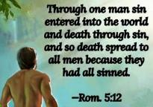
Genesis 2:16-17
“¹⁶ The Lord God commanded the man, saying, ‘From any tree of the garden you may eat freely; ¹⁷ but from the tree of the knowledge of good and evil you shall not eat, for in the day that you eat from it you will surely die (muwth).’”

Slide 38
Genesis 2 Outline
Genesis 2:4-7 – Creation of man
Genesis 2:8-14 – Man placed in the Garden of Eden
Genesis 2:15-17 – Man’s responsibilities in the Garden of Eden
Genesis 2:18-25 – First marriage

Slide 39
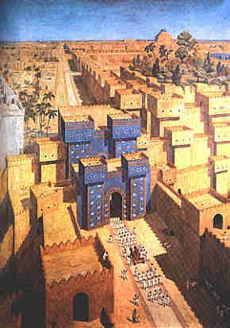
East = Babylon
Genesis 2:8
Genesis 11:2
Matthew 2:2

Slide 40


Slide 41

Daniel 1:1-2
“¹ In the third year of the reign of Jehoiakim king of Judah, Nebuchadnezzar king of Babylon came to Jerusalem and besieged it.² The Lord gave Jehoiakim king of Judah into his hand, along with some of the vessels of the house of God; and he brought them to the land of Shinar, to the house of his god, and he brought the vessels into the treasury of his god.”

Slide 42


Slide 43

Zechariah 5:5-11
⁹ Then I lifted up my eyes and looked, and there two women were coming out with the wind in their wings; and they had wings like the wings of a stork, and they lifted up the ephah between the earth and the heavens. ¹⁰ I said to the angel who was speaking with me, “Where are they taking the ephah?” ¹¹ Then he said to me, “To build a temple for her in the land of Shinar; and when it is prepared, she will be set there on her own pedestal.”

Slide 44
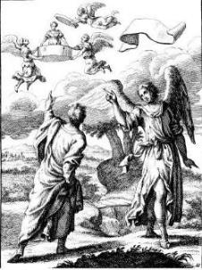
Zechariah 5:5-11
Woman (wickedness)
Ephah (commerce)
House (Temple-2 Sam 7; religion)
Shinar (Gen 10:10; 11:2; Dan 1:2)

Slide 45
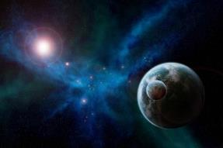
Genesis 1:31
“God saw all that He had made, and behold, it was very good. And there was evening and there was morning, the sixth day.”

Slide 46
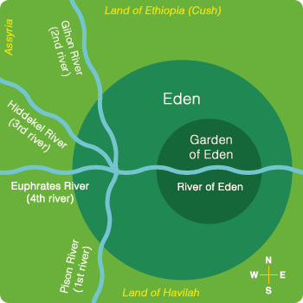
Description of the Garden of Eden
(Gen 2:8-14)
Two trees (Gen 2:9)
Four rivers: Pishon, Gihon, Tigris, Euphrates

Slide 47
Description of the Garden of Eden
(Gen 2:8-14)
Two trees (Gen 2:9)
Four rivers: Pishon, Gihon, Tigris, Euphrates

Slide 48
Genesis 1:26-28
²⁶ Then God said, “Let Us make man in Our image, according to Our likeness; and let them rule over the fish of the sea and over the birds of the sky and over the cattle and over all the earth, and over every creeping thing that creeps on the earth.” ²⁷ God created man in His own image, in the image of God He created him; male and female He created them. ²⁸ God blessed them; and God said to them, “Be fruitful and multiply, and fill the earth, and subdue it; and rule over the fish of the sea and over the birds of the sky and over every living thing that moves on the earth.”

Slide 49
Description of the Garden of Eden
(Gen 2:8-14)
Two trees (Gen 2:9)
Four rivers: Pishon, Gihon, Tigris, Euphrates

Slide 50
Local Flood?
(Gen 2:8-14)
All four rivers had a common source
Pishon and Gihon?
Local flood? Features of post flood world given names familiar to those who survived the flood (Ex: York/New York)

Slide 51
Local Flood?
(Gen 2:8-14)
All four rivers had a common source
Pishon and Gihon?
Local flood? Features of post flood world given names familiar to those who survived the flood (Ex: York/New York)

Slide 53
Local Flood?
(Gen 2:8-14)
All four rivers had a common source
Pishon and Gihon?
Local flood? Features of post flood world given names familiar to those who survived the flood (Ex: York/New York)

Slide 54
Daniel 2:37-38
You, O king, are the king of kings, to whom the God of heaven has given the kingdom, the power, the strength and the glory; ³⁸ and wherever the sons of men dwell, or the beasts of the field, or the birds of the sky, He has given them into your hand and has caused you to rule over them all. You are the head of gold.

Slide 55


Statue
&
Stone

Slide 56


Slide 57
Eden = Probationary Environment
EDEN (GENESIS 1-2) | ETERNAL STATE (REV 21-22)
Division of light and darkness 1:4 | No night 21:25
Division of land and sea 1:10 | No sea 21:1
Sun and moon 1:16 | No sun and moon 21:23
Garden 2:8-9 | City (21:2)
River flowing out of Eden 2:10 | River flowing from throne 22:1
Gold in the land 2:12 | Gold in the city 21:21
Tree of life in the middle of the garden 2:9 | Tree of life throughout the city 22:2
Bdellium and onyx stone 2:12 | All manner of stones 21:19
God walking in the garden 3:8 | God dwelling with His people 21:3
Henry Morris, Genesis Record, p.33

Slide 58

Notes:
And the streets are made of what? Gold. When a man heard he was about to die, he desperately gathered up his life’s greatest accumulation—gold bars. When he did finally enter heaven, toting the heaven load, one angel poked another angel in the ribs. He said, “Hey, look, that guy brought pavement!”

Slide 59
Local Flood?
(Gen 2:8-14)
All four rivers had a common source
Pishon and Gihon?
Local flood? Features of post flood world given names familiar to those who survived the flood (Ex: York/New York)

Slide 61
Local Flood?
(Gen 2:8-14)
All four rivers had a common source
Pishon and Gihon?
Local flood? Features of post flood world given names familiar to those who survived the flood (Ex: York/New York)

Slide 62
Genesis 2 Outline
Genesis 2:4-7 – Creation of man
Genesis 2:8-14 – Man placed in the Garden of Eden
Genesis 2:15-17 – Man’s responsibilities in the Garden of Eden
Genesis 2:18-25 – First marriage

Slide 63

Man’s Duties in Eden
(Gen 2:15-17)
Theocratic administration
Cultivate and keep the garden – both labor and procreation (Gen 1:28) are pre fall institutions

Slide 64
Man’s Duties in Eden
(Gen 2:15-17)
Theocratic administration
Cultivate and keep the garden – both labor and procreation (Gen 1:28) are pre fall institutions

Slide 65
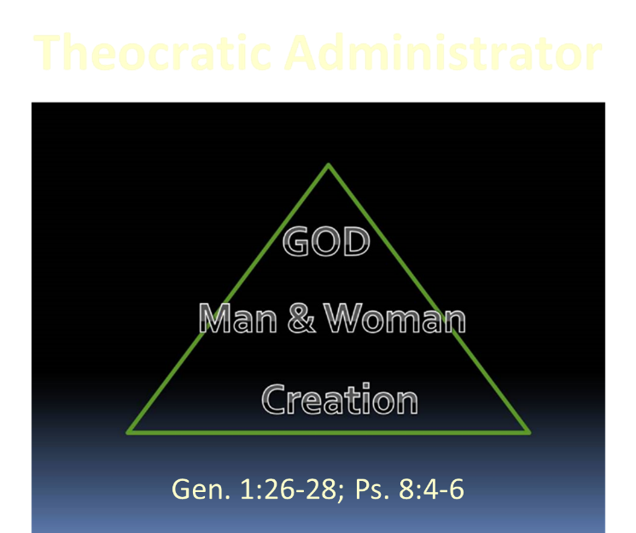

Slide 66
Genesis 1:26-28
²⁶ Then God said, “Let Us make man in Our image, according to Our likeness; and let them rule over the fish of the sea and over the birds of the sky and over the cattle and over all the earth, and over every creeping thing that creeps on the earth.” ²⁷ God created man in His own image, in the image of God He created him; male and female He created them. ²⁸ God blessed them; and God said to them, “Be fruitful and multiply, and fill the earth, and subdue it; and rule over the fish of the sea and over the birds of the sky and over every living thing that moves on the earth.”

Slide 67
Man’s Duties in Eden
(Gen 2:15-17)
Theocratic administration
Cultivate and keep the garden – both labor and procreation (Gen 1:28) are pre fall institutions

Slide 68
Genesis 3:19
“By the sweat of your face You will eat bread, Till you return to the ground, Because from it you were taken; For you are dust, And to dust you shall return.”

Slide 69
Genesis 2:16-17
“¹⁶ The Lord God commanded the man, saying, ‘From any tree of the garden you may eat freely; ¹⁷ but from the tree of the knowledge of good and evil you shall not eat, for in the day that you eat from it you will surely die (muwth).’”

Slide 70

“Do not eat from the Tree of Knowledge”
(Gen 2:17)
  Free will
  Physical death: 791x, Gen 3:19
  Humanity’s dependency upon special revelation even in the pr-fall world (Gen. 2:9)
  Deuteronomy 30:15
  Gen 2:17 and the Day Age theory?
  Gen. 1 creation days-yom with ordinal modifier and “evening and morning”
  yom + prep = “when” (1 Kgs. 2:37)

Slide 71
“Do not eat from the Tree of Knowledge”
(Gen 2:17)
  Free will
  Physical death: 791x, Gen 3:19
  Humanity’s dependency upon special revelation even in the pr-fall world (Gen. 2:9)
  Deuteronomy 30:15
  Gen 2:17 and the Day Age theory?
  Gen. 1 creation days-yom with ordinal modifier and “evening and morning”
  yom + prep = “when” (1 Kgs. 2:37)

Slide 72
Genesis 1:26-28
²⁶ Then God said, “Let Us make man in Our image, according to Our likeness; and let them rule over the fish of the sea and over the birds of the sky and over the cattle and over all the earth, and over every creeping thing that creeps on the earth.” ²⁷ God created man in His own image, in the image of God He created him; male and female He created them. ²⁸ God blessed them; and God said to them, “Be fruitful and multiply, and fill the earth, and subdue it; and rule over the fish of the sea and over the birds of the sky and over every living thing that moves on the earth.”

Slide 73
“Do not eat from the Tree of Knowledge”
(Gen 2:17)
  Free will
  Physical death: 791x, Gen 3:19
  Humanity’s dependency upon special revelation even in the pr-fall world (Gen. 2:9)
  Deuteronomy 30:15
  Gen 2:17 and the Day Age theory?
  Gen. 1 creation days-yom with ordinal modifier and “evening and morning”
  yom + prep = “when” (1 Kgs. 2:37)

Slide 74
Genesis 3:19
“By the sweat of your face You will eat bread, Till you return to the ground, Because from it you were taken; For you are dust, And to dust you shall return.”

Slide 75

1 Corinthians 15:21-22
“²¹ For since by a man came death, by a man also came the resurrection of the dead. ²² For as in Adam all die, so also in Christ all will be made alive.”

Slide 76

Romans 5:12
“Therefore, just as through one man sin entered into the world, and death through sin, and so death spread to all men, because all sinned—.”

Slide 77
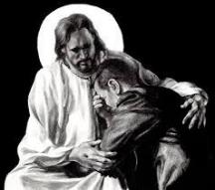
Revelation 21:4
“and He will wipe away every tear from their eyes; and there will no longer be any death; there will no longer be any mourning, or crying, or pain; the first things have passed away.”

Slide 79
“Do not eat from the Tree of Knowledge”
(Gen 2:17)
  Free will
  Physical death: 791x, Gen 3:19
  Humanity’s dependency upon special revelation even in the pr-fall world (Gen. 2:9)
  Deuteronomy 30:15
  Gen 2:17 and the Day Age theory?
  Gen. 1 creation days-yom with ordinal modifier and “evening and morning”
  yom + prep = “when” (1 Kgs. 2:37)

Slide 80
General vs. Special Revelation
 | GENERAL | SPECIAL
EXAMPLES | Nature, conscience (Rom 1–2) | Incarnation, Scripture, miracles
AVAILABILITY | All | Some
ACCOMPLISHMENT | Accountability (Rom 1) | Salvation (Acts 4:12; 2 Tim 3:15)
FORM | Non-written | Written
QUALITY | Natural | Supernatural, miraculous

Slide 81
Louis Berkhof
Introductory volume to Systematic Theology
(Grand Rapids, Eerdmans, 1946), 60, 96.
“Since the entrance of sin into the world, man can gather true knowledge about God from his general revelation only if he studies it in light of Scripture, in which the elements of God’s original self-revelation, which were obscured and perverted by the blight of sin, are republished, corrected, and interpreted… Some are inclined to speak of God’s revelation as a second source; but this is hardly correct in view of the fact that nature can come into consideration here only as interpreted in the light of Scripture.”

Slide 82
“Do not eat from the Tree of Knowledge”
(Gen 2:17)
  Free will
  Physical death: 791x, Gen 3:19
  Humanity’s dependency upon special revelation even in the pr-fall world (Gen. 2:9)
  Deuteronomy 30:15
  Gen 2:17 and the Day Age theory?
  Gen. 1 creation days-yom with ordinal modifier and “evening and morning”
  yom + prep = “when” (1 Kgs. 2:37)

Slide 83
“Do not eat from the Tree of Knowledge”
(Gen 2:17)
  Free will
  Physical death: 791x, Gen 3:19
  Humanity’s dependency upon special revelation even in the pr-fall world (Gen. 2:9)
  Deuteronomy 30:15
  Gen 2:17 and the Day Age theory?
  Gen. 1 creation days-yom with ordinal modifier and “evening and morning”
  yom + prep = “when” (1 Kgs. 2:37)

Slide 84
“Do not eat from the Tree of Knowledge”
(Gen 2:17)
  Free will
  Physical death: 791x, Gen 3:19
  Humanity’s dependency upon special revelation even in the pr-fall world (Gen. 2:9)
  Deuteronomy 30:15
  Gen 2:17 and the Day Age theory?
  Gen. 1 creation days-yom with ordinal modifier and “evening and morning”
  yom + prep = “when” (1 Kgs. 2:37)

Slide 85
“Do not eat from the Tree of Knowledge”
(Gen 2:17)
  Free will
  Physical death: 791x, Gen 3:19
  Humanity’s dependency upon special revelation even in the pr-fall world (Gen. 2:9)
  Deuteronomy 30:15
  Gen 2:17 and the Day Age theory?
  Gen. 1 creation days-yom with ordinal modifier and “evening and morning”
  yom + prep = “when” (1 Kgs. 2:37)

Slide 86
Genesis 2:17; 1 Kings 2:37 (NET)
“but you must not eat from the tree of the knowledge of good and evil, for when [yom + in] you eat from it you will surely die.”
“If [yom + in] you ever do leave and cross the Kidron Valley, know for sure that you will certainly die! You will be responsible for your own death.”

Slide 87
Genesis 2 Outline
Genesis 2:4-7 – Creation of man
Genesis 2:8-14 – Man placed in the Garden of Eden
Genesis 2:15-17 – Man’s responsibilities in the Garden of Eden
Genesis 2:18-25 – First marriage

Slide 88
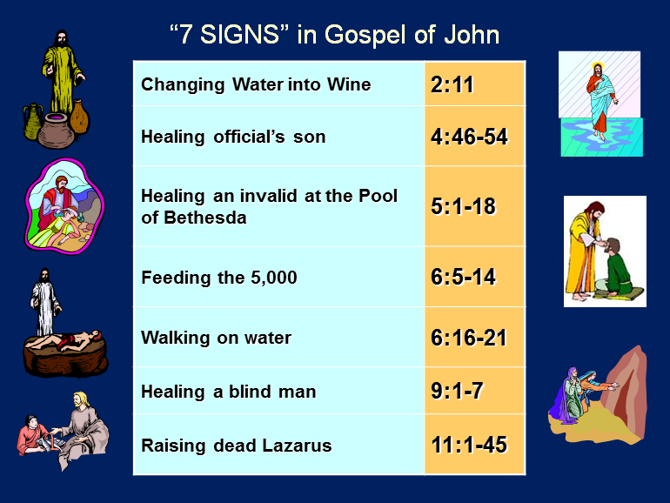

Slide 89
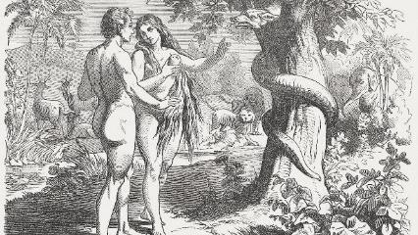
First Marriage
(Gen 2:18-25)
  Problem identified (Gen. 2:18)
  Problem recognized (Gen. 2:19-20)
  Problem solved (Gen. 2:21-25)

Slide 90
First Marriage
(Gen 2:18-25)
  Problem identified (Gen. 2:18)
  Problem recognized (Gen. 2:19-20)
  Problem solved (Gen. 2:21-25)

Slide 91
First Marriage
(Gen 2:18-25)
  Something not good (Gen 1:31; 2:18) – Man’s incompleteness resolved
  Genesis 2:18-20
  Naming all of the animals in one day?
    beasts of the field (2:20) vs. beasts of the earth (1:25)
    animals brought to him
    Adam’s mind, uniformitarian presupposition
    marriage context

Slide 92
First Marriage
(Gen 2:18-25)
  Something not good (Gen 1:31; 2:18) – Man’s incompleteness resolved
  Genesis 2:18-20
  Naming all of the animals in one day?
    beasts of the field (2:20) vs. beasts of the earth (1:25)
    animals brought to him
    Adam’s mind, uniformitarian presupposition
    marriage context

Slide 93
Genesis 1:31
“God saw all that He had made, and behold, it was very good. And there was evening and there was morning, the sixth day.”

Slide 94
First Marriage
(Gen 2:18-25)
  Problem identified (Gen. 2:18)
  Problem recognized (Gen. 2:19-20)
  Problem solved (Gen. 2:21-25)

Slide 95
First Marriage
(Gen 2:18-25)
  Something not good (Gen 1:31; 2:18) – Man’s incompleteness resolved
  Genesis 2:18-20
  Naming all of the animals in one day?
    beasts of the field (2:20) vs. beasts of the earth (1:25)
    animals brought to him
    Adam’s mind, uniformitarian presupposition
    marriage context

Slide 96
First Marriage
(Gen 2:18-25)
  Something not good (Gen 1:31; 2:18) – Man’s incompleteness resolved
  Genesis 2:18-20
  Naming all of the animals in one day?
    beasts of the field (2:20) vs. beasts of the earth (1:25)
    animals brought to him
    Adam’s mind, uniformitarian presupposition
    marriage context

Slide 97
First Marriage
(Gen 2:18-25)
  Something not good (Gen 1:31; 2:18) – Man’s incompleteness resolved
  Genesis 2:18-20
  Naming all of the animals in one day?
    beasts of the field (2:20) vs. beasts of the earth (1:25)
    animals brought to him
    Adam’s mind, uniformitarian presupposition
    marriage context

Slide 98
First Marriage
(Gen 2:18-25)
  Something not good (Gen 1:31; 2:18) – Man’s incompleteness resolved
  Genesis 2:18-20
  Naming all of the animals in one day?
    beasts of the field (2:20) vs. beasts of the earth (1:25)
    animals brought to him
    Adam’s mind, uniformitarian presupposition
    marriage context

Slide 99
First Marriage
(Gen 2:18-25)
  Something not good (Gen 1:31; 2:18) – Man’s incompleteness resolved
  Genesis 2:18-20
  Naming all of the animals in one day?
    beasts of the field (2:20) vs. beasts of the earth (1:25)
    animals brought to him
    Adam’s mind, uniformitarian presupposition
    marriage context

Slide 100
First Marriage
(Gen 2:18-25)
  Something not good (Gen 1:31; 2:18) – Man’s incompleteness resolved
  Genesis 2:18-20
  Naming all of the animals in one day?
    beasts of the field (2:20) vs. beasts of the earth (1:25)
    animals brought to him
    Adam’s mind, uniformitarian presupposition
    marriage context

Slide 101
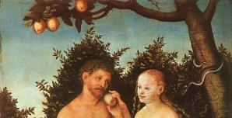
Day Six Activities
  God created the livestock, beasts of the earth, & everything that creeps on the earth
  God created Adam
  God planted the garden
  God talked to Adam
  God brought certain animals to Adam
  Adam named these animals
  God created Eve
Mark Van Bebber and Paul S. Taylor, Creation and Time: A Report on the Progressive Creationist Book by Hugh Ross (Gilbert, AZ: Eden Communications, 1994), 82

Slide 102
First Marriage
(Gen 2:18-25)
  Problem identified (Gen. 2:18)
  Problem recognized (Gen. 2:19-20)
  Problem solved (Gen. 2:21-25)

Slide 103

Evangelical Feminism
A theological movement within the evangelical church that seeks to abolish all gender role distinctions within marriage and the church

Slide 104

Male headship
Genesis 2:21-23
Order – 1 Tim 2:11-13; transcends post-fall culture
Adam named Eve (Gen 2:23; 1:5)

Slide 105
Male headship
Genesis 2:21-23
Order – 1 Tim 2:11-13; transcends post-fall culture
Adam named Eve (Gen 2:23; 1:5)

Slide 106
Male headship
Genesis 2:21-23
Order – 1 Tim 2:11-13; transcends post-fall culture
Adam named Eve (Gen 2:23; 1:5)

Slide 107
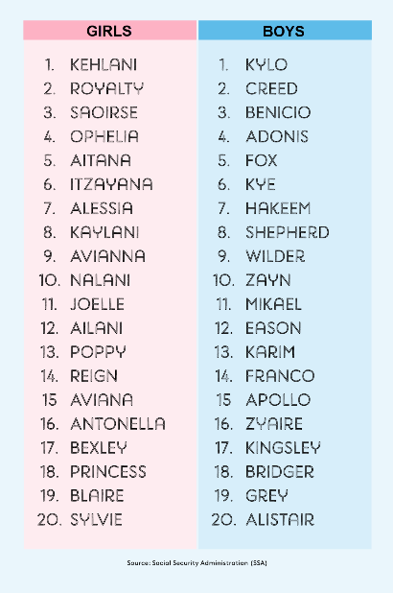
Biblical Significance of Naming
Genesis 1:8
Numbers 32:37-38
2 Kings 23:24
2 Kings 24:17
Daniel 1:6-7
Fruchtenbaum, Genesis, 84

Slide 108

Woman created from man’s side…not his foot
To complete what is lacking in man
Helper and not slave (Gen 2:18)
  “Helper” (ezer) also used of God (Exod 18:4; Deut 33:7; 1 Sam 7:12)
  Same essence as Adam (2:24)
  Both sexes retain the image of God (Gen 1:27-28)
  Both sexes are co-rulers (Gen 1:26-28)
  Trinitarian analogy
  No feminism or chauvinism

Slide 109
Woman created from man’s side…not his foot
To complete what is lacking in man
Helper and not slave (Gen 2:18)
  “Helper” (ezer) also used of God (Exod 18:4; Deut 33:7; 1 Sam 7:12)
  Same essence as Adam (2:24)
  Both sexes retain the image of God (Gen 1:27-28)
  Both sexes are co-rulers (Gen 1:26-28)
  Trinitarian analogy
  No feminism or chauvinism

Slide 110
Woman created from man’s side…not his foot
To complete what is lacking in man
Helper and not slave (Gen 2:18)
  “Helper” (ezer) also used of God (Exod 18:4; Deut 33:7; 1 Sam 7:12)
  Same essence as Adam (2:24)
  Both sexes retain the image of God (Gen 1:27-28)
  Both sexes are co-rulers (Gen 1:26-28)
  Trinitarian analogy
  No feminism or chauvinism

Slide 111
Woman created from man’s side…not his foot
To complete what is lacking in man
Helper and not slave (Gen 2:18)
  “Helper” (ezer) also used of God (Exod 18:4; Deut 33:7; 1 Sam 7:12)
  Same essence as Adam (2:24)
  Both sexes retain the image of God (Gen 1:27-28)
  Both sexes are co-rulers (Gen 1:26-28)
  Trinitarian analogy
  No feminism or chauvinism

Slide 112
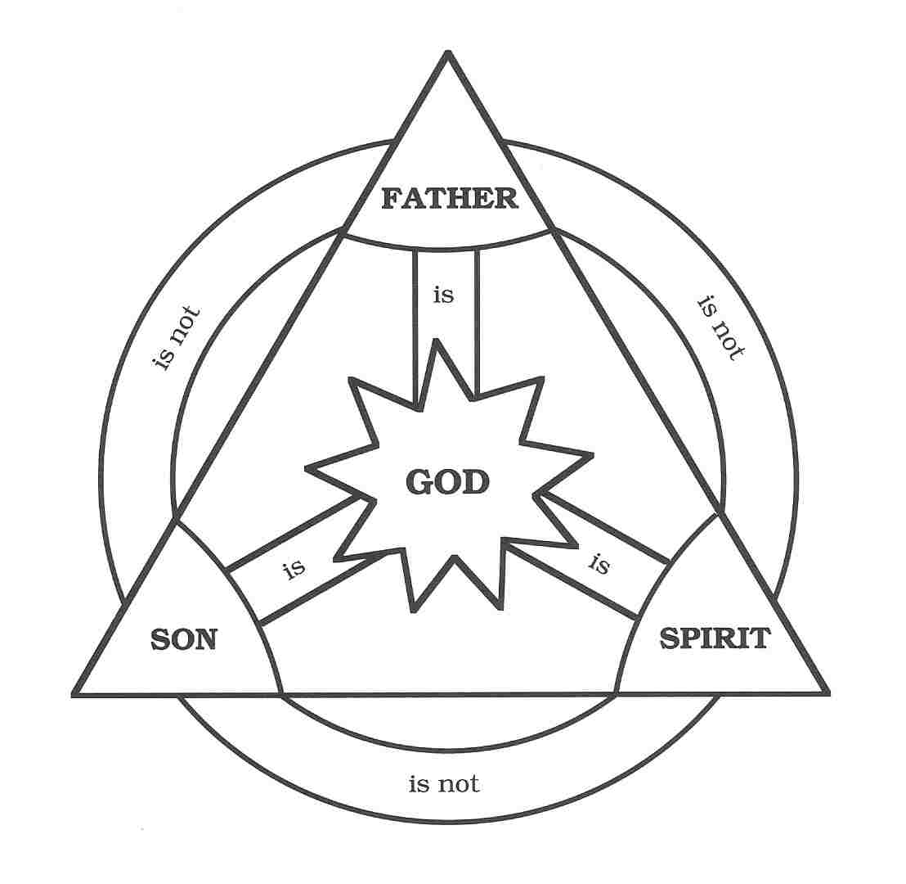

Slide 113

John 16:7-11
“⁷ But I tell you the truth, it is to your advantage that I go away; for if I do not go away, the Helper [paraklētos] will not come to you; but if I go, I will send Him to you. ⁸ And He, when He comes, will convict the world concerning sin and righteousness and judgment; ⁹ concerning sin, because they do not believe in Me; ¹⁰ and concerning righteousness, because I go to the Father and you no longer see Me; ¹¹ and concerning judgment, because the ruler of this world has been judged.”

Slide 114
Woman created from man’s side…not his foot
To complete what is lacking in man
Helper and not slave (Gen 2:18)
  “Helper” (ezer) also used of God (Exod 18:4; Deut 33:7; 1 Sam 7:12)
  Same essence as Adam (2:24)
  Both sexes retain the image of God (Gen 1:27-28)
  Both sexes are co-rulers (Gen 1:26-28)
  Trinitarian analogy
  No feminism or chauvinism

Slide 115
Woman created from man’s side…not his foot
To complete what is lacking in man
Helper and not slave (Gen 2:18)
  “Helper” (ezer) also used of God (Exod 18:4; Deut 33:7; 1 Sam 7:12)
  Same essence as Adam (2:24)
  Both sexes retain the image of God (Gen 1:27-28)
  Both sexes are co-rulers (Gen 1:26-28)
  Trinitarian analogy
  No feminism or chauvinism

Slide 116
Genesis 1:26-28
²⁶ Then God said, “Let Us make man in Our image, according to Our likeness; and let them rule over the fish of the sea and over the birds of the sky and over the cattle and over all the earth, and over every creeping thing that creeps on the earth.” ²⁷ God created man in His own image, in the image of God He created him; male and female He created them. ²⁸ God blessed them; and God said to them, “Be fruitful and multiply, and fill the earth, and subdue it; and rule over the fish of the sea and over the birds of the sky and over every living thing that moves on the earth.”

Slide 117
Woman created from man’s side…not his foot
To complete what is lacking in man
Helper and not slave (Gen 2:18)
  “Helper” (ezer) also used of God (Exod 18:4; Deut 33:7; 1 Sam 7:12)
  Same essence as Adam (2:24)
  Both sexes retain the image of God (Gen 1:27-28)
  Both sexes are co-rulers (Gen 1:26-28)
  Trinitarian analogy
  No feminism or chauvinism

Slide 118
Genesis 1:26-28
²⁶ Then God said, “Let Us make man in Our image, according to Our likeness; and let them rule over the fish of the sea and over the birds of the sky and over the cattle and over all the earth, and over every creeping thing that creeps on the earth.” ²⁷ God created man in His own image, in the image of God He created him; male and female He created them. ²⁸ God blessed them; and God said to them, “Be fruitful and multiply, and fill the earth, and subdue it; and rule over the fish of the sea and over the birds of the sky and over every living thing that moves on the earth.”

Slide 120
Woman created from man’s side…not his foot
To complete what is lacking in man
Helper and not slave (Gen 2:18)
  “Helper” (ezer) also used of God (Exod 18:4; Deut 33:7; 1 Sam 7:12)
  Same essence as Adam (2:24)
  Both sexes retain the image of God (Gen 1:27-28)
  Both sexes are co-rulers (Gen 1:26-28)
  Trinitarian analogy
  No feminism or chauvinism

Slide 122
Woman created from man’s side…not his foot
To complete what is lacking in man
Helper and not slave (Gen 2:18)
  “Helper” (ezer) also used of God (Exod 18:4; Deut 33:7; 1 Sam 7:12)
  Same essence as Adam (2:24)
  Both sexes retain the image of God (Gen 1:27-28)
  Both sexes are co-rulers (Gen 1:26-28)
  Trinitarian analogy
  No feminism or chauvinism

Slide 123
Genesis 2:24-25
Genesis 2:24
  New relational priority in order for the marriage to work (Matt 19:6)
Genesis 2:25
  Transition to the next chapter; like Gen. 1:31

Slide 124
Genesis 2:24-25
Genesis 2:24
  New relational priority in order for the marriage to work (Matt 19:6)
Genesis 2:25
  Transition to the next chapter; like Gen. 1:31

Slide 125
Genesis 2:24-25
Genesis 2:24
  New relational priority in order for the marriage to work (Matt 19:6)
Genesis 2:25
  Transition to the next chapter; like Gen. 1:31

Slide 126
Conclusion

Slide 127
Genesis 2 Outline
Genesis 2:4-7 – Creation of man
Genesis 2:8-14 – Man placed in the Garden of Eden
Genesis 2:15-17 – Man’s responsibilities in the Garden of Eden
Genesis 2:18-25 – First marriage

Slide 128
Genesis 1–2 Summation
  Perfect environment
  Man and Woman
  as pinnacle of creation
  theocratic administrators

Slide 129

“The Lord bless you and keep you; the Lord make his face shine on you and be gracious to you; the Lord turn his face toward you and give you peace.” (NIV)

