Slide 1


THE RAPTURE
What and When? – Part 21
Andrew Marshall Woods, Th.M., JD., PhD.
Sr. Pastor, Sugar Land Bible Church

Slide 2

What is the Rapture?
An important doctrine
Distinct from the Second Advent
Catching away of all living believers (1 Thess 4:17)
Reunion (1 Thess 4:14-16)
Resurrection (1 Cor 15:50-54)
Exemption from death (1 Cor 15:51, 54-56)
Instantaneous (1 Cor 15:52)
Mystery (1 Cor 15:51)
Imminent (1 Cor 15:51; 1 Thess 4:15)
Traditional doctrine now being recovered

Slide 3
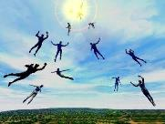
When Will the Rapture Take Place Relative to the Tribulation Period?
Pre-tribulation rapture theory
Mid-tribulation rapture theory
Post-tribulation rapture theory
Pre-wrath rapture theory
Partial rapture theory

Slide 4


Slide 5
When is the Rapture?
7 Arguments Favoring the Pre-Tribulation View
Tribulation's purpose concerns Israel (Jer 30:7; Dan 9:24)
No biblical reference to the church on earth during the Tribulation period (Rev 4-22)
Church is promised an exemption from divine wrath (1 Thess 1:10; 5:9; Rom 5:9; Rev 3:10; 6:17)
Rapture is imminent (1 Cor 15:51; 1 Thess 4:15)
Rapture is a comfort (1 Thess 4:18)
Antichrist cannot come to power until the restrainer is removed (2 Thess 2:6-7)
Symbolic parallels (2 Peter 2:5-9)

Slide 6
Strengthening the Pre-Tribulation Case
John 14:1-4
Revelation 3:10
First Thessalonians 4‒5
Second Thessalonians 2:3a
Matthew 24‒25

Slide 7

The Olivet Discourse
Is the Rapture in the Olivet Discourse?
Matthew 24–25
Andy Woods, Th.M., JD., PhD.
Sr. Pastor, Sugar Land Bible Church
President – Chafer Theological Seminary

Slide 8
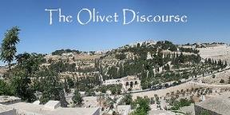
Preview of Matthew 24–25
The problem
The larger context
The immediate context (23:37-39)
The Disciples’ questions (24:1-3)
The Tribulation’s first half (24:4-14)
The Tribulation’s mid-point (24:15-20)
The Tribulation’s second half (24:21-22)
The Second Advent (24:23-31)
Eight parabolic exhortations (24:32‒25:46)

Slide 9
Preview of Matthew 24–25
The problem
The larger context
The immediate context (23:37-39)
The Disciples’ questions (24:1-3)
The Tribulation’s first half (24:4-14)
The Tribulation’s mid-point (24:15-20)
The Tribulation’s second half (24:21-22)
The Second Advent (24:23-31)
Eight parabolic exhortations (24:32‒25:46)

Slide 10

THE RAPTURE IN MATTHEW 24
²⁹ “But immediately after the tribulation of those days the sun will be darkened, and the moon will not give its light, and the stars will fall from the sky, and the powers of the heavens will be shaken. ³⁰ “And then the sign of the Son of Man will appear in the sky, and then all the tribes of the earth will mourn, and they will see the Son of Man coming on the clouds of the sky with power and great glory. ³¹ “And He will send forth His angels with a great trumpet and they will gather together His elect from the four winds, from one end of the sky to the other. …⁴⁰ “Then there will be two men in the field; one will be taken and one will be left. ⁴¹ “Two women will be grinding at the mill; one will be taken and one will be left.

Slide 11
THE RAPTURE IN MATTHEW 24
Note the order of events:
        ²⁹ There are days of tribulation
        ³⁰ The whole world sees Jesus return
        ³¹ The elect are gathered to Him
        ⁴⁰⁻⁴¹ The rapture reiterated
How do Pre-Tribulation theorists explain the Rapture occurring before the apocalypse and before the Second Coming? Jesus says exactly the opposite in simple, unmistakable language.
Are there two Raptures - one before this that Jesus mysteriously didn't describe and then this one, which He did? Why would He leave one out? Or is there only one, but when he discusses it He jumbles up the order of events? Why would He do that?

Slide 12
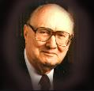
John F. Walvoord
"Christ's Olivet Discourse on the End of the Age - Part I," Bibliotheca Sacra 128/#510 (April 1971), p. 116..
“In Matthew 24–Matthew 25 the expositor should, therefore, understand that the program of God for the end of the age has in view the period ending with the second coming of Christ to the earth and the establishment of His earthly Kingdom, not the church age specifically ending with the rapture. Both the questions of the disciples and the answers of Christ are therefore, keyed to the Jewish expectation based on Old Testament prophecy, and the program of God for the earth in general rather than the church as the body of Christ.”

Slide 13
Preview of Matthew 24–25
The problem
The larger context
The immediate context (23:37-39)
The Disciples’ questions (24:1-3)
The Tribulation’s first half (24:4-14)
The Tribulation’s mid-point (24:15-20)
The Tribulation’s second half (24:21-22)
The Second Advent (24:23-31)
Eight parabolic exhortations (24:32‒25:46)

Slide 14
Matthew’s Purposes
To explain that Jesus in whom they had believed was the long-awaited Jewish Messiah
To explain why the kingdom had been postponed despite the fact that the king had arrived
To explain the interim program of God during the kingdom’s absence

Slide 15
Matthew’s Message
Jesus is the predicted Jewish king who ushered in an interim program by building the sons of the kingdom into the church in between Israel’s past rejection and future acceptance of her king.

Slide 16

Matthew & the Kingdom
Kingdom offered
Kingdom rejected
Kingdom postponed
Kingdom ultimately accepted
Interim program

Slide 17
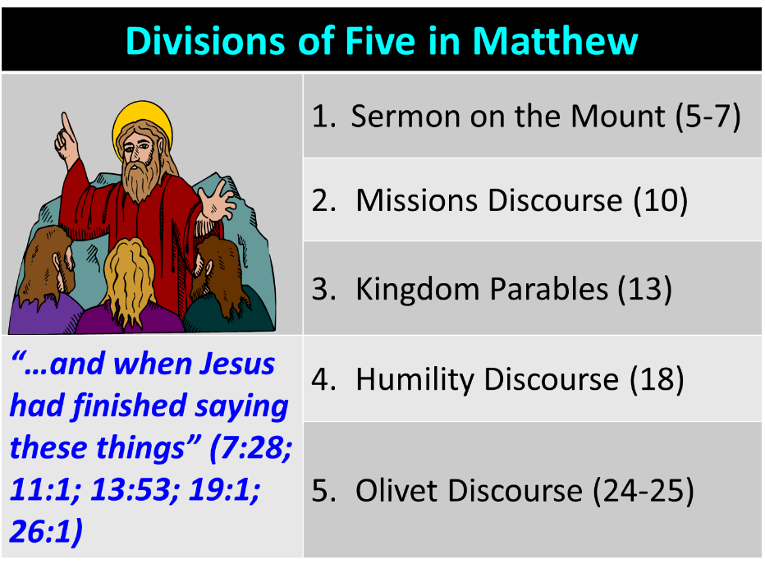

Slide 18
A Comparison of the Olivet and Upper Room Discourses
Discourse | Olivet | Upper Room
Scripture | Matt 24─25 | John 13─17
Location | Mount of Olives | Upper Room
Passion week | Third day | Sixth day
General focus | Farewell: Israel | Hello: Church
Specific focus | Israel’s future | Divine provisions
Prompting | Temple's destruction | Christ's imminent departure
Explanations | Written OT | Unwritten NT
Apostles | Israel (Matt. 19:28) | Church (Eph. 2:20)

Slide 19
Preview of Matthew 24–25
The problem
The larger context
The immediate context (23:37-39)
The Disciples’ questions (24:1-3)
The Tribulation’s first half (24:4-14)
The Tribulation’s mid-point (24:15-20)
The Tribulation’s second half (24:21-22)
The Second Advent (24:23-31)
Eight parabolic exhortations (24:32‒25:46)

Slide 20

Matthew 23:37-39
³⁷ “Jerusalem, Jerusalem, who kills the prophets and stones those who are sent to her! How often I wanted to gather [episynagō] your children together, the way a hen gathers [episynagō] her chicks under her wings, and you were unwilling. ³⁸ Behold, your house is being left to you desolate! ³⁹ For I say to you, from now on you will not see Me until you say, ‘Blessed is He who comes in the name of the Lord!’”

Slide 21
Matthew 23:37-39
³⁷ “Jerusalem, Jerusalem, who kills the prophets and stones those who are sent to her! How often I wanted to gather [episynagō] your children together, the way a hen gathers [episynagō] her chicks under her wings, and you were unwilling. ³⁸ Behold, your house is being left to you desolate! ³⁹ For I say to you, from now on you will not see Me until you say, ‘Blessed is He who comes in the name of the Lord!’”

Slide 22
Matthew 23:37-39
³⁷ “Jerusalem, Jerusalem, who kills the prophets and stones those who are sent to her! How often I wanted to gather [episynagō] your children together, the way a hen gathers [episynagō] her chicks under her wings, and you were unwilling. ³⁸ Behold, your house is being left to you desolate! ³⁹ For I say to you, from now on you will not see Me until you say, ‘Blessed is He who comes in the name of the Lord!’”

Slide 23
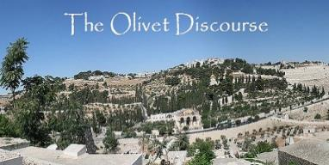
Matthew 24:31
³¹ “And He will send forth His angels with a great trumpet and they will gather together [episynagō] His elect from the four winds, from one end of the sky to the other.”

Slide 24
Matthew 23:37-39
³⁷ “Jerusalem, Jerusalem, who kills the prophets and stones those who are sent to her! How often I wanted to gather [episynagō] your children together, the way a hen gathers [episynagō] her chicks under her wings, and you were unwilling. ³⁸ Behold, your house is being left to you desolate! ³⁹ For I say to you, from now on you will not see Me until you say, ‘Blessed is He who comes in the name of the Lord!’”

Slide 25
Acts 7 – Stephen’s Speech
7:1-5 – Abraham’s partial obedience
7:6-38 – Israel’s initial rejections and later acceptances
7:39-41 – Israel’s early rebellion against Moses
7:42-45 – Israel reinterpreted Moses’ teachings though a polytheistic framework
7:46-50 – Neither the Tabernacle nor Temple were intended as permanent habitations of God
7:51-53 – Current generation imitating these same rebellions

Slide 26
Matthew 23:37-39
³⁷ “Jerusalem, Jerusalem, who kills the prophets and stones those who are sent to her! How often I wanted to gather [episynagō] your children together, the way a hen gathers [episynagō] her chicks under her wings, and you were unwilling. ³⁸ Behold, your house is being left to you desolate! ³⁹ For I say to you, from now on you will not see Me until you say, ‘Blessed is He who comes in the name of the Lord!’”

Slide 27
Matthew 24:1-2
“¹ Jesus came out from the temple and was going away when His disciples came up to point out the temple buildings to Him. ² And He said to them, “Do you not see all these things? Truly I say to you, not one stone here will be left upon another, which will not be torn down.”

Slide 28
Matthew 24:15-16, 20
“¹⁵ Therefore when you see the abomination of desolation which was spoken of through Daniel the prophet, standing in the holy place (let the reader understand) ¹⁶ then those who are in Judea must flee to the mountains…²⁰ But pray that your flight will not be in the winter, or on a Sabbath.”

Slide 29
Matthew 23:37-39
³⁷ “Jerusalem, Jerusalem, who kills the prophets and stones those who are sent to her! How often I wanted to gather [episynagō] your children together, the way a hen gathers [episynagō] her chicks under her wings, and you were unwilling. ³⁸ Behold, your house is being left to you desolate! ³⁹ For I say to you, from now on you will not see Me until you say, ‘Blessed is He who comes in the name of the Lord!’”

Slide 30
Preview of Matthew 24–25
The problem
The larger context
The immediate context (23:37-39)
The Disciples’ questions (24:1-3)
The Tribulation’s first half (24:4-14)
The Tribulation’s mid-point (24:15-20)
The Tribulation’s second half (24:21-22)
The Second Advent (24:23-31)
Eight parabolic exhortations (24:32‒25:46)

Slide 31
Matthew 24:1-2
“¹ Jesus came out from the temple and was going away when His disciples came up to point out the temple buildings to Him. ² And He said to them, “Do you not see all these things? Truly I say to you, not one stone here will be left upon another, which will not be torn down.”

Slide 32
Luke 21:5-7
“ ⁵ And while some were talking about the temple, that it was adorned with beautiful stones and votive gifts, He said, ^{6 ’}As for these things which you are looking at, the days will come in which there will not be left one stone upon another which will not be torn down.’ ⁷ They questioned Him, saying, ‘Teacher, when therefore will these things happen? And what will be the sign when these things are about to take place?’”

Slide 33
Matthew 24:1-2
“¹ Jesus came out from the temple and was going away when His disciples came up to point out the temple buildings to Him. ² And He said to them, “Do you not see all these things? Truly I say to you, not one stone here will be left upon another, which will not be torn down.”

Slide 34
Six Parts of a Suzerain-Vassal
Treaty in Deuteronomy
Preamble (1:1-5)
Prologue (1:6–4:40)
Covenant obligations (5–26)
Storage and reading instructions (27:2-3; 31:9, 24, 26)
Witnesses (32:1)
Blessings and curses (28)

Slide 35

Deuteronomy 28:49-50
“⁴⁹ The Lord will bring a nation against you from afar, from the end of the earth, as the eagle swoops down, a nation whose language you shall not understand, ⁵⁰ a nation of fierce countenance who will have no respect for the old, nor show favor to the young.”

Slide 36

Israel's Judgments
Division of the kingdom in 931 B.C. (1 Kgs. 12)
Assyrian judgment in 722 B.C. (2 Kgs. 17)
Babylonian captivity in 586 B.C. (2 Kgs. 25)
Roman judgment in A.D. 70 (Luke 19:41-44)

Slide 37
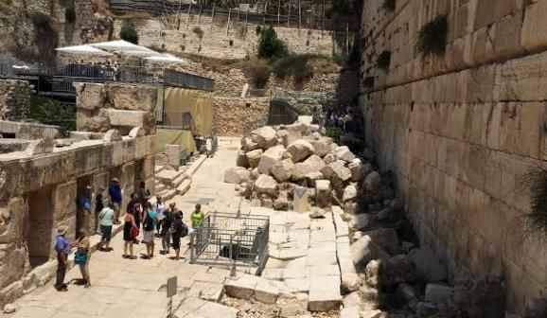
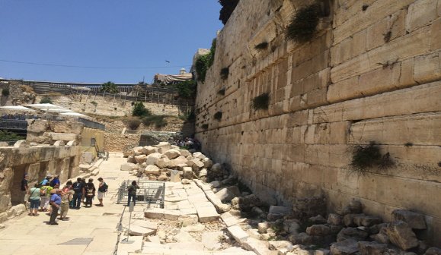

Slide 38
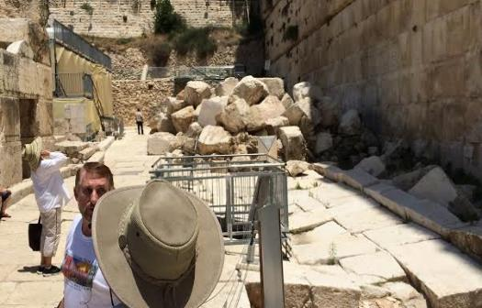
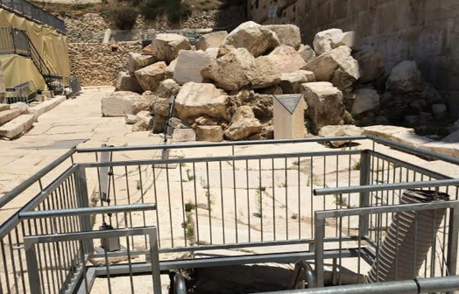

Slide 39
Matthew 24:3
“³ As He was sitting on the Mount of Olives, the disciples came to Him privately, saying, ‘Tell us, when will these things happen, and what will be the sign of Your coming, and of the end of the age?’”

Slide 40
Matthew 24:3
“³ As He was sitting on the Mount of Olives, the disciples came to Him privately, saying, ‘Tell us, when will these things happen, and what will be the sign of Your coming, and of the end of the age?’”

Slide 41
Matthew 24:3
“³ As He was sitting on the Mount of Olives, the disciples came to Him privately, saying, ‘Tell us, when will these things happen, and what will be the sign of Your coming, and of the end of the age?’”

Slide 42
Matthew 24:3
“³ As He was sitting on the Mount of Olives, the disciples came to Him privately, saying, ‘Tell us, when will these things happen, and what will be the sign of Your coming, and of the end of the age?’”

Slide 43
Luke 21:5-7
“ ⁵ And while some were talking about the temple, that it was adorned with beautiful stones and votive gifts, He said, ^{6 ’}As for these things which you are looking at, the days will come in which there will not be left one stone upon another which will not be torn down.’ ⁷ They questioned Him, saying, ‘Teacher, when therefore will these things happen? And what will be the sign when these things are about to take place?’”

Slide 44
Luke 21:20-24
“²⁰ But when you see Jerusalem surrounded by armies, then recognize that her desolation is near. ²¹ Then those who are in Judea must flee to the mountains, and those who are in the midst of the city must leave, and those who are in the country must not enter the city; ²² because these are days of vengeance, so that all things which are written will be fulfilled. ²³ Woe to those who are pregnant and to. . .

Slide 45
Luke 21:20-24
. . . those who are nursing babies in those days; for there will be great distress upon the land and wrath to this people; ²⁴ and they will fall by the edge of the sword, and will be led captive into all the nations; and Jerusalem will be trampled under foot by the Gentiles until the times of the Gentiles are fulfilled.”

Slide 46
Preview of Matthew 24–25
The problem
The larger context
The immediate context (23:37-39)
The Disciples’ questions (24:1-3)
The Tribulation’s first half (24:4-14)
The Tribulation’s mid-point (24:15-20)
The Tribulation’s second half (24:21-22)
The Second Advent (24:23-31)
Eight parabolic exhortations (24:32‒25:46)

Slide 47


Slide 48


Jeremiah 30:6-7
“⁶ Ask now, and see If a male can give birth. Why do I see every man With his hands on his loins, as a woman in childbirth? And why have all faces turned pale? ⁷ Alas! for that day is great, There is none like it; And it is the time of Jacob’s distress (Gen. 32:8; 35:10), But he will be saved from it.”

Slide 49
Matt 24 / Rev 6 Parallels
Prediction | Birth pangs (Matt 24) | Seal judgments (Rev 6)
False Christ | 24:5 | 6:2
War | 24:6 | 6:3-4
Famine | 24:7 | 6:5-6
Death | 24:6-7 | 6:7-8
Martyrs | 24:9-13 | 6:9-11
Earthquakes | 24:7 | 6:12-17
Evangelism | 24:14 | 7:1-9

Slide 50


Slide 51

Matthew 24:13
“But the one who endures to the end, he will be saved.”

Slide 52

John MacArthur
Matthew 24‒25, The Macarthur New Testament Commentary (Chicago: Moody, 1989), 28.
"But the one who endures to the end, he shall be saved…his endurance will be a Spirit-empowered product and proof of the reality that he is saved. Neither the high cost of discipleship nor the deception of false prophets nor the enticement of sin will cause true believers to renounce Christ, because He Himself will protect them from defection. Endurance is always a mark of salvation…The perseverance of the saints in faith is a very basic element of salvation teaching in the New Testament. It states that people who are genuinely saved do not depart from the faith (see John 8: 31; 1 Cor. 15: 1-2; Col. 1: 21-23; Heb. 2: 1-3; 3: 14; 4: 14; 6: 11-12; 10: 39; 12: 14; James 1: 2-4)…Endurance…does give evidence of the spiritual life that resides in the believer...”

Slide 53
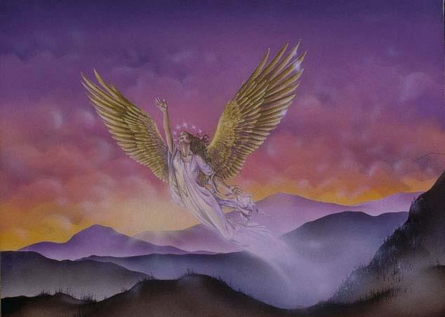
CONNECTING
REV 12 & ANTI-SEMITISM
DANIEL’S 70th WEEK (7 years)
Israel flees
3 ½ years
1260 days

Slide 54
Matthew 24:31
³¹ “And He will send forth His angels with a great trumpet and they will gather together [episynagō] His elect from the four winds, from one end of the sky to the other.”

Slide 55
Matthew 24:14
“This gospel of the kingdom shall be preached in the whole world as a testimony to all the nations, and then the end will come.”

Slide 56
Deuteronomy 17:15
“you shall surely set a king over you whom the Lord your God chooses, one from among your countrymen you shall set as king over yourselves; you may not put a foreigner over yourselves who is not your countryman.”

Slide 57
Matthew 3:1-2
“Now in those days John the Baptist came, preaching in the wilderness of Judea, saying, ‘Repent, for the kingdom of heaven is at hand.”

Slide 58
Matthew 4:17
“From that time Jesus began to preach and say, ‘Repent, for the kingdom of heaven is at hand.’”

Slide 59
Matthew 10:5-7
“These twelve Jesus sent out after instructing them: “Do not go in the way of the Gentiles, and do not enter any city of the Samaritans; ⁶ but rather go to the lost sheep of the house of Israel. ⁷ And as you go, preach, saying, ‘The kingdom of heaven is at hand.’”

Slide 60
Luke 10:9
“Now after this the Lord appointed seventy others, and sent them in pairs ahead of Him to every city and place where He Himself was going to come…and heal those in it who are sick, and say to them, ‘The kingdom of God has come near to you.’”

Slide 61
Messengers of the Kingdom In Matthew
John the Baptist – 3:2
Jesus Christ – 4:17
12 Apostles – 10:5-7
Seventy – Luke 10:1, 9
Toussaint, Behold the King, 18-20

Slide 62

Matthew 12:24
“But when the Pharisees heard this, they said, “This man casts out demons only by Beelzebul the ruler of the demons.”

Slide 63
Matthew Outline
Pedigree of the king (1–2)
  Preparation of the king (3–4)
    Pedagogy of the king (5–7)
      Power of the king (8–9)
        Program of the king (10)
          Progressive rejection of the king (11–12)
        Preparation of the king’s disciples (13–20)
      Presentation & rejection of the king (21–23)
    Prophecies of the king (24–25)
  Passion of the king (26–27)
Proof of the king (28)

Slide 64
Matthew Outline
Pedigree of the king (1–2)
  Preparation of the king (3–4)
    Pedagogy of the king (5–7)
      Power of the king (8–9)
        Program of the king (10)
          Progressive rejection of the king (11–12)
        Preparation of the king’s disciples (13–20)
      Presentation & rejection of the king (21–23)
    Prophecies of the king (24–25)
  Passion of the king (26–27)
Proof of the king (28)

Slide 65
Kingdom Gospel vs. Personal Gospel
 | Kingdom Gospel | Personal Gospel
Biblical example | Matt. 3:2; 4:17; 10:5-7 | Acts 16:30-31
Target audience | National Israel (Matt. 10:5-7) | All nations (Matt. 28:18-20)
Type of salvation offered | National | Personal and individual
Portrayal of Christ | National savior and king | Personal savior
Kingdom expectancy | Imminent | Absent
Contribution to God’s program | Appearing of the kingdom | Building of the church (Matt. 16:18; Rom. 11:25b)

Slide 66
Kingdom Gospel vs. Personal Gospel
 | Kingdom Gospel | Personal Gospel
Scriptural foundation | Mosaic Covenant (Exod. 19:5-6; Deut. 28:15-68) | Gen. 3:15; 15:6; John 3:16; Gal 3:16
When preached? | Early Gospels and Tribulation (Matt. 3:2; 24:14) | Church Age
Preached today? | No | Yes
Perpetual availability? | No | Yes
Which Gospels? | Synoptics | John
Cross, atonement, resurrection, Ascension, Holy Spirit, forgiveness of sins | No | Yes

Slide 67

Acts 16:30-31
³⁰ and after he brought them out, he said, “Sirs, what must I do to be saved?” ³¹ They said, “Believe in the Lord Jesus, and you will be saved, you and your household.”

Slide 68
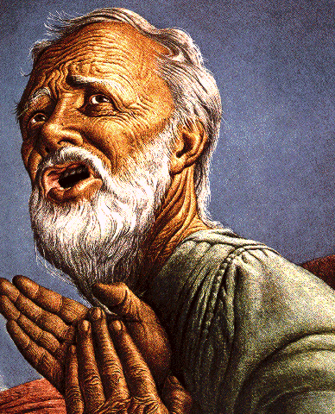
Belief – God’s One Condition for Justification
Gen 15:6
Then he believed in the LORD; and He reckoned it to him as righteousness.
John 3:16
For God so loved the world, that He gave His only begotten Son, that whoever believes in Him shall not perish, but have eternal life.
Acts 16:30-31
"Sirs, what must I do to be saved?" They said, "Believe in the Lord Jesus, and you will be saved..."

Slide 69
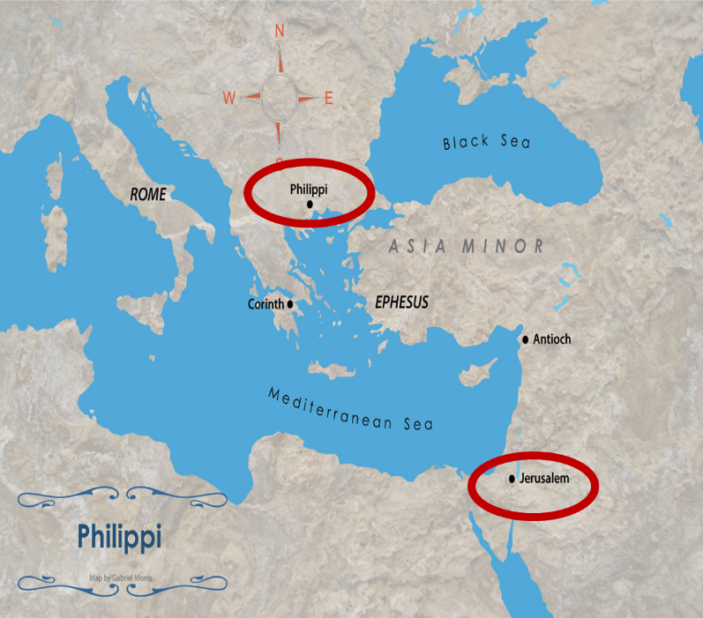

Slide 70

Lewis Sperry Chafer
Salvation: God’s Marvelous Work of Grace (Grand Rapids: Kregel, 1991), 49–50; idem, Grace: The Glorious Theme (Grand Rapids: Zondervan, 1972), 132.
“Such insistence is too often based on Scripture which is addressed to the covenant people, Israel. They . . . being covenant people, are privileged to return to God on the grounds of their covenant by repentance. There is much Scripture both in the Old Testament and in the New that calls this one nation to its long-predicted repentance....The preaching of John the Baptist, of Jesus and the early message of the disciples, was, ‘repent for the kingdom of heaven is at hand’; but it was addressed only to Israel (Matt. 10:5, 6).” “This good news to that nation was the ‘gospel of the kingdom,’ and should in no wise be confused with the Gospel of saving grace.”

Slide 71

Charles Ryrie
So Great A Salvation, Pages 36-37
“Even the New Testament uses the word gospel to mean various types of good news, so one has to describe what good news is in view. . . . In the Gospel of Matthew, all but one time the word gospel is used concerning the good news of the gospel of the kingdom. This is the message of John the Baptist (Matthew 3:1–2), of our Lord (Matthew 4:17), and of the twelve disciples when they were first sent out by the Lord (Matthew 10:5–7). What was the good news about the kingdom? The correct answer lies in the concept and hope of the kingdom that the Jewish people had at the time of the first coming. . .

Slide 72
Charles Ryrie
So Great A Salvation, Pages 36-37
“. . . of Christ. In fact, their hope was for the establishment of the promised rule of the Messiah in His kingdom on this earth, and in the kingdom that would exalt the Jewish people and free them from the rule of Rome under which they lived. But the rule of heaven did not arrive during Jesus’ lifetime because the people refused to repent and meet the spiritual conditions for the kingdom. Most only wanted a political deliverance without having to meet any personal requirements for change of life. So the kingdom did not arrive because the people would not prepare properly for it.”

Slide 73
Distinctions Between 144,000 & Multitude
144,000 | MULTITUDE
Revelation 7:1-8 | Revelation 7:9-17
Numbered | Innumerable
Jews | All nations
Sealed | Slain
Sealed before the Tribulation | Converted out of the Tribulation
Hitchcock and Ice, The Truth Behind Left Behind, 77

Slide 74

Matthew 24:14
“This gospel of the kingdom shall be preached in the whole world as a testimony to all the nations, and then the end will come.”

Slide 75
Preview of Matthew 24–25
The problem
The larger context
The immediate context (23:37-39)
The Disciples’ questions (24:1-3)
The Tribulation’s first half (24:4-14)
The Tribulation’s mid-point (24:15-20)
The Tribulation’s second half (24:21-22)
The Second Advent (24:23-31)
Eight parabolic exhortations (24:32‒25:46)

Slide 76
Matthew 24:15-16, 20
“¹⁵ Therefore when you see the abomination of desolation which was spoken of through Daniel the prophet, standing in the holy place (let the reader understand) ¹⁶ then those who are in Judea must flee to the mountains…²⁰ But pray that your flight will not be in the winter, or on a Sabbath.”

Slide 78
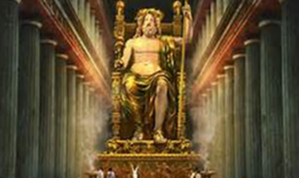
Daniel 11:31
Forces from him will arise, desecrate the sanctuary fortress, and do away with the regular sacrifice. And they will set up the abomination of desolation.

Slide 79

HANUKKAH
The Maccabean revolt
December 25th 165 BC : the temple is liberated and rededicated
1 & 2 Maccabees
The miracle of the lamp oil
Hanukkah “Feast of Dedication” (festival of lights).
Christmas / Jewish Holiday
John 10:22-24

Slide 80


Slide 81
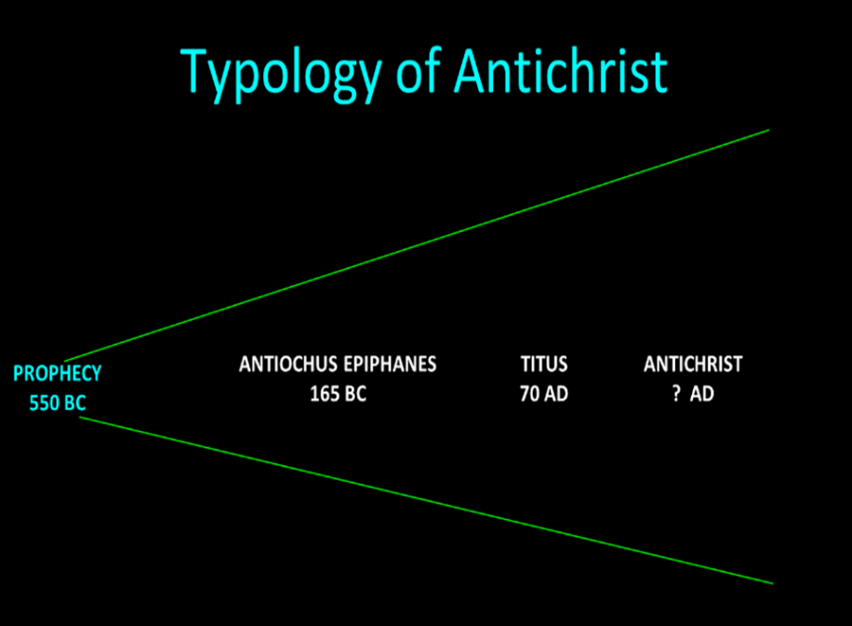

Slide 82
Daniel 9:24
Seventy weeks have been decreed for your people and your holy city, to finish the transgression, to make an end of sin, to make atonement for iniquity, to bring in everlasting righteousness, to seal up vision and prophecy and to anoint the most holy place.

Slide 83
Matthew 24:15-16, 20
“¹⁵ Therefore when you see the abomination of desolation which was spoken of through Daniel the prophet, standing in the holy place (let the reader understand) ¹⁶ then those who are in Judea must flee to the mountains…²⁰ But pray that your flight will not be in the winter, or on a Sabbath.”

Slide 84
Matthew 24:15-16, 20
“¹⁵ Therefore when you see the abomination of desolation which was spoken of through Daniel the prophet, standing in the holy place (let the reader understand) ¹⁶ then those who are in Judea must flee to the mountains…²⁰ But pray that your flight will not be in the winter, or on a Sabbath.”

Slide 85
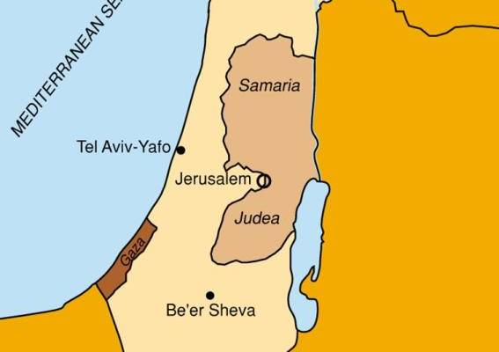

Slide 86
Matthew 24:15-16, 20
“¹⁵ Therefore when you see the abomination of desolation which was spoken of through Daniel the prophet, standing in the holy place (let the reader understand) ¹⁶ then those who are in Judea must flee to the mountains…²⁰ But pray that your flight will not be in the winter, or on a Sabbath.”

Slide 87

Randall Price
“Historical Problems with a First-Century Fulfillment of the Olivet Discourse,” in The End Times Controversy, ed. Tim LaHaye and Thomas Ice (Eugene, OR: Harvest, 2003), 394.
“…stormy weather comes with torrential rains that make crossing wadis in the Judean hills treacherous…concern about the possibility of travel on the Sabbath, where rabbinic law prohibited going more than a Sabbath day’s journey (i.e., beyond the immediate vicinity of the city)…”

Slide 88
Matthew 24:15-16, 20
“¹⁵ Therefore when you see the abomination of desolation which was spoken of through Daniel the prophet, standing in the holy place (let the reader understand) ¹⁶ then those who are in Judea must flee to the mountains…²⁰ But pray that your flight will not be in the winter, or on a Sabbath.”

Slide 89

Acts 20:7
“⁷ On the first day of the week, when we were gathered together to break bread, Paul began talking to them, intending to leave the next day, and he prolonged his message until midnight.”

Slide 90
1 Corinthians 16:2
“¹ Now concerning the collection for the saints, as I directed the churches of Galatia, so do you also. ² On the first day of every week each one of you is to put aside and save, as he may prosper, so that no collections be made when I come.”

Slide 91
Exodus 20:8-11
⁸ “Remember the sabbath day, to keep it holy. ⁹ Six days you shall labor and do all your work, ¹⁰ but the seventh day is a sabbath of the Lord your God; in it you shall not do any work, you or your son or your daughter, your male or your female servant or your cattle or your sojourner who stays with you. ¹¹ For in six days the Lord made the heavens and the earth, the sea and all that is in them, and rested on the seventh day; therefore the Lord blessed the sabbath day and made it holy.”

Slide 92
Exodus 31:15-17
¹⁵ ‘For six days work may be done, but on the seventh day there is a sabbath of complete rest, holy to the Lord; whoever does any work on the sabbath day shall surely be put to death. ¹⁶ ‘So the sons of Israel shall observe the sabbath, to celebrate the sabbath throughout their generations as a perpetual covenant.’ ¹⁷ “It is a sign between Me and the sons of Israel forever; for in six days the Lord made heaven and earth, but on the seventh day He ceased from labor, and was refreshed.”

Slide 93
Preview of Matthew 24–25
The problem
The larger context
The immediate context (23:37-39)
The Disciples’ questions (24:1-3)
The Tribulation’s first half (24:4-14)
The Tribulation’s mid-point (24:15-20)
The Tribulation’s second half (24:21-22)
The Second Advent (24:23-31)
Eight parabolic exhortations (24:32‒25:46)

Slide 94
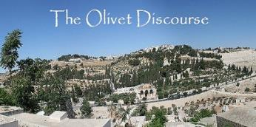
Matthew 24:21-22
“²¹ For then there will be a great tribulation, such as has not occurred since the beginning of the world until now, nor ever will. ²² Unless those days had been cut short, no life would have been saved; but for the sake of the elect those days will be cut short.”

Slide 95

Jeremiah 30:7
“Alas! for that day is great, There is none like it; And it is the time of Jacob’s distress (Gen. 32:8; 35:10), But he will be saved from it.”

Slide 96
Matthew 24:21-22
“²¹ For then there will be a great tribulation, such as has not occurred since the beginning of the world until now, nor ever will. ²² Unless those days had been cut short, no life would have been saved; but for the sake of the elect those days will be cut short.”

Slide 98
Matthew 24:21-22
“²¹ For then there will be a great tribulation, such as has not occurred since the beginning of the world until now, nor ever will. ²² Unless those days had been cut short, no life would have been saved; but for the sake of the elect those days will be cut short.”

Slide 99

Isaiah 13:12
“I will make mortal man scarcer than pure gold and mankind than the gold of Ophir.”

Slide 100
Matthew 24:21-22
“²¹ For then there will be a great tribulation, such as has not occurred since the beginning of the world until now, nor ever will. ²² Unless those days had been cut short, no life would have been saved; but for the sake of the elect those days will be cut short.”

Slide 101
Deuteronomy 7:7
⁷ “The LORD did not set His love on you nor choose you because you were more in number than any of the peoples, for you were the fewest of all peoples.”

Slide 102
Isaiah 65:21-22
²¹ “They will build houses and inhabit them; They will also plant vineyards and eat their fruit.²² They will not build and another inhabit, They will not plant and another eat; For as the lifetime of a tree, so will be the days of My people, And My chosen ones will wear out the work of their hands.”

Slide 103
Preview of Matthew 24–25
The problem
The larger context
The immediate context (23:37-39)
The Disciples’ questions (24:1-3)
The Tribulation’s first half (24:4-14)
The Tribulation’s mid-point (24:15-20)
The Tribulation’s second half (24:21-22)
The Second Advent (24:23-31)
Eight parabolic exhortations (24:32‒25:46)

Slide 104

VII. The Second Advent
(Matthew 24:23-31)
False returns of Christ (24:23-26)
The true return of Christ (24:27-31)

Slide 105
VII. The Second Advent
(Matthew 24:23-31)
False returns of Christ (24:23-26)
The true return of Christ (24:27-31)

Slide 106
Antichrist’s Satanic Miracles (2 Thessalonians 2:9)
MIRACLE | GREEK | CHRIST’S MINISTRY
Powers | Dynamis | Matt. 11:20
Signs | Semēion | John 20:30
Wonders | Teras | Acts 2:22

Slide 107

Satanic/Demonic Miracles
Exod. 7–8
Deut. 13:1-3
Matt. 7:21-23; 24:24
Acts 8:9; 16:16
Gal. 1:6-9
2 Thess. 2:9
Rev. 13:3, 13, 15; 16:13-14

Slide 108
VII. The Second Advent
(Matthew 24:23-31)
False returns of Christ (24:23-26)
The true return of Christ (24:27-31)

Slide 109
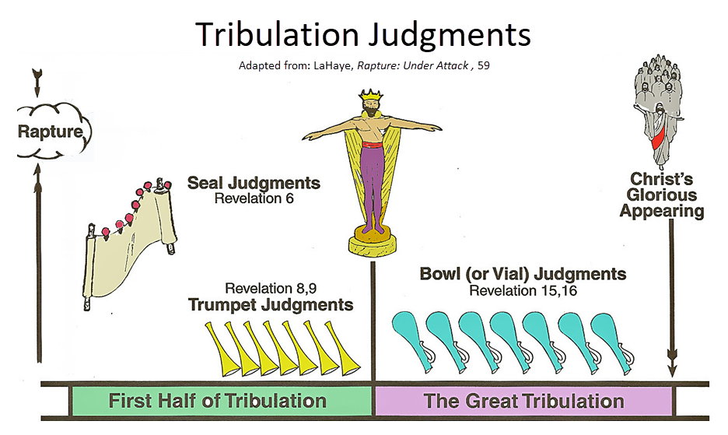

Slide 110


Seven Bowls
(Revelation 16)
1st Bowl (16:1-2) – Boils
2nd Bowl (16:3) – Sea becomes blood
3rd Bowl (16:4-7) – Freshwater destroyed
4th Bowl (16:8-9) – Sun scorches man
5th Bowl (16:10-11) – Darkness
6th Bowl (16:13-16) – Euphrates dried
7th Bowl (16:17-21) – Greatest earthquake

Slide 111
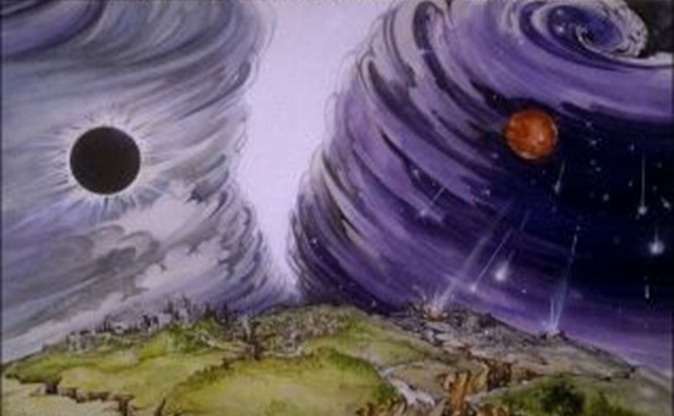
Isaiah 13/Matthew 24 Connection
Isaiah 13:10; Matthew 24:29
Isaiah 13:12; Matthew 24:21-22

Slide 112
Matthew 24:30
“And then the sign of the Son of Man will appear in the sky, and then all the tribes of the earth will mourn, and they will see the SON OF MAN COMING ON THE CLOUDS OF THE SKY with power and great glory.”

Slide 113
Matthew 24:30
“And then the sign of the Son of Man will appear in the sky, and then all the tribes of the earth will mourn, and they will see the SON OF MAN COMING ON THE CLOUDS OF THE SKY with power and great glory.”

Slide 114
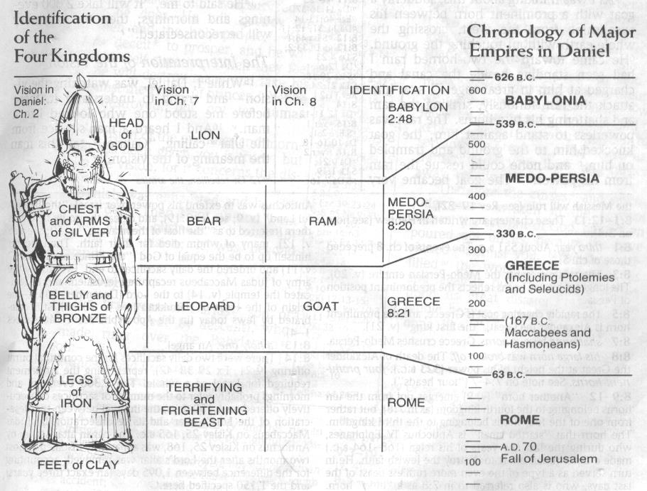

Slide 115
Matthew 24:30
“And then the sign of the Son of Man will appear in the sky, and then all the tribes of the earth will mourn, and they will see the SON OF MAN COMING ON THE CLOUDS OF THE SKY with power and great glory.”

Slide 116
Matthew 24:31
“And He will send forth His angels with a great trumpet and they will gather together [episynagō] His elect from the four winds, from one end of the sky to the other.”

Slide 117
John A. Sproule
"An Exegetical Defense of Pretribulationalism" (Th.D. diss., Grace Theological Seminary, 1981), 53.
“Where does Paul mention the darkening of the sun (Matt. 24:29), the moon not giving its light (Matt. 24:29), the stars falling from the sky (Matt. 24:29), the powers of the heavens being shaken (Matt. 24:29), all the tribes of the earth mourning (Matt. 24:30), all the world seeing the coming of the Son of Man (Matt. 24:30), or God sending forth angels (Matt.24:31)?”

Slide 118
Paul D. Feinberg
"Response: Paul D. Feinberg," in The Rapture: Pre-, Mid-, or Posttribulational, ed. Richard R. Reiter (Grand Rapids: Zondervan, 1984), 225.
“Notice what happens when you examine both passages carefully. In Matthew the Son of Man comes on the clouds, while in 1 Thessalonians 4 the ascending believers are in them. In Matthew the angels gather the elect; in 1 Thessalonians the Lord Himself (note the emphasis) gathers the believers. Thessalonians only speaks of the voice of the archangel. In the Olivet Discourse nothing is said about a resurrection, while in the latter text it is the central point. In the two passages the differences in what will take place prior to the appearance of Christ is striking. Moreover, the order of ascent is absent from Matthew in spite of the fact that it is the central part of the epistle.”

Slide 119

Isaiah 27:13
“It will come about also in that day that a great trumpet will be blown, and those who were perishing in the land of Assyria and who were scattered in the land of Egypt will come and worship the Lord in the holy mountain at Jerusalem.”

Slide 120
Matthew 24:31
“And He will send forth His angels with a great trumpet and they will gather together [episynagō] His elect from the four winds, from one end of the sky to the other.”

Slide 121
Isaiah 11:11-12
Then it will happen on that day that the Lord Will again recover the second time with His hand The remnant of His people, who will remain, From Assyria, Egypt, Pathros, Cush, Elam, Shinar, Hamath, And from the islands of the sea.¹² And He will lift up a standard for the nations And assemble the banished ones of Israel, And will gather the dispersed of Judah From the four corners of the earth.

Slide 122
Matthew 24:31
“And He will send forth His angels with a great trumpet and they will gather together [episynagō] His elect from the four winds, from one end of the sky to the other.”

Slide 123
Matthew 23:37-39
³⁷ “Jerusalem, Jerusalem, who kills the prophets and stones those who are sent to her! How often I wanted to gather [episynagō] your children together, the way a hen gathers [episynagō] her chicks under her wings, and you were unwilling. ³⁸ Behold, your house is being left to you desolate! ³⁹ For I say to you, from now on you will not see Me until you say, ‘Blessed is He who comes in the name of the Lord!’”

Slide 124
Preview of Matthew 24–25
The problem
The larger context
The immediate context (23:37-39)
The Disciples’ questions (24:1-3)
The Tribulation’s first half (24:4-14)
The Tribulation’s mid-point (24:15-20)
The Tribulation’s second half (24:21-22)
The Second Advent (24:23-31)
Eight parabolic exhortations (24:32‒25:46)

Slide 125
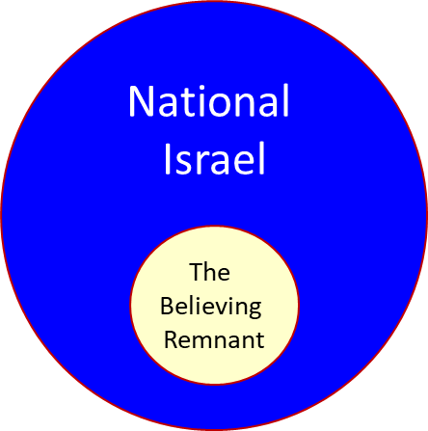

Slide 126
Zechariah 13:8-9
⁸“It will come about in all the land,” Declares the Lord, “That two parts in it will be cut off and perish; But the third will be left in it. ⁹“And I will bring the third part through the fire, Refine them as silver is refined, And test them as gold is tested. They will call on My name, And I will answer them; I will say, ‘They are My people,’ And they will say, ‘The Lord is my God.’ ”

Slide 127
Ezekiel 20:33-38
³³ “As I live,” declares the Lord God, “surely with a mighty hand and with an outstretched arm and with wrath poured out, I shall be king over you. ³⁴ I will bring you out from the peoples and gather you from the lands where you are scattered, with a mighty hand and with an outstretched arm and with wrath poured out; ³⁵ and I will bring you into the wilderness of the peoples, and there I will enter into judgment . . .

Slide 128
Ezekiel 20:33-38
…with you face to face. ³⁶ As I entered into judgment with your fathers in the wilderness of the land of Egypt, so I will enter into judgment with you,” declares the Lord God. ³⁷ “I will make you pass under the rod, and I will bring you into the bond of the covenant; ³⁸ and I will purge from you the rebels and those who transgress against Me; I will bring them out of the land where they sojourn, but they will not enter the land of Israel. Thus you will know that I am the Lord.

Slide 129

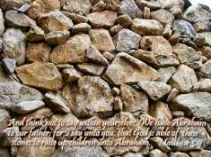
Matthew 3:9
“and do not suppose that you can say to yourselves, ‘We have Abraham for our father’; for I say to you that from these stones God is able to raise up children to Abraham.”

Slide 130
Romans 2:28-29
“²⁸ For he is not a Jew who is one outwardly, nor is circumcision that which is outward in the flesh. ²⁹ But he is a Jew who is one inwardly; and circumcision is that which is of the heart, by the Spirit, not by the letter; and his praise is not from men, but from God.”

Slide 131
Romans 9:6
“But it is not as though the word of God has failed. For they are not all Israel who are descended from Israel.”

Slide 132

Revelation 2:9
“I know your tribulation and your poverty (but you are rich), and the blasphemy by those who say they are Jews and are not, but are a synagogue of Satan.”

Slide 133
Discontinuity Between Israel & the Church
 | ISRAEL | CHURCH
Governing principle | Law | NT
Relation to HS | Selective, temporary, subsequent | Universal, permanent, at moment of salvation
Farewell address | Olivet Discourse | Upper Room Discourse
Designation | First Born Son | Bride of Christ
Revealed in OT | Yes | No
Evangelism | Come & See | Go & Proclaim
Blessings | Earthly | Heavenly
Composition | Believers & Unbelievers | Believers Only

Slide 134
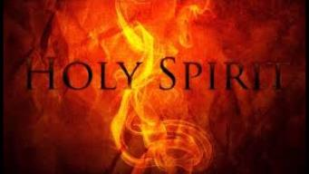
1 Corinthians 12:13
“For by one Spirit we were all baptized into one body, whether Jews or Greeks, whether slaves or free, and we were all made to drink of one Spirit.”

Slide 135
1 Corinthians 3:1-3 (NKJV)
¹ And I, brethren, could not speak to you as to spiritual people but as to carnal, as to babes in Christ. ² I fed you with milk and not with solid food; for until now you were not able to receive it, and even now you are still not able; ³ for you are still carnal. For where there are envy, strife, and divisions among you, are you not carnal and behaving like mere men?

Slide 136

Notes:
Ray Steadman – “1st Californians”
Unbelievers vs Categories of Believers
Unbelievers – ψυχικός psuchikós; Natural, pertaining to the natural as distinguished from the spiritual
Spiritual Believers – πνευματικός pneumatikós; of persons who are spiritual, enlightened by the Holy Spirit
Infant Believers – σάρκινος sárkinos; with propensities of the flesh unto sin; νήπιος nḗpios; an infant, child, baby without any definite limitation of age. (This relates to immaturity and lack of instruction)
Carnal Believers – σαρκικός sarkikós; tendency to satisfy the flesh, implying sinfulness, sinful propensity, carnal (This relates to disobedience and open rebellion)

Slide 137
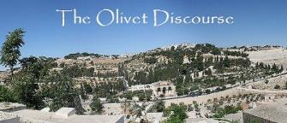
VIII. Eight Parabolic Exhortations
(Matthew 24:32–25:46)
The fig tree (24:32-35)
The days of Noah (24:36-39)
The comparison of two men & women (24:40-41)
The householder (24:42-44)
The wise servant (24:45-51)
The wise virgins (25:1-13)
The talents (25:14-30)
The sheep & goat judgment (25:31-46)

Slide 138
VIII. Eight Parabolic Exhortations
(Matthew 24:32–25:46)
The fig tree (24:32-35)
The days of Noah (24:36-39)
The comparison of two men & women (24:40-41)
The householder (24:42-44)
The wise servant (24:45-51)
The wise virgins (25:1-13)
The talents (25:14-30)
The sheep & goat judgment (25:31-46)

Slide 140
CONNECTING
REV 12 & ANTI-SEMITISM
DANIEL’S 70th WEEK (7 years)
Israel flees
3 ½ years
1260 days

Slide 141
VIII. Eight Parabolic Exhortations
(Matthew 24:32–25:46)
The fig tree (24:32-35)
The days of Noah (24:36-39)
The comparison of two men & women (24:40-41)
The householder (24:42-44)
The wise servant (24:45-51)
The wise virgins (25:1-13)
The talents (25:14-30)
The sheep & goat judgment (25:31-46)

Slide 142
VIII. Eight Parabolic Exhortations
(Matthew 24:32–25:46)
The fig tree (24:32-35)
The days of Noah (24:36-39)
The comparison of two men & women (24:40-41)
The householder (24:42-44)
The wise servant (24:45-51)
The wise virgins (25:1-13)
The talents (25:14-30)
The sheep & goat judgment (25:31-46)

Slide 143

Matthew 24:36-41
³⁶ “But of that day and hour no one knows, not even the angels of heaven, nor the Son, but the Father alone. ³⁷ For the coming of the Son of Man will be just like the days of Noah. ³⁸ For as in those days before the flood they were eating and drinking, marrying and giving in marriage, until the day that Noah entered the ark, ³⁹ and they did not understand until the flood came and took them all away; so will the coming of the Son of Man be. ⁴⁰ Then there will be two men in the field; one will be taken and one will be left. ⁴¹ Two women will be grinding at the mill; one will be taken and one will be left.”

Slide 144
C. The Comparison of Two Men and Women
Matthew 24:40-41
No rapture reasons
  Preceding context
  Days of Noah chronology
  Son of Man
  Other Matthean judgments
  Lukan parallel passage

Slide 145
C. The Comparison of Two Men and Women
Matthew 24:40-41
No rapture reasons
  Preceding context
  Days of Noah chronology
  Son of Man
  Other Matthean judgments
  Lukan parallel passage

Slide 146
C. The Comparison of Two Men and Women
Matthew 24:40-41
No rapture reasons
  Preceding context
  Days of Noah chronology
  Son of Man
  Other Matthean judgments
  Lukan parallel passage

Slide 147
Matthew 24:36-41
³⁶ “But of that day and hour no one knows, not even the angels of heaven, nor the Son, but the Father alone. ³⁷ For the coming of the Son of Man will be just like the days of Noah. ³⁸ For as in those days before the flood they were eating and drinking, marrying and giving in marriage, until the day that Noah entered the ark, ³⁹ and they did not understand until the flood came and took them all away; so will the coming of the Son of Man be. ⁴⁰ Then there will be two men in the field; one will be taken and one will be left. ⁴¹ Two women will be grinding at the mill; one will be taken and one will be left.”

Slide 148

Dr. John Walvoord
Matthew: Thy Kingdom Come (Chicago: Moody, 1974), 193.
“According to Matthew 24:40-41, ‘Then there will be two men in the field; one will be taken and one will be left. Two women will be grinding at the mill; one will be taken and one will be left.’ Because at the rapture, believers will be taken out of the world, some have confused this with the rapture of the church. Here, however, the situation is the reverse. The one who is left, is left to enter the kingdom; the one who is taken, is taken in judgment. This is in keeping with the illustration of the time of Noah when the ones taken away are the unbelievers.”

Slide 149
C. The Comparison of Two Men and Women
Matthew 24:40-41
No rapture reasons
  Preceding context
  Days of Noah chronology
  Son of Man
  Other Matthean judgments
  Lukan parallel passage

Slide 150
Matthew 24:36-41
³⁶ “But of that day and hour no one knows, not even the angels of heaven, nor the Son, but the Father alone. ³⁷ For the coming of the Son of Man will be just like the days of Noah. ³⁸ For as in those days before the flood they were eating and drinking, marrying and giving in marriage, until the day that Noah entered the ark, ³⁹ and they did not understand until the flood came and took them all away; so will the coming of the Son of Man be. ⁴⁰ Then there will be two men in the field; one will be taken and one will be left. ⁴¹ Two women will be grinding at the mill; one will be taken and one will be left.”

Slide 152
C. The Comparison of Two Men and Women
Matthew 24:40-41
No rapture reasons
  Preceding context
  Days of Noah chronology
  Son of Man
  Other Matthean judgments
  Lukan parallel passage

Slide 153
C. The Comparison of Two Men and Women
Matthew 24:40-41
No rapture reasons
  Preceding context
  Days of Noah chronology
  Son of Man
  Other Matthean judgments
  Lukan parallel passage

Slide 154
Luke 17:34-37
³⁴ “I tell you, on that night there will be two in one bed; one will be taken and the other will be left. ³⁵ “There will be two women grinding at the same place; one will be taken and the other will be left. ³⁶ “Two men will be in the field; one will be taken and the other will be left.” ³⁷ And answering they said to Him, “Where, Lord?” And He said to them, “Where the body is, there also the vultures will be gathered.”

Slide 155
C. The Comparison of Two Men and Women
Matthew 24:40-41
Pro-rapture reasons
  From airō to paralambanō
  Day or hour can be known in the Tribulation
  Normal life activities at the end of the Tribulation
  Peri De (“Now Concerning”) construction

Slide 156
C. The Comparison of Two Men and Women
Matthew 24:40-41
Pro-rapture reasons
  From airō to paralambanō
  Day or hour can be known in the Tribulation
  Normal life activities at the end of the Tribulation
  Peri De (“Now Concerning”) construction

Slide 157
Matthew 24:36-41
³⁶ “But of that day and hour no one knows, not even the angels of heaven, nor the Son, but the Father alone. ³⁷ For the coming of the Son of Man will be just like the days of Noah. ³⁸ For as in those days before the flood they were eating and drinking, marrying and giving in marriage, until the day that Noah entered the ark, ³⁹ and they did not understand until the flood came and took (airō) them all away; so will the coming of the Son of Man be. ⁴⁰ Then there will be two men in the field; one will be taken (paralambanō) and one will be left. ⁴¹ “Two women will be grinding at the mill; one will be taken (paralambanō) and one will be left.”

Slide 158

John 14:1–4
¹ “Do not let your heart be troubled; believe in God, believe also in Me. ² “In My Father’s house are many dwelling places; if it were not so, I would have told you; for I go to prepare a place for you. ³ “If I go and prepare a place for you, I will come again and receive you (paralambanō) to Myself, that where I am, there you may be also. ⁴ “And you know the way where I am going.”

Slide 159

Arnold G. Fruchtenbaum
Yeshua: The Life of Messiah from a Messianic Jewish Perspective, 4 vols., vol. 3 (San Antonio, TX: Ariel Ministries, 2017), 365.
“The phrase translated as taken away is not a technical term and could be used in more than one way in the same context. Furthermore, while the same word is used in the English translation, it is not in Greek. Verse 39 contains the verb airō (“to raise,“ “take up,“ “to lift“) and verse 40 the verb is paralambanō (“to receive from“), suggesting that the verses might be dealing with two separate concepts.”

Slide 160
C. The Comparison of Two Men and Women
Matthew 24:40-41
Pro-rapture reasons
  From airō to paralambanō
  Day or hour can be known in the Tribulation
  Normal life activities at the end of the Tribulation
  Peri De (“Now Concerning”) construction

Slide 161
Matthew 24:36-41
³⁶ “But of that day and hour no one knows, not even the angels of heaven, nor the Son, but the Father alone. ³⁷ For the coming of the Son of Man will be just like the days of Noah. ³⁸ For as in those days before the flood they were eating and drinking, marrying and giving in marriage, until the day that Noah entered the ark, ³⁹ and they did not understand until the flood came and took them all away; so will the coming of the Son of Man be. ⁴⁰ Then there will be two men in the field; one will be taken and one will be left. ⁴¹ “Two women will be grinding at the mill; one will be taken and one will be left.”

Slide 163
Arnold G. Fruchtenbaum
Yeshua: The Life of Messiah from a Messianic Jewish Perspective, 4 vols., vol. 3 (San Antonio, TX: Ariel Ministries, 2017), 365-66.
“No one will ever know the timing of the rapture. Yeshua noted that the angels of heaven do not know when it will occur (Matt. 24:36). Not even the Son in His humanity knew the timing. Only God the father knows when the believers will be taken up to meet their Messiah in the air. This will always be true of the rapture. The second coming, on the other hand, will occur exactly seven years after the beginning of the seven-year covenant and 42 months, or 1260 days, after the abomination of desolation. Once the tribulation begins, the second coming can be accurately calculated, so the passage above must be dealing with the rapture and not the second coming.”

Slide 165

Genesis 6:1-4
“¹ Now it came about, when men began to multiply on the face of the land, and daughters were born to them, ² that the sons of God saw that the daughters of men were beautiful; and they took wives for themselves, whomever they chose. ³ Then the Lord said, ‘My Spirit shall not strive with man forever, because he also is flesh; nevertheless his days shall be one hundred and twenty years.’ . . .

Slide 166
C. The Comparison of Two Men and Women
Matthew 24:40-41
Pro-rapture reasons
  From airō to paralambanō
  Day or hour can be known in the Tribulation
  Normal life activities at the end of the Tribulation
  Peri De (“Now Concerning”) construction

Slide 167
Matthew 24:36-41
³⁶ “But of that day and hour no one knows, not even the angels of heaven, nor the Son, but the Father alone. ³⁷ For the coming of the Son of Man will be just like the days of Noah. ³⁸ For as in those days before the flood they were eating and drinking, marrying and giving in marriage, until the day that Noah entered the ark, ³⁹ and they did not understand until the flood came and took them all away; so will the coming of the Son of Man be. ⁴⁰ Then there will be two men in the field; one will be taken and one will be left. ⁴¹ “Two women will be grinding at the mill; one will be taken and one will be left.”

Slide 168
Luke 17:26-30
²⁶ “And just as it happened in the days of Noah, so it will be also in the days of the Son of Man: ²⁷ they were eating, they were drinking, they were marrying, they were being given in marriage, until the day that Noah entered the ark, and the flood came and destroyed them all. ²⁸ “It was the same as happened in the days of Lot: they were eating, they were drinking, they were buying, they were selling, they were planting, they were building; ²⁹ but on the day that Lot went out from Sodom it rained fire and brimstone from heaven and destroyed them all. ³⁰ “It will be just the same on the day that the Son of Man is revealed.”

Slide 170
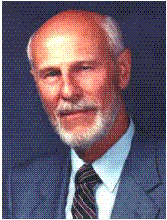
Dave Hunt
Dave Hunt, How Close Are We? Compelling Evidence for the Soon Return of Christ (Eugene, OR: Harvest House, 1993), 210-11.
“﻿When Christ says, ‘As it was in the days of Noah and Lot,’ it is absolutely certain that He is not describing conditions that will prevail at the time of the Second Coming. Therefore, these must be the conditions which will prevail just prior to the Rapture at a different time—and, obviously, before the devastation of the tribulation period.”

Slide 171
Arnold G. Fruchtenbaum
Yeshua: The Life of Messiah from a Messianic Jewish Perspective, 4 vols., vol. 3 (San Antonio, TX: Ariel Ministries, 2017), 366.
“The rapture will occur when conditions on earth are normal and people are eating and drinking, marrying and giving in marriage (Matt. 24:38). These are common activities in human society. Marrying and giving in marriage are necessary to propagate life; eating and drinking are essential to sustain it. During the time of Noah, life was normal when suddenly the flood came and took the people away. The rapture will occur in the same manner: so shall be the coming of the Son of Man (Matt. 24:39). Nothing spectacular will forewarn people that the believers are about to be taken up. However, things . . .

Slide 172
Arnold G. Fruchtenbaum
Yeshua: The Life of Messiah from a Messianic Jewish Perspective, 4 vols., vol. 3 (San Antonio, TX: Ariel Ministries, 2017), 366.
. . .will be abnormal at the time of the second coming. Nearly three-quarters of the earth will be destroyed in seven long years of tribulation. A blackness paired with tremendous tidal waves, anarchy, confusion, and perplexity will envelop the world. The Olivet Discourse shows that conditions will be abnormal at the time of the second coming, and so it is better to interpret this passage as referring to the rapture.”

Slide 173

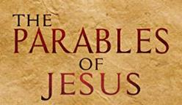
Matthew 24:32-33
³² “Now learn the parable from the fig tree: when its branch has already become tender and puts forth its leaves, you know that summer is near; ³³ so, you too, when you see all these things, recognize that He is near, right at the door.”

Slide 174
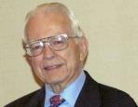

Dr. Roy B. Zuck
Basic Bible Interpretation, p. 215-16.
“﻿Usually a parable, like a sermon illustration, is teaching a single truth. When Jesus explained a number of His parables, He usually…stated one spiritual truth. For example when the man found his one lost sheep, he rejoiced, and Jesus said this illustrates the truth that there is rejoicing in heaven when a sinner repents (Luke 15:7)...He gave one simple spiritual lesson, and made no attempt to see any spiritual significance to the vineyard, the denarius, or the sixth hour, the ninth hour, or the eleventh hour, nor the vineyard foreman…To hunt for meanings in every detail in the parables is to turn them into allegories.”

Slide 175
C. The Comparison of Two Men and Women
Matthew 24:40-41
Pro-rapture reasons
  From airō to paralambanō
  Day or hour can be known in the Tribulation
  Normal life activities at the end of the Tribulation
  Peri De (“Now Concerning”) construction

Slide 176

Matthew 24:36
“But (peri de) of that day and hour no one knows, not even the angels of heaven, nor the Son, but the Father alone.”

Slide 177
Arnold G. Fruchtenbaum
Yeshua: The Life of Messiah from a Messianic Jewish Perspective, 4 vols., vol. 3 (San Antonio, TX: Ariel Ministries, 2017), 365.
“Matthew began the passage with the word but (Matt. 24:36). In the Greek language, there is more than one way of saying but. Here, the English word is a translation of two Greek words, peri de, meaning ‘now concerning.’ As Greek grammar books show, this construction denotes a contrast and often introduces a new subject. Paul uses the formula frequently in his writings when presenting a new topic (eg. 1 Cor. 7:1, 25; 8:1; 12:1; 16:1, 12; 1 Thess. 4:9; 5:1; etc.). In the context of Matthew 24, Yeshua had been talking about one topic (the second coming), then introduced a new subject (the rapture)...In the passage above, He introduced the new topic by using the peri de construction.”

Slide 178
VIII. Eight Parabolic Exhortations
(Matthew 24:32–25:46)
The fig tree (24:32-35)
The days of Noah (24:36-39)
The comparison of two men & women (24:40-41)
The householder (24:42-44)
The wise servant (24:45-51)
The wise virgins (25:1-13)
The talents (25:14-30)
The sheep & goat judgment (25:31-46)

Slide 179
VIII. Eight Parabolic Exhortations
(Matthew 24:32–25:46)
The fig tree (24:32-35)
The days of Noah (24:36-39)
The comparison of two men & women (24:40-41)
The householder (24:42-44)
The wise servant (24:45-51)
The wise virgins (25:1-13)
The talents (25:14-30)
The sheep & goat judgment (25:31-46)

Slide 180
VIII. Eight Parabolic Exhortations
(Matthew 24:32–25:46)
The fig tree (24:32-35)
The days of Noah (24:36-39)
The comparison of two men & women (24:40-41)
The householder (24:42-44)
The wise servant (24:45-51)
The wise virgins (25:1-13)
The talents (25:14-30)
The sheep & goat judgment (25:31-46)

Slide 181
VIII. Eight Parabolic Exhortations
(Matthew 24:32–25:46)
The fig tree (24:32-35)
The days of Noah (24:36-39)
The comparison of two men & women (24:40-41)
The householder (24:42-44)
The wise servant (24:45-51)
The wise virgins (25:1-13)
The talents (25:14-30)
The sheep & goat judgment (25:31-46)

Slide 183
VIII. Eight Parabolic Exhortations
(Matthew 24:32–25:46)
The fig tree (24:32-35)
The days of Noah (24:36-39)
The comparison of two men & women (24:40-41)
The householder (24:42-44)
The wise servant (24:45-51)
The wise virgins (25:1-13)
The talents (25:14-30)
The sheep & goat judgment (25:31-46)

Slide 184
VIII. Eight Parabolic Exhortations
(Matthew 24:32–25:46)
The fig tree (24:32-35)
The days of Noah (24:36-39)
The comparison of two men & women (24:40-41)
The householder (24:42-44)
The wise servant (24:45-51)
The wise virgins (25:1-13)
The talents (25:14-30)
The sheep & goat judgment (25:31-46)

Slide 185
CONNECTING
REV 12 & ANTI-SEMITISM
DANIEL’S 70th WEEK (7 years)
Israel flees
3 ½ years
1260 days

Slide 186
Scripture’s Four Judgments
Name | Sheep and Goat | Judgment of the Jews | Bema Seat | Great White Throne
Scripture | Matt 25:31-46 | Ezek 20:33-44 | 1 Cor 3:10-15 | Rev 20:11-15
Place | Earth, Jerusalem | Earth, wilderness | Heaven | Earth
Audience | Gentile Tribulation survivors | Jewish Tribulation survivors | Church Age believers | All unsaved
When | After Tribulation | After Tribulation | After rapture | After Millennium
Purpose | Saved Gentiles enter kingdom | Saved Jews enter kingdom | Reward believers | Degree of punishment in hell
Evaluation | Treatment of Christ’s brethren | Passing under shepherd’s rod | Works taken through fire | Not in the book; judged by books

Slide 187
Conclusion

Slide 188
Preview of Matthew 24–25
The problem
The larger context
The immediate context (23:37-39)
The Disciples’ questions (24:1-3)
The Tribulation’s first half (24:4-14)
The Tribulation’s mid-point (24:15-20)
The Tribulation’s second half (24:21-22)
The Second Advent (24:23-31)
Eight parabolic exhortations (24:32‒25:46)

