Slide 1
Law and Grace: An Overview Jim McGowan, Th.D. Sugar Land Bible Church 09-20-2020
…but grace and truth were realized through Jesus Christ - John 1:17
For the Law was given through Moses…
Special thanks to Dr. Vern Peterman for access to his insights and resources.

Slide 2
Session 25 Outline
Review
Purpose, Aim, and Objective
Session 24
How Do We Approach the SOM?
General Information
Comparisons
Contrasts
Concluding Observations

Slide 3
OUR PURPOSE, AIM AND OBJECTIVE
Law and Grace
…is to Compare and Contrast Law and Grace so as to properly understand these two important themes and how they are related to the life of the New Testament Believer.

Slide 4
C. I. SCOFIELD, D. D.
The Grace of God, The Fundamentals Vol. 3, Chapter VII, p. 98
We have, most of us, been reared and now live under the influence of Galatianism. Protestant theology, alas, is for the most part, thoroughly Galatianized, in that neither law nor grace are given their distinct and separated places, as in the counsels of God, but are mingled together in one incoherent system.
The law is no longer, as in the Divine intent, a ministration of death (2 Cor. 3:7), of cursing (Gal. 3:10), of conviction (Rom. 3:19), because we are taught that we must try to keep it, and that by Divine help we may.
Nor, on the other hand, does grace bring us blessed deliverance from the dominion of sin, for we are kept under the law as a rule of life despite the plain declaration, “Sin shall not have dominion over you: for ye are not under the law, but under grace” (Rom. 6:14). (emphasis mine)

Slide 5
William R. Newell
Romans Verse-by-Verse (p. 274).
Grand Rapids, MI: Christian Classics Ethereal Library.
It is because Reformed theology has kept us Gentiles under the Law,—if not as a means of righteousness, then as “a rule of life,” that all the trouble has arisen. The Law is no more a rule of life than it is a means of righteousness. Walking in the Spirit has now taken the place of walking by ordinances. God has another principle under which He has put his saints: “Ye are not under law, but, under grace!” (italics mine)

Slide 6
Henry Ironside
The Continual Burnt Offering: Daily Meditations on the Word of God (p. 265). Neptune, NJ: Loizeaux Brothers.
In Romans 7 we have a man renewed by the Spirit of God, but struggling under law, hoping thereby to subdue or find deliverance from the power of the old Adamic nature. In chapter 8 we have God’s way of deliverance through the death and resurrection of Christ with which the believer is identified before God. The chapter begins with “no condemnation” and ends with “no separation.” All who are in Christ Jesus are ACCEPTED IN THE BELOVED and as free from every charge of guilt as He is Himself. He paid our penalty on the cross. Now we are linked up with Him in resurrection, not under law but under grace.

Slide 7
Session 25 Outline
Review
Purpose, Aim, and Objective
Session 24
How Do We Approach the SOM?
General Information
Comparisons
Contrasts
Concluding Observations

Slide 8
Matthew’s Purposes
Law and Grace: Session 24 Review The SOM – Matthew 5:1–8:1 (Luke 6:17–49)
To explain that Jesus in whom they (Jewish believers) had believed was the long-awaited Jewish Messiah.
To explain why the kingdom had been postponed despite the fact that the king had arrived.
To explain the interim program of God during the kingdom’s absence.

Slide 9
Matthew & the Kingdom
Law and Grace: Session 24 Review The SOM – Matthew 5:1–8:1 (Luke 6:17–49)
Kingdom offered
Kingdom rejected
Kingdom postponed
Interim program
Kingdom ultimately accepted

Slide 10
Matthew & the Kingdom
Law and Grace: Session 24 Review The SOM – Matthew 5:1–8:1 (Luke 6:17–49)
Kingdom offered (Matt. 1-11)
Kingdom rejected (Matt. 12-22)
Kingdom postponed (Matt. 13; 21:43)
Interim program (Matt. 13; 16:18)
Kingdom ultimately accepted (Matt. 23:37-39; 24-25)

Slide 11
Matthew’s Message
Law and Grace: Session 24 Review The SOM – Matthew 5:1–8:1 (Luke 6:17–49)
Jesus is the predicted Jewish king who ushered in an interim program by building the sons of the kingdom into the Church, in between Israel’s past rejection and future acceptance of her king.

Slide 12
Law and Grace: Session 24 Review The SOM – Matthew 5:1–8:1 (Luke 6:17–49)
Approaches to ‘The Sermon on the Mount’
Pros & Cons
The Soteriological Interpretation
The Sociological Interpretation
The Kingdom (Millennial) Interpretation
The Penitential Interpretation
THE INTERIM ETHIC INTERPRETATION
The Believer’s Ethic (Ecclesiastical) Interpretation
The Ecumenical Interpretation
Constable, T. (2003). Tom Constable’s Expository Notes on the Bible (Mt 4:21). Galaxie Software.

Slide 13
The Interim Ethic Interpretation
Law and Grace: Session 24 Review The SOM – Matthew 5:1–8:1 (Luke 6:17–49)
This interpretation suggests that the primary purpose of the Sermon presents ethical instructions for Jesus’ disciples that apply from the time Jesus gave them until the beginning of the kingdom.
This view fits best into the historical context for the giving of the Sermon (the kingdom was at hand).
This view anticipates the inauguration of the kingdom.
This view recognizes that the primary recipients were Jesus’ disciples whom He taught (5:1–2, 19; 7:29).
The content of the Sermon favors the interim interpretation.
Constable, T. (2003). Tom Constable’s Expository Notes on the Bible (Mt 4:21). Galaxie Software.

Slide 14
Occasion
Law and Grace: Session 24 Review The SOM – Matthew 5:1–8:1 (Luke 6:17–49)
Matthew 5:1-2 records that Jesus went up into the mountain hence the title, “The Sermon on the Mount.” In Matthew’s account, Jesus spoke specifically to His disciples.
Luke 6:17-19 gives a more detailed account. Luke records that Not only were the disciples there, but there were multitudes from all over the country, even Judaea and Jerusalem, though this occurred up in the Galilee. Furthermore, there were even Jews from outside the Land, from the coastal plain of Phoenicia and the cities of Tyre and Sidon.
Fruchtenbaum, A. G. (1983). The Messianic Bible Study Collection (Vol. 94, p. 4). Tustin, CA: Ariel Ministries.

Slide 15
Background
Law and Grace: Session 24 Review The SOM – Matthew 5:1–8:1 (Luke 6:17–49)
The Sermon on the Mount occurred after:
intense interest in the person of Jesus was stirred up.
the selection of the Twelve Disciples.
several conflicts with the Pharisees regarding the authority of Pharisaic Judaism and the Pharisaic interpretation of the Mosaic Law.
Fruchtenbaum, A. G. (1983). The Messianic Bible Study Collection (Vol. 94, p. 4). Tustin, CA: Ariel Ministries..

Slide 16
Background
Law and Grace: Session 24 Review The SOM – Matthew 5:1–8:1 (Luke 6:17–49)
The sermon occurred when the Jewish people were looking for the Messiah to come and establish His Kingdom in opposition to the kingdom of Rome.
The question being raised among the Jewish masses was, “What kind of righteousness is necessary for entering into the Kingdom?” Was it “Pharisaic righteousness” or was it righteousness, according to the Old Testament prophets, which Jesus taught?
From that perspective, the most important single statement in the Sermon on the Mount is Matthew 5:20.
Fruchtenbaum, A. G. (1983). The Messianic Bible Study Collection (Vol. 94, p. 4). Tustin, CA: Ariel Ministries..

Slide 17
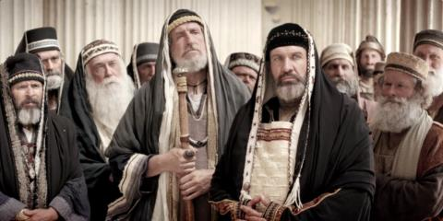
Matthew 5:20
“For I say to you that unless your righteousness surpasses that of the scribes and Pharisees, you will not enter the kingdom of heaven.

Slide 18
The Sermon on the Mount - What it is
Law and Grace: Session 24 Review The SOM – Matthew 5:1–8:1 (Luke 6:17–49)
The sermon was designed to lead [the Jewish] multitude away from a false concept of righteousness to a true concept of righteousness; from a false hope of entrance into the kingdom to a sure foundation for entrance into Messiah’s kingdom…the Sermon on the Mount in its historical setting was Christ’s instruction to that generation to which He was offering Himself as Saviour and Sovereign…
Pentecost, J. D. (1995). Thy Kingdom Come: Tracing God’s Kingdom Program and Covenant Promises throughout History (pp. 205–206). Grand Rapids, MI: Kregel Publications.

Slide 19
The Sermon on the Mount - What it is
Law and Grace: Session 24 Review The SOM – Matthew 5:1–8:1 (Luke 6:17–49)
In its context—in the Jewish frame of reference in which it was spoken—the Sermon on the Mount is the Messiah’s interpretation of the standard of righteousness, which the Law demanded, put in contrast with the Pharisaic interpretation of the kind of righteousness, which the Law demanded. A better title for this “sermon” would be “The Messiah’s Interpretation of the Righteousness of the Law.” So, as a unit, it is the Messiah’s interpretation of the kind of righteousness, which the Law demanded, stated in contradistinction to the Pharisaic interpretation of the kind of righteousness that the Law demanded. The difference is between mere external conformity in contrast to internal conformity that naturally lends itself to external conformity.
Fruchtenbaum, A. G. (1983). The Messianic Bible Study Collection
(Vol. 94, pp. 6–7). Tustin, CA: Ariel Ministries.

Slide 20
False Charges Against Dispensationalists
Law and Grace: Session 24 Review The SOM – Matthew 5:1–8:1 (Luke 6:17–49)
False Charges #1 – Dispensationalists teach that the Sermon on the Mount is not for the Church today – “False!” (14 Slides)
False Charges #2 – Dispensationalists teach that the Sermon on the Mount is not for the Church today – “True!” (8 Slides)
IS THIS AN IRRECONCILABLE, SPIRITUAL PARADOX?

Slide 21
Session 25 Outline
Review
Purpose, Aim, and Objective
Session 24
How Do We Approach the SOM?
General Information
Comparisons
Contrasts
Concluding Observations

Slide 22
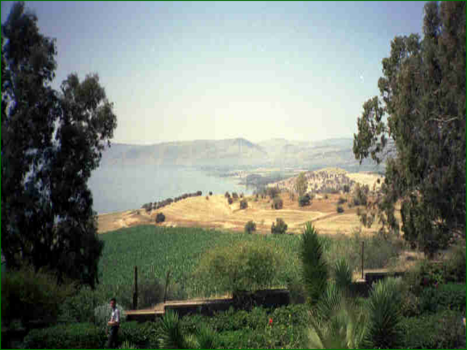
Law and Grace: Session 25 - The SOM – Matthew 5:1–8:1 (Luke 6:17–49)
How will we approach
the Sermon on the Mount?

Slide 23
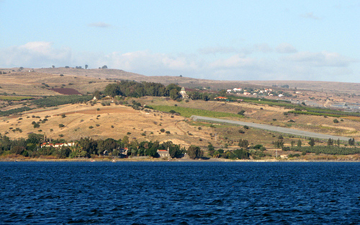
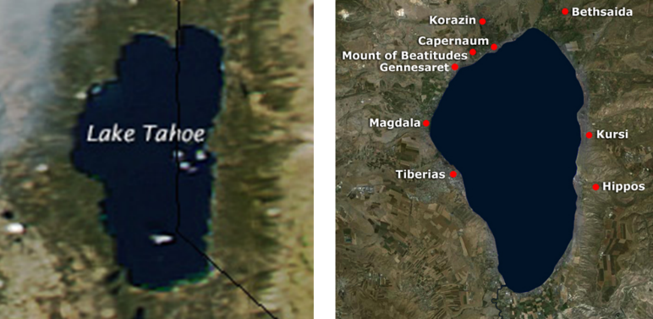
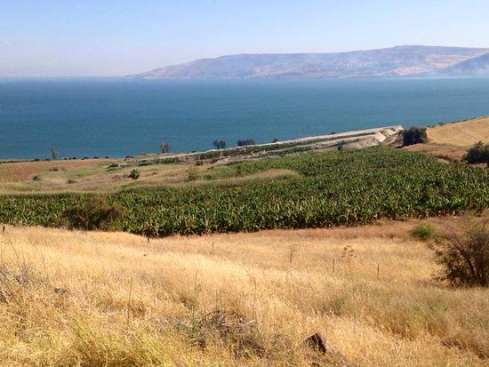
Law and Grace: Session 25 - The SOM – Matthew 5:1–8:1 (Luke 6:17–49)
How will we approach
the Sermon on the Mount?

Slide 24
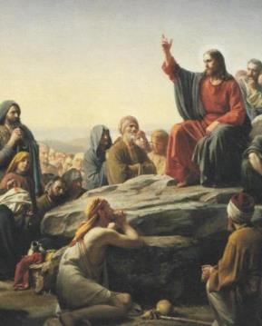
Law and Grace: Session 25 - The SOM – Matthew 5:1–8:1 (Luke 6:17–49)
How will we approach
the Sermon on the Mount?
Many Christians approach the Sermon on the Mount (Matt. 5:1-7:28) as the ultimate statement regarding the Christian’s relationship to God and his fellow man.

Slide 25
Law and Grace: Session 25 - The SOM – Matthew 5:1–8:1 (Luke 6:17–49)
How will we approach
the Sermon on the Mount?
As we study the Sermon on the Mount, we will approach it so that we arrive at the one intended meaning for each passage that Matthew and God intended to convey.
Intended meaning

Slide 26
The Doctrine of Perspicuity
Law and Grace: Session 25 - The SOM – Matthew 5:1–8:1 (Luke 6:17–49)
The doctrine of perspicuity means that the central message of the Bible is clear and understandable and that the Bible itself can be properly interpreted in a normal, literal sense.
God has a message He wants to convey.
God has a message He is able to convey.
God is not capricious (given to impulsive and unpredictable character and action).

Slide 27
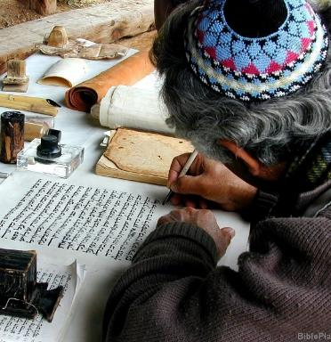
Law and Grace: Session 25 - The SOM – Matthew 5:1–8:1 (Luke 6:17–49)
What God inspired
and the author intended?
As we approach the Sermon on the Mount, we will ask the questions, “What message did God inspire (2 Tim. 3:16-17) and What meaning did the apostle Matthew intend to convey?” (2 Peter 1:20–21)

Slide 28
Law and Grace: Session 25 - The SOM – Matthew 5:1–8:1 (Luke 6:17–49)
What God inspired
and the author intended?

Slide 29
The Doctrine of Perspicuity
Law and Grace: Session 25 - The SOM – Matthew 5:1–8:1 (Luke 6:17–49)
The doctrine of perspicuity means that the central message of the Bible is clear and understandable and that the Bible itself can be properly interpreted in a normal, literal sense.
God has a message He wants to convey.
God has a message He is able to convey.
God is not capricious (given to impulsive and unpredictable character and action).

Slide 30
Literal-Grammatical-Historical interpretation
Law and Grace: Session 25 - The SOM – Matthew 5:1–8:1 (Luke 6:17–49)
This commonsense method of interpretation gives to every word the same meaning it would have in normal usage, whether employed in writing, speaking, or thinking while taking into account grammatical and historical considerations.

Slide 31
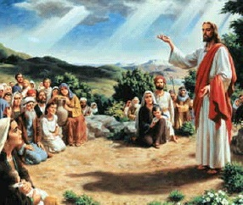
Law and Grace: Session 25 - The SOM – Matthew 5:1–8:1 (Luke 6:17–49)
What God inspired
and the author intended?
Consistently observing:
who is speaking (Christ),
to whom He was speaking (Jews), and
how He was speaking to them (as Jews, under the Law of Moses),
will be commonsense key to our approach so that we get the full context!

Slide 32
Law and Grace: Session 25 - The SOM – Matthew 5:1–8:1 (Luke 6:17–49)
What God inspired
and the author intended?

Slide 33
Context, context, context!
Law and Grace: Session 25 - The SOM – Matthew 5:1–8:1 (Luke 6:17–49)
As we study, we will see that there were very well understood meanings to words and terms that we might not quite understand in the same way, unless we examine the historical context.

Slide 34
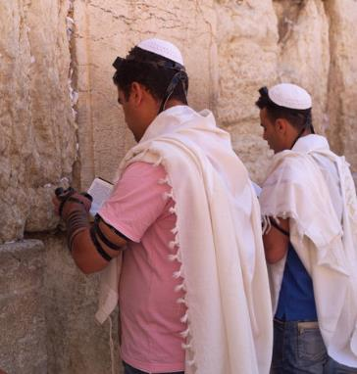
Context, context, context!
Law and Grace: Session 25 - The SOM – Matthew 5:1–8:1 (Luke 6:17–49)
Some culturally specific words and phrases include:
Brother
Blessed
City set on a hill
Make no oath
Hate your enemy
Divorce
Kingdom
Your neighbor
My father,
and others.

Slide 35
Context, context, context!
Law and Grace: Session 25 - The SOM – Matthew 5:1–8:1 (Luke 6:17–49)
Some culturally specific words and phrases include:
Brother
Blessed
City set on a hill
Make no oath
Hate your enemy
Divorce
Kingdom
Your neighbor
My father,
and others.

Slide 36
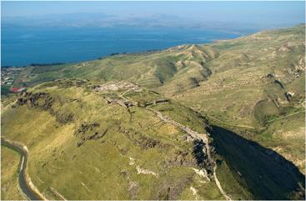
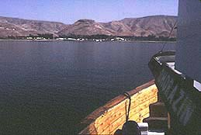
Context, context, context!
Law and Grace: Session 25 - The SOM – Matthew 5:1–8:1 (Luke 6:17–49)
Hippos was the ‘city on a hill’ across the Sea of Galilee from where Jesus gave the Sermon on the Mount and it was clearly visible to His audience!
The bottom picture is looking from the general direction of where Jesus gave the Sermon on the Mount, across from Hippos.

Slide 37
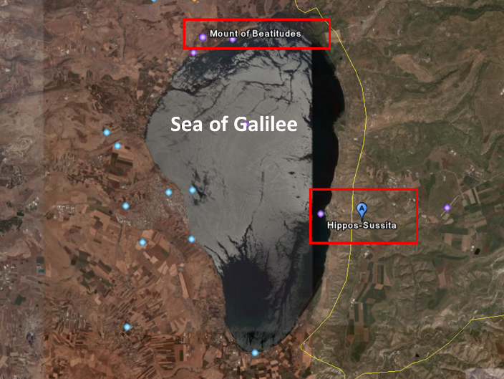
Law and Grace: Session 25 - The SOM – Matthew 5:1–8:1 (Luke 6:17–49)
Context, context, context!

Slide 38
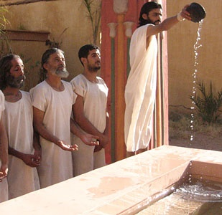
Context, context, context!
Law and Grace: Session 25 - The SOM – Matthew 5:1–8:1 (Luke 6:17–49)
Some culturally specific words and phrases include:
Brother
Blessed
City set on a hill
Make no oath
Hate your enemy
Divorce
Kingdom
Your neighbor
My father,
and others.
The Essenes were the only Jewish group to teach, “Hate your enemy”.

Slide 39
Context, context, context!
Law and Grace: Session 25 - The SOM – Matthew 5:1–8:1 (Luke 6:17–49)
Some culturally specific words and phrases include:
Brother
Blessed
City set on a hill
Make no oath
Hate your enemy
Divorce
Kingdom
Your neighbor
My father,
and others.

Slide 40
Context, context, context!
Law and Grace: Session 25 - The SOM – Matthew 5:1–8:1 (Luke 6:17–49)
Some culturally specific words and phrases include:
Brother
Blessed
City set on a hill
Make no oath
Hate your enemy
Divorce
Kingdom
Your neighbor
My father,
and others.

Slide 41
Context, context, context!
Law and Grace: Session 25 - The SOM – Matthew 5:1–8:1 (Luke 6:17–49)
Some culturally specific words and phrases include:
Brother
Blessed
City set on a hill
Make no oath
Hate your enemy
Divorce
Kingdom
Your neighbor
My father,
and others.

Slide 42
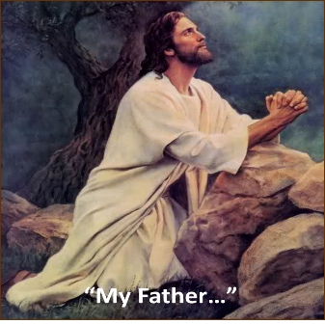
Context, context, context!
Law and Grace: Session 25 - The SOM – Matthew 5:1–8:1 (Luke 6:17–49)
Some culturally specific words and phrases include:
Brother
Blessed
City set on a hill
Make no oath
Hate your enemy
Divorce
Kingdom
Your neighbor
My father,
and others.

Slide 43
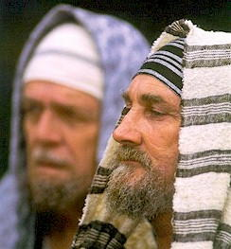
Law and Grace: Session 25 - The SOM – Matthew 5:1–8:1 (Luke 6:17–49)
To Whom is Jesus speaking?
Two things are very clear according to Matthew 10:5-6 and 15:24, namely, that 1) Jesus was sent ‘only to the lost sheep of the house of Israel’ and 2) that He sent His disciples out by twos also ‘only to the lost sheep of the house of Israel’.

Slide 44
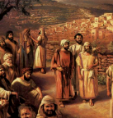
Matthew 10:5–6
⁵ These twelve Jesus sent out after instructing them: “Do not go in the way of the Gentiles, and do not enter any city of the Samaritans; ⁶ but rather go to the lost sheep of the house of Israel.
Matthew 15:24
But He answered and said, “I was sent only to the lost sheep of the house of Israel.”

Slide 45
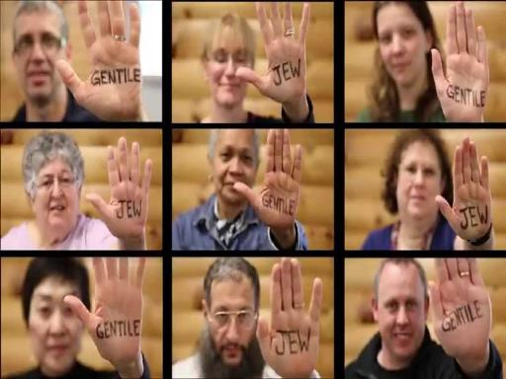
Law and Grace: Session 25 - The SOM – Matthew 5:1–8:1 (Luke 6:17–49)
To Whom is Jesus speaking?
Jesus repeatedly referred to those who were Gentiles (non-Jews) as another people, not a part of His intended audience (cf. Matt. 5:47; 6:7, 32; 10:5, 18; 20:19; 20:25).

Slide 46
Matthew 6:7-8a, 32a
⁷ “And when you are praying, do not use meaningless repetition as the Gentiles do, for they suppose that they will be heard for their many words. ⁸ “So do not be like them; …. ³² “For the Gentiles eagerly seek all these things;….

Slide 47
Law and Grace: Session 25 - The SOM – Matthew 5:1–8:1 (Luke 6:17–49)
The Law of Moses, the Altar,
and the Temple in Jerusalem
Jesus regularly referred to the Law, Moses, the Altar and the Temple in Jerusalem.

Slide 48
Matthew 5:17-18
“¹⁷ Do not think that I came to abolish THE LAW OR THE PROPHETS; I did not come to abolish but to fulfill. ¹⁸ For truly I say to you, until heaven and earth pass away, not the smallest letter or stroke shall pass from THE LAW until all is accomplished."

Slide 49
Matthew 5:23-24
²³ “Therefore if you are presenting your offering at the altar, and there remember that your brother has something against you, ²⁴ leave your offering there before the altar and go; first be reconciled to your brother, and then come and present your offering.

Slide 50
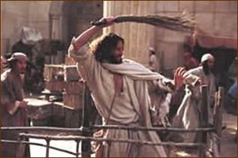
Matthew 21:12-13
‘¹² And Jesus entered the TEMPLE and drove out all those who were buying and selling in the TEMPLE, and overturned the tables of the money changers and the seats of those who were selling doves. ¹³ And He said to them, "It is written, 'My house shall be called a house of prayer'; but you are making it a robbers‘ den."'

Slide 51
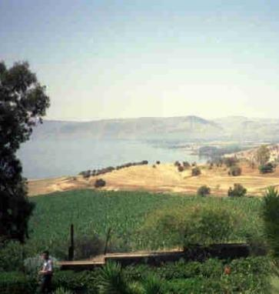
Law and Grace: Session 25 - The SOM – Matthew 5:1–8:1 (Luke 6:17–49)
To Whom is Jesus speaking?
Jesus spoke the Sermon on the Mount entirely to the people of Israel, living in the land of Israel, all of whom were under the Law of Moses.

Slide 52
Law and Grace: Session 25 - The SOM – Matthew 5:1–8:1 (Luke 6:17–49)
To Whom is Jesus speaking?
Doesn’t that apply to me?
Nothing in the Sermon on the Mount nor in its context indicates that it was said directly to us who are in the Body of Christ, the Church [no primary application].
However, by employing the principles of Comparison and Contrast we can discover how the Sermon has valuable secondary applications for us.

Slide 53
Law and Grace: Session 25 - The SOM – Matthew 5:1–8:1 (Luke 6:17–49)
Direct Application vs. Secondary Application
Jesus told Peter to pay the temple maintenance tax with the shekel from the fish’s mouth. Is that a command for us to head to our favorite fishing hole on or before April 15th? (Matt. 17:24-27)
Jesus told Judas, “What you do, do quickly”. Is that a command for us to seek out opportunities to betray Christ? (John 13:27)

Slide 54
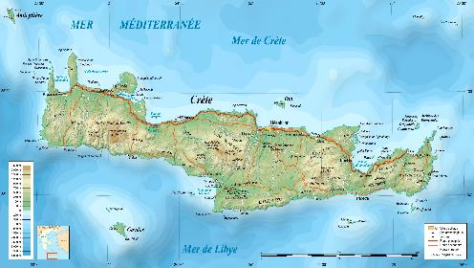
Law and Grace: Session 25 - The SOM – Matthew 5:1–8:1 (Luke 6:17–49)
Direct Application vs. Secondary Application
Paul sent Titus to Crete to appoint elders in every city. (Titus 1:5) Are we to take Paul’s instructions to him as direct, individual, commands to each one of us? No, we must recognize who is speaking, the direct audience, and then interpret accordingly.

Slide 55
Law and Grace: Session 25 - The SOM – Matthew 5:1–8:1 (Luke 6:17–49)
Do we just ignore everything that
directly applies only to the Jews?
No, we don’t just set aside the Sermon on the Mount as irrelevant because it was directly spoken only to the people of Israel. (cf. 2 Tim. 3:16, 17; Rom. 15:4; 1 Cor. 10:11).

Slide 56
Law and Grace: Session 25 - The SOM – Matthew 5:1–8:1 (Luke 6:17–49)
Do we just ignore everything that
directly applies only to the Jews?
The letters written to the church make many, many references to writings, people, events and truths written directly to the Jews (1 Cor. 10:1–2).

Slide 57
Session 25 Outline
Review
Purpose, Aim, and Objective
Session 24
How Do We Approach the SOM?
General Information
Comparisons
Contrasts
Concluding Observations

Slide 58
Law and Grace: Session 25 - The SOM – Matthew 5:1–8:1 (Luke 6:17–49)
We Compare and Contrast
When we compare, we ask, ‘What about what is said in the Sermon is the same or similar to what is addressed to the church, and why?’
When we contrast, we ask, ‘What about what is said in the Sermon is different from what is written to us who are in the church, and why?’
When we take this approach, we will find that the Word of God can be very clearly understood and is consistent throughout.

Slide 59
Law and Grace: Session 25 - The SOM – Matthew 5:1–8:1 (Luke 6:17–49)
Comparison: What is the same or similar?
While we have said that the Gospel of Matthew is directed to the Jews and in keeping with the anticipation of the coming kingdom, we do not want to convey that the Sermon on the Mount has nothing for us in the Church.
There are indeed a number of ways in which the content of the Sermon on the Mount has application to believers in the Church, the Body of Christ.

Slide 60
Law and Grace: Session 25 - The SOM – Matthew 5:1–8:1 (Luke 6:17–49)
Comparison: What is the same or similar?
The character of God is always the same and He does not lie or change His mind (1 Sam. 15:29; Mal. 3:6; Titus 1:2; Heb. 1:10-12; 6:18; 13:8; Jam. 1:17).
God is always the Creator and all of Creation has a creature relationship with reference to Him (Gen. 1:1; Matt. 19:4; Mar. 13:19; Acts 14:15; 17:24,24; Col. 1:15).
Due to the Fall, all “in Adam” have the same nature (Gen. 3:5; Isa. 53:6; Rom. 3:23; 5:14; 1 Cor. 15:20-22; 42-49).

Slide 61
Law and Grace: Session 25 - The SOM – Matthew 5:1–8:1 (Luke 6:17–49)
Comparison: What is the same or similar?
Salvation for all those “in Adam” is ALWAYS by faith in God’s provision (Gen. 22:1-14; Isa. 12:2; Hab. 2:4; Rom. 4:1-25; Gal. 3:6-9).
The earth that we walk is cursed until the recreation. (Gen. 3:17-19; 5:29; Rom. 8:18-25; Rev. 21:1; 22:3).
Israel has a unique relationship to the kingdom that Christ addresses in the Gospel of Matthew. However, we too have a place in, and a similar forward-looking time perspective, regarding the coming kingdom (Acts 28:23, 31; 2 Thess. 1:5).

Slide 62
Law and Grace: Session 25 - The SOM – Matthew 5:1–8:1 (Luke 6:17–49)
Comparison: What is the same or similar?
Like Israel, entrance into the kingdom is not on the basis of something earthly but is spiritual (Romans 9:6; 11:26; 14:7; James 2:5).
While Israel was then under the Principle of Law, and we in the Church are under the Principle of Grace, we are going to find that the ethics, morals, and even some of the spiritual principles conveyed in the Sermon have a lot in common with what is revealed for Church Age believers in the New Testament epistles (Rom. 12:8; 1 Cor. 13:1-7).

Slide 63
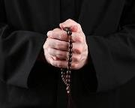
Law and Grace: Session 25 - The SOM – Matthew 5:1–8:1 (Luke 6:17–49)
Comparison: What is the same or similar?
Why? Because God does not change. God’s character is the same all the time. (Num. 23:19; 1 Sam. 15:29; Mal. 3:6; Titus 1:2; Heb. 1:10-12; 6:18; 13:8; Jam. 1:17).
Neither the Sermon on the Mount nor the epistles to the church encourage endless repetitions of the same prayer. And both the Sermon on the Mount and the epistles to the church call us to forgive.

Slide 64
Session 25 Outline
Review
Purpose, Aim, and Objective
Session 24
How Do We Approach the SOM?
General Information
Comparisons
Contrasts
Concluding Observations

Slide 65
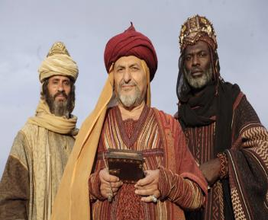
Law and Grace: Session 25 - The SOM – Matthew 5:1–8:1 (Luke 6:17–49)
Contrast: What is different?
Jesus was born and presented Himself in the land of Israel, as the King of Israel, to the people of Israel, who were all under the Mosaic Law, given to Israel and to whom were promised earthly blessings, in the land of Israel, if they obeyed the Laws given Israel!
“Where is He who has been born King of the Jews?”

Slide 66
Law and Grace: Session 25 - The SOM – Matthew 5:1–8:1 (Luke 6:17–49)
Contrast: What is different?
The rulers and leaders of Israel, with very few exceptions, rejected Jesus as their king, so, God postponed the Kingdom and temporarily shifted the focus from national Israel, to the Church, which under Grace, partakes of all spiritual blessings in the heavenly places.

Slide 67
Romans 11:9–11
⁹ And David says, “Let their table become a snare and a trap, And a stumbling block and a retribution to them. ¹⁰ “Let their eyes be darkened to see not, And bend their backs forever.” ¹¹ I say then, they did not stumble so as to fall, did they? May it never be! But by their transgression salvation has come to the Gentiles, to make them jealous.

Slide 68
Law and Grace: Session 25 - The SOM – Matthew 5:1–8:1 (Luke 6:17–49)
Contrast:
How do you live and how are you blessed?
During the coming earthly reign of Christ in the Millennial Kingdom, the people of Israel will all be blessed in the land, because they will all have the Holy Spirit indwelling them and enabling them to know and perfectly live out Kingdom Law.

Slide 69
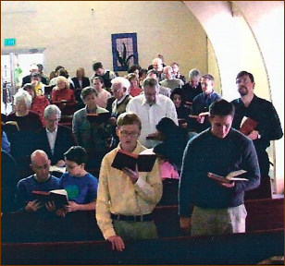
Law and Grace: Session 25 - The SOM – Matthew 5:1–8:1 (Luke 6:17–49)
Contrast:
How do you live and how are you blessed?
In the Church, we in the Body of Christ, indwelt by the Holy Spirit, are already blessed heavenly in Christ, and Christ is right now living His life through us, apart from any Law.

Slide 70
Session 25 Outline
Review
Purpose, Aim, and Objective
Session 24
How Do We Approach the SOM?
General Information
Comparisons
Contrasts
Concluding Observations

Slide 71
Three Tenses of Salvation
Phase | Justification | Sanctification | Glorification
Tense | Past | Present | Future
Saved from sin’s: | Penalty | Power | Presence
Scripture | Eph 2:8-9; Titus 3:5 | Philip 2:12 | Rom 5:10
Nature | Single | Dual | Single

Slide 72
Matthew 6:14-15
¹⁴ “For if you forgive others for their transgressions, your heavenly Father will also forgive you. ¹⁵ But if you do not forgive others, then your Father will not forgive your transgressions.”
Numbers 14:18
‘The LORD is slow to anger and abundant in lovingkindness, forgiving iniquity and transgression; but He will by no means clear the guilty, ...’

Slide 73
Matthew 6:14-15
¹⁴ “For if you forgive others for their transgressions, your heavenly Father will also forgive you. ¹⁵ But if you do not forgive others, then your Father will not forgive your transgressions.”
Numbers 14:18
‘The LORD is slow to anger and abundant in lovingkindness, forgiving iniquity and transgression; but He will by no means clear the guilty, …’

Slide 74
Ephesians 4:32
“Be kind to one another, tender-hearted, forgiving each other, just as God in Christ also has forgiven you.”

Slide 75
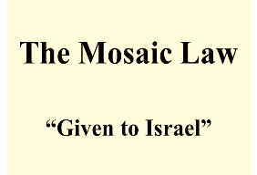
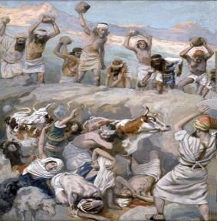
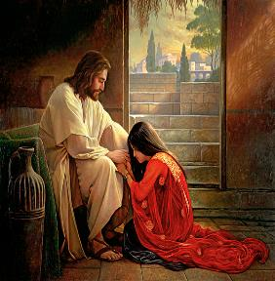
Law and Grace: Session 25 - The SOM – Matthew 5:1–8:1 (Luke 6:17–49)
Contrast: Forgiveness - What is ‘My’ Motivation?

Slide 76
Three Tenses of Salvation
Phase | Justification | Sanctification | Glorification
Tense | Past | Present | Future
Saved from sin’s: | Penalty | Power | Presence
Scripture | Eph 2:8-9; Titus 3:5 | Philip 2:12 | Rom 5:10
Nature | Single | Dual | Single

Slide 77
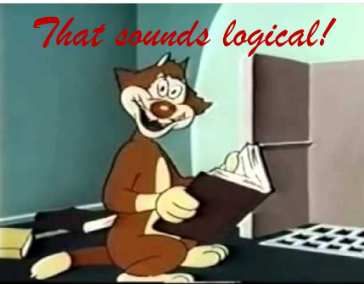
Law and Grace: Session 25 - The SOM – Matthew 5:1–8:1 (Luke 6:17–49)
HOW WILL WE APPROACH
THE SERMON ON THE MOUNT?
WE APPROACH THE SOM JUST AS WE DO ALL SCRIPTURE!
There is no special formula for understanding the Sermon on the Mount!

Slide 78
Law and Grace: An Overview Jim McGowan, Th.D. Sugar Land Bible Church 09-20-2020
…but grace and truth were realized through Jesus Christ - John 1:17
For the Law was given through Moses…
Special thanks to Dr. Vern Peterman for access to his insights and resources.

