Slide 1
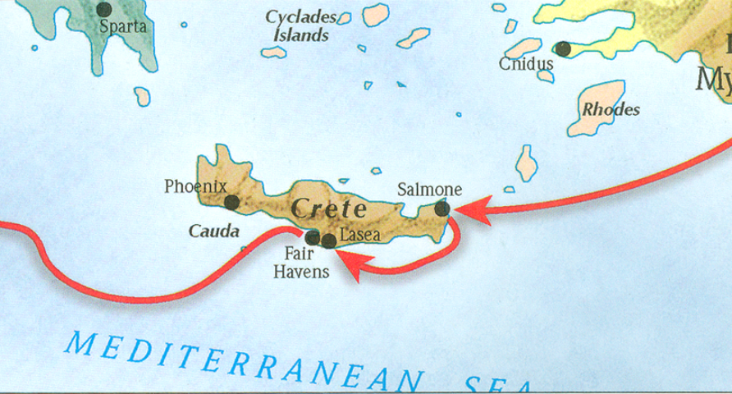
The book of Titus
Worthy of the Gospel

Slide 2
8 Questions?
Who wrote it? - Paul the Apostle
What do we know about the author? – Greatest missionary, theologian, and contributor of the NT.
Who was the book written to? – Titus
When was the book written? - AD 63-66

Slide 3
8 Questions?
Where was the book written? Macedonia
What is the purpose of the book?
Task Titus in bringing order to the churches in Crete by appointing elders.
Provide the church at Crete doctrinal instruction to promote good works
To warn believers of the false teachers

Slide 4
8 Questions?
7. What’s in the book?
Salutation (1-5a)
Assignor (1:1-3)
Assignee (1:4)
Assignment (1:5)
Assignment Explained (1:5-3:11)
Appoint Leaders (1:5b-16)
Addressing Doctrinal Issues (2:1-3:11)
Conclusion (3:12-15)
Requests (3:12-14)
Greetings (3:15a-b)
Benediction (3:15c)
Outline adapted from Titus Argument, Article by Andy Woods, 2007.

Slide 5
8 Questions?
What’s the message of the book?
To promote healthy and godly order, works, and growth in the church through sound doctrine and leadership.

Slide 6
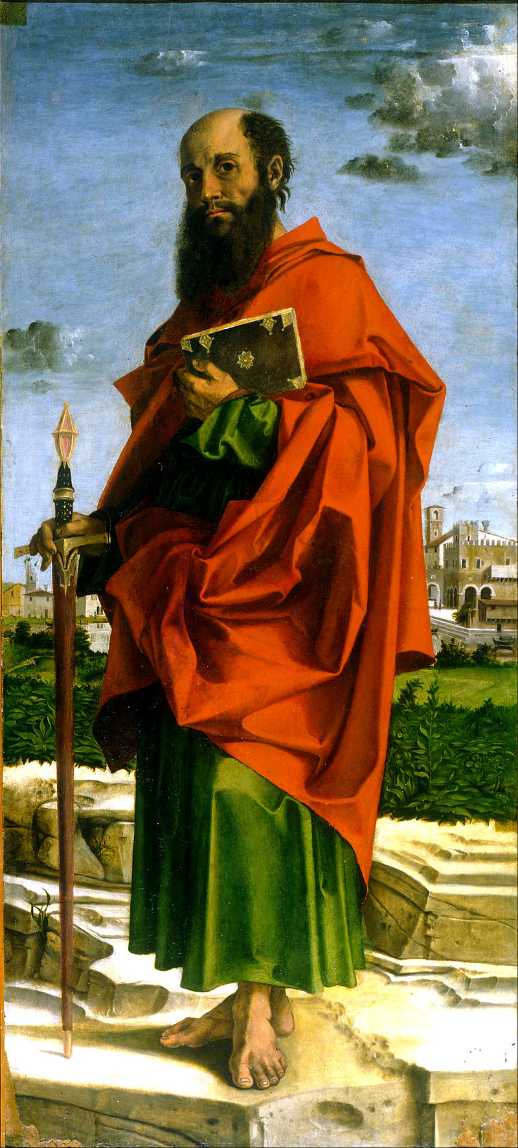
What do we know about Paul?
Born around AD 10
An Israelite, Tribe of Benjamin, Pharisee (Phil 3:5)
Raised in Jerusalem, educated in Tarsus (Acts 26:4-5)
Mentored by Gamaliel (Acts 21:40
Fluent in Hebrew (Acts 21:40)
From Tarsus of Cecilia (Acts 9:11; 21:39)
Roman citizen (Acts 22:25-28)
Saul (Hebrew- šā˒ûl) / Paul (Grk – Paulos)
Persecutor of the Church
Converted by Christ Himself (Acts 9)
Instrument and sufferer of Christ (Acts 9:16)
Greatest missionary and theologian
Greatest contributor to the Bible (13 books)
Bartolomeo Montagna - Saint Paul

Slide 7
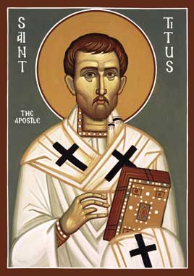
Who was the book written to?
Titus
A believer in Christ (1:4)
Brother to Paul (2 Cor 2:13)
Reliable (2 Cor 7:6)
Greek Gentile (Gal 2:3)
Test case in the Jerusalem Council of AD 49 (Gal2:1-4; Acts 11:27-30)
Courier for 2 Corinthians letter
Minister to Corinth believers
Loved God’s people (2 Cor 8:16-17)
Joy to Paul (2 Cor 7:13)
Joy to believers (2 Cor 7:6)
Prominent church leader in Crete (Titus 1:5)

Slide 8
The Book of Titus
“The Task of Titus”

Slide 9
8 Questions?
7. What’s in the book?
Salutation (1-5a)
Assignor (1:1-3)
Assignee (1:4)
Assignment (1:5)
Assignment Explained (1:5-3:11)
Appoint Leaders (1:5b-16)
Addressing Doctrinal Issues (2:1-3:11)
Conclusion (3:12-15)
Requests (3:12-14)
Greetings (3:15a-b)
Benediction (3:15c)
Outline adapted from Titus Argument, Article by Andy Woods, 2007.

Slide 10
2 Corinthians 5:21
“He made Him who knew no sin to be sin on our behalf, so that we might become the righteousness of God in Him.”

Slide 11
1 Timothy 3:14
14 “I am writing these things to you, hoping to come to you before long; 15 but in case I am delayed, I write so that you will know how one ought to conduct himself in the household of God, which is the church of the living God, the pillar and support of the truth.”

Slide 12
2 Peter 1:3-4
3 “His divine power has granted to us everything pertaining to life and godliness, through the true knowledge of Him who called us by His own glory and excellence. 4 For by these He has granted to us His precious and magnificent promises, so that by them you may become partakers of the divine nature.”

Slide 13
Ephesians 4:11–12.
11 “And He gave some as apostles, and some as prophets, and some as evangelists, and some as pastors and teachers,
12 for the equipping of the saints for the work of service, to the building up of the body of Christ;

Slide 14
What do we know about Paul?
Born around AD 10
An Israelite, Tribe of Benjamin, Pharisee (Phil 3:5)
Raised in Jerusalem, educated in Tarsus (Acts 26:4-5)
Mentored by Gamaliel (Acts 21:40
Fluent in Hebrew (Acts 21:40)
From Tarsus of Cecilia (Acts 9:11; 21:39)
Roman citizen (Acts 22:25-28)
Saul (Hebrew- šā˒ûl) / Paul (Grk – Paulos)
Persecutor of the Church
Converted by Christ Himself (Acts 9)
Instrument and sufferer of Christ (Acts 9:16)
Greatest missionary and theologian
Greatest contributor to the Bible (13 books)
Bartolomeo Montagna - Saint Paul

Slide 15
Grace:
The gift of God as expressed in his actions of extending mercy, loving-kindness, and salvation to people. Grace is the dimension of divine activity that enables God to confront human indifference and rebellion with an inexhaustible capacity to forgive and to bless.
Walter A. Elwell and Philip Wesley Comfort, Tyndale Bible Dictionary, Tyndale Reference Library (Wheaton, IL: Tyndale House Publishers, 2001), 550.

Slide 16
Titus 1:4
“To Titus, my true child in a common faith: Grace and peace from God the Father and Christ Jesus our Savior.”

Slide 17
Grace:
The gift of God as expressed in his actions of extending mercy, loving-kindness, and salvation to people. Grace is the dimension of divine activity that enables God to confront human indifference and rebellion with an inexhaustible capacity to forgive and to bless.
Walter A. Elwell and Philip Wesley Comfort, Tyndale Bible Dictionary, Tyndale Reference Library (Wheaton, IL: Tyndale House Publishers, 2001), 550.

Slide 18
Titus 1:5
“Compared with Timothy’s task, Titus’s may have been a bit easier—Crete was no Ephesus, though it was known for its many cities ever since Homer (Iliad 2.649)—and while Timothy found himself in a situation where there were already elders (some of whom at least seem to have been in need of rebuke, 1 Ti 5:19–20), Titus is charged with the fresh appointment of elders “in every town” (Paul and Titus may have planted the churches after Paul’s first Roman imprisonment, with no time left to establish leadership at that time).”
Andreas Köstenberger, “Titus,” in The Expositor’s Bible Commentary: Ephesians–Philemon (Revised Edition), ed. Tremper Longman III and David E. Garland, vol. 12 (Grand Rapids, MI: Zondervan, 2006), 606.

Slide 19
Titus 1:5
“For this reason I left you in Crete, that you would set in order what remains and appoint elders in every city as I directed you…”

Slide 20
2 Timothy 2:1–2
1 “You therefore, my son, be strong in the grace that is in Christ Jesus. 2 The things which you have heard from me in the presence of many witnesses, entrust these to faithful men who will be able to teach others also.

Slide 21
Acts 9:15 – 16
15 “But the Lord said to him, “Go, for he is a chosen instrument of Mine, to bear My name before the Gentiles and kings and the sons of Israel; 16 for I will show him how much he must suffer for My name’s sake.”

Slide 22
1 Timothy 1:12
“He said, “I thank Christ Jesus our Lord, who has strengthened me, because He considered me faithful, putting me into service…”

Slide 23
Slbc constitution
Sub-article B – ORGANIZATION
Section 1: THE TRUE HEAD OF THE LOCAL CHURCH
The Head of Sugar Land Bible Church is Jesus Christ
(Eph. 1:22-23; Col. 1:18-19).

Slide 24
Slbc constitution
Section 2: ELDER RULE
a. For the purposes of carrying out God’s will in the life of this church, the church as a body has the responsibility to recognize qualified men in the church as Elders and to recognize certain Elders as members of the Elder Board. Those members of the congregation who have served on the Elder Board, but who are not currently serving on the Elder Board, shall be Elders-At-Large. The Senior Pastor, by virtue of his position, shall be a permanent member of the Elder Board. The government of this church, under the leadership of the Holy Spirit, is vested in the Elder Board whose decisions shall be final (Acts 14:23, Acts 20:28).

Slide 25
Slbc constitution
Section 2: ELDER RULE
a. For the purposes of carrying out God’s will in the life of this church, the church as a body has the responsibility to recognize qualified men in the church as Elders and to recognize certain Elders as members of the Elder Board. Those members of the congregation who have served on the Elder Board, but who are not currently serving on the Elder Board, shall be Elders-At-Large. The Senior Pastor, by virtue of his position, shall be a permanent member of the Elder Board. The government of this church, under the leadership of the Holy Spirit, is vested in the Elder Board whose decisions shall be final (Acts 14:23, Acts 20:28).

Slide 26
Titus 1:5
“For this reason I left you in Crete, that you would set in order what remains and appoint elders in every city as I directed you…”

Slide 27
1 Timothy 2:12–14.
“But I do not allow a woman to teach or exercise authority over a man, but to remain quiet.13 For it was Adam who was first created, and then Eve.14 And it was not Adam who was deceived, but the woman being deceived, fell into transgression.

Slide 28
Acts 9:15 – 16
15 “But the Lord said to him, “Go, for he is a chosen instrument of Mine, to bear My name before the Gentiles and kings and the sons of Israel; 16 for I will show him how much he must suffer for My name’s sake.”

Slide 29
1 Timothy 3:6
…and not a new convert, so that he will not become conceited and fall into the condemnation incurred by the devil.

Slide 30
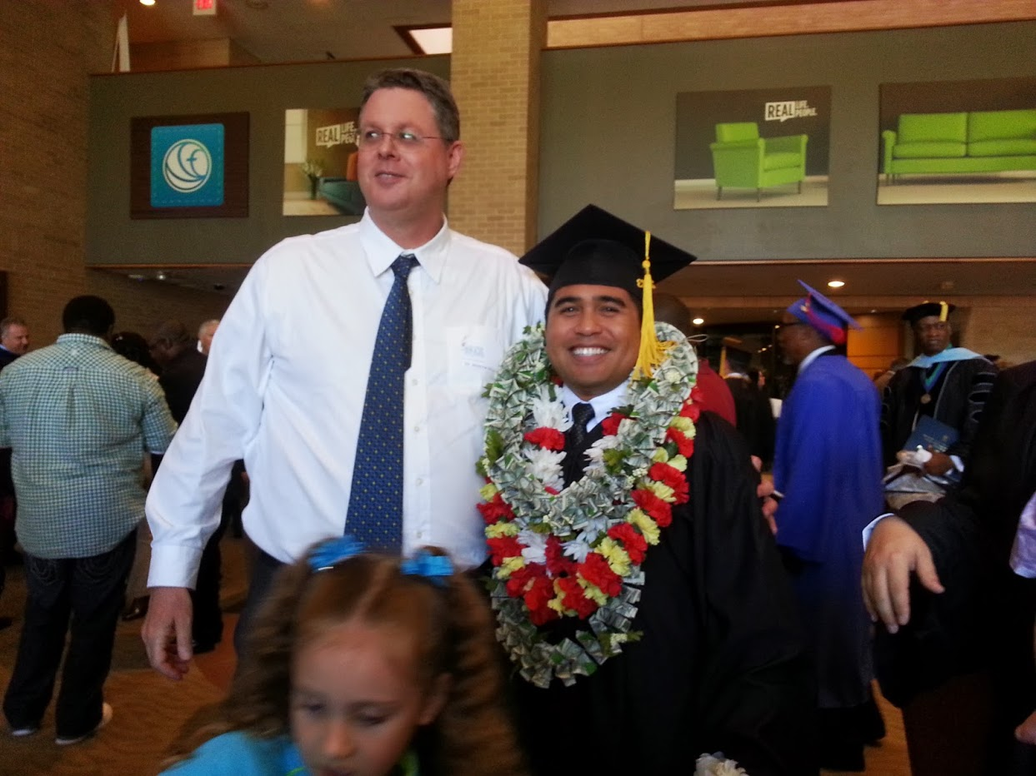

Slide 31
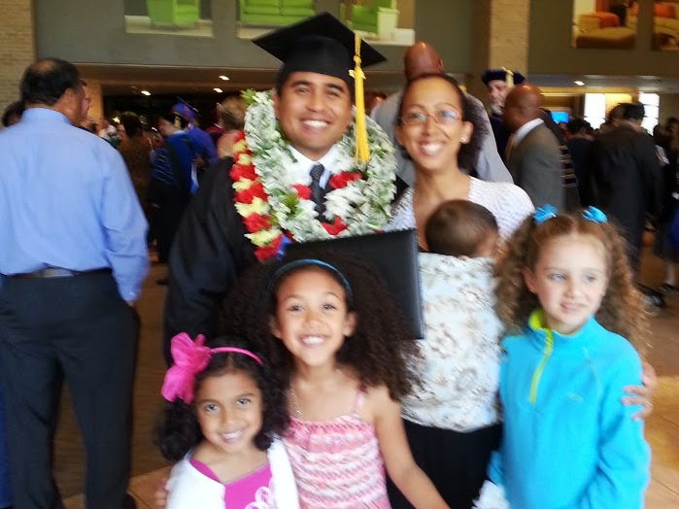

Slide 32
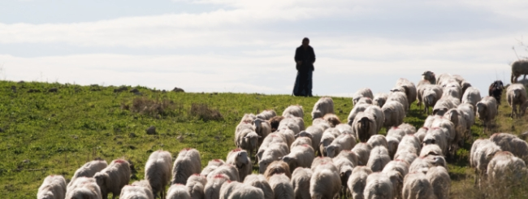

Slide 34
The book of Titus
Worthy of the Gospel

