Slide 1
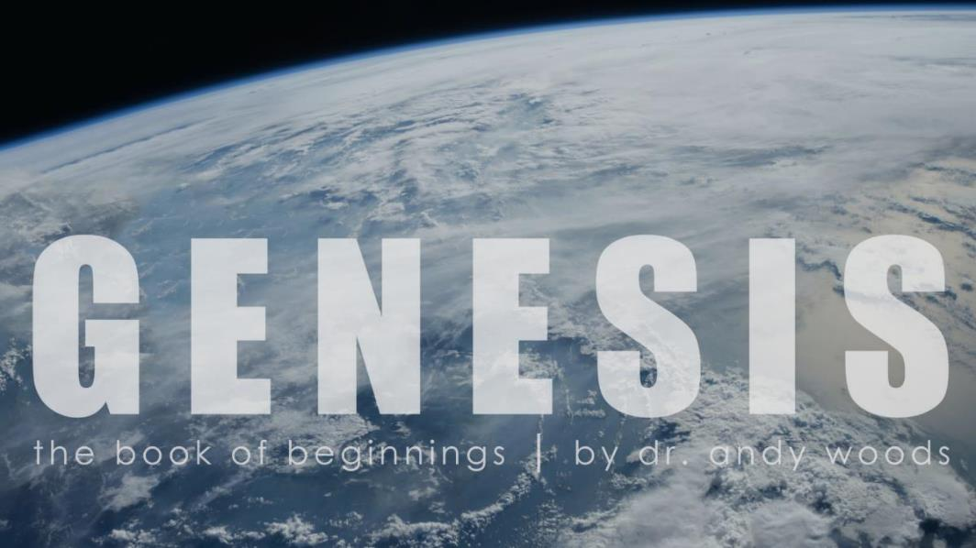
Genesis 1:1–2:3
Creation of the Cosmos

Slide 2
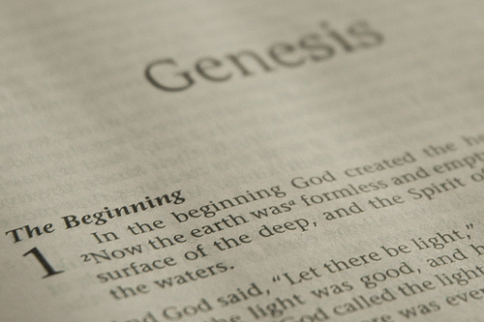
GENESIS STRUCTURE
Beginning of the Human race (Gen. 1‒11)
Beginning of the Hebrew race (Gen. 12‒50)

Slide 3
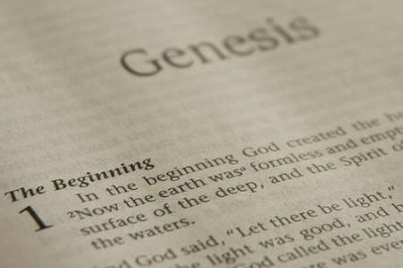
GENESIS STRUCTURE
Genesis 1-11 (four events)
Creation (1-2)
Fall (3-5)
Flood (6-9)
National dispersion (10-11)

Slide 4
Contradictory Account of Creation?
Genesis 1 – Overview of the whole creation
Genesis 2 – Details surrounding the creation of the garden, the first man, and his activities on day 6.

Slide 5
Genesis 1:1–2:3 Outline
Original creation on the first day (Gen 1:1)
Original creation in its unfilled and unformed state (Gen 1:2)
Creation week (Gen 1:3–2:3): “And God said,” “good”
First day 1:3-5
Second day 1:6-8
Third day 1:9-13
Fourth day 1:14-19
Fifth day 1:20-23
Sixth day 1:24-31
Seventh day 2:1-3

Slide 6
Genesis 1:1–2:3 Outline
Original creation on the first day (Gen 1:1)
Original creation in its unfilled and unformed state (Gen 1:2)
Creation week (Gen 1:3–2:3): “And God said,” “good”
First day 1:3-5
Second day 1:6-8
Third day 1:9-13
Fourth day 1:14-19
Fifth day 1:20-23
Sixth day 1:24-31
Seventh day 2:1-3

Slide 7
Genesis 1:1–2:3 Outline
Original creation on the first day (Gen 1:1)
Original creation in its unfilled and unformed state (Gen 1:2)
Creation week (Gen 1:3–2:3): “And God said,” “good”
First day 1:3-5
Second day 1:6-8
Third day 1:9-13
Fourth day 1:14-19
Fifth day 1:20-23
Sixth day 1:24-31
Seventh day 2:1-3

Slide 8
Genesis 1:1–2:3 Outline
Original creation on the first day (Gen 1:1)
Original creation in its unfilled and unformed state (Gen 1:2)
Creation week (Gen 1:3–2:3): “And God said,” “good”
First day 1:3-5
Second day 1:6-8
Third day 1:9-13
Fourth day 1:14-19
Fifth day 1:20-23
Sixth day 1:24-31
Seventh day 2:1-3

Slide 9
Shaping and Populating (Gen 1:1)
Day 1: | Light | Day 4: | Luminaries
Day 2: | Water, sky | Day 5: | Sea animals, birds
Day 3: | Land, vegetation | Day 6: | Land animals, man

Slide 10
Genesis 1:1–2:3 Outline
Original creation on the first day (Gen 1:1)
Original creation in its unfilled and unformed state (Gen 1:2)
Creation week (Gen 1:3–2:3): “And God said,” “good”
First day 1:3-5
Second day 1:6-8
Third day 1:9-13
Fourth day 1:14-19
Fifth day 1:20-23
Sixth day 1:24-31
Seventh day 2:1-3

Slide 11
Genesis 1:26-28
²⁶ Then God said, “Let Us make man in Our image, according to Our likeness; and let them rule over the fish of the sea and over the birds of the sky and over the cattle and over all the earth, and over every creeping thing that creeps on the earth.” ²⁷ God created man in His own image, in the image of God He created him; male and female He created them. ²⁸ God blessed them; and God said to them, “Be fruitful and multiply, and fill the earth, and subdue it; and rule over the fish of the sea and over the birds of the sky and over every living thing that moves on the earth.”

Slide 12
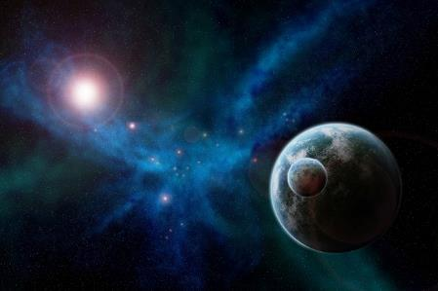
Genesis 1:31
“God saw all that He had made, and behold, it was very good. And there was evening and there was morning, the sixth day.”

Slide 13
Genesis 1:1-3
“¹ In the beginning God created the heavens and the earth. ² The earth was formless and void, and darkness was over the surface of the deep, and the Spirit of God was moving over the surface of the waters. ³ Then God said, ‘Let there be light’; and there was light.”

Slide 14
Renald Showers
Renald Showers, Those Invisible Spirits Called Angels (Bellmawr, NJ: Friends of Israel, 1997), 82-83.
“When did Satan fall away from God? We noted earlier that sin was nonexistent in every part of God‘s creation, including the angels, through the end of the sixth or final day of creation (Gen. 1:31). Satan‘s fall therefore took place after the end of creation. However, Satan was evil by the time he came to earth to tempt man to fall away from God (Gen. 3). These things prompt the conclusion that Satan‘s fall took place in the interval between the end of creation and the fall of man. How long was the interval? It must have been quite short because when God created the first man and woman, he commanded them to be fruitful and multiply through procreation (Gen. 1:27–28), but there was no human conception until after the fall of man (Gen. 4:1).”

Slide 15
Genesis 1:1–2:3 Outline
Original creation on the first day (Gen 1:1)
Original creation in its unfilled and unformed state (Gen 1:2)
Creation week (Gen 1:3–2:3): “And God said,” “good”
First day 1:3-5
Second day 1:6-8
Third day 1:9-13
Fourth day 1:14-19
Fifth day 1:20-23
Sixth day 1:24-31
Seventh day 2:1-3

Slide 16
Genesis 2:1-3
“¹ Thus the heavens and the earth were completed, and all their hosts. ² By the seventh day God completed His work which He had done, and He rested on the seventh day from all His work which He had done. ³ Then God blessed the seventh day and sanctified it, because in it He rested from all His work which God had created and made.”

Slide 17
1 Kings 22:19
“¹⁹ Micaiah said, ‘Therefore, hear the word of the Lord. I saw the Lord sitting on His throne, and all the host of heaven standing by Him on His right and on His left.’”

Slide 18
Genesis 1:1-3
“¹ In the beginning God created the heavens and the earth. ² The earth was formless and void, and darkness was over the surface of the deep, and the Spirit of God was moving over the surface of the waters. ³ Then God said, ‘Let there be light’; and there was light.”

Slide 19
Jeremiah 23:24
“‘Can a man hide himself in hiding places So I do not see him?’ declares the Lord. ‘Do I not fill the heavens and the earth?’ declares the Lord.”

Slide 20
Exodus 20:8-11
⁸ “Remember the sabbath day, to keep it holy. ⁹ Six days you shall labor and do all your work, ¹⁰ but the seventh day is a sabbath of the Lord your God; in it you shall not do any work, you or your son or your daughter, your male or your female servant or your cattle or your sojourner who stays with you. ¹¹ For in six days the Lord made the heavens and the earth, the sea and all that is in them, and rested on the seventh day; therefore the Lord blessed the sabbath day and made it holy.”

Slide 21
Job 38:4-7
“⁴ Where were you when I laid the foundation of the earth? Tell Me, if you have understanding, ⁵ Who set its measurements? Since you know. Or who stretched the line on it? ⁶ On what were its bases sunk? Or who laid its cornerstone, ⁷ When the morning stars sang together and all the sons of God shouted for joy?”

Slide 22
Renald Showers
Renald Showers, Those Invisible Spirits Called Angels (Bellmawr, NJ: Friends of Israel, 1997), 18-19.
“It [Genesis 1:1; Exodus 20:11] strongly implies that the angels were created within the scope of the six days of creation of Genesis 1, not before or after those days...Thus, the angels were created by God on the first day of the six days of creation, but before the earth was created on that same day. It is interesting to note the order of Moses’ statement in Genesis 1:1. He referred to the heavens first, then the earth. It would appear that early on the first day God created the heavens. Later on that day He created the angels to inhabit the heavens. Still later on that first day He created the earth in its undeveloped, uninhabited state.”

Slide 23
Job 38:4-7
“⁴ Where were you when I laid the foundation of the earth? Tell Me, if you have understanding, ⁵ Who set its measurements? Since you know. Or who stretched the line on it? ⁶ On what were its bases sunk? Or who laid its cornerstone, ⁷ When the morning stars sang together and all the sons of God shouted for joy?”

Slide 24
Hebrews 1:14
“Are they not all ministering spirits, sent out to render service for the sake of those who will inherit salvation?”

Slide 25
Key Issues in Genesis 1
Importance of Gen. 1:1
Gap Theory?
Length of the creation days
Canopy Theory (day 2)
Light before the sun (day 4)
Creation of man (day 6)
Sabbath (day 7)
Evolution?

Slide 26
Genesis 2:1-3
“¹ Thus the heavens and the earth were completed, and all their hosts. ² By the seventh day God completed His work which He had done, and He rested on the seventh day from all His work which He had done. ³ Then God blessed the seventh day and sanctified it, because in it He rested from all His work which God had created and made.”

Slide 27
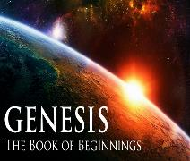
Day 7 Sabbath (Gen 2:1-3)
The Lord rested
Sabbath pattern (Exod. 20:8-11; 31:15-17)
7th day continues?
Creation is past (Heb. 4:3-4)
Absence of “evening and morning”
Yom + ordinal modifier

Slide 28
Day 7 Sabbath (Gen 2:1-3)
The Lord rested
Sabbath pattern (Exod. 20:8-11; 31:15-17)
7th day continues?
Creation is past (Heb. 4:3-4)
Absence of “evening and morning”
Yom + ordinal modifier

Slide 29
Day 7 Sabbath (Gen 2:1-3)
The Lord rested
Sabbath pattern (Exod. 20:8-11; 31:15-17)
7th day continues?
Creation is past (Heb. 4:3-4)
Absence of “evening and morning”
Yom + ordinal modifier

Slide 30
Exodus 20:8-11
⁸ “Remember the sabbath day, to keep it holy. ⁹ Six days you shall labor and do all your work, ¹⁰ but the seventh day is a sabbath of the Lord your God; in it you shall not do any work, you or your son or your daughter, your male or your female servant or your cattle or your sojourner who stays with you. ¹¹ For in six days the Lord made the heavens and the earth, the sea and all that is in them, and rested on the seventh day; therefore the Lord blessed the sabbath day and made it holy.”

Slide 31
Exodus 31:15-17
¹⁵ ‘For six days work may be done, but on the seventh day there is a sabbath of complete rest, holy to the Lord; whoever does any work on the sabbath day shall surely be put to death. ¹⁶ ‘So the sons of Israel shall observe the sabbath, to celebrate the sabbath throughout their generations as a perpetual covenant.’ ¹⁷ “It is a sign between Me and the sons of Israel forever; for in six days the Lord made heaven and earth, but on the seventh day He ceased from labor, and was refreshed.”

Slide 32
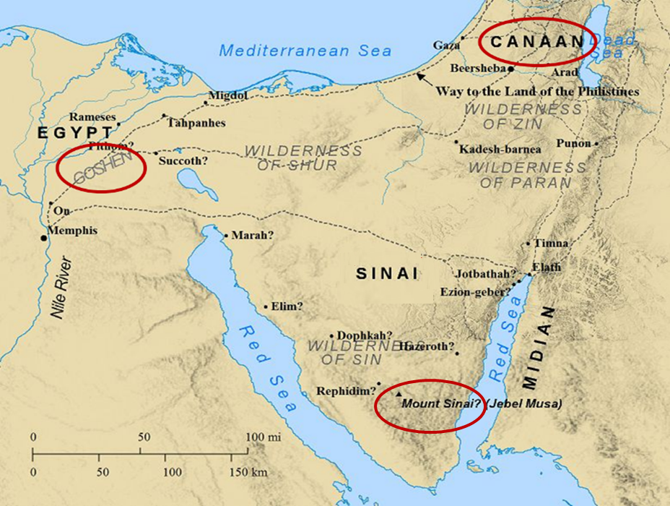

Slide 33
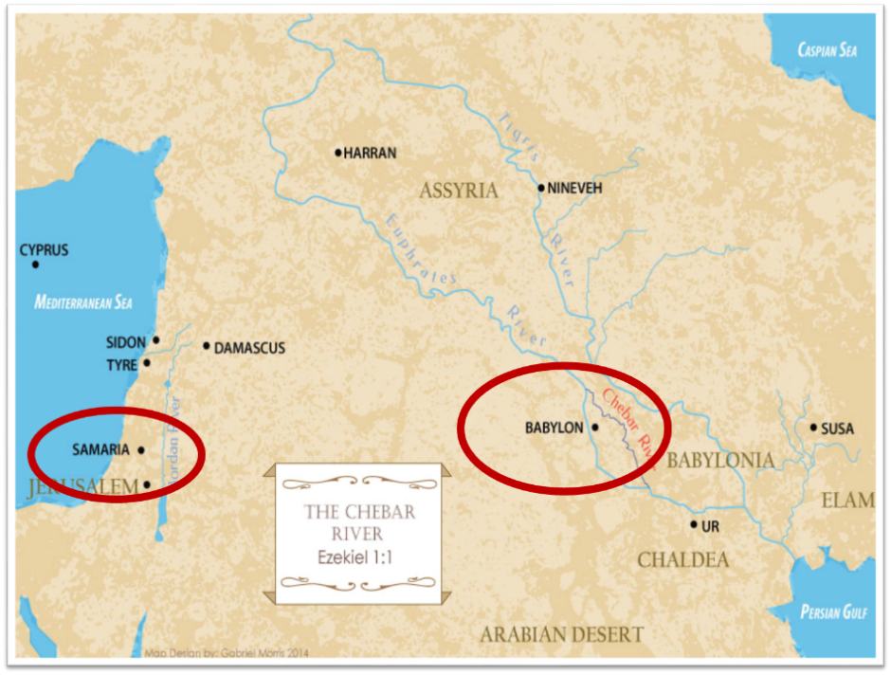

Slide 34
Matthew 24:15-16, 20
“¹⁵ Therefore when you see the abomination of desolation which was spoken of through Daniel the prophet, standing in the holy place (let the reader understand) ¹⁶ then those who are in Judea must flee to the mountains…²⁰ But pray that your flight will not be in the winter, or on a Sabbath.”

Slide 35
Thomas L. Constable “Notes on John,” online: www.soniclight.com, accessed 12 September 2020, 528.
“John located this post-resurrection appearance on the eighth day after (seven days later) Easter Sunday, namely, the following Sunday. His "eight days" (Gr. hemeras okto) evidently included both Sundays. Perhaps he identified the day because, by the time John wrote, Sunday had become the day of worship for Christians, when they commemorated Jesus' resurrection. They worshipped Him on Easter Sunday, then again the following Sunday, and then on succeeding Sundays from then on (cf. Acts 20:7). However, Sunday worship has its roots in tradition rather than commandment.”

Slide 36
Acts 20:7
“On the first day of the week, when we were gathered together to break bread, Paul began talking to them, intending to leave the next day, and he prolonged his message until midnight.”

Slide 37
1 Corinthians 16:1-2
“¹ Now concerning the collection for the saints, as I directed the churches of Galatia, so do you also. ² On the first day of every week each one of you is to put aside and save, as he may prosper, so that no collections be made when I come.”

Slide 38
SABBATH
Article I, Section 7, Paragraph 2 of the Constitution says, “If any bill should not be returned by the President within ten days (Sundays excepted) after it shall have been presented to him, the same shall be a law in like manner as if he had signed it.”
Brewer, United States A Christian Nation, 27

Slide 39
Day 7 Sabbath (Gen 2:1-3)
The Lord rested
Sabbath pattern (Exod. 20:8-11; 31:15-17)
7th day continues?
Creation is past (Heb. 4:3-4)
Absence of “evening and morning”
Yom + ordinal modifier

Slide 40
Day 7 Sabbath (Gen 2:1-3)
The Lord rested
Sabbath pattern (Exod. 20:8-11; 31:15-17)
7th day continues?
Creation is past (Heb. 4:3-4)
Absence of “evening and morning”
Yom + ordinal modifier

Slide 41
Day 7 Sabbath (Gen 2:1-3)
The Lord rested
Sabbath pattern (Exod. 20:8-11; 31:15-17)
7th day continues?
Creation is past (Heb. 4:3-4)
Absence of “evening and morning”
Yom + ordinal modifier

Slide 42
Day 7 Sabbath (Gen 2:1-3)
The Lord rested
Sabbath pattern (Exod. 20:8-11; 31:15-17)
7th day continues?
Creation is past (Heb. 4:3-4)
Absence of “evening and morning”
Yom + ordinal modifier

Slide 43
Genesis 2:1-3
“¹ Thus the heavens and the earth were completed, and all their hosts. ² By the seventh day God completed His work which He had done, and He rested on the seventh day from all His work which He had done. ³ Then God blessed the seventh day and sanctified it, because in it He rested from all His work which God had created and made.”

Slide 44
CONCLUSION

Slide 45
Genesis 1:1–2:3 Outline
Original creation on the first day (Gen 1:1)
Original creation in its unfilled and unformed state (Gen 1:2)
Creation week (Gen 1:3–2:3): “And God said,” “good”
First day 1:3-5
Second day 1:6-8
Third day 1:9-13
Fourth day 1:14-19
Fifth day 1:20-23
Sixth day 1:24-31
Seventh day 2:1-3

Slide 46
Contradictory Account of Creation?
Genesis 1 – Overview of the whole creation
Genesis 2 – Details surrounding the creation of the garden, the first man, and his activities on day 6.

Slide 47
Contradictory Account of Creation?
Genesis 1 – Overview of the whole creation
Genesis 2 – Details surrounding the creation of the garden, the first man, and his activities on day 6.

Slide 48
“The Lord bless you and keep you; the Lord make his face shine on you and be gracious to you; the Lord turn his face toward you and give you peace.” (NIV)

