Slide 1


PRACTICAL RIGHTEOUSNESS
Dr. Andy Woods
Senior Pastor – Sugar Land Bible Church
President – Chafer Theological Seminary

Slide 2

Preview
Authorship
Biography
Audience
Place of writing
Date
Occasion
Purpose
Message
Themes
Unique characteristics
Structure

Slide 3
Preview
Authorship
Biography
Audience
Place of writing
Date
Occasion
Purpose
Message
Themes
Unique characteristics
Structure

Slide 4
Authorship
Father of Judas (not Iscariot)
The son of Alphaeus
The son of Zebedee and brother of John
The half brother of Christ

Slide 5
Preview
Authorship
Biography
Audience
Place of writing
Date
Occasion
Purpose
Message
Themes
Unique characteristics
Structure

Slide 6

James’ Biography
Half brother of Christ
Initial unbelief (John 7:5)
One of the first to receive word of Christ’s resurrection (John 20:17)
Post resurrection ministry (Acts 1:14)
Leader of Jerusalem church (Acts 15)
Married (1 Cor 9:5)
Camel knees
James the Just
Martyrdom

Slide 7
Preview
Authorship
Biography
Audience
Place of writing
Date
Occasion
Purpose
Message
Themes
Unique characteristics
Structure

Slide 8
Audience
Jewish (1:1)
Persecution (Acts 8:1-4; 11:19)
In Babylon-Mesopotamia or North-Central Turkey?
Believers (Jas 1:2-4, 18; 4:5)

Slide 9
Audience
Jewish (1:1)
Persecution (Acts 8:1-4; 11:19)
In Babylon-Mesopotamia or North-Central Turkey?
Believers (Jas 1:2-4, 18; 4:5)

Slide 10
Preview
Authorship
Biography
Audience
Place of writing
Date
Occasion
Purpose
Message
Themes
Unique characteristics
Structure

Slide 11
Place of Writing
Jerusalem
Pastor of Jerusalem church
Lived his entire life in Jerusalem

Slide 12


Slide 13
Preview
Authorship
Biography
Audience
Place of writing
Date
Occasion
Purpose
Message
Themes
Unique characteristics
Structure

Slide 14
Date (AD 44-47)
AD 70
AD 62-63
AD 49
AD 48-49
Sermon on the Mt
Primitive congregational worship (Jas 2:2; 3:1; 5:14)
Jas 1:1 = Acts 8:1-4; 11:19

Slide 15
Date (AD 44-47)
AD 70
AD 62-63
AD 49
AD 48-49
Sermon on the Mt
Primitive congregational worship (Jas 2:2; 3:1; 5:14)
Jas 1:1 = Acts 8:1-4; 11:19

Slide 16
Date (AD 44-47)
AD 70
AD 62-63
AD 49
AD 48-49
Sermon on the Mt
Primitive congregational worship (Jas 2:2; 3:1; 5:14)
Jas 1:1 = Acts 8:1-4; 11:19

Slide 17
Date (AD 44-47)
AD 70
AD 62-63
AD 49
AD 48-49
Sermon on the Mt
Primitive congregational worship (Jas 2:2; 3:1; 5:14)
Jas 1:1 = Acts 8:1-4; 11:19

Slide 18
Date (AD 44-47)
AD 70
AD 62-63
AD 49
AD 48-49
Sermon on the Mt
Primitive congregational worship (Jas 2:2; 3:1; 5:14)
Jas 1:1 = Acts 8:1-4; 11:19

Slide 19
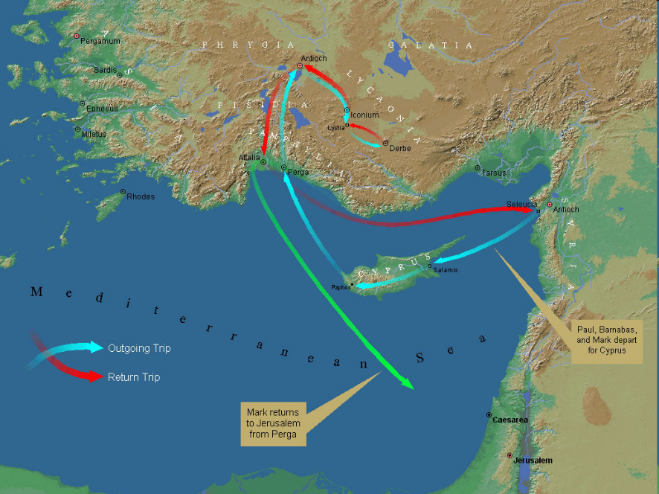

Slide 20
Date (AD 44-47)
AD 70
AD 62-63
AD 49
AD 48-49
Sermon on the Mt
Primitive congregational worship (Jas 2:2; 3:1; 5:14)
Jas 1:1 = Acts 8:1-4; 11:19

Slide 21
Date (AD 44-47)
AD 70
AD 62-63
AD 49
AD 48-49
Sermon on the Mt
Primitive congregational worship (Jas 2:2; 3:1; 5:14)
Jas 1:1 = Acts 8:1-4; 11:19

Slide 22

James 2:2
“For if a man comes into your assembly [synagōgē] with a gold ring and dressed in fine clothes, and there also comes in a poor man in dirty clothes.”

Slide 23
Date (AD 44-47)
AD 70
AD 62-63
AD 49
AD 48-49
Sermon on the Mt
Primitive congregational worship (Jas 2:2; 3:1; 5:14)
Jas 1:1 = Acts 8:1-4; 11:19

Slide 24
James 1:1
“James, a bond-servant of God and of the Lord Jesus Christ, To the twelve tribes who are dispersed abroad: Greetings.”

Slide 25
Acts 8:3-4; 11:19
“³ But Saul began ravaging the church, entering house after house, and dragging off men and women, he would put them in prison. ⁴ Therefore, those who had been scattered went about preaching the word…^{11:19} So then those who were scattered because of the persecution that occurred in connection with Stephen made their way to Phoenicia and Cyprus and Antioch, speaking the word to no one except to Jews alone.”

Slide 26
Order of Paul’s Letters
Galatians (A.D. 49)
1‒2 Thessalonians (A.D. 51)
1‒2 Corinthians (A.D. 56)
Romans (A.D. 57)
Ephesians, Colossians, Philemon, Philippians (A.D. 60‒62)
1 Timothy, Titus (A.D. 62‒66)
2 Timothy (A.D. 67)

Slide 27
Preview
Authorship
Biography
Audience
Place of writing
Date
Occasion
Purpose
Message
Themes
Unique characteristics
Structure

Slide 28
Occasion
Diaspora (Jas 1:1; Acts 8:1-4; 11:19)
Outside of Jerusalem
Without the supervision of an apostle
Without the law
National history
Concerned with practical righteousness

Slide 29
Occasion
Diaspora (Jas 1:1; Acts 8:1-4; 11:19)
Outside of Jerusalem
Without the supervision of an apostle
Without the law
National history
Concerned with practical righteousness

Slide 30
James 1:1
“James, a bond-servant of God and of the Lord Jesus Christ, To the twelve tribes who are dispersed abroad: Greetings.”

Slide 31
Acts 8:3-4; 11:19
“³ But Saul began ravaging the church, entering house after house, and dragging off men and women, he would put them in prison. ⁴ Therefore, those who had been scattered went about preaching the word…^{11:19} So then those who were scattered because of the persecution that occurred in connection with Stephen made their way to Phoenicia and Cyprus and Antioch, speaking the word to no one except to Jews alone.”

Slide 32
Occasion
Diaspora (Jas 1:1; Acts 8:1-4; 11:19)
Outside of Jerusalem
Without the supervision of an apostle
Without the law
National history
Concerned with practical righteousness

Slide 33
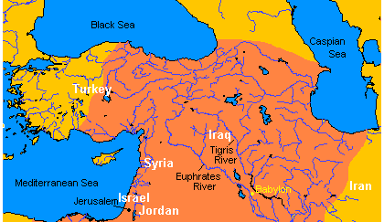

Map of Ancient Near East

Slide 35
Occasion
Diaspora (Jas 1:1; Acts 8:1-4; 11:19)
Outside of Jerusalem
Without the supervision of an apostle
Without the law
National history
Concerned with practical righteousness

Slide 36
Occasion
Diaspora (Jas 1:1; Acts 8:1-4; 11:19)
Outside of Jerusalem
Without the supervision of an apostle
Without the law
National history
Concerned with practical righteousness

Slide 37
Occasion
Diaspora (Jas 1:1; Acts 8:1-4; 11:19)
Outside of Jerusalem
Without the supervision of an apostle
Without the law
National history
Concerned with practical righteousness

Slide 38


Slide 39
Six Parts of a Suzerain-Vassal Treaty in Deuteronomy
Preamble (1:1-5)
Prologue (1:6–4:40)
Covenant obligations (5–26)
Storage and reading instructions (27:2-3; 31:9, 24, 26)
Witnesses (32:1)
Blessings and curses (28)

Slide 40

Deuteronomy 28:49-50
“⁴⁹ The Lord will bring a nation against you from afar, from the end of the earth, as the eagle swoops down, a nation whose language you shall not understand, ⁵⁰ a nation of fierce countenance who will have no respect for the old, nor show favor to the young.”

Slide 41
ISRAEL'S JUDGMENTS
Division of the kingdom in 931 B.C. (1 Kgs. 12)
Assyrian judgment in 722 B.C. (2 Kgs. 17)
Babylonian captivity in 586 B.C. (2 Kgs. 25)

Slide 42
Occasion
Diaspora (Jas 1:1; Acts 8:1-4; 11:19)
Outside of Jerusalem
Without the supervision of an apostle
Without the law
National history
Concerned with practical righteousness

Slide 43
Preview
Authorship
Biography
Audience
Place of writing
Date
Occasion
Purpose
Message
Themes
Unique characteristics
Structure

Slide 44

Purpose
James wrote in order to show his Jewish-Christian readers living in the Diaspora how to achieve practical righteousness

Slide 45
Preview
Authorship
Biography
Audience
Place of writing
Date
Occasion
Purpose
Message
Themes
Unique characteristics
Structure

Slide 46
Message
Practical righteousness is attainable when believers live by faith and walk by wisdom

Slide 47
Three Tenses of Salvation
Phase | Justification | Sanctification | Glorification
Tense | Past | Present | Future
Saved from sin’s: | Penalty | Power | Presence
Scripture | Eph 2:8-9; Titus 3:5 | Philip 2:12 | Rom 5:10
Nature | Single | Dual | Single

Slide 48
Three Tenses of Salvation
Phase | Justification | Sanctification | Glorification
Tense | Past | Present | Future
Saved from sin’s: | Penalty | Power | Presence
Scripture | Eph 2:8-9; Titus 3:5 | Philip 2:12 | Rom 5:10
Nature | Single | Dual | Single

Slide 49
Preview
Authorship
Biography
Audience
Place of writing
Date
Occasion
Purpose
Message
Themes
Unique characteristics
Structure

Slide 50
Themes
Hearer to doer
Belief to behavior
Doctrine to deed

Slide 51
James 1:22
“But prove yourselves doers of the word, and not merely hearers who delude themselves.”

Slide 52
The Writer/Apostle of…
Paul – Faith
Peter – Hope
John – Love
Jude – Truth
James – Conduct

Slide 53
Preview
Authorship
Biography
Audience
Place of writing
Date
Occasion
Purpose
Message
Themes
Unique characteristics
Structure

Slide 54
UNIQUE CHARACTERISTICS
Sermon on Mt | Concise
OT | High quality GK
Illustrations from nature and daily living | Proverbs and Amos of the NT
Undeveloped Christology | Imperatives
Practical | Oldest book in NT
Many literary devices | Difficult to outline

Slide 55
Preview
Authorship
Biography
Audience
Place of writing
Date
Occasion
Purpose
Message
Themes
Unique characteristics
Structure

Slide 56
JAMES STRUCTURE
  Faith (James 1:1‒3:12)
  Wisdom (James 3:13‒5:20)

Slide 57
JAMES STRUCTURE
  Faith (James 1:1‒3:12)
  Wisdom (James 3:13‒5:20)

Slide 58

Lewis Sperry Chafer
Systematic Theology (Grand Rapids, MI: Kregel Publications, 1993), vol. 7, 148.
“In its larger usage, the word faith represents at least four varied ideas: (1) As above, it can be personal confidence in God. This the most common aspect of faith may be subdivided into three features: (a) Saving faith, which is the inwrought confidence in God’s promises and provisions respecting the Savior that leads one to elect to repose upon and trust in the One who alone can save. (b) Serving faith, which contemplates as true the fact of divinely bestowed gifts and all details respecting divine appointments for service. This faith is always a personal matter, and so one believer should not become a pattern for another. That such faith with its personal characteristic may be kept inviolate, …

Slide 59
Lewis Sperry Chafer
Systematic Theology (Grand Rapids, MI: Kregel Publications, 1993), vol. 7, 148.
“…the Apostle writes: “Hast thou faith? have it to thyself before God” (Rom. 14:22). Great injury may be wrought if one Christian imitates another in matters of appointment for service. (c) Sanctifying or sustaining faith, which lays hold of the power of God for one’s daily life. It is the life lived in dependence upon God, working upon a new life-principle (Rom. 6:4). The justified one, having become what he is by faith, must go ahead living on the same principle of utter dependence upon God.”

Slide 61
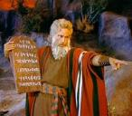

Exodus 14:30-31 (NASB)
³⁰ Thus the Lord saved Israel that day from the hand of the Egyptians, and Israel saw the Egyptians dead on the seashore. ³¹ When Israel saw the great power which the Lord had used against the Egyptians, the people feared the Lord, and they believed in the Lord and in His servant Moses.”

Slide 62
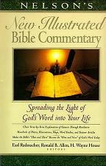
Exodus 14:31
“When we read so the people feared the Lord and the words that follow, we are meant to understand that the community had come to saving faith and so were a reborn people. They believed the Lord (the same wording used of Abraham’s saving faith in Gen. 15:6; read Paul’s comments in Rom. 4)…The people were transformed spiritually even as they were delivered physically.”
Nelson's New Illustrated Bible Commentary, 113.

Slide 63
Hebrews 11:28-29 (NASB)
^{“28} By faith he kept the Passover and the sprinkling of the blood, so that he who destroyed the firstborn would not touch them. ²⁹ By faith they passed through the Red Sea as though they were passing through dry land; and the Egyptians, when they attempted it, were drowned.”

Slide 65
Numbers 14:11 (NASB)
^{“11} The Lord said to Moses, “How long will this people spurn Me? And how long will they not believe in Me, despite all the signs which I have performed in their midst?.”

Slide 66
Structure
Faith (1:1–3:12)
  Trials (1:2-18)
  Obedience to the Word (1:19-27)
  Favoritism (2:1-13)
  Faith manifesting works (2:14-26)
  Tongue (3:1-12)

Slide 67
JAMES STRUCTURE
  Faith (James 1:1‒3:12)
  Wisdom (James 3:13‒5:20)

Slide 68

Structure
Wisdom (3:13–5:20)
  Wisdom defined (3:13-18)
  Spirituality (4:1-12)
  Commerce (4:13-17)
  Use of wealth (5:1-6)
  Waiting for the Lord’s return (5:7-12)
  Prayer (5:13-18)
  Restoration of the erring brother (5:19-20)

Slide 69
CONCLUSION

Slide 70
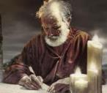
Answering Eleven Questions
Who wrote it? – James
What do we know about the author? – Christ’s ½ Brother
Who was the audience? – Believing Jews in the Diaspora
Where was if written from? – Jerusalem
When was the book written? – A.D. 44‒47
What was the book’s occasion? – Practical righteousness
What is the book’s purpose? – Achieving practical righteousness
What is the book about? – Practical righteousness
What is the book’s theme? – Daily living
What makes the book different? – Practicality
How is the book organized? – Faith and Wisdom

