Slide 1
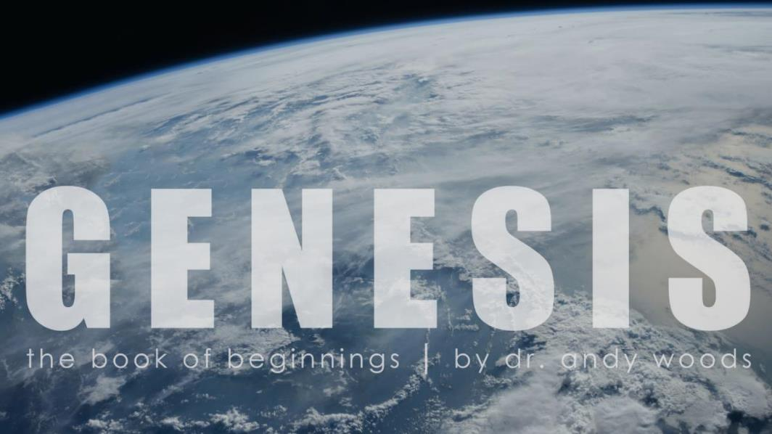
Genesis 1:1–2:3
Creation of the Cosmos

Slide 2
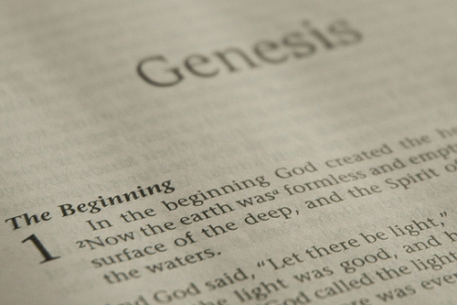
GENESIS STRUCTURE
Beginning of the Human race (Gen. 1‒11)
Beginning of the Hebrew race (Gen. 12‒50)

Slide 3
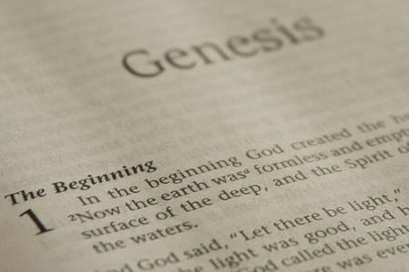
GENESIS STRUCTURE
Genesis 1-11 (four events)
Creation (1-2)
Fall (3-5)
Flood (6-9)
National dispersion (10-11)

Slide 4
Contradictory Account of Creation?
Genesis 1 – Overview of the whole creation
Genesis 2 – Details surrounding the creation of the garden, the first man, and his activities on day 6.

Slide 5
Genesis 1:1–2:3 Outline
Original creation on the first day (Gen 1:1)
Original creation in its unfilled and unformed state (Gen 1:2)
Creation week (Gen 1:3–2:3): “And God said,” “good”
First day 1:3-5
Second day 1:6-8
Third day 1:9-13
Fourth day 1:14-19
Fifth day 1:20-23
Sixth day 1:24-31
Seventh day 2:1-3

Slide 6
Genesis 1:1–2:3 Outline
Original creation on the first day (Gen 1:1)
Original creation in its unfilled and unformed state (Gen 1:2)
Creation week (Gen 1:3–2:3): “And God said,” “good”
First day 1:3-5
Second day 1:6-8
Third day 1:9-13
Fourth day 1:14-19
Fifth day 1:20-23
Sixth day 1:24-31
Seventh day 2:1-3

Slide 7
Genesis 1:1–2:3 Outline
Original creation on the first day (Gen 1:1)
Original creation in its unfilled and unformed state (Gen 1:2)
Creation week (Gen 1:3–2:3): “And God said,” “good”
First day 1:3-5
Second day 1:6-8
Third day 1:9-13
Fourth day 1:14-19
Fifth day 1:20-23
Sixth day 1:24-31
Seventh day 2:1-3

Slide 8
Genesis 1:1–2:3 Outline
Original creation on the first day (Gen 1:1)
Original creation in its unfilled and unformed state (Gen 1:2)
Creation week (Gen 1:3–2:3): “And God said,” “good”
First day 1:3-5
Second day 1:6-8
Third day 1:9-13
Fourth day 1:14-19
Fifth day 1:20-23
Sixth day 1:24-31
Seventh day 2:1-3

Slide 9
Shaping and Populating (Gen 1:1)
Day 1: | Light | Day 4: | Luminaries
Day 2: | Water, sky | Day 5: | Sea animals, birds
Day 3: | Land, vegetation | Day 6: | Land animals, man

Slide 10
Genesis 1:1–2:3 Outline
Original creation on the first day (Gen 1:1)
Original creation in its unfilled and unformed state (Gen 1:2)
Creation week (Gen 1:3–2:3): “And God said,” “good”
First day 1:3-5
Second day 1:6-8
Third day 1:9-13
Fourth day 1:14-19
Fifth day 1:20-23
Sixth day 1:24-31
Seventh day 2:1-3

Slide 11
Day 6 Theocratic Administrator (Gen 1:24-31)
Land animals (Gen. 1:24-25)
Man (Gen. 1:26-28)
Office of Theocratic Administrator
Beginning of kingdom program
Animal & man as vegetarian (Gen. 1:29-30; 2:17; 9:3)
The perfection of creation (Gen. 1:31)

Slide 12
Day 6 Theocratic Administrator (Gen 1:24-31)
Land animals (Gen. 1:24-25)
Man (Gen. 1:26-28)
Office of Theocratic Administrator
Beginning of kingdom program
Animal & man as vegetarian (Gen. 1:29-30; 2:17; 9:3)
The perfection of creation (Gen. 1:31)

Slide 13
Genesis 1:26-28
²⁶ Then God said, “Let Us make man in Our image, according to Our likeness; and let them rule over the fish of the sea and over the birds of the sky and over the cattle and over all the earth, and over every creeping thing that creeps on the earth.” ²⁷ God created man in His own image, in the image of God He created him; male and female He created them. ²⁸ God blessed them; and God said to them, “Be fruitful and multiply, and fill the earth, and subdue it; and rule over the fish of the sea and over the birds of the sky and over every living thing that moves on the earth.”

Slide 14
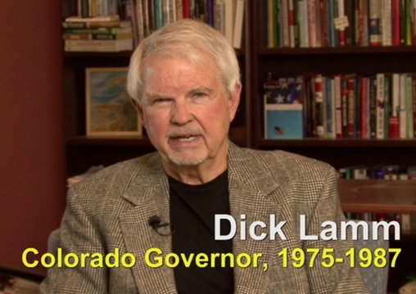
Richard D. Lamm
“DENVER, March 28, 1984 — Elderly people who are terminally ill have a “duty to die and get out of the way” instead of trying to prolong their lives by artificial means, Gov. Richard D. Lamm of Colorado said Tuesday. People who die without having life artificially extended are similar to “leaves falling off a tree and forming humus for the other plants to grow up,” the Governor told a meeting of the Colorado Health Lawyers Association at St. Joseph's Hospital. “You've got a duty to die and get out of the way,” said the 48-year-old Governor. “Let the others in society, our kids, build a reasonable life.”
Quoted In Gov. Lamm Asserts Elderly, If Very Ill, Have 'Duty To Die,’ New York Times, March 29, 1984.

Slide 15
Acts 17:26
“and He made from one man every nation of mankind to live on all the face of the earth, having determined their appointed times and the boundaries of their habitation.” (Italics added)
15

Slide 16
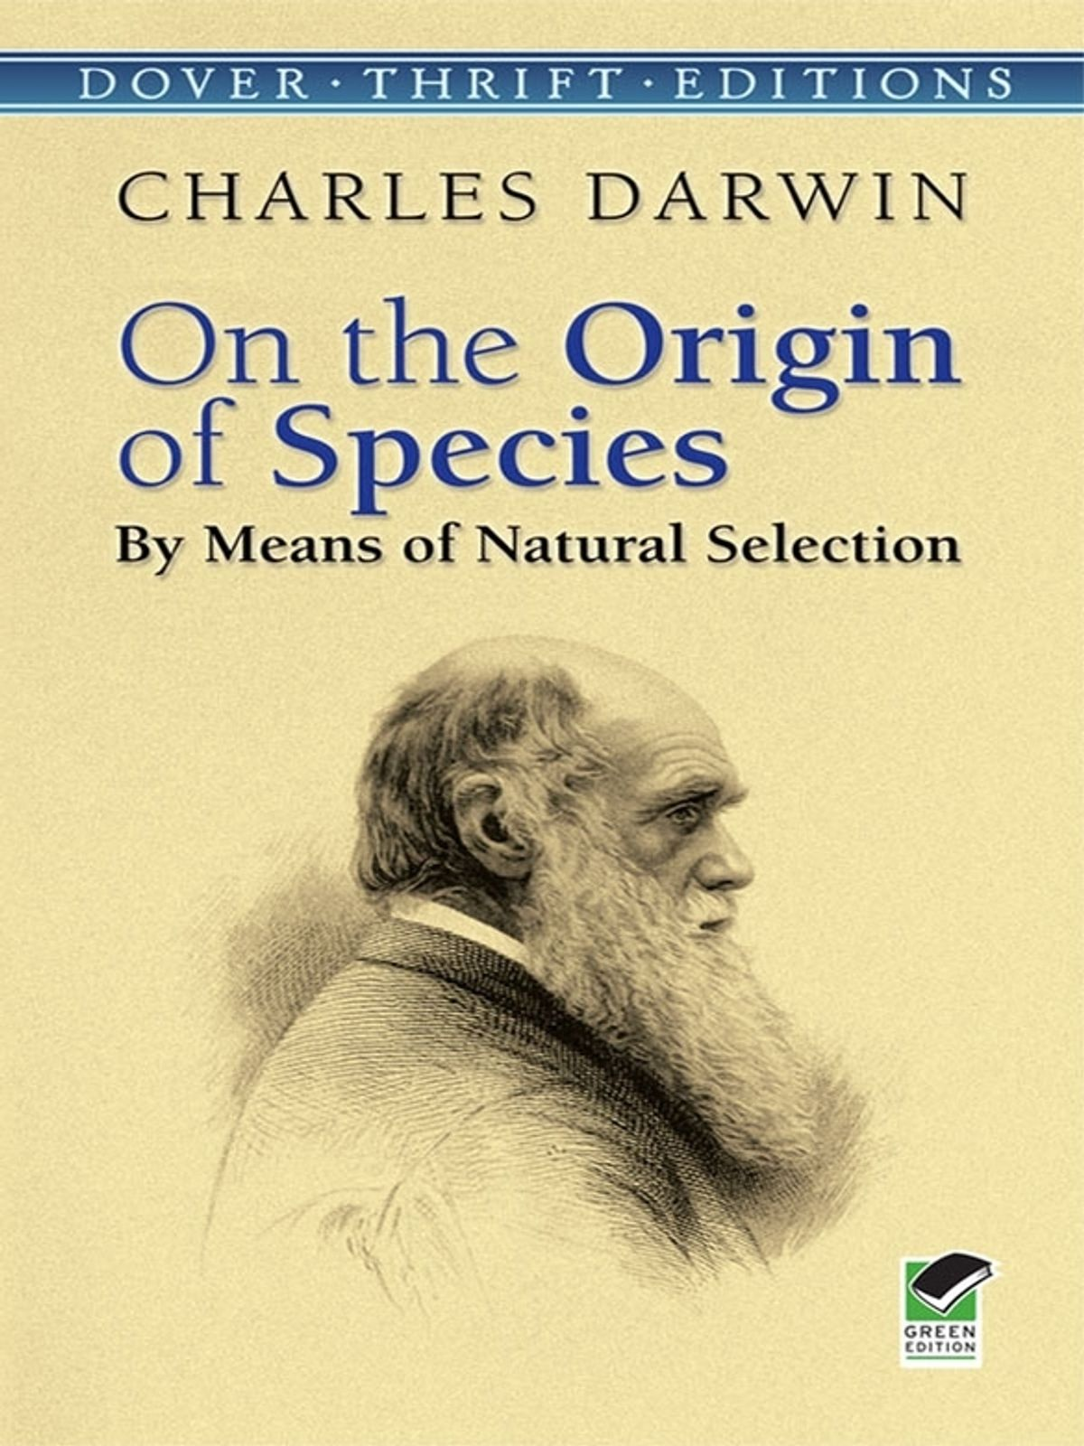

Slide 17
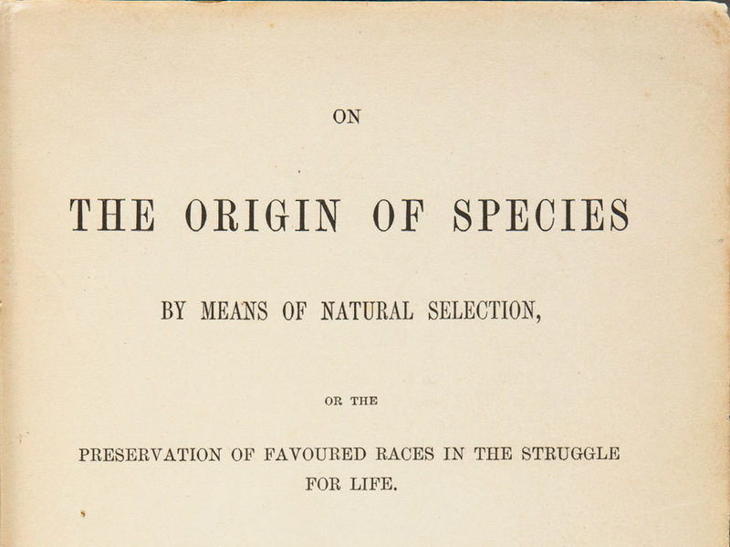

Slide 18
Day 6 Theocratic Administrator (Gen 1:24-31)
Land animals (Gen. 1:24-25)
Man (Gen. 1:26-28)
Office of Theocratic Administrator
Beginning of kingdom program
Animal & man as vegetarian (Gen. 1:29-30; 2:17; 9:3)
The perfection of creation (Gen. 1:31)

Slide 19
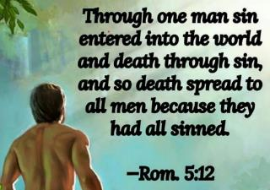
Genesis 1:29-30
“²⁹ Then God said, ‘Behold, I have given you every plant yielding seed that is on the surface of all the earth, and every tree which has fruit yielding seed; it shall be food for you; ³⁰ and to every beast of the earth and to every bird of the sky and to every thing that moves on the earth which has life, I have given every green plant for food’; and it was so.”

Slide 20
Genesis 2:16-17
“¹⁶ The Lord God commanded the man, saying, ‘From any tree of the garden you may eat freely; ¹⁷ but from the tree of the knowledge of good and evil you shall not eat, for in the day that you eat from it you will surely die (muwth).’”

Slide 21
Genesis 3:19
“¹⁹ By the sweat of your face You will eat bread, Till you return to the ground, Because from it you were taken; For you are dust, And to dust you shall return.”

Slide 22
Genesis 9:3
“³ Every moving thing that is alive shall be food for you; I give all to you, as I gave the green plant.”

Slide 23
Day 6 Theocratic Administrator (Gen 1:24-31)
Land animals (Gen. 1:24-25)
Man (Gen. 1:26-28)
Office of Theocratic Administrator
Beginning of kingdom program
Animal & man as vegetarian (Gen. 1:29-30; 2:17; 9:3)
The perfection of creation (Gen. 1:31)

Slide 24
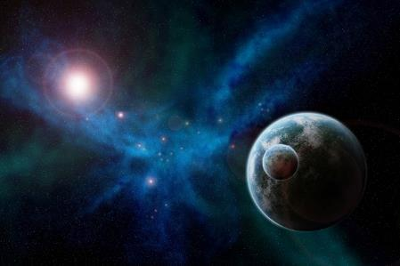
Genesis 1:31
“God saw all that He had made, and behold, it was very good. And there was evening and there was morning, the sixth day.”

Slide 25
Genesis 1:31
“God saw all that He had made, and behold, it was very good. And there was evening and there was morning, the sixth day.”

Slide 27
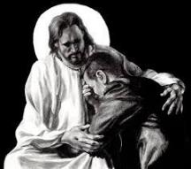
Revelation 21:4
“and He will wipe away every tear from their eyes; and there will no longer be any death; there will no longer be any mourning, or crying, or pain; the first things have passed away.”

Slide 28
Revelation 21:4
“and He will wipe away every tear from their eyes; and there will no longer be any death; there will no longer be any mourning, or crying, or pain; the first things have passed away.”

Slide 29
Dominoes in a Row

Slide 30
Genesis 1:31
“God saw all that He had made, and behold, it was very good. And there was evening and there was morning, the sixth day.”

Slide 31
Genesis 1:1-3
“¹ In the beginning God created the heavens and the earth. ² The earth was formless and void, and darkness was over the surface of the deep, and the Spirit of God was moving over the surface of the waters. ³ Then God said, ‘Let there be light’; and there was light.”

Slide 32
Renald Showers
Renald Showers, Those Invisible Spirits Called Angels (Bellmawr, NJ: Friends of Israel, 1997), 82-83.
“When did Satan fall away from God? We noted earlier that sin was nonexistent in every part of God‘s creation, including the angels, through the end of the sixth or final day of creation (Gen. 1:31). Satan‘s fall therefore took place after the end of creation. However, Satan was evil by the time he came to earth to tempt man to fall away from God (Gen. 3). These things prompt the conclusion that Satan‘s fall took place in the interval between the end of creation and the fall of man. How long was the interval? It must have been quite short because when God created the first man and woman, he commanded them to be fruitful and multiply through procreation (Gen. 1:27–28), but there was no human conception until after the fall of man (Gen. 4:1).”

Slide 33
Genesis 1:1–2:3 Outline
Original creation on the first day (Gen 1:1)
Original creation in its unfilled and unformed state (Gen 1:2)
Creation week (Gen 1:3–2:3): “And God said,” “good”
First day 1:3-5
Second day 1:6-8
Third day 1:9-13
Fourth day 1:14-19
Fifth day 1:20-23
Sixth day 1:24-31
Seventh day 2:1-3

Slide 34
Genesis 2:1-3
“¹ Thus the heavens and the earth were completed, and all their hosts. ² By the seventh day God completed His work which He had done, and He rested on the seventh day from all His work which He had done. ³ Then God blessed the seventh day and sanctified it, because in it He rested from all His work which God had created and made.”

Slide 35
Key Issues in Genesis 1
Importance of Gen. 1:1
Gap Theory?
Length of the creation days
Canopy Theory (day 2)
Light before the sun (day 4)
Creation of man (day 6)
Sabbath (day 7)
Evolution?

Slide 36
Genesis 2:1-3
“¹ Thus the heavens and the earth were completed, and all their hosts. ² By the seventh day God completed His work which He had done, and He rested on the seventh day from all His work which He had done. ³ Then God blessed the seventh day and sanctified it, because in it He rested from all His work which God had created and made.”

Slide 37
Day 7 Sabbath (Gen 2:1-3)
The Lord rested
Sabbath pattern (Exod. 20:8-11; 31:15-17)
7th day continues?
Creation is past (Heb. 4:3-4)
Absence of “evening and morning”
Yom + ordinal modifier

Slide 38
Day 7 Sabbath (Gen 2:1-3)
The Lord rested
Sabbath pattern (Exod. 20:8-11; 31:15-17)
7th day continues?
Creation is past (Heb. 4:3-4)
Absence of “evening and morning”
Yom + ordinal modifier

Slide 39
Day 7 Sabbath (Gen 2:1-3)
The Lord rested
Sabbath pattern (Exod. 20:8-11; 31:15-17)
7th day continues?
Creation is past (Heb. 4:3-4)
Absence of “evening and morning”
Yom + ordinal modifier

Slide 40
Exodus 20:8-11
⁸ “Remember the sabbath day, to keep it holy. ⁹ Six days you shall labor and do all your work, ¹⁰ but the seventh day is a sabbath of the Lord your God; in it you shall not do any work, you or your son or your daughter, your male or your female servant or your cattle or your sojourner who stays with you. ¹¹ For in six days the Lord made the heavens and the earth, the sea and all that is in them, and rested on the seventh day; therefore the Lord blessed the sabbath day and made it holy.”

Slide 41
Exodus 31:15-17
¹⁵ ‘For six days work may be done, but on the seventh day there is a sabbath of complete rest, holy to the Lord; whoever does any work on the sabbath day shall surely be put to death. ¹⁶ ‘So the sons of Israel shall observe the sabbath, to celebrate the sabbath throughout their generations as a perpetual covenant.’ ¹⁷ “It is a sign between Me and the sons of Israel forever; for in six days the Lord made heaven and earth, but on the seventh day He ceased from labor, and was refreshed.”

Slide 42
SABBATH
Article I, Section 7, Paragraph 2 of the Constitution says, “If any bill should not be returned by the President within ten days (Sundays excepted) after it shall have been presented to him, the same shall be a law in like manner as if he had signed it.”
Brewer, United States A Christian Nation, 27

Slide 43
Day 7 Sabbath (Gen 2:1-3)
The Lord rested
Sabbath pattern (Exod. 20:8-11; 31:15-17)
7th day continues?
Creation is past (Heb. 4:3-4)
Absence of “evening and morning”
Yom + ordinal modifier

Slide 44
Day 7 Sabbath (Gen 2:1-3)
The Lord rested
Sabbath pattern (Exod. 20:8-11; 31:15-17)
7th day continues?
Creation is past (Heb. 4:3-4)
Absence of “evening and morning”
Yom + ordinal modifier

Slide 45
Day 7 Sabbath (Gen 2:1-3)
The Lord rested
Sabbath pattern (Exod. 20:8-11; 31:15-17)
7th day continues?
Creation is past (Heb. 4:3-4)
Absence of “evening and morning”
Yom + ordinal modifier

Slide 46
Day 7 Sabbath (Gen 2:1-3)
The Lord rested
Sabbath pattern (Exod. 20:8-11; 31:15-17)
7th day continues?
Creation is past (Heb. 4:3-4)
Absence of “evening and morning”
Yom + ordinal modifier

Slide 47
Genesis 2:1-3
“¹ Thus the heavens and the earth were completed, and all their hosts. ² By the seventh day God completed His work which He had done, and He rested on the seventh day from all His work which He had done. ³ Then God blessed the seventh day and sanctified it, because in it He rested from all His work which God had created and made.”

Slide 48
CONCLUSION

Slide 49
Genesis 1:1–2:3 Outline
Original creation on the first day (Gen 1:1)
Original creation in its unfilled and unformed state (Gen 1:2)
Creation week (Gen 1:3–2:3): “And God said,” “good”
First day 1:3-5
Second day 1:6-8
Third day 1:9-13
Fourth day 1:14-19
Fifth day 1:20-23
Sixth day 1:24-31
Seventh day 2:1-3

Slide 50
“The Lord bless you and keep you; the Lord make his face shine on you and be gracious to you; the Lord turn his face toward you and give you peace.” (NIV)

