Slide 1


PRACTICAL RIGHTEOUSNESS
Dr. Andy Woods
Senior Pastor – Sugar Land Bible Church
President – Chafer Theological Seminary

Slide 2

Preview
Authorship
Biography
Audience
Place of writing
Date
Occasion
Purpose
Message
Themes
Unique characteristics
Structure

Slide 3
Preview
Authorship
Biography
Audience
Place of writing
Date
Occasion
Purpose
Message
Themes
Unique characteristics
Structure

Slide 4

James 1:1
“¹ James, a bond-servant of God and of the Lord Jesus Christ, To the twelve tribes who are dispersed abroad: Greetings.”

Slide 5
Acts 1:13-14
“ ¹³ When they had entered the city, they went up to the upper room where they were staying; that is, Peter and John and James and Andrew, Philip and Thomas, Bartholomew and Matthew, James the son of Alphaeus, and Simon the Zealot, and Judas the son of James. ¹⁴ These all with one mind were continually devoting themselves to prayer, along with the women, and Mary the mother of Jesus, and with His brothers.”

Slide 6
Authorship
Father of Judas (not Iscariot)
The son of Alphaeus
The son of Zebedee and brother of John
The half brother of Christ

Slide 7
Authorship
Father of Judas (not Iscariot)
The son of Alphaeus
The son of Zebedee and brother of John
The half brother of Christ

Slide 8
Authorship
Father of Judas (not Iscariot)
The son of Alphaeus
The son of Zebedee and brother of John
The half brother of Christ

Slide 9
Authorship
Father of Judas (not Iscariot)
The son of Alphaeus
The son of Zebedee and brother of John
The half brother of Christ

Slide 10
Authorship
Father of Judas (not Iscariot)
The son of Alphaeus
The son of Zebedee and brother of John
The half brother of Christ

Slide 11
SIMILARITIES WITH ACTS 15
 | James | Acts 15
Greetings | 1:1 | 15:23
Visit | 1:27 | 15:14
Listen | 2:5 | 15:13
Turn | 5:19-20 | 15:19
Being called by God’s name | 2:7 | 15:17

Slide 12
Arguments Against James, the Brother of Christ, as Author
Does not identify himself as Christ’s brother
Greek is too good
Lack of unanimous acceptance in the early church

Slide 13
Arguments Against James, the Brother of Christ, as Author
Does not identify himself as Christ’s brother
Greek is too good
Lack of unanimous acceptance in the early church

Slide 14
Arguments Against James, the Brother of Christ, as Author
Does not identify himself as Christ’s brother
Greek is too good
Lack of unanimous acceptance in the early church

Slide 15
Arguments Against James, the Brother of Christ, as Author
Does not identify himself as Christ’s brother
Greek is too good
Lack of unanimous acceptance in the early church

Slide 16
Preview
Authorship
Biography
Audience
Place of writing
Date
Occasion
Purpose
Message
Themes
Unique characteristics
Structure

Slide 17

James’ Biography
Half brother of Christ
Initial unbelief (John 7:5)
One of the first to receive word of Christ’s resurrection (John 20:17)
Post resurrection ministry (Acts 1:14)
Leader of Jerusalem church (Acts 15)
Married (1 Cor 9:5)
Camel knees
James the Just
Martyrdom

Slide 18
Acts 1:13-14
“ ¹³ When they had entered the city, they went up to the upper room where they were staying; that is, Peter and John and James and Andrew, Philip and Thomas, Bartholomew and Matthew, James the son of Alphaeus, and Simon the Zealot, and Judas the son of James. ¹⁴ These all with one mind were continually devoting themselves to prayer, along with the women, and Mary the mother of Jesus, and with His brothers.”

Slide 19
Preview
Authorship
Biography
Audience
Place of writing
Date
Occasion
Purpose
Message
Themes
Unique characteristics
Structure

Slide 20
Audience
Jewish (1:1)
Persecution (Acts 8:1-4; 11:19)
In Babylon-Mesopotamia or North-Central Turkey?
Believers (Jas 1:2-4)

Slide 21
Audience
Jewish (1:1)
Persecution (Acts 8:1-4; 11:19)
In Babylon-Mesopotamia or North-Central Turkey?
Believers (Jas 1:2-4)

Slide 22
James 1:1
“¹ James, a bond-servant of God and of the Lord Jesus Christ, To the twelve tribes who are dispersed abroad: Greetings.”

Slide 23
Audience
Jewish (1:1)
Persecution (Acts 8:1-4; 11:19)
In Babylon-Mesopotamia or North-Central Turkey?
Believers (Jas 1:2-4)

Slide 24
Acts 8:3-4; 11:19
“³ But Saul began ravaging the church, entering house after house, and dragging off men and women, he would put them in prison. ⁴ Therefore, those who had been scattered went about preaching the word…¹⁹ So then those who were scattered because of the persecution that occurred in connection with Stephen made their way to Phoenicia and Cyprus and Antioch, speaking the word to no one except to Jews alone.”

Slide 25
James 1:1
“¹ James, a bond-servant of God and of the Lord Jesus Christ, To the twelve tribes who are dispersed abroad: Greetings.”

Slide 26
Audience
Jewish (1:1)
Persecution (Acts 8:1-4; 11:19)
In Babylon-Mesopotamia or North-Central Turkey?
Believers (Jas 1:2-4)

Slide 27
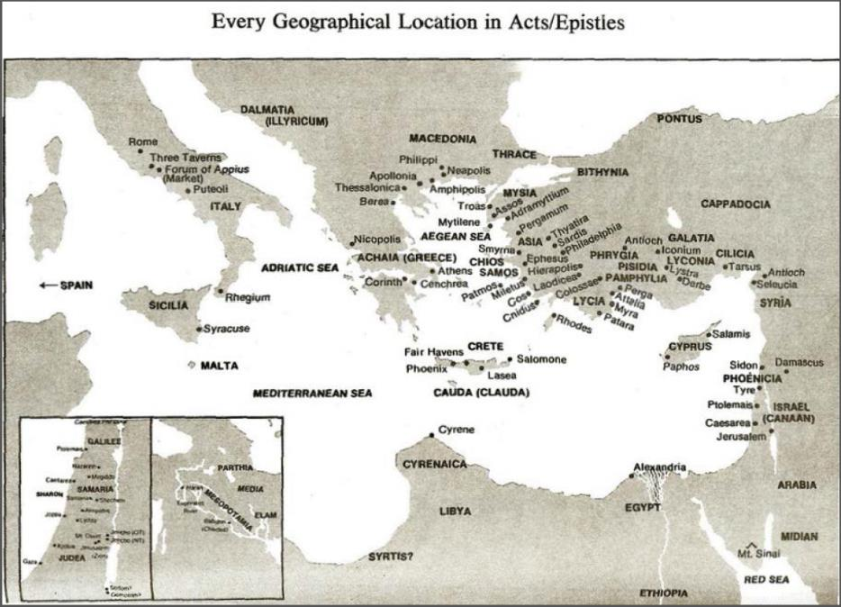

Slide 28
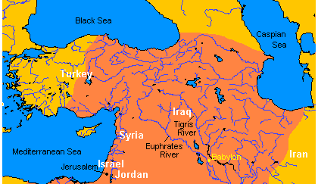

Map of Ancient Near East

Slide 29
Map of Ancient Near East

Slide 30
Josephus
Antiquities, 15.2.2
“But when Hyrcanus was brought into Parthia the king Phraates treated him after a very gentle manner, as having already learned of what an illustrious family he was; on which account he set him free from his bonds, and gave him a habitation at Babylon, where there were Jews in great numbers. These Jews honored Hyrcanus as their high priest and king, as did all the Jewish nation that dwelt as far as Euphrates; which respect was very much to his satisfaction...”

Slide 32
Map of Ancient Near East

Slide 33
Audience
Jewish (1:1)
Persecution (Acts 8:1-4; 11:19)
In Babylon-Mesopotamia or North-Central Turkey?
Believers (Jas 1:2-4)

Slide 34
Acts 16:30-31
“and after he brought them out, he said, ‘Sirs, what must I do to be saved?’ ³¹ They said, ‘Believe in the Lord Jesus, and you will be saved, you and your household.’”

Slide 35
Preview
Authorship
Biography
Audience
Place of writing
Date
Occasion
Purpose
Message
Themes
Unique characteristics
Structure

Slide 36
Place of Writing
Jerusalem
Pastor of Jerusalem church
Lived his entire life in Jerusalem

Slide 37

Map of Ancient Near East

Slide 38


Slide 39
Preview
Authorship
Biography
Audience
Place of writing
Date
Occasion
Purpose
Message
Themes
Unique characteristics
Structure

Slide 40
Date (AD 44-47)
AD 70
AD 62-63
AD 49
AD 48-49
Sermon on the Mt
Primitive congregational worship (Jas 2:2; 3:1; 5:14)
Jas 1:1 = Acts 8:1-4; 11:19

Slide 41
Date (AD 44-47)
AD 70
AD 62-63
AD 49
AD 48-49
Sermon on the Mt
Primitive congregational worship (Jas 2:2; 3:1; 5:14)
Jas 1:1 = Acts 8:1-4; 11:19

Slide 42
Date (AD 44-47)
AD 70
AD 62-63
AD 49
AD 48-49
Sermon on the Mt
Primitive congregational worship (Jas 2:2; 3:1; 5:14)
Jas 1:1 = Acts 8:1-4; 11:19

Slide 43
Date (AD 44-47)
AD 70
AD 62-63
AD 49
AD 48-49
Sermon on the Mt
Primitive congregational worship (Jas 2:2; 3:1; 5:14)
Jas 1:1 = Acts 8:1-4; 11:19

Slide 44
Date (AD 44-47)
AD 70
AD 62-63
AD 49
AD 48-49
Sermon on the Mt
Primitive congregational worship (Jas 2:2; 3:1; 5:14)
Jas 1:1 = Acts 8:1-4; 11:19

Slide 45
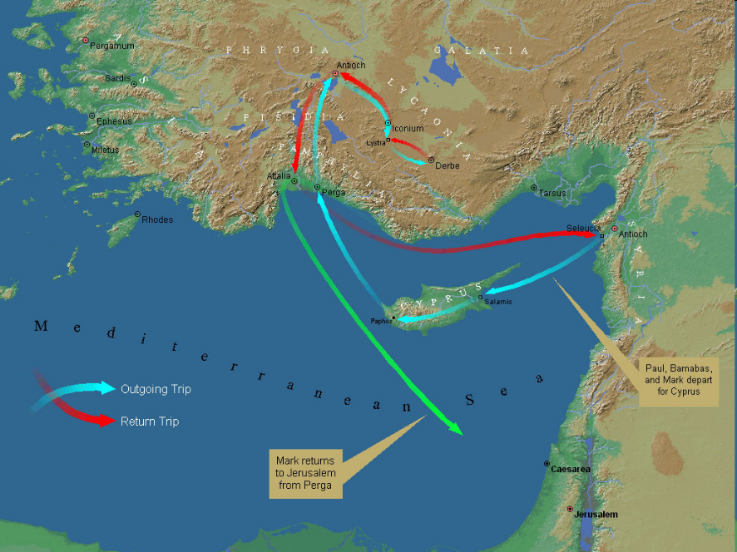

Slide 46
Date (AD 44-47)
AD 70
AD 62-63
AD 49
AD 48-49
Sermon on the Mt
Primitive congregational worship (Jas 2:2; 3:1; 5:14)
Jas 1:1 = Acts 8:1-4; 11:19

Slide 47
Date (AD 44-47)
AD 70
AD 62-63
AD 49
AD 48-49
Sermon on the Mt
Primitive congregational worship (Jas 2:2; 3:1; 5:14)
Jas 1:1 = Acts 8:1-4; 11:19

Slide 48
James 2:2
“² For if a man comes into your assembly [synagōgē] with a gold ring and dressed in fine clothes, and there also comes in a poor man in dirty clothes.”

Slide 49
Date (AD 44-47)
AD 70
AD 62-63
AD 49
AD 48-49
Sermon on the Mt
Primitive congregational worship (Jas 2:2; 3:1; 5:14)
Jas 1:1 = Acts 8:1-4; 11:19

Slide 50
Acts 8:3-4; 11:19
“³ But Saul began ravaging the church, entering house after house, and dragging off men and women, he would put them in prison. ⁴ Therefore, those who had been scattered went about preaching the word…¹⁹ So then those who were scattered because of the persecution that occurred in connection with Stephen made their way to Phoenicia and Cyprus and Antioch, speaking the word to no one except to Jews alone.”

Slide 51
Order of Paul’s Letters
Galatians (A.D. 49)
1‒2 Thessalonians (A.D. 51)
1‒2 Corinthians (A.D. 56)
Romans (A.D. 57)
Ephesians, Colossians, Philemon, Philippians (A.D. 60‒62)
1 Timothy, Titus (A.D. 62‒66)
2 Timothy (A.D. 67)

Slide 52
Preview
Authorship
Biography
Audience
Place of writing
Date
Occasion
Purpose
Message
Themes
Unique characteristics
Structure

Slide 53
Occasion
Diaspora (Jas 1:1; Acts 8:1-4; 11:19)
Outside of Jerusalem
Without the supervision of an apostle
Without the law
National history
Concerned with practical righteousness

Slide 54
Occasion
Diaspora (Jas 1:1; Acts 8:1-4; 11:19)
Outside of Jerusalem
Without the supervision of an apostle
Without the law
National history
Concerned with practical righteousness

Slide 55
James 1:1
“¹ James, a bond-servant of God and of the Lord Jesus Christ, To the twelve tribes who are dispersed abroad: Greetings.”

Slide 56
Acts 8:3-4; 11:19
“³ But Saul began ravaging the church, entering house after house, and dragging off men and women, he would put them in prison. ⁴ Therefore, those who had been scattered went about preaching the word…¹⁹ So then those who were scattered because of the persecution that occurred in connection with Stephen made their way to Phoenicia and Cyprus and Antioch, speaking the word to no one except to Jews alone.”

Slide 57
Occasion
Diaspora (Jas 1:1; Acts 8:1-4; 11:19)
Outside of Jerusalem
Without the supervision of an apostle
Without the law
National history
Concerned with practical righteousness

Slide 58
Occasion
Diaspora (Jas 1:1; Acts 8:1-4; 11:19)
Outside of Jerusalem
Without the supervision of an apostle
Without the law
National history
Concerned with practical righteousness

Slide 59

Deuteronomy 28:49-50
“⁴⁹ The Lord will bring a nation against you from afar, from the end of the earth, as the eagle swoops down, a nation whose language you shall not understand, ⁵⁰ a nation of fierce countenance who will have no respect for the old, nor show favor to the young.”

Slide 60
ISRAEL'S JUDGMENTS
Division of the kingdom in 931 B.C. (1 Kgs. 12)
Assyrian judgment in 722 B.C. (2 Kgs. 17)
Babylonian captivity in 586 B.C. (2 Kgs. 25)

Slide 61
Occasion
Diaspora (Jas 1:1; Acts 8:1-4; 11:19)
Outside of Jerusalem
Without the supervision of an apostle
Without the law
National history
Concerned with practical righteousness

Slide 62
Preview
Authorship
Biography
Audience
Place of writing
Date
Occasion
Purpose
Message
Themes
Unique characteristics
Structure

Slide 63
Purpose
James wrote in order to show his Jewish-Christian readers living in the Diaspora how to achieve practical righteousness

Slide 64
Preview
Authorship
Biography
Audience
Place of writing
Date
Occasion
Purpose
Message
Themes
Unique characteristics
Structure

Slide 65
Message
Practical righteousness is attainable when believers live by faith and walk by wisdom

Slide 66
Preview
Authorship
Biography
Audience
Place of writing
Date
Occasion
Purpose
Message
Themes
Unique characteristics
Structure

Slide 67
Themes
Hearer to doer
Belief to behavior
Doctrine to deed

Slide 68
The Writer/Apostle of…
Paul – Faith
Peter – Hope
John – Love
Jude – Truth
James – Conduct

Slide 69
Preview
Authorship
Biography
Audience
Place of writing
Date
Occasion
Purpose
Message
Themes
Unique characteristics
Structure

Slide 70
UNIQUE CHARACTERISTICS
Sermon on Mt | Concise
OT | High quality GK
Illustrations from nature and daily living | Proverbs and Amos of the NT
Undeveloped Christology | Imperatives
Practical | Oldest book in NT
Many literary devices | Difficult to outline

Slide 71
Preview
Authorship
Biography
Audience
Place of writing
Date
Occasion
Purpose
Message
Themes
Unique characteristics
Structure

Slide 72

JAMES STRUCTURE
  Faith (James 1:1‒3:12)
  Wisdom (James 3:13‒5:20)

Slide 73
JAMES STRUCTURE
  Faith (James 1:1‒3:12)
  Wisdom (James 3:13‒5:20)

Slide 74
Structure
Faith (1:1–3:12)
  Trials (1:2-18)
  Obedience to the Word (1:19-27)
  Favoritism (2:1-13)
  Faith manifesting works (2:14-26)
  Tongue (3:1-12)

Slide 75
JAMES STRUCTURE
  Faith (James 1:1‒3:12)
  Wisdom (James 3:13‒5:20)

Slide 76

Structure
Wisdom (3:13–5:20)
  Wisdom defined (3:13-18)
  Spirituality (4:1-12)
  Commerce (4:13-17)
  Use of wealth (5:1-6)
  Waiting for the Lord’s return (5:7-12)
  Prayer (5:13-18)
  Restoration of the erring brother (5:19-20)

Slide 77
CONCLUSION

Slide 78
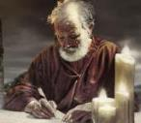
Answering Eleven Questions
Who wrote it? – James
What do we know about the author? – Christ’s ½ Brother
Who was the audience? – Believing Jews in the Diaspora
Where was if written from? – Jerusalem
When was the book written? – A.D. 44‒47
What was the book’s occasion? – Practical righteousness
What is the book’s purpose? – Achieving practical righteousness
What is the book about? – Practical righteousness
What is the book’s theme? – Daily living
What makes the book different? – Practicality
How is the book organized? – Faith and Wisdom

