Slide 1
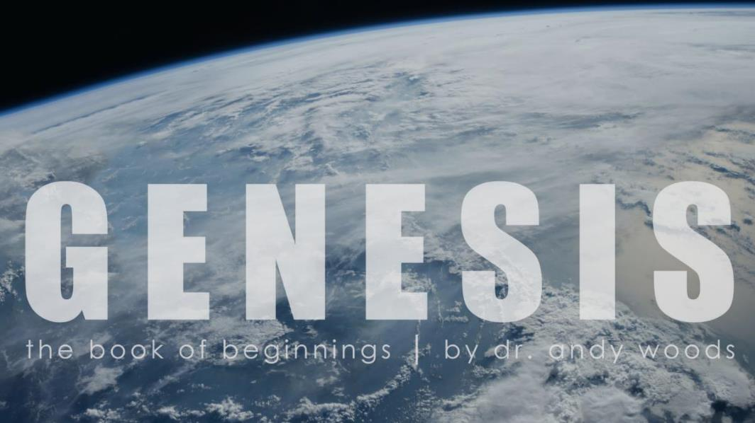
Genesis 1:1–2:3
Creation of the Cosmos

Slide 2
INTRODUCTORY MATTERS
Title ‒ Genesis
Authorship, Date, Recipients ‒ Moses; 1445 ‒ 1405; Exodus Generation
Structure ‒ Toledoth; 2 Parts (4 Events)
Setting ‒ Mesopotamia, Canaan, Egypt
Message & Purpose ‒ Israel; Conquest
Unique Characteristics ‒ Beginnings
Themes ‒ Beginnings
Christ In Genesis ‒ Gen. 3:15 Tracing
Importance ‒ God’s Glory; Salvation
Historicity ‒ Christ’s Genealogy

Slide 3
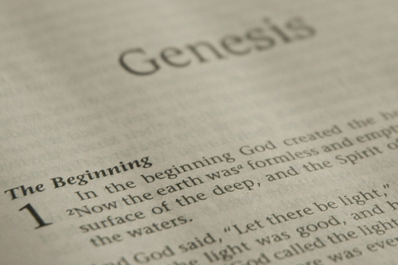
GENESIS STRUCTURE
Beginning of the Human race (Gen. 1‒11)
Beginning of the Hebrew race (Gen. 12‒50)

Slide 4
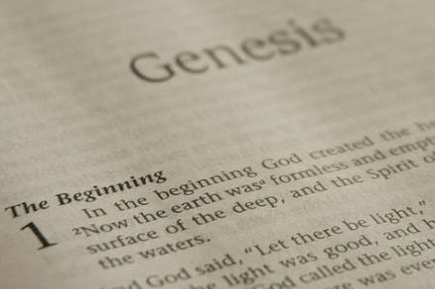
GENESIS STRUCTURE
Genesis 1-11 (four events)
Creation (1-2)
Fall (3-5)
Flood (6-9)
National dispersion (10-11)

Slide 5
Contradictory Account of Creation?
Genesis 1 – Overview of the whole creation
Genesis 2 – Details surrounding the creation of the garden, the first man, and his activities on day 6.

Slide 6
Genesis 1:1–2:3 Outline
Original creation on the first day (Gen 1:1)
Original creation in its unfilled and unformed state (Gen 1:2)
Creation week (Gen 1:3–2:3): “And God said,” “good”
First day 1:3-5
Second day 1:6-8
Third day 1:9-13
Fourth day 1:14-19
Fifth day 1:20-23
Sixth day 1:24-31
Seventh day 2:1-3

Slide 7
Genesis 1:1–2:3 Outline
Original creation on the first day (Gen 1:1)
Original creation in its unfilled and unformed state (Gen 1:2)
Creation week (Gen 1:3–2:3): “And God said,” “good”
First day 1:3-5
Second day 1:6-8
Third day 1:9-13
Fourth day 1:14-19
Fifth day 1:20-23
Sixth day 1:24-31
Seventh day 2:1-3

Slide 8
Genesis 1:1–2:3 Outline
Original creation on the first day (Gen 1:1)
Original creation in its unfilled and unformed state (Gen 1:2)
Creation week (Gen 1:3–2:3): “And God said,” “good”
First day 1:3-5
Second day 1:6-8
Third day 1:9-13
Fourth day 1:14-19
Fifth day 1:20-23
Sixth day 1:24-31
Seventh day 2:1-3

Slide 9
Genesis 1:1–2:3 Outline
Original creation on the first day (Gen 1:1)
Original creation in its unfilled and unformed state (Gen 1:2)
Creation week (Gen 1:3–2:3): “And God said,” “good”
First day 1:3-5
Second day 1:6-8
Third day 1:9-13
Fourth day 1:14-19
Fifth day 1:20-23
Sixth day 1:24-31
Seventh day 2:1-3

Slide 10
Genesis 1:1–2:3 Outline
Original creation on the first day (Gen 1:1)
Original creation in its unfilled and unformed state (Gen 1:2)
Creation week (Gen 1:3–2:3): “And God said,” “good”
First day 1:3-5
Second day 1:6-8
Third day 1:9-13
Fourth day 1:14-19
Fifth day 1:20-23
Sixth day 1:24-31
Seventh day 2:1-3

Slide 11
Genesis 1:1-3
“¹ In the beginning God created the heavens and the earth. ² The earth was formless and void, and darkness was over the surface of the deep, and the Spirit of God was moving over the surface of the waters. ³ Then God said, ‘Let there be light’; and there was light.”

Slide 12
Genesis 1:1–2:3 Outline
Original creation on the first day (Gen 1:1)
Original creation in its unfilled and unformed state (Gen 1:2)
Creation week (Gen 1:3–2:3): “And God said,” “good”
First day 1:3-5
Second day 1:6-8
Third day 1:9-13
Fourth day 1:14-19
Fifth day 1:20-23
Sixth day 1:24-31
Seventh day 2:1-3

Slide 13
Genesis 1:1–2:3 Outline
Original creation on the first day (Gen 1:1)
Original creation in its unfilled and unformed state (Gen 1:2)
Creation week (Gen 1:3–2:3): “And God said,” “good”
First day 1:3-5
Second day 1:6-8
Third day 1:9-13
Fourth day 1:14-19
Fifth day 1:20-23
Sixth day 1:24-31
Seventh day 2:1-3

Slide 14
Shaping and Populating (Gen 1:1)
Day 1: | Light | Day 4: | Luminaries
Day 2: | Water, sky | Day 5: | Sea animals, birds
Day 3: | Land, vegetation | Day 6: | Land animals, man

Slide 15
Genesis 1:1–2:3 Outline
Original creation on the first day (Gen 1:1)
Original creation in its unfilled and unformed state (Gen 1:2)
Creation week (Gen 1:3–2:3): “And God said,” “good”
First day 1:3-5
Second day 1:6-8
Third day 1:9-13
Fourth day 1:14-19
Fifth day 1:20-23
Sixth day 1:24-31
Seventh day 2:1-3

Slide 16
Genesis 1:14
Then God said, “Let there be lights in the expanse of the heavens to separate the day from the night, and let them be for signs and for seasons and for days and years.”

Slide 18
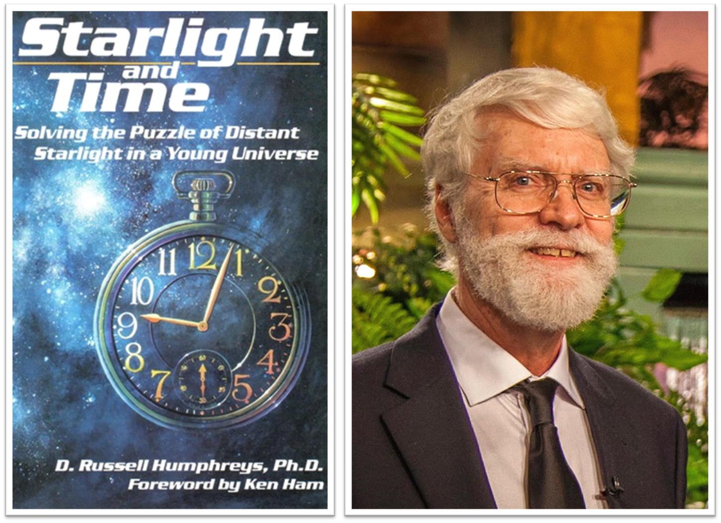

Slide 19
Key Issues in Genesis 1
Importance of Gen. 1:1
Gap Theory?
Length of the creation days
Canopy Theory (day 2)
Light before the sun (day 4)
Creation of man (day 6)
Sabbath (day 7)
Evolution?

Slide 20
Genesis 1:1-3
“¹ In the beginning God created the heavens and the earth. ² The earth was formless and void, and darkness was over the surface of the deep, and the Spirit of God was moving over the surface of the waters. ³ Then God said, ‘Let there be light’; and there was light.”

Slide 21
Day 4 Light Before the Sun? (Gen. 1:3; Gen 1:14-19)
God can create light independently without the use of a secondary source
Revelation 21:23; 22:5
Deuteronomy 4:19

Slide 22
Day 4 Light Before the Sun? (Gen. 1:3; Gen 1:14-19)
God can create light independently without the use of a secondary source
Revelation 21:23; 22:5
Deuteronomy 4:19

Slide 23
Day 4 Light Before the Sun? (Gen. 1:3; Gen 1:14-19)
God can create light independently without the use of a secondary source
Revelation 21:23; 22:5
Deuteronomy 4:19

Slide 25
DIFFERENCES BETWEEN THE MILLENNIUM & ETERNAL STATE
MILLENNIUM (REV. 20:1-10) | ETERNAL STATE (REV. 21‒22)
Present earth (Gen. 13:17) | New Earth (Rev. 21:1)
Waters (Gen. 15:18-21) | No sea (Rev. 21:1)
Rebellion (Zech. 14:16-18) | No rebellion (Rev. 21:4)
Tribal land (Ezek. 47:13-23) | Tribal city gates (Rev. 21:12)
Sin exists (Ezek 45:22) | No sin (Rev. 21:4)
Temple (Ezek. 40‒46) | No temple (Rev. 21:22)
Rod of iron (Ps. 2:6-8) | No rod needed (Rev. 21:8)
Death (Isa. 65:20) | No death (Rev. 21:4)
Sun exists (Isa. 30:26) | No sun (Rev. 21:23; 22:5)

Slide 26
Day 4 Light Before the Sun? (Gen. 1:3; Gen 1:14-19)
God can create light independently without the use of a secondary source
Revelation 21:23; 22:5
Deuteronomy 4:19

Slide 27
Deuteronomy 4:19
“And beware not to lift up your eyes to heaven and see the sun and the moon and the stars, all the host of heaven, and be drawn away and worship them and serve them, those which the Lord your God has allotted to all the peoples under the whole heaven.”

Slide 28
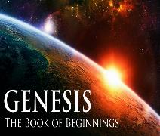
Light only Revealed on Day 4?
Luminaries not created on day 4 but only became visible to someone standing upon the earth?
Big bang cosmology indicating that the sun preceded the earth
Man not created until day 6
Asah = “to show” (Gen 1:16; 24:12) yet asah (Gen 1:26) and bara (Gen 1:27)
Raah = “Appear” (Gen 1:9)

Slide 29
Days of Revelation?
Gen 1:26-27
²⁶ Then God said, “Let Us make (asah) man in Our image, according to Our likeness; and let them rule over the fish of the sea and over the birds of the sky and over the cattle and over all the earth, and over every creeping thing that creeps on the earth.” ²⁷ God created man in His own image, in the image of God He created (bara) him; male and female He created them.

Slide 30
Genesis 1:1–2:3 Outline
Original creation on the first day (Gen 1:1)
Original creation in its unfilled and unformed state (Gen 1:2)
Creation week (Gen 1:3–2:3): “And God said,” “good”
First day 1:3-5
Second day 1:6-8
Third day 1:9-13
Fourth day 1:14-19
Fifth day 1:20-23
Sixth day 1:24-31
Seventh day 2:1-3

Slide 31
Genesis 1:1–2:3 Outline
Original creation on the first day (Gen 1:1)
Original creation in its unfilled and unformed state (Gen 1:2)
Creation week (Gen 1:3–2:3): “And God said,” “good”
First day 1:3-5
Second day 1:6-8
Third day 1:9-13
Fourth day 1:14-19
Fifth day 1:20-23
Sixth day 1:24-31
Seventh day 2:1-3

Slide 32
Key Issues in Genesis 1
Importance of Gen. 1:1
Gap Theory?
Length of the creation days
Canopy Theory (day 2)
Light before the sun (day 4)
Creation of man (day 6)
Sabbath (day 7)
Evolution?

Slide 33
Day 6 Theocratic Administrator (Gen 1:24-31)
Land animals (Gen. 1:24-25)
Man (Gen. 1:26-28)
Office of Theocratic Administrator
Beginning of kingdom program
Animal & man as vegetarian (Gen. 1:29-30; 2:17; 9:3)
The perfection of creation (Gen. 1:31)

Slide 34
Day 6 Theocratic Administrator (Gen 1:24-31)
Land animals (Gen. 1:24-25)
Man (Gen. 1:26-28)
Office of Theocratic Administrator
Beginning of kingdom program
Animal & man as vegetarian (Gen. 1:29-30; 2:17; 9:3)
The perfection of creation (Gen. 1:31)

Slide 35
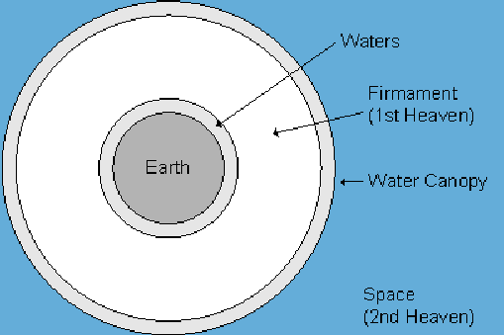

Slide 37
Day 6 Theocratic Administrator (Gen 1:24-31)
Land animals (Gen. 1:24-25)
Man (Gen. 1:26-28)
Office of Theocratic Administrator
Beginning of kingdom program
Animal & man as vegetarian (Gen. 1:29-30; 2:17; 9:3)
The perfection of creation (Gen. 1:31)

Slide 38
Genesis 1:26-28
²⁶ Then God said, “Let Us make man in Our image, according to Our likeness; and let them rule over the fish of the sea and over the birds of the sky and over the cattle and over all the earth, and over every creeping thing that creeps on the earth.” ²⁷ God created man in His own image, in the image of God He created him; male and female He created them. ²⁸ God blessed them; and God said to them, “Be fruitful and multiply, and fill the earth, and subdue it; and rule over the fish of the sea and over the birds of the sky and over every living thing that moves on the earth.”

Slide 39
Genesis 1:26-28
²⁶ Then God said, “Let Us make man in Our image, according to Our likeness; and let them rule over the fish of the sea and over the birds of the sky and over the cattle and over all the earth, and over every creeping thing that creeps on the earth.” ²⁷ God created man in His own image, in the image of God He created him; male and female He created them. ²⁸ God blessed them; and God said to them, “Be fruitful and multiply, and fill the earth, and subdue it; and rule over the fish of the sea and over the birds of the sky and over every living thing that moves on the earth.”

Slide 40
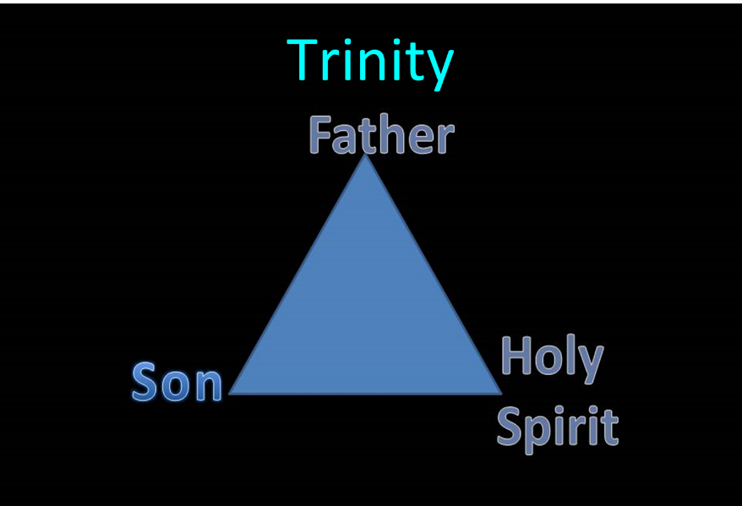
Trinitarianism in Genesis
Gen 1:26
Gen 3:22
Gen 11:7
Isa 6:8

Slide 41
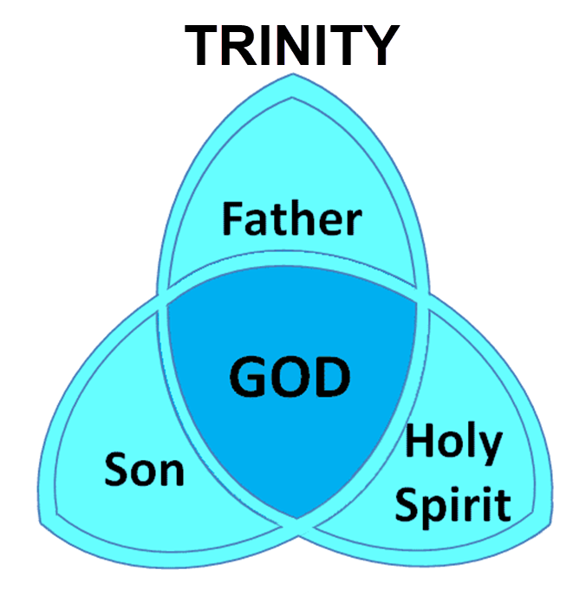

Slide 42
Genesis 1:26-28
²⁶ Then God said, “Let Us make man in Our image, according to Our likeness; and let them rule over the fish of the sea and over the birds of the sky and over the cattle and over all the earth, and over every creeping thing that creeps on the earth.” ²⁷ God created man in His own image, in the image of God He created him; male and female He created them. ²⁸ God blessed them; and God said to them, “Be fruitful and multiply, and fill the earth, and subdue it; and rule over the fish of the sea and over the birds of the sky and over every living thing that moves on the earth.”

Slide 43
Genesis 1:26-28
²⁶ Then God said, “Let Us make man in Our image, according to Our likeness; and let them rule over the fish of the sea and over the birds of the sky and over the cattle and over all the earth, and over every creeping thing that creeps on the earth.” ²⁷ God created man in His own image, in the image of God He created him; male and female He created them. ²⁸ God blessed them; and God said to them, “Be fruitful and multiply, and fill the earth, and subdue it; and rule over the fish of the sea and over the birds of the sky and over every living thing that moves on the earth.”

Slide 44
Day 6 Theocratic Administrator (Gen 1:24-31)
Land animals (Gen. 1:24-25)
Man (Gen. 1:26-28)
Office of Theocratic Administrator
Beginning of kingdom program
Animal & man as vegetarian (Gen. 1:29-30; 2:17; 9:3)
The perfection of creation (Gen. 1:31)

Slide 45
Genesis 1:26-28
²⁶ Then God said, “Let Us make man in Our image, according to Our likeness; and let them rule over the fish of the sea and over the birds of the sky and over the cattle and over all the earth, and over every creeping thing that creeps on the earth.” ²⁷ God created man in His own image, in the image of God He created him; male and female He created them. ²⁸ God blessed them; and God said to them, “Be fruitful and multiply, and fill the earth, and subdue it; and rule over the fish of the sea and over the birds of the sky and over every living thing that moves on the earth.”

Slide 47
Day 6 Theocratic Administrator (Gen 1:24-31)
Land animals (Gen. 1:24-25)
Man (Gen. 1:26-28)
Office of Theocratic Administrator
Beginning of kingdom program
Animal & man as vegetarian (Gen. 1:29-30; 2:17; 9:3)
The perfection of creation (Gen. 1:31)

Slide 49
Charles Ryrie
Basic Theology. Page 511
“Why is an earthly kingdom necessary? Did He not receive His inheritance when He was raised and exalted in heaven? Is not His present rule His inheritance? Why does there need to be an earthly kingdom? Because He must be triumphant in the same arena where His was seemingly defeated. His rejection by the rulers of this world was on this earth (1 Cor. 2:8). His exaltation must also be on this earth. And so it shall be when He comes again to rule this world in righteousness. He has waited long for His inheritance; soon He shall receive it.”

Slide 50
J. Dwight Pentecost Thy kingdom Come, Page 316
“Apart from the reign of Christ…here on earth…And apart from this rule, God’s purpose for man would never be brought to conclusion. God’s purpose for the earth would be unrealized and the problem generated by Satan’s rebellion would never be resolved. Thus the physical, literal reign of Christ on the earth is a theological and biblical necessity—unless Satan is victorious over God.”

Slide 51
Mark Hitchcock The End, Page 421-22
“Johahn Sebastian Bach sometimes slept more than he should have. His children had a unique way of waking him up. They would go to the piano and begin to play a composition. When they would get to the last note, they would stop. They wouldn't play the last note. It worked like a charm, and it would always wake him up. He would get up from his sleep, go to the piano, and play the final chord. He couldn't stand to leave it hanging there incomplete – unfinished. In the same way today, we are all waiting for the last note on the final page of God's song of victory. God will not leave His grand composition without striking the final note. That final note is the messianic Kingdom of Jesus Christ.”

Slide 52
Day 6 Theocratic Administrator (Gen 1:24-31)
Land animals (Gen. 1:24-25)
Man (Gen. 1:26-28)
Office of Theocratic Administrator
Beginning of kingdom program
Animal & man as vegetarian (Gen. 1:29-30; 2:17; 9:3)
The perfection of creation (Gen. 1:31)

Slide 53
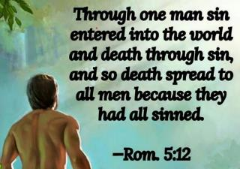
Genesis 1:29-30
“²⁹ Then God said, ‘Behold, I have given you every plant yielding seed that is on the surface of all the earth, and every tree which has fruit yielding seed; it shall be food for you; ³⁰ and to every beast of the earth and to every bird of the sky and to every thing that moves on the earth which has life, I have given every green plant for food’; and it was so.”

Slide 54
Genesis 2:16-17
“¹⁶ The Lord God commanded the man, saying, ‘From any tree of the garden you may eat freely; ¹⁷ but from the tree of the knowledge of good and evil you shall not eat, for in the day that you eat from it you will surely die (muwth).’”

Slide 55
Genesis 3:19
“¹⁹ By the sweat of your face You will eat bread, Till you return to the ground, Because from it you were taken; For you are dust, And to dust you shall return.”

Slide 56
Genesis 9:3
“³ Every moving thing that is alive shall be food for you; I give all to you, as I gave the green plant.”

Slide 57
Day 6 Theocratic Administrator (Gen 1:24-31)
Land animals (Gen. 1:24-25)
Man (Gen. 1:26-28)
Office of Theocratic Administrator
Beginning of kingdom program
Animal & man as vegetarian (Gen. 1:29-30; 2:17; 9:3)
The perfection of creation (Gen. 1:31)

Slide 58
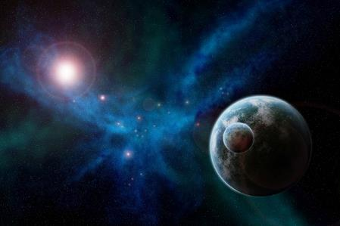
Genesis 1:31
“God saw all that He had made, and behold, it was very good. And there was evening and there was morning, the sixth day.”

Slide 59
Genesis 1:1-3
“¹ In the beginning God created the heavens and the earth. ² The earth was formless and void, and darkness was over the surface of the deep, and the Spirit of God was moving over the surface of the waters. ³ Then God said, ‘Let there be light’; and there was light.”

Slide 60
Renald Showers
Renald Showers, Those Invisible Spirits Called Angels (Bellmawr, NJ: Friends of Israel, 1997), 82-83.
“When did Satan fall away from God? We noted earlier that sin was nonexistent in every part of God‘s creation, including the angels, through the end of the sixth or final day of creation (Gen. 1:31). Satan‘s fall therefore took place after the end of creation. However, Satan was evil by the time he came to earth to tempt man to fall away from God (Gen. 3). These things prompt the conclusion that Satan‘s fall took place in the interval between the end of creation and the fall of man. How long was the interval? It must have been quite short because when God created the first man and woman, he commanded them to be fruitful and multiply through procreation (Gen. 1:27–28), but there was no human conception until after the fall of man (Gen. 4:1).”

Slide 61
Genesis 1:1–2:3 Outline
Original creation on the first day (Gen 1:1)
Original creation in its unfilled and unformed state (Gen 1:2)
Creation week (Gen 1:3–2:3): “And God said,” “good”
First day 1:3-5
Second day 1:6-8
Third day 1:9-13
Fourth day 1:14-19
Fifth day 1:20-23
Sixth day 1:24-31
Seventh day 2:1-3

Slide 62
Genesis 2:1-3
“¹ Thus the heavens and the earth were completed, and all their hosts. ² By the seventh day God completed His work which He had done, and He rested on the seventh day from all His work which He had done. ³ Then God blessed the seventh day and sanctified it, because in it He rested from all His work which God had created and made.”

Slide 63
Key Issues in Genesis 1
Importance of Gen. 1:1
Gap Theory?
Length of the creation days
Canopy Theory (day 2)
Light before the sun (day 4)
Creation of man (day 6)
Sabbath (day 7)
Evolution?

Slide 64
Genesis 2:1-3
“¹ Thus the heavens and the earth were completed, and all their hosts. ² By the seventh day God completed His work which He had done, and He rested on the seventh day from all His work which He had done. ³ Then God blessed the seventh day and sanctified it, because in it He rested from all His work which God had created and made.”

Slide 65
Day 7 Sabbath (Gen 2:1-3)
The Lord rested
Sabbath pattern (Exod. 20:8-11; 31:15-17)
7th day continues?
Creation is past (Heb. 4:3-4)
Absence of “evening and morning”
Yom + ordinal modifier

Slide 66
Day 7 Sabbath (Gen 2:1-3)
The Lord rested
Sabbath pattern (Exod. 20:8-11; 31:15-17)
7th day continues?
Creation is past (Heb. 4:3-4)
Absence of “evening and morning”
Yom + ordinal modifier

Slide 67
Day 7 Sabbath (Gen 2:1-3)
The Lord rested
Sabbath pattern (Exod. 20:8-11; 31:15-17)
7th day continues?
Creation is past (Heb. 4:3-4)
Absence of “evening and morning”
Yom + ordinal modifier

Slide 68
Exodus 20:8-11
⁸ “Remember the sabbath day, to keep it holy. ⁹ Six days you shall labor and do all your work, ¹⁰ but the seventh day is a sabbath of the Lord your God; in it you shall not do any work, you or your son or your daughter, your male or your female servant or your cattle or your sojourner who stays with you. ¹¹ For in six days the Lord made the heavens and the earth, the sea and all that is in them, and rested on the seventh day; therefore the Lord blessed the sabbath day and made it holy.”

Slide 69
Exodus 31:15-17
¹⁵ ‘For six days work may be done, but on the seventh day there is a sabbath of complete rest, holy to the Lord; whoever does any work on the sabbath day shall surely be put to death. ¹⁶ ‘So the sons of Israel shall observe the sabbath, to celebrate the sabbath throughout their generations as a perpetual covenant.’ ¹⁷ “It is a sign between Me and the sons of Israel forever; for in six days the Lord made heaven and earth, but on the seventh day He ceased from labor, and was refreshed.”

Slide 70
Day 7 Sabbath (Gen 2:1-3)
The Lord rested
Sabbath pattern (Exod. 20:8-11; 31:15-17)
7th day continues?
Creation is past (Heb. 4:3-4)
Absence of “evening and morning”
Yom + ordinal modifier

Slide 71
Day 7 Sabbath (Gen 2:1-3)
The Lord rested
Sabbath pattern (Exod. 20:8-11; 31:15-17)
7th day continues?
Creation is past (Heb. 4:3-4)
Absence of “evening and morning”
Yom + ordinal modifier

Slide 72
Day 7 Sabbath (Gen 2:1-3)
The Lord rested
Sabbath pattern (Exod. 20:8-11; 31:15-17)
7th day continues?
Creation is past (Heb. 4:3-4)
Absence of “evening and morning”
Yom + ordinal modifier

Slide 73
Day 7 Sabbath (Gen 2:1-3)
The Lord rested
Sabbath pattern (Exod. 20:8-11; 31:15-17)
7th day continues?
Creation is past (Heb. 4:3-4)
Absence of “evening and morning”
Yom + ordinal modifier

Slide 74
Genesis 2:1-3
“¹ Thus the heavens and the earth were completed, and all their hosts. ² By the seventh day God completed His work which He had done, and He rested on the seventh day from all His work which He had done. ³ Then God blessed the seventh day and sanctified it, because in it He rested from all His work which God had created and made.”

Slide 75
Key Issues in Genesis 1
Importance of Gen. 1:1
Gap Theory?
Length of the creation days
Canopy Theory (day 2)
Light before the sun (day 4)
Creation of man (day 6)
Sabbath (day 7)
Evolution?

Slide 76
Origin of Man
Two views
Evolution
Creation

Slide 77
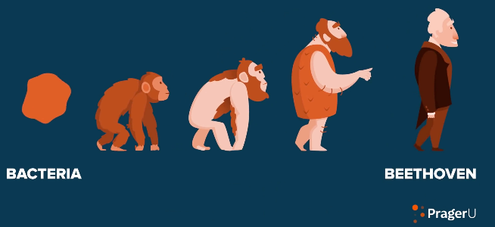
Evolution Wikapedia
Definition – A gradual process in which something changes into a different and usually more complex or better form. Change in the genetic composition of a population during successive generations, as a result of natural selection acting on the genetic variation among individuals, and resulting in the development of new species.

Slide 78
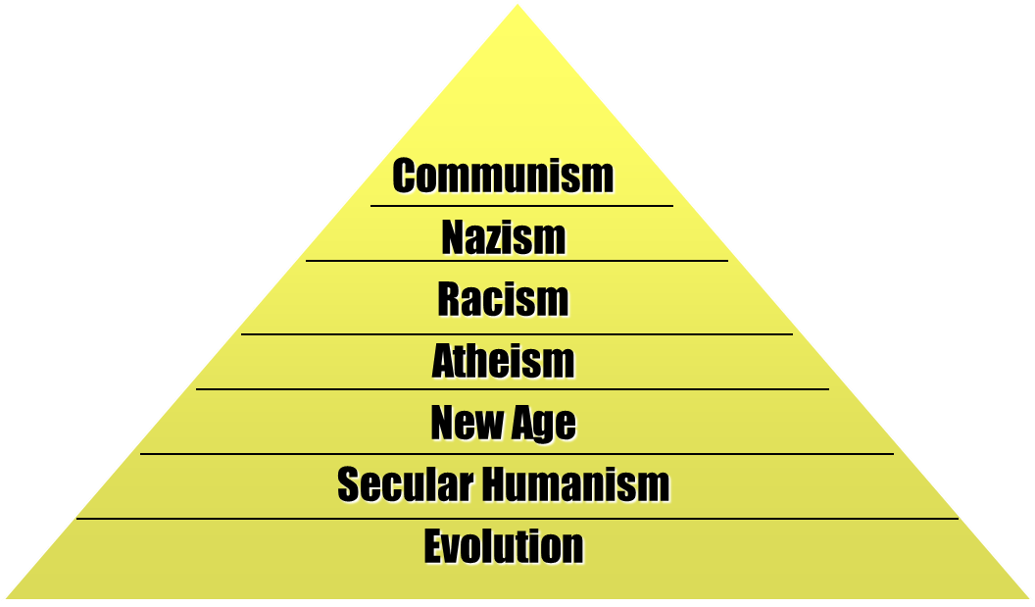
Source: Henry Morris, The Long War Against God

Slide 79
Intelligent Design Resources
Michael Behe – Darwin’s Black Box
Michael Denton – Evolution: A Theory in Crisis
Philip Johnson – Darwin on Trial
William Dembski – Intelligent Design
Marvin Lubenow – Bones of Contention

Slide 80
Evolution’s Flaws
The “missing link” is still missing
No design from randomness
Contradiction with scientific laws: Biogenesis, Second Law of Thermodynamics
Statistical improbabilities
Young earth clocks
Not conforming to the scientific method

Slide 81
Evolution’s Flaws
The “missing link” is still missing
No design from randomness
Contradiction with scientific laws: Biogenesis, Second Law of Thermodynamics
Statistical improbabilities
Young earth clocks
Not conforming to the scientific method

Slide 82
Missing Links
“Links are missing just where we most fervently desire them and its all too probable that many ‘links’ will continue to be missing.”
Alfred S. Romer, Genetics, Evolution, and Paleontology, p. 114

Slide 83
Missing Links
“Gradualism is a concept I believe in…Yet Gould and the American museum people are hard to contradict when they say that there are no transitional fossils..You say that I should show a photo of the fossil from which each type of organism was derived. I will lay it on the line-there is not one such fossil from which one could make an airtight argument…It is easy enough to make up stories of how one form gave rise to another, and to find reasons why the stages should be favoured by natural selection. But such stories are not part of science, for there is no way of putting them to the test.”
Colin Patterson of the British Museum of Natural History, Bible-Science Newsletter (Aug, 1981), p. 8.

Slide 84
Evolution’s Flaws
The “missing link” is still missing
No design from randomness
Contradiction with scientific laws: Biogenesis, Second Law of thermodynamics
Statistical improbabilities
Young earth clocks
Not conforming to the scientific method

Slide 85
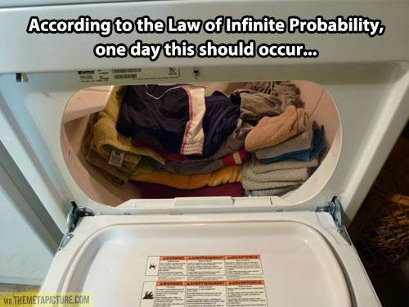

Slide 86
Evolution’s Flaws
The “missing link” is still missing
No design from randomness
Contradiction with scientific laws: Biogenesis, Second Law of thermodynamics
Statistical improbabilities
Young earth clocks
Not conforming to the scientific method

Slide 87
Evolution’s Flaws
The “missing link” is still missing
No design from randomness
Contradiction with scientific laws: Biogenesis, Second Law of thermodynamics
Statistical improbabilities
Young earth clocks
Not conforming to the scientific method

Slide 88
Evolution’s Flaws
The “missing link” is still missing
No design from randomness
Contradiction with scientific laws: Biogenesis, Second Law of thermodynamics
Statistical improbabilities
Young earth clocks
Not conforming to the scientific method

Slide 89
Evolution’s Flaws
The “missing link” is still missing
No design from randomness
Contradiction with scientific laws: Biogenesis, Second Law of thermodynamics
Statistical improbabilities
Young earth clocks
Not conforming to the scientific method

Slide 90
Why Evolution’s Popularity?
“The evolutionary origin of man relieves man of responsibility to a personal Creator outside of himself.”
Rom 1:18ff; 2 Pet. 3:5 (KJV)
Ryrie, Survey of Bible Doctrine, 101

Slide 91
Romans 1:18–20
¹⁸ For the wrath of God is revealed from heaven against all ungodliness and unrighteousness of men who suppress the truth in unrighteousness, ¹⁹ because that which is known about God is evident within them; for God made it evident to them. ²⁰ For since the creation of the world His invisible attributes, His eternal power and divine nature, have been clearly seen, being understood through what has been made, so that they are without excuse.

Slide 92
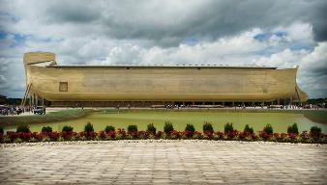
2 Peter 3:5 (KJV)
“For this they willingly are ignorant of [thelō], that by the word of God the heavens were of old, and the earth standing out of the water and in the water.”

Slide 93
Theistic Evolution?
Evolution | Gen 1:1–2:3
Naturalistic creation | Miraculous creation
Gen 1-11 is myth | Gen 1-11 is history
No creator/creation distinction | Ex-Nihilo creation (Ps. 33:6)
Light before the earth | Earth before the light
Took billions of years | Took 6 days
Luminaries before the earth | Earth before the luminaries (Deut 4:19; Rev. 21:23; 22:5)
Hot to cold | Cold (Gen 1:2) to hot (2 Pet 3:10)
Land before ocean | Ocean before land (Gen 1:9)
Present is key to past | God worked suddenly in the past (Job 38:4-7; Heb 11:3; 2 Peter 3:3-7)
Early rain on the earth | No rain until later (Gen 2:5-6; Heb 11:6-7)
List adapted from Walt Brown, In The Beginning, 276-80

Slide 94
Theistic Evolution?
Evolution | Gen 1:1–2:3
Naturalistic creation | Miraculous creation
Gen 1-11 is myth | Gen 1-11 is history
No creator/creation distinction | Ex-Nihilo creation (Ps. 33:6)
Light before the earth | Earth before the light
Took billions of years | Took 6 days
Luminaries before the earth | Earth before the luminaries (Deut 4:19; Rev. 21:23; 22:5)
Hot to cold | Cold (Gen 1:2) to hot (2 Pet 3:10)
Land before ocean | Ocean before land (Gen 1:9)
Present is key to past | God worked suddenly in the past (Job 38:4-7; Heb 11:3; 2 Peter 3:3-7)
Early rain on the earth | No rain until later (Gen 2:5-6; Heb 11:6-7)
List adapted from Walt Brown, In The Beginning, 276-80

Slide 95
Genesis 1:1-3
“¹ In the beginning God created the heavens and the earth. ² The earth was formless and void, and darkness was over the surface of the deep, and the Spirit of God was moving over the surface of the waters. ³ Then God said, ‘Let there be light’; and there was light.”

Slide 96
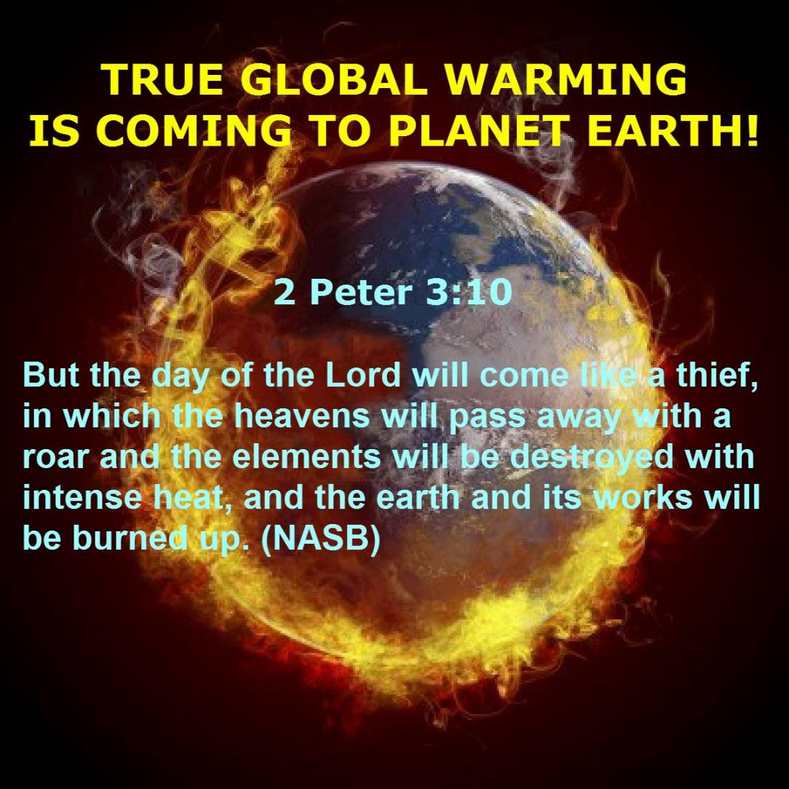

Slide 97
Theistic Evolution?
Evolution | Gen 1:1–2:3
Naturalistic creation | Miraculous creation
Gen 1-11 is myth | Gen 1-11 is history
No creator/creation distinction | Ex-Nihilo creation (Ps. 33:6)
Light before the earth | Earth before the light
Took billions of years | Took 6 days
Luminaries before the earth | Earth before the luminaries (Deut 4:19; Rev. 21:23; 22:5)
Hot to cold | Cold (Gen 1:2) to hot (2 Pet 3:10)
Land before ocean | Ocean before land (Gen 1:9)
Present is key to past | God worked suddenly in the past (Job 38:4-7; Heb 11:3; 2 Peter 3:3-7)
Early rain on the earth | No rain until later (Gen 2:5-6; Heb 11:6-7)
List adapted from Walt Brown, In The Beginning, 276-80

Slide 98
Theistic Evolution?
Evolution | Gen 1:1–2:3
Naturalistic creation | Miraculous creation
Gen 1-11 is myth | Gen 1-11 is history
No creator/creation distinction | Ex-Nihilo creation (Ps. 33:6)
Light before the earth | Earth before the light
Took billions of years | Took 6 days
Luminaries before the earth | Earth before the luminaries (Deut 4:19; Rev. 21:23; 22:5)
Hot to cold | Cold (Gen 1:2) to hot (2 Pet 3:10)
Land before ocean | Ocean before land (Gen 1:9)
Present is key to past | God worked suddenly in the past (Job 38:4-7; Heb 11:3; 2 Peter 3:3-7)
Early rain on the earth | No rain until later (Gen 2:5-6; Heb 11:6-7)
List adapted from Walt Brown, In The Beginning, 276-80

Slide 99
Uniformitarianism Defined
https://www.britannica.com/science/uniformitarianism
“Uniformitarianism, in geology, the doctrine suggesting that Earth’s geologic processes acted in the same manner and with essentially the same intensity in the past as they do in the present and that such uniformity is sufficient to account for all geologic change. This principle is fundamental to geologic thinking and underlies the whole development of the science of geology... When William Whewell, a University of Cambridge scholar, introduced the term in 1832, the prevailing view (called catastrophism) was that…Earth had originated through supernatural means and had been affected by a series of catastrophic events such as the biblical Flood. In contrast to catastrophism, uniformitarianism postulates that phenomena displayed in rocks may be entirely accounted for by geologic processes that continue to operate—in other words, the present is the key to the past.”

Slide 100
Uniformitarianism is not Biblicism
 | ERA | SCRIPTURE | DISTINCTIVES
1. | Creation | Genesis 1-2 | No death
2. | Fall | Genesis 3-6 | Death, painful pregnancy & toil, long life spans, no human government
3. | Flood | Genesis 7-10 | Shorter life spans, human government, one language, no nations
4. | Babel | Genesis 11-present | No global government, multiple languages, nations, ethnicities
5. | Antichrist | Rapture to 2nd Advent | Global government, restrainer removed
6. | Kingdom | Rev. 20:1-10 | Long life spans, kingdom conditions, reality of death, renovated earth
7. | Eternal State | Rev. 21-22 | No death, new earth

Slide 101
Theistic Evolution?
Evolution | Gen 1:1–2:3
Naturalistic creation | Miraculous creation
Gen 1-11 is myth | Gen 1-11 is history
No creator/creation distinction | Ex-Nihilo creation (Ps. 33:6)
Light before the earth | Earth before the light
Took billions of years | Took 6 days
Luminaries before the earth | Earth before the luminaries (Deut 4:19; Rev. 21:23; 22:5)
Hot to cold | Cold (Gen 1:2) to hot (2 Pet 3:10)
Land before ocean | Ocean before land (Gen 1:9)
Present is key to past | God worked suddenly in the past (Job 38:4-7; Heb 11:3; 2 Peter 3:3-7)
Early rain on the earth | No rain until later (Gen 2:5-6; Heb 11:6-7)
List adapted from Walt Brown, In The Beginning, 276-80

Slide 104
Theistic Evolution?
Evolution | Gen 1:1–2:3
Initial microscopic animals | Initial complex animals
Plant life before atmosphere | Atmosphere before plant life
Sun before plant life | Plant life before the sun
Continuity among all life | Each only produces after its own kind (Gen 1:24; John 3:3-7)
Sea life before land life | Land life before sea life
Reptiles/dinosaurs before birds | Birds before reptiles/dinosaurs (Gen 1:24-25; Ps 148:4; Gen 1:6-7; 5:5, 27; 11:24-25; Job 40-41)
Fish before birds and trees | Trees before fish and fish created with birds
Early animals were meat eaters | Early animals were plant eaters (Gen1:29-30)
Females before males | Males before females (Gen 2:18-25)
List adapted from Walt Brown, In The Beginning, 276-80

Slide 105
Theistic Evolution?
Evolution | Gen 1:1–2:3
Initial microscopic animals | Initial complex animals
Plant life before atmosphere | Atmosphere before plant life
Sun before plant life | Plant life before the sun
Continuity among all life | Each only produces after its own kind (Gen 1:24; John 3:3-7)
Sea life before land life | Land life before sea life
Reptiles/dinosaurs before birds | Birds before reptiles/dinosaurs (Gen 1:24-25; Ps 148:4; Gen 1:6-7; 5:5, 27; 11:24-25; Job 40-41)
Fish before birds and trees | Trees before fish and fish created with birds
Early animals were meat eaters | Early animals were plant eaters (Gen1:29-30)
Females before males | Males before females (Gen 2:18-25)
List adapted from Walt Brown, In The Beginning, 276-80

Slide 106
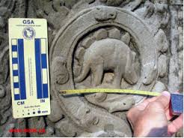

Slide 107
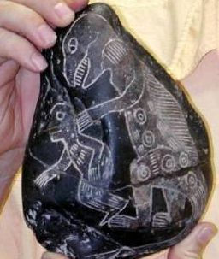

Slide 109
Theistic Evolution?
Evolution | Gen 1:1–2:3
Initial microscopic animals | Initial complex animals
Plant life before atmosphere | Atmosphere before plant life
Sun before plant life | Plant life before the sun
Continuity among all life | Each only produces after its own kind (Gen 1:24; John 3:3-7)
Sea life before land life | Land life before sea life
Reptiles/dinosaurs before birds | Birds before reptiles/dinosaurs (Gen 1:24-25; Ps 148:4; Gen 1:6-7; 5:5, 27; 11:24-25; Job 40-41)
Fish before birds and trees | Trees before fish and fish created with birds
Early animals were meat eaters | Early animals were plant eaters (Gen1:29-30)
Females before males | Males before females (Gen 2:18-25)
List adapted from Walt Brown, In The Beginning, 276-80

Slide 110
Theistic Evolution?
Evolution | Gen 1:1–2:3
Evolution continues | Creation is complete (Gen 2:1-3; John 5:17; Col 1:17; Heb 4:3-4, 10)
Suffering is natural | Suffering is unnatural (Gen 1:31; Rom 8:19-23; Rev. 21:4)
Death before Adam | Death after Adam (Gen 2:17; Rom 5:12)
Man is an evolved animal | Man created higher than the animals (Gen 1:26-28; Ps 8:4-6)
Man exists long after history | Man existed at beginning (Matt 19:4)
Man evolved from the animals | Man created from the dust (Gen 2:7)
Fossils before man | Fossils after man
Man related to animals | Man not related to animals (Gen 5;11)
Man’s genealogy is ancient | Man’s genealogy is recent
Early man meat eaters | Early man plant eaters (Gen 1:29; 9:3)
List adapted from Walt Brown, In The Beginning, 276-80

Slide 111
Theistic Evolution?
Evolution | Gen 1:1–2:3
Evolution continues | Creation is complete (Gen 2:1-3; John 5:17; Col 1:17; Heb 4:3-4, 10)
Suffering is natural | Suffering is unnatural (Gen 1:31; Rom 8:19-23; Rev. 21:4)
Death before Adam | Death after Adam (Gen 2:17; Rom 5:12)
Man is an evolved animal | Man created higher than the animals (Gen 1:26-28; Ps 8:4-6)
Man exists long after history | Man existed at beginning (Matt 19:4)
Man evolved from the animals | Man created from the dust (Gen 2:7)
Fossils before man | Fossils after man
Man related to animals | Man not related to animals (Gen 5;11)
Man’s genealogy is ancient | Man’s genealogy is recent
Early man meat eaters | Early man plant eaters (Gen 1:29; 9:3)
List adapted from Walt Brown, In The Beginning, 276-80

Slide 112
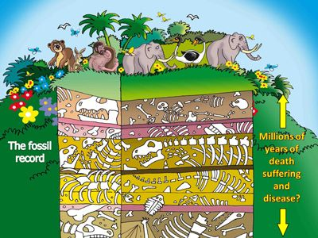

Slide 113
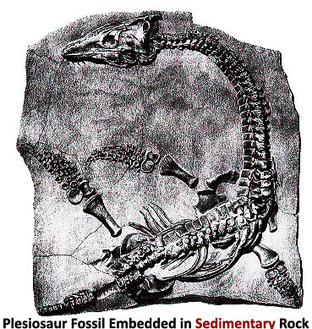

Slide 114
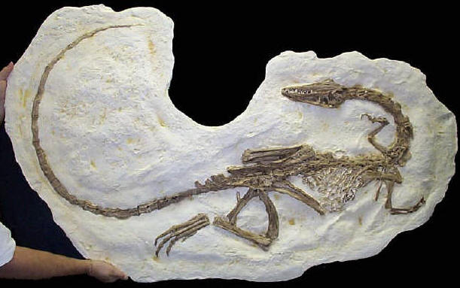

Slide 115
Theistic Evolution?
Evolution | Gen 1:1–2:3
Evolution continues | Creation is complete (Gen 2:1-3; John 5:17; Col 1:17; Heb 4:3-4, 10)
Suffering is natural | Suffering is unnatural (Gen 1:31; Rom 8:19-23; Rev. 21:4)
Death before Adam | Death after Adam (Gen 2:17; Rom 5:12)
Man is an evolved animal | Man created higher than the animals (Gen 1:26-28; Ps 8:4-6)
Man exists long after history | Man existed at beginning (Matt 19:4)
Man evolved from the animals | Man created from the dust (Gen 2:7)
Fossils before man | Fossils after man
Man related to animals | Man not related to animals (Gen 5;11)
Man’s genealogy is ancient | Man’s genealogy is recent
Early man meat eaters | Early man plant eaters (Gen 1:29; 9:3)
List adapted from Walt Brown, In The Beginning, 276-80

Slide 116
Theistic Evolution?
Evolution | Gen 1:1–2:3
Marriage is an evolved custom | Marriage was instituted by God (Gen 2:18-25; John 2:11)
Man developed units of time | God implemented units of time (Gen 1:14)
Seven day week developed | God implemented the seven day week (Exod. 20:8-11; 31:15-17)
People did not reach 100 | People reached 900 years of age (Ps 148:4; 90:10; Gen 1:6-7; 5:5, 27; 11:24-25)
Early man was primitive | Early man was advanced (Gen 4:17, 20-22; 6:14; 11:4; Prov. 1:7; Ps 14:1; Rom 1:18ff)
Language evolved slowly | Man created with speaking ability (Gen 2:23; 3:9-10)
Things are improving | Things are deteriorating
Thorns evolved with plants | Adam’s sin cause the thorns (Gen 3:18)
Animalistic nature causes evil | Sin nature causes evil (Jer. 17:9)
List adapted from Walt Brown, In The Beginning, 276-80

Slide 117
Theistic Evolution?
Evolution | Gen 1:1–2:3
Marriage is an evolved custom | Marriage was instituted by God (Gen 2:18-25; John 2:11)
Man developed units of time | God implemented units of time (Gen 1:14)
Seven day week developed | God implemented the seven day week (Exod. 20:8-11; 31:15-17)
People did not reach 100 | People reached 900 years of age (Ps 148:4; 90:10; Gen 1:6-7; 5:5, 27; 11:24-25)
Early man was primitive | Early man was advanced (Gen 4:17, 20-22; 6:14; 11:4; Prov. 1:7; Ps 14:1; Rom 1:18ff)
Language evolved slowly | Man created with speaking ability (Gen 2:23; 3:9-10)
Things are improving | Things are deteriorating
Thorns evolved with plants | Adam’s sin cause the thorns (Gen 3:18)
Animalistic nature causes evil | Sin nature causes evil (Jer. 17:9)
List adapted from Walt Brown, In The Beginning, 276-80

Slide 118
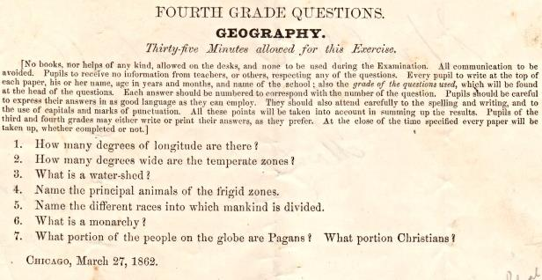
Geography Quiz
(from the WallBuilders' library) that was given to Fourth Grades in 1862

Slide 119
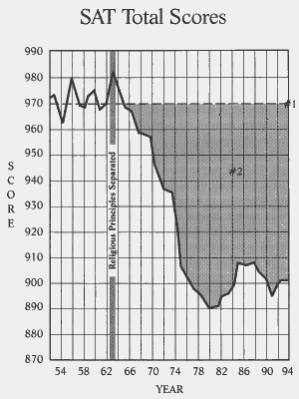

Slide 120
Theistic Evolution?
Evolution | Gen 1:1–2:3
Marriage is an evolved custom | Marriage was instituted by God (Gen 2:18-25; John 2:11)
Man developed units of time | God implemented units of time (Gen 1:14)
Seven day week developed | God implemented the seven day week (Exod. 20:8-11; 31:15-17)
People did not reach 100 | People reached 900 years of age (Ps 148:4; 90:10; Gen 1:6-7; 5:5, 27; 11:24-25)
Early man was primitive | Early man was advanced (Gen 4:17, 20-22; 6:14; 11:4; Prov. 1:7; Ps 14:1; Rom 1:18ff)
Language evolved slowly | Man created with speaking ability (Gen 2:23; 3:9-10)
Things are improving | Things are deteriorating
Thorns evolved with plants | Adam’s sin cause the thorns (Gen 3:18)
Animalistic nature causes evil | Sin nature causes evil (Jer. 17:9)
List adapted from Walt Brown, In The Beginning, 276-80

Slide 121
Theistic Evolution?
Evolution | Gen 1:1–2:3
Suffering precedes man | Suffering follows man (Gen 1:31; Rom 8:19-23; Rev. 21:4)
Man is improving | Man is failing (Rev. 14:20)
List adapted from Walt Brown, In The Beginning, 276-80

Slide 122
CONCLUSION

Slide 123
Genesis 1:1–2:3 Outline
Original creation on the first day (Gen 1:1)
Original creation in its unfilled and unformed state (Gen 1:2)
Creation week (Gen 1:3–2:3): “And God said,” “good”
First day 1:3-5
Second day 1:6-8
Third day 1:9-13
Fourth day 1:14-19
Fifth day 1:20-23
Sixth day 1:24-31
Seventh day 2:1-3

