Slide 1
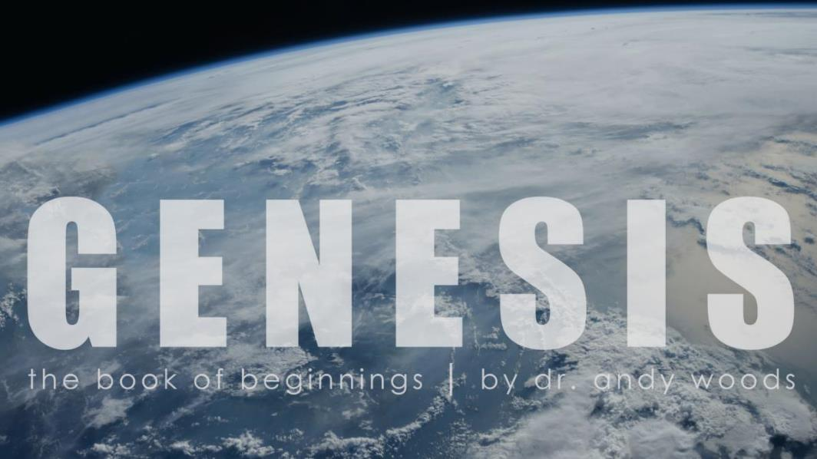
Genesis 1:1–2:3
Creation of the Cosmos

Slide 2
INTRODUCTORY MATTERS
Title ‒ Genesis
Authorship, Date, Recipients ‒ Moses; 1445 ‒ 1405; Exodus Generation
Structure ‒ Toledoth; 2 Parts (4 Events)
Setting ‒ Mesopotamia, Canaan, Egypt
Message & Purpose ‒ Israel; Conquest
Unique Characteristics ‒ Beginnings
Themes ‒ Beginnings
Christ In Genesis ‒ Gen. 3:15 Tracing
Importance ‒ God’s Glory; Salvation
Historicity ‒ Christ’s Genealogy

Slide 3
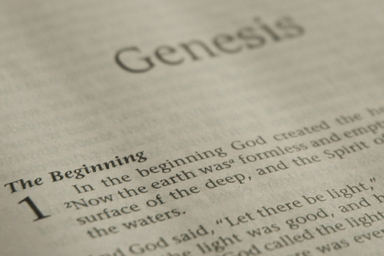
GENESIS STRUCTURE
Beginning of the Human race (Gen. 1‒11)
Beginning of the Hebrew race (Gen. 12‒50)

Slide 4
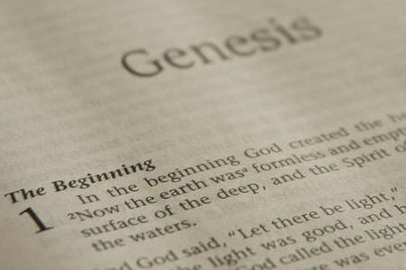
GENESIS STRUCTURE
Genesis 1-11 (four events)
Creation (1-2)
Fall (3-5)
Flood (6-9)
National dispersion (10-11)

Slide 5
Contradictory Account of Creation?
Genesis 1 – Overview of the whole creation
Genesis 2 – Details surrounding the creation of the garden, the first man, and his activities on day 6.

Slide 6
Genesis 1:1–2:3 Outline
Original creation on the first day (Gen 1:1)
Original creation in its unfilled and unformed state (Gen 1:2)
Creation week (Gen 1:3–2:3): “And God said,” “good”
First day 1:3-5
Second day 1:6-8
Third day 1:9-13
Fourth day 1:14-19
Fifth day 1:20-23
Sixth day 1:24-31
Seventh day 2:1-3

Slide 7
Key Issues in Genesis 1
Importance of Gen. 1:1
Gap Theory?
Length of the creation days
Canopy Theory (day 2)
Light before the sun (day 4)
Creation of man (day 6)
Sabbath (day 7)
Evolution?
Notes:
Outline

Slide 8
Genesis 1:1–2:3 Outline
Original creation on the first day (Gen 1:1)
Original creation in its unfilled and unformed state (Gen 1:2)
Creation week (Gen 1:3–2:3): “And God said,” “good”
First day 1:3-5
Second day 1:6-8
Third day 1:9-13
Fourth day 1:14-19
Fifth day 1:20-23
Sixth day 1:24-31
Seventh day 2:1-3

Slide 9
Key Issues in Genesis 1
Importance of Gen. 1:1
Gap Theory?
Length of the creation days
Canopy Theory (day 2)
Light before the sun (day 4)
Creation of man (day 6)
Sabbath (day 7)
Evolution?
Notes:
Outline

Slide 10
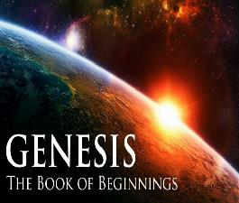
Refutation of Man’s Philosophies (Gen 1:1)
Atheism – God created (Ps. 14:1)
Pantheism – God is transcendent over creation
Polytheism – One God created (Deut. 6:4; Isa 43:11; 44:6; 45:5)
Materialism – Matter began
Dualism – God alone created (Ezek. 28:13, 15)
Humanism – God rather than man created
Naturalism – God created
Morris, Genesis Record, 38

Slide 11
Genesis 1:1–2:3 Outline
Original creation on the first day (Gen 1:1)
Original creation in its unfilled and unformed state (Gen 1:2)
Creation week (Gen 1:3–2:3): “And God said,” “good”
First day 1:3-5
Second day 1:6-8
Third day 1:9-13
Fourth day 1:14-19
Fifth day 1:20-23
Sixth day 1:24-31
Seventh day 2:1-3

Slide 12
Genesis 1:1-3
Original creation view = no creation before creation
1:1 God’s original creation on the first day
1:2 Description of this original creation in its original state and described through the use of three circumstantial participles
Unfilled & unformed (tohu and bohu)
Darkness = no physical light (Gen. 1:3)
Spirit = anticipation
1:3-31 Filling and forming process

Slide 13
Genesis 1:1–2:3 Outline
Original creation on the first day (Gen 1:1)
Original creation in its unfilled and unformed state (Gen 1:2)
Creation week (Gen 1:3–2:3): “And God said,” “good”
First day 1:3-5
Second day 1:6-8
Third day 1:9-13
Fourth day 1:14-19
Fifth day 1:20-23
Sixth day 1:24-31
Seventh day 2:1-3

Slide 14
Genesis 1:1–2:3 Outline
Original creation on the first day (Gen 1:1)
Original creation in its unfilled and unformed state (Gen 1:2)
Creation week (Gen 1:3–2:3): “And God said,” “good”
First day 1:3-5
Second day 1:6-8
Third day 1:9-13
Fourth day 1:14-19
Fifth day 1:20-23
Sixth day 1:24-31
Seventh day 2:1-3

Slide 15
Genesis 1:1-3
“¹ In the beginning God created the heavens and the earth. ² The earth was formless and void, and darkness was over the surface of the deep, and the Spirit of God was moving over the surface of the waters. ³ Then God said, ‘Let there be light’; and there was light.”

Slide 16
Key Issues in Genesis 1
Importance of Gen. 1:1
Gap Theory?
Length of the creation days
Canopy Theory (day 2)
Light before the sun (day 4)
Creation of man (day 6)
Sabbath (day 7)
Evolution?

Slide 17
Days of Creation
Revelatory Days
Solar Non-consecutive Days
Day Age Theory
Solar And Consecutive Days

Slide 18
Days of Creation
Revelatory Days
Solar Non-consecutive Days
Day Age Theory
Solar And Consecutive Days

Slide 19
Days of Revelation?
Definition
Asah = “to show” (Gen 24:12) in Exodus 20:11
Asah (Gen 1:26) and bara (Gen 1:27)

Slide 20
Solar Non-Consecutive Days?
Exodus 20:11
This is the account of the heavens and the earth when they were created (bara), in the day that the Lord God made (asah) earth and heaven.

Slide 21
Days of Revelation?
Gen 1:26-27
²⁶ Then God said, “Let Us make (asah) man in Our image, according to Our likeness; and let them rule over the fish of the sea and over the birds of the sky and over the cattle and over all the earth, and over every creeping thing that creeps on the earth.” ²⁷ God created man in His own image, in the image of God He created (bara) him; male and female He created them.

Slide 22
Days of Revelation?
Gen 2:4
This is the account of the heavens and the earth when they were created (bara), in the day that the Lord God made (asah) earth and heaven.
Isaiah 43:7
Everyone who is called by My name, And whom I have created (bara) for My glory, Whom I have formed, even whom I have made (asah).

Slide 23
Solar Non-Consecutive Days?
Exodus 20:11
This is the account of the heavens and the earth when they were created (bara), in the day that the Lord God made (asah) earth and heaven.

Slide 24
Illegitimate Totality Transfer
“Unwarranted adoption of an expanded semantic field: The fallacy in this instance lies in the supposition that the meaning of a word in a specific context is much broader than the context itself allows and may bring with it the word’s entire semantic range. This step is sometimes called illegitimate totality transfer.”
D. A. Carson, Exegetical Fallacies, 2nd ed. (Grand Rapids, MI: Baker Academic, 1996), 60-61.

Slide 25
George Gunn
John 14:1-3 – The Father’s House: Are We There Yet?, 30. www.pre-trib.org
I ran out of ingredients for the salad, so I decided to make a quick run down to the store. While at the store, I left the car engine running while I made my purchase, thinking that I would be right out again. However, while I was in the store, I ran into my good friend Edward who was running for county supervisor. This resulted in my having to endure a somewhat long-winded rundown on how his campaign was running. Finally, fearing that my car would run out of gas, I ran with great haste out to the parking lot and returned home with the car surely running only on fumes.

Slide 26
Days of Creation
Revelatory Days
Solar Non-consecutive Days
Day Age Theory
Solar And Consecutive Days

Slide 27
Solar Non-Consecutive Days?
Exodus 20:8-11
⁸ “Remember the sabbath day, to keep it holy. ⁹ Six days you shall labor and do all your work, ¹⁰ but the seventh day is a sabbath of the Lord your God; in it you shall not do any work, you or your son or your daughter, your male or your female servant or your cattle or your sojourner who stays with you. ¹¹ For in six days the Lord made the heavens and the earth, the sea and all that is in them, and rested on the seventh day; therefore the Lord blessed the sabbath day and made it holy.

Slide 28
Solar Non-Consecutive Days?
Exodus 31:15-17
¹⁵ ‘For six days work may be done, but on the seventh day there is a sabbath of complete rest, holy to the Lord; whoever does any work on the sabbath day shall surely be put to death. ¹⁶ ‘So the sons of Israel shall observe the sabbath, to celebrate the sabbath throughout their generations as a perpetual covenant.’ ¹⁷ “It is a sign between Me and the sons of Israel forever; for in six days the Lord made heaven and earth, but on the seventh day He ceased from labor, and was refreshed.”

Slide 29
Days of Creation
Revelatory Days
Solar Non-consecutive Days
Day Age Theory
Solar And Consecutive Days

Slide 30
Day Age?
2 Peter 3:8
But do not let this one fact escape your notice, beloved, that with the Lord one day is like a thousand years, and a thousand years like one day.
Genesis 2:4?
This is the account of the heavens and the earth when they were created, in the day that the LORD God made earth and heaven.

Slide 31
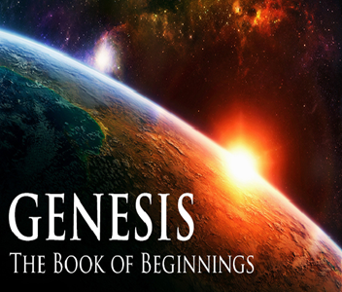
Ken Ham et al, Answers in Genesis, rev ed. (Green Forest, AR: Master Books, 1990), 37-emphasis mine.
“Back in my father’s day, it took ten days to drive across the Australian outback during the day.”

Slide 32
George Gunn
John 14:1-3-The Father’s House: Are We There Yet?, 30. www.pre-trib.org
I ran out of ingredients for the salad, so I decided to make a quick run down to the store. While at the store, I left the car engine running while I made my purchase, thinking that I would be right out again. However, while I was in the store, I ran into my good friend Edward who was running for county supervisor. This resulted in my having to endure a somewhat long-winded run down on how his campaign was running. Finally, fearing that my car would run out of gas, I ran with great haste out to the parking lot and returned home with the car surely running only on fumes.

Slide 33
Alternative Ways of Describing Ages
Olam
Attached adjective “long” (rab) to the word “day” (yom)

Slide 34
Alternative Ways of Describing Ages
Olam
Attached adjective “long” (rab) to the word “day” (yom)

Slide 35
Psalm 90:2
“Before the mountains were born Or You gave birth to the earth and the world, Even from everlasting (olam) to everlasting (olam), You are God.”

Slide 36
Exodus 21:2, 5-6
² “If you buy a Hebrew servant, he shall serve six years; and in the seventh he shall go out free and pay nothing…⁵ But if the servant plainly says, ‘I love my master, my wife, and my children; I will not go out free,’. ⁶ then his master shall bring him to the judges. He shall also bring him to the door, or to the doorpost, and his master shall pierce his ear with an awl; and he shall serve him forever (olam).”

Slide 37
Alternative Ways of Describing Ages
Olam
Attached adjective “long” (rab) to the word “day” (yom)

Slide 38
10 Ways of Communicating Ages in Gen 1
yāmîm – with “evening and morning” = many days of evening and morning | tamîd – continually, forever
dōr – generation, period | `orek – with yom = length of days
`ad – ancient, forever | zemān – season, time
qedem – of old, ancient time | `et – time
netsach – always, everlasting, forever | mô `ēd – time, season
Jonathan Sarfati, Refuting Compromise (Green Forest, AR: Master Books), 327-28

Slide 39
Days of Creation
Revelatory Days
Solar Non-consecutive Days
Day Age Theory
Solar And Consecutive Days

Slide 40
Ordinary and Consecutive Days?
Numerical ordinal modifier used 359 times outside of Genesis 1-2 (Joshua 6:3; Esther 4:16)
“Evening and morning” used 38 times outside of Genesis 1-2
Exodus 20:8-11; 31:17
Adam’s age (Gen. 5:5)

Slide 41
Solar Non-Consecutive Days?
Exodus 20:8-11
⁸ “Remember the sabbath day, to keep it holy. ⁹ Six days you shall labor and do all your work, ¹⁰ but the seventh day is a sabbath of the Lord your God; in it you shall not do any work, you or your son or your daughter, your male or your female servant or your cattle or your sojourner who stays with you. ¹¹ For in six days the Lord made the heavens and the earth, the sea and all that is in them, and rested on the seventh day; therefore the Lord blessed the sabbath day and made it holy.

Slide 42
Solar Non-Consecutive Days?
Exodus 31:15-17
¹⁵ ‘For six days work may be done, but on the seventh day there is a sabbath of complete rest, holy to the Lord; whoever does any work on the sabbath day shall surely be put to death. ¹⁶ ‘So the sons of Israel shall observe the sabbath, to celebrate the sabbath throughout their generations as a perpetual covenant.’ ¹⁷ “It is a sign between Me and the sons of Israel forever; for in six days the Lord made heaven and earth, but on the seventh day He ceased from labor, and was refreshed.”

Slide 43
Ordinary and Consecutive Days?
Numerical ordinal modifier used 359 times outside of Genesis 1-2 (Joshua 6:3; Esther 4:16)
“Evening and morning” used 38 times outside of Genesis 1-2
Exodus 20:8-11; 31:17
Adam’s age (Gen. 5:5)

Slide 44
Gleason Archer
Survey of Old Testament Introduction (Chicago, IL: Moody Press, 1994), 196-97-emphasis mine.
“From a superficial reading of Genesis 1, the impression would seem to be that the entire creative process took place in six twenty-four-hour days. This seems to run counter to modern scientific research, which indicates that planet earth was created several billion years ago.”

Slide 45
Genesis 1:1–2:3 Outline
Original creation on the first day (Gen 1:1)
Original creation in its unfilled and unformed state (Gen 1:2)
Creation week (Gen 1:3–2:3): “And God said,” “good”
First day 1:3-5
Second day 1:6-8
Third day 1:9-13
Fourth day 1:14-19
Fifth day 1:20-23
Sixth day 1:24-31
Seventh day 2:1-3

Slide 46
Key Issues in Genesis 1
Importance of Gen. 1:1
Gap Theory?
Length of the creation days
Canopy Theory (day 2)
Light before the sun (day 4)
Creation of man (day 6)
Sabbath (day 7)
Evolution?

Slide 47
Day 2 Canopy Theory (Gen 1:6-8)
Implied – Gen. 1:6-7; Ps. 148:4
Explains
Long life spans of early man-Gen. 5:5, 27
Strange beasts (Gen. 1:24-25; Job 40‒41)
Where the flood waters came from (Gen. 2:5-6)
Why man’s post-flood life span cut short (Gen. 11:24-25)

Slide 48
Day 2 Canopy Theory (Gen 1:6-8)
Implied – Gen. 1:6-7; Ps. 148:4
Explains
Long life spans of early man-Gen. 5:5, 27
Strange beasts (Gen. 1:24-25; Job 40‒41)
Where the flood waters came from (Gen. 2:5-6)
Why man’s post-flood life span cut short (Gen. 11:24-25)

Slide 49
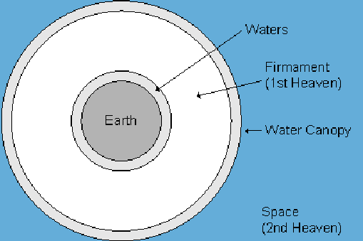

Slide 51
Day 2 Canopy Theory (Gen 1:6-8)
Implied – Gen. 1:6-7; Ps. 148:4
Explains
Long life spans of early man-Gen. 5:5, 27
Strange beasts (Gen. 1:24-25; Job 40‒41)
Where the flood waters came from (Gen. 2:5-6)
Why man’s post-flood life span cut short (Gen. 11:24-25)

Slide 52
Day 2 Canopy Theory (Gen 1:6-8)
Implied – Gen. 1:6-7; Ps. 148:4
Explains
Long life spans of early man-Gen. 5:5, 27
Strange beasts (Gen. 1:24-25; Job 40‒41)
Where the flood waters came from (Gen. 2:5-6)
Why man’s post-flood life span cut short (Gen. 11:24-25)

Slide 53
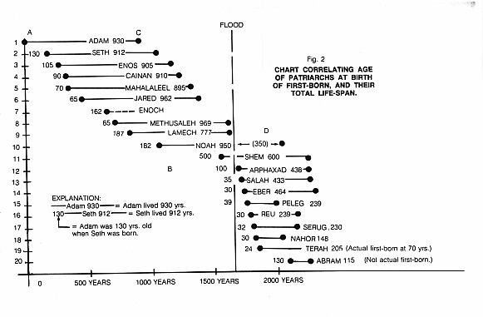

Slide 54
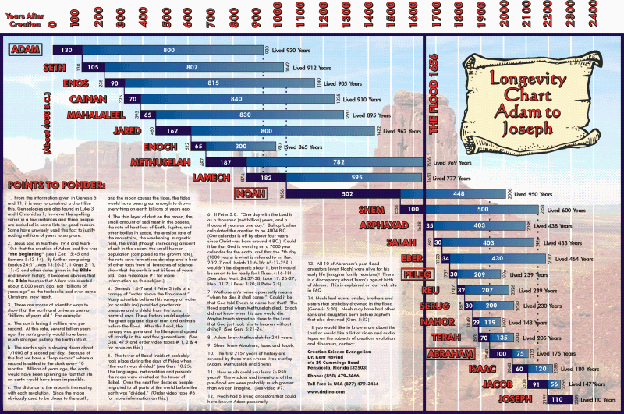

Slide 55
Day 2 Canopy Theory (Gen 1:6-8)
Implied – Gen. 1:6-7; Ps. 148:4
Explains
Long life spans of early man-Gen. 5:5, 27
Strange beasts (Gen. 1:24-25; Job 40‒41)
Where the flood waters came from (Gen. 2:5-6)
Why man’s post-flood life span cut short (Gen. 11:24-25)

Slide 56
Day 2 Canopy Theory (Gen 1:6-8)
Implied – Gen. 1:6-7; Ps. 148:4
Explains
Long life spans of early man-Gen. 5:5, 27
Strange beasts (Gen. 1:24-25; Job 40‒41)
Where the flood waters came from (Gen. 2:5-6)
Why man’s post-flood life span cut short (Gen. 11:24-25)

Slide 57
Day 2 Canopy Theory (Gen 1:6-8)
Implied – Gen. 1:6-7; Ps. 148:4
Explains
Long life spans of early man-Gen. 5:5, 27
Strange beasts (Gen. 1:24-25; Job 40‒41)
Where the flood waters came from (Gen. 2:5-6)
Why man’s post-flood life span cut short (Gen. 11:24-25)

Slide 60
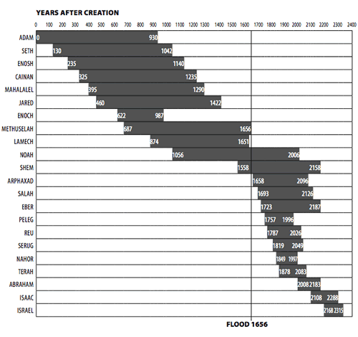

Slide 61
Genesis 1:1–2:3 Outline
Original creation on the first day (Gen 1:1)
Original creation in its unfilled and unformed state (Gen 1:2)
Creation week (Gen 1:3–2:3): “And God said,” “good”
First day 1:3-5
Second day 1:6-8
Third day 1:9-13
Fourth day 1:14-19
Fifth day 1:20-23
Sixth day 1:24-31
Seventh day 2:1-3

Slide 62
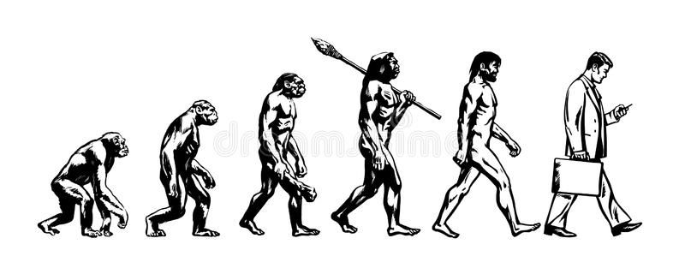

Slide 63
Genesis 1:1–2:3 Outline
Original creation on the first day (Gen 1:1)
Original creation in its unfilled and unformed state (Gen 1:2)
Creation week (Gen 1:3–2:3): “And God said,” “good”
First day 1:3-5
Second day 1:6-8
Third day 1:9-13
Fourth day 1:14-19
Fifth day 1:20-23
Sixth day 1:24-31
Seventh day 2:1-3

Slide 64
Shaping and Populating (Gen 1:1)
Day 1: | Light | Day 4: | Luminaries
Day 2: | Water, sky | Day 5: | Sea animals, birds
Day 3: | Land, vegetation | Day 6: | Land animals, man

Slide 66
Key Issues in Genesis 1
Importance of Gen. 1:1
Gap Theory?
Length of the creation days
Canopy Theory (day 2)
Light before the sun (day 4)
Creation of man (day 6)
Sabbath (day 7)
Evolution?

Slide 67
Genesis 1:1-3
“¹ In the beginning God created the heavens and the earth. ² The earth was formless and void, and darkness was over the surface of the deep, and the Spirit of God was moving over the surface of the waters. ³ Then God said, ‘Let there be light’; and there was light.”

Slide 68
Day 4 Light Before the Sun? (Gen. 1:3; Gen 1:14-19)
God can create light independently without the use of a secondary source
Revelation 21:23; 22:5
Deuteronomy 4:19

Slide 69
Day 4 Light Before the Sun? (Gen. 1:3; Gen 1:14-19)
God can create light independently without the use of a secondary source
Revelation 21:23; 22:5
Deuteronomy 4:19

Slide 70
Day 4 Light Before the Sun? (Gen. 1:3; Gen 1:14-19)
God can create light independently without the use of a secondary source
Revelation 21:23; 22:5
Deuteronomy 4:19

Slide 72
Day 4 Light Before the Sun? (Gen. 1:3; Gen 1:14-19)
God can create light independently without the use of a secondary source
Revelation 21:23; 22:5
Deuteronomy 4:19

Slide 73
Deuteronomy 4:19
“And beware not to lift up your eyes to heaven and see the sun and the moon and the stars, all the host of heaven, and be drawn away and worship them and serve them, those which the Lord your God has allotted to all the peoples under the whole heaven.”

Slide 74
Light only Revealed on Day 4?
Luminaries not created on day 4 but only became visible to someone standing upon the earth?
Big bang cosmology indicating that the sun preceded the earth
Man not created until day 6
Asah = “to show” (Gen 1:16; 24:12) yet asah (Gen 1:26) and bara (Gen 1:27)
Raah = “Appear” (Gen 1:9)

Slide 75
Genesis 1:1–2:3 Outline
Original creation on the first day (Gen 1:1)
Original creation in its unfilled and unformed state (Gen 1:2)
Creation week (Gen 1:3–2:3): “And God said,” “good”
First day 1:3-5
Second day 1:6-8
Third day 1:9-13
Fourth day 1:14-19
Fifth day 1:20-23
Sixth day 1:24-31
Seventh day 2:1-3

Slide 76
Genesis 1:1–2:3 Outline
Original creation on the first day (Gen 1:1)
Original creation in its unfilled and unformed state (Gen 1:2)
Creation week (Gen 1:3–2:3): “And God said,” “good”
First day 1:3-5
Second day 1:6-8
Third day 1:9-13
Fourth day 1:14-19
Fifth day 1:20-23
Sixth day 1:24-31
Seventh day 2:1-3

Slide 77
Key Issues in Genesis 1
Importance of Gen. 1:1
Gap Theory?
Length of the creation days
Canopy Theory (day 2)
Light before the sun (day 4)
Creation of man (day 6)
Sabbath (day 7)
Evolution?

Slide 78
Day 6 Theocratic Administrator (Gen 1:24-31)
Land animals (Gen. 1:24-25)
Man (Gen. 1:26-28)
Office of Theocratic Administrator
Beginning of kingdom program
Animal & man as vegetarian (Gen. 1:29-30; 2:17; 9:3)
The perfection of creation (Gen. 1:31)

Slide 79
Day 6 Theocratic Administrator (Gen 1:24-31)
Land animals (Gen. 1:24-25)
Man (Gen. 1:26-28)
Office of Theocratic Administrator
Beginning of kingdom program
Animal & man as vegetarian (Gen. 1:29-30; 2:17; 9:3)
The perfection of creation (Gen. 1:31)

Slide 80
Day 6 Theocratic Administrator (Gen 1:24-31)
Land animals (Gen. 1:24-25)
Man (Gen. 1:26-28)
Office of Theocratic Administrator
Beginning of kingdom program
Animal & man as vegetarian (Gen. 1:29-30; 2:17; 9:3)
The perfection of creation (Gen. 1:31)

Slide 81
Genesis 1:26-28
²⁶ Then God said, “Let Us make man in Our image, according to Our likeness; and let them rule over the fish of the sea and over the birds of the sky and over the cattle and over all the earth, and over every creeping thing that creeps on the earth.” ²⁷ God created man in His own image, in the image of God He created him; male and female He created them. ²⁸ God blessed them; and God said to them, “Be fruitful and multiply, and fill the earth, and subdue it; and rule over the fish of the sea and over the birds of the sky and over every living thing that moves on the earth.”

Slide 82
Genesis 1:26-28
²⁶ Then God said, “Let Us make man in Our image, according to Our likeness; and let them rule over the fish of the sea and over the birds of the sky and over the cattle and over all the earth, and over every creeping thing that creeps on the earth.” ²⁷ God created man in His own image, in the image of God He created him; male and female He created them. ²⁸ God blessed them; and God said to them, “Be fruitful and multiply, and fill the earth, and subdue it; and rule over the fish of the sea and over the birds of the sky and over every living thing that moves on the earth.”

Slide 83
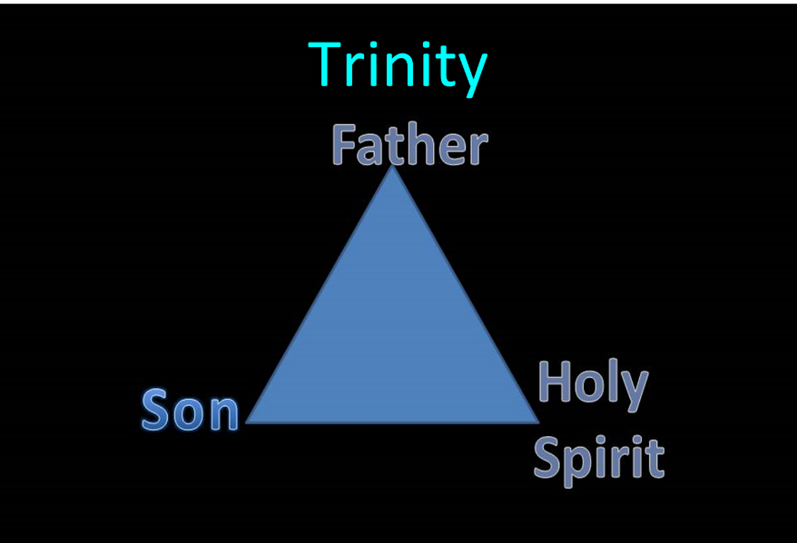
Trinitarianism in Genesis
Gen 1:26
Gen 3:22
Gen 11:7
Isa 6:8

Slide 84
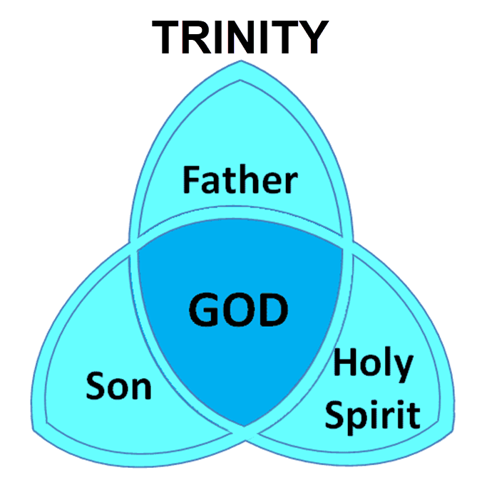

Slide 85
Genesis 1:26-28
²⁶ Then God said, “Let Us make man in Our image, according to Our likeness; and let them rule over the fish of the sea and over the birds of the sky and over the cattle and over all the earth, and over every creeping thing that creeps on the earth.” ²⁷ God created man in His own image, in the image of God He created him; male and female He created them. ²⁸ God blessed them; and God said to them, “Be fruitful and multiply, and fill the earth, and subdue it; and rule over the fish of the sea and over the birds of the sky and over every living thing that moves on the earth.”

Slide 86
Genesis 1:26-28
²⁶ Then God said, “Let Us make man in Our image, according to Our likeness; and let them rule over the fish of the sea and over the birds of the sky and over the cattle and over all the earth, and over every creeping thing that creeps on the earth.” ²⁷ God created man in His own image, in the image of God He created him; male and female He created them. ²⁸ God blessed them; and God said to them, “Be fruitful and multiply, and fill the earth, and subdue it; and rule over the fish of the sea and over the birds of the sky and over every living thing that moves on the earth.”

Slide 87
Day 6 Theocratic Administrator (Gen 1:24-31)
Land animals (Gen. 1:24-25)
Man (Gen. 1:26-28)
Office of Theocratic Administrator
Beginning of kingdom program
Animal & man as vegetarian (Gen. 1:29-30; 2:17; 9:3)
The perfection of creation (Gen. 1:31)

Slide 88
Genesis 1:26-28
²⁶ Then God said, “Let Us make man in Our image, according to Our likeness; and let them rule over the fish of the sea and over the birds of the sky and over the cattle and over all the earth, and over every creeping thing that creeps on the earth.” ²⁷ God created man in His own image, in the image of God He created him; male and female He created them. ²⁸ God blessed them; and God said to them, “Be fruitful and multiply, and fill the earth, and subdue it; and rule over the fish of the sea and over the birds of the sky and over every living thing that moves on the earth.”

Slide 90
Day 6 Theocratic Administrator (Gen 1:24-31)
Land animals (Gen. 1:24-25)
Man (Gen. 1:26-28)
Office of Theocratic Administrator
Beginning of kingdom program
Animal & man as vegetarian (Gen. 1:29-30; 2:17; 9:3)
The perfection of creation (Gen. 1:31)

Slide 92
Charles Ryrie
Basic Theology. Page 511
“Why is an earthly kingdom necessary? Did He not receive His inheritance when He was raised and exalted in heaven? Is not His present rule His inheritance? Why does there need to be an earthly kingdom? Because He must be triumphant in the same arena where His was seemingly defeated. His rejection by the rulers of this world was on this earth (1 Cor. 2:8). His exaltation must also be on this earth. And so it shall be when He comes again to rule this world in righteousness. He has waited long for His inheritance; soon He shall receive it.”

Slide 93
J. Dwight Pentecost Thy kingdom Come, Page 316
“Apart from the reign of Christ…here on earth…And apart from this rule, God’s purpose for man would never be brought to conclusion. God’s purpose for the earth would be unrealized and the problem generated by Satan’s rebellion would never be resolved. Thus the physical, literal reign of Christ on the earth is a theological and biblical necessity—unless Satan is victorious over God.”

Slide 94
Mark Hitchcock The End, Page 421-22
“Johahn Sebastian Bach sometimes slept more than he should have. His children had a unique way of waking him up. They would go to the piano and begin to play a composition. When they would get to the last note, they would stop. They wouldn't play the last note. It worked like a charm, and it would always wake him up. He would get up from his sleep, go to the piano, and play the final chord. He couldn't stand to leave it hanging there incomplete – unfinished. In the same way today, we are all waiting for the last note on the final page of God's song of victory. God will not leave His grand composition without striking the final note. That final note is the messianic Kingdom of Jesus Christ.”

Slide 95
Day 6 Theocratic Administrator (Gen 1:24-31)
Land animals (Gen. 1:24-25)
Man (Gen. 1:26-28)
Office of Theocratic Administrator
Beginning of kingdom program
Animal & man as vegetarian (Gen. 1:29-30; 2:17; 9:3)
The perfection of creation (Gen. 1:31)

Slide 96
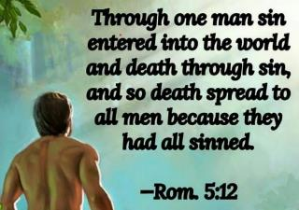
Genesis 1:29-30
“²⁹ Then God said, ‘Behold, I have given you every plant yielding seed that is on the surface of all the earth, and every tree which has fruit yielding seed; it shall be food for you; ³⁰ and to every beast of the earth and to every bird of the sky and to every thing that moves on the earth which has life, I have given every green plant for food’; and it was so.”

Slide 97
Genesis 2:16-17
“¹⁶ The Lord God commanded the man, saying, ‘From any tree of the garden you may eat freely; ¹⁷ but from the tree of the knowledge of good and evil you shall not eat, for in the day that you eat from it you will surely die (muwth).’”

Slide 98
Genesis 3:19
“¹⁹ By the sweat of your face You will eat bread, Till you return to the ground, Because from it you were taken; For you are dust, And to dust you shall return.”

Slide 99
Genesis 9:3
“³ Every moving thing that is alive shall be food for you; I give all to you, as I gave the green plant.”

Slide 100
Day 6 Theocratic Administrator (Gen 1:24-31)
Land animals (Gen. 1:24-25)
Man (Gen. 1:26-28)
Office of Theocratic Administrator
Beginning of kingdom program
Animal & man as vegetarian (Gen. 1:29-30; 2:17; 9:3)
The perfection of creation (Gen. 1:31)

Slide 101
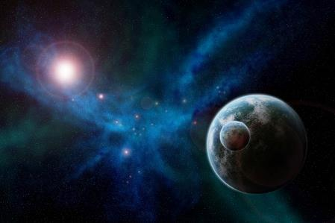
Genesis 1:31
“God saw all that He had made, and behold, it was very good. And there was evening and there was morning, the sixth day.”

Slide 102
Renald Showers
Renald Showers, Those Invisible Spirits Called Angels (Bellmawr, NJ: Friends of Israel, 1997), 82-83.
“When did Satan fall away from God? We noted earlier that sin was nonexistent in every part of God‘s creation, including the angels, through the end of the sixth or final day of creation (Gen. 1:31). Satan‘s fall therefore took place after the end of creation. However, Satan was evil by the time he came to earth to tempt man to fall away from God (Gen. 3). These things prompt the conclusion that Satan‘s fall took place in the interval between the end of creation and the fall of man. How long was the interval? It must have been quite short because when God created the first man and woman, he commanded them to be fruitful and multiply through procreation (Gen. 1:27–28), but there was no human conception until after the fall of man (Gen. 4:1).”

Slide 103
Genesis 1:1–2:3 Outline
Original creation on the first day (Gen 1:1)
Original creation in its unfilled and unformed state (Gen 1:2)
Creation week (Gen 1:3–2:3): “And God said,” “good”
First day 1:3-5
Second day 1:6-8
Third day 1:9-13
Fourth day 1:14-19
Fifth day 1:20-23
Sixth day 1:24-31
Seventh day 2:1-3

Slide 104
Genesis 2:1-3
“¹ Thus the heavens and the earth were completed, and all their hosts. ² By the seventh day God completed His work which He had done, and He rested on the seventh day from all His work which He had done. ³ Then God blessed the seventh day and sanctified it, because in it He rested from all His work which God had created and made.”

Slide 105
Key Issues in Genesis 1
Importance of Gen. 1:1
Gap Theory?
Length of the creation days
Canopy Theory (day 2)
Light before the sun (day 4)
Creation of man (day 6)
Sabbath (day 7)
Evolution?

Slide 106
Genesis 2:1-3
“¹ Thus the heavens and the earth were completed, and all their hosts. ² By the seventh day God completed His work which He had done, and He rested on the seventh day from all His work which He had done. ³ Then God blessed the seventh day and sanctified it, because in it He rested from all His work which God had created and made.”

Slide 107
Day 7 Sabbath (Gen 2:1-3)
The Lord rested
Sabbath pattern (Exod. 20:8-11; 31:15-17)
7th day continues?
Creation is past (Heb. 4:3-4)
Absence of “evening and morning”
Yom + ordinal modifier

Slide 108
Day 7 Sabbath (Gen 2:1-3)
The Lord rested
Sabbath pattern (Exod. 20:8-11; 31:15-17)
7th day continues?
Creation is past (Heb. 4:3-4)
Absence of “evening and morning”
Yom + ordinal modifier

Slide 109
Day 7 Sabbath (Gen 2:1-3)
The Lord rested
Sabbath pattern (Exod. 20:8-11; 31:15-17)
7th day continues?
Creation is past (Heb. 4:3-4)
Absence of “evening and morning”
Yom + ordinal modifier

Slide 110
Exodus 20:8-11
⁸ “Remember the sabbath day, to keep it holy. ⁹ Six days you shall labor and do all your work, ¹⁰ but the seventh day is a sabbath of the Lord your God; in it you shall not do any work, you or your son or your daughter, your male or your female servant or your cattle or your sojourner who stays with you. ¹¹ For in six days the Lord made the heavens and the earth, the sea and all that is in them, and rested on the seventh day; therefore the Lord blessed the sabbath day and made it holy.”

Slide 111
Exodus 31:15-17
¹⁵ ‘For six days work may be done, but on the seventh day there is a sabbath of complete rest, holy to the Lord; whoever does any work on the sabbath day shall surely be put to death. ¹⁶ ‘So the sons of Israel shall observe the sabbath, to celebrate the sabbath throughout their generations as a perpetual covenant.’ ¹⁷ “It is a sign between Me and the sons of Israel forever; for in six days the Lord made heaven and earth, but on the seventh day He ceased from labor, and was refreshed.”

Slide 112
Day 7 Sabbath (Gen 2:1-3)
The Lord rested
Sabbath pattern (Exod. 20:8-11; 31:15-17)
7th day continues?
Creation is past (Heb. 4:3-4)
Absence of “evening and morning”
Yom + ordinal modifier

Slide 113
Day 7 Sabbath (Gen 2:1-3)
The Lord rested
Sabbath pattern (Exod. 20:8-11; 31:15-17)
7th day continues?
Creation is past (Heb. 4:3-4)
Absence of “evening and morning”
Yom + ordinal modifier

Slide 114
Day 7 Sabbath (Gen 2:1-3)
The Lord rested
Sabbath pattern (Exod. 20:8-11; 31:15-17)
7th day continues?
Creation is past (Heb. 4:3-4)
Absence of “evening and morning”
Yom + ordinal modifier

Slide 115
Day 7 Sabbath (Gen 2:1-3)
The Lord rested
Sabbath pattern (Exod. 20:8-11; 31:15-17)
7th day continues?
Creation is past (Heb. 4:3-4)
Absence of “evening and morning”
Yom + ordinal modifier

Slide 116
Genesis 2:1-3
“¹ Thus the heavens and the earth were completed, and all their hosts. ² By the seventh day God completed His work which He had done, and He rested on the seventh day from all His work which He had done. ³ Then God blessed the seventh day and sanctified it, because in it He rested from all His work which God had created and made.”

Slide 117
Key Issues in Genesis 1
Importance of Gen. 1:1
Gap Theory?
Length of the creation days
Canopy Theory (day 2)
Light before the sun (day 4)
Creation of man (day 6)
Sabbath (day 7)
Evolution?

Slide 118
Origin of Man
Two views
Evolution
Creation

Slide 119
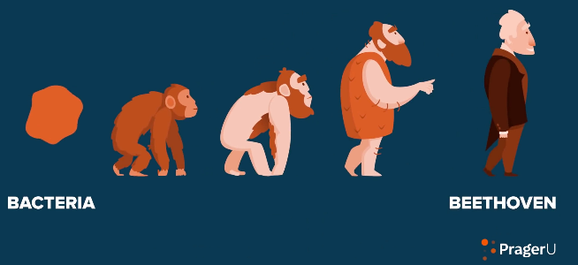
Evolution Wikapedia
Definition – A gradual process in which something changes into a different and usually more complex or better form. Change in the genetic composition of a population during successive generations, as a result of natural selection acting on the genetic variation among individuals, and resulting in the development of new species.

Slide 120
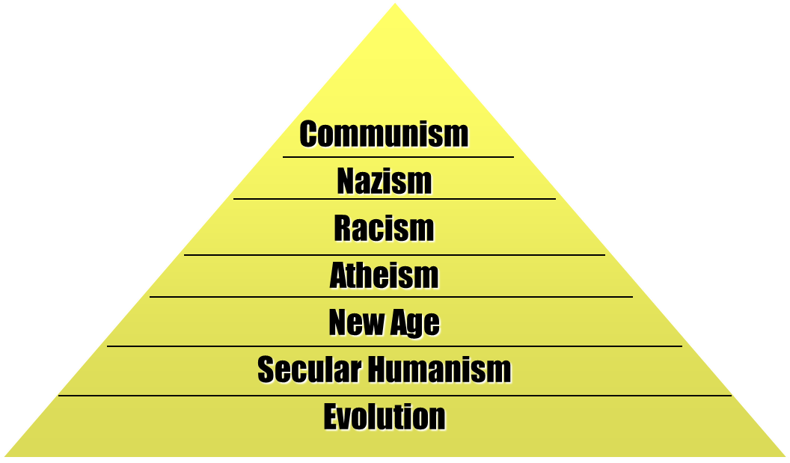
Source: Henry Morris, The Long War Against God

Slide 121
Intelligent Design Resources
Michael Behe – Darwin’s Black Box
Michael Denton – Evolution: A Theory in Crisis
Philip Johnson – Darwin on Trial
William Dembski – Intelligent Design
Marvin Lubenow – Bones of Contention

Slide 122
Evolution’s Flaws
The “missing link” is still missing
No design from randomness
Contradiction with scientific laws: Biogenesis, Second Law of Thermodynamics
Statistical improbabilities
Young earth clocks
Not conforming to the scientific method

Slide 123
Evolution’s Flaws
The “missing link” is still missing
No design from randomness
Contradiction with scientific laws: Biogenesis, Second Law of Thermodynamics
Statistical improbabilities
Young earth clocks
Not conforming to the scientific method

Slide 124
Missing Links
“Links are missing just where we most fervently desire them and its all too probable that many ‘links’ will continue to be missing.”
Alfred S. Romer, Genetics, Evolution, and Paleontology, p. 114

Slide 125
Missing Links
“Gradualism is a concept I believe in…Yet Gould and the American museum people are hard to contradict when they say that there are no transitional fossils..You say that I should show a photo of the fossil from which each type of organism was derived. I will lay it on the line-there is not one such fossil from which one could make an airtight argument…It is easy enough to make up stories of how one form gave rise to another, and to find reasons why the stages should be favoured by natural selection. But such stories are not part of science, for there is no way of putting them to the test.”
Colin Patterson of the British Museum of Natural History, Bible-Science Newsletter (Aug, 1981), p. 8.

Slide 126
Evolution’s Flaws
The “missing link” is still missing
No design from randomness
Contradiction with scientific laws: Biogenesis, Second Law of thermodynamics
Statistical improbabilities
Young earth clocks
Not conforming to the scientific method

Slide 127
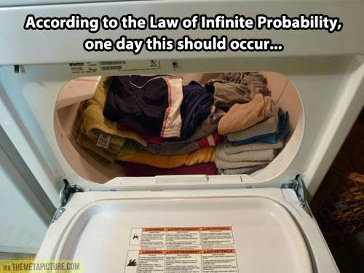

Slide 128
Evolution’s Flaws
The “missing link” is still missing
No design from randomness
Contradiction with scientific laws: Biogenesis, Second Law of thermodynamics
Statistical improbabilities
Young earth clocks
Not conforming to the scientific method

Slide 129
Evolution’s Flaws
The “missing link” is still missing
No design from randomness
Contradiction with scientific laws: Biogenesis, Second Law of thermodynamics
Statistical improbabilities
Young earth clocks
Not conforming to the scientific method

Slide 130
Evolution’s Flaws
The “missing link” is still missing
No design from randomness
Contradiction with scientific laws: Biogenesis, Second Law of thermodynamics
Statistical improbabilities
Young earth clocks
Not conforming to the scientific method

Slide 131
Evolution’s Flaws
The “missing link” is still missing
No design from randomness
Contradiction with scientific laws: Biogenesis, Second Law of thermodynamics
Statistical improbabilities
Young earth clocks
Not conforming to the scientific method

Slide 132
Why Evolution’s Popularity?
“The evolutionary origin of man relieves man of responsibility to a personal Creator outside of himself.”
Rom 1:18ff; 2 Pet. 3:5 (KJV)
Ryrie, Survey of Bible Doctrine, 101

Slide 133
Romans 1:18–20
¹⁸ For the wrath of God is revealed from heaven against all ungodliness and unrighteousness of men who suppress the truth in unrighteousness, ¹⁹ because that which is known about God is evident within them; for God made it evident to them. ²⁰ For since the creation of the world His invisible attributes, His eternal power and divine nature, have been clearly seen, being understood through what has been made, so that they are without excuse.

Slide 134
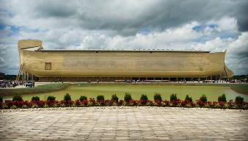
2 Peter 3:5 (KJV)
“For this they willingly are ignorant of [thelō], that by the word of God the heavens were of old, and the earth standing out of the water and in the water.”

Slide 135
Theistic Evolution?
Evolution | Gen 1:1–2:3
Naturalistic creation | Miraculous creation
Gen 1-11 is myth | Gen 1-11 is history
No creator/creation distinction | Ex-Nihilo creation (Ps. 33:6)
Light before the earth | Earth before the light
Took billions of years | Took 6 days
Luminaries before the earth | Earth before the luminaries (Deut 4:19; Rev. 21:23; 22:5)
Hot to cold | Cold (Gen 1:2) to hot (2 Pet 3:10)
Land before ocean | Ocean before land (Gen 1:9)
Present is key to past | God worked suddenly in the past (Job 38:4-7; Heb 11:3; 2 Peter 3:3-7)
Early rain on the earth | No rain until later (Gen 2:5-6; Heb 11:6-7)
List adapted from Walt Brown, In The Beginning, 276-80

Slide 136
Theistic Evolution?
Evolution | Gen 1:1–2:3
Naturalistic creation | Miraculous creation
Gen 1-11 is myth | Gen 1-11 is history
No creator/creation distinction | Ex-Nihilo creation (Ps. 33:6)
Light before the earth | Earth before the light
Took billions of years | Took 6 days
Luminaries before the earth | Earth before the luminaries (Deut 4:19; Rev. 21:23; 22:5)
Hot to cold | Cold (Gen 1:2) to hot (2 Pet 3:10)
Land before ocean | Ocean before land (Gen 1:9)
Present is key to past | God worked suddenly in the past (Job 38:4-7; Heb 11:3; 2 Peter 3:3-7)
Early rain on the earth | No rain until later (Gen 2:5-6; Heb 11:6-7)
List adapted from Walt Brown, In The Beginning, 276-80

Slide 137
Genesis 1:1-3
“¹ In the beginning God created the heavens and the earth. ² The earth was formless and void, and darkness was over the surface of the deep, and the Spirit of God was moving over the surface of the waters. ³ Then God said, ‘Let there be light’; and there was light.”

Slide 138
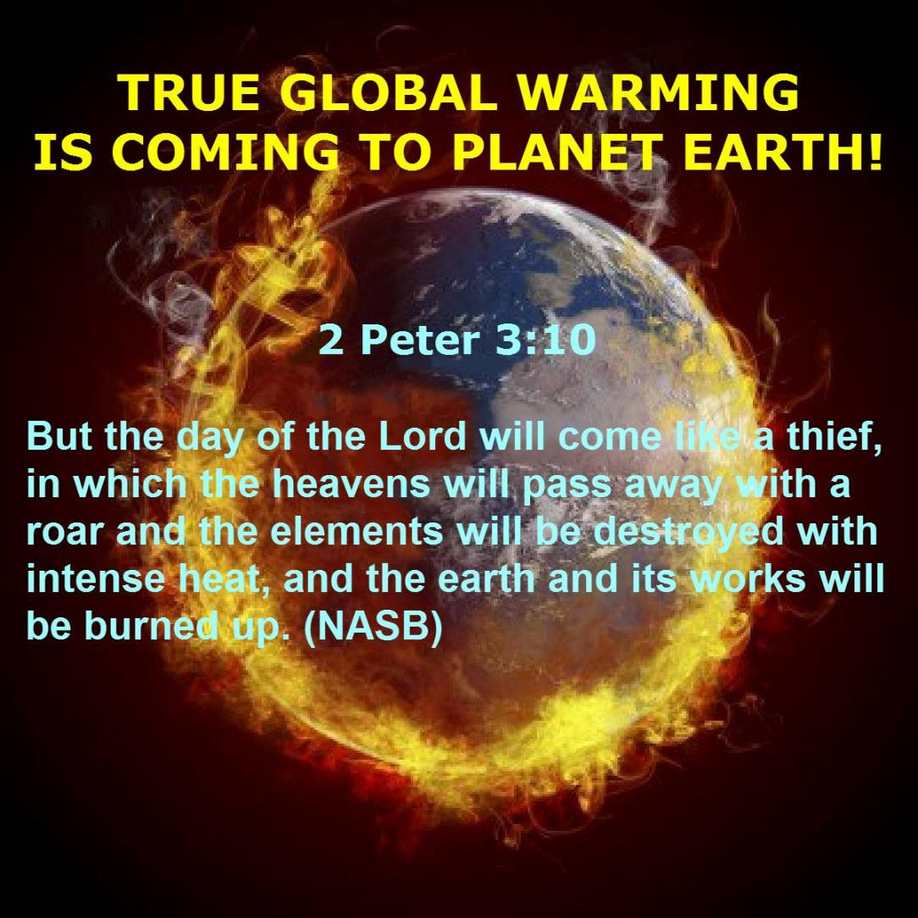

Slide 139
Theistic Evolution?
Evolution | Gen 1:1–2:3
Naturalistic creation | Miraculous creation
Gen 1-11 is myth | Gen 1-11 is history
No creator/creation distinction | Ex-Nihilo creation (Ps. 33:6)
Light before the earth | Earth before the light
Took billions of years | Took 6 days
Luminaries before the earth | Earth before the luminaries (Deut 4:19; Rev. 21:23; 22:5)
Hot to cold | Cold (Gen 1:2) to hot (2 Pet 3:10)
Land before ocean | Ocean before land (Gen 1:9)
Present is key to past | God worked suddenly in the past (Job 38:4-7; Heb 11:3; 2 Peter 3:3-7)
Early rain on the earth | No rain until later (Gen 2:5-6; Heb 11:6-7)
List adapted from Walt Brown, In The Beginning, 276-80

Slide 140
Theistic Evolution?
Evolution | Gen 1:1–2:3
Naturalistic creation | Miraculous creation
Gen 1-11 is myth | Gen 1-11 is history
No creator/creation distinction | Ex-Nihilo creation (Ps. 33:6)
Light before the earth | Earth before the light
Took billions of years | Took 6 days
Luminaries before the earth | Earth before the luminaries (Deut 4:19; Rev. 21:23; 22:5)
Hot to cold | Cold (Gen 1:2) to hot (2 Pet 3:10)
Land before ocean | Ocean before land (Gen 1:9)
Present is key to past | God worked suddenly in the past (Job 38:4-7; Heb 11:3; 2 Peter 3:3-7)
Early rain on the earth | No rain until later (Gen 2:5-6; Heb 11:6-7)
List adapted from Walt Brown, In The Beginning, 276-80

Slide 141
Uniformitarianism Defined
https://www.britannica.com/science/uniformitarianism
“Uniformitarianism, in geology, the doctrine suggesting that Earth’s geologic processes acted in the same manner and with essentially the same intensity in the past as they do in the present and that such uniformity is sufficient to account for all geologic change. This principle is fundamental to geologic thinking and underlies the whole development of the science of geology... When William Whewell, a University of Cambridge scholar, introduced the term in 1832, the prevailing view (called catastrophism) was that…Earth had originated through supernatural means and had been affected by a series of catastrophic events such as the biblical Flood. In contrast to catastrophism, uniformitarianism postulates that phenomena displayed in rocks may be entirely accounted for by geologic processes that continue to operate—in other words, the present is the key to the past.”

Slide 142
Uniformitarianism is not Biblicism
 | ERA | SCRIPTURE | DISTINCTIVES
1. | Creation | Genesis 1-2 | No death
2. | Fall | Genesis 3-6 | Death, painful pregnancy & toil, long life spans, no human government
3. | Flood | Genesis 7-10 | Shorter life spans, human government, one language, no nations
4. | Babel | Genesis 11-present | No global government, multiple languages, nations, ethnicities
5. | Antichrist | Rapture to 2nd Advent | Global government, restrainer removed
6. | Kingdom | Rev. 20:1-10 | Long life spans, kingdom conditions, reality of death, renovated earth
7. | Eternal State | Rev. 21-22 | No death, new earth

Slide 143
Theistic Evolution?
Evolution | Gen 1:1–2:3
Naturalistic creation | Miraculous creation
Gen 1-11 is myth | Gen 1-11 is history
No creator/creation distinction | Ex-Nihilo creation (Ps. 33:6)
Light before the earth | Earth before the light
Took billions of years | Took 6 days
Luminaries before the earth | Earth before the luminaries (Deut 4:19; Rev. 21:23; 22:5)
Hot to cold | Cold (Gen 1:2) to hot (2 Pet 3:10)
Land before ocean | Ocean before land (Gen 1:9)
Present is key to past | God worked suddenly in the past (Job 38:4-7; Heb 11:3; 2 Peter 3:3-7)
Early rain on the earth | No rain until later (Gen 2:5-6; Heb 11:6-7)
List adapted from Walt Brown, In The Beginning, 276-80

Slide 146
Theistic Evolution?
Evolution | Gen 1:1–2:3
Initial microscopic animals | Initial complex animals
Plant life before atmosphere | Atmosphere before plant life
Sun before plant life | Plant life before the sun
Continuity among all life | Each only produces after its own kind (Gen 1:24; John 3:3-7)
Sea life before land life | Land life before sea life
Reptiles/dinosaurs before birds | Birds before reptiles/dinosaurs (Gen 1:24-25; Ps 148:4; Gen 1:6-7; 5:5, 27; 11:24-25; Job 40-41)
Fish before birds and trees | Trees before fish and fish created with birds
Early animals were meat eaters | Early animals were plant eaters (Gen1:29-30)
Females before males | Males before females (Gen 2:18-25)
List adapted from Walt Brown, In The Beginning, 276-80

Slide 147
Theistic Evolution?
Evolution | Gen 1:1–2:3
Initial microscopic animals | Initial complex animals
Plant life before atmosphere | Atmosphere before plant life
Sun before plant life | Plant life before the sun
Continuity among all life | Each only produces after its own kind (Gen 1:24; John 3:3-7)
Sea life before land life | Land life before sea life
Reptiles/dinosaurs before birds | Birds before reptiles/dinosaurs (Gen 1:24-25; Ps 148:4; Gen 1:6-7; 5:5, 27; 11:24-25; Job 40-41)
Fish before birds and trees | Trees before fish and fish created with birds
Early animals were meat eaters | Early animals were plant eaters (Gen1:29-30)
Females before males | Males before females (Gen 2:18-25)
List adapted from Walt Brown, In The Beginning, 276-80

Slide 148
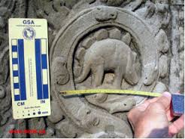

Slide 149
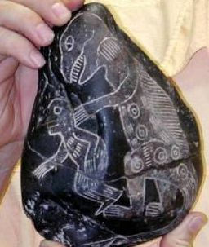

Slide 151
Theistic Evolution?
Evolution | Gen 1:1–2:3
Initial microscopic animals | Initial complex animals
Plant life before atmosphere | Atmosphere before plant life
Sun before plant life | Plant life before the sun
Continuity among all life | Each only produces after its own kind (Gen 1:24; John 3:3-7)
Sea life before land life | Land life before sea life
Reptiles/dinosaurs before birds | Birds before reptiles/dinosaurs (Gen 1:24-25; Ps 148:4; Gen 1:6-7; 5:5, 27; 11:24-25; Job 40-41)
Fish before birds and trees | Trees before fish and fish created with birds
Early animals were meat eaters | Early animals were plant eaters (Gen1:29-30)
Females before males | Males before females (Gen 2:18-25)
List adapted from Walt Brown, In The Beginning, 276-80

Slide 152
Theistic Evolution?
Evolution | Gen 1:1–2:3
Evolution continues | Creation is complete (Gen 2:1-3; John 5:17; Col 1:17; Heb 4:3-4, 10)
Suffering is natural | Suffering is unnatural (Gen 1:31; Rom 8:19-23; Rev. 21:4)
Death before Adam | Death after Adam (Gen 2:17; Rom 5:12)
Man is an evolved animal | Man created higher than the animals (Gen 1:26-28; Ps 8:4-6)
Man exists long after history | Man existed at beginning (Matt 19:4)
Man evolved from the animals | Man created from the dust (Gen 2:7)
Fossils before man | Fossils after man
Man related to animals | Man not related to animals (Gen 5;11)
Man’s genealogy is ancient | Man’s genealogy is recent
Early man meat eaters | Early man plant eaters (Gen 1:29; 9:3)
List adapted from Walt Brown, In The Beginning, 276-80

Slide 153
Theistic Evolution?
Evolution | Gen 1:1–2:3
Evolution continues | Creation is complete (Gen 2:1-3; John 5:17; Col 1:17; Heb 4:3-4, 10)
Suffering is natural | Suffering is unnatural (Gen 1:31; Rom 8:19-23; Rev. 21:4)
Death before Adam | Death after Adam (Gen 2:17; Rom 5:12)
Man is an evolved animal | Man created higher than the animals (Gen 1:26-28; Ps 8:4-6)
Man exists long after history | Man existed at beginning (Matt 19:4)
Man evolved from the animals | Man created from the dust (Gen 2:7)
Fossils before man | Fossils after man
Man related to animals | Man not related to animals (Gen 5;11)
Man’s genealogy is ancient | Man’s genealogy is recent
Early man meat eaters | Early man plant eaters (Gen 1:29; 9:3)
List adapted from Walt Brown, In The Beginning, 276-80

Slide 154
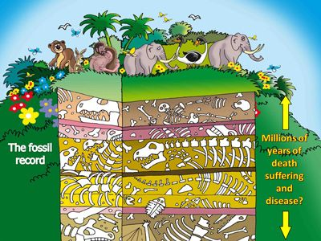

Slide 155
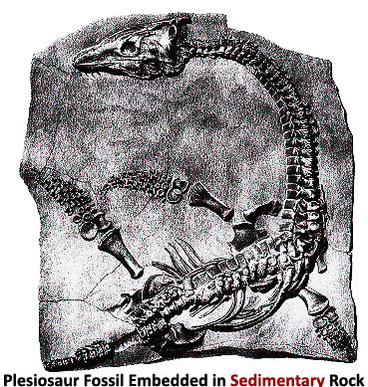

Slide 156
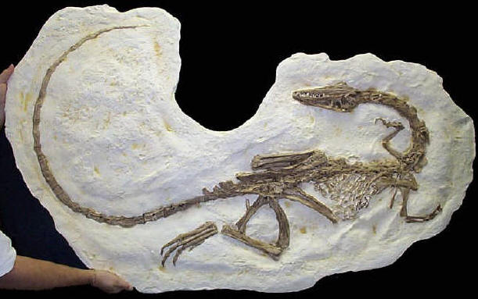

Slide 157
Theistic Evolution?
Evolution | Gen 1:1–2:3
Evolution continues | Creation is complete (Gen 2:1-3; John 5:17; Col 1:17; Heb 4:3-4, 10)
Suffering is natural | Suffering is unnatural (Gen 1:31; Rom 8:19-23; Rev. 21:4)
Death before Adam | Death after Adam (Gen 2:17; Rom 5:12)
Man is an evolved animal | Man created higher than the animals (Gen 1:26-28; Ps 8:4-6)
Man exists long after history | Man existed at beginning (Matt 19:4)
Man evolved from the animals | Man created from the dust (Gen 2:7)
Fossils before man | Fossils after man
Man related to animals | Man not related to animals (Gen 5;11)
Man’s genealogy is ancient | Man’s genealogy is recent
Early man meat eaters | Early man plant eaters (Gen 1:29; 9:3)
List adapted from Walt Brown, In The Beginning, 276-80

Slide 158
Theistic Evolution?
Evolution | Gen 1:1–2:3
Marriage is an evolved custom | Marriage was instituted by God (Gen 2:18-25; John 2:11)
Man developed units of time | God implemented units of time (Gen 1:14)
Seven day week developed | God implemented the seven day week (Exod. 20:8-11; 31:15-17)
People did not reach 100 | People reached 900 years of age (Ps 148:4; 90:10; Gen 1:6-7; 5:5, 27; 11:24-25)
Early man was primitive | Early man was advanced (Gen 4:17, 20-22; 6:14; 11:4; Prov. 1:7; Ps 14:1; Rom 1:18ff)
Language evolved slowly | Man created with speaking ability (Gen 2:23; 3:9-10)
Things are improving | Things are deteriorating
Thorns evolved with plants | Adam’s sin cause the thorns (Gen 3:18)
Animalistic nature causes evil | Sin nature causes evil (Jer. 17:9)
List adapted from Walt Brown, In The Beginning, 276-80

Slide 159
Theistic Evolution?
Evolution | Gen 1:1–2:3
Marriage is an evolved custom | Marriage was instituted by God (Gen 2:18-25; John 2:11)
Man developed units of time | God implemented units of time (Gen 1:14)
Seven day week developed | God implemented the seven day week (Exod. 20:8-11; 31:15-17)
People did not reach 100 | People reached 900 years of age (Ps 148:4; 90:10; Gen 1:6-7; 5:5, 27; 11:24-25)
Early man was primitive | Early man was advanced (Gen 4:17, 20-22; 6:14; 11:4; Prov. 1:7; Ps 14:1; Rom 1:18ff)
Language evolved slowly | Man created with speaking ability (Gen 2:23; 3:9-10)
Things are improving | Things are deteriorating
Thorns evolved with plants | Adam’s sin cause the thorns (Gen 3:18)
Animalistic nature causes evil | Sin nature causes evil (Jer. 17:9)
List adapted from Walt Brown, In The Beginning, 276-80

Slide 160
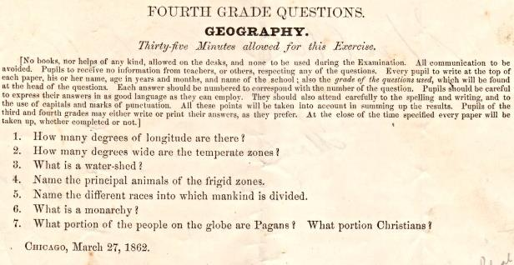
Geography Quiz
(from the WallBuilders' library) that was given to Fourth Grades in 1862

Slide 161
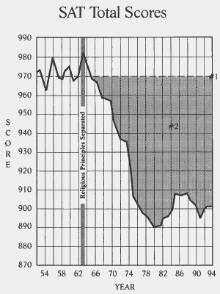

Slide 162
Theistic Evolution?
Evolution | Gen 1:1–2:3
Marriage is an evolved custom | Marriage was instituted by God (Gen 2:18-25; John 2:11)
Man developed units of time | God implemented units of time (Gen 1:14)
Seven day week developed | God implemented the seven day week (Exod. 20:8-11; 31:15-17)
People did not reach 100 | People reached 900 years of age (Ps 148:4; 90:10; Gen 1:6-7; 5:5, 27; 11:24-25)
Early man was primitive | Early man was advanced (Gen 4:17, 20-22; 6:14; 11:4; Prov. 1:7; Ps 14:1; Rom 1:18ff)
Language evolved slowly | Man created with speaking ability (Gen 2:23; 3:9-10)
Things are improving | Things are deteriorating
Thorns evolved with plants | Adam’s sin cause the thorns (Gen 3:18)
Animalistic nature causes evil | Sin nature causes evil (Jer. 17:9)
List adapted from Walt Brown, In The Beginning, 276-80

Slide 163
Theistic Evolution?
Evolution | Gen 1:1–2:3
Suffering precedes man | Suffering follows man (Gen 1:31; Rom 8:19-23; Rev. 21:4)
Man is improving | Man is failing (Rev. 14:20)
List adapted from Walt Brown, In The Beginning, 276-80

Slide 164
CONCLUSION

Slide 165
Genesis 1:1–2:3 Outline
Original creation on the first day (Gen 1:1)
Original creation in its unfilled and unformed state (Gen 1:2)
Creation week (Gen 1:3–2:3): “And God said,” “good”
First day 1:3-5
Second day 1:6-8
Third day 1:9-13
Fourth day 1:14-19
Fifth day 1:20-23
Sixth day 1:24-31
Seventh day 2:1-3

