Slide 1


THE RAPTURE
What and When? – Part 18
Andrew Marshall Woods, Th.M., JD., PhD.
Sr. Pastor, Sugar Land Bible Church

Slide 2

What is the Rapture?
An important doctrine
Distinct from the Second Advent
Catching away of all living believers (1 Thess 4:17)
Reunion (1 Thess 4:14-16)
Resurrection (1 Cor 15:50-54)
Exemption from death (1 Cor 15:51, 54-56)
Instantaneous (1 Cor 15:52)
Mystery (1 Cor 15:51)
Imminent (1 Cor 15:51; 1 Thess 4:15)
Traditional doctrine now being recovered

Slide 3
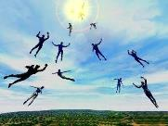
When Will the Rapture Take Place Relative to the Tribulation Period?
Pre-tribulation rapture theory
Mid-tribulation rapture theory
Post-tribulation rapture theory
Pre-wrath rapture theory
Partial rapture theory

Slide 4


Slide 5
When is the Rapture?
7 Arguments Favoring the Pre-Tribulation View
Tribulation's purpose concerns Israel (Jer 30:7; Dan 9:24)
No biblical reference to the church on earth during the Tribulation period (Rev 4-22)
Church is promised an exemption from divine wrath (1 Thess 1:10; 5:9; Rom 5:9; Rev 3:10; 6:17)
Rapture is imminent (1 Cor 15:51; 1 Thess 4:15)
Rapture is a comfort (1 Thess 4:18)
Antichrist cannot come to power until the restrainer is removed (2 Thess 2:6-7)
Symbolic parallels (2 Peter 2:5-9)

Slide 6
Strengthening the Pre-Tribulation Case
John 14:1-4
Revelation 3:10
First Thessalonians 4‒5
Second Thessalonians 2:3a
Matthew 24‒25

Slide 7


Apostasy or Rapture?
(2 Thessalonians 2:3A)
Dr. Andy Woods
Senior Pastor – Sugar Land Bible Church
President – Chafer Theological Seminary

Slide 8


2 Thessalonians 2:3
“Let no one in any way deceive you, for it will not come unless the apostasy [apostasia] comes first, and the man of lawlessness is revealed, the son of destruction.”

Slide 9
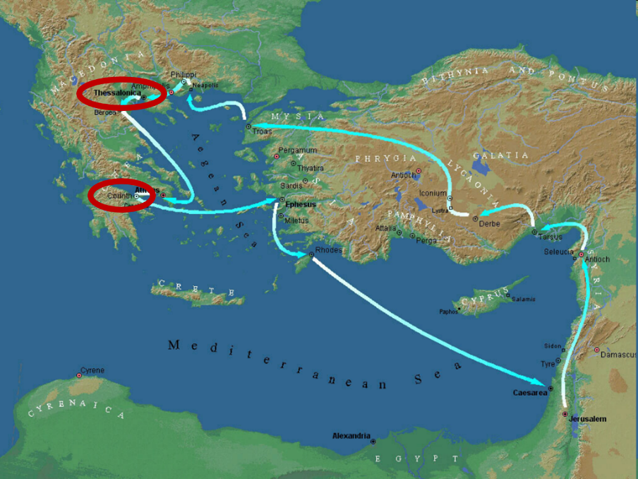

Slide 10
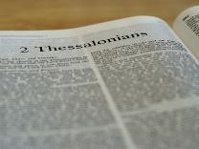
2 Thessalonians 2:1-12
Problem (2:1-2)
Prerequisites for the Day of the Lord (2:3-12)
  The apostasy (2:3a)
  Advent of the lawless one (2:3b-4)
  Removal of the restrainer (2:5-7)
  Destruction of the lawless one (2:8-9)
  Destruction of lawless one’s followers (2:10-12)

Slide 11
2 Thessalonians 2:1-12
Problem (2:1-2)
Prerequisites for the Day of the Lord (2:3-12)
  The apostasy (2:3a)
  Advent of the lawless one (2:3b-4)
  Removal of the restrainer (2:5-7)
  Destruction of the lawless one (2:8-9)
  Destruction of lawless one’s followers (2:10-12)

Slide 12

2 Thessalonians 2:2
“that you not be quickly shaken from your composure or be disturbed either by a spirit or a message or a letter as if from us, to the effect that the day of the Lord has come.”

Slide 13
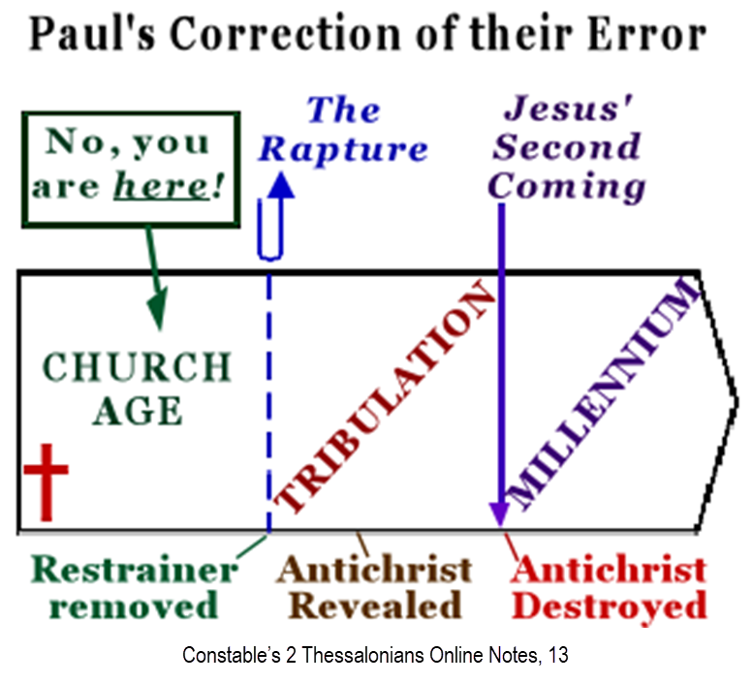

Slide 14
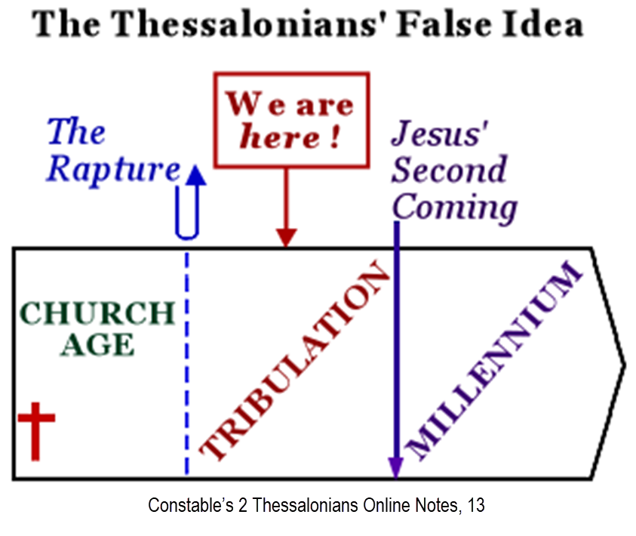

Slide 15
2 Thessalonians 2:1-12
Problem (2:1-2)
Prerequisites for the Day of the Lord (2:3-12)
  The apostasy (2:3a)
  Advent of the lawless one (2:3b-4)
  Removal of the restrainer (2:5-7)
  Destruction of the lawless one (2:8-9)
  Destruction of lawless one’s followers (2:10-12)

Slide 16
2 Thessalonians 2:1-12
Problem (2:1-2)
Prerequisites for the Day of the Lord (2:3-12)
  The apostasy (2:3a)
  Advent of the lawless one (2:3b-4)
  Removal of the restrainer (2:5-7)
  Destruction of the lawless one (2:8-9)
  Destruction of lawless one’s followers (2:10-12)

Slide 17

Apostasy? (2:3a)
Spiritual departure (Acts 21:21) – Unbelieving world embracing the antichrist
Physical departure (Acts 12:10; 2 Cor. 12:8) – Rapture

Slide 18
Apostasy? (2:3a)
Spiritual departure (Acts 21:21) – Unbelieving world embracing the antichrist
Physical departure (Acts 12:10; 2 Cor. 12:8) – Rapture

Slide 19
Apostasy? (2:3a)
Spiritual departure (Acts 21:21) – Unbelieving world embracing the antichrist
Physical departure (Acts 12:10; 2 Cor. 12:8) – Rapture

Slide 20
When Will the Rapture Take Place Relative to the Tribulation Period?
Pre-tribulation rapture theory
Mid-tribulation rapture theory
Post-tribulation rapture theory
Pre-wrath rapture theory
Partial rapture theory

Slide 21
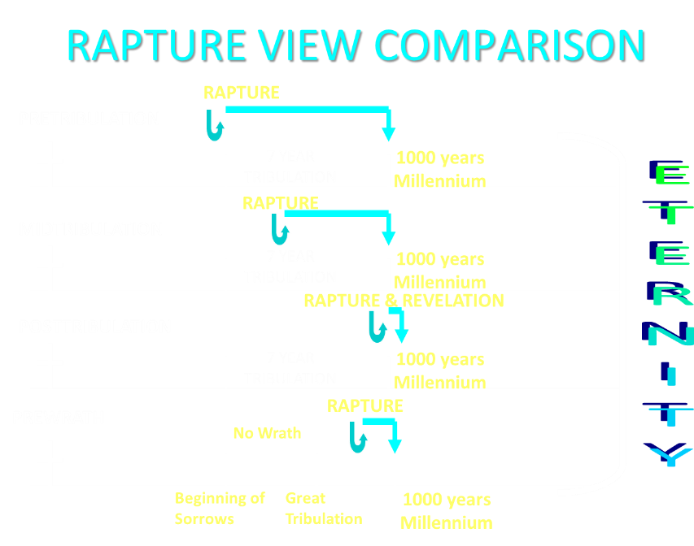

Slide 22
Apostasy? (2:3a)
Spiritual departure (Acts 21:21) – Unbelieving world embracing the antichrist
Physical departure (Acts 12:10; 2 Cor. 12:8) – Rapture

Slide 23
2 Thessalonians 2:3
“Let no one in any way deceive you, for it will not come unless the apostasy [apostasia] comes first [prōton], and the man of lawlessness is revealed, the son of destruction.”

Slide 24
2 Thessalonians 2:1-12
Problem (2:1-2)
Prerequisites for the Day of the Lord (2:3-12)
  The apostasy (2:3a)
  Advent of the lawless one (2:3b-4)
  Removal of the restrainer (2:5-7)
  Destruction of the lawless one (2:8-9)
  Destruction of lawless one’s followers (2:10-12)

Slide 26

Mark Hitchcock
The Coming Apostasy, Kindle Edition, Loc. 2367
“Since the word apostasia means ‘departure,’ some have understood the term ‘the apostasy’ to be the physical departure of the church itself—that is, the Rapture, since the Rapture will be a physical departure of believers from the earth. If this view were correct, it would definitely place the Rapture before the Tribulation, which would be a slam dunk for the pre-Tribulation Rapture position.”

Slide 27

10 Reasons Favoring Physical Departure
There have always been doctrinal departures
2 Thess. was an early letter
The definite article before apostasia
Noun apostasia can refer to physical departure
Verb aphistēmi can refer to physical departure

Slide 28
10 Reasons Favoring Physical Departure
Extended context favors physical departure
Immediate context favors physical departure
2 Thess. 2:2 is a review course
Early Bible translations favor physical departure
Physical departure is held by credible scholars

Slide 29


Slide 30
10 Reasons Favoring Physical Departure
There have always been doctrinal departures
2 Thess. was an early letter
The definite article before apostasia
Noun apostasia can refer to physical departure
Verb aphistēmi can refer to physical departure

Slide 31

Acts 20:29-31
“For I know this, that after my departure savage wolves will come in among you, not sparing the flock.”Also from among yourselves men will rise up, speaking perverse things, to draw away the disciples after themselves. Therefore be on the alert, remembering that night and day for a period of three years I did not cease to admonish each one with tears.” (Italics added).

Slide 32


Acts 19:10
“This took place for two years, so that all who lived in Asia heard the word of the Lord, both Jews and Greeks.”

Slide 33
2 Timothy 1:15
“You are aware of the fact that all who are in Asia turned away from me, among whom are Phygelus and Hermogenes.”

Slide 34



Slide 35
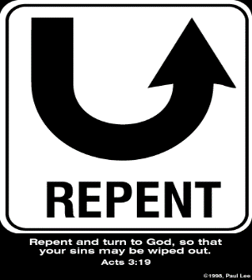
Rev 2:4-5
Apostasy
“⁴ But I have this against you, that you have left your first love. ⁵ Therefore remember from where you have fallen, and repent and do the deeds you did at first; or else I am coming to you and will remove your lampstand out of its place—unless you repent.”

Slide 36
2 Thessalonians 2:7
“For the mystery of lawlessness is already at work; only he who now restrains will do so until he is taken out of the way.”

Slide 37

1 John 4:3
“and every spirit that does not confess Jesus is not from God; this is the spirit of the antichrist, of which you have heard that it is coming, and now it is already in the world.”

Slide 38

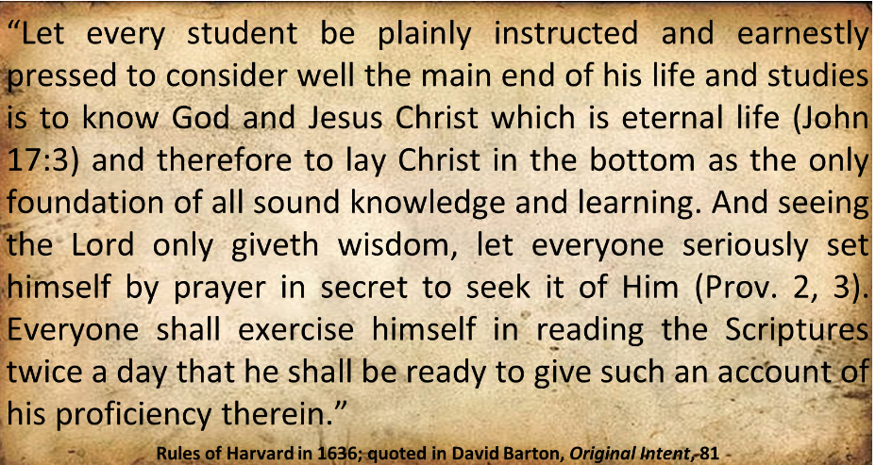
Harvard University

Slide 39
Henry M. Morris
The Defender's Study Bible: King James Version (Iowa Falls, IA: World Bible Publishers, 1995), 1338.
“2:3 falling away…The entire context, before and after, fits this understanding of the text better than the idea of the apostasy from the faith. Over the 1950 years since Paul wrote these lines, there have been numerous great apostasies from the faith, and none of these introduced the day of the Lord, although the persecuted believers in each case might easily have so interpreted them.”

Slide 40
Jimmy De Young
Prophetic Prospective – Daily Devotional
“If the word ‘apostasia’ was communicating that ‘apostasy’ was what it was talking about then the Rapture and the coming of the Antichrist would have happened during the writing of II Thessalonians. Apostasy had infiltrated the early church by the time Paul wrote this passage. What Paul is saying here is that the Antichrist, the ‘Son of Perdition’, would not come until the Church departs from one place and goes to another. That is what happens at the Rapture. The scenario for the future according to all prophetic passages is that the Rapture takes all Christians into Heaven and then the Antichrist. . .

Slide 41
Jimmy De Young
Prophetic Prospective – Daily Devotional
. . . appears on earth. Let me remind you that all preparations have been made for the temple to be built in Jerusalem. False teachers and deception presently are a part of our society today, which indicates that Antichrist is nearing his appearance on earth. Remember, before the appearance of Antichrist and the temple is built, the Rapture happens. Actually the Rapture could happen at any moment. Be ready!”

Slide 42
10 Reasons Favoring Physical Departure
There have always been doctrinal departures
2 Thess. was an early letter
The definite article before apostasia
Noun apostasia can refer to physical departure
Verb aphistēmi can refer to physical departure

Slide 43
Order of Paul’s Letters
Galatians (A.D. 49)
1‒2 Thessalonians (A.D. 51)
1‒2 Corinthians (A.D. 56)
Romans (A.D. 57)
Ephesians, Colossians, Philemon, Philippians (A.D. 60‒62)
1 Timothy, Titus (A.D. 62‒66)
2 Timothy (A.D. 67)

Slide 44
Unique Characteristics of
1‒2 Thessalonians
Every chapter ends with a reference to the Second Advent
Small amount of time in between planting of the church and the first letter to the church

Slide 45

Acts 20:29-31
“For I know this, that after my departure savage wolves will come in among you, not sparing the flock.”Also from among yourselves men will rise up, speaking perverse things, to draw away the disciples after themselves. Therefore be on the alert, remembering that night and day for a period of three years I did not cease to admonish each one with tears.” (Italics added).

Slide 46
Order of Paul’s Letters
Galatians (A.D. 49)
1‒2 Thessalonians (A.D. 51)
1‒2 Corinthians (A.D. 56)
Romans (A.D. 57)
Ephesians, Colossians, Philemon, Philippians (A.D. 60‒62)
1 Timothy, Titus (A.D. 62‒66)
2 Timothy (A.D. 67)

Slide 47
1 Timothy 4:1
“But the Spirit explicitly says that in later times some will fall away [aphistēmi] from the faith, paying attention to deceitful spirits and doctrines of demons.”

Slide 48
10 Reasons Favoring Physical Departure
There have always been doctrinal departures
2 Thess. was an early letter
The definite article before apostasia
Noun apostasia can refer to physical departure
Verb aphistēmi can refer to physical departure

Slide 49
2 Thessalonians 2:3
“Let no one in any way deceive you, for it will not come unless the apostasy [apostasia] comes first, and the man of lawlessness is revealed, the son of destruction.”

Slide 50
2 Thessalonians 2:3
“Let no one in any way deceive you, for it will not come unless the apostasy [apostasia] comes first, and the man of lawlessness is revealed, the son of destruction.”

Slide 51


Slide 52


Slide 54
Rev 2:4-5
Apostasy
“⁴ But I have this against you, that you have left your first love. ⁵ Therefore remember from where you have fallen, and repent and do the deeds you did at first; or else I am coming to you and will remove your lampstand out of its place—unless you repent.”

Slide 55
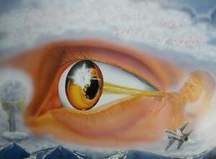
1 Corinthians 15:52
“in a moment, in the twinkling of an eye, at the last trumpet; for the trumpet will sound, and the dead will be raised imperishable, and we will be changed.”

Slide 56
1 Corinthians 15:52
“in a moment [atomos], in the twinkling of an eye, at the last trumpet; for the trumpet will sound, and the dead will be raised imperishable, and we will be changed.”

Slide 57

Instantaneous
(1 Cor 15:52)
Twinkling of an eye
Flash or moment
Split second
Atomos (Greek) = atom (English)

Slide 58
10 Reasons Favoring Physical Departure
There have always been doctrinal departures
2 Thess. was an early letter
The definite article before apostasia
Noun apostasia can refer to physical departure
Verb aphistēmi can refer to physical departure

Slide 59
Apostasy? (2:3a)
Spiritual departure (Acts 21:21) – Unbelieving world embracing the antichrist
Physical departure (Acts 12:10; 2 Cor. 12:8) – Rapture

Slide 60

Acts 21:21
“and they have been told about you, that you are teaching all the Jews who are among the Gentiles to forsake [apostasia] Moses, telling them not to circumcise their children nor to walk according to the customs.”

Slide 61
Apostasy? (2:3a)
Spiritual departure (Acts 21:21) – Unbelieving world embracing the antichrist
Physical departure (Acts 12:10; 2 Cor. 12:8) – Rapture

Slide 62

Entries for Apostasia in Liddell & Scott
Rebellion against God
Apostasy
Departure
Disappearance
Distance
Henry Liddell & Henry Scott, A Greek English Lexicon (Oxford: Oxford University Press, 1940), 218.

Slide 63
Entries for Apostasia in Lampe’s
A Patristic Greek Lexicon
Revolt
Defection
Apostasy from paganism, Judaism, Christianity, orthodoxy
Divorce
Departure
Standing aloof
G. W. H. Lampe, A Patristic Greek Lexicon (Oxford: Clarnedon Press, 1961), 208.

Slide 64
H. Wayne House
"Apostasia in 2 Thessalonians 2:3: Apostasy of Rapture?," in When the Trumpet Sounds: Today's Foremost Authorities Speak out on End-Time Controversies, ed. Thomas Ice and Timothy Demy(Eugene, OR: Harvest House, 1995), 273.
“The noun form allows for apostasia as a simple departure in the classical period, proved by examples from Liddell and Scott...If one says that this is not important because the meaning is only classical or ancient and thus lost its meaning by the time of the New Testament, then I may turn to the same root meaning of apostasia in the patristic era immediately following the New Testament period, as indicated in the definitions for the noun form in Lampe's Patristic Greek Lexicon. Although the noun used in the sense of spatial departure is not the normal meaning…during New Testament times, the word is found with this meaning in time periods before and after the New Testament era, and it is likely to have been understood this way at least sometimes.”

Slide 65
Matthew 5:32
“It was said, ‘Whoever sends his wife away, let him give her a certificate of divorce [apostosion]’”

Slide 66

Definition of “Apostasy”
apos = away from
histēmi = to stand
Apostasy = to stand away from
Apostasy = a departure
A departure from what?
  From previously known truth
  Physically from something

Slide 67
10 Reasons Favoring Physical Departure
There have always been doctrinal departures
2 Thess. was an early letter
The definite article before apostasia
Noun apostasia can refer to physical departure
Verb aphistēmi can refer to physical departure

Slide 68
New Testament Meanings of Aphistēmi
15 New Testament uses
Spiritual departure – Luke 8:13; 1 Tim. 4:1; Heb. 3:12
Physical departure – Luke 2:37; 4:13; 13:27; Acts 5:37-38; 12:10; 13:13; 15:38; 19:9; 22:29; 2 Cor. 12:8; 2 Tim. 2:19

Slide 69
New Testament Meanings of Aphistēmi
15 New Testament uses
Spiritual departure – Luke 8:13; 1 Tim. 4:1; Heb. 3:12
Physical departure – Luke 2:37; 4:13; 13:27; Acts 5:37-38; 12:10; 13:13; 15:38; 19:9; 22:29; 2 Cor. 12:8; 2 Tim. 2:19

Slide 70
New Testament Meanings of Aphistēmi
15 New Testament uses
Spiritual departure – Luke 8:13; 1 Tim. 4:1; Heb. 3:12
Physical departure – Luke 2:37; 4:13; 13:27; Acts 5:37-38; 12:10; 13:13; 15:38; 19:9; 22:29; 2 Cor. 12:8; 2 Tim. 2:19

Slide 71
1 Timothy 4:1
“But the Spirit explicitly says that in later times some will fall away [aphistēmi] from the faith, paying attention to deceitful spirits and doctrines of demons.”

Slide 72
New Testament Meanings of Aphistēmi
15 New Testament uses
Spiritual departure – Luke 8:13; 1 Tim. 4:1; Heb. 3:12
Physical departure – Luke 2:37; 4:13; 13:27; Acts 5:37-38; 12:10; 13:13; 15:38; 19:9; 22:29; 2 Cor. 12:8; 2 Tim. 2:19

Slide 73
George Gunn
John 14:1-3 – The Father’s House: Are We There Yet?, 30. www.pre-trib.org
“I ran out of ingredients for the salad, so I decided to make a quick run down to the store. While at the store, I left the car engine running while I made my purchase, thinking that I would be right out again. However, while I was in the store, I ran into my good friend Edward who was running for county supervisor. This resulted in my having to endure a somewhat long-winded rundown on how his campaign was running. Finally, fearing that my car would run out of gas, I ran with great haste out to the parking lot and returned home with the car surely running only on fumes.”

Slide 74
Illegitimate Totality Transfer
“Unwarranted adoption of an expanded semantic field: The fallacy in this instance lies in the supposition that the meaning of a word in a specific context is much broader than the context itself allows and may bring with it the word’s entire semantic range. This step is sometimes called illegitimate totality transfer.”
D. A. Carson, Exegetical Fallacies, 2nd ed. (Grand Rapids, MI: Baker Academic, 1996), 60-61.

Slide 75
Acts 21:21
“and they have been told about you, that you are teaching all the Jews who are among the Gentiles to forsake [apostasia] Moses, telling them not to circumcise their children nor to walk according to the customs.”

Slide 76
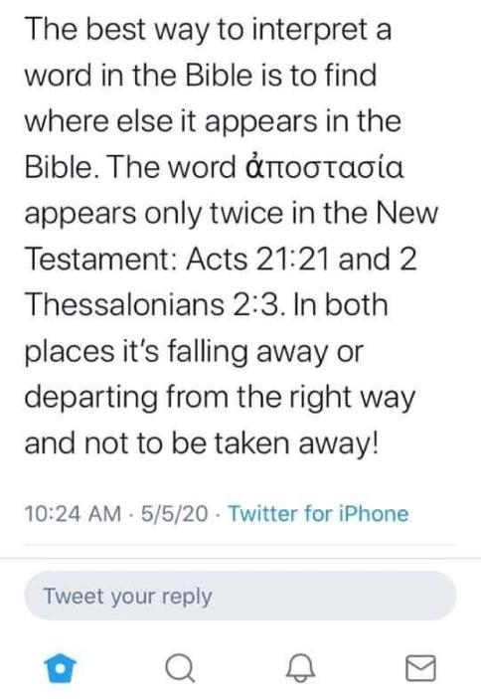

Slide 77
Acts 21:21
“and they have been told about you, that you are teaching all the Jews who are among the Gentiles to forsake [apostasia] Moses, telling them not to circumcise their children nor to walk according to the customs.”

Slide 78
2 Thessalonians 2:3
“Let no one in any way deceive you, for it will not come unless the apostasy [apostasia] comes first, and the man of lawlessness is revealed, the son of destruction.”

Slide 79
THE APOSTASIA
2 Thessalonians 2:3a | Acts 21:21
Pauline authorship | Lukan authorship
Paul speaking | Paul not speaking (v. 20)
Mosaic Law not mentioned | Departure from the Mosaic Law
Epistolary genre | Narrative genre
Definite article | No definite article

Slide 80
10 Reasons Favoring Physical Departure
Extended context favors physical departure
Immediate context favors physical departure
2 Thess. 2:2 is a review course
Early Bible translations favor physical departure
Physical departure is held by credible scholars

Slide 81
Unique Characteristics of 1 Thessalonians
Every chapter ends with a reference to the Second Advent
Small amount of time in between planting of the church and the first letter to the church

Slide 82
10 Reasons Favoring Physical Departure
Extended context favors physical departure
Immediate context favors physical departure
2 Thess. 2:2 is a review course
Early Bible translations favor physical departure
Physical departure is held by credible scholars

Slide 83
2 Thessalonians 2:1
“Now we request you, brethren, with regard to the coming of our Lord Jesus Christ and our gathering together to Him.”

Slide 84
2 Thessalonians 2:1-12
Problem (2:1-2)
Prerequisites for the Day of the Lord (2:3-12)
  The apostasy (2:3a)
  Advent of the lawless one (2:3b-4)
  Removal of the restrainer (2:5-7)
  Destruction of the lawless one (2:8-9)
  Destruction of lawless one’s followers (2:10-12)

Slide 85

2 Thessalonians 2:6-7
⁶And you know what restrains [katechō; neuter] him now, so that in his time he will be revealed. ⁷For the mystery of lawlessness is already at work; only he who now restrains [katechō; masculine] will do so until he is taken out of the way.

Slide 86

Restrainer? (2:6-7)
Rome?
Satan?
Government?
Michael?
Spirit?

Slide 87
Restrainer? (2:6-7)
Rome?
Satan?
Government?
Michael?
Spirit?

Slide 88
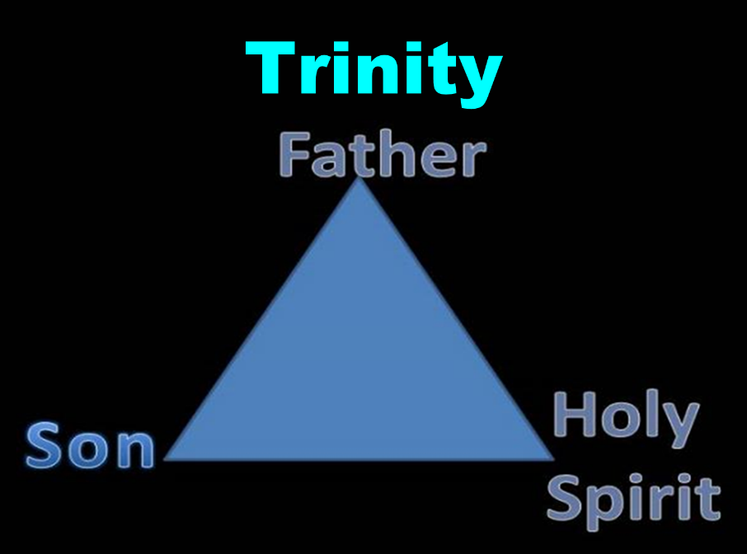

Slide 89


Slide 90

3 Reasons Why the Restrainer is the Holy Spirit
(2 Thessalonians 2:6-7)
The Holy Spirit is omnipotent (2 Thess. 2:9)
The Holy Spirit is active in the world (Gen. 6:3; John 16:7-11)
The Holy Spirit view handles well the switch in gender from the neuter (vs. 6) to the masculine (vs. 7)

Slide 91
3 Reasons Why the Restrainer is the Holy Spirit
(2 Thessalonians 2:6-7)
The Holy Spirit is omnipotent (2 Thess. 2:9)
The Holy Spirit is active in the world (Gen. 6:3; John 16:7-11)
The Holy Spirit view handles well the switch in gender from the neuter (vs. 6) to the masculine (vs. 7)

Slide 92

2 Thessalonians 2:9
“that is, the one whose coming is in accord with the activity of Satan, with all power and signs and false wonders.”

Slide 93
3 Reasons Why the Restrainer is the Holy Spirit
(2 Thessalonians 2:6-7)
The Holy Spirit is omnipotent (2 Thess. 2:9)
The Holy Spirit is active in the world (Gen. 6:3; John 16:7-11)
The Holy Spirit view handles well the switch in gender from the neuter (vs. 6) to the masculine (vs. 7)

Slide 94

Genesis 6:1-4
“¹ Now it came about, when men began to multiply on the face of the land, and daughters were born to them, ² that the sons of God saw that the daughters of men were beautiful; and they took wives for themselves, whomever they chose. ³ Then the Lord said, ‘My Spirit shall not strive with man forever, because he also is flesh; nevertheless his days shall be one hundred and twenty years.’ . . .

Slide 95
John 16:7-11
“⁷ But I tell you the truth, it is to your advantage that I go away; for if I do not go away, the Helper will not come to you; but if I go, I will send Him to you. ⁸ And He, when He comes, will convict the world concerning sin and righteousness and judgment; ⁹ concerning sin, because they do not believe in Me; ¹⁰ and concerning righteousness, because I go to the Father and you no longer see Me; ¹¹ and concerning judgment, because the ruler of this world has been judged.”

Slide 96
3 Reasons Why the Restrainer is the Holy Spirit
(2 Thessalonians 2:6-7)
The Holy Spirit is omnipotent (2 Thess. 2:9)
The Holy Spirit is active in the world (Gen. 6:3; John 16:7-11)
The Holy Spirit view handles well the switch in gender from the neuter (vs. 6) to the masculine (vs. 7)

Slide 97
2 Thessalonians 2:6-7
⁶And you know what restrains [katechō; neuter] him now, so that in his time he will be revealed. ⁷For the mystery of lawlessness is already at work; only he who now restrains [katechō; masculine] will do so until he is taken out of the way.

Slide 98


John 14:16-17
¹⁶ I will ask the Father, and He will give you another Helper, that He may be with you forever; ¹⁷ that is the Spirit of truth, whom the world cannot receive, because it does not see Him or know Him, but you know Him because He abides with you and will be in you.

Slide 99
John 16:7-11
“⁷ But I tell you the truth, it is to your advantage that I go away; for if I do not go away, the Helper will not come to you; but if I go, I will send Him to you. ⁸ And He, when He comes, will convict the world concerning sin and righteousness and judgment; ⁹ concerning sin, because they do not believe in Me; ¹⁰ and concerning righteousness, because I go to the Father and you no longer see Me; ¹¹ and concerning judgment, because the ruler of this world has been judged.”

Slide 100
Restrainer Must First be Removed
Restrainer holds back the Antichrist (2 Thess 2:6-7)
Restrainer = the omnipotent Holy Spirit (2 Thess 2:9)
Holy Spirit permanently indwells all Christians (John 14:16; Rom 8:9)
Sprit indwelt Christians must first be removed prior to the Antichrist's advent

Slide 101

1 Samuel 16:13-14
“¹³ Then Samuel took the horn of oil and anointed him in the midst of his brothers; and the Spirit of the Lord came mightily upon David from that day forward. And Samuel arose and went to Ramah. ¹⁴ Now the Spirit of the Lord departed from Saul, and an evil spirit from the Lord terrorized him.”

Slide 102
John 14:16-17
¹⁶ I will ask the Father, and He will give you another Helper, that He may be with you forever; ¹⁷ that is the Spirit of truth, whom the world cannot receive, because it does not see Him or know Him, but you know Him because He abides with you and will be in you.

Slide 103
Guessing the Identity of the Antichrist?
“We will not, however, incur the risk of pronouncing positively as to the name of Antichrist. But if it had been necessary to announce his name plainly at the present time, it would have been spoken by him who saw the apocalypse. For it was not seen long ago, but almost in our own time, at the end of the reign of Domitian.”
Irenaeus Against Heresies 5.30.3

Slide 104
10 Reasons Favoring Physical Departure
Extended context favors physical departure
Immediate context favors physical departure
2 Thess. 2:2 is a review course
Early Bible translations favor physical departure
Physical departure is held by credible scholars

Slide 105
1 Thessalonians 4:13-18
. . . have fallen asleep. ¹⁶ For the Lord Himself will descend from heaven with a shout, with the voice of the archangel and with the trumpet of God, and the dead in Christ will rise first. ¹⁷ Then we who are alive and remain will be caught up [harpazō] together with them in the clouds to meet the Lord in the air, and so we shall always be with the Lord. ¹⁸ Therefore comfort one another with these words."

Slide 106
2 Thessalonians 2:3
“Let no one in any way deceive you, for it will not come unless the apostasy [apostasia] comes first, and the man of lawlessness is revealed, the son of destruction.”

Slide 107

Paul’s Various Rapture Terms
parousia (2 Thess. 2:1)
episynagōgē (2 Thess. 2:1)
apokalypsis (1 Cor. 1:7)
epiphaneia (Titus 2:13)
rhyomai (1 Thess. 1:10)
harpazō (1 Thess. 4:17)
apostasia (2 Thess. 2:3a)

Slide 108

2 Thessalonians 2:5
“Do you not remember that while I was still with you, I was telling you these things?”

Slide 109
10 Reasons Favoring Physical Departure
Extended context favors physical departure
Immediate context favors physical departure
2 Thess. 2:2 is a review course
Early Bible translations favor physical departure
Physical departure is held by credible scholars

Slide 110
“Departing First” or “Falling Away”
Year | Bible | Translation
1384 | Wycliffe Bible | Departynge First
1526 | Tyndale Bible | Departynge First
1535 | Coverdale Bible | Departynge First
1539 | Crammer Bible | Departing First
1576 | Breeches Bible | Departing First
1583 | Beeza Bible | Departing First
1608 | Geneva Bible | Departing First
1576 | Rheims Bible | The Protestant Revolt
1611 | King James V. | Falling Away
House, When the Trumpet Sounds, p. 270.

Slide 111
Thomas Ice
“The ‘Departure’ in 2 Thessalonians 2:3,”
online: www.pre-trib.org, accessed 7 May 2017, 2.
“Most scholars say that no one knows the reason for the translation shift. However, a plausible theory has been put forth by Martin Butalla in his Master of Theology thesis produced at Dallas Theology Seminary in 1998. It appears that the Catholic translation into English from Jerome’s Latin Vulgate known as the Rheims Bible (1576) was the first to break the translation trend. “Apostasia was revised from ‘the departure’ to ‘the Protestant Revolt,’” explains Butalla. “Revolution is the terminology still in use today when Catholicism teaches the history of the Protestant Reformation. Under this guise, apostasia would refer to a departure of Protestants from the Catholic Church.” The Catholic translators appear eager to engage in polemics against the Reformation by even allowing it to impact Bible translation.”

Slide 112
NKJV, NIV, RSV, ASV, JB, NASB
“apostasy”
“falling away”
“revolt”
“rejection”
“rebellion”

Slide 113
10 Reasons Favoring Physical Departure
Extended context favors physical departure
Immediate context favors physical departure
2 Thess. 2:2 is a review course
Early Bible translations favor physical departure
Physical departure is held by credible scholars

Slide 114

Physical Departure Adherents
Kenneth Wuest |  | Paul Lee Tan
E. Schuyler English |  | Arnold Fruchtenbaum*
J. Dwight Pentecost |  | Tim LaHaye
H. Wayne House |  | Thomas Ice
Stanley Ellison |  | Don Stewart
J.S. Mabie |  | Robert Thieme
Allen McRae |  | Gordon Olson*
Gordon Lewis |  | J. Vernon McGee*
Henry Morris* |  | Jimmy DeYoung*
John. R. Rice |  | J.D. Farag

Slide 115
C. Gordon Olson
C. Gordon Olson, The Resurrection New Testament (Lynchburg, VA: Global Gospel Publishers, 2017), 261, n. B.
“‘Let no one deceive you in anyway, for that day will not come unless the departure comes first and the man of lawlessness is revealed, the man doomed to destruction.’….The Greek Apostasy means a departure, as does its verb aphistēmi. It can refer to a physical departure, a spiritual departure, or a rebellion. The rapture of Christians would be a physical departure, which is supported by his announced subject in 2:1, ‘our gathering together unto him’ (cf. 1 Th. 4:13-18). Otherwise Paul never returned to his declared topic in a lapse of thought, which raises questions. Only two other versions so render it: GNV & WNB.”

Slide 116
Henry M. Morris
The Defender's Study Bible: King James Version (Iowa Falls, IA: World Bible Publishers, 1995), 1337-38.
“2:3 falling away. The ‘falling away’ (Greek apostasia) has commonly been translated as the apostasy (the definite article in the Greek indicates Paul had already told them about it), and then assumed to apply to the final, great religious apostasy at the end of the age. The context, however, as well as the etymology of the word itself, makes this interpretation unlikely. In this precise form, it is used nowhere else in the New Testament, so its meaning must be defined by its context here. It is derived from two Greek words, apo (meaning ‘away from’) and stasis (meaning ‘standing’). It could properly be rendered ‘standing away’ instead of ‘falling away.’”

Slide 117
Henry M. Morris
The Defender's Study Bible: King James Version (Iowa Falls, IA: World Bible Publishers, 1995), 1337-38.
“In Paul’s previous letter, he made no reference to a coming departure from the faith, but he had discussed, at length, a coming departure from the earth by all believers when Christ returns to meet them in the air (1 Thessalonians 4:13-18). This standing away from, in context, seems to refer to all the raptured believers standing away from the earth, as they stand before their returning Lord when they meet Him in the heavens. Here, Paul is reminding them that the ‘sudden destruction’ that would come upon unbelievers when the day of the Lord begins could not happen until the rapture - the standing away from the earth before Christ (Romans 14:10) - had taken place.”

Slide 118
Henry M. Morris
The Defender's Study Bible: King James Version (Iowa Falls, IA: World Bible Publishers, 1995), 1337-38.
“The entire context, before and after, fits this understanding of the text better than the idea of the apostasy from the faith. Over the 1950 years since Paul wrote these lines, there have been numerous great apostasies from the faith, and none of these introduced the day of the Lord, although the persecuted believers in each case might easily have so interpreted them.”

Slide 119
J. Vernon McGee
Thru the Bible with J. Vernon McGee. 5 vols. Pasadena, Calif.: Thru The Bible Radio; and Nashville: Thomas Nelson, Inc., 1983. 5:413.
"… (1) the organization of the church [as contrasted with the true church] has separated from the faith—it has apostatized and (2) there has been another departure, the departure of the true church from the earth. The departure of the true church leads into the total apostatizing of the organized church.“

Slide 120
Jimmy De Young
Prophetic Prospective – Daily Devotional
“Our key verse for this devotional, verse 3, has become somewhat controversial. There are those that believe that the Antichrist will come when the ‘falling away’ of the church, apostasy in the Church, has happened. This then seems to be saying that the church will be here when the Antichrist appears. This belief comes from a wrong understanding of the Greek word used in the passage and translated, ‘a falling away’…A close and careful word study of the Greek word apostasia will conclude that the true meaning of the word is found in the phrase, ‘departing from one place and going to another’, not a falling away from the doctrines of the church.”

Slide 121
Jimmy De Young
Prophetic Prospective – Daily Devotional
“If the word ‘apostasia’ was communicating that ‘apostasy’ was what it was talking about then the Rapture and the coming of the Antichrist would have happened during the writing of II Thessalonians. Apostasy had infiltrated the early church by the time Paul wrote this passage. What Paul is saying here is that the Antichrist, the ‘Son of Perdition’, would not come until the Church departs from one place and goes to another. That is what happens at the Rapture. The scenario for the future according to all prophetic passages is that the Rapture takes all Christians into Heaven and then the Antichrist appears on earth…Let me remind you that all preparations have been made for the temple to be built in . . .

Slide 122
Jimmy De Young
Prophetic Prospective – Daily Devotional
. . . Jerusalem. False teachers and deception presently are a part of our society today, which indicates that Antichrist is nearing his appearance on earth. Remember, before the appearance of Antichrist and the temple is built, the Rapture happens. Actually the Rapture could happen at any moment. Be ready!”

Slide 123

Answering Objections to the Physical Departure View
Subtraction from the Last Days will be characterized by continual apostasy?
Rapture is passive and apostasy is active?
Incongruence with verse 1?
Paul is re-assuring the Thessalonians that they had not already missed the rapture; therefore, it would be incomprehensible to read, “the rapture cannot have happened unless the rapture happens first”!

Slide 124
Answering Objections to the Physical Departure View
Subtraction from the Last Days will be characterized by continual apostasy?
Rapture is passive and apostasy is active?
Incongruence with verse 1?
Paul is re-assuring the Thessalonians that they had not already missed the rapture; therefore, it would be incomprehensible to read, “the rapture cannot have happened unless the rapture happens first”!

Slide 125
Order of Paul’s Letters
Galatians (A.D. 49)
1‒2 Thessalonians (A.D. 51)
1‒2 Corinthians (A.D. 56)
Romans (A.D. 57)
Ephesians, Colossians, Philemon, Philippians (A.D. 60‒62)
1 Timothy, Titus (A.D. 62‒66)
2 Timothy (A.D. 67)

Slide 126
1 Timothy 4:1
“But the Spirit explicitly says that in later times some will fall away [aphistēmi] from the faith, paying attention to deceitful spirits and doctrines of demons.”

Slide 127
Answering Objections to the Physical Departure View
Subtraction from the Last Days will be characterized by continual apostasy?
Rapture is passive and apostasy is active?
Incongruence with verse 1?
Paul is re-assuring the Thessalonians that they had not already missed the rapture; therefore, it would be incomprehensible to read, “the rapture cannot have happened unless the rapture happens first”!

Slide 128
D. Edmond Hiebert
The Thessalonian Epistles. Chicago: Moody Press, 1971. Page 306
"Nowhere else does the Scripture speak of the rapture as 'the departure.' A departure denotes an act on the part of the individual or company departing. But the rapture is not an act of departure on the part of the saints. In the rapture the church is passive, not active. At the rapture, the church is 'caught up' or 'snatched away,' an event wherein the Lord acts to transport believers from earth into His presence (1 Thess. 4:16-17). Everything that takes place with the believers at the rapture is initiated by the Lord and done by Him.”

Slide 129

Matthew 4:4
“But He answered and said, “It is written, ‘Man shall not live on bread alone, but on every word that proceeds out of the mouth of God.’”

Slide 130
Matthew 5:18
“For truly I say to you, until heaven and earth pass away, not the smallest letter or stroke shall pass from the Law until all is accomplished.”

Slide 131
Answering Objections to the Physical Departure View
Subtraction from the Last Days will be characterized by continual apostasy?
Rapture is passive and apostasy is active?
Incongruence with verse 1?
Paul is re-assuring the Thessalonians that they had not already missed the rapture; therefore, it would be incomprehensible to read, “the rapture cannot have happened unless the rapture happens first”!

Slide 132
2 Thessalonians 2:1
“Now we request you, brethren, with regard to the coming [parousia] of our Lord Jesus Christ and our gathering [episynagōgē] together to Him.”

Slide 133
2 Thessalonians 2:3
“Let no one in any way deceive you, for it will not come unless the apostasy [apostasia] comes first, and the man of lawlessness is revealed, the son of destruction.”

Slide 134
D. Edmond Hiebert
The Thessalonian Epistles. Chicago: Moody Press, 1971. Page 306
"Paul has just referred to the rapture as 'our gathering together unto him' (v. 1); why then should he now use this unlikely term to mean the same thing?”

Slide 135
Paul’s Various Rapture Terms
parousia (2 Thess. 2:1)
episynagōgē (2 Thess. 2:1)
apokalypsis (1 Cor. 1:7)
epiphaneia (Titus 2:13)
rhyomai (1 Thess. 1:10)
harpazō (1 Thess. 4:17)
apostasia (2 Thess. 2:3a)

Slide 136
Answering Objections to the Physical Departure View
Subtraction from the Last Days will be characterized by continual apostasy?
Rapture is passive and apostasy is active?
Incongruence with verse 1?
Paul is re-assuring the Thessalonians that they had not already missed the rapture; therefore, it would be incomprehensible to read, “the rapture cannot have happened unless the rapture happens first”!

Slide 137
2 Thessalonians 2:2
“that you not be quickly shaken from your composure or be disturbed either by a spirit or a message or a letter as if from us, to the effect that the day of the Lord has come.”

Slide 138
2 Thessalonians 2:1-12
Problem (2:1-2)
Prerequisites for the Day of the Lord (2:3-12)
  The apostasy (2:3a)
  Advent of the lawless one (2:3b-4)
  Removal of the restrainer (2:5-7)
  Destruction of the lawless one (2:8-9)
  Destruction of lawless one’s followers (2:10-12)

Slide 139
2 Thessalonians 2:1-12
Problem (2:1-2)
Prerequisites for the Day of the Lord (2:3-12)
  The apostasy (2:3a)
  Advent of the lawless one (2:3b-4)
  Removal of the restrainer (2:5-7)
  Destruction of the lawless one (2:8-9)
  Destruction of lawless one’s followers (2:10-12)

Slide 140
Conclusion

Slide 141
10 Reasons Favoring Physical Departure
There have always been doctrinal departures
2 Thess. was an early letter
The definite article before apostasia
Noun apostasia can refer to physical departure
Verb aphistēmi can refer to physical departure

Slide 142
10 Reasons Favoring Physical Departure
Extended context favors physical departure
Immediate context favors physical departure
2 Thess. 2:2 is a review course
Early Bible translations favor physical departure
Physical departure is held by credible scholars

Slide 144

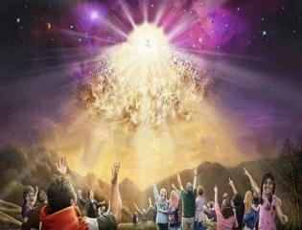
Titus 2:13
“Looking for the blessed hope and the appearing of the glory of our great God and Savior, Christ Jesus.”
144

Slide 145
Strengthening the Pre-Tribulation Case
John 14:1-4
Revelation 3:10
First Thessalonians 4‒5
Second Thessalonians 2:3a
Matthew 24‒25

