Slide 1
Genesis 1:1–2:3
Creation of the Cosmos

Slide 2
INTRODUCTORY MATTERS
Title ‒ Genesis
Authorship, Date, Recipients ‒ Moses; 1445 ‒ 1405; Exodus Generation
Structure ‒ Toledoth; 2 Parts (4 Events)
Setting ‒ Mesopotamia, Canaan, Egypt
Message & Purpose ‒ Israel; Conquest
Unique Characteristics ‒ Beginnings
Themes ‒ Beginnings
Christ In Genesis ‒ Gen. 3:15 Tracing
Importance ‒ God’s Glory; Salvation
Historicity ‒ Christ’s Genealogy

Slide 3
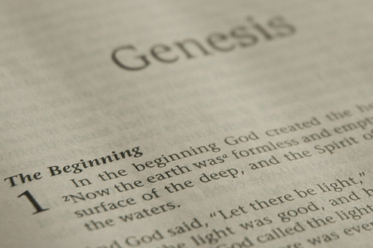
GENESIS STRUCTURE
Beginning of the Human race (Gen. 1‒11)
Beginning of the Hebrew race (Gen. 12‒50)

Slide 4
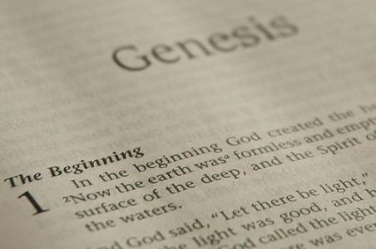
GENESIS STRUCTURE
Genesis 1-11 (four events)
Creation (1-2)
Fall (3-5)
Flood (6-9)
National dispersion (10-11)

Slide 5
Contradictory Account of Creation?
Genesis 1 – Overview of the whole creation
Genesis 2 – Details surrounding the creation of the garden, the first man, and his activities on day 6.

Slide 6
Genesis 1:1–2:3 Outline
Original creation on the first day (Gen 1:1)
Original creation in its unfilled and unformed state (Gen 1:2)
Creation week (Gen 1:3–2:3): “And God said,” “good”
First day 1:3-5
Second day 1:6-8
Third day 1:9-13
Fourth day 1:14-19
Fifth day 1:20-23
Sixth day 1:24-31
Seventh day 2:1-3

Slide 7
Key Issues in Genesis 1
Importance of Gen. 1:1
Gap Theory?
Length of the creation days
Canopy Theory (day 2)
Light before the sun (day 4)
Creation of man (day 6)
Sabbath (day 7)
Evolution?
Notes:
Outline

Slide 8
Genesis 1:1–2:3 Outline
Original creation on the first day (Gen 1:1)
Original creation in its unfilled and unformed state (Gen 1:2)
Creation week (Gen 1:3–2:3): “And God said,” “good”
First day 1:3-5
Second day 1:6-8
Third day 1:9-13
Fourth day 1:14-19
Fifth day 1:20-23
Sixth day 1:24-31
Seventh day 2:1-3

Slide 9
Genesis 1:1-3
“¹ In the beginning God created the heavens and the earth. ² The earth was formless and void, and darkness was over the surface of the deep, and the Spirit of God was moving over the surface of the waters. ³ Then God said, ‘Let there be light’; and there was light.”

Slide 10
Key Issues in Genesis 1
Importance of Gen. 1:1
Gap Theory?
Length of the creation days
Canopy Theory (day 2)
Light before the sun (day 4)
Creation of man (day 6)
Sabbath (day 7)
Evolution?
Notes:
Outline

Slide 11
Refutation of Man’s Philosophies (Gen 1:1)
Atheism – God created (Ps. 14:1)
Pantheism – God is transcendent over creation
Polytheism – One God created (Deut. 6:4; Isa 43:11; 44:6; 45:5)
Materialism – Matter began
Dualism – God alone created (Ezek. 28:13, 15)
Humanism – God rather than man created
Naturalism – God created
Morris, Genesis Record, 38

Slide 12
Refutation of Man’s Philosophies (Gen 1:1)
Atheism – God created (Ps. 14:1)
Pantheism – God is transcendent over creation
Polytheism – One God created (Deut. 6:4; Isa 43:11; 44:6; 45:5)
Materialism – Matter began
Dualism – God alone created (Ezek. 28:13, 15)
Humanism – God rather than man created
Naturalism – God created
Morris, Genesis Record, 38

Slide 14
Ezekiel 28:13, 15
“¹³ You were in Eden, the garden of God; Every precious stone was your covering: The ruby, the topaz and the diamond; The beryl, the onyx and the jasper; The lapis lazuli, the turquoise and the emerald; And the gold, the workmanship of your settings and sockets, Was in you. On the day that you were created They were prepared… ¹⁵ You were blameless in your ways From the day you were created Until unrighteousness was found in you.”

Slide 15
Refutation of Man’s Philosophies (Gen 1:1)
Atheism – God created (Ps. 14:1)
Pantheism – God is transcendent over creation
Polytheism – One God created (Deut. 6:4; Isa 43:11; 44:6; 45:5)
Materialism – Matter began
Dualism – God alone created (Ezek. 28:13, 15)
Humanism – God rather than man created
Naturalism – God created
Morris, Genesis Record, 38

Slide 16
Genesis 1:1–2:3 Outline
Original creation on the first day (Gen 1:1)
Original creation in its unfilled and unformed state (Gen 1:2)
Creation week (Gen 1:3–2:3): “And God said,” “good”
First day 1:3-5
Second day 1:6-8
Third day 1:9-13
Fourth day 1:14-19
Fifth day 1:20-23
Sixth day 1:24-31
Seventh day 2:1-3

Slide 17
Genesis 1:1-3
“¹ In the beginning God created the heavens and the earth. ² The earth was formless and void, and darkness was over the surface of the deep, and the Spirit of God was moving over the surface of the waters. ³ Then God said, ‘Let there be light’; and there was light.”

Slide 18
Genesis 1:1-3
Original creation view = no creation before creation
1:1 God’s original creation on the first day
1:2 Description of this original creation in its original state and described through the use of three circumstantial participles
Unfilled & unformed (tohu and bohu)
Darkness = no physical light (Gen. 1:3)
Spirit = anticipation
1:3-31 Filling and forming process

Slide 19
Genesis 1:1-3
“¹ In the beginning God created the heavens and the earth. ² The earth was formless and void, and darkness was over the surface of the deep, and the Spirit of God was moving over the surface of the waters. ³ Then God said, ‘Let there be light’; and there was light.”

Slide 20
“In the case of tohu and bohu…it is equally admissible to consider these words as referring to the unformed nature of the earth before God impressed upon it His creative will. A marble block and a crumbled statue are both formless. The former is in a state which awaits a form and from that formlessness emerges the image. When God made the earth He made it like a marble block out of which He would bring the beauty of the world.”
Bernard Ramm
The Christian View of Science and Scripture (Grand Rapids: Eerdmans, 1954), 203.

Slide 21
“תֹּהוּ n.m. formlessness, confusion, unreality, emptiness — 1. formlessness, of primaeval earth, of land reduced to primaeval chaos (both + וָבֹהוּ and voidness), ˊקִרְיַת־תּ‍ city of chaos (of ruined city); = nothingness, empty space; of empty, trackless waste. 2. fig. of what is empty, unreal, as idols (coll. of idolmakers), groundless arguments or considerations, moral unreality or falsehood; = a thing of nought, worthlessness; as adv. acc. I said not, תֹּהוּ בַקְּשׁוּנִי seek me emptily, to no purpose.”
Tohu & Bohu
Francis Brown, S. R. Driver, and Charles A. Briggs, eds., A Hebrew and English Lexicon of the Old Testament: With an Appendix Containing the Biblical Aramaic (Oxford: Clarendon Press, 1907), 1062.

Slide 22
בֹּהוn.[m.] emptiness, alw. c. תֹּהוּ q.v.; תֹּהוּ וָבֹהוּ of primaeval earth; of earth under judgment of ˊי‍; קַו־תֹהוּ וְאבְנֵי בֹהוּ the line of wasteness and the stones of emptiness, i.e. plummets, employed, not as usual for building, but for destroying walls; v. sub אבן6.
Tohu & Bohu
Francis Brown, S. R. Driver, and Charles A. Briggs, eds., A Hebrew and English Lexicon of the Old Testament: With an Appendix Containing the Biblical Aramaic (Oxford: Clarendon Press, 1907), 96.

Slide 23
Genesis 1:1-3
“¹ In the beginning God created the heavens and the earth. ² The earth was formless and void, and darkness was over the surface of the deep, and the Spirit of God was moving over the surface of the waters. ³ Then God said, ‘Let there be light’; and there was light.”

Slide 24
Genesis 1:1-3
“¹ In the beginning God created the heavens and the earth. ² The earth was formless and void, and darkness was over the surface of the deep, and the Spirit of God was moving over the surface of the waters. ³ Then God said, ‘Let there be light’; and there was light.”

Slide 25
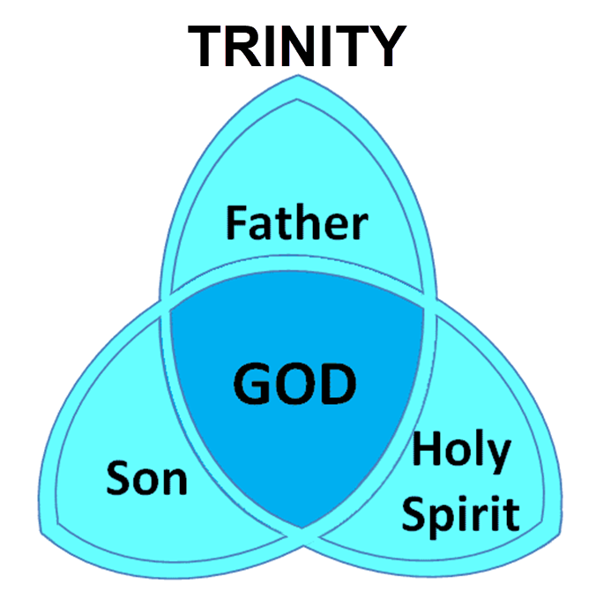

Slide 26
1 Samuel 16:13-14
“¹³ Then Samuel took the horn of oil and anointed him in the midst of his brothers; and the Spirit of the Lord came mightily upon David from that day forward. And Samuel arose and went to Ramah. ¹⁴ Now the Spirit of the Lord departed from Saul, and an evil spirit from the Lord terrorized him.”

Slide 27
John 14:16-17
¹⁶ I will ask the Father, and He will give you another Helper, that He may be with you forever; ¹⁷ that is the Spirit of truth, whom the world cannot receive, because it does not see Him or know Him, but you know Him because He abides with you and will be in you.

Slide 28
John 14:16-17
¹⁶ I will ask the Father, and He will give you another Helper, that He may be with you forever; ¹⁷ that is the Spirit of truth, whom the world cannot receive, because it does not see Him or know Him, but you know Him because He abides with you and will be in you.

Slide 29
Shaping and Populating (Gen 1:1)
Day 1: | Light | Day 4: | Luminaries
Day 2: | Water, sky | Day 5: | Sea animals, birds
Day 3: | Land, vegetation | Day 6: | Land animals, man

Slide 30
Key Issues in Genesis 1
Importance of Gen. 1:1
Gap Theory?
Length of the creation days
Canopy Theory (day 2)
Light before the sun (day 4)
Creation of man (day 6)
Sabbath (day 7)
Evolution?
Notes:
Outline

Slide 31
Gap Theory
Original creation brought into existence on the first day of creation (Gen 1:1)
Billions of years and Satan's fall in between verses 1 and 2
Chaotic conditions and fossil record (Gen 1:2)
Chaos (Jer. 4:23)
Darkness (John 3:19)
Spirit (Eph. 4:30)
Renovation (Gen 1:3-31)

Slide 32
Genesis 1:1-3
“¹ In the beginning God created the heavens and the earth. ² The earth was formless and void, and darkness was over the surface of the deep, and the Spirit of God was moving over the surface of the waters. ³ Then God said, ‘Let there be light’; and there was light.”

Slide 33
Gap Theory Problems
Waw + noun + hayah (qal perfect 3rd person) = “was” and not “became” in rest of OT (Judges 8:11; Jonah 3:3)
Tohu and bohu only means “unfilled” and “unformed” and not chaotic conditions
Jer 4:23 and “Illegitimate Totality Transfer”
Gen 1:28 “replenish” (KJV)? Male = “be full” or “fill” (BDB pp.569-71) and not “refill.” “Re” prefix did not always signify “again” but intensification as in “research.”
God created (not renovated) in the six creation days (Exod 20:8-11; Jer 23:24)

Slide 34
Gap Theory Problems
“Good” (Gen 1:4, 10, 12, 18, 21, 25), “very good” (1:31)
Scripture traces all chaos from Adam’s sin and not before Adam’s sin (Gen 3:17-19; Rom 5:12; 8:19-22)
Luciferian flood? (Gradual? Two floods? 1 Pet. 3:20-21; 2 Pet. 2:5)
Late 19th century accommodation attempt to explain the fossil record
Man existed from the beginning (Matt 19:4)
Fields, Unformed and Unfilled, 1976

Slide 35
Gap Theory Problems
Waw + noun + hayah (qal perfect 3rd person) = “was” and not “became” in rest of OT (Judges 8:11; Jonah 3:3)
Tohu and bohu only means “unfilled” and “unformed” and not chaotic conditions
Jer 4:23 and “Illegitimate Totality Transfer”
Gen 1:28 “replenish” (KJV)? Male = “be full” or “fill” (BDB pp.569-71) and not “refill.” “Re” prefix did not always signify “again” but intensification as in “research.”
God created (not renovated) in the six creation days (Exod 20:8-11; Jer 23:24)

Slide 36
Genesis 1:1-3
“¹ In the beginning God created the heavens and the earth. ² The earth was [hāyāh; became] formless and void, and darkness was over the surface of the deep, and the Spirit of God was moving over the surface of the waters. ³ Then God said, ‘Let there be light’; and there was light.”

Slide 37
Jonah 3:3
“So Jonah arose and went to Nineveh according to the word of the Lord. Now Nineveh was [hāyāh] an exceedingly great city, a three days’ walk.”
Waw + noun + hayah (qal perfect 3rd person) = “was” and not “became” in rest of OT (Judges 8:11; Jonah 3:3)

Slide 38
Judges 8:11
“Gideon went up by the way of those who lived in tents on the east of Nobah and Jogbehah, and attacked the camp when the camp was [hāyāh] unsuspecting.”
Waw + noun + hayah (qal perfect 3rd person) = “was” and not “became” in rest of OT (Judges 8:11; Jonah 3:3)

Slide 39
Gap Theory Problems
Waw + noun + hayah (qal perfect 3rd person) = “was” and not “became” in rest of OT (Judges 8:11; Jonah 3:3)
Tohu and bohu only means “unfilled” and “unformed” and not chaotic conditions
Jer 4:23 and “Illegitimate Totality Transfer”
Gen 1:28 “replenish” (KJV)? Male = “be full” or “fill” (BDB pp.569-71) and not “refill.” “Re” prefix did not always signify “again” but intensification as in “research.”
God created (not renovated) in the six creation days (Exod 20:8-11; Jer 23:24)

Slide 40
“In the case of tohu and bohu…it is equally admissible to consider these words as referring to the unformed nature of the earth before God impressed upon it His creative will. A marble block and a crumbled statue are both formless. The former is in a state which awaits a form and from that formlessness emerges the image. When God made the earth He made it like a marble block out of which He would bring the beauty of the world.”
Bernard Ramm
The Christian View of Science and Scripture (Grand Rapids: Eerdmans, 1954), 203.

Slide 41
“תֹּהוּ n.m. formlessness, confusion, unreality, emptiness — 1. formlessness, of primaeval earth, of land reduced to primaeval chaos (both + וָבֹהוּ and voidness), ˊקִרְיַת־תּ‍ city of chaos (of ruined city); = nothingness, empty space; of empty, trackless waste. 2. fig. of what is empty, unreal, as idols (coll. of idolmakers), groundless arguments or considerations, moral unreality or falsehood; = a thing of nought, worthlessness; as adv. acc. I said not, תֹּהוּ בַקְּשׁוּנִי seek me emptily, to no purpose.”
Tohu & Bohu
Francis Brown, S. R. Driver, and Charles A. Briggs, eds., A Hebrew and English Lexicon of the Old Testament: With an Appendix Containing the Biblical Aramaic (Oxford: Clarendon Press, 1907), 1062.

Slide 42
בֹּהוn.[m.] emptiness, alw. c. תֹּהוּ q.v.; תֹּהוּ וָבֹהוּ of primaeval earth; of earth under judgment of ˊי‍; קַו־תֹהוּ וְאבְנֵי בֹהוּ the line of wasteness and the stones of emptiness, i.e. plummets, employed, not as usual for building, but for destroying walls; v. sub אבן6.
Tohu & Bohu
Francis Brown, S. R. Driver, and Charles A. Briggs, eds., A Hebrew and English Lexicon of the Old Testament: With an Appendix Containing the Biblical Aramaic (Oxford: Clarendon Press, 1907), 96.

Slide 43
Gap Theory Problems
Waw + noun + hayah (qal perfect 3rd person) = “was” and not “became” in rest of OT (Judges 8:11; Jonah 3:3)
Tohu and bohu only means “unfilled” and “unformed” and not chaotic conditions
Jer 4:23 and “Illegitimate Totality Transfer”
Gen 1:28 “replenish” (KJV)? Male = “be full” or “fill” (BDB pp.569-71) and not “refill.” “Re” prefix did not always signify “again” but intensification as in “research.”
God created (not renovated) in the six creation days (Exod 20:8-11; Jer 23:24)

Slide 44
Jeremiah 4:23-25
“²³ I looked on the earth, and behold, it was formless and void [tohu & bohu]; And to the heavens, and they had no light. ²⁴ I looked on the mountains, and behold, they were quaking, And all the hills moved to and fro. ²⁵ I looked, and behold, there was no man, And all the birds of the heavens had fled.”

Slide 45
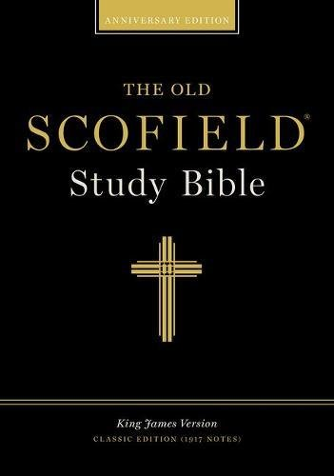
Scofield Reference Bible
Page 776 note
Jeremiah 4:23-“...[It] describes the condition of the earth as the result of judgment . . . which overthrew the primal order of Gen. I:I.”

Slide 46
Illegitimate Totality Transfer
“Unwarranted adoption of an expanded semantic field: The fallacy in this instance lies in the supposition that the meaning of a word in a specific context is much broader than the context itself allows and may bring with it the word’s entire semantic range. This step is sometimes called illegitimate totality transfer.”
D. A. Carson, Exegetical Fallacies, 2nd ed. (Grand Rapids, MI: Baker Academic, 1996), 60-61.

Slide 47
George Gunn
John 14:1-3 – The Father’s House: Are We There Yet?, 30. www.pre-trib.org
“I ran out of ingredients for the salad, so I decided to make a quick run down to the store. While at the store, I left the car engine running while I made my purchase, thinking that I would be right out again. However, while I was in the store, I ran into my good friend Edward who was running for county supervisor. This resulted in my having to endure a somewhat long-winded rundown on how his campaign was running. Finally, fearing that my car would run out of gas, I ran with great haste out to the parking lot and returned home with the car surely running only on fumes.”

Slide 48
Tolu & Bohu
Genesis 1:2 | Jeremiah 4:23
Original creation | Future judgment
Creation “very good” | Creation not “very good”
Entire earth | The Land of Israel
Looking backward | Looking forward
No humans | Surviving humans

Slide 49
Gap Theory Problems
Waw + noun + hayah (qal perfect 3rd person) = “was” and not “became” in rest of OT (Judges 8:11; Jonah 3:3)
Tohu and bohu only means “unfilled” and “unformed” and not chaotic conditions
Jer 4:23 and “Illegitimate Totality Transfer”
Gen 1:28 “replenish” (KJV)? Male = “be full” or “fill” (BDB pp.569-71) and not “refill.” “Re” prefix did not always signify “again” but intensification as in “research.”
God created (not renovated) in the six creation days (Exod 20:8-11; Jer 23:24)

Slide 50
Genesis 1:28 (KJV)
“And God blessed them, and God said unto them, Be fruitful, and multiply, and replenish [male’] the earth, and subdue it: and have dominion over the fish of the sea, and over the fowl of the air, and over every living thing that moveth upon the earth.”

Slide 51
Replenish?
Gen 1:28 “replenish” (KJV)?
Male’ = “be full” or “fill” (BDB pp.569-71) and not “refill.”
“Re” prefix did not always signify “again” but intensification as in “research.”

Slide 52
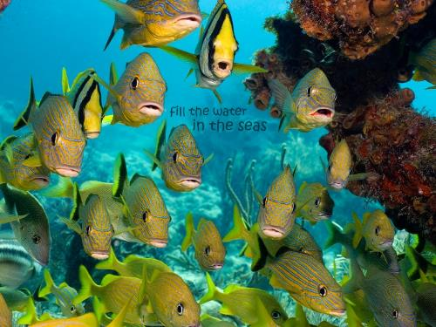
Genesis 1:22 (KJV)
“And God blessed them, saying, Be fruitful, and multiply, and fill [male’] the waters in the seas, and let fowl multiply in the earth.”

Slide 53
Gap Theory Problems
Waw + noun + hayah (qal perfect 3rd person) = “was” and not “became” in rest of OT (Judges 8:11; Jonah 3:3)
Tohu and bohu only means “unfilled” and “unformed” and not chaotic conditions
Jer 4:23 and “Illegitimate Totality Transfer”
Gen 1:28 “replenish” (KJV)? Male = “be full” or “fill” (BDB pp.569-71) and not “refill.” “Re” prefix did not always signify “again” but intensification as in “research.”
God created (not renovated) in the six creation days (Exod 20:8-11; Jer 23:24)

Slide 54
Genesis 2:3-4
“³ Then God blessed the seventh day and sanctified it, because in it He rested from all His work which God had created and made. ⁴ This is the account of the heavens and the earth when they were created, in the day that the Lord God made earth and heaven.”

Slide 55
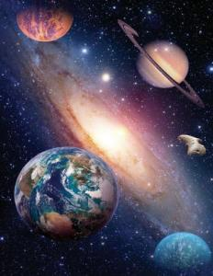
Exodus 20:11
“For in six days the Lord made the heavens and the earth, the sea and all that is in them, and rested on the seventh day; therefore the Lord blessed the sabbath day and made it holy.”

Slide 56
Gap Theory Problems
“Good” (Gen 1:4, 10, 12, 18, 21, 25), “very good” (1:31)
Scripture traces all chaos from Adam’s sin and not before Adam’s sin (Gen 3:17-19; Rom 5:12; 8:19-22)
Luciferian flood? (Gradual? Two floods? 1 Pet. 3:20-21; 2 Pet. 2:5)
Late 19th century accommodation attempt to explain the fossil record
Man existed from the beginning (Matt 19:4)
Fields, Unformed and Unfilled, 1976

Slide 57
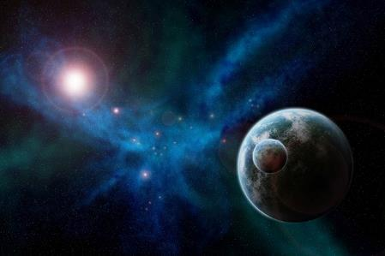
Genesis 1:31
“God saw all that He had made, and behold, it was very good. And there was evening and there was morning, the sixth day.”

Slide 58
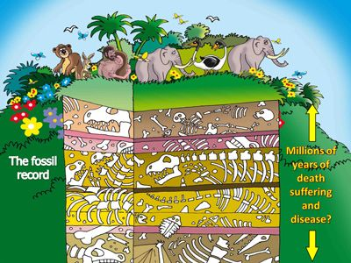

Slide 59
Gap Theory Problems
“Good” (Gen 1:4, 10, 12, 18, 21, 25), “very good” (1:31)
Scripture traces all chaos from Adam’s sin and not before Adam’s sin (Gen 3:17-19; Rom 5:12; 8:19-22)
Luciferian flood? (Gradual? Two floods? 1 Pet. 3:20-21; 2 Pet. 2:5)
Late 19th century accommodation attempt to explain the fossil record
Man existed from the beginning (Matt 19:4)
Fields, Unformed and Unfilled, 1976

Slide 60
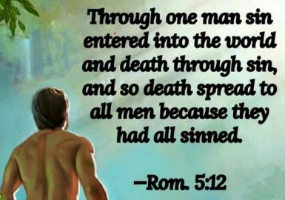
Genesis 2:16-17
“¹⁶ The Lord God commanded the man, saying, ‘From any tree of the garden you may eat freely; ¹⁷ but from the tree of the knowledge of good and evil you shall not eat, for in the day that you eat from it you will surely die (muwth).’”

Slide 61
Genesis 3:19
“By the sweat of your face You will eat bread, Till you return to the ground, Because from it you were taken; For you are dust, And to dust you shall return.”

Slide 62
1 Corinthians 15:21-22
“²¹ For since by a man came death, by a man also came the resurrection of the dead. ²² For as in Adam all die, so also in Christ all will be made alive.”

Slide 63
Romans 5:12
“Therefore, just as through one man sin entered into the world, and death through sin, and so death spread to all men, because all sinned—.”

Slide 64
Romans 8:19-22
¹⁹ For the anxious longing of the creation waits eagerly for the revealing of the sons of God. ²⁰ For the creation was subjected to futility, not willingly, but because of Him who subjected it, in hope ²¹ that the creation itself also will be set free from its slavery to corruption into the freedom of the glory of the children of God. ²² For we know that the whole creation groans and suffers the pains of childbirth together until now.

Slide 66
Gap Theory Problems
“Good” (Gen 1:4, 10, 12, 18, 21, 25), “very good” (1:31)
Scripture traces all chaos from Adam’s sin and not before Adam’s sin (Gen 3:17-19; Rom 5:12; 8:19-22)
Luciferian flood? (Gradual? Two floods? 1 Pet. 3:20-21; 2 Pet. 2:5)
Late 19th century accommodation attempt to explain the fossil record
Man existed from the beginning (Matt 19:4)
Fields, Unformed and Unfilled, 1976

Slide 67
Mathew 24:38-39
“³⁸ For as in those days before the flood they were eating and drinking, marrying and giving in marriage, until the day that Noah entered the ark, ³⁹ and they did not understand until the flood came and took them all away; so will the coming of the Son of Man be.”

Slide 68
1 Peter 3:18-21
“¹⁸ For Christ also died for sins once for all, the just for the unjust, so that He might bring us to God, having been put to death in the flesh, but made alive in the spirit; ¹⁹ in which also He went and made proclamation to the spirits now in prison, ²⁰ who once were disobedient, when the patience of God kept waiting in the days of Noah, during the construction of the ark, in which a few, that is . . .

Slide 69
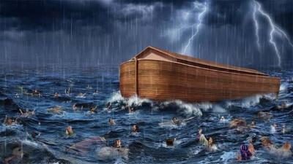
1 Peter 3:18-21
...eight persons, were brought safely through the water. ²¹ Corresponding to that, baptism now saves you — not the removal of dirt from the flesh, but an appeal to God for a good conscience—through the resurrection of Jesus Christ.”

Slide 70
2 Peter 2:5
“and did not spare the ancient world, but preserved Noah, a preacher of righteousness, with seven others, when He brought a flood upon the world of the ungodly.”

Slide 71
2 Peter 3:5-7
“⁵ For when they maintain this, it escapes their notice that by the word of God the heavens existed long ago and the earth was formed out of water and by water, ⁶ through which the world at that time was destroyed, being flooded with water. ⁷ But by His word the present heavens and earth are being reserved for fire, kept for the day of judgment and destruction of ungodly men.”

Slide 72
Gap Theory Problems
“Good” (Gen 1:4, 10, 12, 18, 21, 25), “very good” (1:31)
Scripture traces all chaos from Adam’s sin and not before Adam’s sin (Gen 3:17-19; Rom 5:12; 8:19-22)
Luciferian flood? (Gradual? Two floods? 1 Pet. 3:20-21; 2 Pet. 2:5)
Late 19th century accommodation attempt to explain the fossil record
Man existed from the beginning (Matt 19:4)
Fields, Unformed and Unfilled, 1976

Slide 73
Two Views on Harmonization of Early Genesis with “Science”
Accommodation Model
Definition
W.H. Green (1892)
Old strategy
Backward Christian soldier
Not exegesis but eisegesis
Moving target (Job 38:4-7; Heb. 11:3; 1 Tim. 6:20)
Chalmers, Scofield, Chafer, Larkin, etc…

Slide 74
Two Views on Harmonization of Early Genesis with “Science”
Biblical Presupposition Model
Definition
“Genesis Flood” (1961) by Morris and Whitcomb
New strategy
Not eisegesis but exegesis

Slide 75
Gap Theory Problems
“Good” (Gen 1:4, 10, 12, 18, 21, 25), “very good” (1:31)
Scripture traces all chaos from Adam’s sin and not before Adam’s sin (Gen 3:17-19; Rom 5:12; 8:19-22)
Luciferian flood? (Gradual? Two floods? 1 Pet. 3:20-21; 2 Pet. 2:5)
Late 19th century accommodation attempt to explain the fossil record
Man existed from the beginning (Matt 19:4)
Fields, Unformed and Unfilled, 1976

Slide 76
Matthew 19:4-6
“³ Some Pharisees came to Jesus, testing Him and asking, “Is it lawful for a man to divorce his wife for any reason at all?” ⁴ And He answered and said, “Have you not read that He who created them from the beginning made them male and female, ⁵ and said, ‘For this reason a man shall leave his father and mother and be…

Slide 77
Mark 10:6
“But from the beginning of creation, God made them male and female.”

Slide 78
Genesis 1:1–2:3 Outline
Original creation on the first day (Gen 1:1)
Original creation in its unfilled and unformed state (Gen 1:2)
Creation week (Gen 1:3–2:3): “And God said,” “good”
First day 1:3-5
Second day 1:6-8
Third day 1:9-13
Fourth day 1:14-19
Fifth day 1:20-23
Sixth day 1:24-31
Seventh day 2:1-3

Slide 79
Genesis 1:1–2:3 Outline
Original creation on the first day (Gen 1:1)
Original creation in its unfilled and unformed state (Gen 1:2)
Creation week (Gen 1:3–2:3): “And God said,” “good”
First day 1:3-5
Second day 1:6-8
Third day 1:9-13
Fourth day 1:14-19
Fifth day 1:20-23
Sixth day 1:24-31
Seventh day 2:1-3

Slide 80
Genesis 1:1-3
“¹ In the beginning God created the heavens and the earth. ² The earth was formless and void, and darkness was over the surface of the deep, and the Spirit of God was moving over the surface of the waters. ³ Then God said, ‘Let there be light’; and there was light.”

Slide 81
Key Issues in Genesis 1
Importance of Gen. 1:1
Gap Theory?
Length of the creation days
Canopy Theory (day 2)
Light before the sun (day 4)
Creation of man (day 6)
Sabbath (day 7)
Evolution?

Slide 82
Days of Creation
Revelatory Days
Solar Non-consecutive Days
Day Age Theory
Solar And Consecutive Days

Slide 83
Days of Creation
Revelatory Days
Solar Non-consecutive Days
Day Age Theory
Solar And Consecutive Days

Slide 84
Days of Revelation?
Definition
Asah = “to show” (Gen 24:12) in Exodus 20:11
Asah (Gen 1:26) and bara (Gen 1:27)

Slide 85
Solar Non-Consecutive Days?
Exodus 20:8-11
This is the account of the heavens and the earth when they were created (bara), in the day that the Lord God made (asah) earth and heaven.

Slide 86
Days of Revelation?
Gen 1:26-27
²⁶ Then God said, “Let Us make (asah) man in Our image, according to Our likeness; and let them rule over the fish of the sea and over the birds of the sky and over the cattle and over all the earth, and over every creeping thing that creeps on the earth.” ²⁷ God created man in His own image, in the image of God He created (bara) him; male and female He created them.

Slide 87
Days of Revelation?
Gen 2:4
This is the account of the heavens and the earth when they were created (bara), in the day that the Lord God made (asah) earth and heaven.
Isaiah 43:7
Everyone who is called by My name, And whom I have created (bara) for My glory, Whom I have formed, even whom I have made (asah).

Slide 88
Solar Non-Consecutive Days?
Exodus 20:8-11
This is the account of the heavens and the earth when they were created (bara), in the day that the Lord God made (asah) earth and heaven.

Slide 89
George Gunn
John 14:1-3 – The Father’s House: Are We There Yet?, 30. www.pre-trib.org
I ran out of ingredients for the salad, so I decided to make a quick run down to the store. While at the store, I left the car engine running while I made my purchase, thinking that I would be right out again. However, while I was in the store, I ran into my good friend Edward who was running for county supervisor. This resulted in my having to endure a somewhat long-winded rundown on how his campaign was running. Finally, fearing that my car would run out of gas, I ran with great haste out to the parking lot and returned home with the car surely running only on fumes.

Slide 90
Days of Creation
Revelatory Days
Solar Non-consecutive Days
Day Age Theory
Solar And Consecutive Days

Slide 91
Solar Non-Consecutive Days?
Exodus 20:8-11
⁸ “Remember the sabbath day, to keep it holy. ⁹ Six days you shall labor and do all your work, ¹⁰ but the seventh day is a sabbath of the Lord your God; in it you shall not do any work, you or your son or your daughter, your male or your female servant or your cattle or your sojourner who stays with you. ¹¹ For in six days the Lord made the heavens and the earth, the sea and all that is in them, and rested on the seventh day; therefore the Lord blessed the sabbath day and made it holy.

Slide 92
Solar Non-Consecutive Days?
Exodus 31:15-17
¹⁵ ‘For six days work may be done, but on the seventh day there is a sabbath of complete rest, holy to the Lord; whoever does any work on the sabbath day shall surely be put to death. ¹⁶ ‘So the sons of Israel shall observe the sabbath, to celebrate the sabbath throughout their generations as a perpetual covenant.’ ¹⁷ “It is a sign between Me and the sons of Israel forever; for in six days the Lord made heaven and earth, but on the seventh day He ceased from labor, and was refreshed.”

Slide 93
Days of Creation
Revelatory Days
Solar Non-consecutive Days
Day Age Theory
Solar And Consecutive Days

Slide 94
Day Age?
2 Peter 3:8
But do not let this one fact escape your notice, beloved, that with the Lord one day is like a thousand years, and a thousand years like one day.
Genesis 2:4?
This is the account of the heavens and the earth when they were created, in the day that the LORD God made earth and heaven.

Slide 95
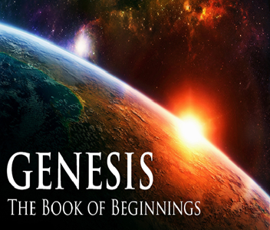
Ken Ham et al, Answers in Genesis, rev ed. (Green Forest, AR: Master Books, 1990), 37-emphasis mine.
“Back in my father’s day, it took ten days to drive across the Australian outback during the day.”

Slide 96
George Gunn
John 14:1-3-The Father’s House: Are We There Yet?, 30. www.pre-trib.org
I ran out of ingredients for the salad, so I decided to make a quick run down to the store. While at the store, I left the car engine running while I made my purchase, thinking that I would be right out again. However, while I was in the store, I ran into my good friend Edward who was running for county supervisor. This resulted in my having to endure a somewhat long-winded rundown on how his campaign was running. Finally, fearing that my car would run out of gas, I ran with great haste out to the parking lot and returned home with the car surely running only on fumes.

Slide 97
Alternative Ways of Describing Ages
Olam
Attached adjective “long” (rab) to the word “day” (yom)

Slide 98
Alternative Ways of Describing Ages
Olam
Attached adjective “long” (rab) to the word “day” (yom)

Slide 99
Exodus 21:2, 5-6
² “If you buy a Hebrew servant, he shall serve six years; and in the seventh he shall go out free and pay nothing…⁵ But if the servant plainly says, ‘I love my master, my wife, and my children; I will not go out free,’. ⁶ then his master shall bring him to the judges. He shall also bring him to the door, or to the doorpost, and his master shall pierce his ear with an awl; and he shall serve him forever (olam).”

Slide 100
Alternative Ways of Describing Ages
Olam
Attached adjective “long” (rab) to the word “day” (yom)

Slide 101
10 Ways of Communicating Ages in Gen 1
yāmîm – with “evening and morning” = many days of evening and morning | tamîd – continually, forever
dōr – generation, period | `orek – with yom = length of days
`ad – ancient, forever | zemān – season, time
qedem – of old, ancient time | `et – time
netsach – always, everlasting, forever | mô `ēd – time, season
Jonathan Sarfati, Refuting Compromise (Green Forest, AR: Master Books), 327-28

Slide 102
Days of Creation
Revelatory Days
Solar Non-consecutive Days
Day Age Theory
Solar And Consecutive Days

Slide 103
Ordinary and Consecutive Days?
Numerical ordinal modifier used 359 times outside of Genesis 1-2 (Joshua 6:3; Esther 4:16)
“Evening and morning” used 38 times outside of Genesis 1-2
Exodus 20:8-11; 31:17
Adam’s age (Gen. 5:5)

Slide 104
Solar Non-Consecutive Days?
Exodus 20:8-11
⁸ “Remember the sabbath day, to keep it holy. ⁹ Six days you shall labor and do all your work, ¹⁰ but the seventh day is a sabbath of the Lord your God; in it you shall not do any work, you or your son or your daughter, your male or your female servant or your cattle or your sojourner who stays with you. ¹¹ For in six days the Lord made the heavens and the earth, the sea and all that is in them, and rested on the seventh day; therefore the Lord blessed the sabbath day and made it holy.

Slide 105
Solar Non-Consecutive Days?
Exodus 31:15-17
¹⁵ ‘For six days work may be done, but on the seventh day there is a sabbath of complete rest, holy to the Lord; whoever does any work on the sabbath day shall surely be put to death. ¹⁶ ‘So the sons of Israel shall observe the sabbath, to celebrate the sabbath throughout their generations as a perpetual covenant.’ ¹⁷ “It is a sign between Me and the sons of Israel forever; for in six days the Lord made heaven and earth, but on the seventh day He ceased from labor, and was refreshed.”

Slide 106
Ordinary and Consecutive Days?
Numerical ordinal modifier used 359 times outside of Genesis 1-2 (Joshua 6:3; Esther 4:16)
“Evening and morning” used 38 times outside of Genesis 1-2
Exodus 20:8-11; 31:17
Adam’s age (Gen. 5:5)

Slide 107
Gleason Archer
Survey of Old Testament Introduction (Chicago, IL: Moody Press, 1994), 196-97-emphasis mine.
“From a superficial reading of Genesis 1, the impression would seem to be that the entire creative process took place in six twenty-four-hour days. This seems to run counter to modern scientific research, which indicates that planet earth was created several billion years ago.”

Slide 108
Genesis 1:1–2:3 Outline
Original creation on the first day (Gen 1:1)
Original creation in its unfilled and unformed state (Gen 1:2)
Creation week (Gen 1:3–2:3): “And God said,” “good”
First day 1:3-5
Second day 1:6-8
Third day 1:9-13
Fourth day 1:14-19
Fifth day 1:20-23
Sixth day 1:24-31
Seventh day 2:1-3

Slide 109
Key Issues in Genesis 1
Importance of Gen. 1:1
Gap Theory?
Length of the creation days
Canopy Theory (day 2)
Light before the sun (day 4)
Creation of man (day 6)
Sabbath (day 7)
Evolution?

Slide 110
Day 2 Canopy Theory (Gen 1:6-8)
Implied – Gen. 1:6-7; Ps. 148:4
Explains
Long life spans of early man-Gen. 5:5, 27
Strange beasts (Gen. 1:24-25; Job 40‒41)
Where the flood waters came from (Gen. 2:5-6)
Why man’s post-flood life span cut short (Gen. 11:24-25)

Slide 111
Day 2 Canopy Theory (Gen 1:6-8)
Implied – Gen. 1:6-7; Ps. 148:4
Explains
Long life spans of early man-Gen. 5:5, 27
Strange beasts (Gen. 1:24-25; Job 40‒41)
Where the flood waters came from (Gen. 2:5-6)
Why man’s post-flood life span cut short (Gen. 11:24-25)

Slide 112
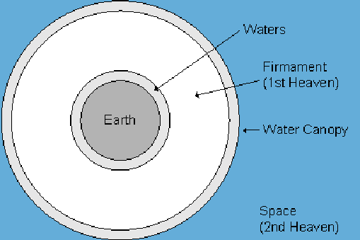

Slide 114
Day 2 Canopy Theory (Gen 1:6-8)
Implied – Gen. 1:6-7; Ps. 148:4
Explains
Long life spans of early man-Gen. 5:5, 27
Strange beasts (Gen. 1:24-25; Job 40‒41)
Where the flood waters came from (Gen. 2:5-6)
Why man’s post-flood life span cut short (Gen. 11:24-25)

Slide 115
Day 2 Canopy Theory (Gen 1:6-8)
Implied – Gen. 1:6-7; Ps. 148:4
Explains
Long life spans of early man-Gen. 5:5, 27
Strange beasts (Gen. 1:24-25; Job 40‒41)
Where the flood waters came from (Gen. 2:5-6)
Why man’s post-flood life span cut short (Gen. 11:24-25)

Slide 116
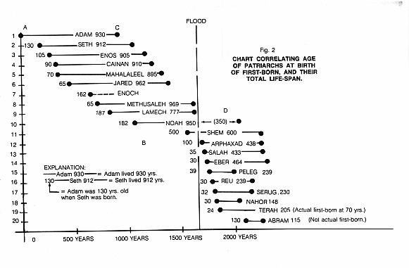

Slide 117
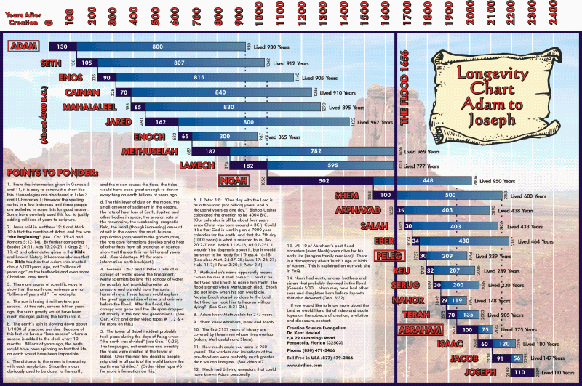

Slide 118
Day 2 Canopy Theory (Gen 1:6-8)
Implied – Gen. 1:6-7; Ps. 148:4
Explains
Long life spans of early man-Gen. 5:5, 27
Strange beasts (Gen. 1:24-25; Job 40‒41)
Where the flood waters came from (Gen. 2:5-6)
Why man’s post-flood life span cut short (Gen. 11:24-25)

Slide 119
Day 2 Canopy Theory (Gen 1:6-8)
Implied – Gen. 1:6-7; Ps. 148:4
Explains
Long life spans of early man-Gen. 5:5, 27
Strange beasts (Gen. 1:24-25; Job 40‒41)
Where the flood waters came from (Gen. 2:5-6)
Why man’s post-flood life span cut short (Gen. 11:24-25)

Slide 120
Day 2 Canopy Theory (Gen 1:6-8)
Implied – Gen. 1:6-7; Ps. 148:4
Explains
Long life spans of early man-Gen. 5:5, 27
Strange beasts (Gen. 1:24-25; Job 40‒41)
Where the flood waters came from (Gen. 2:5-6)
Why man’s post-flood life span cut short (Gen. 11:24-25)

Slide 123
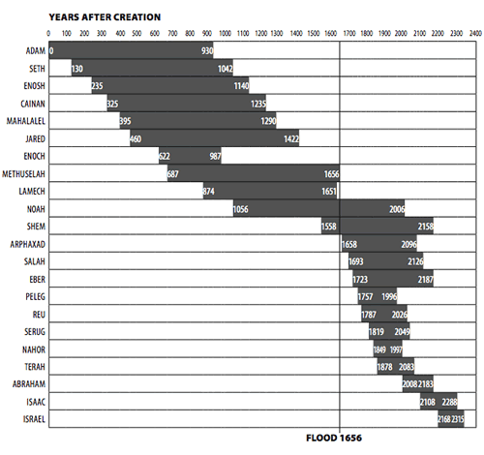

Slide 124
Genesis 1:1–2:3 Outline
Original creation on the first day (Gen 1:1)
Original creation in its unfilled and unformed state (Gen 1:2)
Creation week (Gen 1:3–2:3): “And God said,” “good”
First day 1:3-5
Second day 1:6-8
Third day 1:9-13
Fourth day 1:14-19
Fifth day 1:20-23
Sixth day 1:24-31
Seventh day 2:1-3

Slide 125
Genesis 1:1–2:3 Outline
Original creation on the first day (Gen 1:1)
Original creation in its unfilled and unformed state (Gen 1:2)
Creation week (Gen 1:3–2:3): “And God said,” “good”
First day 1:3-5
Second day 1:6-8
Third day 1:9-13
Fourth day 1:14-19
Fifth day 1:20-23
Sixth day 1:24-31
Seventh day 2:1-3

Slide 126
Shaping and Populating (Gen 1:1)
Day 1: | Light | Day 4: | Luminaries
Day 2: | Water, sky | Day 5: | Sea animals, birds
Day 3: | Land, vegetation | Day 6: | Land animals, man

Slide 128
Key Issues in Genesis 1
Importance of Gen. 1:1
Gap Theory?
Length of the creation days
Canopy Theory (day 2)
Light before the sun (day 4)
Creation of man (day 6)
Sabbath (day 7)
Evolution?

Slide 129
Genesis 1:1-3
“¹ In the beginning God created the heavens and the earth. ² The earth was formless and void, and darkness was over the surface of the deep, and the Spirit of God was moving over the surface of the waters. ³ Then God said, ‘Let there be light’; and there was light.”

Slide 130
Day 4 Light Before the Sun? (Gen. 1:3; Gen 1:14-19)
God can create light independently without the use of a secondary source
Revelation 21:23; 22:5
Deuteronomy 4:19

Slide 131
Day 4 Light Before the Sun? (Gen. 1:3; Gen 1:14-19)
God can create light independently without the use of a secondary source
Revelation 21:23; 22:5
Deuteronomy 4:19

Slide 132
Day 4 Light Before the Sun? (Gen. 1:3; Gen 1:14-19)
God can create light independently without the use of a secondary source
Revelation 21:23; 22:5
Deuteronomy 4:19

Slide 134
Day 4 Light Before the Sun? (Gen. 1:3; Gen 1:14-19)
God can create light independently without the use of a secondary source
Revelation 21:23; 22:5
Deuteronomy 4:19

Slide 135
Deuteronomy 4:19
“And beware not to lift up your eyes to heaven and see the sun and the moon and the stars, all the host of heaven, and be drawn away and worship them and serve them, those which the Lord your God has allotted to all the peoples under the whole heaven.”

Slide 136
Light only Revealed on Day 4?
Luminaries not created on day 4 but only became visible to someone standing upon the earth?
Big bang cosmology indicating that the sun preceded the earth
Man not created until day 6
Asah = “to show” (Gen 1:16; 24:12) yet asah (Gen 1:26) and bara (Gen 1:27)
Raah = “Appear” (Gen 1:9)

Slide 137
Genesis 1:1–2:3 Outline
Original creation on the first day (Gen 1:1)
Original creation in its unfilled and unformed state (Gen 1:2)
Creation week (Gen 1:3–2:3): “And God said,” “good”
First day 1:3-5
Second day 1:6-8
Third day 1:9-13
Fourth day 1:14-19
Fifth day 1:20-23
Sixth day 1:24-31
Seventh day 2:1-3

Slide 138
Genesis 1:1–2:3 Outline
Original creation on the first day (Gen 1:1)
Original creation in its unfilled and unformed state (Gen 1:2)
Creation week (Gen 1:3–2:3): “And God said,” “good”
First day 1:3-5
Second day 1:6-8
Third day 1:9-13
Fourth day 1:14-19
Fifth day 1:20-23
Sixth day 1:24-31
Seventh day 2:1-3

Slide 139
Key Issues in Genesis 1
Importance of Gen. 1:1
Gap Theory?
Length of the creation days
Canopy Theory (day 2)
Light before the sun (day 4)
Creation of man (day 6)
Sabbath (day 7)
Evolution?

Slide 140
Day 6 Theocratic Administrator (Gen 1:24-31)
Land animals (Gen. 1:24-25)
Man (Gen. 1:26-28)
Office of Theocratic Administrator
Beginning of kingdom program
Animal & man as vegetarian (Gen. 1:29-30; 2:17; 9:3)
The perfection of creation (Gen. 1:31)

Slide 141
Day 6 Theocratic Administrator (Gen 1:24-31)
Land animals (Gen. 1:24-25)
Man (Gen. 1:26-28)
Office of Theocratic Administrator
Beginning of kingdom program
Animal & man as vegetarian (Gen. 1:29-30; 2:17; 9:3)
The perfection of creation (Gen. 1:31)

Slide 142
Day 6 Theocratic Administrator (Gen 1:24-31)
Land animals (Gen. 1:24-25)
Man (Gen. 1:26-28)
Office of Theocratic Administrator
Beginning of kingdom program
Animal & man as vegetarian (Gen. 1:29-30; 2:17; 9:3)
The perfection of creation (Gen. 1:31)

Slide 143
Genesis 1:26-28
²⁶ Then God said, “Let Us make man in Our image, according to Our likeness; and let them rule over the fish of the sea and over the birds of the sky and over the cattle and over all the earth, and over every creeping thing that creeps on the earth.” ²⁷ God created man in His own image, in the image of God He created him; male and female He created them. ²⁸ God blessed them; and God said to them, “Be fruitful and multiply, and fill the earth, and subdue it; and rule over the fish of the sea and over the birds of the sky and over every living thing that moves on the earth.”

Slide 144
Genesis 1:26-28
²⁶ Then God said, “Let Us make man in Our image, according to Our likeness; and let them rule over the fish of the sea and over the birds of the sky and over the cattle and over all the earth, and over every creeping thing that creeps on the earth.” ²⁷ God created man in His own image, in the image of God He created him; male and female He created them. ²⁸ God blessed them; and God said to them, “Be fruitful and multiply, and fill the earth, and subdue it; and rule over the fish of the sea and over the birds of the sky and over every living thing that moves on the earth.”

Slide 145
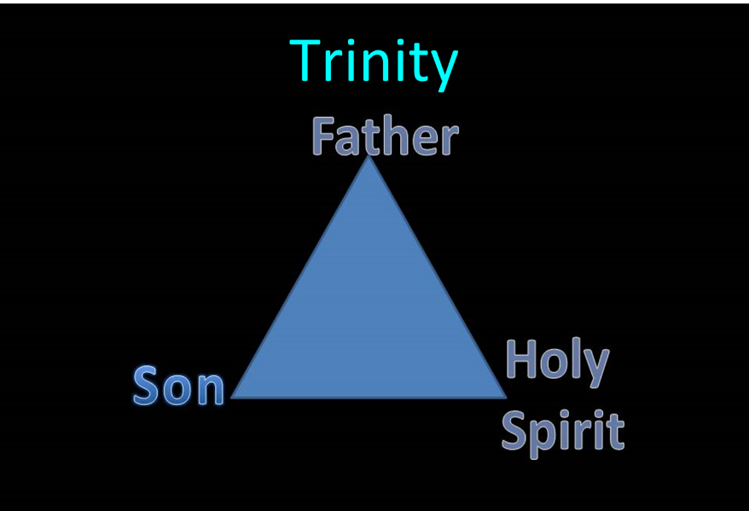
Trinitarianism in Genesis
Gen 1:26
Gen 3:22
Gen 11:7
Isa 6:8

Slide 147
Genesis 1:26-28
²⁶ Then God said, “Let Us make man in Our image, according to Our likeness; and let them rule over the fish of the sea and over the birds of the sky and over the cattle and over all the earth, and over every creeping thing that creeps on the earth.” ²⁷ God created man in His own image, in the image of God He created him; male and female He created them. ²⁸ God blessed them; and God said to them, “Be fruitful and multiply, and fill the earth, and subdue it; and rule over the fish of the sea and over the birds of the sky and over every living thing that moves on the earth.”

Slide 148
Genesis 1:26-28
²⁶ Then God said, “Let Us make man in Our image, according to Our likeness; and let them rule over the fish of the sea and over the birds of the sky and over the cattle and over all the earth, and over every creeping thing that creeps on the earth.” ²⁷ God created man in His own image, in the image of God He created him; male and female He created them. ²⁸ God blessed them; and God said to them, “Be fruitful and multiply, and fill the earth, and subdue it; and rule over the fish of the sea and over the birds of the sky and over every living thing that moves on the earth.”

Slide 149
Day 6 Theocratic Administrator (Gen 1:24-31)
Land animals (Gen. 1:24-25)
Man (Gen. 1:26-28)
Office of Theocratic Administrator
Beginning of kingdom program
Animal & man as vegetarian (Gen. 1:29-30; 2:17; 9:3)
The perfection of creation (Gen. 1:31)

Slide 150
Genesis 1:26-28
²⁶ Then God said, “Let Us make man in Our image, according to Our likeness; and let them rule over the fish of the sea and over the birds of the sky and over the cattle and over all the earth, and over every creeping thing that creeps on the earth.” ²⁷ God created man in His own image, in the image of God He created him; male and female He created them. ²⁸ God blessed them; and God said to them, “Be fruitful and multiply, and fill the earth, and subdue it; and rule over the fish of the sea and over the birds of the sky and over every living thing that moves on the earth.”

Slide 152
Day 6 Theocratic Administrator (Gen 1:24-31)
Land animals (Gen. 1:24-25)
Man (Gen. 1:26-28)
Office of Theocratic Administrator
Beginning of kingdom program
Animal & man as vegetarian (Gen. 1:29-30; 2:17; 9:3)
The perfection of creation (Gen. 1:31)

Slide 154
Charles Ryrie
Basic Theology. Page 511
“Why is an earthly kingdom necessary? Did He not receive His inheritance when He was raised and exalted in heaven? Is not His present rule His inheritance? Why does there need to be an earthly kingdom? Because He must be triumphant in the same arena where His was seemingly defeated. His rejection by the rulers of this world was on this earth (1 Cor. 2:8). His exaltation must also be on this earth. And so it shall be when He comes again to rule this world in righteousness. He has waited long for His inheritance; soon He shall receive it.”

Slide 155
J. Dwight Pentecost Thy kingdom Come, Page 316
“Apart from the reign of Christ…here on earth…And apart from this rule, God’s purpose for man would never be brought to conclusion. God’s purpose for the earth would be unrealized and the problem generated by Satan’s rebellion would never be resolved. Thus the physical, literal reign of Christ on the earth is a theological and biblical necessity—unless Satan is victorious over God.”

Slide 156
Mark Hitchcock The End, Page 421-22
“Johahn Sebastian Bach sometimes slept more than he should have. His children had a unique way of waking him up. They would go to the piano and begin to play a composition. When they would get to the last note, they would stop. They wouldn't play the last note. It worked like a charm, and it would always wake him up. He would get up from his sleep, go to the piano, and play the final chord. He couldn't stand to leave it hanging there incomplete – unfinished. In the same way today, we are all waiting for the last note on the final page of God's song of victory. God will not leave His grand composition without striking the final note. That final note is the messianic Kingdom of Jesus Christ.”

Slide 157
Day 6 Theocratic Administrator (Gen 1:24-31)
Land animals (Gen. 1:24-25)
Man (Gen. 1:26-28)
Office of Theocratic Administrator
Beginning of kingdom program
Animal & man as vegetarian (Gen. 1:29-30; 2:17; 9:3)
The perfection of creation (Gen. 1:31)

Slide 158
Genesis 1:29-30
“²⁹ Then God said, ‘Behold, I have given you every plant yielding seed that is on the surface of all the earth, and every tree which has fruit yielding seed; it shall be food for you; ³⁰ and to every beast of the earth and to every bird of the sky and to every thing that moves on the earth which has life, I have given every green plant for food’; and it was so.”

Slide 159
Genesis 2:16-17
“¹⁶ The Lord God commanded the man, saying, ‘From any tree of the garden you may eat freely; ¹⁷ but from the tree of the knowledge of good and evil you shall not eat, for in the day that you eat from it you will surely die (muwth).’”

Slide 160
Genesis 3:19
“¹⁹ By the sweat of your face You will eat bread, Till you return to the ground, Because from it you were taken; For you are dust, And to dust you shall return.”

Slide 161
Genesis 9:3
“³ Every moving thing that is alive shall be food for you; I give all to you, as I gave the green plant.”

Slide 162
Day 6 Theocratic Administrator (Gen 1:24-31)
Land animals (Gen. 1:24-25)
Man (Gen. 1:26-28)
Office of Theocratic Administrator
Beginning of kingdom program
Animal & man as vegetarian (Gen. 1:29-30; 2:17; 9:3)
The perfection of creation (Gen. 1:31)

Slide 163
Genesis 1:31
“God saw all that He had made, and behold, it was very good. And there was evening and there was morning, the sixth day.”

Slide 164
Renald Showers
Renald Showers, Those Invisible Spirits Called Angels (Bellmawr, NJ: Friends of Israel, 1997), 82-83.
“When did Satan fall away from God? We noted earlier that sin was nonexistent in every part of God‘s creation, including the angels, through the end of the sixth or final day of creation (Gen. 1:31). Satan‘s fall therefore took place after the end of creation. However, Satan was evil by the time he came to earth to tempt man to fall away from God (Gen. 3). These things prompt the conclusion that Satan‘s fall took place in the interval between the end of creation and the fall of man. How long was the interval? It must have been quite short because when God created the first man and woman, he commanded them to be fruitful and multiply through procreation (Gen. 1:27–28), but there was no human conception until after the fall of man (Gen. 4:1).”

Slide 165
Genesis 1:1–2:3 Outline
Original creation on the first day (Gen 1:1)
Original creation in its unfilled and unformed state (Gen 1:2)
Creation week (Gen 1:3–2:3): “And God said,” “good”
First day 1:3-5
Second day 1:6-8
Third day 1:9-13
Fourth day 1:14-19
Fifth day 1:20-23
Sixth day 1:24-31
Seventh day 2:1-3

Slide 166
Genesis 2:1-3
“¹ Thus the heavens and the earth were completed, and all their hosts. ² By the seventh day God completed His work which He had done, and He rested on the seventh day from all His work which He had done. ³ Then God blessed the seventh day and sanctified it, because in it He rested from all His work which God had created and made.”

Slide 167
Key Issues in Genesis 1
Importance of Gen. 1:1
Gap Theory?
Length of the creation days
Canopy Theory (day 2)
Light before the sun (day 4)
Creation of man (day 6)
Sabbath (day 7)
Evolution?

Slide 168
Genesis 2:1-3
“¹ Thus the heavens and the earth were completed, and all their hosts. ² By the seventh day God completed His work which He had done, and He rested on the seventh day from all His work which He had done. ³ Then God blessed the seventh day and sanctified it, because in it He rested from all His work which God had created and made.”

Slide 169
Day 7 Sabbath (Gen 2:1-3)
The Lord rested
Sabbath pattern (Exod. 20:8-11; 31:15-17)
7th day continues?
Creation is past (Heb. 4:3-4)
Absence of “evening and morning”
Yom + ordinal modifier

Slide 170
Day 7 Sabbath (Gen 2:1-3)
The Lord rested
Sabbath pattern (Exod. 20:8-11; 31:15-17)
7th day continues?
Creation is past (Heb. 4:3-4)
Absence of “evening and morning”
Yom + ordinal modifier

Slide 171
Day 7 Sabbath (Gen 2:1-3)
The Lord rested
Sabbath pattern (Exod. 20:8-11; 31:15-17)
7th day continues?
Creation is past (Heb. 4:3-4)
Absence of “evening and morning”
Yom + ordinal modifier

Slide 172
Exodus 20:8-11
⁸ “Remember the sabbath day, to keep it holy. ⁹ Six days you shall labor and do all your work, ¹⁰ but the seventh day is a sabbath of the Lord your God; in it you shall not do any work, you or your son or your daughter, your male or your female servant or your cattle or your sojourner who stays with you. ¹¹ For in six days the Lord made the heavens and the earth, the sea and all that is in them, and rested on the seventh day; therefore the Lord blessed the sabbath day and made it holy.”

Slide 173
Exodus 31:15-17
¹⁵ ‘For six days work may be done, but on the seventh day there is a sabbath of complete rest, holy to the Lord; whoever does any work on the sabbath day shall surely be put to death. ¹⁶ ‘So the sons of Israel shall observe the sabbath, to celebrate the sabbath throughout their generations as a perpetual covenant.’ ¹⁷ “It is a sign between Me and the sons of Israel forever; for in six days the Lord made heaven and earth, but on the seventh day He ceased from labor, and was refreshed.”

Slide 174
Day 7 Sabbath (Gen 2:1-3)
The Lord rested
Sabbath pattern (Exod. 20:8-11; 31:15-17)
7th day continues?
Creation is past (Heb. 4:3-4)
Absence of “evening and morning”
Yom + ordinal modifier

Slide 175
Day 7 Sabbath (Gen 2:1-3)
The Lord rested
Sabbath pattern (Exod. 20:8-11; 31:15-17)
7th day continues?
Creation is past (Heb. 4:3-4)
Absence of “evening and morning”
Yom + ordinal modifier

Slide 176
Day 7 Sabbath (Gen 2:1-3)
The Lord rested
Sabbath pattern (Exod. 20:8-11; 31:15-17)
7th day continues?
Creation is past (Heb. 4:3-4)
Absence of “evening and morning”
Yom + ordinal modifier

Slide 177
Day 7 Sabbath (Gen 2:1-3)
The Lord rested
Sabbath pattern (Exod. 20:8-11; 31:15-17)
7th day continues?
Creation is past (Heb. 4:3-4)
Absence of “evening and morning”
Yom + ordinal modifier

Slide 178
Genesis 2:1-3
“¹ Thus the heavens and the earth were completed, and all their hosts. ² By the seventh day God completed His work which He had done, and He rested on the seventh day from all His work which He had done. ³ Then God blessed the seventh day and sanctified it, because in it He rested from all His work which God had created and made.”

Slide 179
Key Issues in Genesis 1
Importance of Gen. 1:1
Gap Theory?
Length of the creation days
Canopy Theory (day 2)
Light before the sun (day 4)
Creation of man (day 6)
Sabbath (day 7)
Evolution?

Slide 180
Origin of Man
Two views
Evolution
Creation

Slide 181
Evolution Wikapedia
Definition – A gradual process in which something changes into a different and usually more complex or better form. Change in the genetic composition of a population during successive generations, as a result of natural selection acting on the genetic variation among individuals, and resulting in the development of new species.

Slide 182
Intelligent Design Resources
Michael Behe – Darwin’s Black Box
Michael Denton – Evolution: A Theory in Crisis
Philip Johnson – Darwin on Trial
William Dembski – Intelligent Design
Marvin Lubenow – Bones of Contention

Slide 183
Evolution’s Flaws
The “missing link” is still missing
No design from randomness
Contradiction with scientific laws: Biogenesis, Second Law of Thermodynamics
Statistical improbabilities
Young earth clocks
Not conforming to the scientific method

Slide 184
Evolution’s Flaws
The “missing link” is still missing
No design from randomness
Contradiction with scientific laws: Biogenesis, Second Law of Thermodynamics
Statistical improbabilities
Young earth clocks
Not conforming to the scientific method

Slide 185
Missing Links
“Links are missing just where we most fervently desire them and its all too probable that many ‘links’ will continue to be missing.”
Alfred S. Romer, Genetics, Evolution, and Paleontology, p. 114

Slide 186
Missing Links
“Gradualism is a concept I believe in…Yet Gould and the American museum people are hard to contradict when they say that there are no transitional fossils..You say that I should show a photo of the fossil from which each type of organism was derived. I will lay it on the line-there is not one such fossil from which one could make an airtight argument…It is easy enough to make up stories of how one form gave rise to another, and to find reasons why the stages should be favoured by natural selection. But such stories are not part of science, for there is no way of putting them to the test.”
Colin Patterson of the British Museum of Natural History, Bible-Science Newsletter (Aug, 1981), p. 8.

Slide 187
Evolution’s Flaws
The “missing link” is still missing
No design from randomness
Contradiction with scientific laws: Biogenesis, Second Law of thermodynamics
Statistical improbabilities
Young earth clocks
Not conforming to the scientific method

Slide 188
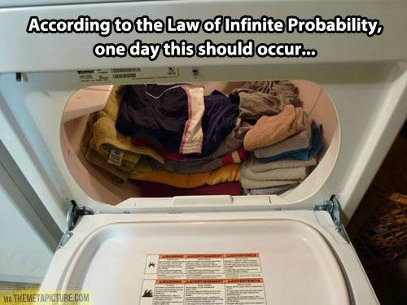

Slide 189
Evolution’s Flaws
The “missing link” is still missing
No design from randomness
Contradiction with scientific laws: Biogenesis, Second Law of thermodynamics
Statistical improbabilities
Young earth clocks
Not conforming to the scientific method

Slide 190
Evolution’s Flaws
The “missing link” is still missing
No design from randomness
Contradiction with scientific laws: Biogenesis, Second Law of thermodynamics
Statistical improbabilities
Young earth clocks
Not conforming to the scientific method

Slide 191
Evolution’s Flaws
The “missing link” is still missing
No design from randomness
Contradiction with scientific laws: Biogenesis, Second Law of thermodynamics
Statistical improbabilities
Young earth clocks
Not conforming to the scientific method

Slide 192
Evolution’s Flaws
The “missing link” is still missing
No design from randomness
Contradiction with scientific laws: Biogenesis, Second Law of thermodynamics
Statistical improbabilities
Young earth clocks
Not conforming to the scientific method

Slide 193
Why Evolution’s Popularity?
“The evolutionary origin of man relieves man of responsibility to a personal Creator outside of himself.”
Rom 1:18ff; 2 Pet. 3:5 (KJV)
Ryrie, Survey of Bible Doctrine, 101

Slide 194
Romans 1:18–20
¹⁸ For the wrath of God is revealed from heaven against all ungodliness and unrighteousness of men who suppress the truth in unrighteousness, ¹⁹ because that which is known about God is evident within them; for God made it evident to them. ²⁰ For since the creation of the world His invisible attributes, His eternal power and divine nature, have been clearly seen, being understood through what has been made, so that they are without excuse.

Slide 195
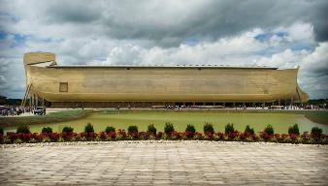
2 Peter 3:5 (KJV)
“For this they willingly are ignorant of [thelō], that by the word of God the heavens were of old, and the earth standing out of the water and in the water.”

Slide 196
Theistic Evolution?
Evolution | Gen 1:1–2:3
Naturalistic creation | Miraculous creation
Gen 1-11 is myth | Gen 1-11 is history
No creator/creation distinction | Ex-Nihilo creation (Ps. 33:6)
Light before the earth | Earth before the light
Took billions of years | Took 6 days
Luminaries before the earth | Earth before the luminaries (Deut 4:19; Rev. 21:23; 22:5)
Hot to cold | Cold (Gen 1:2) to hot (2 Pet 3:10)
Land before ocean | Ocean before land (Gen 1:9)
Present is key to past | God worked suddenly in the past (Job 38:4-7; Heb 11:3; 2 Peter 3:3-7)
Early rain on the earth | No rain until later (Gen 2:5-6; Heb 11:6-7)
List adapted from Walt Brown, In The Beginning, 276-80

Slide 197
Theistic Evolution?
Evolution | Gen 1:1–2:3
Naturalistic creation | Miraculous creation
Gen 1-11 is myth | Gen 1-11 is history
No creator/creation distinction | Ex-Nihilo creation (Ps. 33:6)
Light before the earth | Earth before the light
Took billions of years | Took 6 days
Luminaries before the earth | Earth before the luminaries (Deut 4:19; Rev. 21:23; 22:5)
Hot to cold | Cold (Gen 1:2) to hot (2 Pet 3:10)
Land before ocean | Ocean before land (Gen 1:9)
Present is key to past | God worked suddenly in the past (Job 38:4-7; Heb 11:3; 2 Peter 3:3-7)
Early rain on the earth | No rain until later (Gen 2:5-6; Heb 11:6-7)
List adapted from Walt Brown, In The Beginning, 276-80

Slide 198
Genesis 1:1-3
“¹ In the beginning God created the heavens and the earth. ² The earth was formless and void, and darkness was over the surface of the deep, and the Spirit of God was moving over the surface of the waters. ³ Then God said, ‘Let there be light’; and there was light.”

Slide 199
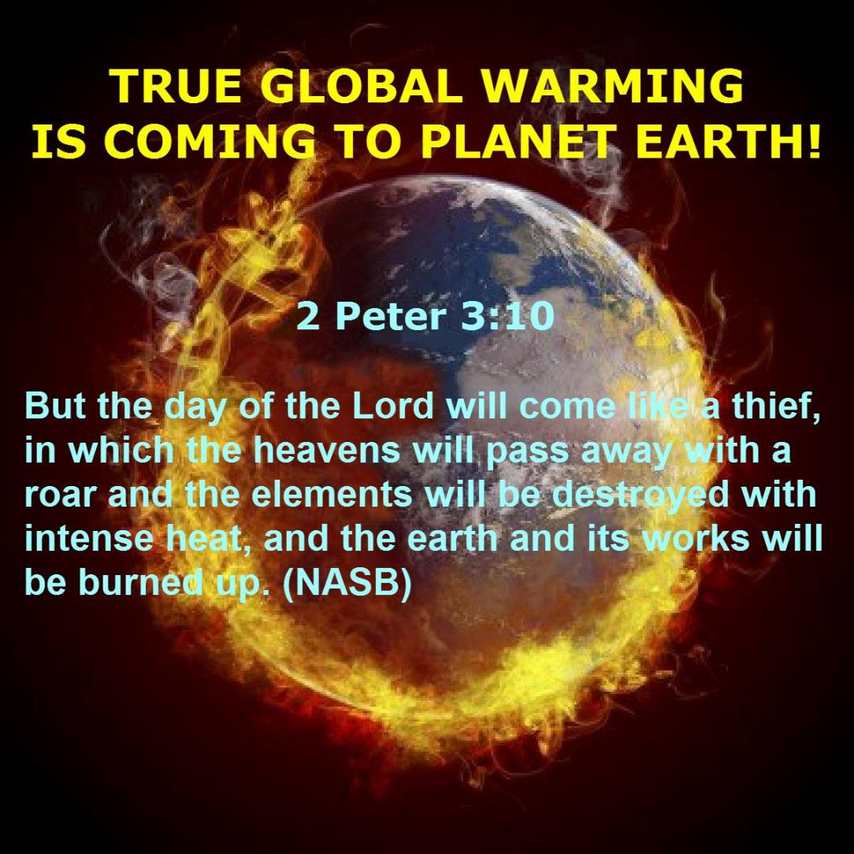

Slide 200
Theistic Evolution?
Evolution | Gen 1:1–2:3
Naturalistic creation | Miraculous creation
Gen 1-11 is myth | Gen 1-11 is history
No creator/creation distinction | Ex-Nihilo creation (Ps. 33:6)
Light before the earth | Earth before the light
Took billions of years | Took 6 days
Luminaries before the earth | Earth before the luminaries (Deut 4:19; Rev. 21:23; 22:5)
Hot to cold | Cold (Gen 1:2) to hot (2 Pet 3:10)
Land before ocean | Ocean before land (Gen 1:9)
Present is key to past | God worked suddenly in the past (Job 38:4-7; Heb 11:3; 2 Peter 3:3-7)
Early rain on the earth | No rain until later (Gen 2:5-6; Heb 11:6-7)
List adapted from Walt Brown, In The Beginning, 276-80

Slide 201
Theistic Evolution?
Evolution | Gen 1:1–2:3
Naturalistic creation | Miraculous creation
Gen 1-11 is myth | Gen 1-11 is history
No creator/creation distinction | Ex-Nihilo creation (Ps. 33:6)
Light before the earth | Earth before the light
Took billions of years | Took 6 days
Luminaries before the earth | Earth before the luminaries (Deut 4:19; Rev. 21:23; 22:5)
Hot to cold | Cold (Gen 1:2) to hot (2 Pet 3:10)
Land before ocean | Ocean before land (Gen 1:9)
Present is key to past | God worked suddenly in the past (Job 38:4-7; Heb 11:3; 2 Peter 3:3-7)
Early rain on the earth | No rain until later (Gen 2:5-6; Heb 11:6-7)
List adapted from Walt Brown, In The Beginning, 276-80

Slide 202
Uniformitarianism Defined
https://www.britannica.com/science/uniformitarianism
“Uniformitarianism, in geology, the doctrine suggesting that Earth’s geologic processes acted in the same manner and with essentially the same intensity in the past as they do in the present and that such uniformity is sufficient to account for all geologic change. This principle is fundamental to geologic thinking and underlies the whole development of the science of geology... When William Whewell, a University of Cambridge scholar, introduced the term in 1832, the prevailing view (called catastrophism) was that…Earth had originated through supernatural means and had been affected by a series of catastrophic events such as the biblical Flood. In contrast to catastrophism, uniformitarianism postulates that phenomena displayed in rocks may be entirely accounted for by geologic processes that continue to operate—in other words, the present is the key to the past.”

Slide 203
Uniformitarianism is not Biblicism
 | ERA | SCRIPTURE | DISTINCTIVES
1. | Creation | Genesis 1-2 | No death
2. | Fall | Genesis 3-6 | Death, painful pregnancy & toil, long life spans, no human government
3. | Flood | Genesis 7-10 | Shorter life spans, human government, one language, no nations
4. | Babel | Genesis 11-present | No global government, multiple languages, nations, ethnicities
5. | Antichrist | Rapture to 2nd Advent | Global government, restrainer removed
6. | Kingdom | Rev. 20:1-10 | Long life spans, kingdom conditions, reality of death, renovated earth
7. | Eternal State | Rev. 21-22 | No death, new earth

Slide 204
Theistic Evolution?
Evolution | Gen 1:1–2:3
Naturalistic creation | Miraculous creation
Gen 1-11 is myth | Gen 1-11 is history
No creator/creation distinction | Ex-Nihilo creation (Ps. 33:6)
Light before the earth | Earth before the light
Took billions of years | Took 6 days
Luminaries before the earth | Earth before the luminaries (Deut 4:19; Rev. 21:23; 22:5)
Hot to cold | Cold (Gen 1:2) to hot (2 Pet 3:10)
Land before ocean | Ocean before land (Gen 1:9)
Present is key to past | God worked suddenly in the past (Job 38:4-7; Heb 11:3; 2 Peter 3:3-7)
Early rain on the earth | No rain until later (Gen 2:5-6; Heb 11:6-7)
List adapted from Walt Brown, In The Beginning, 276-80

Slide 207
Theistic Evolution?
Evolution | Gen 1:1–2:3
Initial microscopic animals | Initial complex animals
Plant life before atmosphere | Atmosphere before plant life
Sun before plant life | Plant life before the sun
Continuity among all life | Each only produces after its own kind (Gen 1:24; John 3:3-7)
Sea life before land life | Land life before sea life
Reptiles/dinosaurs before birds | Birds before reptiles/dinosaurs (Gen 1:24-25; Ps 148:4; Gen 1:6-7; 5:5, 27; 11:24-25; Job 40-41)
Fish before birds and trees | Trees before fish and fish created with birds
Early animals were meat eaters | Early animals were plant eaters (Gen1:29-30)
Females before males | Males before females (Gen 2:18-25)
List adapted from Walt Brown, In The Beginning, 276-80

Slide 208
Theistic Evolution?
Evolution | Gen 1:1–2:3
Initial microscopic animals | Initial complex animals
Plant life before atmosphere | Atmosphere before plant life
Sun before plant life | Plant life before the sun
Continuity among all life | Each only produces after its own kind (Gen 1:24; John 3:3-7)
Sea life before land life | Land life before sea life
Reptiles/dinosaurs before birds | Birds before reptiles/dinosaurs (Gen 1:24-25; Ps 148:4; Gen 1:6-7; 5:5, 27; 11:24-25; Job 40-41)
Fish before birds and trees | Trees before fish and fish created with birds
Early animals were meat eaters | Early animals were plant eaters (Gen1:29-30)
Females before males | Males before females (Gen 2:18-25)
List adapted from Walt Brown, In The Beginning, 276-80

Slide 209
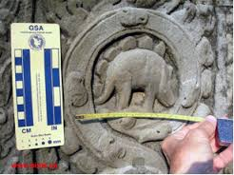

Slide 210
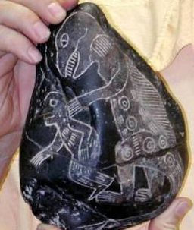

Slide 212
Theistic Evolution?
Evolution | Gen 1:1–2:3
Initial microscopic animals | Initial complex animals
Plant life before atmosphere | Atmosphere before plant life
Sun before plant life | Plant life before the sun
Continuity among all life | Each only produces after its own kind (Gen 1:24; John 3:3-7)
Sea life before land life | Land life before sea life
Reptiles/dinosaurs before birds | Birds before reptiles/dinosaurs (Gen 1:24-25; Ps 148:4; Gen 1:6-7; 5:5, 27; 11:24-25; Job 40-41)
Fish before birds and trees | Trees before fish and fish created with birds
Early animals were meat eaters | Early animals were plant eaters (Gen1:29-30)
Females before males | Males before females (Gen 2:18-25)
List adapted from Walt Brown, In The Beginning, 276-80

Slide 213
Theistic Evolution?
Evolution | Gen 1:1–2:3
Evolution continues | Creation is complete (Gen 2:1-3; John 5:17; Col 1:17; Heb 4:3-4, 10)
Suffering is natural | Suffering is unnatural (Gen 1:31; Rom 8:19-23; Rev. 21:4)
Death before Adam | Death after Adam (Gen 2:17; Rom 5:12)
Man is an evolved animal | Man created higher than the animals (Gen 1:26-28; Ps 8:4-6)
Man exists long after history | Man existed at beginning (Matt 19:4)
Man evolved from the animals | Man created from the dust (Gen 2:7)
Fossils before man | Fossils after man
Man related to animals | Man not related to animals (Gen 5;11)
Man’s genealogy is ancient | Man’s genealogy is recent
Early man meat eaters | Early man plant eaters (Gen 1:29; 9:3)
List adapted from Walt Brown, In The Beginning, 276-80

Slide 214
Theistic Evolution?
Evolution | Gen 1:1–2:3
Evolution continues | Creation is complete (Gen 2:1-3; John 5:17; Col 1:17; Heb 4:3-4, 10)
Suffering is natural | Suffering is unnatural (Gen 1:31; Rom 8:19-23; Rev. 21:4)
Death before Adam | Death after Adam (Gen 2:17; Rom 5:12)
Man is an evolved animal | Man created higher than the animals (Gen 1:26-28; Ps 8:4-6)
Man exists long after history | Man existed at beginning (Matt 19:4)
Man evolved from the animals | Man created from the dust (Gen 2:7)
Fossils before man | Fossils after man
Man related to animals | Man not related to animals (Gen 5;11)
Man’s genealogy is ancient | Man’s genealogy is recent
Early man meat eaters | Early man plant eaters (Gen 1:29; 9:3)
List adapted from Walt Brown, In The Beginning, 276-80

Slide 216
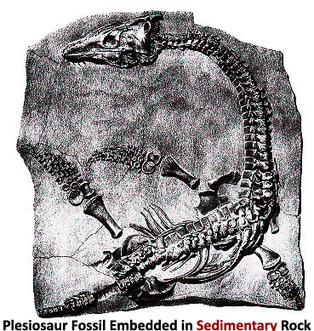

Slide 217
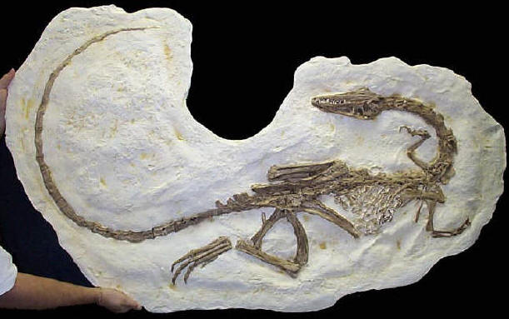

Slide 218
Theistic Evolution?
Evolution | Gen 1:1–2:3
Evolution continues | Creation is complete (Gen 2:1-3; John 5:17; Col 1:17; Heb 4:3-4, 10)
Suffering is natural | Suffering is unnatural (Gen 1:31; Rom 8:19-23; Rev. 21:4)
Death before Adam | Death after Adam (Gen 2:17; Rom 5:12)
Man is an evolved animal | Man created higher than the animals (Gen 1:26-28; Ps 8:4-6)
Man exists long after history | Man existed at beginning (Matt 19:4)
Man evolved from the animals | Man created from the dust (Gen 2:7)
Fossils before man | Fossils after man
Man related to animals | Man not related to animals (Gen 5;11)
Man’s genealogy is ancient | Man’s genealogy is recent
Early man meat eaters | Early man plant eaters (Gen 1:29; 9:3)
List adapted from Walt Brown, In The Beginning, 276-80

Slide 219
Theistic Evolution?
Evolution | Gen 1:1–2:3
Marriage is an evolved custom | Marriage was instituted by God (Gen 2:18-25; John 2:11)
Man developed units of time | God implemented units of time (Gen 1:14)
Seven day week developed | God implemented the seven day week (Exod. 20:8-11; 31:15-17)
People did not reach 100 | People reached 900 years of age (Ps 148:4; 90:10; Gen 1:6-7; 5:5, 27; 11:24-25)
Early man was primitive | Early man was advanced (Gen 4:17, 20-22; 6:14; 11:4; Prov. 1:7; Ps 14:1; Rom 1:18ff)
Language evolved slowly | Man created with speaking ability (Gen 2:23; 3:9-10)
Things are improving | Things are deteriorating
Thorns evolved with plants | Adam’s sin cause the thorns (Gen 3:18)
Animalistic nature causes evil | Sin nature causes evil (Jer. 17:9)
List adapted from Walt Brown, In The Beginning, 276-80

Slide 220
Theistic Evolution?
Evolution | Gen 1:1–2:3
Marriage is an evolved custom | Marriage was instituted by God (Gen 2:18-25; John 2:11)
Man developed units of time | God implemented units of time (Gen 1:14)
Seven day week developed | God implemented the seven day week (Exod. 20:8-11; 31:15-17)
People did not reach 100 | People reached 900 years of age (Ps 148:4; 90:10; Gen 1:6-7; 5:5, 27; 11:24-25)
Early man was primitive | Early man was advanced (Gen 4:17, 20-22; 6:14; 11:4; Prov. 1:7; Ps 14:1; Rom 1:18ff)
Language evolved slowly | Man created with speaking ability (Gen 2:23; 3:9-10)
Things are improving | Things are deteriorating
Thorns evolved with plants | Adam’s sin cause the thorns (Gen 3:18)
Animalistic nature causes evil | Sin nature causes evil (Jer. 17:9)
List adapted from Walt Brown, In The Beginning, 276-80

Slide 221
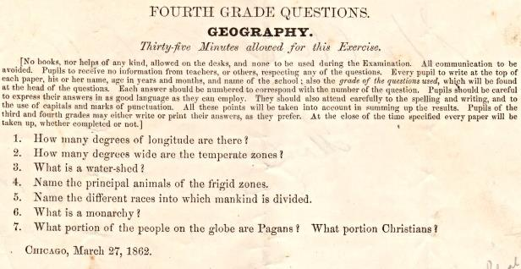
Geography Quiz
(from the WallBuilders' library) that was given to Fourth Grades in 1862

Slide 222
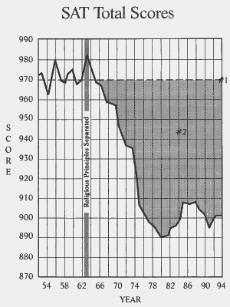

Slide 223
Theistic Evolution?
Evolution | Gen 1:1–2:3
Marriage is an evolved custom | Marriage was instituted by God (Gen 2:18-25; John 2:11)
Man developed units of time | God implemented units of time (Gen 1:14)
Seven day week developed | God implemented the seven day week (Exod. 20:8-11; 31:15-17)
People did not reach 100 | People reached 900 years of age (Ps 148:4; 90:10; Gen 1:6-7; 5:5, 27; 11:24-25)
Early man was primitive | Early man was advanced (Gen 4:17, 20-22; 6:14; 11:4; Prov. 1:7; Ps 14:1; Rom 1:18ff)
Language evolved slowly | Man created with speaking ability (Gen 2:23; 3:9-10)
Things are improving | Things are deteriorating
Thorns evolved with plants | Adam’s sin cause the thorns (Gen 3:18)
Animalistic nature causes evil | Sin nature causes evil (Jer. 17:9)
List adapted from Walt Brown, In The Beginning, 276-80

Slide 224
Theistic Evolution?
Evolution | Gen 1:1–2:3
Suffering precedes man | Suffering follows man (Gen 1:31; Rom 8:19-23; Rev. 21:4)
Man is improving | Man is failing (Rev. 14:20)
List adapted from Walt Brown, In The Beginning, 276-80

Slide 225
CONCLUSION

Slide 226
Genesis 1:1–2:3 Outline
Original creation on the first day (Gen 1:1)
Original creation in its unfilled and unformed state (Gen 1:2)
Creation week (Gen 1:3–2:3): “And God said,” “good”
First day 1:3-5
Second day 1:6-8
Third day 1:9-13
Fourth day 1:14-19
Fifth day 1:20-23
Sixth day 1:24-31
Seventh day 2:1-3

