Slide 1
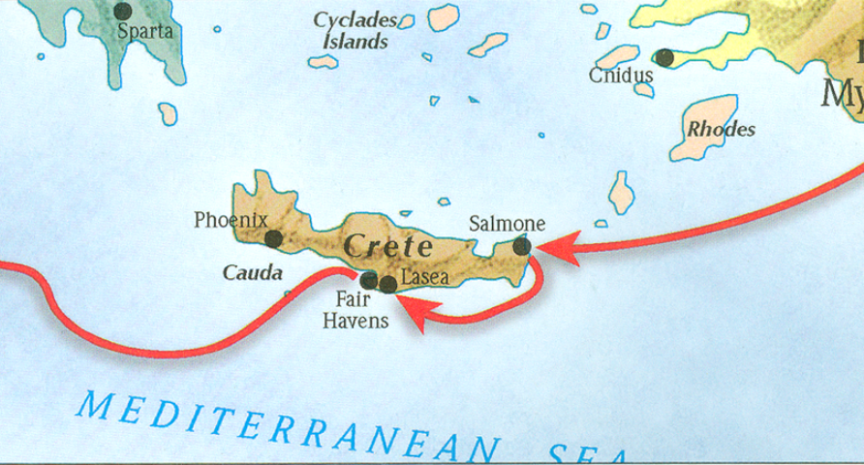
The book of Titus
Worthy of the Gospel

Slide 2
Introduction
The Book of Titus

Slide 3
8 Questions?
Who wrote it?
What do we know about the author?
Who was the book written to?
When was the book written?
Where was the book written from?
What’s the purpose of the book?
What’s in the book? (Outline)
What is the message of this book?
Book’s uniqueness?

Slide 4
8 Questions?
Who wrote it? -Paul the Apostle
What do we know about the author?
Who was the book written to?

Slide 5
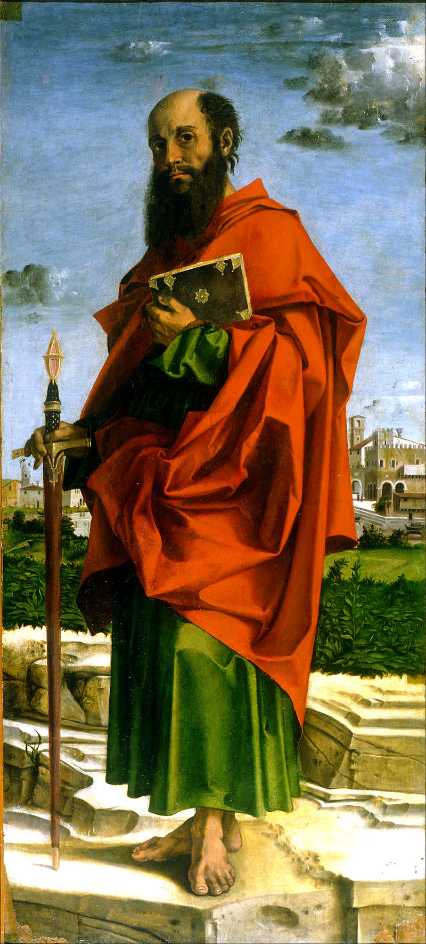
What do we know about Paul?
Born around AD 10
An Israelite, Tribe of Benjamin, Pharisee (Phil 3:5)
Raised in Jerusalem, educated in Tarsus (Acts 26:4-5)
Mentored by Gamaliel (Acts 21:40
Fluent in Hebrew (Acts 21:40)
From Tarsus of Cecilia (Acts 9:11; 21:39)
Roman citizen (Acts 22:25-28)
Saul (Hebrew- šā˒ûl) / Paul (Grk – Paulos)
Persecutor of the Church
Converted by Christ Himself (Acts 9)
Instrument and sufferer of Christ (Acts 9:16)
Greatest missionary and theologian
Greatest contributor to the Bible (13 books)
Bartolomeo Montagna - Saint Paul

Slide 6
8 Questions?
Who wrote it? -Paul the Apostle
What do we know about the author? – Greatest missionary, theologian, and contributor of the NT.
Who was the book written to? - Titus

Slide 7
Titus 1:4a
“To Titus, my true child in a common faith…”

Slide 8
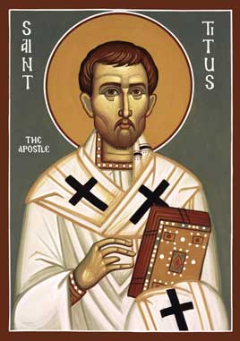
Who was the book written to?
Titus
A believer in Christ (1:4)
Brother to Paul (2 Cor 2:13)
Reliable (2 Cor 7:6)
Greek Gentile (Gal 2:3)
Test case in the Jerusalem Council of AD 49 (Gal2:1-4; Acts 11:27-30)
Courier for 2 Corinthians letter
Minister to Corinth believers
Loved God’s people (2 Cor 8:16-17)
Joy to Paul (2 Cor 7:13)
Prominent church leader in Crete (Titus 1:5)

Slide 9
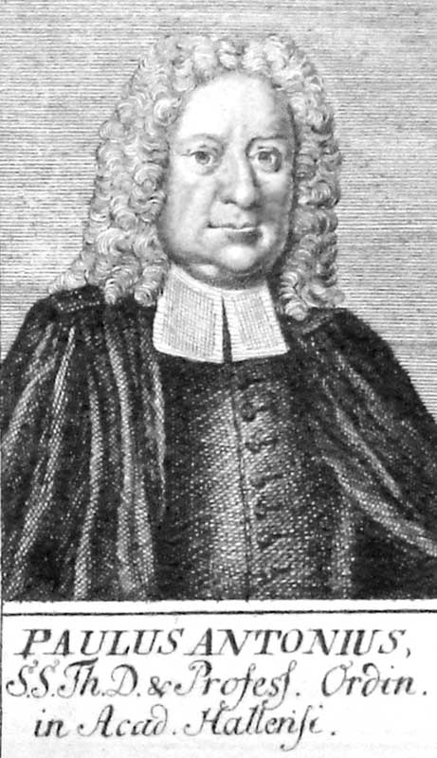
Paul Anton - 1726
“Pastoral Epistles”

Slide 10
8 Questions?
When was the book written?
AD 63-66
Where was the book written?
What is the purpose of the book?

Slide 11
8 Questions?
When was the book written?
AD 63-66
Where was the book written? Macedonia
What is the purpose of the book?

Slide 12
8 Questions?
When was the book written?
AD 63-66
Where was the book written? Macedonia
What is the purpose of the book?

Slide 13
Titus 1:5
“For this reason I left you in Crete, that you would set in order what remains and appoint elders in every city as I directed you…”

Slide 14
Titus 3:8
“This is a trustworthy statement; and concerning these things I want you to speak confidently, so that those who have believed God will be careful to engage in good deeds. These things are good and profitable for men.”

Slide 15
Titus 3:8
“This is a trustworthy statement; and concerning these things I want you to speak confidently, so that those who have believed God will be careful to engage in good deeds. These things are good and profitable for men.”

Slide 16
Titus 3:1-2
“Remind them to be subject to rulers, to authorities, to be obedient, to be ready for every good deed, to be ready for every good deed, malign no one, be peaceable, gentle, showing every consideration for all men. For we were once foolish ourselves…”

Slide 18
8 Questions?
What is the purpose of the book?
Task Titus in bringing order to the churches in Crete by appointing elders.
Provide the church at Crete doctrinal instruction to promote good works
To warn believers of the false teachers

Slide 19
8 Questions?
7. What’s in the book?

Slide 20
8 Questions?
7. What’s in the book?
Salutation (1-5a)
Assignor (1:1-3)
Assignee (1:4)
Assignment (1:5)
Assignment Explained (1:5-3:11)
Appoint Leaders (1:5b-16)
Addressing Doctrinal Issues (2:1-3:11)
Conclusion (3:12-15)
Requests (3:12-14)
Greetings (3:15a-b)
Benediction (3:15c)
Outline adapted from Titus Argument, Article by Andy Woods, 2007.

Slide 21
8 Questions?
What’s the message of the book?

Slide 22
8 Questions?
What’s the message of the book?
To promote healthy and godly order, works, and growth in the church through sound doctrine and leadership.

Slide 23
Titus 2:7
“in all things show yourself to be an example of good deeds, with purity in doctrine, dignified…”

Slide 24
Titus 2:14
“who gave Himself for us to redeem us from every lawless deed, and to purify for Himself a people for His own possession, zealous for good deeds.”

Slide 25
Titus 1:9
“holding fast the faithful word which is in accordance with the teaching, so that he will be able both to exhort in sound doctrine and to refute those who contradict.”

Slide 26
8 Questions?
What’s the message of the book?
To promote healthy and godly order, works, and growth in the church through sound doctrine and leadership.

Slide 27
8 Questions?
Who wrote it? -Paul the Apostle
What do we know about the author? – Greatest missionary, theologian, and contributor of the NT.
Who was the book written to? - Titus

Slide 28
8 Questions?
When was the book written?
AD 63-66
Where was the book written? Macedonia
What is the purpose of the book?

Slide 29
8 Questions?
What is the purpose of the book?
Task Titus in bringing order to the churches in Crete by appointing elders.
Provide the church at Crete doctrinal instruction to promote good works
To warn believers of the false teachers

Slide 30
8 Questions?
7. What’s in the book?
Salutation (1-5a)
Assignor (1:1-3)
Assignee (1:4)
Assignment (1:5)
Assignment Explained (1:5-3:11)
Appoint Leaders (1:5b-16)
Addressing Doctrinal Issues (2:1-3:11)
Conclusion (3:12-15)
Requests (3:12-14)
Greetings (3:15a-b)
Benediction (3:15c)
Outline adapted from Titus Argument, Article by Andy Woods, 2007.

Slide 31
8 Questions?
What’s the message of the book?
To promote healthy and godly order, works, and growth in the church through sound doctrine and leadership.

Slide 32
Outline of titus
Salutation (1-5a)
Assignor (1:1-3)
Assignee (1:4)
Assignment (1:5)
Assignment Explained (1:5-3:11)
Appoint Leaders (1:5b-16)
Addressing Doctrinal Issues (2:1-3:11)
Conclusion (3:12-15)
Requests (3:12-14)
Greetings (3:15a-b)
Benediction (3:15c)
Outline adapted from Titus Argument, Article by Andy Woods, 2007.

Slide 33
Outline of titus
Salutation (1-5a)
Assignor (1:1-3)
Assignee (1:4)
Assignment (1:5)
Outline adapted from Titus Argument, Article by Andy Woods, 2007.

Slide 34
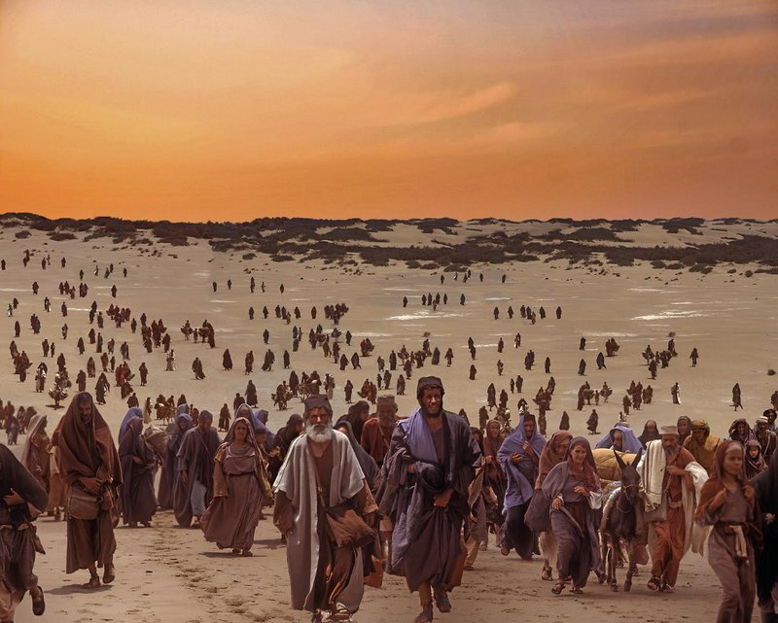
Leviticus 25:55
“For the sons of Israel are My servants; they are My servants whom I brought out from the land of Egypt. I am the Lord your God.”

Slide 35
Revelation 22:3-5
“There will be no longer be any curse; and the throne of God and of the Lamb will be in it, and His bond-servants will serve Him, they will see His face, and His name will be on their foreheads. And there will no longer be any night; and they will not have need of the light of a lamp nor the light of the sun, because the Lord God will illumine them; and they will reign forever and ever.”

Slide 36
1 Corinthians 9:19
“For though I am free from all men, I have made myself a slave to all, that I might win the more”

Slide 37
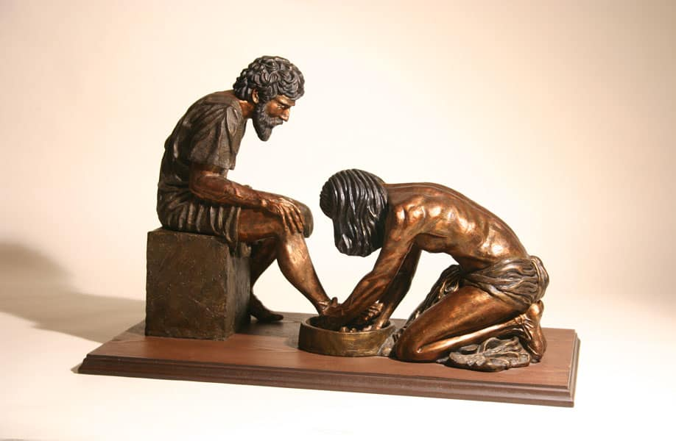
Philippians 2:5-8
“Have this attitude in yourselves which was also in Christ Jesus, who, although He existed in the form of God, did not regard equality with God a thing to be grasped, but emptied Himself, taking the form of a bond-servant, and being made in the likeness of men.””

Slide 38
1 Corinthians 9:19
“For though I am free from all men, I have made myself a slave to all, that I might win the more”

Slide 39
Titus 1:1-2a
“1 Paul, a bond-servant of God and an apostle of Jesus Christ, for the faith of those chosen of God and the knowledge of the truth which is according to godliness, 2 in the hope of eternal life…”

Slide 40
Titus 1:1-2a
“1 Paul, a bond-servant of God and an apostle of Jesus Christ, for the faith of those chosen of God and the knowledge of the truth which is according to godliness, 2 in the hope of eternal life…”

Slide 41
Titus 1:1-2a
“1 Paul, a bond-servant of God and an apostle of Jesus Christ, for the faith of those chosen of God and the knowledge of the truth which is according to godliness, 2 in the hope of eternal life…”

Slide 42
Titus 1:1-2a
“1 Paul, a bond-servant of God and an apostle of Jesus Christ, for the faith of those chosen of God and the knowledge of the truth which is according to godliness, 2 in the hope of eternal life…”

Slide 43
Titus 1:2-3
2 “in the hope of eternal life, which God, who cannot lie, promised long ages ago, 3 but at the proper time manifested, even His word, in the proclamation with which I was entrusted according to the commandment of God our Savior…”

Slide 44
2 Timothy 1:9
“God, who has saved us and called us with a holy calling, not according to our works, but according to His own purpose and grace which was granted us in Christ Jesus from all eternity.”

Slide 45
Ephesians 1:4
“just as He chose us in Him before the foundation of the world, that we would be holy and blameless before Him. He predestined us to adoption as sons through Jesus Christ to Himself, according to the kind intention of His will, 6 to the praise of the glory of His grace, which He freely bestowed on us in the Beloved.”

Slide 46
Titus 1:2-3
2 “in the hope of eternal life, which God, who cannot lie, promised long ages ago, 3 but at the proper time manifested, even His word, in the proclamation with which I was entrusted according to the commandment of God our Savior…”

Slide 47
Galatians 1:15-18
15 But when God, who had set me apart even from my mother’s womb and called me through His grace, was pleased 16 to reveal His Son in me so that I might preach Him among the Gentiles, I did not immediately consult with flesh and blood, 17 nor did I go up to Jerusalem to those who were apostles before me; but I went away to Arabia, and returned once more to Damascus. 18 Then three years later I went up to Jerusalem to become acquainted with Cephas, and stayed with him fifteen days.

Slide 48
Titus 1:4-5
4 “To Titus, my true child in a common faith: Grace and peace from God the Father and Christ Jesus our Savior. 5 For this reason I left you in Crete, that you would set in order what remains and appoint elders in every city as I directed you…”

Slide 49
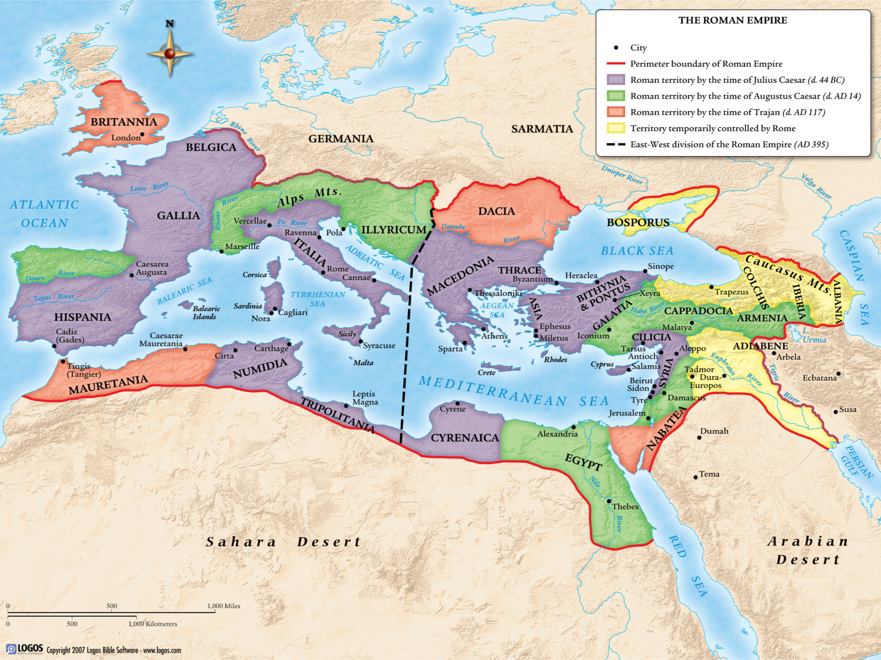
The Roman Empire

Slide 50
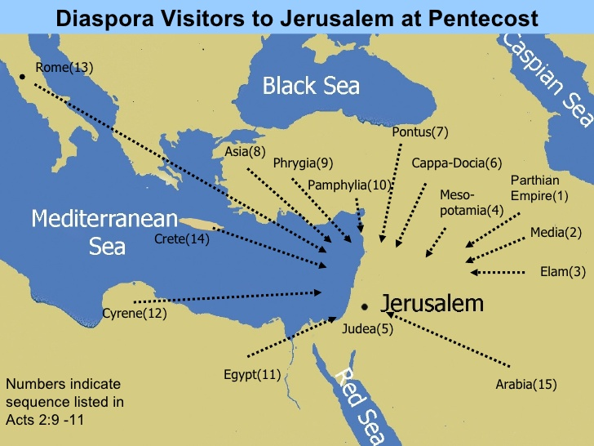

Slide 51
Outline of titus
Salutation (1-5a)
Assignor (1:1-3)
Assignee (1:4)
Assignment (1:5)
Outline adapted from Titus Argument, Article by Andy Woods, 2007.

Slide 52
Conclusion

Slide 53
The book of Titus
Worthy of the Gospel

