Slide 1


INTRODUCTION

Slide 2
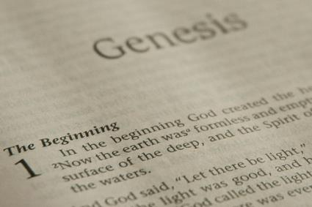
INTRODUCTORY MATTERS
Title
Authorship, date, recipients
Structure
Setting
Message and Purpose
Unique Characteristics
Themes
Christ in Genesis
Importance
Historicity

Slide 3
INTRODUCTORY MATTERS
Title
Authorship, date, recipients
Structure
Setting
Message and Purpose
Unique Characteristics
Themes
Christ in Genesis
Importance
Historicity

Slide 4
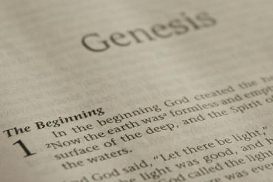
TITLE
Hebrew – bereshith
LXX – geneseos
Vulgate – liber geneseos
English – Book of Genesis

Slide 5
INTRODUCTORY MATTERS
Title
Authorship, date, recipients
Structure
Setting
Message and Purpose
Unique Characteristics
Themes
Christ in Genesis
Importance
Historicity

Slide 6

AUTHORSHIP
Charles Darwin
Karl Marx
Julius Wellhausen
John Dewey
Sigmund Freud
John Maynard Keynes
Soren Kierkegaard

Slide 7
THREE PHASES OF MOSES’ 120 YEAR LIFE
LIFE PHASE | SCRIPTURE | YEARS | AGE | ACTIVITY
Natural Training | Acts 7:23 | 1526–1486 B.C. | 1-40 | Egyptian Education
Spiritual Training | Exod. 7:7 | 1486–1446 B.C. | 40-80 | Midian Shepherding
Ministry | Deut. 31:2; 34:7; Acts 7:36 | 1446–1406 B.C. | 80-120 | Exodus, Law, Wilderness Preservation, Pentateuch Authorship

Slide 8
DATE AND RECIPIENTS
Date of Exodus: 1446 B.C. (1 Kgs. 6:1)
Scope of Moses’ life: 1525–1405 B.C.
Purpose: to prepare Israel for entry/obedience to the Mosaic Covenant and the conquest
Date of Pentatuch: 1445–1405 B.C.

Slide 9
INTRODUCTORY MATTERS
Title
Authorship, date, recipients
Structure
Setting
Message and Purpose
Unique Characteristics
Themes
Christ in Genesis
Importance
Historicity

Slide 10

GENESIS STRUCTURE
  Beginning of the Human race (Gen. 1‒11)
  Beginning of the Hebrew race (Gen. 12‒50)

Slide 11

GENESIS STRUCTURE
  Genesis 1-11 (four events)
  Creation (1-2)
  Fall (3-5)
  Flood (6-9)
  National dispersion (10-11)

Slide 12
GENESIS STRUCTURE
  Genesis 12-50 (four people)
  Abraham (12:1–25:11)
  Isaac (25:12–26:35)
  Jacob (27–36)
  Joseph (37–50)

Slide 13
INTRODUCTORY MATTERS
Title
Authorship, date, recipients
Structure
Setting
Message and Purpose
Unique Characteristics
Themes
Christ in Genesis
Importance
Historicity

Slide 14
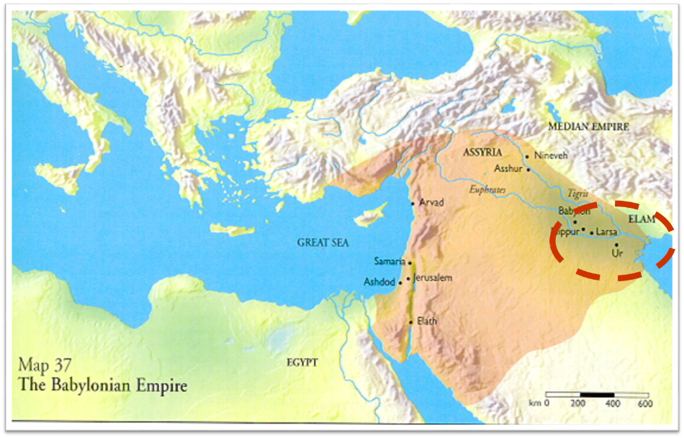

Slide 15
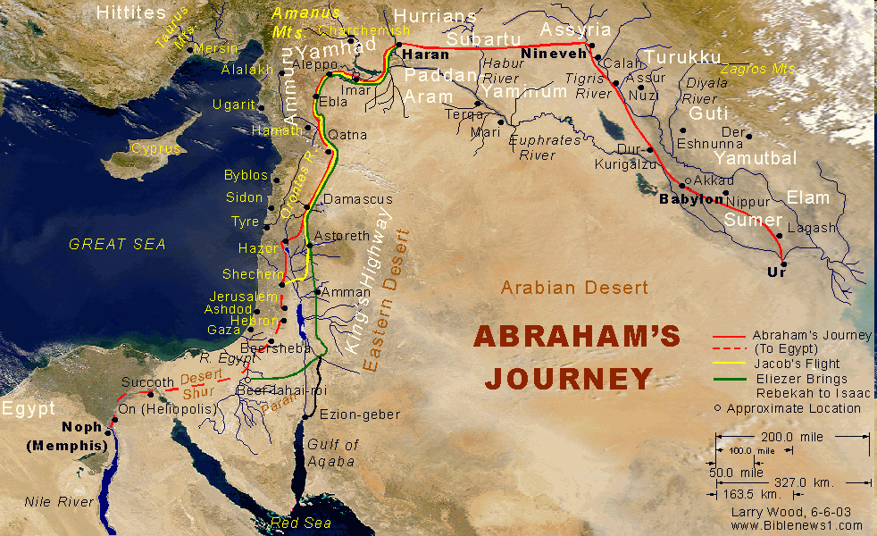

Slide 16
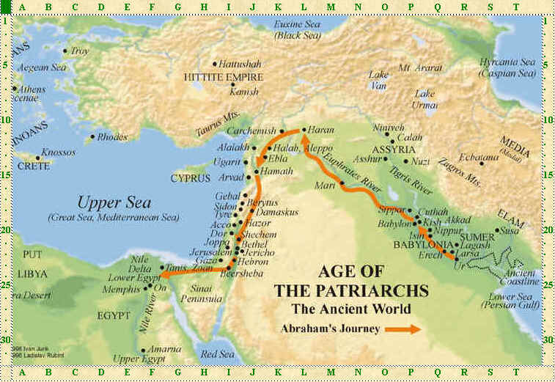

Slide 17
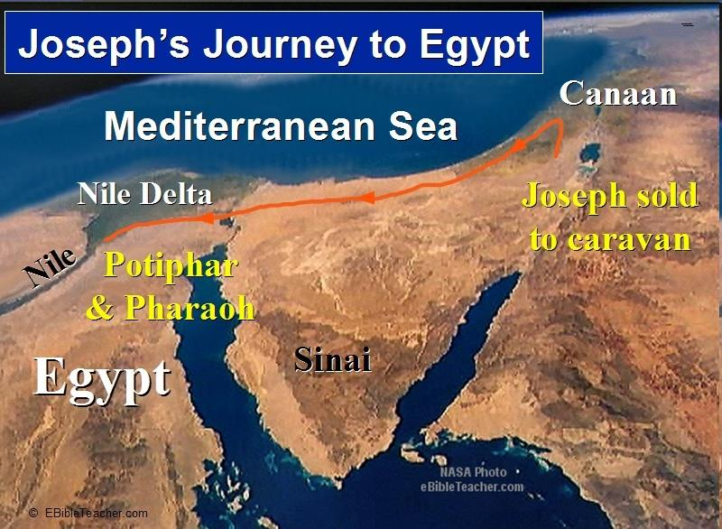

Slide 18

Age of the Earth?
971-931 BC = Solomonic reign
966 = Solomon rebuilds temple (1 Kgs 6:1b)
- 480 years for the Exodus’ date (1 Kgs 6:1a)
= 1446 BC for Exodus’ date
- 430 years for Jacob’s migration to Egypt (Exod 12:40)
= 1876 BC for Jacob’s migration to Egypt (Gen 46)
Genealogies of Gen 5; 11
= 4000 BC for the earth’s age

Slide 19
Age of the Earth?
971-931 BC = Solomonic reign
966 = Solomon rebuilds temple (1 Kgs 6:1b)
- 480 years for the Exodus’ date (1 Kgs 6:1a)
= 1446 BC for Exodus’ date
- 430 years for Jacob’s migration to Egypt (Exod 12:40)
= 1876 BC for Jacob’s migration to Egypt (Gen 46)
Genealogies of Gen 5; 11
= 4000 BC for the earth’s age

Slide 20
Age of the Earth?
971-931 BC = Solomonic reign
966 = Solomon rebuilds temple (1 Kgs 6:1b)
- 480 years for the Exodus’ date (1 Kgs 6:1a)
= 1446 BC for Exodus’ date
- 430 years for Jacob’s migration to Egypt (Exod 12:40)
= 1876 BC for Jacob’s migration to Egypt (Gen 46)
Genealogies of Gen 5; 11
= 4000 BC for the earth’s age

Slide 21

1 Kings 6:1
“Now it came about in the four hundred and eightieth year after the sons of Israel came out of the land of Egypt, in the fourth year of Solomon’s reign over Israel, in the month of Ziv which is the second month, that he began to build the house of the Lord.”

Slide 22
1 Kings 6:1
“Now it came about in the four hundred and eightieth year after the sons of Israel came out of the land of Egypt, in the fourth year of Solomon’s reign over Israel, in the month of Ziv which is the second month, that he began to build the house of the Lord.”

Slide 23
Age of the Earth?
971-931 BC = Solomonic reign
966 = Solomon rebuilds temple (1 Kgs 6:1b)
- 480 years for the Exodus’ date (1 Kgs 6:1a)
= 1446 BC for Exodus’ date
- 430 years for Jacob’s migration to Egypt (Exod 12:40)
= 1876 BC for Jacob’s migration to Egypt (Gen 46)
Genealogies of Gen 5; 11
= 4000 BC for the earth’s age

Slide 24
1 Kings 6:1
“Now it came about in the four hundred and eightieth year after the sons of Israel came out of the land of Egypt, in the fourth year of Solomon’s reign over Israel, in the month of Ziv which is the second month, that he began to build the house of the Lord.”

Slide 25
Age of the Earth?
971-931 BC = Solomonic reign
966 = Solomon rebuilds temple (1 Kgs 6:1b)
- 480 years for the Exodus’ date (1 Kgs 6:1a)
= 1446 BC for Exodus’ date
- 430 years for Jacob’s migration to Egypt (Exod 12:40)
= 1876 BC for Jacob’s migration to Egypt (Gen 46)
Genealogies of Gen 5; 11
= 4000 BC for the earth’s age

Slide 26
THREE PHASES OF MOSES’ 120 YEAR LIFE
LIFE PHASE | SCRIPTURE | YEARS | AGE | ACTIVITY
Natural Training | Acts 7:23 | 1526–1486 B.C. | 1-40 | Egyptian Education
Spiritual Training | Exod. 7:7 | 1486–1446 B.C. | 40-80 | Midian Shepherding
Ministry | Deut. 31:2; 34:7; Acts 7:36 | 1446–1406 B.C. | 80-120 | Exodus, Law, Wilderness Preservation, Pentateuch Authorship

Slide 27
Age of the Earth?
971-931 BC = Solomonic reign
966 = Solomon rebuilds temple (1 Kgs 6:1b)
- 480 years for the Exodus’ date (1 Kgs 6:1a)
= 1446 BC for Exodus’ date
- 430 years for Jacob’s migration to Egypt (Exod 12:40)
= 1876 BC for Jacob’s migration to Egypt (Gen 46)
Genealogies of Gen 5; 11
= 4000 BC for the earth’s age

Slide 28
Exodus 12:40-41
“⁴⁰ Now the time that the sons of Israel lived in Egypt was four hundred and thirty years. ⁴¹ And at the end of four hundred and thirty years, to the very day, all the hosts of the Lord went out from the land of Egypt.”

Slide 29
Exodus 12:40-41
“⁴⁰ Now the time that the sons of Israel lived in Egypt was four hundred and thirty years. ⁴¹ And at the end of four hundred and thirty years, to the very day, all the hosts of the Lord went out from the land of Egypt.”

Slide 30
Age of the Earth?
971-931 BC = Solomonic reign
966 = Solomon rebuilds temple (1 Kgs 6:1b)
- 480 years for the Exodus’ date (1 Kgs 6:1a)
=1446 BC for Exodus’ date
- 430 years for Jacob’s migration to Egypt (Exod 12:40)
= 1876 BC for Jacob’s migration to Egypt (Gen 46)
Genealogies of Gen 5; 11
= 4000 BC for the earth’s age

Slide 31
Age of the Earth?
971-931 BC = Solomonic reign
966 = Solomon rebuilds temple (1 Kgs 6:1b)
- 480 years for the Exodus’ date (1 Kgs 6:1a)
= 1446 BC for Exodus’ date
- 430 years for Jacob’s migration to Egypt (Exod 12:40)
= 1876 BC for Jacob’s migration to Egypt (Gen 46)
Genealogies of Gen 5; 11
= 4000 BC for the earth’s age

Slide 32
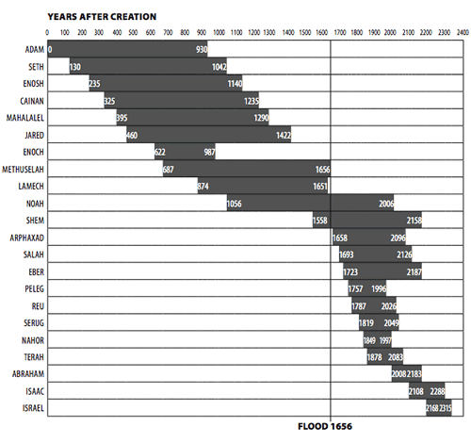

Slide 33
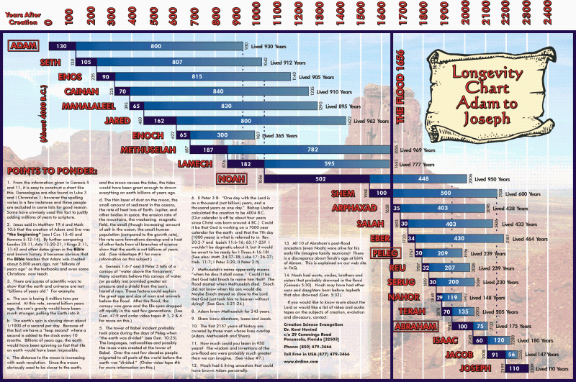

Slide 34
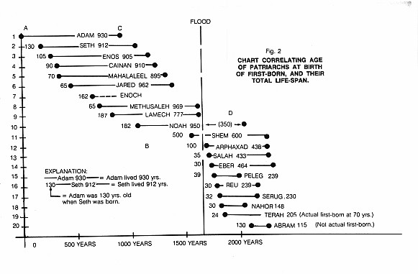

Slide 35
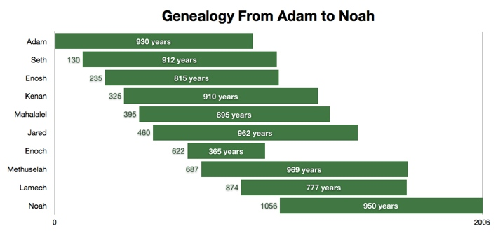

Slide 36
Age of the Earth?
971-931 BC = Solomonic reign
966 = Solomon rebuilds temple (1 Kgs 6:1b)
- 480 years for the Exodus’ date (1 Kgs 6:1a)
= 1446 BC for Exodus’ date
- 430 years for Jacob’s migration to Egypt (Exod 12:40)
= 1876 BC for Jacob’s migration to Egypt (Gen 46)
Genealogies of Gen 5; 11
= 4000 BC for the earth’s age

Slide 37
Matthew 19:4-6
“³ Some Pharisees came to Jesus, testing Him and asking, “Is it lawful for a man to divorce his wife for any reason at all?” ⁴ And He answered and said, “Have you not read that He who created them from the beginning made them male and female, ⁵ and said, ‘For this reason a man shall leave his father and mother and be…

Slide 38
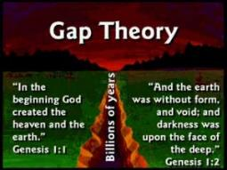
Matthew 19:4-6
…joined to his wife, and the two shall become one flesh’? ⁶ So they are no longer two, but one flesh. What therefore God has joined together, let no man separate.”

Slide 39

Mark 10:6
“But from the beginning of creation, God made them male and female.”

Slide 40

James Barr
“Letter from Professor James Barr to David C.C. Watson of the UK, dated 23 April 1984.” Cited in Jonathan Sarfati, Refuting Compromise: A Biblical and Scientific Refutation of "Progressive Creationism" (Billions of Years), as Popularized by Astronomer Hugh Ross. Updated and expanded ed. (Powder Springs, GA: Creation Book Publishers, 2014), 134-35.
“Probably, so far as I know, there is no professor of Hebrew or Old Testament at any world-class university who does not believe that the writer(s) of Genesis 1–11 intended to convey to their readers the ideas that: (a) creation took place in a series of six days which were the same as the days of 24 hours we now experience. (b) the figures contained in the Genesis genealogies provided by simple addition a chronology from the beginning of the world up to later stages in the biblical story (c) Noah’s flood was understood to be world-wide and extinguish all human and animal life except for those in the ark. Or, to put it negatively, the apologetic arguments which suppose the ‘days’ of creation to be long eras of time, the figures of years not to be chronological, and the flood to be a merely local Mesopotamian flood, are not taken seriously by any such professors, as far as I know.”

Slide 41
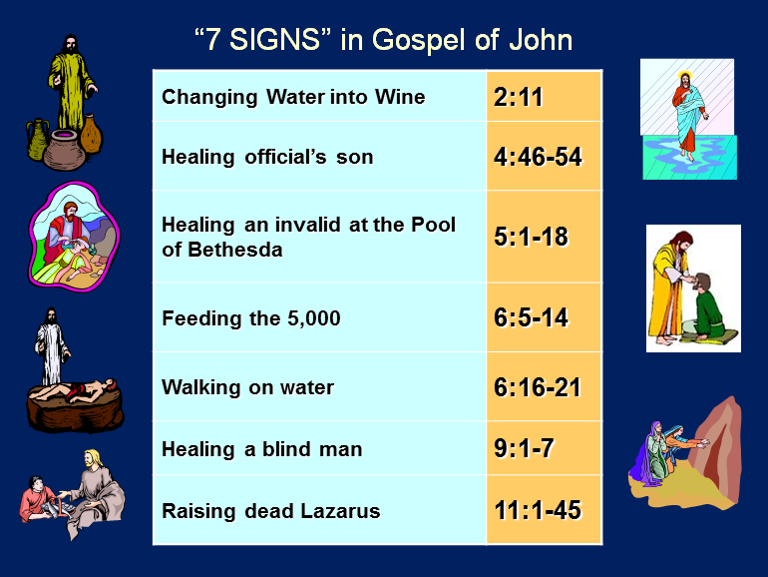

Slide 42
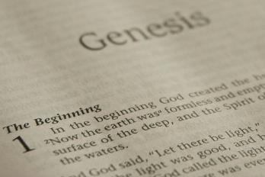
Patriarchal Dates
Abraham: 2166–1991 B.C.
Isaac: 2066–1886 B.C.
Jacob: 2006–1859 B.C.
Joseph: 1916–1806 B.C.

Slide 43
INTRODUCTORY MATTERS
Title
Authorship, date, recipients
Structure
Setting
Message and Purpose
Unique Characteristics
Themes
Christ in Genesis
Importance
Historicity

Slide 44
Message
Israel’s role of mediating redemptive blessings to the fallen world is explained through:
a description of the world’s fallen condition (1-11),
Israel’s birth through the Abrahamic Covenant (12–36),
and the preservation of Israel in furtherance of the covenant (37–50)

Slide 45

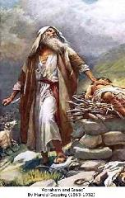
Genesis 12:3
“And I will bless those who bless you, And the one who curses you I will curse. And in you all the families of the earth will be blessed.”

Slide 46
Purposes
A nation that does not know where it has been does not know where it is going
To explain that Israel has a right to the land (Gen. 15:18-21) and that the Canaanites are under a curse (Gen. 9:25; 15:16)
Obedience leads to blessings (Gen. 22:18)

Slide 47

Message and Purpose
At the time of the Exodus, God reveals to Israel her divinely ordained role to mediate His redemptive purposes to a fallen world. This exalted position is communicated through the revelation of Israel’s unconditional covenant and God’s miraculous preservation of the nation in furtherance of this covenant. Moses reveals this information so that Israel would press into her intended design during the conquest and beyond.

Slide 48
INTRODUCTORY MATTERS
Title
Authorship, date, recipients
Structure
Setting
Message and Purpose
Unique Characteristics
Themes
Christ in Genesis
Importance
Historicity

Slide 49
Unique Characteristics
Election and preservation of Israel
Covenantal faithfulness
Book of beginnings
Scope (4000 ‒ 1806 B.C.)
Seed plot of the Bible

Slide 50
INTRODUCTORY MATTERS
Title
Authorship, date, recipients
Structure
Setting
Message and Purpose
Unique Characteristics
Themes
Christ in Genesis
Importance
Historicity

Slide 51
Genesis as the Seed-Plot of the Bible
“…Genesis gives us a synoptic preface to the entire Bible. It is the seed-plot of the Bible. The germ or beginning of all truth is within this wonderful book. Genesis is the foundation upon which the entire revelation rests; the root out of which the rest grows. Truths found here are developed in successive ages.”
Herbert Lockyer, The Gospel in the Pentateuch (Chicago: The Bible Institute Colportage Association, 1939), 25.

Slide 52
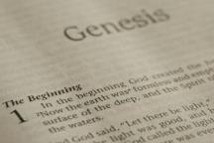
Beginning Themes
Universe Life Man Marriage Evil Clothing | Religion Salvation Language Government Nations Israel
Morris, Genesis Record, 18-20

Slide 53
Themes of Genesis 1-11
Perfect creation and man as the pinnacle of creation
How this perfect creation was lost leading to the terrible progress of sin necessitating divine redemption through the Jewish messianic line
Tracing of the messianic line that would bring about this redemption (Gen 3:15 to Abraham)

Slide 54
INTRODUCTORY MATTERS
Title
Authorship, date, recipients
Structure
Setting
Message and Purpose
Unique Characteristics
Themes
Christ in Genesis
Importance
Historicity

Slide 55

John 5:39, 46
“³⁹ You search the Scriptures because you think that in them you have eternal life; it is these that testify about Me…⁴⁶ For if you believed Moses, you would believe Me, for he wrote about Me.”

Slide 56
Luke 24:27
“Then beginning with Moses and with all the prophets, He explained to them the things concerning Himself in all the Scriptures.”

Slide 57
Luke 24:44
“²⁷ Then beginning with Moses and with all the prophets, He explained to them the things concerning Himself in all the Scriptures…⁴⁴ Now He said to them, ‘These are My words which I spoke to you while I was still with you, that all things which are written about Me in the Law of Moses and the Prophets and the Psalms must be fulfilled.’”

Slide 58
Acts 17:1-3
“Now when they had traveled through Amphipolis and Apollonia, they came to Thessalonica, where there was a synagogue of the Jews. ² And according to Paul’s custom, he went to them, and for three Sabbaths reasoned with them from the Scriptures, ³ explaining and giving evidence that the Christ had to suffer and rise again from the dead, and saying, ‘This Jesus whom I am proclaiming to you is the Christ.’”

Slide 59
God’s Messianic Purposes Beginning in Genesis
Proto-evangelium (3:15, 21)
Seth (4:25)
Noah (Gen 5:29)
Shem (9:26)
Abraham (12:3)
Isaac (21:12)
Jacob (25:23)
Judah (49:10)

Slide 60
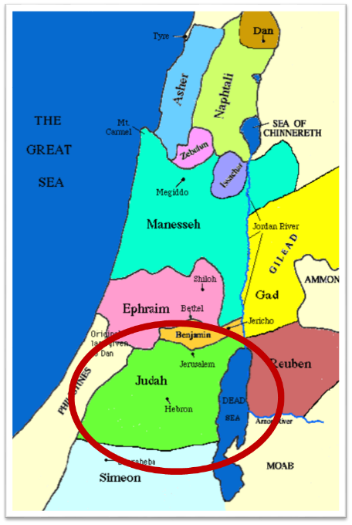

Slide 61
Christ in Genesis
(Luke 24:27, 44)
Christ is typologically seen in:
Adam (Gen. 1‒3; Rom 5:14)
Melchizedek (Gen. 14:18-20; Heb 7:3)
Isaac (Gen. 22:5; Heb 11:19)
Joseph (Gen. 37‒50)

Slide 62
Christ in Genesis
(Luke 24:27, 44)
Christ is typologically seen in:
Adam (Gen. 1‒3; Rom 5:14)
Melchizedek (Gen. 14:18-20; Heb 7:3)
Isaac (Gen. 22:5; Heb 11:19)
Joseph (Gen. 37‒50)

Slide 63
The Two Most Influential Men in World History
 | Adam | Jesus
Single action | Disobedience | Obedience
Tree | Knowledge | Cross
Universal impact | Curse | Blessing
Birth | Physical | Spiritual
Adam | First | Last

Slide 64
Christ in Genesis
(Luke 24:27, 44)
Christ is typologically seen in:
Adam (Gen. 1‒3; Rom 5:14)
Melchizedek (Gen. 14:18-20; Heb 7:3)
Isaac (Gen. 22:5; Heb 11:19)
Joseph (Gen. 37‒50)

Slide 65
Christ in Genesis
(Luke 24:27, 44)
Christ is typologically seen in:
Adam (Gen. 1‒3; Rom 5:14)
Melchizedek (Gen. 14:18-20; Heb 7:3)
Isaac (Gen. 22:5; Heb 11:19)
Joseph (Gen. 37‒50)

Slide 66
Christ in Genesis
(Luke 24:27, 44)
Christ is typologically seen in:
Adam (Gen. 1‒3; Rom 5:14)
Melchizedek (Gen. 14:18-20; Heb 7:3)
Isaac (Gen. 22:5; Heb 11:19)
Joseph (Gen. 37‒50)

Slide 67
Scriptural Comparisons Between Joseph & Jesus
Favorite son of a wealthy father (Gen. 37:3; Matt. 3:17)
Shepherd of his father's sheep (Gen. 37:2; John 10:11-14)
Taken into Egypt to avoid being killed (Gen. 37:28; Matt. 2:13)
Servant (Gen. 39:4; Phil. 2:7)
Began their ministry at the age of thirty years old (Gen. 41:46 Luke 3:23)
Filled with the Spirit of God (Gen. 41:38 Luke 4:1)
Returned good for evil (Gen. 50:20; Matt. 5:44

Slide 68
Scriptural Comparisons Between Joseph & Jesus
Humble and unspoiled by wealth (Gen. 45:7-8; John 13:12)
Taught by God (Gen. 41:16; John 5:19)
Loved people freely (Gen. 45:15; John 13:34)
Gained the confidence of others quickly (Gen. 39:3; Matt. 8:8)
Gave bread to hungry people who came to him (Gen. 41:57; Mark 6:41)
Resisted the most difficult temptations. Gen. 39:8-9; Heb. 4:15)

Slide 69
Scriptural Comparisons Between Joseph & Jesus
Given visions of the future (Gen. 37:6; Matt. 24:3)
Tested people to reveal their true nature (Gen. 42:25; Mark 11:30)
Hated for their teachings (Gen. 37:8 John 7:7)
Sold for the price of a slave (Gen. 37:28 Matt. 26:15)
Falsely accused (Gen. 39:14; Mark 14)
Silent before their accusers (Gen. 39:20; Mark 15:4)
Condemned between two prisoners (Gen. 40:2-3; Luke 23:32)

Slide 70
Scriptural Comparisons Between Joseph & Jesus
Arose into a new life (Gen. 41:41 Mark 16:6)
Not recognized by their own brethren (Gen. 42.8; Luke 24:37)
Returned to their father (Gen. 46:29; Mark 16:19)
Became royalty (Gen. 45:8; Rev. 19:16)
www.near-death.com

Slide 71
INTRODUCTORY MATTERS
Title
Authorship, date, recipients
Structure
Setting
Message and Purpose
Unique Characteristics
Themes
Christ in Genesis
Importance
Historicity

Slide 72
Importance
God’s glory (Rev 4:11)
Need for salvation
Foundation for the rest of Scripture (Ps. 11:3)
Precedent for believing the rest of Scripture
Structure for the rest of the Bible
  68 New Testament references
  Brown, In the Beginning, pp. 283-84

Slide 73
Importance
God’s glory (Rev 4:11)
Need for salvation
Foundation for the rest of Scripture (Ps. 11:3)
Precedent for believing the rest of Scripture
Structure for the rest of the Bible
  68 New Testament references
  Brown, In the Beginning, pp. 283-84

Slide 74
Revelation 4:11
“Worthy are You, our Lord and our God, to receive glory and honor and power; for You created all things, and because of Your will they existed, and were created.”

Slide 75
Importance
God’s glory (Rev 4:11)
Need for salvation
Foundation for the rest of Scripture (Ps. 11:3)
Precedent for believing the rest of Scripture
Structure for the rest of the Bible
  68 New Testament references
  Brown, In the Beginning, pp. 283-84

Slide 76
Importance
God’s glory (Rev 4:11)
Need for salvation
Foundation for the rest of Scripture (Ps. 11:3)
Precedent for believing the rest of Scripture
Structure for the rest of the Bible
  68 New Testament references
  Brown, In the Beginning, pp. 283-84

Slide 77
Psalm 11:3
“If the foundations are destroyed, What can the righteous do?”

Slide 78
Importance
God’s glory (Rev 4:11)
Need for salvation
Foundation for the rest of Scripture (Ps. 11:3)
Precedent for believing the rest of Scripture
Structure for the rest of the Bible
  68 New Testament references
  Brown, In the Beginning, pp. 283-84

Slide 79
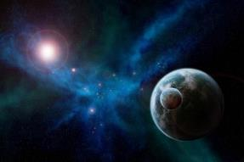
Hebrews 11:3
“By faith we understand that the worlds were prepared by the word of God, so that what is seen was not made out of things which are visible.”

Slide 80
John 3:12
“If I told you earthly things and you do not believe, how will you believe if I tell you heavenly things?”

Slide 81
Importance
God’s glory (Rev 4:11)
Need for salvation
Foundation for the rest of Scripture (Ps. 11:3)
Precedent for believing the rest of Scripture
Structure for the rest of the Bible
  68 New Testament references
  Brown, In the Beginning, pp. 283-84

Slide 82
INTRODUCTORY MATTERS
Title
Authorship, date, recipients
Structure
Setting
Message and Purpose
Unique Characteristics
Themes
Christ in Genesis
Importance
Historicity

Slide 83
Historicity
Only God was an eyewitness (Heb 11:3; Job 38:4)
Luke 3:23-38
Toledoth

Slide 84
Historicity
Only God was an eyewitness (Heb 11:3; Job 38:4)
Luke 3:23-38
Toledoth

Slide 85
Hebrews 11:3
“By faith we understand that the worlds were prepared by the word of God, so that what is seen was not made out of things which are visible.”

Slide 86
Job 38:3-10
“³ “Now gird up your loins like a man, And I will ask you, and you instruct Me! ⁴ “Where were you when I laid the foundation of the earth? Tell Me, if you have understanding, ⁵ Who set its measurements? Since you know. Or who stretched the line on it? ⁶ “On what were its bases sunk? Or who laid its cornerstone, . . .

Slide 87
Job 38:3-10
... ⁷ When the morning stars sang together And all thesons of God shouted for joy? ⁸ “Or who enclosed the sea with doors When, bursting forth, it went out from the womb; ⁹ When I made a cloud its garment And thick darkness its swaddling band, ¹⁰ And I placed boundaries on it And set a bolt and doors…”

Slide 88
Historicity
Only God was an eyewitness (Heb 11:3; Job 38:4)
Luke 3:23-38
Toledoth

Slide 89
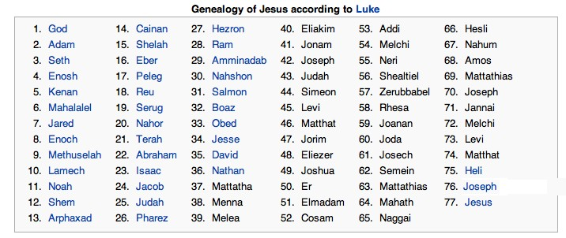

Slide 90
Historicity
Only God was an eyewitness (Heb 11:3; Job 38:4)
Luke 3:23-38
Toledoth

Slide 91
Toledoth
“And These Are the Generations of…”
Introduction to the generations (1:1–2:3)
Generations of the heaven and earth (2:4–4:26)
Generations of Adam (5:1–6:8)
Generations of Noah (6:9–9:29)
Generations of the sons of Noah (10:1–11:9)
Generations of Shem (11:10–26)
Generations of Terah (11:27–25:11)
Generations of Ishmael (25:12-18)
Generations of Isaac (25:19–35:29)
Generations of Esau (36:1–37:1)
Generations of Jacob (37:2–50:26)

Slide 92
Conclusion

Slide 93
INTRODUCTORY MATTERS
Title ‒ Genesis
Authorship, Date, Recipients ‒ Moses; 1445 ‒ 1405; Exodus Generation
Structure ‒ Toledoth; 2 Parts (4 Events)
Setting ‒ Mesopotamia, Canaan, Egypt
Message & Purpose ‒ Israel; Conquest
Unique Characteristics ‒ Beginnings
Themes ‒ Beginnings
Christ In Genesis ‒ Gen. 3:15 Tracing
Importance ‒ God’s Glory; Salvation
Historicity ‒ Christ’s Genealogy

Slide 94

“The Lord bless you and keep you; the Lord make his face shine on you and be gracious to you; the Lord turn his face toward you and give you peace.” (NIV)

