Slide 1
THE RAPTURE
What and When? – Part 16
Andrew Marshall Woods, Th.M., JD., PhD.
Sr. Pastor, Sugar Land Bible Church

Slide 2
What is the Rapture?
An important doctrine
Distinct from the Second Advent
Catching away of all living believers (1 Thess 4:17)
Reunion (1 Thess 4:14-16)
Resurrection (1 Cor 15:50-54)
Exemption from death (1 Cor 15:51, 54-56)
Instantaneous (1 Cor 15:52)
Mystery (1 Cor 15:51)
Imminent (1 Cor 15:51; 1 Thess 4:15)
Traditional doctrine now being recovered

Slide 3
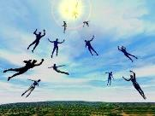
When Will the Rapture Take Place Relative to the Tribulation Period?
Pre-tribulation rapture theory
Mid-tribulation rapture theory
Post-tribulation rapture theory
Pre-wrath rapture theory
Partial rapture theory

Slide 5
When is the Rapture?
7 Arguments Favoring the Pre-Tribulation View
Tribulation's purpose concerns Israel (Jer 30:7; Dan 9:24)
No biblical reference to the church on earth during the Tribulation period (Rev 4-22)
Church is promised an exemption from divine wrath (1 Thess 1:10; 5:9; Rom 5:9; Rev 3:10; 6:17)
Rapture is imminent (1 Cor 15:51; 1 Thess 4:15)
Rapture is a comfort (1 Thess 4:18)
Antichrist cannot come to power until the restrainer is removed (2 Thess 2:6-7)
Symbolic parallels (2 Peter 2:5-9)

Slide 6
Strengthening the Pre-Tribulation Case
John 14:1-4
Revelation 3:10
First Thessalonians 4‒5
Second Thessalonians 2:3a
Matthew 24‒25

Slide 7
Strengthening the Pre-Tribulation Case
John 14:1-4
Revelation 3:10
First Thessalonians 4‒5
Second Thessalonians 2:3a
Matthew 24‒25

Slide 8
Strengthening the Pre-Tribulation Case
John 14:1-4
Revelation 3:10
First Thessalonians 4‒5
Second Thessalonians 2:3a
Matthew 24‒25

Slide 9
Revelation 3:10
Because you have kept the word of My perseverance, I also will keep you from the hour of testing, that hour which is about to come upon the whole world, to test those who dwell on the earth.

Slide 10
Does Revelation 3:10 Teach the Pre-Tribulation Rapture?
Are there easier ways to convey “protection through”?
Will God protect believers during the Tribulation?
What is the meaning of “keep you from”?
What is the meaning of “the hour”?
What is the meaning of the “whole world”?
What is the meaning of “testing/to test”?

Slide 11
Does Revelation 3:10 Teach the Pre-Tribulation Rapture?
Are there easier ways to convey “protection through”? YES
Will God protect believers during the Tribulation? NO
What is the meaning of “keep you from”? Kept out of the Time Period Completely
What is the meaning of “the hour”? The Time of the Tribulation Period
What is the meaning of the “whole world”? The Entire Earth
What is the meaning of “testing/to test”? To Expose Someone’s True Character

Slide 12
Does Revelation 3:10 Teach the Pre-Tribulation Rapture?
Who are the “earth-dwellers”?
What is the meaning of “about to come”?
How will Christ keep His promise?
Is this promise for Philadelphia only?
How does the Pre-Trib. View of Rev. 3:10 harmonize with the rest of the Book of Revelation?

Slide 13
Revelation 3:10
‘Because you have kept the word of My perseverance, I also will keep you from the hour of testing, that hour which is about to come upon the whole world, to test those who dwell on the earth [katoikeō epi gē].

Slide 14
Revelation 13:8
“All who dwell on the earth [katoikeō epi gē] will worship him, everyone whose name has not been written from the foundation of the world in the book of life of the Lamb who has been slain.”

Slide 15
Revelation 17:8
“⁸ The beast that you saw was, and is not, and is about to come up out of the abyss and go to destruction. And those who dwell on the earth [katoikeō epi gē], whose name has not been written in the book of life from the foundation of the world, will wonder when they see the beast, that he was and is not and will come.”

Slide 16
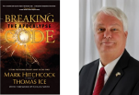
Thomas Ice
Thomas Ice, “Kept From the Hour,” online: www.pre-trib.org, accessed 4 September 2014, 2.
“This phrase ‘earth dwellers’ is used eleven times in nine verses in Revelation (3:10; 6:10; 8:13; 11:10 2xs; 13:8, 12, 14 2xs; 14:6; 17:8). As you examine each individual use, except 3:10, you will see that all refer to a special class of stubborn sinners who are set in their rebellion against the God of heaven. You will also find that the phrase is only used to refer to those during the tribulation period. Therefore, since the future hour spoken of in 3:10 is set in contrast with the present set of believers in the church age, and the future ‘earth dwellers’ will be active during the time period in which believers are said to be kept from, it is clear that John speaks of the time or hour of the tribulation. This is why 3:10 is a clear promise that Christ will keep believers from the time of the seven year tribulation.”

Slide 17
Revelation 3:10
‘Because you have kept the word of My perseverance, I also will keep you from the hour of testing [peirasmós], that hour which is about to come upon the whole world, to test [peirázō] those who dwell on the earth.

Slide 18
6. Test (Revelation 3:10)
Peirasmós / peirázō
To demonstrate the quality of something rather than to purify its contents
A Test for the purpose of exposing someone’s true character typically with the negative intent to demonstrate a failure
Examples (Jas. 1:13-14; Rev. 2:2)

Slide 19
Revelation 2:2
‘I know your deeds and your toil and perseverance, and that you cannot tolerate evil men, and you put to the test [peirázō] those who call themselves apostles, and they are not, and you found them to be false;

Slide 20
James 1:13-14
“¹³ Let no one say when he is tempted [peirázō], ‘I am being tempted [peirázō] by God’; for God cannot be tempted by evil, and He Himself does not tempt [peirázō] anyone. ¹⁴ But each one is tempted [peirázō] when he is carried away and enticed by his own lust.”

Slide 21
Revelation 9:20-21
²⁰ “The rest of mankind, who were not killed by these plagues, did not repent of the works of their hands, so as not to worship demons, and the idols of gold and of silver and of brass and of stone and of wood, which can neither see nor hear nor walk; ²¹ and they did not repent of their murders nor of their sorceries nor of their immorality nor of their thefts.”

Slide 22
Pretribulationism IS NOT Escapism
Trials (John 16:33)
Man’s wrath (2 Tim. 3:12)
Satan’s wrath (Eph. 6:11-12)
World’s wrath (John 15:18-19)

Slide 23
Revelation 3:10
‘Because you have kept the word of My perseverance, I also will keep you from the hour of testing, that hour which is about to come upon the whole world, to test those who dwell on the earth.

Slide 24
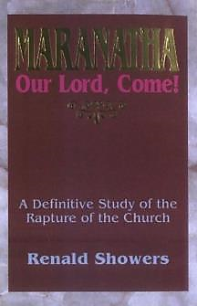
Renald Showers
Renald Showers, Maranatha Our Lord, Come! (Bellmawr, NJ: Friends of Israel, 1995), 212.
“Christ based His promise on the fact that the church saints had already passed their test. In light of that, it appears that because they had already passed their test, Christ promised that He would not put them into the period that...will have the purpose of testing a very different group of people.”

Slide 25
Does Revelation 3:10 Teach the Pre-Tribulation Rapture?
Who are the “earth-dwellers”?
What is the meaning of “about to come”?
How will Christ keep His promise?
Is this promise for Philadelphia only?
How does the Pre-Trib. View of Rev. 3:10 harmonize with the rest of the Book of Revelation?

Slide 26
Revelation 3:10
‘Because you have kept the word of My perseverance, I also will keep you from the hour of testing, that hour which is about to come [mellō] upon the whole world, to test those who dwell on the earth.

Slide 27
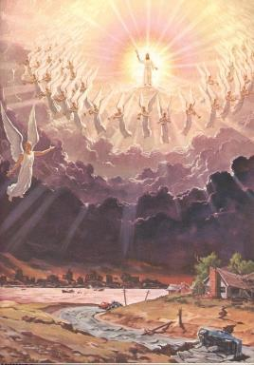
Imminency
Méllō: “and one who will share in the glory to be [mellō] revealed” (1 Pet 5:1)

Slide 28
Does Revelation 3:10 Teach the Pre-Tribulation Rapture?
Who are the “earth-dwellers”?
What is the meaning of “about to come”?
How will Christ keep His promise?
Is this promise for Philadelphia only?
How does the Pre-Trib. View of Rev. 3:10 harmonize with the rest of the Book of Revelation?

Slide 29
Revelation 3:11
“I am coming quickly; hold fast what you have, so that no one will take your crown.”

Slide 30
Revelation 3:11
“I am coming quickly; hold fast what you have, so that no one will take your crown.”

Slide 31
Revelation 3:11
“I am coming quickly; hold fast what you have, so that no one will take your crown.”

Slide 32
1 Corinthians 4:5
“ Therefore do not go on passing judgment before the time, but wait until the Lord comes who will both bring to light the things hidden in the darkness and disclose the motives of men’s hearts; and then each man’s praise will come to him from God.”

Slide 33
2 Timothy 4:8
“In the future there is laid up for me the crown of righteousness, which the Lord, the righteous Judge, will award to me on that day; and not only to me, but also to all who have loved His appearing.”

Slide 34
Does Revelation 3:10 Teach the Pre-Tribulation Rapture?
Who are the “earth-dwellers”?
What is the meaning of “about to come”?
How will Christ keep His promise?
Is this promise for Philadelphia only?
How does the Pre-Trib. View of Rev. 3:10 harmonize with the rest of the Book of Revelation?

Slide 35
Revelation 3:7
“And to the angel of the church in Philadelphia write: He who is holy, who is true, who has the key of David, who opens and no one will shut, and who shuts and no one opens, says this:”

Slide 36
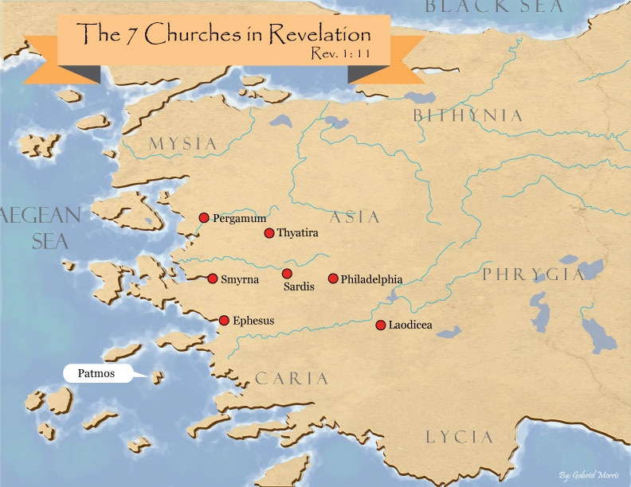

Slide 37
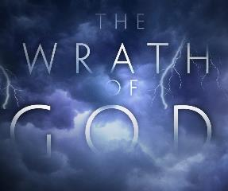
Promised Exemption from Divine Wrath
The promise (1 Thess. 1:10; 5:9; Rom 5:9; 8:1; Rev 3:10)
Tribulation = divine wrath (Rev 6:16-17; 11:18; 15:1, 7; 16:19)

Slide 38
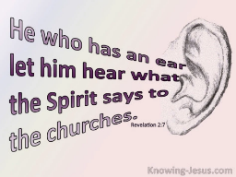
Revelation 3:13
exhortation to listen
“He who has an ear, let him hear what the Spirit says to the churches.”

Slide 39
Revelation 3:11-12
“¹¹ I am coming quickly; hold fast what you have, so that no one will take your crown. ¹² He who overcomes, I will make him a pillar in the temple of My God, and he will not go out from it anymore; and I will write on him the name of My God, and the name of the city of My God, the new Jerusalem, which comes down out of heaven from My God, and My new name.”

Slide 40
Does Revelation 3:10 Teach the Pre-Tribulation Rapture?
Who are the “earth-dwellers”?
What is the meaning of “about to come”?
How will Christ keep His promise?
Is this promise for Philadelphia only?
How does the Pre-Trib. View of Rev. 3:10 harmonize with the rest of the Book of Revelation?

Slide 41
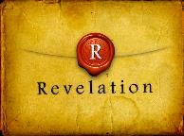
Revelation 1:19
“Therefore write the things which you have seen, and the things which are, and the things which will take place after these things [meta tauta].”

Slide 42
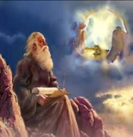
Revelation 1:19
Seen (Chapter 1)
Are (Chapters 2–3)
After these things (Chapters 4–22)

Slide 43
Revelation 1:19
Seen (Chapter 1)
Are (Chapters 2–3)
After these things (Chapters 4–22)

Slide 44
The Missing Church
Rev 4-19
Rev 13:9
Revelation’s Jewish nature

Slide 45
Romans 10:19
But I say, surely Israel did not know, did they? First Moses says, “I will make you jealous by that which is not a nation, By a nation without understanding will I anger you.”

Slide 46
Galatians 3:28
There is neither Jew nor Greek, there is neither slave nor free man, there is neither male nor female; for you are all one in Christ Jesus.

Slide 47
Ephesians 2:14
For He Himself is our peace, who made both groups into one and broke down the barrier of the dividing wall.

Slide 48
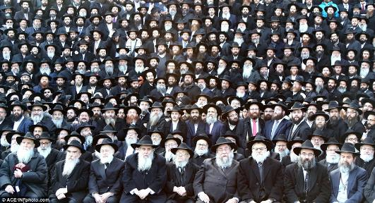
God’s Work Through Israel
Revelation 7 – 144,000 Jews
Revelation 11 – Two Jewish witnesses
Revelation 12 – Israel flees

Slide 49
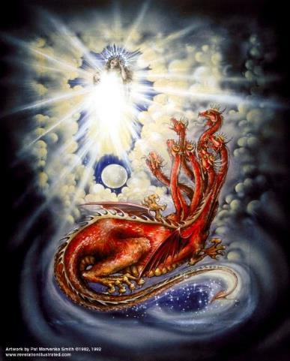
CAST OF 3 CHARACTERS Revelation 12:1-5
SON = Messiah (v.5)
DRAGON = Satan (v. 3)
WOMAN = Israel (v.1)

Slide 50
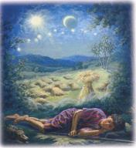
Genesis 37:9
Now he had still another dream, and related it to his brothers, and said, “Lo, I have had still another dream; and behold, the sun and the moon and eleven stars were bowing down to me.

Slide 51
Genesis 37:10
He related it to his father and to his brothers; and his father rebuked him and said to him, “What is this dream that you have had? Shall I and your mother and your brothers actually come to bow ourselves down before you to the ground?”

Slide 52
Sun = Jacob
Moon = Leah
11 Stars = Joseph’s brothers
12th Star = Joseph
12 Stars = Israel’s twelve tribes

Slide 53
Conclusion

Slide 54
Revelation 3:10
Because you have kept the word of My perseverance, I also will keep you from the hour of testing, that hour which is about to come upon the whole world, to test those who dwell on the earth.

Slide 55
Does Revelation 3:10 Teach the Pre-Tribulation Rapture?
Are there easier ways to convey “protection through”? YES
Will God protect believers during the Tribulation? NO
What is the meaning of “keep you from”? Kept out of the Time Period Completely
What is the meaning of “the hour”? The Time of the Tribulation Period
What is the meaning of the “whole world”? The Entire Earth
What is the meaning of “testing/to test”? To Expose Someone’s True Character

Slide 56
Does Revelation 3:10 Teach the Pre-Tribulation Rapture?
Who are the “earth-dwellers”? Tribulation Unbelievers
What is the meaning of “about to come”? Imminency
How will Christ keep His promise? His Coming in the Rapture
Is this promise for Philadelphia only? NO
Does the Pre-Trib. View of Rev. 3:10 harmonize with the rest of the Book of Revelation? YES

Slide 57
Strengthening the Pre-Tribulation Case
John 14:1-4
Revelation 3:10
First Thessalonians 4‒5
Second Thessalonians 2:3a
Matthew 24‒25

