Slide 1
THE RAPTURE
What and When? – Part 15
Andrew Marshall Woods, Th.M., JD., PhD.
Sr. Pastor, Sugar Land Bible Church

Slide 2
What is the Rapture?
An important doctrine
Distinct from the Second Advent
Catching away of all living believers (1 Thess 4:17)
Reunion (1 Thess 4:14-16)
Resurrection (1 Cor 15:50-54)
Exemption from death (1 Cor 15:51, 54-56)
Instantaneous (1 Cor 15:52)
Mystery (1 Cor 15:51)
Imminent (1 Cor 15:51; 1 Thess 4:15)
Traditional doctrine now being recovered

Slide 3
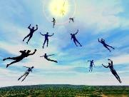
When Will the Rapture Take Place Relative to the Tribulation Period?
Pre-tribulation rapture theory
Mid-tribulation rapture theory
Post-tribulation rapture theory
Pre-wrath rapture theory
Partial rapture theory

Slide 5
When is the Rapture?
7 Arguments Favoring the Pre-Tribulation View
Tribulation's purpose concerns Israel (Jer 30:7; Dan 9:24)
No biblical reference to the church on earth during the Tribulation period (Rev 4-22)
Church is promised an exemption from divine wrath (1 Thess 1:10; 5:9; Rom 5:9; Rev 3:10; 6:17)
Rapture is imminent (1 Cor 15:51; 1 Thess 4:15)
Rapture is a comfort (1 Thess 4:18)
Antichrist cannot come to power until the restrainer is removed (2 Thess 2:6-7)
Symbolic parallels (2 Peter 2:5-9)

Slide 6
Strengthening the Pre-Tribulation Case
John 14:1-4
Revelation 3:10
First Thessalonians 4‒5
Second Thessalonians 2:3a
Matthew 24‒25

Slide 7
Strengthening the Pre-Tribulation Case
John 14:1-4
Revelation 3:10
First Thessalonians 4‒5
Second Thessalonians 2:3a
Matthew 24‒25

Slide 8
Strengthening the Pre-Tribulation Case
John 14:1-4
Revelation 3:10
First Thessalonians 4‒5
Second Thessalonians 2:3a
Matthew 24‒25

Slide 9
Revelation 3:10
Because you have kept the word of My perseverance, I also will keep you from the hour of testing, that hour which is about to come upon the whole world, to test those who dwell on the earth.

Slide 10
Does Revelation 3:10 Teach the Pre-Tribulation Rapture?
Are there easier ways to convey “protection through”?
Will God protect believers during the Tribulation?
What is the meaning of “keep you from”?
What is the meaning of “the hour”?
What is the meaning of the “whole world”?
What is the meaning of “testing/to test”?

Slide 11
Does Revelation 3:10 Teach the Pre-Tribulation Rapture?
Who are the “earth-dwellers”?
What is the meaning of “about to come”?
How will Christ keep His promise?
Is this promise for Philadelphia only?
How does the Pre-Trib. View of Rev. 3:10 harmonize with the rest of the Book of Revelation?

Slide 12
Does Revelation 3:10 Teach the Pre-Tribulation Rapture?
Are there easier ways to convey “protection through”?
Will God protect believers during the Tribulation?
What is the meaning of “keep you from”?
What is the meaning of “the hour”?
What is the meaning of the “whole world”?
What is the meaning of “testing/to test”?

Slide 13
Revelation 3:10
Because you have kept the word of My perseverance, I also will keep you from [ek] the hour of testing, that hour which is about to come upon the whole world, to test those who dwell on the earth.

Slide 14
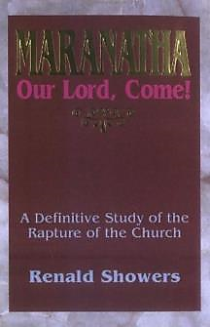
Renald Showers
Renald Showers, Maranatha Our Lord, Come! (Bellmawr, NJ: Friends of Israel, 1995), 212.
“The idea of the saints being shielded from the testing while living within and through this time period also would have been expressed more clearly through the use of another preposition, either en (meaning ‘in’) or dia (meaning ‘through’) [thus, ‘I will keep you in or through the time period of testing’] rather than ek.”

Slide 15
Does Revelation 3:10 Teach the Pre-Tribulation Rapture?
Are there easier ways to convey “protection through”?
Will God protect believers during the Tribulation?
What is the meaning of “keep you from”?
What is the meaning of “the hour”?
What is the meaning of the “whole world”?
What is the meaning of “testing/to test”?

Slide 16
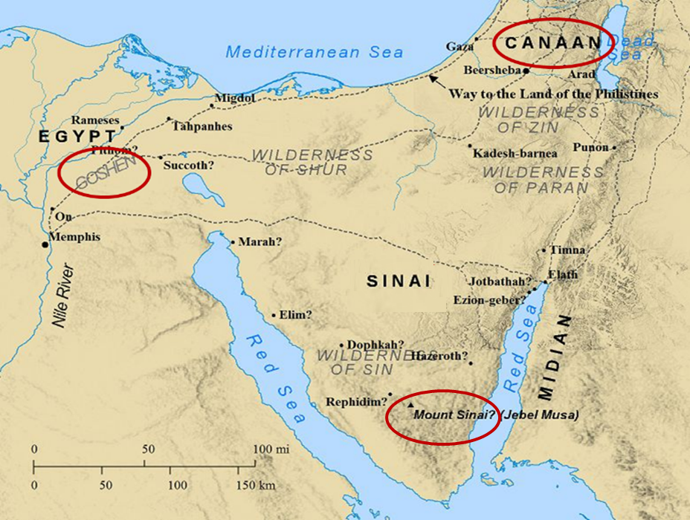

Slide 17
2. Protection Through the Tribulation?
(Revelation 3:10)
Like the protection in Goshen (Exod. 8:22, 24; 9;4, 6; 11:4-7; Rev. 9;4; 16:2)
Effective ? Rev. 6:9-11; 7:13-14; 13:10, 15:20:4
Comfort? John 14:1; 1 Thess. 4:18; Titus 2:13

Slide 18
Does Revelation 3:10 Teach the Pre-Tribulation Rapture?
Are there easier ways to convey “protection through”?
Will God protect believers during the Tribulation?
What is the meaning of “keep you from”?
What is the meaning of “the hour”?
What is the meaning of the “whole world”?
What is the meaning of “testing/to test”?

Slide 19
Revelation 3:10
Because you have kept the word of My perseverance, I also will keep you from [ek] the hour of testing, that hour which is about to come upon the whole world, to test those who dwell on the earth.

Slide 20
Charles Ryrie
Charles C. Ryrie, What You Should Know About the Rapture, Current Christian Issues (Chicago: Moody, 1981), 114-15.
“Posttribulationists say that ‘from’ (ek) refers to protection of the church within the Tribulation. Pretribulationalists understand it to mean preservation by being absent from the time of tribulation. One is internal protection (while living through the Tribulation); the other is external protection (being in heaven during that time). Which meaning does ‘from’ (ek) support? The answer is either, if the preposition is considered alone. But for the record, let it be said that ek does denote a position outside something without implying a prior position inside and then emergence from within. The pretribulationist understanding of ek is supported by a number of verses that have nothing to do with the rapture and therefore do not beg the question.”

Slide 21
Matthew 7:5
“You hypocrite, first take the log out of [ek] your own eye, and then you will see clearly to take the speck out of [ek] your brother’s eye.”

Slide 22
Revelation 3:10
‘Because you have kept the word of My perseverance, I also will keep [tēreō] you from [ek] the hour of testing, that hour which is about to come upon the whole world, to test those who dwell on the earth.

Slide 23
Acts 15:29
“that you abstain from things sacrificed to idols and from blood and from things strangled and from fornication; if you keep [diatēreō] yourselves free from [ek] such things, you will do well. Farewell.”

Slide 24
John 12:27
“Now My soul has become troubled; and what shall I say, ‘Father, save [sōzō] Me from [ek] this hour’? But for this purpose I came to this hour.”

Slide 25
Colossians 1:13
“For He rescued [rhyomai] us from [ek] the domain of darkness, and transferred us to the kingdom of His beloved Son.”

Slide 26
1 John 5:18
“We know that no one who is born of God sins; but He who was born of God keeps him, and the evil one does not touch him.”

Slide 27
John 17:15
“I do not ask You to take them out of the world, but to keep [tēreō] them from [ek] the evil one.”

Slide 28
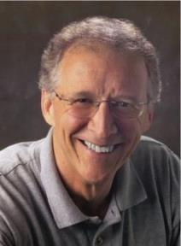
John Piper
Lauren Leigh Noske, "Nine Reasons Why john Piper Disagrees with Nicolas' Cage's 'Left Behind' Movie's View of Rapture," The Gospel Herald, August 6, 2014; www.gospelheradld.com. See also John Piper, "Definition and Observations Concerning the Second Coming of Christ," Desiring God Ministry, August 30, 1987; www.desringgod.org.
“John Piper believes that the main Scripture which some believe supports the pre-tribulational rapture viewpoint (Revelation 3:10) does not necessarily mean that believers will be taken away from the earth, however; rather, it could mean that God will keep or protect His people from evil during the tribulation (see also John 17:15).”

Slide 29
John 17:15
“I do not ask You to take them out of the world, but to keep [tēreō] them from [ek] the evil one.”

Slide 30
Colossians 1:13
“For He rescued us from the domain of darkness, and transferred us to the kingdom of His beloved Son.”

Slide 31
1 John 5:18
“We know that no one who is born of God sins; but He who was born of God keeps him, and the evil one does not touch him.”

Slide 32
Does Revelation 3:10 Teach the Pre-Tribulation Rapture?
Are there easier ways to convey “protection through”?
Will God protect believers during the Tribulation?
What is the meaning of “keep you from”?
What is the meaning of “the hour”?
What is the meaning of the “whole world”?
What is the meaning of “testing/to test”?

Slide 33
Revelation 3:10
‘Because you have kept the word of My perseverance, I also will keep you from the hour [hōra] of testing, that hour which is about to come upon the whole world, to test those who dwell on the earth.

Slide 34
John 12:27
“Now My soul has become troubled; and what shall I say, ‘Father, save Me from this hour [hōra]’? But for this purpose I came to this hour [hōra]’.”

Slide 35
Revelation 3:10
‘Because you have kept the word of My perseverance, I also will keep you from the hour [hōra] of testing, that hour which is about to come upon the whole world, to test those who dwell on the earth.

Slide 38
Charles Ryrie
Charles C. Ryrie, What You Should Know About the Rapture, Current Christian Issues (Chicago: Moody, 1981), 116-17.
“However, the promise of Revelation 3:10 not only guarantees being kept from the trials of the Tribulation period but being kept from the time period of the Tribulation. The promise is not, I will keep you from the trials. It is I will keep you from the hour of the trials...But how clear and plain is the promise. ‘I...will keep you from the hour of testing.’ Not just from any persecution, but from the coming time that will affect the whole earth. (The only way to escape worldwide trouble is not to be on the earth.) And not just from the events, but from the time. And the only way to escape the time when the events take place is not to be in a place where time ticks on. The only place that meets those qualifications is heaven.”

Slide 39
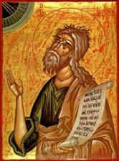
Jeremiah 30:7 (LXX)
“Alas! for that day is great, There is none like it; And it is the time of Jacob’s distress (Gen. 32:8; 35:10), But he will be saved [sōzō] from [apo] it.”

Slide 40
Zechariah 13:8-9
⁸“It will come about in all the land,” Declares the Lord, “That two parts in it will be cut off and perish; But the third will be left in it. ⁹“And I will bring the third part through the fire, Refine them as silver is refined, And test them as gold is tested. They will call on My name, And I will answer them; I will say, ‘They are My people,’ And they will say, ‘The Lord is my God.’ ”

Slide 41
Does Revelation 3:10 Teach the Pre-Tribulation Rapture?
Are there easier ways to convey “protection through”?
Will God protect believers during the Tribulation?
What is the meaning of “keep you from”?
What is the meaning of “the hour”?
What is the meaning of the “whole world”?
What is the meaning of “testing/to test”?

Slide 42
Revelation 3:10
‘Because you have kept the word of My perseverance, I also will keep you from the hour of testing, that hour which is about to come upon the whole [holos] world [oikouménē], to test those who dwell on the earth.

Slide 43
5. The Whole World? (Revelation 3:10)
Oikouménē – known world? (Luke 2:1; Acts 11:28)
Oikouménē – entire world (Luke 4:5; Acts 17:31; Rev. 12:9)
Context favors the global definition
Adjective “whole” (holos)
Rev. 6‒18

Slide 44
Revelation 3:10
‘Because you have kept the word of My perseverance, I also will keep you from the hour of testing, that hour which is about to come upon the whole [holos] world [oikouménē], to test those who dwell on the earth.

Slide 46
Does Revelation 3:10 Teach the Pre-Tribulation Rapture?
Are there easier ways to convey “protection through”?
Will God protect believers during the Tribulation?
What is the meaning of “keep you from”?
What is the meaning of “the hour”?
What is the meaning of the “whole world”?
What is the meaning of “testing/to test”?

Slide 47
Revelation 3:10
‘Because you have kept the word of My perseverance, I also will keep you from the hour of testing [peirasmós], that hour which is about to come upon the whole world, to test [peirázō] those who dwell on the earth.

Slide 48
6. Test (Revelation 3:10)
Peirasmós / peirázō
To demonstrate the quality of something rather than to purify its contents
A Test for the purpose of exposing someone’s true character typically with the negative intent to demonstrate a failure
Examples (Jas. 1:13-14; Rev. 2:2)

Slide 49
Revelation 2:2
‘I know your deeds and your toil and perseverance, and that you cannot tolerate evil men, and you put to the test [peirázō] those who call themselves apostles, and they are not, and you found them to be false;

Slide 50
James 1:13-14
“¹³ Let no one say when he is tempted [peirázō], ‘I am being tempted [peirázō] by God’; for God cannot be tempted by evil, and He Himself does not tempt [peirázō] anyone. ¹⁴ But each one is tempted [peirázō] when he is carried away and enticed by his own lust.”

Slide 51
Renald Showers
Renald Showers, Maranatha Our Lord, Come! (Bellmawr, NJ: Friends of Israel, 1995), 215.
“Christ was declaring that the purpose of the future period of testing will be for God to test 'them that dwell on the earth' to demonstrate or expose the kind of people they are.”

Slide 52
Does Revelation 3:10 Teach the Pre-Tribulation Rapture?
Who are the “earth-dwellers”?
What is the meaning of “about to come”?
How will Christ keep His promise?
Is this promise for Philadelphia only?
How does the Pre-Trib. View of Rev. 3:10 harmonize with the rest of the Book of Revelation?

Slide 53
Revelation 3:10
‘Because you have kept the word of My perseverance, I also will keep you from the hour of testing, that hour which is about to come upon the whole world, to test those who dwell on the earth [katoikeō epi gē].

Slide 54
Revelation 13:8
“All who dwell on the earth [katoikeō epi gē] will worship him, everyone whose name has not been written from the foundation of the world in the book of life of the Lamb who has been slain.”

Slide 55
Revelation 17:8
“⁸ The beast that you saw was, and is not, and is about to come up out of the abyss and go to destruction. And those who dwell on the earth [katoikeō epi gē], whose name has not been written in the book of life from the foundation of the world, will wonder when they see the beast, that he was and is not and will come..”

Slide 56
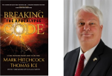
Thomas Ice
Thomas Ice, “Kept From the Hour,” online: www.pre-trib.org, accessed 4 September 2014, 2.
“This phrase ‘earth dwellers’ is used eleven times in nine verses in Revelation (3:10; 6:10; 8:13; 11:10 2xs; 13:8, 12, 14 2xs; 14:6; 17:8). As you examine each individual use, except 3:10, you will see that all refer to a special class of stubborn sinners who are set in their rebellion against the God of heaven. You will also find that the phrase is only used to refer to those during the tribulation period. Therefore, since the future hour spoken of in 3:10 is set in contrast with the present set of believers in the church age, and the future ‘earth dwellers’ will be active during the time period in which believers are said to be kept from, it is clear that John speaks of the time or hour of the tribulation. This is why 3:10 is a clear promise that Christ will keep believers from the time of the seven year tribulation.”

Slide 57
Pretribulationism IS NOT Escapism
Trials (John 16:33)
Man’s wrath (2 Tim. 3:12)
Satan’s wrath (Eph. 6:11-12)
World’s wrath (John 15:18-19)

Slide 58
Revelation 3:10
‘Because you have kept the word of My perseverance, I also will keep you from the hour of testing, that hour which is about to come upon the whole world, to test those who dwell on the earth.

Slide 59
Renald Showers
Renald Showers, Maranatha Our Lord, Come! (Bellmawr, NJ: Friends of Israel, 1995), 212.
“Christ based His promise on the fact that the church saints had already passed their test. In light of that, it appears that because they had already passed their test, Christ promised that He would not put them into the period that...will have the purpose of testing a very different group of people.”

Slide 60
Does Revelation 3:10 Teach the Pre-Tribulation Rapture?
Who are the “earth-dwellers”?
What is the meaning of “about to come”?
How will Christ keep His promise?
Is this promise for Philadelphia only?
How does the Pre-Trib. View of Rev. 3:10 harmonize with the rest of the Book of Revelation?

Slide 61
Revelation 3:10
‘Because you have kept the word of My perseverance, I also will keep you from the hour of testing, that hour which is about to come [mellō] upon the whole world, to test those who dwell on the earth.

Slide 62
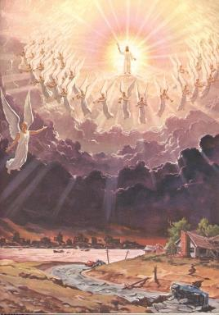
Imminency
Méllō: “and one who will share in the glory to be [mellō] revealed” (1 Pet 5:1)

Slide 63
Does Revelation 3:10 Teach the Pre-Tribulation Rapture?
Who are the “earth-dwellers”?
What is the meaning of “about to come”?
How will Christ keep His promise?
Is this promise for Philadelphia only?
How does the Pre-Trib. View of Rev. 3:10 harmonize with the rest of the Book of Revelation?

Slide 64
Revelation 3:11
“I am coming quickly; hold fast what you have, so that no one will take your crown.”

Slide 65
Revelation 3:11
“I am coming quickly; hold fast what you have, so that no one will take your crown.”

Slide 66
Revelation 3:11
“I am coming quickly; hold fast what you have, so that no one will take your crown.”

Slide 67
1 Corinthians 4:5
“ Therefore do not go on passing judgment before the time, but wait until the Lord comes who will both bring to light the things hidden in the darkness and disclose the motives of men’s hearts; and then each man’s praise will come to him from God.”

Slide 68
2 Timothy 4:8
“In the future there is laid up for me the crown of righteousness, which the Lord, the righteous Judge, will award to me on that day; and not only to me, but also to all who have loved His appearing.”

Slide 69
Does Revelation 3:10 Teach the Pre-Tribulation Rapture?
Who are the “earth-dwellers”?
What is the meaning of “about to come”?
How will Christ keep His promise?
Is this promise for Philadelphia only?
How does the Pre-Trib. View of Rev. 3:10 harmonize with the rest of the Book of Revelation?

Slide 70
Revelation 3:7
“And to the angel of the church in Philadelphia write: He who is holy, who is true, who has the key of David, who opens and no one will shut, and who shuts and no one opens, says this:”

Slide 71
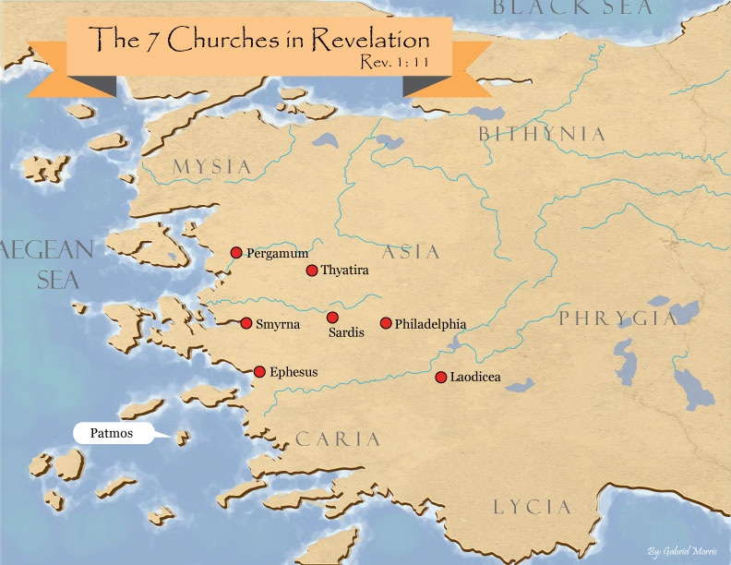

Slide 72
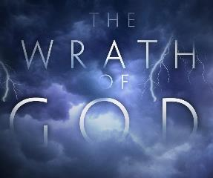
Promised Exemption from Divine Wrath
The promise (1 Thess. 1:10; 5:9; Rom 5:9; 8:1; Rev 3:10)
Tribulation = divine wrath (Rev 6:16-17; 11:18; 15:1, 7; 16:19)

Slide 73
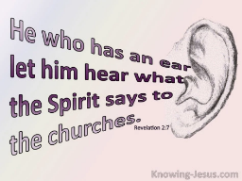
Revelation 3:13
exhortation to listen
“He who has an ear, let him hear what the Spirit says to the churches.”

Slide 74
Revelation 3:11-12
“¹¹ I am coming quickly; hold fast what you have, so that no one will take your crown. ¹² He who overcomes, I will make him a pillar in the temple of My God, and he will not go out from it anymore; and I will write on him the name of My God, and the name of the city of My God, the new Jerusalem, which comes down out of heaven from My God, and My new name.”

Slide 75
Does Revelation 3:10 Teach the Pre-Tribulation Rapture?
Who are the “earth-dwellers”?
What is the meaning of “about to come”?
How will Christ keep His promise?
Is this promise for Philadelphia only?
How does the Pre-Trib. View of Rev. 3:10 harmonize with the rest of the Book of Revelation?

Slide 76
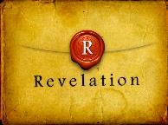
Revelation 1:19
“Therefore write the things which you have seen, and the things which are, and the things which will take place after these things [meta tauta].”

Slide 77
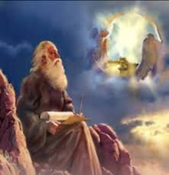
Revelation 1:19
Seen (Chapter 1)
Are (Chapters 2–3)
After these things (Chapters 4–22)

Slide 78
Revelation 1:19
Seen (Chapter 1)
Are (Chapters 2–3)
After these things (Chapters 4–22)

Slide 79
The Missing Church
Rev 4-19
Rev 13:9
Revelation’s Jewish nature

Slide 80
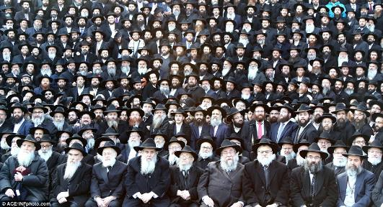
God’s Work Through Israel
Revelation 7 – 144,000 Jews
Revelation 11 – Two Jewish witnesses
Revelation 12 – Israel flees

Slide 81
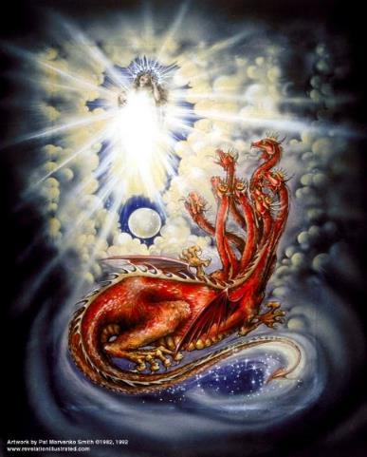
CAST OF 3 CHARACTERS Revelation 12:1-5
SON = Messiah (v.5)
DRAGON = Satan (v. 3)
WOMAN = Israel (v.1)

Slide 82
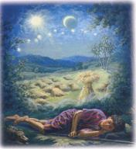
Genesis 37:9
Now he had still another dream, and related it to his brothers, and said, “Lo, I have had still another dream; and behold, the sun and the moon and eleven stars were bowing down to me.

Slide 83
Genesis 37:10
He related it to his father and to his brothers; and his father rebuked him and said to him, “What is this dream that you have had? Shall I and your mother and your brothers actually come to bow ourselves down before you to the ground?”

Slide 84
Sun = Jacob
Moon = Leah
11 Stars = Joseph’s brothers
12th Star = Joseph
12 Stars = Israel’s twelve tribes

Slide 85
Conclusion

Slide 86
Does Revelation 3:10 Teach the Pre-Tribulation Rapture?
Are there easier ways to convey “protection through”? YES
Will God protect believers during the Tribulation? NO
What is the meaning of “keep you from”? Kept out of the Time Period Completely
What is the meaning of “the hour”? The Time of the Tribulation Period
What is the meaning of the “whole world”? The Entire Earth
What is the meaning of “testing/to test”? To Expose Someone’s True Character

Slide 87
Does Revelation 3:10 Teach the Pre-Tribulation Rapture?
Who are the “earth-dwellers”? Tribulation Unbelievers
What is the meaning of “about to come”? Imminency
How will Christ keep His promise? His Coming in the Rapture
Is this promise for Philadelphia only? NO
Does the Pre-Trib. View of Rev. 3:10 harmonize with the rest of the Book of Revelation? YES

