Slide 1
HOW TO FIND JOY IN THE CHRISTIAN LIFE

Slide 2
Answering Ten Questions
Who wrote it? – Paul
To Whom was it written? – The Believers at Philippi
Where was it written from? – Rome
When was it written? – A.D. 62
What was the book’s occasion? – Five contacts
Who are the opponents? – Four opponents threatening joy
What is the book’s purpose? – To give joy during adversity
How is it organized (outline)? – Four- part outline
What is it about? – Joy during adverstiy
What makes the book different? – Personal & informal

Slide 3
Outline
Ch 1 – God can use negative circumstances to bring about positive results
Ch 2 – Christ’s example of servanthood
Ch 3 – Avoiding legalism
Ch 4 – Reliance upon Christ’s strength for daily life

Slide 4
Outline
Ch 1 – God can use negative circumstances to bring about positive results
Ch 2 – Christ’s example of servanthood
Ch 3 – Avoiding legalism
Ch 4 – Reliance upon Christ’s strength for daily life

Slide 5
4 Positive Results of Imprisonment (Phil. 1:12-30)
Captive audience (Phil. 1:12-13)
Church’s boldness in preaching (Phil. 1:14-18)
Greater prayer (Phil. 1:19)
Protection from martyrdom (Phil. 1:20-26)

Slide 6
Outline
Ch 1 – God can use negative circumstances to bring about positive results
Ch 2 – Christ’s example of servanthood
Ch 3 – Avoiding legalism
Ch 4 – Reliance upon Christ’s strength for daily life

Slide 7
4 Examples of Humble Service
(Phil. 2)
Christ (Phil. 2:5-16)
Paul (Phil. 2:17-18)
Timothy (Phil. 2:19-24)
Epaphroditus (Phil. 2:25-30)

Slide 8
Outline
Ch 1 – God can use negative circumstances to bring about positive results
Ch 2 – Christ’s example of servanthood
Ch 3 – Avoiding legalism
Ch 4 – Reliance upon Christ’s strength for daily life

Slide 9
Avoid Legalism
(Phil. 3)
Legalists vs. true believers (Phil. 3:1-3)
Paul’s transition away from legalism (Phil. 3:4-14)
Other items to embrace in lieu of legalism (Phil. 3:15–4:3)

Slide 10
Outline
Ch 1 – God can use negative circumstances to bring about positive results
Ch 2 – Christ’s example of servanthood
Ch 3 – Avoiding legalism
Ch 4 – Reliance upon Christ’s strength for daily life

Slide 11
Draw Upon the Divine Resources for Daily life (Phil. 4)
Peace (Phil. 4:4-9)
Contentment (Phil. 4:10-13)
Provision (Phil. 4:14-19)

Slide 12
Philippians 4:20-23
“²⁰ Now to our God and Father be the glory forever and ever. Amen. ²¹ Greet every saint in Christ Jesus. The brethren who are with me greet you. ²² All the saints greet you, especially those of Caesar’s household. ²³ The grace of the Lord Jesus Christ be with your spirit.”

Slide 13
Matthew 5:18
“For truly I say to you, until heaven and earth pass away, not the smallest letter or stroke shall pass from the Law until all is accomplished.”

Slide 14
Matthew 4:4
“But He answered and said, “It is written, ‘Man shall not live on bread alone, but on every word that proceeds out of the mouth of God.’”

Slide 15
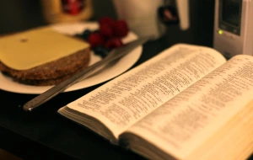
Job 23:12
“I have not departed from the command of His lips; I have treasured the words of His mouth more than my necessary food.”

Slide 16
Conclusion (Phil. 4:20–23)
Doxology (Phil. 4:20)
Greeting (Phil. 4:21-22)
Benediction (Phil. 4:23)

Slide 17
Conclusion (Phil. 4:20–23)
Doxology (Phil. 4:20)
Greeting (Phil. 4:21-22)
Benediction (Phil. 4:23)

Slide 18
Philippians 4:20-23
“²⁰ Now to our God and Father be the glory forever and ever. Amen. ²¹ Greet every saint in Christ Jesus. The brethren who are with me greet you. ²² All the saints greet you, especially those of Caesar’s household. ²³ The grace of the Lord Jesus Christ be with your spirit.”

Slide 19
Philippians 4:20-23
“²⁰ Now to our God and Father be the glory forever and ever. Amen. ²¹ Greet every saint in Christ Jesus. The brethren who are with me greet you. ²² All the saints greet you, especially those of Caesar’s household. ²³ The grace of the Lord Jesus Christ be with your spirit.”

Slide 20
Matthew 7:21-23
“Not everyone who says to Me, ‘Lord, Lord,’ will enter the kingdom of heaven, but he who does the will of My Father who is in heaven will enter. ²² Many will say to Me on that day, ‘Lord, Lord, did we not prophesy in Your name, and in Your name cast out demons, and in Your name perform many miracles?’ ²³ And then I will declare to them, ‘I never knew [ginōskō] you; depart from Me, you who practice lawlessness.’”

Slide 21
Three Tenses of Salvation
Phase | Justification | Sanctification | Glorification
Tense | Past | Present | Future
Saved from sin’s: | Penalty | Power | Presence
Scripture | Eph 2:8-9; Titus 3:5 | Philip 2:12 | Rom 5:10
Nature | Single | Dual | Single

Slide 22
Three Tenses of Salvation
Phase | Justification | Sanctification | Glorification
Tense | Past | Present | Future
Saved from sin’s: | Penalty | Power | Presence
Scripture | Eph 2:8-9; Titus 3:5 | Philip 2:12 | Rom 5:10
Nature | Single | Dual | Single

Slide 23
Philippians 4:20-23
“²⁰ Now to our God and Father be the glory [doxa] forever and ever. Amen. ²¹ Greet every saint in Christ Jesus. The brethren who are with me greet you. ²² All the saints greet you, especially those of Caesar’s household. ²³ The grace of the Lord Jesus Christ be with your spirit.”

Slide 24
Philippians 4:20-23
“²⁰ Now to our God and Father be the glory forever [aionios] and ever [aionios]. Amen. ²¹ Greet every saint in Christ Jesus. The brethren who are with me greet you. ²² All the saints greet you, especially those of Caesar’s household. ²³ The grace of the Lord Jesus Christ be with your spirit.”

Slide 25
Philippians 4:20-23
“²⁰ Now to our God and Father be the glory forever and ever. Amen. ²¹ Greet every saint in Christ Jesus. The brethren who are with me greet you. ²² All the saints greet you, especially those of Caesar’s household. ²³ The grace of the Lord Jesus Christ be with your spirit.”

Slide 26
John 5:24
“Truly, truly [amēn, amēn], I say to you, he who hears My word, and believes Him who sent Me, has eternal life, and does not come into judgment, but has passed out of death into life.”

Slide 27
Dispensational Theology is a System of Theology
Traditional-normative dispensational theology is a system that embodies three essential, fundamental concepts called the sine qua non (lit. “without which is not”):
The consistent use of a plain, normal, literal, grammatical-historical method of interpretation;
Which reveals that the Church is distinct from Israel;
God’s overall purpose is to bring glory to Himself (Eph. 1:6, 12, 14).
Dr. Charles Ryrie, Dispensationalism, pp. 38-41

Slide 28
Doxological Purpose
God’s ultimate purpose for the ages is to glorify Himself. Scripture is not human-centered, as though salvation were the principle point, but God-centered, because His glory is at the center.
The glory of God is the primary principle that unifies all dispensations, the program of salvation being just one of the means by which God glorifies Himself. Each successive revelation of God’s plan for the ages, as well as His dealing with the elect, non-elect, angels, and nations all manifest His glory.
Dictionary of Premillennial Theology, Charles Ryrie, p. 94

Slide 30
Westminster Shorter Catechism
Q. 1. What is the chief end of man?
A. Man’s chief end is to glorify God, and to enjoy Him forever.

Slide 31
Conclusion (Phil. 4:20–23)
Doxology (Phil. 4:20)
Greeting (Phil. 4:21-22)
Benediction (Phil. 4:23)

Slide 32
Philippians 4:20-23
“²⁰ Now to our God and Father be the glory forever and ever. Amen. ²¹ Greet every saint in Christ Jesus. The brethren who are with me greet you. ²² All the saints greet you, especially those of Caesar’s household. ²³ The grace of the Lord Jesus Christ be with your spirit.”

Slide 33
Philippians 4:20-23
“²⁰ Now to our God and Father be the glory forever and ever. Amen. ²¹ Greet every saint in Christ Jesus. The brethren who are with me greet you. ²² All the saints greet you, especially those of Caesar’s household. ²³ The grace of the Lord Jesus Christ be with your spirit.”

Slide 34
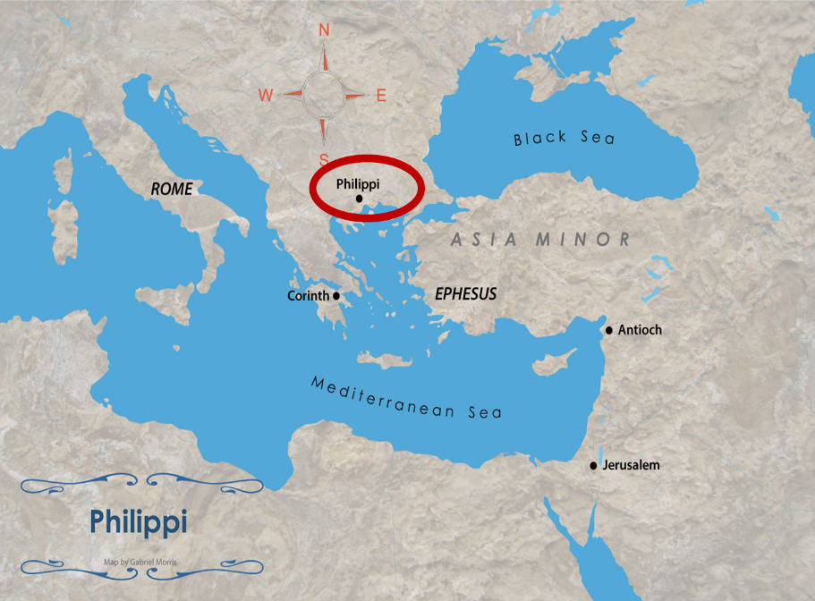

Slide 35
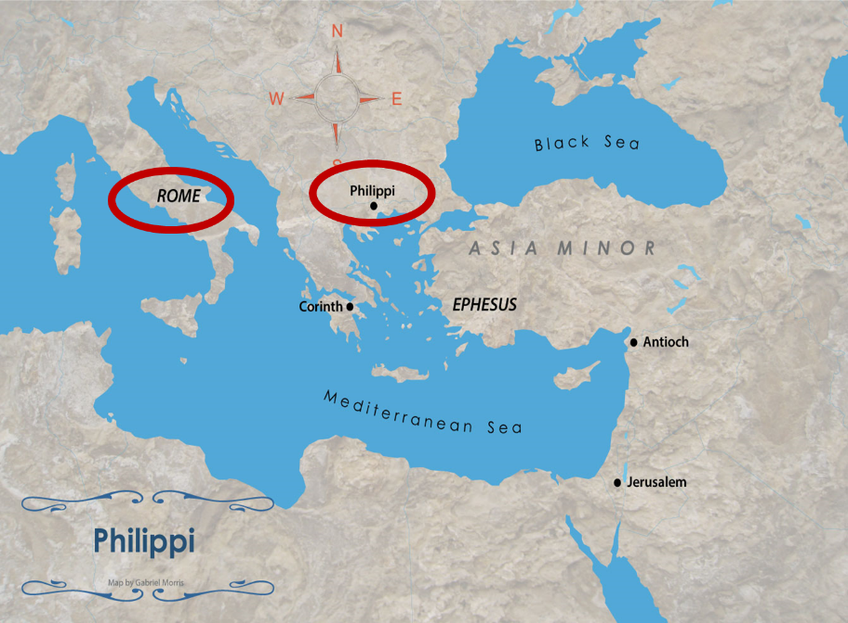

Slide 36
Philippians 4:20-23
“²⁰ Now to our God and Father be the glory forever and ever. Amen. ²¹ Greet every saint in Christ Jesus. The brethren who are with me greet you. ²² All the saints greet you, especially those of Caesar’s household. ²³ The grace of the Lord Jesus Christ be with your spirit.”

Slide 37
Philippians 4:20-23
“²⁰ Now to our God and Father be the glory forever and ever. Amen. ²¹ Greet every saint in Christ Jesus. The brethren who are with me greet you. ²² All the saints greet you, especially those of Caesar’s household. ²³ The grace of the Lord Jesus Christ be with your spirit.”

Slide 38
Philippians 4:20-23
“²⁰ Now to our God and Father be the glory forever and ever. Amen. ²¹ Greet every saint in Christ Jesus. The brethren who are with me greet you. ²² All the saints greet you, especially those of Caesar’s household. ²³ The grace of the Lord Jesus Christ be with your spirit.”

Slide 39
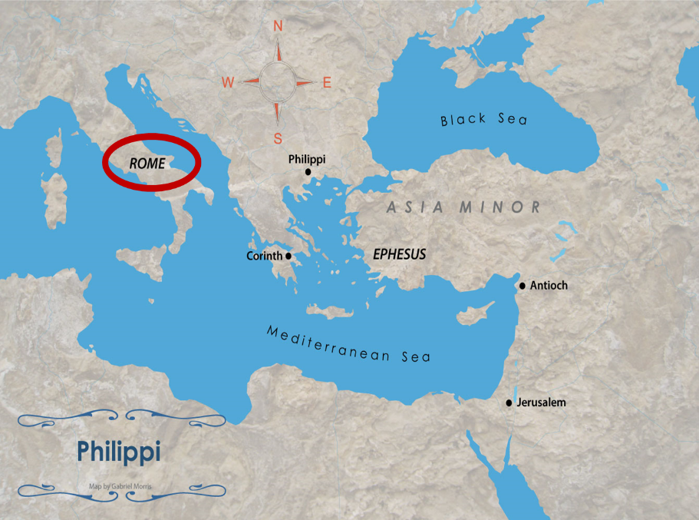

Slide 41
Philippians 4:20-23
“²⁰ Now to our God and Father be the glory forever and ever. Amen. ²¹ Greet every saint in Christ Jesus. The brethren who are with me greet you. ²² All the saints greet you, especially those of Caesar’s household. ²³ The grace of the Lord Jesus Christ be with your spirit.”

Slide 42
Philippians 4:20-23
“²⁰ Now to our God and Father be the glory forever and ever. Amen. ²¹ Greet every saint in Christ Jesus. The brethren who are with me greet you. ²² All the saints greet you, especially those of Caesar’s household. ²³ The grace of the Lord Jesus Christ be with your spirit.”

Slide 43
Philippians 4:20-23
“²⁰ Now to our God and Father be the glory forever and ever. Amen. ²¹ Greet every saint in Christ Jesus. The brethren who are with me greet you. ²² All the saints greet you, especially those of Caesar’s household. ²³ The grace of the Lord Jesus Christ be with your spirit.”

Slide 44
Conclusion (Phil. 4:20–23)
Doxology (Phil. 4:20)
Greeting (Phil. 4:21-22)
Benediction (Phil. 4:23)

Slide 45
Philippians 4:20-23
“²⁰ Now to our God and Father be the glory forever and ever. Amen. ²¹ Greet every saint in Christ Jesus. The brethren who are with me greet you. ²² All the saints greet you, especially those of Caesar’s household. ²³ The grace of the Lord Jesus Christ be with your spirit.”

Slide 46
Philippians 4:20-23
“²⁰ Now to our God and Father be the glory forever and ever. Amen. ²¹ Greet every saint in Christ Jesus. The brethren who are with me greet you. ²² All the saints greet you, especially those of Caesar’s household. ²³ The grace [charis] of the Lord Jesus Christ be with your spirit.”

Slide 47
Three Tenses of Salvation
Phase | Justification | Sanctification | Glorification
Tense | Past | Present | Future
Saved from sin’s: | Penalty | Power | Presence
Scripture | Eph 2:8-9; Titus 3:5 | Philip 2:12 | Rom 5:10
Nature | Single | Dual | Single

Slide 48
Three Tenses of Salvation
Phase | Justification | Sanctification | Glorification
Tense | Past | Present | Future
Saved from sin’s: | Penalty | Power | Presence
Scripture | Eph 2:8-9; Titus 3:5 | Philip 2:12 | Rom 5:10
Nature | Single | Dual | Single

Slide 49
Philippians 4:20-23
“²⁰ Now to our God and Father be the glory forever and ever. Amen. ²¹ Greet every saint in Christ Jesus. The brethren who are with me greet you. ²² All the saints greet you, especially those of Caesar’s household. ²³ The grace of the Lord Jesus Christ be with your spirit.”

Slide 50
Philippians 4:20-23
“²⁰ Now to our God and Father be the glory forever and ever. Amen. ²¹ Greet every saint in Christ Jesus. The brethren who are with me greet you. ²² All the saints greet you, especially those of Caesar’s household. ²³ The grace of the Lord Jesus Christ be with your spirit [pneuma].”

Slide 51
2 Peter 1:3-4
“³ Seeing that His divine power has granted to us everything pertaining to life and godliness, through the true knowledge of Him who called us by His own glory and excellence. ⁴For by these He has granted to us His precious and magnificent promises, so that by them you may become partakers of the divine nature, having escaped the corruption that is in the world by lust.”

Slide 52
Conclusion

Slide 53
Conclusion (Phil. 4:20–23)
Doxology (Phil. 4:20)
Greeting (Phil. 4:21-22)
Benediction (Phil. 4:23)

Slide 54
Message
Joy in the midst of adverse circumstances is possible as believers understand that God uses adversity to bring about positive results, follow Christ's example of servanthood, avoid legalism, and draw upon divine resources for daily life

Slide 55
Outline
CHAPTER 1
God can use negative circumstances to bring about positive results
CHAPTER 2
Christ’s example of servanthood
CHAPTER 3
Avoiding legalism
CHAPTER 4
Reliance upon Christ’s strength for daily life

Slide 56
“The Lord bless you and keep you; the Lord make his face shine on you and be gracious to you; the Lord turn his face toward you and give you peace.” (NIV)

