Slide 1


The Principles That Made America Great
Dr. Andy Woods
Senior Pastor – Sugar Land Bible Church
President – Chafer Theological Seminary

Slide 2



Slide 3
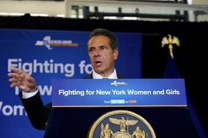
https://www.democratandchronicle.com/videos/news/politics/albany/2018/08/15/andrew-cuomo-america-was-never-great/1000295002/
New York Governor Andrew Cuomo
“We’re not going to make America great again,” Cuomo said while signing a bill dealing with human trafficking. “It was never that great. We have not reached greatness. We will reach greatness when every American is fully engaged.”

Slide 4

God Blesses His Truth
Proverbs 14:34
“Righteousness exalts a nation, but sin is a reproach to any people.”
Ps 33:12
“Blessed is the nation whose God is the Lord.”

Slide 5

God Blesses His Truth
Amos 7:7-8
⁷ Thus He showed me, and behold, the Lord was standing by a vertical wall with a plumb line in His hand. ⁸ The LORD said to me, “What do you see, Amos?” And I said, “A plumb line.” Then the Lord said, “Behold I am about to put a plumb line In the midst of My people Israel. I will spare them no longer.”

Slide 6
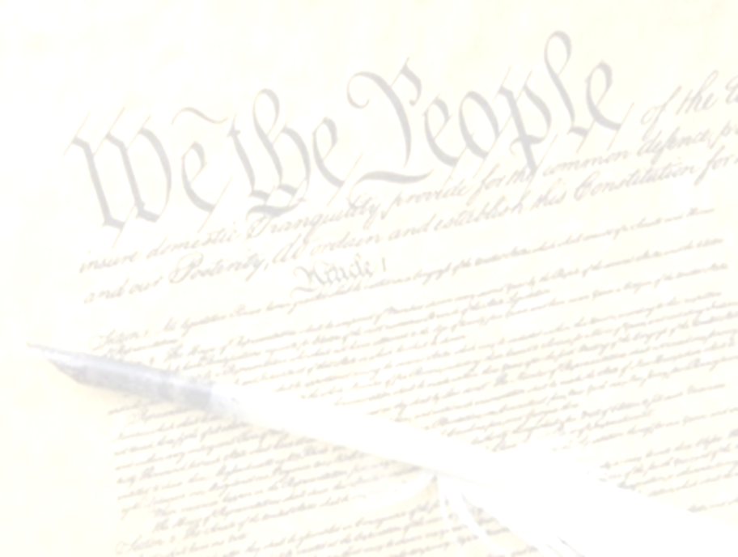
The Principles that Made America Great
Bible as the Source of Authority Principle (Isa. 40:8)
God-Given Rights Principle (Gen. 1:27)
Recognition of Human Depravity Principle (Gen. 8:21)
Non-New World Order Principle (Gen. 11:6)
Cooperation with Christianity Principle (Prov. 14:34)
Christian Education Principle (Deut. 6:6-7)
Christian Consensus Principle (Prov. 29:2)
Heterosexual Monogamy Principle (Gen. 2:24)
Economic Justice Principle (Gen. 3:19)
Pro-Israel Principle (Gen. 12:3)
Prayer Principle (Prov. 21:1)

Slide 7
The Principles that Made America Great
Bible as the Source of Authority Principle (Isa. 40:8)
God-Given Rights Principle (Gen. 1:27)
Recognition of Human Depravity Principle (Gen. 8:21)
Non-New World Order Principle (Gen. 11:6)
Cooperation with Christianity Principle (Prov. 14:34)
Christian Education Principle (Deut. 6:6-7)
Christian Consensus Principle (Prov. 29:2)
Heterosexual Monogamy Principle (Gen. 2:24)
Economic Justice Principle (Gen. 3:19)
Pro-Israel Principle (Gen. 12:3)
Prayer Principle (Prov. 21:1)

Slide 8

Calvin Coolidge
Calvin Coolidge stated July 5, 1926: "The principles...which went into the Declaration of Independence...are found in...the sermons...of the early colonial clergy...They justified freedom by the text that we are all created in the Divine image."
Calvin Coolidge, July 5, 1926, College of William and Mary, Williamsburg, Virginia, http.americanminute.com/index.php?date=05-15

Slide 9

Founders’ Sources
34% Bible
8.3% Baron Montesquieu
7.9% William Blackstone
2.9% John Locke
Donald S. Lutz, The Origins of American Constitutionalism (Baton Rouge, LA: Louisiana State University Press, 1988), 141.

Slide 10
Founders’ Sources
34% Bible
8.3% Baron Montesquieu
7.9% William Blackstone
2.9% John Locke
Donald S. Lutz, The Origins of American Constitutionalism (Baton Rouge, LA: Louisiana State University Press, 1988), 141.

Slide 11
Founders’ Sources
34% Bible
8.3% Baron Montesquieu
7.9% William Blackstone
2.9% John Locke
Donald S. Lutz, The Origins of American Constitutionalism (Baton Rouge, LA: Louisiana State University Press, 1988), 141.

Slide 12

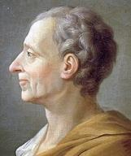
Baron Montesquieu
“The Christian religion…is a stranger to mere despotic power. The mildness so frequently recommended in the Gospel, is incompatible with the despotic rage with which a prince punishes his subjects, and exercises himself in cruelty…[W]e shall see, that we owe to Christianity, in government, a certain political law; and in war, a certain law of nations; benefits which nature can sufficiently acknowledge.”
Alvin J. Schmidt, Under the Influence: How Christianity Transformed Civilization (Grand Rapids: Zondervan, 2001), 257-58.

Slide 13
Founders’ Sources
34% Bible
8.3% Baron Montesquieu
7.9% William Blackstone
2.9% John Locke
Donald S. Lutz, The Origins of American Constitutionalism (Baton Rouge, LA: Louisiana State University Press, 1988), 141.

Slide 14

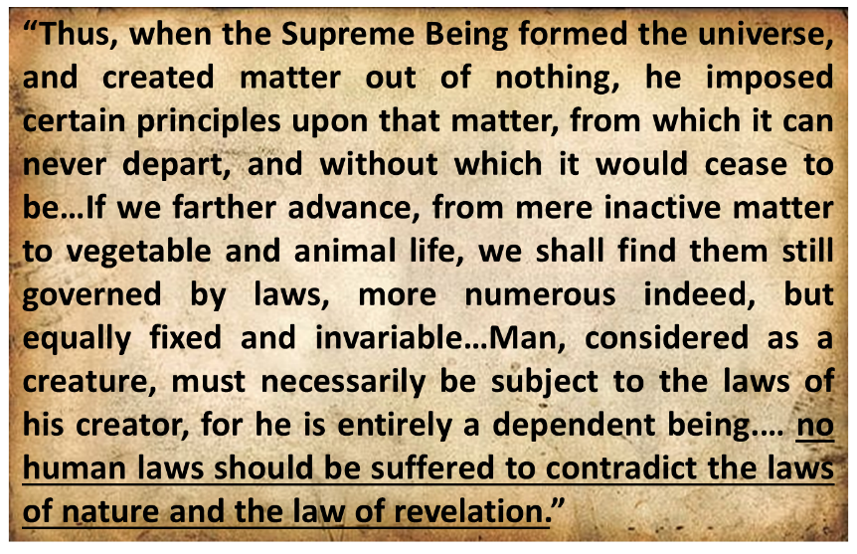
Sir William Blackstone
Sir William Blackstone, Commentaries on the Laws of New England, 5 vols. (Philadelphia: Robert Bell Union Library, 1771; reprint, NY: Layston, 1967), 1:38-39, 42.

Slide 15
Founders’ Sources
34% Bible
8.3% Baron Montesquieu
7.9% William Blackstone
2.9% John Locke
Donald S. Lutz, The Origins of American Constitutionalism (Baton Rouge, LA: Louisiana State University Press, 1988), 141.

Slide 16
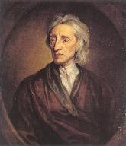
John Locke
“Locke’s theory reflects St. Paul’s Christian understanding of the natural law. Although he has often been referred to as a deist, it is clear from his writings that he considered himself a Christian. In his monograph The Reasonableness of Christianity (1695), he talks about sinners being ‘restored by Christ at the resurrection.’ Frequently, he also cites Scripture references in support of his arguments.”
Alvin J. Schmidt, Under the Influence: How Christianity Transformed Civilization (Grand Rapids: Zondervan, 2001), 253-54.

Slide 17
The Principles that Made America Great
Bible as the Source of Authority Principle (Isa. 40:8)
God-Given Rights Principle (Gen. 1:27)
Recognition of Human Depravity Principle (Gen. 8:21)
Non-New World Order Principle (Gen. 11:6)
Cooperation with Christianity Principle (Prov. 14:34)
Christian Education Principle (Deut. 6:6-7)
Christian Consensus Principle (Prov. 29:2)
Heterosexual Monogamy Principle (Gen. 2:24)
Economic Justice Principle (Gen. 3:19)
Pro-Israel Principle (Gen. 12:3)
Prayer Principle (Prov. 21:1)

Slide 18

Genesis 1:27
God created man in His own image, in the image of God He created him; male and female He created them.

Slide 19

Genesis 9:6
“Whoever sheds man’s blood, By man his blood shall be shed, For in the image of God He made man.”

Slide 20


Genesis 6:11
“Now the earth was corrupt in the sight of God, and the earth was filled with violence.”

Slide 21
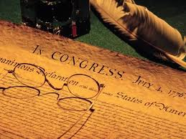
Declaration of Independence
“the Laws of Nature and of Nature’s God,”
“we hold these truths to be self evident, that all men are created equal,”
“they are endowed by their Creator with certain unalienable Rights,”
“appealing to the Supreme Judge of the world for the rectitude of our intentions,”
“with firm reliance on the protection of Divine Providence.”
Church of the Holy Trinity v. U.S., 143 U.S. 457, 467-68 (1892)

Slide 22
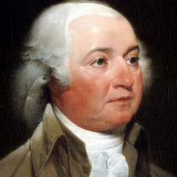
John Adams
John Adams - America's second President "Rights [are] antecedent to all earthly government; Rights...cannot be repealed or restrained by human laws; Rights [are] derived from the great Legislature of the universe."
John Adams, The Works of John Adams, Second President of the United States, ed. Charles Francis Adams, 10 vols. (Boston: Little, Brown, 1856), 3:449.

Slide 23
Declaration of Independence
“We hold these truths to be self-evident, that all men are created equal, that they are endowed by their Creator with certain unalienable Rights, that among these are Life, Liberty and the pursuit of Happiness.”
“That to secure these rights, Governments are instituted among Men, deriving their just powers from the consent of the governed,”
“That whenever any Form of Government becomes destructive of these ends, it is the Right of the People to alter or to abolish it, and to institute new Government…”
Declaration of Independence, In Congress, July 4, 1776, The unanimous Declaration of the thirteen united States of America

Slide 24
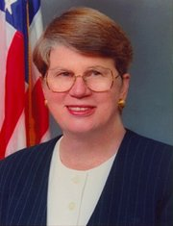
Speech by Attorney General Janet Reno, Newark, New Jersey, May 5, 1995. Quoted in James Bovard, “Waco Must Get a Hearing,” Wall Street Journal, May 15, 1995.
Former Attorney General Janet Reno
“You are part of a government that has given its people more freedom…than any other government in the history of the world.”

Slide 25
The Principles that Made America Great
Bible as the Source of Authority Principle (Isa. 40:8)
God-Given Rights Principle (Gen. 1:27)
Recognition of Human Depravity Principle (Gen. 8:21)
Non-New World Order Principle (Gen. 11:6)
Cooperation with Christianity Principle (Prov. 14:34)
Christian Education Principle (Deut. 6:6-7)
Christian Consensus Principle (Prov. 29:2)
Heterosexual Monogamy Principle (Gen. 2:24)
Economic Justice Principle (Gen. 3:19)
Pro-Israel Principle (Gen. 12:3)
Prayer Principle (Prov. 21:1)

Slide 26
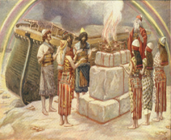
Genesis 8:21
The Lord smelled the soothing aroma; and the Lord said to Himself, “I will never again curse the ground on account of man, for the intent of man’s heart is evil from his youth; and I will never again destroy every living thing, as I have done.[emphasis mine].

Slide 27


Jeremiah 17:9
“The heart is more deceitful than all else And is desperately sick; Who can understand it?.”

Slide 28
Mark 7:20-23
“²⁰ And He was saying, ‘That which proceeds out of the man, that is what defiles the man. ²¹ For from within, out of the heart of men, proceed the evil thoughts, fornications, thefts, murders, adulteries, ²² deeds of coveting and wickedness, as well as deceit, sensuality, envy, slander, pride and foolishness. ²³ All these evil things proceed from within and defile the man.’”

Slide 29
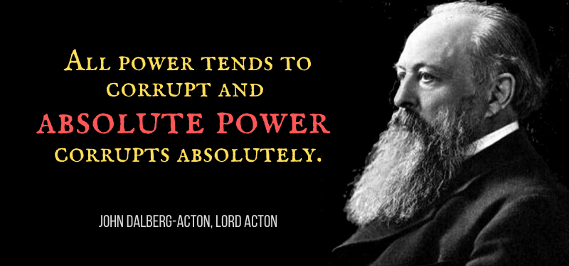
LORD ACTON

Slide 30

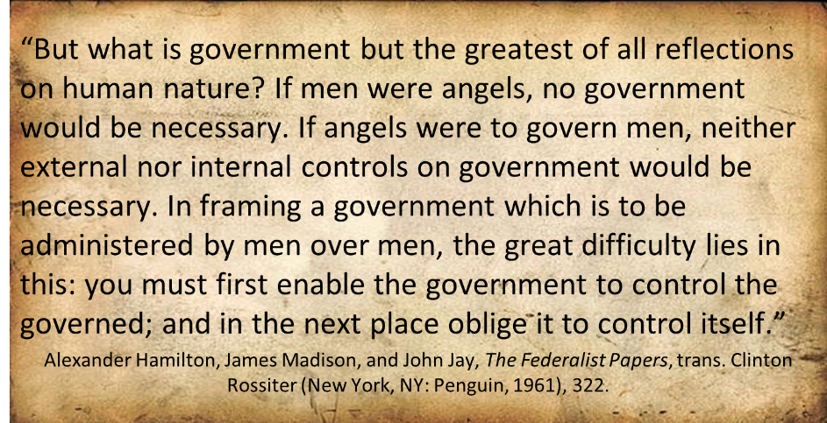
Federalist # 51

Slide 31
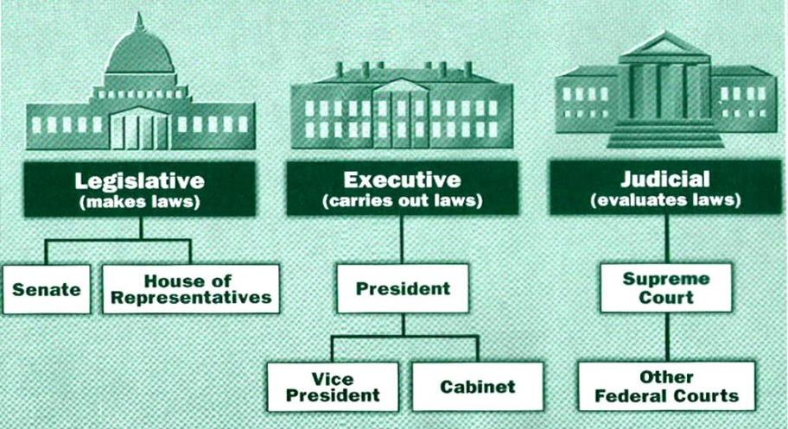

Slide 32
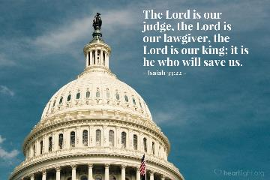
Isaiah 33:22
“For the LORD is our judge, The LORD is our lawgiver, The LORD is our king.”

Slide 33
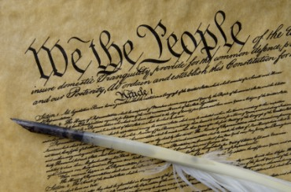
Tenth Amendment
“The powers not delegated to the United States by the Constitution nor prohibited by it to the States are reserved to the States respectively or to the people.”

Slide 34
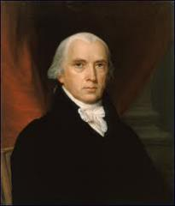
Federalist # 45
“The powers delegated by the proposed Constitution to the federal government, are few and defined. Those which are to remain in the State governments are numerous and indefinite.”
Alexander Hamilton, James Madison, and John Jay, The Federalist Papers, trans. Clinton Rossiter (New York, NY: Penguin, 1961), 292.

Slide 35
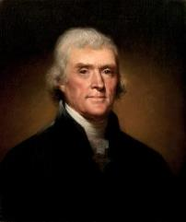
Thomas Jefferson
Kentucky Resolutions of 1798: "...in questions of power then, let no more be heard of confidence in man, but bind him down from mischief by the chains of the constitution..." (from draft)
Papers of Thomas Jefferson 30:529-556

Slide 36
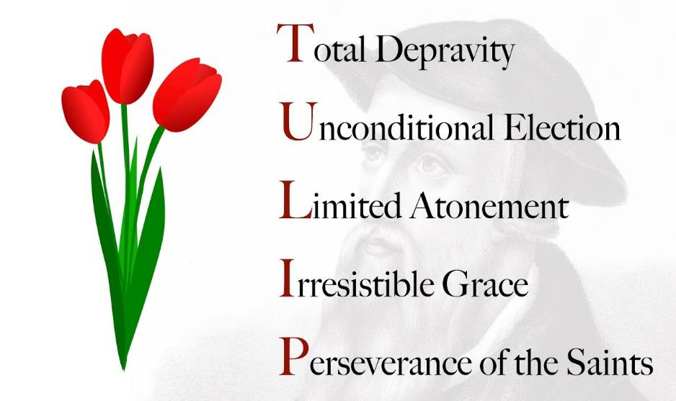

Slide 37
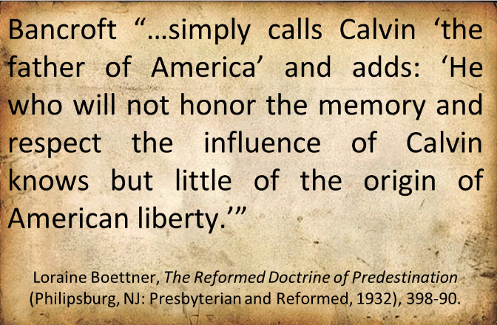
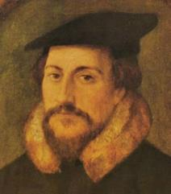
John Calvin

Slide 38
The Principles that Made America Great
Bible as the Source of Authority Principle (Isa. 40:8)
God-Given Rights Principle (Gen. 1:27)
Recognition of Human Depravity Principle (Gen. 8:21)
Non-New World Order Principle (Gen. 11:6)
Cooperation with Christianity Principle (Prov. 14:34)
Christian Education Principle (Deut. 6:6-7)
Christian Consensus Principle (Prov. 29:2)
Heterosexual Monogamy Principle (Gen. 2:24)
Economic Justice Principle (Gen. 3:19)
Pro-Israel Principle (Gen. 12:3)
Prayer Principle (Prov. 21:1)

Slide 39

Genesis 11:6
The Lord said, “Behold, they are one people, and they all have the same language. And this is what they began to do, and now nothing which they purpose to do will be impossible for them.”

Slide 40
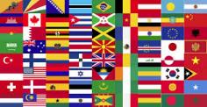
God’s Doctrine of Nations
Since Babel | Deut. 32:8; Acts 17:26
Millennium | Isaiah 2:4; 66:18; Zech. 14:16-18; Rev. 12:5; 20:3
Eternal State | Rev. 21:24, 26

Slide 41

Acts 17:26
“and He made from one man every nation of mankind to live on all the face of the earth, having determined their appointed times and the boundaries of their habitation.”

Slide 42
The Divine Institutions
Conscience (Gen. 3:22)
Marriage and family (Gen. 1:26-28; 2:18-25)
Labor (Gen. 2:15; 3:19)
Government (Gen. 9:6)
Nationalism (Gen. 11:1-9)

Slide 43

Sine Qua Non of Nationhood
Common language
Common culture
Common currency
Enforceable national borders

Slide 44

John Winthrop
(1587‒1649)
“For we must consider that we shall be as a City set upon a Hill; the eyes of all people are upon us; so that if we shall deal falsely with our God in this work we have undertaken and so cause him to withdraw his present help from us, we shall be a story and a by-word through the world.”
John Winthrop, “A Model of Christian Charity,” Winthrop Papers, 2:292-95.

Slide 45
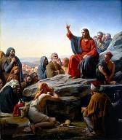
Matt 5:13, 16
“You are the light of the world. A city set on a hill cannot be hidden…Let your light shine before men in such a way that they may see your good works, and glorify your Father who is in heaven.”

Slide 46
Thomas Jefferson
"...comparisons of our governments with those of Europe are like a comparison of heaven and hell.”
Thomas Jefferson, Memoir, Correspondence, and Miscellanies, Vol. II, 221, to Joseph Jones on August 14, 1787

Slide 47
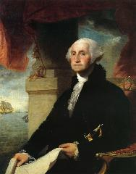
George Washington’s Farwell Address of 1790
"It is our true policy to steer clear of permanent alliances with any portion of the foreign world."
George Washington, “Washington’s Farewell Address,” online: www.wikapedia.org, accessed 7 May 2010, 1.

Slide 48
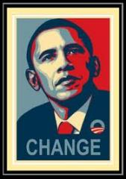
American Exceptionalism?
“I believe in American exceptionalism, just as I suspect that the Brits believe in British exceptionalism and the Greeks believe in Greek exceptionalism."
www.youtube.com/watch?v=c15wk3InDws

Slide 49
The Principles that Made America Great
Bible as the Source of Authority Principle (Isa. 40:8)
God-Given Rights Principle (Gen. 1:27)
Recognition of Human Depravity Principle (Gen. 8:21)
Non-New World Order Principle (Gen. 11:6)
Cooperation with Christianity Principle (Prov. 14:34)
Christian Education Principle (Deut. 6:6-7)
Christian Consensus Principle (Prov. 29:2)
Heterosexual Monogamy Principle (Gen. 2:24)
Economic Justice Principle (Gen. 3:19)
Pro-Israel Principle (Gen. 12:3)
Prayer Principle (Prov. 21:1)

Slide 50

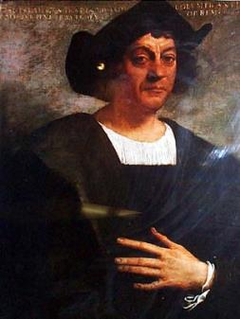
Christopher Columbus
“Our Lord opened to my understanding (I could sense his hand upon me) so it became clear to me that the voyage was feasible…All those who heard of my enterprise rejected it with laughter, scoffing at me . . .Who doubts this illumination was from the Holy Spirit? I attest that He, with marvelous rays of light, consoled me with the holy and sacred Scriptures . . .”

Slide 51
Christopher Columbus
. . .“they inflame me with a sense of great urgency…No one should be afraid to take on any enterprise in the name of the savior if it is right and if the purpose is purely for His holy service . . .And I say that the sign that convinces me that our Lord is hastening the end of the world is the preaching of the Gospel in so many distant lands.”
Columbus, Book of Prophecies, trans. Kay Brigham, 178-79, 182-83.

Slide 52
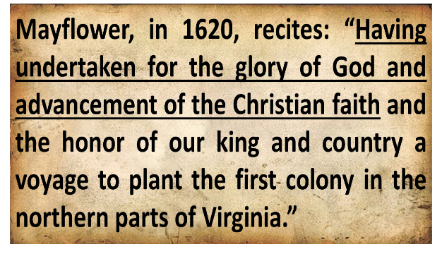
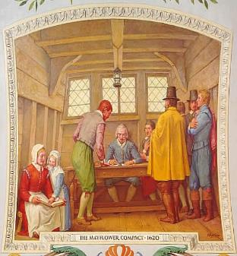
Mayflower Compact (1620)
David Brewer, United States A Christian Nation, 14

Slide 53
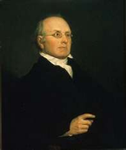
“Probably at the time of the adoption of the Constitution, and of the amendment to it now under consideration [the First Amendment], the general if not the universal sentiment in America was, that Christianity ought to receive encouragement from the state so far as it was not incompatible with the private rights of conscience and the freedom of religious worship. An attempt to level all religions, and to make it a matter of state policy to hold all in utter indifference, would have created universal disapprobation, if not universal indignation” (underlining mine).
Joseph Story, Commentaries on the Constitution of the United States: With a Preliminary Review of the Constitutional History of the Colonies and the States before the Adoption of the Constitution, 5th ed., 2 vols., ed. Melville M. Bigelow (Boston, MA: Little and Brown, 1891; reprint, Buffalo, NY: Hein, 1994), 2:630-31.

Slide 54
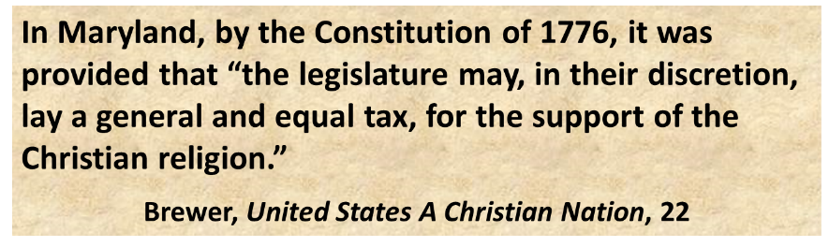
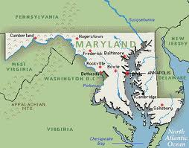
Maryland Constitution (1776)

Slide 55

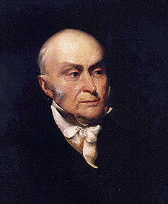
John Quincy Adams
“The birth-day of the nation is indissolubly linked with the birth-day of the Saviour [and] forms a leading event in the progress of the gospel dispensation…the Declaration of Independence first organized the social compact on the foundation of the Redeemer’s mission upon the earth [and] laid the corner stone of human government upon the first precepts of Christianity.”
John Quincy Adams, An Oration Delivered before the Inhabitants of the Town of Newburyport at Their Request on the Sixty-First Anniversary of the Declaration of Independence (Newburyport: Whipple, 1837), 5-6.
55

Slide 56
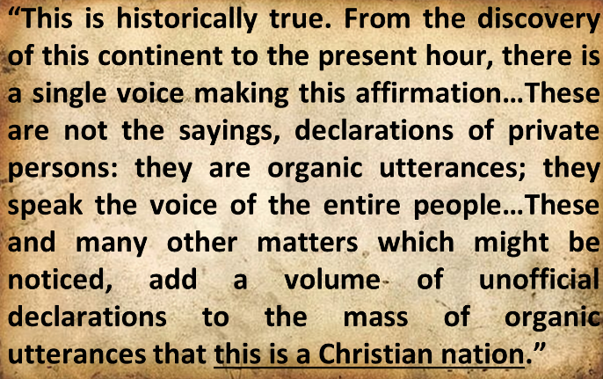
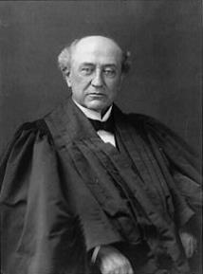
America is a “Christian Nation”
Church of the Holy Trinity v. U.S., 143 U.S. 457, 465, 470-71 (1892)

Slide 57

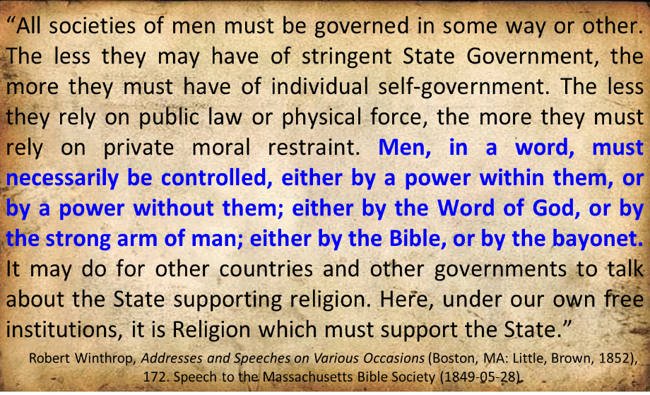
Robert Charles Winthrop

Slide 58

Thomas Jefferson
"My views ... are the result of a life of inquiry and reflection, and very different from the anti-Christian system imputed to me by those who know nothing of my opinions. To the corruptions of Christianity, I am, indeed, opposed; but not to the genuine precepts of Jesus Himself. I am a Christian in the only sense in which He wished any one to be; sincerely attached to his doctrines in preference to all others...His system of morals...if filled up in the style and spirit of the rich fragments He left us, would be the most perfect and sublime that has ever been taught by man...”
On April 21, 1803, Jefferson wrote to Dr. Benjamin Rush, also a signer of the Declaration

Slide 59
Thomas Jefferson
“His moral doctrines...were more pure and perfect than those of the most correct of the philosophers...gathering all into one family under the bonds of love, charity, peace, common wants and common aids. A development of this head will evince the peculiar superiority of the system of Jesus over all others. The precepts of philosophy, and of the Hebrew code, laid hold of actions only. He pushed his scrutinies into the heart of man; erected his tribunal in the region of his thoughts, and purified the waters at the fountain head.”
On April 21, 1803, Jefferson wrote to Dr. Benjamin Rush, also a signer of the Declaration

Slide 60
Baker Faces Prison for Refusing to Bake Same-Sex Wedding Cake
“Jack Phillips is a baker who declined to bake a wedding cake for a same-sex couple because his Christian belief is that marriage exists only between a man and woman. Now a Colorado judge has ordered him to bake cakes for same-sex marriages, and if Phillips refuses, he could go to jail.”
Ken Klukowski, “Baker Faces Prison for Refusing to Bake Same-Sex Wedding Cake,” online: http://www.breitbart.com/Big-Government/2013/12/12/Christian-Baker-Willing-to-Go-to-Jail-for-Declining-Gay-Wedding-Cake, 12 December 2013, accessed 16 May 2014.

Slide 61
The Principles that Made America Great
Bible as the Source of Authority Principle (Isa. 40:8)
God-Given Rights Principle (Gen. 1:27)
Recognition of Human Depravity Principle (Gen. 8:21)
Non-New World Order Principle (Gen. 11:6)
Cooperation with Christianity Principle (Prov. 14:34)
Christian Education Principle (Deut. 6:6-7)
Christian Consensus Principle (Prov. 29:2)
Heterosexual Monogamy Principle (Gen. 2:24)
Economic Justice Principle (Gen. 3:19)
Pro-Israel Principle (Gen. 12:3)
Prayer Principle (Prov. 21:1)

Slide 62
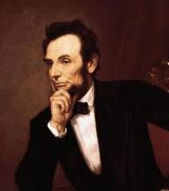
Cited in Mark A. Beliles and Stephen K. McDowell, America's Providential History (Charlottesville, VA: Providence, 1989), 95.
“The philosophy of the school room in one generation will be the philosophy of government in the next.”

Slide 63
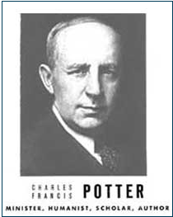
Humanist Proselytizing
“Education is thus a most powerful ally of Humanism, and every public school is a school of Humanism. What can the theistic Sunday-schools, meeting for an hour once a week, and teaching only a fraction of the children, do to stem the tide of a five-day program of humanistic teaching?”
Charles Francis Potter, Humanism: A New Religion (New York: Simon and Schuster, 1930), 128

Slide 64
Yoram Ettinger
“Iran's School Textbooks‒Can Congress Afford to Ignore It?,” online: http://theettingerreport.com/Iran-and-MidEast/Iran-s-School-Textbooks-%E2%80%93-can-Congress-afford-to-i.aspx, May 29, 2015, accessed 30 May 2015.
“Iranian school textbooks, such as The Qur'an and Life (Grade 12, p. 125) prepare Iranian children for the Ayatollahs' sublime goal: the apocalyptic, horrifying, millenarian, military battle against the USA and other "arrogant oppressors of the world," which are ostensibly led by "idolatrous devils." While the "savior" – the infallible, immortal, divinely ordained and eventual global leader, the Mahdi – has not surfaced yet, Iranian children are taught that the battle is already raging throughout the world, awaiting their sacrifice. School textbooks of Western democracies are the most authentic reflection of peoples' values and worldview. School textbooks of tyrannies are the most authentic reflection of the nature and mission of the regimes. Iranian school textbooks reflect the strategy and tactics of the Ayatollahs, much more authentically than speeches, interviews, diplomatic statements and conversations conducted by President Rouhani and Foreign Minister Zarif.”

Slide 65
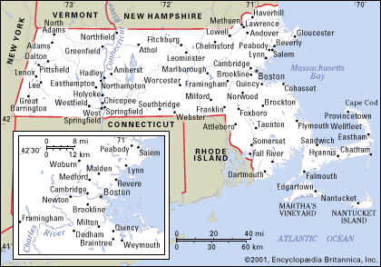
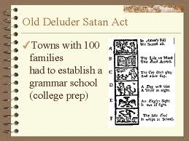
Old Satan Deluder Law: 1642 Massachusetts
“It being one chief project of that old deluder, Satan, to keep men from the knowledge of the Scriptures, as in former time…It is therefore ordered…that after the Lord hath increased the settlement…they shall…appoint one within their town, to teach all such children to read…they shall set up a grammar school to instruct youths…”
Church of the Holy Trinity v. U.S., 143 U.S. 457, 467 (1892)

Slide 66
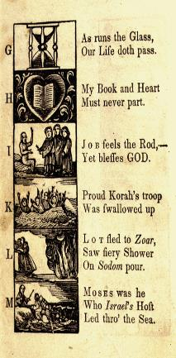
New England Primer
A: “In Adam’s fall we sinned all.”
C: Christ crucify’d for sinners dy’d.”
D: “The deluge drown’d the earth around.”
J: Job feels the rod, yet blesses God
N: “Noah did view the old world & new.”
Z: “Zaccheus he did climb the tree our Lord to see.”
New England Primer, 1737

Slide 67

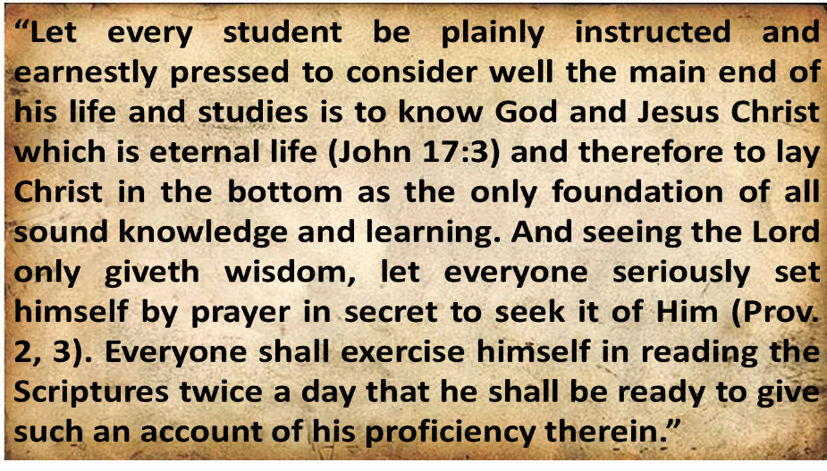
Harvard University
Rules of Harvard in 1636; quoted in David Barton, Original Intent, 81

Slide 68

Scripture and Psychological Damage
“But if portions of the New Testament were read without explanation, they could be, and in his specific experience with children Dr. Grayzel observed, had been, psychologically harmful to the child and had caused a divisive force within the social media of the school.”
School District of Abington Township v. Schempp, 374 U.S. 203, 209 (1963).

Slide 69
The Principles that Made America Great
Bible as the Source of Authority Principle (Isa. 40:8)
God-Given Rights Principle (Gen. 1:27)
Recognition of Human Depravity Principle (Gen. 8:21)
Non-New World Order Principle (Gen. 11:6)
Cooperation with Christianity Principle (Prov. 14:34)
Christian Education Principle (Deut. 6:6-7)
Christian Consensus Principle (Prov. 29:2)
Heterosexual Monogamy Principle (Gen. 2:24)
Economic Justice Principle (Gen. 3:19)
Pro-Israel Principle (Gen. 12:3)
Prayer Principle (Prov. 21:1)

Slide 70
John Adams
John Adams - America's second President "Because we have no government armed with power capable of contending with human passions unbridled by morality and religion, avarice, ambition, revenge or galantry, would break the strongest cords of our Constitution as a whale goes through a net. Our Constitution was made only for a moral and religious People. It is wholly inadequate to the government of any other."
From John Adams to Massachusetts Militia, 11 October 1798
https://founders.archives.gov/documents/Adams/99-02-02-3102

Slide 71
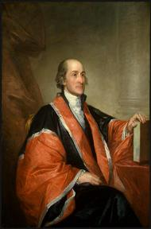
John Jay
“Providence has given to our people the choice of their rulers, and it is the duty, as well as the privilege and interest of our Christian nation to select and prefer Christians for their rulers.”
William Jay, The Life of John Jay (New York: J. & J. Harper, 1833), Vol. II, p. 376, to John Murray Jr. on October 12, 1816.

Slide 72

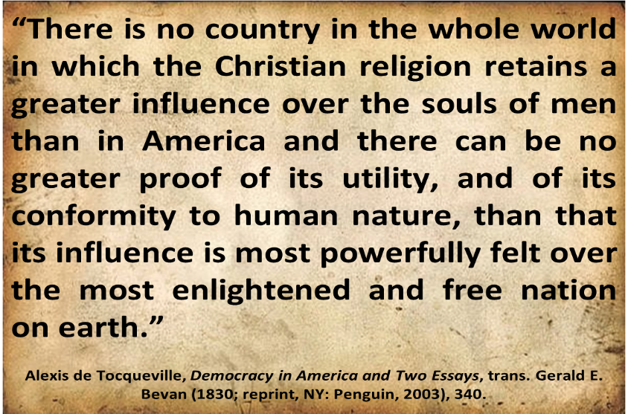
Alexis de Tocqueville

Slide 73
Alexis de Tocqueville
“Upon my arrival in the United States, the religious aspect of the country was the first thing that struck my attention; and the longer I stayed there, the more I did perceive the great political consequences resulting from the state of things, to which I was unaccustomed. In France I had almost always seen the spirit of religion and the spirit of freedom pursuing courses diametrically opposed to each other, but in America I found that they were intimately united, and that they reigned in common over the same country.”
Alexis de Tocqueville, Democracy in America, 345.

Slide 74
Alexis de Tocqueville
“The Americans combine the notions of Christianity and of liberty so intimately in their minds, that is impossible to make them conceive the one without the other.”
Alexis de Tocqueville, Democracy in America, 343.

Slide 75
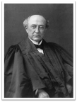
American Population (1890)
“In other words, about one-third of the entire population were directly connected with Christian organizations… and yet it is clear that there is an identification of the great mass of American citizens with the Christian church.”
Brewer, United States A Christian Nation, 37-38

Slide 76
The Principles that Made America Great
Bible as the Source of Authority Principle (Isa. 40:8)
God-Given Rights Principle (Gen. 1:27)
Recognition of Human Depravity Principle (Gen. 8:21)
Non-New World Order Principle (Gen. 11:6)
Cooperation with Christianity Principle (Prov. 14:34)
Christian Education Principle (Deut. 6:6-7)
Christian Consensus Principle (Prov. 29:2)
Heterosexual Monogamy Principle (Gen. 2:24)
Economic Justice Principle (Gen. 3:19)
Pro-Israel Principle (Gen. 12:3)
Prayer Principle (Prov. 21:1)

Slide 77
Genesis 1:26-28
“²⁶ Then God said, “Let Us make man in Our image, according to Our likeness; and let them rule over the fish of the sea and over the birds of the sky and over the cattle and over all the earth, and over every creeping thing that creeps on the earth.” ²⁷ God created man in His own image, in the image of God He created him; male and female He created them. ²⁸ God blessed them; and God said to them, “Be fruitful and multiply, and fill the earth, and subdue it; and rule over the fish of the sea and over the birds of the sky and over every living thing that moves on the earth.”

Slide 78
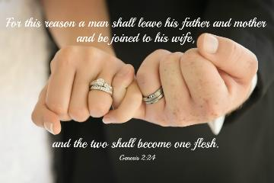
Genesis 2:24
“For this reason a man shall leave his father and his mother, and be joined to his wife; and they shall become one flesh.”

Slide 79
Matthew 19:3-6
“³ Some Pharisees came to Jesus, testing Him and asking, “Is it lawful for a man to divorce his wife for any reason at all?” ⁴ And He answered and said, “Have you not read that He who created them from the beginning made them male and female, ⁵ and said, ‘For this reason a man shall leave his father and mother and be joined to his wife, and the two shall become one flesh’? ⁶ So they are no longer two, but one flesh. What therefore God has joined together, let no man separate.”

Slide 80
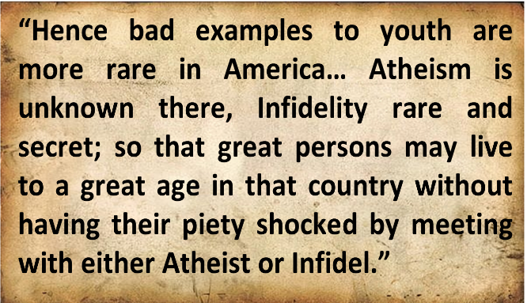
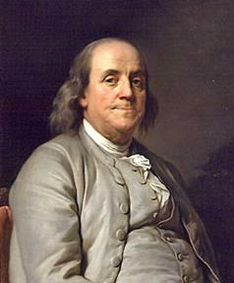
Benjamin Franklin
Benjamin Franklin, “Advice on Coming to America,” America in Person, ed. George D. Youstra, 109.

Slide 81
The Principles that Made America Great
Bible as the Source of Authority Principle (Isa. 40:8)
God-Given Rights Principle (Gen. 1:27)
Recognition of Human Depravity Principle (Gen. 8:21)
Non-New World Order Principle (Gen. 11:6)
Cooperation with Christianity Principle (Prov. 14:34)
Christian Education Principle (Deut. 6:6-7)
Christian Consensus Principle (Prov. 29:2)
Heterosexual Monogamy Principle (Gen. 2:24)
Economic Justice Principle (Gen. 3:19)
Pro-Israel Principle (Gen. 12:3)
Prayer Principle (Prov. 21:1)

Slide 82

Genesis 3:19
“By the sweat of your face You will eat bread, Till you return to the ground, Because from it you were taken; For you are dust, And to dust you shall return.”

Slide 83
2 Thessalonians 3:10
“For even when we were with you, we used to give you this order: if anyone is not willing to work, then he is not to eat, either.”

Slide 84
The Principles that Made America Great
Bible as the Source of Authority Principle (Isa. 40:8)
God-Given Rights Principle (Gen. 1:27)
Recognition of Human Depravity Principle (Gen. 8:21)
Non-New World Order Principle (Gen. 11:6)
Cooperation with Christianity Principle (Prov. 14:34)
Christian Education Principle (Deut. 6:6-7)
Christian Consensus Principle (Prov. 29:2)
Heterosexual Monogamy Principle (Gen. 2:24)
Economic Justice Principle (Gen. 3:19)
Pro-Israel Principle (Gen. 12:3)
Prayer Principle (Prov. 21:1)

Slide 85
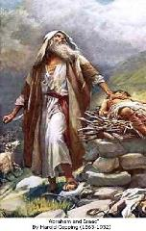
Genesis 12:3
“And I will bless those who bless you, And the one who curses you I will curse. And in you all the families of the earth will be blessed.”

Slide 86

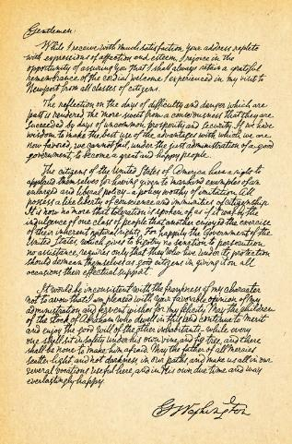
George Washington’s Letter to the Hebrew Congregation of Newport, Rhode Island, August 18, 1790
"I rejoice in the opportunity of assuring you, that I shall always retain a grateful remembrance of the cordial welcome I experienced in my visit to Newport...the Government of the United States, which gives to bigotry no sanction, to persecution no assistance...May the Children of the Stock of Abraham, who dwell in this land, continue to merit and enjoy the good will of the other Inhabitants; while every one shall sit in safety under his own vine and fig tree, and there shall be none to make him afraid."

Slide 87
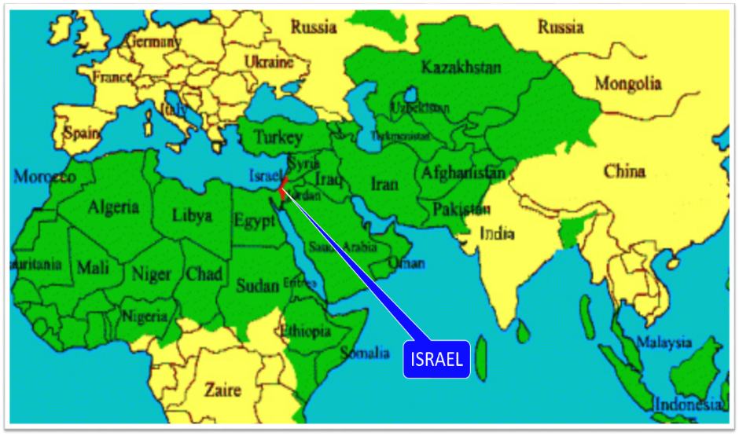

Slide 88
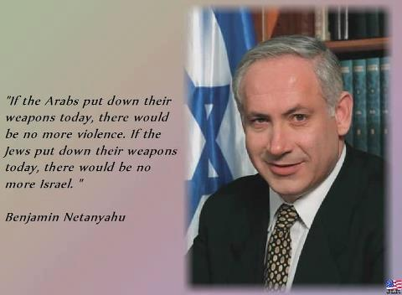

Slide 89
The Principles that Made America Great
Bible as the Source of Authority Principle (Isa. 40:8)
God-Given Rights Principle (Gen. 1:27)
Recognition of Human Depravity Principle (Gen. 8:21)
Non-New World Order Principle (Gen. 11:6)
Cooperation with Christianity Principle (Prov. 14:34)
Christian Education Principle (Deut. 6:6-7)
Christian Consensus Principle (Prov. 29:2)
Heterosexual Monogamy Principle (Gen. 2:24)
Economic Justice Principle (Gen. 3:19)
Pro-Israel Principle (Gen. 12:3)
Prayer Principle (Prov. 21:1)

Slide 90

1 Timothy 2:1-4
“¹ Therefore I exhort first of all that supplications, prayers, intercessions, and giving of thanks be made for all men, ² for kings and all who are in authority, that we may lead a quiet and peaceable life in all godliness and reverence. ³ For this is good and acceptable in the sight of God our Savior, ⁴ who desires all men to be saved and to come to the knowledge of the truth.”
90

Slide 91

Benjamin Franklin
“In the beginning of the contest with Britain, when we were sensible of danger, we had daily prayers in this room for the divine protection. Our prayers, Sir, were heard-and they were graciously answered…I therefore beg leave to move that, henceforth, prayers imploring the assistance of heaven and its blessings on our deliberations be held in this assembly every morning before we proceed to business, and that one or more of the clergy of this city be requested to officiate in that service.”
Benjamin Franklin, June 28, 1787; quoted by Albert Henry Smyth, ed., The Writings of Benjamin Franklin (New York: The Macmillan Company, 1905-7), IX:600-1.

Slide 92
Conclusion

Slide 93
The Principles that Made America Great
Bible as the Source of Authority Principle (Isa. 40:8)
God-Given Rights Principle (Gen. 1:27)
Recognition of Human Depravity Principle (Gen. 8:21)
Non-New World Order Principle (Gen. 11:6)
Cooperation with Christianity Principle (Prov. 14:34)
Christian Education Principle (Deut. 6:6-7)
Christian Consensus Principle (Prov. 29:2)
Heterosexual Monogamy Principle (Gen. 2:24)
Economic Justice Principle (Gen. 3:19)
Pro-Israel Principle (Gen. 12:3)
Prayer Principle (Prov. 21:1)

Slide 94

“The Lord bless you and keep you; the Lord make his face shine on you and be gracious to you; the Lord turn his face toward you and give you peace.” (NIV)

