Slide 1
HOW TO FIND JOY IN THE CHRISTIAN LIFE

Slide 2
Answering Ten Questions
Who wrote it? – Paul
To Whom was it written? – The Believers at Philippi
Where was it written from? – Rome
When was it written? – A.D. 62
What was the book’s occasion? – Five contacts
Who are the opponents? – Four opponents threatening joy
What is the book’s purpose? – To give joy during adversity
How is it organized (outline)? – Four- part outline
What is it about? – Joy during adverstiy
What makes the book different? – Personal & informal

Slide 3
Outline
Ch 1 – God can use negative circumstances to bring about positive results
Ch 2 – Christ’s example of servanthood
Ch 3 – Avoiding legalism
Ch 4 – Reliance upon Christ’s strength for daily life

Slide 4
Outline
Ch 1 – God can use negative circumstances to bring about positive results
Ch 2 – Christ’s example of servanthood
Ch 3 – Avoiding legalism
Ch 4 – Reliance upon Christ’s strength for daily life

Slide 5
4 Positive Results of Imprisonment (Phil. 1:12-30)
Captive audience (Phil. 1:12-13)
Church’s boldness in preaching (Phil. 1:14-18)
Greater prayer (Phil. 1:19)
Protection from martyrdom (Phil. 1:20-26)

Slide 6
Outline
Ch 1 – God can use negative circumstances to bring about positive results
Ch 2 – Christ’s example of servanthood
Ch 3 – Avoiding legalism
Ch 4 – Reliance upon Christ’s strength for daily life

Slide 7
4 Examples of Humble Service
(Phil. 2)
Christ (Phil. 2:5-16)
Paul (Phil. 2:17-18)
Timothy (Phil. 2:19-24)
Epaphroditus (Phil. 2:25-30)

Slide 8
Outline
Ch 1 – God can use negative circumstances to bring about positive results
Ch 2 – Christ’s example of servanthood
Ch 3 – Avoiding legalism
Ch 4 – Reliance upon Christ’s strength for daily life

Slide 9
Avoid Legalism
(Phil. 3)
Legalists vs. true believers (Phil. 3:1-3)
Paul’s transition away from legalism (Phil. 3:4-14)
Other items to embrace in lieu of legalism (Phil. 3:15–4:3)

Slide 10
Outline
Ch 1 – God can use negative circumstances to bring about positive results
Ch 2 – Christ’s example of servanthood
Ch 3 – Avoiding legalism
Ch 4 – Reliance upon Christ’s strength for daily life

Slide 11
Draw Upon the Divine Resources for Daily life (Phil. 4)
Peace (Phil. 4:4-9)
Contentment (Phil. 4:10-13)
Provision (Phil. 4:14-19)

Slide 12
Draw Upon the Divine Resources for Daily life (Phil. 4)
Peace (Phil. 4:4-9)
Contentment (Phil. 4:10-13)
Provision (Phil. 4:14-19)

Slide 13
Draw Upon the Divine Resources for Daily life (Phil. 4)
Peace (Phil. 4:4-9)
Contentment (Phil. 4:10-13)
Provision (Phil. 4:14-19)

Slide 14
Draw Upon the Divine Resources for Daily life (Phil. 4)
Peace (Phil. 4:4-9)
Contentment (Phil. 4:10-13)
Provision (Phil. 4:14-19)

Slide 15
Provision (Phil. 4:14–19)
Paul’s Thankfulness for Generosity (Phil. 4:14-16)
God’s Reward for Generosity (Phil. 4:17)
Sacrificial Worship = Generosity (Phil. 4:18)
God’s provision for generosity (Phil. 4:19)

Slide 16
Provision (Phil. 4:14–19)
Paul’s Thankfulness for Generosity (Phil. 4:14-16)
God’s Reward for Generosity (Phil. 4:17)
Sacrificial Worship = Generosity (Phil. 4:18)
God’s provision for generosity (Phil. 4:19)

Slide 17
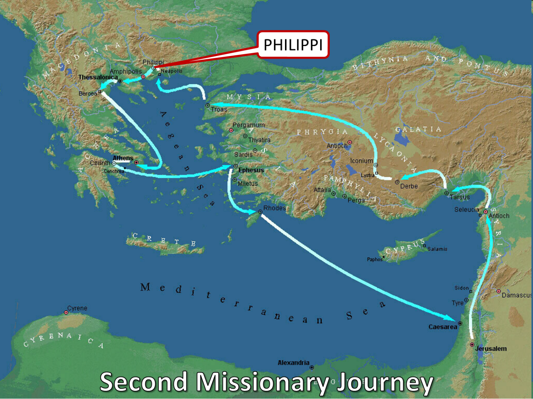

Slide 18
Provision (Phil. 4:14–19)
Paul’s Thankfulness for Generosity (Phil. 4:14-16)
God’s Reward for Generosity (Phil. 4:17)
Sacrificial Worship = Generosity (Phil. 4:18)
God’s provision for generosity (Phil. 4:19)

Slide 19
God’s Reward for the Giver (Phil. 4:17)
Proverbs 11:24-25
Luke 6:38
Acts 20:7
Hebrews 11:6

Slide 20
Provision (Phil. 4:14–19)
Paul’s Thankfulness for Generosity (Phil. 4:14-16)
God’s Reward for Generosity (Phil. 4:17)
Sacrificial Worship = Generosity (Phil. 4:18)
God’s provision for generosity (Phil. 4:19)

Slide 21
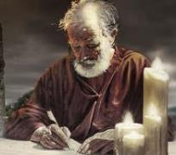
Occasion
News of Paul’s imprisonment reaches Philippi
Epaphroditus comes from Philippi to Rome
Word of Epaphroditus’ sickness reaches Philippi
Some Philippians came to Rome to express concern over Epaphroditus’ condition
Epaphroditus returns to Philippi

Slide 22
Spiritual Sacrifices
Body – Rom. 12:1
Praise – Heb. 13:15
Good works – Phil. 2:17; 4:18
Financial giving – Heb. 13:16

Slide 23
Provision (Phil. 4:14–19)
Paul’s Thankfulness for Generosity (Phil. 4:14-16)
God’s Reward for Generosity (Phil. 4:17)
Sacrificial Worship = Generosity (Phil. 4:18)
God’s provision for generosity (Phil. 4:19)

Slide 24
God’s Provision for the Giver (Phil. 4:19)
Exodus 16
1 Kings 17:2-6
Psalm 37:25
Matthew 6:25-34

Slide 25
God’s Provision for the Giver (Phil. 4:19)
Exodus 16
1 Kings 17:2-6
Psalm 37:25
Matthew 6:25-34

Slide 26
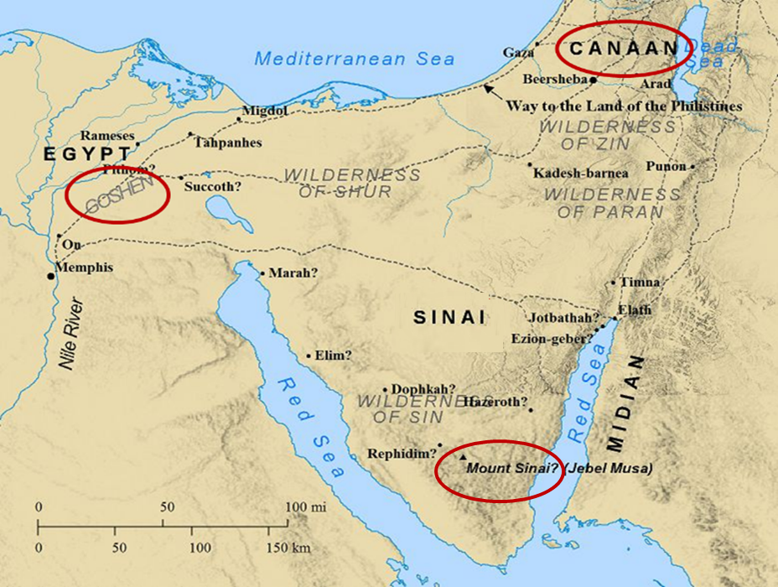

Slide 27
God’s Provision for the Giver (Phil. 4:19)
Exodus 16
1 Kings 17:2-6
Psalm 37:25
Matthew 6:25-34

Slide 28
Genesis 3:19
“By the sweat of your face You will eat bread, Till you return to the ground, Because from it you were taken; For you are dust, And to dust you shall return.”

Slide 29
2 Thessalonians 3:10
“For even when we were with you, we used to give you this order: if anyone is not willing to work, then he is not to eat, either.”

Slide 30
God’s Provision for the Giver (Phil. 4:19)
Exodus 16
1 Kings 17:2-6
Psalm 37:25
Matthew 6:25-34

Slide 31
God’s Provision for the Giver (Phil. 4:19)
Exodus 16
1 Kings 17:2-6
Psalm 37:25
Matthew 6:25-34

Slide 32
Provision (Phil. 4:14–19)
Paul’s Thankfulness for Generosity (Phil. 4:14-16)
God’s Reward for Generosity (Phil. 4:17)
Sacrificial Worship = Generosity (Phil. 4:18)
God’s provision for generosity (Phil. 4:19)

Slide 33
Conclusion (Phil. 4:20–23)
Doxology (Phil. 4:20)
Greeting (Phil. 4:21-22)
Benediction (Phil. 4:23)

Slide 34
Conclusion (Phil. 4:20–23)
Doxology (Phil. 4:20)
Greeting (Phil. 4:21-22)
Benediction (Phil. 4:23)

Slide 35
Dispensational Theology is a System of Theology
Traditional-normative dispensational theology is a system that embodies three essential, fundamental concepts called the sine qua non (lit. “without which is not”):
The consistent use of a plain, normal, literal, grammatical-historical method of interpretation;
Which reveals that the Church is distinct from Israel;
God’s overall purpose is to bring glory to Himself (Eph. 1:6, 12, 14).
Dr. Charles Ryrie, Dispensationalism, pp. 38-41

Slide 36
Doxological Purpose
God’s ultimate purpose for the ages is to glorify Himself. Scripture is not human-centered, as though salvation were the principle point, but God-centered, because His glory is at the center.
The glory of God is the primary principle that unifies all dispensations, the program of salvation being just one of the means by which God glorifies Himself. Each successive revelation of God’s plan for the ages, as well as His dealing with the elect, non-elect, angels, and nations all manifest His glory.
Dictionary of Premillennial Theology, Charles Ryrie, p. 94

Slide 38
Westminster Shorter Catechism
Q. 1. What is the chief end of man?
A. Man’s chief end is to glorify God, and to enjoy Him forever.

Slide 39
Conclusion (Phil. 4:20–23)
Doxology (Phil. 4:20)
Greeting (Phil. 4:21-22)
Benediction (Phil. 4:23)

Slide 40
Conclusion (Phil. 4:20–23)
Doxology (Phil. 4:20)
Greeting (Phil. 4:21-22)
Benediction (Phil. 4:23)

Slide 41
Conclusion

Slide 42
Message
Joy in the midst of adverse circumstances is possible as believers understand that God uses adversity to bring about positive results, follow Christ's example of servanthood, avoid legalism, and draw upon divine resources for daily life

Slide 43
Outline
CHAPTER 1
God can use negative circumstances to bring about positive results
CHAPTER 2
Christ’s example of servanthood
CHAPTER 3
Avoiding legalism
CHAPTER 4
Reliance upon Christ’s strength for daily life

Slide 44
“The Lord bless you and keep you; the Lord make his face shine on you and be gracious to you; the Lord turn his face toward you and give you peace.” (NIV)

