Slide 1
HOW TO FIND JOY IN THE CHRISTIAN LIFE

Slide 2
Answering Ten Questions
Who wrote it? – Paul
To Whom was it written? – The Believers at Philippi
Where was it written from? – Rome
When was it written? – A.D. 62
What was the book’s occasion? – Five contacts
Who are the opponents? – Four opponents threatening joy
What is the book’s purpose? – To give joy during adversity
How is it organized (outline)? – Four- part outline
What is it about? – Joy during adverstiy
What makes the book different? – Personal & informal

Slide 3
Outline
Ch 1 – God can use negative circumstances to bring about positive results
Ch 2 – Christ’s example of servanthood
Ch 3 – Avoiding legalism
Ch 4 – Reliance upon Christ’s strength for daily life

Slide 4
Outline
Ch 1 – God can use negative circumstances to bring about positive results
Ch 2 – Christ’s example of servanthood
Ch 3 – Avoiding legalism
Ch 4 – Reliance upon Christ’s strength for daily life

Slide 5
4 Positive Results of Imprisonment (Phil. 1:12-30)
Captive audience (Phil. 1:12-13)
Church’s boldness in preaching (Phil. 1:14-18)
Greater prayer (Phil. 1:19)
Protection from martyrdom (Phil. 1:20-26)

Slide 6
Outline
Ch 1 – God can use negative circumstances to bring about positive results
Ch 2 – Christ’s example of servanthood
Ch 3 – Avoiding legalism
Ch 4 – Reliance upon Christ’s strength for daily life

Slide 7
4 Examples of Humble Service
(Phil. 2)
Christ (Phil. 2:5-16)
Paul (Phil. 2:17-18)
Timothy (Phil. 2:19-24)
Epaphroditus (Phil. 2:25-30)

Slide 8
Outline
Ch 1 – God can use negative circumstances to bring about positive results
Ch 2 – Christ’s example of servanthood
Ch 3 – Avoiding legalism
Ch 4 – Reliance upon Christ’s strength for daily life

Slide 9
Avoid Legalism
(Phil. 3)
Legalists vs. true believers (Phil. 3:1-3)
Paul’s transition away from legalism (Phil. 3:4-14)
Other items to embrace in lieu of legalism (Phil. 3:15–4:3)

Slide 10
Outline
Ch 1 – God can use negative circumstances to bring about positive results
Ch 2 – Christ’s example of servanthood
Ch 3 – Avoiding legalism
Ch 4 – Reliance upon Christ’s strength for daily life

Slide 11
Draw Upon the Divine Resources for Daily life (Phil. 4)
Peace (Phil. 4:4-9)
Contentment (Phil. 4:10-13)
Provision (Phil. 4:14-19)

Slide 12
Draw Upon the Divine Resources for Daily life (Phil. 4)
Peace (Phil. 4:4-9)
Contentment (Phil. 4:10-13)
Provision (Phil. 4:14-19)

Slide 13
Peace (Phil. 4:4–9)
Prerequisites for Peace (Phil. 4:4-6)
Presence of Peace (Phil. 4:7)
Protection of Peace (Phil. 4:8-9)

Slide 14
I. Prerequisites for Peace (Phil. 4:4–6)
Joy (Phil. 4:4)
Gentleness (Phil. 4:5a)
Awareness of God’s nearness (Phil. 4:5b)
Prayer (6)

Slide 15
III. Protection of Peace (Phil. 4:8–9)
Content of a Disciplined Thought Life (Phil. 4:8)
Practice of a Disciplined Though Life (Phil. 4:9)

Slide 16
Draw Upon the Divine Resources for Daily life (Phil. 4)
Peace (Phil. 4:4-9)
Contentment (Phil. 4:10-13)
Christ promises to meet financial needs (Phil. 4:14-19)

Slide 17
Contentment (Phil. 4:10–13)
Paul rejoices (Phil. 4:10)
Paul’s contentment (Phil. 4:11-12)
Paul’s source (Phil. 4:13)

Slide 18
Contentment (Phil. 4:10–13)
Paul rejoices (Phil. 4:10)
Paul’s contentment (Phil. 4:11-12)
Paul’s source (Phil. 4:13)

Slide 19
Philippians 4:10
“But I rejoiced in the Lord greatly, that now at last you have revived your concern for me; indeed, you were concerned before, but you lacked opportunity.”

Slide 20
Philippians 4:10
“But I rejoiced in the Lord greatly, that now at last you have revived your concern for me; indeed, you were concerned before, but you lacked opportunity.”

Slide 21
Philippians 4:10
“But I rejoiced in the Lord greatly, that now at last you have revived your concern for me; indeed, you were concerned before, but you lacked opportunity.”

Slide 22
Philippians 4:10
“But I rejoiced in the Lord greatly, that now at last you have revived your concern for me; indeed, you were concerned before, but you lacked opportunity.”

Slide 23
Philippians 4:10
“But I rejoiced in the Lord greatly, that now at last you have revived your concern for me; indeed, you were concerned before, but you lacked opportunity.”

Slide 24
Philippians 4:10
“But I rejoiced in the Lord greatly, that now at last you have revived your concern for me; indeed, you were concerned before, but you lacked opportunity.”

Slide 25
Contentment (Phil. 4:10–13)
Paul rejoices (Phil. 4:10)
Paul’s contentment (Phil. 4:11-12)
Paul’s source (Phil. 4:13)

Slide 26
Philippians 4:11-12
“¹¹ Not that I speak from want, for I have learned to be content in whatever circumstances I am. ¹² I know how to get along with humble means, and I also know how to live in prosperity; in any and every circumstance I have learned the secret of being filled and going hungry, both of having abundance and suffering need.”

Slide 27
Philippians 4:11-12
“¹¹ Not that I speak from want, for I have learned to be content in whatever circumstances I am. ¹² I know how to get along with humble means, and I also know how to live in prosperity; in any and every circumstance I have learned the secret of being filled and going hungry, both of having abundance and suffering need.”

Slide 28
Philippians 4:12
“I know how to get along with humble means, and I also know how to live in prosperity; in any and every circumstance I have learned the secret of being filled and going hungry, both of having abundance and suffering need.”

Slide 29
Revelation 2:9
“I know your tribulation and your poverty (but you are rich), and the blasphemy by those who say they are Jews and are not, but are a synagogue of Satan.”

Slide 30
2 Corinthians 8:2-3
“² that in a great ordeal of affliction their abundance of joy and their deep poverty overflowed in the wealth of their liberality. ³ For I testify that according to their ability, and beyond their ability, they gave of their own accord.”

Slide 31
Philippians 4:11-12
“¹¹ Not that I speak from want, for I have learned to be content [autarkēs] in whatever circumstances I am. ¹² I know how to get along with humble means, and I also know how to live in prosperity; in any and every circumstance I have learned the secret of being filled and going hungry, both of having abundance and suffering need.”

Slide 32
Philippians 4:11-12
“¹¹ Not that I speak from want, for I have learned [manthanō] to be content in whatever circumstances I am. ¹² I know how to get along with humble means, and I also know how to live in prosperity; in any and every circumstance I have learned the secret of being filled and going hungry, both of having abundance and suffering need.”

Slide 33
Philippians 4:11-12
“¹¹ Not that I speak from want, for I have learned to be content in whatever circumstances I am. ¹² I know how to get along with humble means, and I also know how to live in prosperity; in any and every circumstance I have learned the secret [myeō] of being filled and going hungry, both of having abundance and suffering need.”

Slide 34
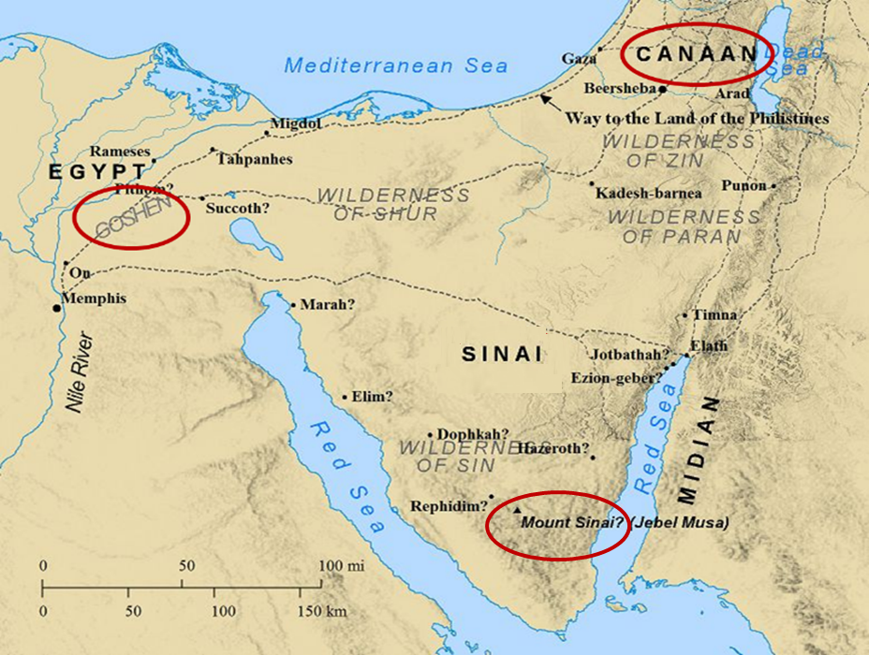

Slide 35
Contentment (Phil. 4:10–13)
Paul rejoices (Phil. 4:10)
Paul’s contentment (Phil. 4:11-12)
Paul’s source (Phil. 4:13)

Slide 36
Philippians 4:13
“I can do all things through Him who strengthens me.”

Slide 37
Philippians 4:13
“I can do all things through Him who strengthens me.”

Slide 38
Philippians 4:13
“I can do all things through Him who strengthens [endynamaoō] me.”

Slide 39
Philippians 4:13
“I can do all things through Him who strengthens me.”

Slide 40
Conclusion

Slide 41
Contentment (Phil. 4:10–13)
Paul rejoices (Phil. 4:10)
Paul’s contentment (Phil. 4:11-12)
Paul’s source (Phil. 4:13)

Slide 42
“The Lord bless you and keep you; the Lord make his face shine on you and be gracious to you; the Lord turn his face toward you and give you peace.” (NIV)

