Slide 1
THE RAPTURE
What and When? – Part 12
Andrew Marshall Woods, Th.M., JD., PhD.
Sr. Pastor, Sugar Land Bible Church

Slide 2
What is the Rapture?
An important doctrine
Distinct from the Second Advent
Catching away of all living believers (1 Thess 4:17)
Reunion (1 Thess 4:14-16)
Resurrection (1 Cor 15:50-54)
Exemption from death (1 Cor 15:51, 54-56)
Instantaneous (1 Cor 15:52)
Mystery (1 Cor 15:51)
Imminent (1 Cor 15:51; 1 Thess 4:15)
Traditional doctrine now being recovered

Slide 3
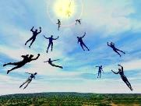
When Will the Rapture Take Place Relative to the Tribulation Period?
Pre-tribulation rapture theory
Mid-tribulation rapture theory
Post-tribulation rapture theory
Pre-wrath rapture theory
Partial rapture theory

Slide 5
When is the Rapture? 7 Arguments Favoring the Pre-Tribulation View
Tribulation's purpose concerns Israel (Jer 30:7; Dan 9:24)
No biblical reference to the church on earth during the Tribulation period (Rev 4-22)
Church is promised an exemption from divine wrath (1 Thess 1:10; 5:9; Rom 5:9; Rev 3:10; 6:17)
Rapture is imminent (1 Cor 15:51; 1 Thess 4:15)
Rapture is a comfort (1 Thess 4:18)
Antichrist cannot come to power until the restrainer is removed (2 Thess 2:6-7)
Symbolic parallels (2 Peter 2:5-9)

Slide 6
Strengthening the Pre-Tribulation Case
John 14:1-4
Revelation 3:10
First Thessalonians 4‒5
Second Thessalonians 2:3a
Matthew 24‒25

Slide 7
Strengthening the Pre-Tribulation Case
John 14:1-4
Revelation 3:10
First Thessalonians 4‒5
Second Thessalonians 2:3a
Matthew 24‒25

Slide 8
Jesus and the Rapture (John 14:1-4)
Andrew Marshall Woods, Th.M., JD., PhD.
Sr. Pastor, Sugar Land Bible Church

Slide 9
John 14:1–4
¹ “Do not let your heart be troubled; believe in God, believe also in Me. ² “In My Father’s house are many dwelling places; if it were not so, I would have told you; for I go to prepare a place for you. ³ “If I go and prepare a place for you, I will come again and receive you to Myself, that where I am, there you may be also. ⁴ “And you know the way where I am going.”

Slide 10
Preview (John 14:1-4)
Preliminary reasons
Exegesis of John 14:1-4
Answering the non-rapture arguments
John 14:1–4
"Do not let your heart be troubled; believe in God, believe also in Me. In My Father's house are many dwelling places; if it were not so, I would have told you; for I go to prepare a place for you. If I go and prepare a place for you, I will come again and receive you to Myself, that where I am, there you may be also. And you know the way where I am going."

Slide 11
Preview (John 14:1-4)
Preliminary reasons
Exegesis of John 14:1-4
Answering the non-rapture arguments
John 14:1–4
"Do not let your heart be troubled; believe in God, believe also in Me. In My Father's house are many dwelling places; if it were not so, I would have told you; for I go to prepare a place for you. If I go and prepare a place for you, I will come again and receive you to Myself, that where I am, there you may be also. And you know the way where I am going."

Slide 12
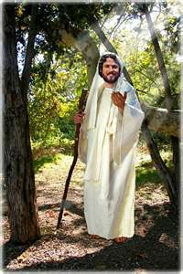
I. Preliminary Reasons
Significance of the Upper Room Discourse (John 13─17)
Eschatological flavor of the Upper Room Discourse
Early church fathers
Jewish marriage analogy
Parallels with other rapture texts

Slide 13
I. Preliminary Reasons
Significance of the Upper Room Discourse (John 13─17)
Eschatological flavor of the Upper Room Discourse
Early church fathers
Jewish marriage analogy
Parallels with other rapture texts

Slide 14
OUTLINE of JOHN
1:1-18 | HEAVENLY GENEALOGY (Explains who Jesus is)
1:19-11:57 | PUBLIC MINISTRY ( 7 signs & discourses)
12:1-50 | TRIUMPHAL ENTRY (public national rejection of Christ-12:37)
13-17 | UPPER ROOM DISCOURSE (new dispensation)
18-21 | PASSION NARRATIVES (crucifixion to resurrection)

Slide 15
OUTLINE of JOHN
1:1-18 | HEAVENLY GENEALOGY (Explains who Jesus is)
1:19-11:57 | PUBLIC MINISTRY ( 7 signs & discourses)
12:1-50 | TRIUMPHAL ENTRY (public national rejection of Christ-12:37)
13-17 | UPPER ROOM DISCOURSE (new dispensation)
18-21 | PASSION NARRATIVES (crucifixion to resurrection)

Slide 16
OUTLINE of JOHN
1:1-18 | HEAVENLY GENEALOGY (Explains who Jesus is)
1:19-11:57 | PUBLIC MINISTRY ( 7 signs & discourses)
12:1-50 | TRIUMPHAL ENTRY (public national rejection of Christ-12:37)
13-17 | UPPER ROOM DISCOURSE (new dispensation)
18-21 | PASSION NARRATIVES (crucifixion to resurrection)

Slide 18
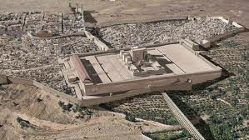
Christ’s Five Trips to Jerusalem
Feast | Verse
Passover | 2:23
Unnamed | 5:1
Tabernacles | 7:2
Dedication | 10:22
Passover | 13:1

Slide 19
OUTLINE of JOHN
1:1-18 | HEAVENLY GENEALOGY (Explains who Jesus is)
1:19-11:57 | PUBLIC MINISTRY ( 7 signs & discourses)
12:1-50 | TRIUMPHAL ENTRY (public national rejection of Christ-12:37)
13-17 | UPPER ROOM DISCOURSE (new dispensation)
18-21 | PASSION NARRATIVES (crucifixion to resurrection)

Slide 20
John 12:37
“But though He had performed so many signs before them, yet they were not believing in Him.”

Slide 21
OUTLINE of JOHN
1:1-18 | HEAVENLY GENEALOGY (Explains who Jesus is)
1:19-11:57 | PUBLIC MINISTRY ( 7 signs & discourses)
12:1-50 | TRIUMPHAL ENTRY (public national rejection of Christ-12:37)
13-17 | UPPER ROOM DISCOURSE (new dispensation)
18-21 | PASSION NARRATIVES (crucifixion to resurrection)

Slide 22
OUTLINE of JOHN
1:1-18 | HEAVENLY GENEALOGY (Explains who Jesus is)
1:19-11:57 | PUBLIC MINISTRY ( 7 signs & discourses)
12:1-50 | TRIUMPHAL ENTRY (public national rejection of Christ-12:37)
13-17 | UPPER ROOM DISCOURSE (new dispensation)
18-21 | PASSION NARRATIVES (crucifixion to resurrection)

Slide 23
Chafer Chafer, Systematic Theology, 1:111.
"The Upper Room Discourse, in which the above passage is found, is the seed-plot of that form of doctrine which is later developed in the Epistles. It is not strange, therefore, that the Apostle Paul takes up this great theme for further elucidation."

Slide 24
Seed Truths (John 13─17)
believers' oneness in Christ (John 17:20-23; Eph 2:11-22)
Spirit's permanent residence in the believer (John 14:16; Eph 4:30)
believer's union with Christ (John 14:20; Gal 2:20; Rom 6:1-14)
believer's opposition to the world (John 15:18-19; Jas 4:4; 1 John 2:15-17)
necessity of believer to stay in fellowship with Christ (John 13:10; 15:1-17; 1 John 1:5-7, 9)

Slide 25
Seed Truths (John 13─17)
abiding in Christ as a prerequisite for fruit bearing (John 15:1-7; Philip 4:13)
believer's election (John 15:16; Eph 1:4)
Christ as the ultimate model of sacrificial living and service (John 13:1-20; Philip 2:5-11)
necessity of divine discipline in the believer's life (John 15:2; Heb 12:5-11)
Satan as the god of this age (John 12:31; 14:30; 16:11; 2 Cor 4:4; Eph 2:2)

Slide 26
Seed Truths (John 13─17)
defeat of Satan at the cross (John 12:31; 16:11; Col 2:15; Heb 2:14)
Spirit as the inspirer of all Scripture (John 14:26; 16:13; 2 Tim 3:16; 2 Pet 1:20-21)
the Spirit as the illuminator of all Scripture (John 14:26; 16:13; 1 Cor 2:14; 1 John 2:20, 27)
Christ's provision of peace in the midst of adversity (John 14:27; Philip 4:7)
necessity of the Sprit's convicting ministry as a prerequisite for salvation (John 16:7-11; 1 Cor 2:14; 2 Cor 4:4)

Slide 27
Seed Truths (John 13─17)
normalcy of tribulations in the present age (John 16:33; Jas 1:2-4)
believer as the ultimate over comer (John 16:33; 1 John 4:4; 5:4-5)
Christ's present session at the Father's right hand (John 14:12-14; 17:5; Heb 7:3b, 25)
power of prayer (John 14:12-14; Eph 6:18-20; Jas 5:16)
inerrancy of Scripture (John 17:20; 2 Tim 3:16)
disclosure of Eschatology (John 16:13; 2 Thess 2:1-12)

Slide 28
A Comparison of the Olivet and Upper Room Discourses
Discourse | Olivet | Upper Room
Scripture | Matt 24─25 | John 13─17
Location | Mount of Olives | Upper Room
Passion week | Third day | Sixth day
General focus | Farewell: Israel | Hello: Church
Specific focus | Israel’s future | Divine provisions
Prompting | Temple's destruction | Christ's imminent departure
Explanations | Written OT | Unwritten NT
Apostles | Israel (Matt. 19:28) | Church (Eph. 2:20)

Slide 29
I. Preliminary Reasons
Significance of the Upper Room Discourse (John 13─17)
Eschatological flavor of the Upper Room Discourse
Early church fathers
Jewish marriage analogy
Parallels with other rapture texts

Slide 30
John’s Eschatological Statements
two final resurrections (John 5:29; Dan 12:2; Acts 24:15; Rev 20:4-5)
Israel's future acceptance of the future Antichrist in lieu of the true Christ (John 5:43; Dan 9:27a)
Christ's promise to preserve and resurrect the believer in the last day (John 6:39-40, 44, 54; 11:25-26)
coming of the Spirit who will disclose "things to come" (John 16:7, 13)

Slide 31
John 20:30-31
³⁰ “Therefore many other signs Jesus also performed in the presence of the disciples, which are not written in this book; ³¹ but these have been written so that you may believe that Jesus is the Christ, the Son of God; and that believing you may have life in His name.”

Slide 32
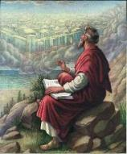
John 21:25
“And there are also many other things which Jesus did, which if they were written in detail, I suppose that even the world itself would not contain the books that would be written.”

Slide 33
I. Preliminary Reasons
Significance of the Upper Room Discourse (John 13─17)
Eschatological flavor of the Upper Room Discourse
Early church fathers
Jewish marriage analogy
Parallels with other rapture texts

Slide 34
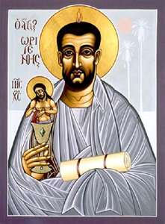
Ante-Nicene Fathers: “Heavenly and Eschatological" Interpretation of John 14:1-4
Papias (AD 110)
Irenaeus (AD 130-202)
Tertullian (AD 196-212)
Origen (AD 182-251)
Cyprian (AD 258)
George A. Gunn, "Jesus and the Rapture: John 14," in Evidence for the Rapture: A Biblical Case for Pretribulationism, ed. John F. Hart (Chicago: Moody, 2015), 104.

Slide 35
Ante-Nicene Fathers: “Heavenly and Eschatological" Interpretation of John 14:1-4
“Interestingly, references to John 14:1-3 virtually disappear when perusing the writings of the Nicene and Post-Nicene fathers. This is a bit surprising, given the abundance of material in these later writers when compared with the Ante-Nicenes. I would assume that with the rise of Augustinian amillennialism and its optimistic interpretation regarding the present arrival of the Kingdom of God, the kind of hope held out in John 14:1-3 ceased to hold relevance.”
George A. Gunn, "Jesus and the Rapture: John 14," in Evidence for the Rapture: A Biblical Case for Pretribulationism, ed. John F. Hart (Chicago: Moody, 2015), 119, n. 22.

Slide 36
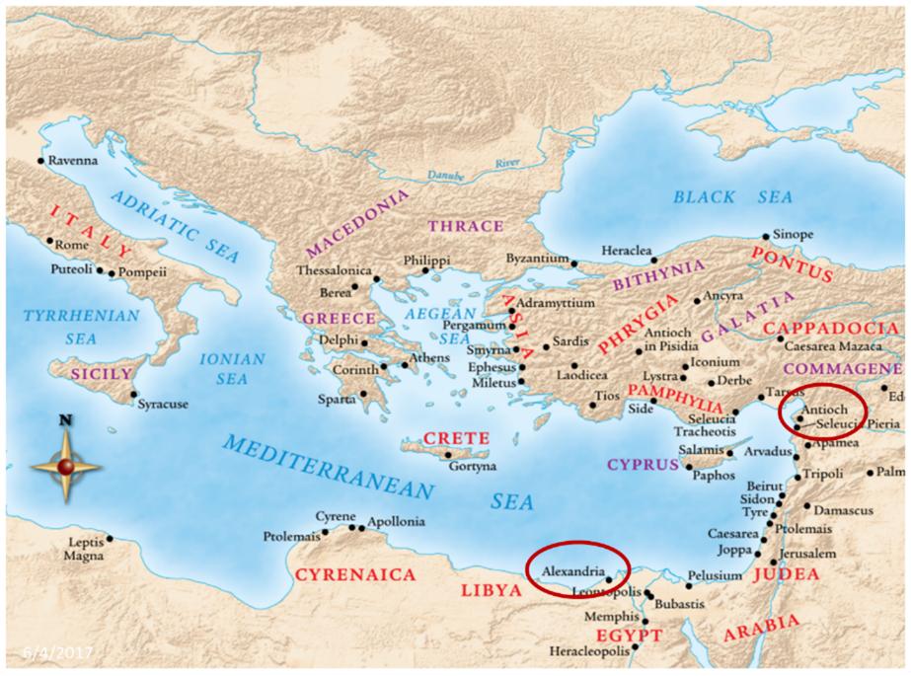

Slide 37
I. Preliminary Reasons
Significance of the Upper Room Discourse (John 13─17)
Eschatological flavor of the Upper Room Discourse
Early church fathers
Jewish marriage analogy
Parallels with other rapture texts

Slide 38
Jewish Marriage Analogy
STEP | JEWISH MARRIAGE | CHURCH ANALOGY
1. Marriage covenant | Groom initiated; Covenant established upon payment for bride; drank same cup | Christ initiated; Christ’s sacrificial death (1 Cor. 6:19-20; 11:25)
2. Bride set apart | Bride set apart exclusively for groom | Church’s positionally sanctified (1 Cor. 1:2; 6:9-11)
3. Bridal chamber prepared | Groom separates from bride and returns to his father’s house to prepare bridal chamber | Christ’s 2000 year separation from church; Ascension; return to heaven to prepare dwellings (John 14:2; Acts 1:9-11)
Showers, Maranatha Our Lord, Come!, 164-69.

Slide 39
Jewish Marriage Analogy
STEP | JEWISH MARRIAGE | CHURCH ANALOGY
1. Marriage covenant | Groom initiated; Covenant established upon payment for bride; drank same cup | Christ initiated; Christ’s sacrificial death (1 Cor. 6:19-20; 11:25)
2. Bride set apart | Bride set apart exclusively for groom | Church’s positionally sanctified (1 Cor. 1:2; 6:9-11)
3. Bridal chamber prepared | Groom separates from bride and returns to his father’s house to prepare bridal chamber | Christ’s 2000 year separation from church; Ascension; return to heaven to prepare dwellings (John 14:2; Acts 1:9-11)
Showers, Maranatha Our Lord, Come!, 164-69.

Slide 40
Jewish Marriage Analogy
STEP | JEWISH MARRIAGE | CHURCH ANALOGY
1. Marriage covenant | Groom initiated; Covenant established upon payment for bride; drank same cup | Christ initiated; Christ’s sacrificial death (1 Cor. 6:19-20; 11:25)
2. Bride set apart | Bride set apart exclusively for groom | Church’s positionally sanctified (1 Cor. 1:2; 6:9-11)
3. Bridal chamber prepared | Groom separates from bride and returns to his father’s house to prepare bridal chamber | Christ’s 2000 year separation from church; Ascension; return to heaven to prepare dwellings (John 14:2; Acts 1:9-11)
Showers, Maranatha Our Lord, Come!, 164-69.

Slide 41
John 14:1–4
¹ “Do not let your heart be troubled; believe in God, believe also in Me. ² “In My Father’s house are many dwelling places; if it were not so, I would have told you; for I go to prepare a place for you. ³ “If I go and prepare a place for you, I will come again and receive you to Myself, that where I am, there you may be also. ⁴ “And you know the way where I am going.”

Slide 42
Jewish Marriage Analogy
STEP | JEWISH MARRIAGE | CHURCH ANALOGY
4. Betrothal period | Loyalty test | Reward determined by orthodoxy and orthopraxy (Jas. 4:4)
5. Bride retrieved | Groom returns at unknown time preceded by a shout with escorts to retrieve bride | Rapture at unknown time (John 14:3; 1 Thess. 4:16-17)
Showers, Maranatha Our Lord, Come!, 164-69.

Slide 43
Jewish Marriage Analogy
STEP | JEWISH MARRIAGE | CHURCH ANALOGY
4. Betrothal period | Loyalty test | Reward determined by orthodoxy and orthopraxy (Jas. 4:4)
5. Bride retrieved | Groom returns at unknown time preceded by a shout with escorts to retrieve bride | Rapture at unknown time (John 14:3; 1 Thess. 4:16-17)
Showers, Maranatha Our Lord, Come!, 164-69.

Slide 44
John 14:1–4
¹ “Do not let your heart be troubled; believe in God, believe also in Me. ² “In My Father’s house are many dwelling places; if it were not so, I would have told you; for I go to prepare a place for you. ³ “If I go and prepare a place for you, I will come again and receive you to Myself, that where I am, there you may be also. ⁴ “And you know the way where I am going.”

Slide 45
Jewish Marriage Analogy
STEP | JEWISH MARRIAGE | CHURCH ANALOGY
6. Bride and groom hidden in Father’s house for seven days | Hidden in the Father’s house for seven days: three events transpire | Church hidden from world during Daniel’s 70th Week
7. Bride cleansed | Bride undergoes ritual cleansing prior to wedding ceremony | Bema Seat Judgment (1 Cor 3:10-15; 2 Cor 5:10)
Showers, Maranatha Our Lord, Come!, 164-69.

Slide 46
Jewish Marriage Analogy
STEP | JEWISH MARRIAGE | CHURCH ANALOGY
6. Bride and groom hidden in Father’s house for seven days | Hidden in the Father’s house for seven days: three events transpire | Church hidden from world during Daniel’s 70th Week
7. Bride cleansed | Bride undergoes ritual cleansing prior to wedding ceremony | Bema Seat Judgment (1 Cor 3:10-15; 2 Cor 5:10)
Showers, Maranatha Our Lord, Come!, 164-69.

Slide 47
Scripture’s Four Judgments
Name | Sheep and Goat | Judgment of the Jews | Bema Seat | Great White Throne
Scripture | Matt 25:31-46 | Ezek 20:33-44 | 1 Cor 3:10-15 | Rev 20:11-15
Place | Earth, Jerusalem | Earth, wilderness | Heaven | Earth
Audience | Gentile Tribulation survivors | Jewish Tribulation survivors | Church Age believers | All unsaved
When | After Tribulation | After Tribulation | After rapture | After Millennium
Purpose | Saved Gentiles enter kingdom | Saved Jews enter kingdom | Reward believers | Degree of punishment in hell
Evaluation | Treatment of Christ’s brethren | Passing under shepherd’s rod | Works taken through fire | Not in the book; judged by books

Slide 48
Scripture’s Five Crowns (Rev 4:10: 3:11; 2 John 8)
SCRIPTURE | CROWN | PURPOSE
1 Cor. 9:24-27 | Incorruptible | Gaining mastery over the flesh
1 Thess. 2:19-20 | Rejoicing | Soul winning
Jas. 1:12; Rev. 2:10 | Life | Enduring trials
1 Pet. 5:2-4 | Glory | Shepherding God’s people
2 Tim. 4:8 | Righteousness | Longing for His appearing

Slide 49
Jewish Marriage Analogy
STEP | JEWISH MARRIAGE | CHURCH ANALOGY
8. Wedding ceremony | Meeting with the Father’s assembled wedding guests; Private wedding ceremony | Meeting with OT saints; Rev 19:7
9. Consummation | Bride and groom consummate the marriage | Eph 5:27
10. Marriage feast | Public presentation; Bride unveiled; marriage feast | Col 3:3-4; Rev 19:9
Showers, Maranatha Our Lord, Come!, 164-69.

Slide 50
Jewish Marriage Analogy
STEP | JEWISH MARRIAGE | CHURCH ANALOGY
8. Wedding ceremony | Meeting with the Father’s assembled wedding guests; Private wedding ceremony | Meeting with OT saints; Rev 19:7
9. Consummation | Bride and groom consummate the marriage | Eph 5:27
10. Marriage feast | Public presentation; Bride unveiled; marriage feast | Col 3:3-4; Rev 19:9
Showers, Maranatha Our Lord, Come!, 164-69.

Slide 51
Jewish Marriage Analogy
STEP | JEWISH MARRIAGE | CHURCH ANALOGY
8. Wedding ceremony | Meeting with the Father’s assembled wedding guests; Private wedding ceremony | Meeting with OT saints; Rev 19:7
9. Consummation | Bride and groom consummate the marriage | Eph 5:27
10. Marriage feast | Public presentation; Bride unveiled; marriage feast | Col 3:3-4; Rev 19:9
Showers, Maranatha Our Lord, Come!, 164-69.

Slide 52
I. Preliminary Reasons
Significance of the Upper Room Discourse (John 13─17)
Eschatological flavor of the Upper Room Discourse
Early church fathers
Jewish marriage analogy
Parallels with other rapture texts

Slide 53
1 Thessalonians 4:13-18
¹³ "But we do not want you to be uninformed, brethren, about those who are asleep, so that you will not grieve as do the rest who have no hope. ¹⁴ For if we believe that Jesus died and rose again, even so God will bring with Him those who have fallen asleep in Jesus. ¹⁵ For this we say to you by the word of the Lord, that we who are alive and remain until the coming of the Lord, will not precede those who have fallen asleep. ¹⁶ For the Lord Himself will descend from heaven with a shout, with the voice of the archangel and with the trumpet of God, and the dead in Christ will rise first. ¹⁷ Then we who are alive and remain will be caught up together with them in the clouds to meet the Lord in the air, and so we shall always be with the Lord. ¹⁸ Therefore comfort one another with these words."

Slide 54
John 14:1–4
¹ “Do not let your heart be troubled; believe in God, believe also in Me. ² “In My Father’s house are many dwelling places; if it were not so, I would have told you; for I go to prepare a place for you. ³ “If I go and prepare a place for you, I will come again and receive you to Myself, that where I am, there you may be also. ⁴ “And you know the way where I am going.”

Slide 55
Parallels
JOHN 14:1-4 | 1 THESS 4:13-18
trouble (1) | sorrow (13)
Believe (1) | believe (14)
God, me (1) | Jesus, God (14)
told you (2) | say to you (15)
come again (3) | coming of the Lord (15)
receive, you (3) | caught up (17)
to myself (3) | to meet the Lord (17)
be where I am (3) | ever be with the Lord (17)
J. B. Smith, A Revelation of Jesus Christ: A Commentary on the Book of Revelation, 311-13

Slide 56
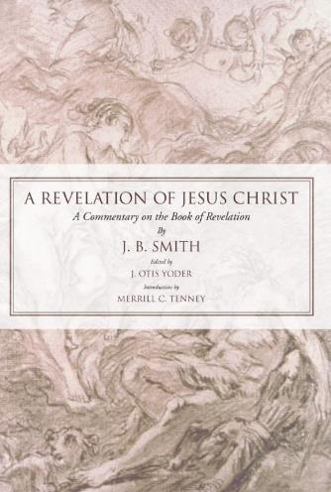
J. B. Smith
A Revelation of Jesus Christ: A Commentary on the Book of Revelation (Scottdale, PA: Herald Press, 1961), pp. 312-13.
“The words or phrases are almost an exact parallel. They follow one another in both passages in exactly the same order. Only the righteous are dealt with in each case. There is not a single irregularity in the progression of words from first to last. Either column takes the believer from the troubles of earth to the glories of heaven.”

Slide 57
J. B. Smith
A Revelation of Jesus Christ: A Commentary on the Book of Revelation (Scottdale, PA: Herald Press, 1961), pp. 312.
“Hence it is impossible that one sentence or even one phrase can be alike in the two lists…And finally not one word in the two lists is used in the same relation or connection...It would be difficult if not impossible to find elsewhere any two important passages of Scripture that are so diverse in the words employed and so opposite in their implications. . . . We believe the comparison of the words of these two passages . . . describe different events.”

Slide 58
1 Thessalonians 4:13-18
¹³ "But we do not want you to be uninformed, brethren, about those who are asleep, so that you will not grieve as do the rest who have no hope. ¹⁴ For if we believe that Jesus died and rose again, even so God will bring with Him those who have fallen asleep in Jesus. ¹⁵ For this we say to you by the word of the Lord, that we who are alive and remain until the coming of the Lord, will not precede those who have fallen asleep. ¹⁶ For the Lord Himself will descend from heaven with a shout, with the voice of the archangel and with the trumpet of God, and the dead in Christ will rise first. ¹⁷ Then we who are alive and remain will be caught up together with them in the clouds to meet the Lord in the air, and so we shall always be with the Lord. ¹⁸ Therefore comfort one another with these words."

Slide 59
Chafer Chafer, Systematic Theology, 1:111.
"The Upper Room Discourse, in which the above passage is found, is the seed-plot of that form of doctrine which is later developed in the Epistles. It is not strange, therefore, that the Apostle Paul takes up this great theme for further elucidation."

Slide 60
I. Preliminary Reasons
Significance of the Upper Room Discourse (John 13─17)
Eschatological flavor of the Upper Room Discourse
Early church fathers
Jewish marriage analogy
Parallels with other rapture texts

Slide 61
Preview (John 14:1-4)
Preliminary reasons
Exegesis of John 14:1-4
Answering the non-rapture arguments
John 14:1–4
"Do not let your heart be troubled; believe in God, believe also in Me. In My Father's house are many dwelling places; if it were not so, I would have told you; for I go to prepare a place for you. If I go and prepare a place for you, I will come again and receive you to Myself, that where I am, there you may be also. And you know the way where I am going."

Slide 62
II. Exegesis of John 14:1-4
vs. 1 – Do not let your heart be troubled; believe in God, believe also in Me.
Christ’s announced departure (13:1)
Comfort (14:1)

Slide 63
II. Exegesis of John 14:1-4
vs. 2 – In My Father's house are many dwelling places…I go to prepare a place for you.
My Father’s house
Many dwellings
I go

Slide 64
II. Exegesis of John 14:1-4
vs. 2 – In My Father's house are many dwelling places…I go to prepare a place for you.
My Father’s house
God’s unique dwelling in heaven (Dt. 26:15; Ps. 33:13-14; Isa. 63:15; Mt. 5:16, 45; 6:1, 9)
Where Christ ascended (Ps 110:1; John 17:5; Rev 3:21)

Slide 65
II. Exegesis of John 14:1-4
vs. 2 – In My Father's house are many dwelling places…I go to prepare a place for you.
Many dwelling places
“Mansions”-mistranslation of Tyndale; KJV from Vulgate
Monē = temporary dwelling place (inn)

Slide 66
Revelation 5:10
“You have made them to be a kingdom and priests to our God; and they will reign [basileuō] upon the earth [gē].”

Slide 67
II. Exegesis of John 14:1-4
vs. 2 – In My Father's house are many dwelling places…I go to prepare a place for you.
I go
Jesus came from (John 16:28; 17:5) and is going back to heaven (John 13:12; 14:12; 16:28)
Poreuomai= Ascension (Acts 1:10-11; 1 Pet 3:22)

Slide 68
II. Exegesis of John 14:1-4
Summary
John 14:2 teaches that Christ will return to the very heaven from which He came in order to prepare temporary dwellings for His disciples.

Slide 69
II. Exegesis of John 14:1-4
vs. 3 – If I go and prepare a place for you, I will come again and receive you to Myself, that where I am, there you may be also.
I will come
Again
And receive you
To
Where

Slide 70
II. Exegesis of John 14:1-4
vs. 3 – “I will come again”
Come
Present tense of erchomai?
Futuristic present
Certainty
Imminence
Common in Johannine literature (1 John 2:18; Rev 2:5, 16; 3:11; 16:15; 22:7, 12, 20)

Slide 71
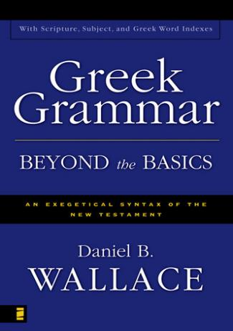
Futuristic Present
“The present tense may be used to describe a future reality...The present tense may describe an event that is wholly subsequent to the time of speaking, although as if it were present...Only an examination of the context will help one see whether this use of the present tense stresses immediacy or certainty.”
Daniel B. Wallace, Greek Grammar Beyond the Basics: Exegetical Syntax of the New Testament (Grand Rapids: Zondervan, 1996), 535-36.

Slide 72
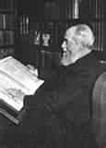
Futuristic Present
“The present tense 'I come' is used rather than the future, for the Return is regarded not as a distant event, but as one ever imminent and at hand.”
Henry Barclay Swete, The Last Discourse and Prayer of Our Lord: A Study of St. John XIV-XVII (London: Macmillian, 1913), 8.

Slide 73
II. Exegesis of John 14:1-4
vs. 3 – “I will come again”
Come
Present tense of erchomai?
Futuristic present
Certainty
Imminence
Common in Johannine literature (1 John 2:18; Rev 2:5, 16; 3:11; 16:15; 22:7, 12, 20)

Slide 74
II. Exegesis of John 14:1-4
vs. 3 – “I will come again”
Again (palin)
"The coming again is the counterpart of the going away; visibly Jesus ascends, visibly he returns, Acts 1:9-11.” (Lenski, p. 974)
"to repetition in the same (or similar) manner, again, once more, anew of someth. a pers. has already done.“ (BDAG, p. 752)

Slide 75
II. Exegesis of John 14:1-4
vs. 3 – “And receive you to myself”
Receive (paralambanō): "to take into close association, take (to oneself), take with/along...I will take you to myself J14:3 ...with me to my home.” (BDAG, p. 767)
To (pros): "pros with the Accusative...This is very common and denotes movement 'towards.'...Spatially, 'to or towards someone or something,' primarily with an intransitive or transitive verb expressing movement.“ (TDNT, p. 721).
Summary: Christ's return to spatially remove believers and to take them to be with Him

Slide 76
II. Exegesis of John 14:1-4
vs. 3 – “that where I am you may be also”
Where (hopou): "a specific location in the present" and is "used in connection w. a designation of place." (BDAG, p. 717)
Summary: Jesus will return to take the believer to the place where He is. This place can hardly be the earth since there would be no need for Him to build the heavenly dwellings spoken of in the preceding verses.

Slide 77
II. Exegesis of John 14:1-4
vs. 4 – “And you know the way where I am going.”
Going (hypagō)
"used esp. of Christ and his going to the Father, characteristically of J...J 7:33; 16:5a;...10, 17 ...13:3 ...8:14a; ...21b, 22; 13:33;...36b...8:21a...14:28...13:36a; 14:4, 5; 16:5b; 1J 2:11.” (BDAG, p. 1028)
Ascension

Slide 78
Conclusion
Christ would return through His Ascension to His Father's heavenly abode.
He would then prepare temporary dwellings for His disciples.
He would return for His disciples in the future.
His return would be just as personal as was His First Coming and Ascension.
He would physically take believers to be with Him by spatially drawing them to Himself.

Slide 79
Conclusion
The purpose of this event is so that believers could dwell in their prepared, temporal, heavenly places and be with Christ where He is.
This information would serve as a comfort to the disciples who were troubled over the announcement over His soon departure (John 13:1).
Christ unfolded the reality of this event for the purpose of comforting His disciples (John 14:1).

Slide 80
New Mystery Truth
“But here in John 14 the Lord gives a new and unique revelation; He speaks of something which no prophet had promised, or even could promise. Where is it written that this Messiah would come and instead of gathering His saints into an earthly Jerusalem, would take them to the Father's house, to the very place where He is? It is something new.”
Arno C. Gaebelein, The Gospel of John, 268.

Slide 81
Chafer Chafer, Systematic Theology, 1:111.
"The Upper Room Discourse, in which the above passage is found, is the seed-plot of that form of doctrine which is later developed in the Epistles. It is not strange, therefore, that the Apostle Paul takes up this great theme for further elucidation."

Slide 82
Preview (John 14:1-4)
Preliminary reasons
Exegesis of John 14:1-4
Answering the non-rapture arguments
John 14:1–4
"Do not let your heart be troubled; believe in God, believe also in Me. In My Father's house are many dwelling places; if it were not so, I would have told you; for I go to prepare a place for you. If I go and prepare a place for you, I will come again and receive you to Myself, that where I am, there you may be also. And you know the way where I am going."

Slide 83
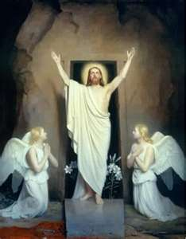
III. Inadequate Alternatives
Believer's death
Believer's salvation
Christ’s resurrection
Coming of the Spirit on Pentecost (Acts 2)
Non-pretribulational rapture

Slide 84
III. Inadequate Alternatives
Believer's death
Believer's salvation
Christ’s resurrection
Coming of the Spirit on Pentecost (Acts 2)
Non-pretribulational rapture

Slide 85
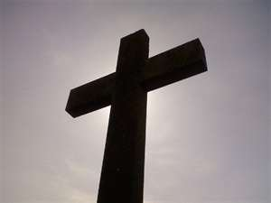
III. Inadequate Alternatives
Believer's death
“Again” (palin) = 1x
Angels take deceased believers to heaven (Luke 16:22)
Christ remains in heaven when believers die (Acts 7:56)
Believers go to the lord upon death (2 Cor 5:8)

Slide 86
III. Inadequate Alternatives
Believer's death
“Again” (palin) = 1x
Angels take deceased believers to heaven (Luke 16:22)
Christ remains in heaven when believers die (Acts 7:56)
Believers go to the lord upon death (2 Cor 5:8)

Slide 87
II. Exegesis of John 14:1-4
vs. 3 – “I will come again”
Again (palin)
"The coming again is the counterpart of the going away; visibly Jesus ascends, visibly he returns, Acts 1:9-11.” (Lenski, p. 974)
"to repetition in the same (or similar) manner, again, once more, anew of someth. a pers. has already done.“ (BDAG, p. 752)

Slide 88
III. Inadequate Alternatives
Believer's death
“Again” (palin) = 1x
Angels take deceased believers to heaven (Luke 16:22)
Christ remains in heaven when believers die (Acts 7:56)
Believers go to the lord upon death (2 Cor 5:8)

Slide 89
III. Inadequate Alternatives
Believer's death
Believer's salvation
Christ’s resurrection
Coming of the Spirit on Pentecost (Acts 2)
Non-pretribulational rapture

Slide 90
III. Inadequate Alternatives
Believer's Salvation
“Again” (palin) = 1x
Allegorization of localized language describing a heavenly-“Father’s house”, “dwelling places”, “a place”, “where I am”, “where I go”

Slide 91
III. Inadequate Alternatives
Believer's Salvation
“Again” (palin) = 1x
Allegorization of localized language describing a heavenly-“Father’s house”, “dwelling places”, “a place”, “where I am”, “where I go”

Slide 92
II. Exegesis of John 14:1-4
vs. 3 – “I will come again”
Again (palin)
"The coming again is the counterpart of the going away; visibly Jesus ascends, visibly he returns, Acts 1:9-11.” (Lenski, p. 974)
"to repetition in the same (or similar) manner, again, once more, anew of someth. a pers. has already done.“ (BDAG, p. 752)

Slide 93
III. Inadequate Alternatives
Believer's Salvation
“Again” (palin) = 1x
Allegorization of localized language describing a heavenly-“Father’s house”, “dwelling places”, “a place”, “where I am”, “where I go”

Slide 94
III. Inadequate Alternatives
Believer's death
Believer's salvation
Christ’s resurrection
Coming of the Spirit on Pentecost (Acts 2)
Non-pretribulational rapture

Slide 95
III. Inadequate Alternatives
Christ’s resurrection (John 14:18-20; 20:19, 26; 21:1)
Christ comes after the Ascension (“I go”) rather than before
“Again” (palin) = like His first coming which was from heaven rather than out of a tomb
“To” (pros) = No spatial movement involved with the resurrected Christ coming to His disciples

Slide 96
III. Inadequate Alternatives
Christ’s resurrection (John 14:18-20; 20:19, 26; 21:1)
Christ comes after the Ascension (“I go”) rather than before
“Again” (palin) = like His first coming which was from heaven rather than out of a tomb
“To” (pros) = No spatial movement involved with the resurrected Christ coming to His disciples

Slide 97
II. Exegesis of John 14:1-4
vs. 2 – In My Father's house are many dwelling places…I go to prepare a place for you.
I go
Jesus came from (John 16:28; 17:5) and is going back to heaven (John 13:12; 14:12; 16:28)
Poreuomai= Ascension (Acts 1:10-11; 1 Pet 3:22)

Slide 98
III. Inadequate Alternatives
Christ’s resurrection (John 14:18-20; 20:19, 26; 21:1)
Christ comes after the Ascension (“I go”) rather than before
“Again” (palin) = like His first coming which was from heaven rather than out of a tomb
“To” (pros) = No spatial movement involved with the resurrected Christ coming to His disciples

Slide 99
II. Exegesis of John 14:1-4
vs. 3 – “I will come again”
Again (palin)
"The coming again is the counterpart of the going away; visibly Jesus ascends, visibly he returns, Acts 1:9-11.” (Lenski, p. 974)
“to repetition in the same (or similar) manner, again, once more, anew of someth. a pers. has already done.” (BDAG, p. 752)

Slide 100
III. Inadequate Alternatives
Christ’s resurrection (John 14:18-20; 20:19, 26; 21:1)
Christ comes after the Ascension (“I go”) rather than before
“Again” (palin) = like His first coming which was from heaven rather than out of a tomb
“To” (pros) = No spatial movement involved with the resurrected Christ coming to His disciples

Slide 101
II. Exegesis of John 14:1-4
vs. 3 – “And receive you to myself”
Receive (paralambanō): "to take into close association, take (to oneself), take with/along...I will take you to myself J14:3 ...with me to my home.” (BDAG, p. 767)
To (pros): "pros with the Accusative...This is very common and denotes movement 'towards.'...Spatially, 'to or towards someone or something,' primarily with an intransitive or transitive verb expressing movement.“ (TDNT, p. 721).
Summary: Christ's return to spatially remove believers and to take them to be with Him

Slide 102
III. Inadequate Alternatives
Believer's death
Believer's salvation
Christ’s resurrection
Coming of the Spirit on Pentecost (Acts 2)
Non-pretribulational rapture

Slide 104
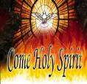
III. Inadequate Alternatives
Coming of the Spirit in Acts 2
“Again” (palin) - like His first coming yet Acts 2 was not a bodily
“To” (pros) - No spatial movement involved with the Spirit coming to the church
“Receive you to Myself” - The Holy Spirit did not receive believers in Acts 2 but believers received the Holy Spirit (John 20:22; Acts 2:38; 8:15-17).

Slide 105
III. Inadequate Alternatives
Coming of the Spirit in Acts 2
“Again” (palin) - like His first coming yet Acts 2 was not a bodily
“To” (pros) - No spatial movement involved with the Spirit coming to the church
“Receive you to Myself” - The Holy Spirit did not receive believers in Acts 2 but believers received the Holy Spirit (John 20:22; Acts 2:38; 8:15-17).

Slide 106
II. Exegesis of John 14:1-4
vs. 3 – “I will come again”
Again (palin)
"The coming again is the counterpart of the going away; visibly Jesus ascends, visibly he returns, Acts 1:9-11.” (Lenski, p. 974)
"to repetition in the same (or similar) manner, again, once more, anew of someth. a pers. has already done.“ (BDAG, p. 752)

Slide 107
III. Inadequate Alternatives
Coming of the Spirit in Acts 2
“Again” (palin) - like His first coming yet Acts 2 was not a bodily
“To” (pros) - No spatial movement involved with the Spirit coming to the church
“Receive you to Myself” - The Holy Spirit did not receive believers in Acts 2 but believers received the Holy Spirit (John 20:22; Acts 2:38; 8:15-17).

Slide 108
II. Exegesis of John 14:1-4
vs. 3 – “And receive you to myself”
Receive (paralambanō): "to take into close association, take (to oneself), take with/along...I will take you to myself J14:3 ...with me to my home.” (BDAG, p. 767)
To (pros): "pros with the Accusative...This is very common and denotes movement 'towards.'...Spatially, 'to or towards someone or something,' primarily with an intransitive or transitive verb expressing movement.“ (TDNT, p. 721).
Summary: Christ's return to spatially remove believers and to take them to be with Him

Slide 109
III. Inadequate Alternatives
Coming of the Spirit in Acts 2
“Again” (palin) - like His first coming yet Acts 2 was not a bodily
“To” (pros) - No spatial movement involved with the Spirit coming to the church
“Receive you to Myself” - The Holy Spirit did not receive believers in Acts 2 but believers received the Holy Spirit (John 20:22; Acts 2:38; 8:15-17).

Slide 110
III. Inadequate Alternatives
Believer's death
Believer's salvation
Christ’s resurrection
Coming of the Spirit on Pentecost (Acts 2)
Non-pretribulational rapture

Slide 112
John 14:1–4
¹ “Do not let your heart be troubled; believe in God, believe also in Me. ² “In My Father’s house are many dwelling places; if it were not so, I would have told you; for I go to prepare a place for you. ³ “If I go and prepare a place for you, I will come again and receive you to Myself, that where I am, there you may be also. ⁴ “And you know the way where I am going.”

Slide 113
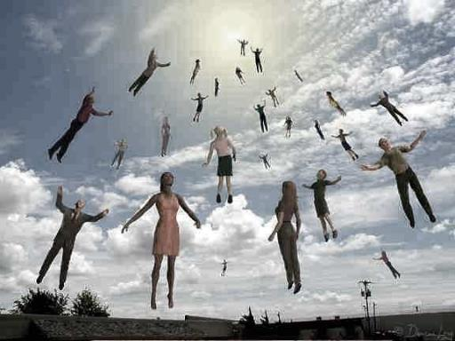
Two Themes
Comfort – John 14:1
Imminence – John 14:3

Slide 115
John 14:1–4
¹ “Do not let your heart be troubled; believe in God, believe also in Me. ² “In My Father’s house are many dwelling places; if it were not so, I would have told you; for I go to prepare a place for you. ³ “If I go and prepare a place for you, I will come again and receive you to Myself, that where I am, there you may be also. ⁴ “And you know the way where I am going.”

Slide 116
Two Themes
Comfort – John 14:1
Imminence – John 14:3

Slide 117
Imminence
Imminency definition
James 5:8; 1 Thess 1:10; 4:15; 1 Cor 1:7; 15:51; Philip 3:20
Other rapture views deny imminence

Slide 119
John 14:1–4
¹ “Do not let your heart be troubled; believe in God, believe also in Me. ² “In My Father’s house are many dwelling places; if it were not so, I would have told you; for I go to prepare a place for you. ³ “If I go and prepare a place for you, I will come again and receive you to Myself, that where I am, there you may be also. ⁴ “And you know the way where I am going.”

Slide 120
Where He Is?
“Since He says He is going to come in order that we may be with Him where he is, we would have to be with Him here on earth. Do you see the problem? The dwelling places in the Father's house would be unused...This makes Jesus' whole promise ridiculous. Why would He speak of preparing a place for us in the Father's house if He didn't mean that His return would take us there?”
Hal Lindsey, The Rapture, 43.

Slide 121
III. Inadequate Alternatives
Believer's death
Believer's salvation
Christ’s resurrection
Coming of the Spirit on Pentecost (Acts 2)
Non-pretribulational rapture

Slide 122
Preview (John 14:1-4)
Preliminary reasons
Exegesis of John 14:1-4
Answering the non-rapture arguments
John 14:1–4
"Do not let your heart be troubled; believe in God, believe also in Me. In My Father's house are many dwelling places; if it were not so, I would have told you; for I go to prepare a place for you. If I go and prepare a place for you, I will come again and receive you to Myself, that where I am, there you may be also. And you know the way where I am going."

