Slide 1


HOW TO FIND JOY IN THE CHRISTIAN LIFE

Slide 2

Answering Ten Questions
Who wrote it? – Paul
To Whom was it written? – The Believers at Philippi
Where was it written from? – Rome
When was it written? – A.D. 62
What was the book’s occasion? – Five contacts
Who are the opponents? – Four opponents threatening joy
What is the book’s purpose? – To give joy during adversity
How is it organized (outline)? – Four- part outline
What is it about? – Joy during adverstiy
What makes the book different? – Personal & informal

Slide 3

Outline
Ch 1 – God can use negative circumstances to bring about positive results
Ch 2 – Christ’s example of servanthood
Ch 3 – Avoiding legalism
Ch 4 – Reliance upon Christ’s strength for daily life

Slide 4
Outline
Ch 1 – God can use negative circumstances to bring about positive results
Ch 2 – Christ’s example of servanthood
Ch 3 – Avoiding legalism
Ch 4 – Reliance upon Christ’s strength for daily life

Slide 5
4 Positive Results of Imprisonment
(Phil. 1:12-30)
Captive audience (Phil. 1:12-13)
Church’s boldness in preaching (Phil. 1:14-18)
Greater prayer (Phil. 1:19)
Protection from martyrdom (Phil. 1:20-26)

Slide 6
Outline
Ch 1 – God can use negative circumstances to bring about positive results
Ch 2 – Christ’s example of servanthood
Ch 3 – Avoiding legalism
Ch 4 – Reliance upon Christ’s strength for daily life

Slide 7

4 Examples of Humble Service
(Phil. 2)
Christ (Phil. 2:5-16)
Paul (Phil. 2:17-18)
Timothy (Phil. 2:19-24)
Epaphroditus (Phil. 2:25-30)

Slide 8
Outline
Ch 1 – God can use negative circumstances to bring about positive results
Ch 2 – Christ’s example of servanthood
Ch 3 – Avoiding legalism
Ch 4 – Reliance upon Christ’s strength for daily life

Slide 9

Avoid Legalism
(Phil. 3)
Legalists vs. true believers (Phil. 3:1-3)
Paul’s transition away from legalism (Phil. 3:4-14)
Other items to embrace in lieu of legalism (Phil. 3:15–4:3)

Slide 10

Other Items to Embrace in Lieu of Legalism
(Phil. 3:15–4:3)
Maturity (Phil. 3:15-16)
Avoiding license (Phil. 3:17-19)
Heavenly and eternal perspective (Phil. 3:20-21)
Unity (Phil. 4:1-3)

Slide 11
Outline
Ch 1 – God can use negative circumstances to bring about positive results
Ch 2 – Christ’s example of servanthood
Ch 3 – Avoiding legalism
Ch 4 – Reliance upon Christ’s strength for daily life

Slide 12
Draw Upon the Divine Resources for Daily life
(Phil. 4)
Peace (Phil. 4:4-9)
Contentment (Phil. 4:10-13)
Provision (Phil. 4:14-19)

Slide 13
Draw Upon the Divine Resources for Daily life
(Phil. 4)
Peace (Phil. 4:4-9)
Contentment (Phil. 4:10-13)
Provision (Phil. 4:14-19)

Slide 14
EPHESIANS: WHAT IS INSIDE?
1–3 | 4–6
Relationship | Responsibility
No imperatives | 35 imperatives
Orthodoxy | Orthopraxy
Knowledge | Wisdom
Belief | Behavior
Position | Practice
Privileges | Responsibility

Slide 15
Ephesians 4:1
Therefore…
1-3
4-6

Slide 16
Romans 12:1
Therefore…
1-11
12-16

Slide 17
Galatians 5:1
Therefore…
1-4
5-6

Slide 18

Peace
(Phil. 4:4–9)
Prerequisites for Peace (Phil. 4:4-6)
Presence of Peace (Phil. 4:7)
Protection of Peace (Phil. 4:8-9)

Slide 19
Peace
(Phil. 4:4–9)
Prerequisites for Peace (Phil. 4:4-6)
Presence of Peace (Phil. 4:7)
Protection of Peace (Phil. 4:8-9)

Slide 20
I. Prerequisites for Peace
(Phil. 4:4–6)
Joy (Phil. 4:4)
Gentleness (Phil. 4:5a)
Awareness of God’s nearness (Phil. 4:5b)
Prayer (6)

Slide 21
I. Prerequisites for Peace
(Phil. 4:4–6)
Joy (Phil. 4:4)
Gentleness (Phil. 4:5a)
Awareness of God’s nearness (Phil. 4:5b)
Prayer (6)

Slide 22
I. Prerequisites for Peace
(Phil. 4:4–6)
Joy (Phil. 4:4)
Gentleness (Phil. 4:5a)
Awareness of God’s nearness (Phil. 4:5b)
Prayer (6)

Slide 23
I. Prerequisites for Peace
(Phil. 4:4–6)
Joy (Phil. 4:4)
Gentleness (Phil. 4:5a)
Awareness of God’s nearness (Phil. 4:5b)
Prayer (6)

Slide 24


Slide 25
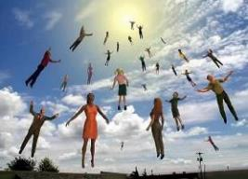
When Will the Rapture Take Place?
Pre-tribulation Rapture Theory
Mid-tribulation Rapture Theory
Post-tribulation Rapture Theory
Pre-wrath Rapture Theory
Partial Rapture Theory

Slide 26
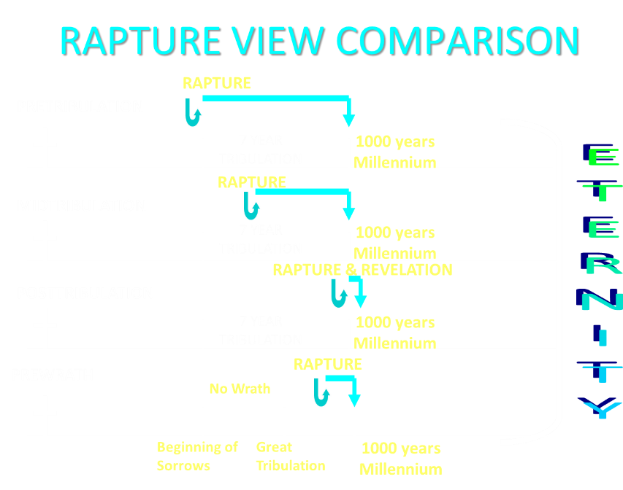

Slide 27

Pretribulationism is not Escapism
Trials (John 16:33)
Man’s wrath (2 Tim 3:12)
Satan’s wrath (Eph 6:11-12)
World’s wrath (John 15:18-19)

Slide 28
I. Prerequisites for Peace
(Phil. 4:4–6)
Joy (Phil. 4:4)
Gentleness (Phil. 4:5a)
Awareness of God’s nearness (Phil. 4:5b)
Prayer (6)

Slide 29
Outline
Ch 1 – God can use negative circumstances to bring about positive results
Ch 2 – Christ’s example of servanthood
Ch 3 – Avoiding legalism
Ch 4 – Reliance upon Christ’s strength for daily life

Slide 30
4 Positive Results of Imprisonment
(Phil. 1:12-30)
Captive audience (Phil. 1:12-13)
Church’s boldness in preaching (Phil. 1:14-18)
Greater prayer (Phil. 1:19)
Protection from martyrdom (Phil. 1:20-26)

Slide 31
Peace
(Phil. 4:4–9)
Prerequisites for Peace (Phil. 4:4-6)
Presence of Peace (Phil. 4:7)
Protection of Peace (Phil. 4:8-9)

Slide 32
Peace
(Phil. 4:4–9)
Prerequisites for Peace (Phil. 4:4-6)
Presence of Peace (Phil. 4:7)
Protection of Peace (Phil. 4:8-9)

Slide 33
III. Protection of Peace
(Phil. 4:8–9)
Content of a Disciplined Thought Life (Phil. 4:8)
Practice of a Disciplined Though Life (Phil. 4:9)

Slide 34
III. Protection of Peace
(Phil. 4:8–9)
Content of a Disciplined Thought Life (Phil. 4:8)
Practice of a Disciplined Though Life (Phil. 4:9)

Slide 35
Three Tenses of Salvation
Phase | Justification | Sanctification | Glorification
Tense | Past | Present | Future
Saved from sin’s: | Penalty | Power | Presence
Scripture | Eph 2:8-9; Titus 3:5 | Philip 2:12 | Rom 5:10
Nature | Single | Dual | Single

Slide 36
Three Tenses of Salvation
Phase | Justification | Sanctification | Glorification
Tense | Past | Present | Future
Saved from sin’s: | Penalty | Power | Presence
Scripture | Eph 2:8-9; Titus 3:5 | Philip 2:12 | Rom 5:10
Nature | Single | Dual | Single

Slide 37

Lewis Sperry Chafer
Notes from an unpublished lecture at Dallas Theological Seminary in the Spiritual Life course given in 1948 speaking to his students, those who he was training to become ministers.
“Now you have the country just filled with preachers. If you could have stopped in to all the services that were held last Sunday between the Atlantic and the Pacific you would have heard a mess of sermons. All of them can be boiled down to just two words—be good. But how many sermons were preached last Sunday that tell people how to be good. They just don’t know anything about that; that involves the plan of deliverance from the reigning power of sin and I have tried to tell you that that is one of the most neglected things—how to be good...”

Slide 38
Lewis Sperry Chafer
Notes from an unpublished lecture at Dallas Theological Seminary in the Spiritual Life course given in 1948 speaking to his students, those who he was training to become ministers.
“God has a way, a plan and a provision but you must know and understand it and I’m just ambitious enough to hope that you men are going to get out there and teach it. Don’t say it’s too big of a job to make the average audience understand; they have to understand if they are to walk as Christians.”

Slide 39


Galatians 3:3
“Are you so foolish? Having begun by the Spirit, are you now being perfected by the flesh?”

Slide 40
Outline
Ch 1 – God can use negative circumstances to bring about positive results
Ch 2 – Christ’s example of servanthood
Ch 3 – Avoiding legalism
Ch 4 – Reliance upon Christ’s strength for daily life

Slide 41
Avoid Legalism
(Phil. 3)
Legalists vs. true believers (Phil. 3:1-3)
Paul’s transition away from legalism (Phil. 3:4-14)
Other items to embrace in lieu of legalism (Phil. 3:15–4:3)

Slide 42

Genesis 2:16-17
“¹⁶ The Lord God commanded the man, saying, ‘From any tree of the garden you may eat freely; ¹⁷ but from the tree of the knowledge of good and evil you shall not eat, for in the day that you eat from it you will surely die.’”

Slide 43
Genesis 3:2-3
“² The woman said to the serpent, ‘From the fruit of the trees of the garden we may eat; ³ but from the fruit of the tree which is in the middle of the garden, God has said, ‘You shall not eat from it or touch it, or you will die.’”

Slide 44
Genesis 3:1, 4
“¹ Now the serpent was more crafty than any beast of the field which the Lord God had made. And he said to the woman, “Indeed, has God said, ‘You shall not eat from any tree of the garden’?” …⁴ The serpent said to the woman, ‘You surely will not die!’”

Slide 45


2 Cor. 11:3
COMPLICATION OF THE SIMPLE
“But I fear, lest somehow, as the serpent deceived Eve by his craftiness, so your minds may be corrupted by from the simplicity that is in Christ.” (Italics mine)

Slide 46


Mark 7:13
“thus invalidating the word of God by your tradition which you have handed down; and you do many things such as that.”

Slide 47

What to Meditate Upon? – 8 Descriptions
(Phil. 4:8)
True
Honorable
Right
Pure
Lovely
Good repute
Excellent
Worthy of Praise

Slide 48
What to Meditate Upon? – 8 Descriptions
(Phil. 4:8)
True
Honorable
Right
Pure
Lovely
Good repute
Excellent
Worthy of Praise

Slide 49
What to Meditate Upon? – 8 Descriptions
(Phil. 4:8)
True
Honorable
Right
Pure
Lovely
Good repute
Excellent
Worthy of Praise

Slide 50
What to Meditate Upon? – 8 Descriptions
(Phil. 4:8)
True
Honorable
Right
Pure
Lovely
Good repute
Excellent
Worthy of Praise

Slide 51
What to Meditate Upon? – 8 Descriptions
(Phil. 4:8)
True
Honorable
Right
Pure
Lovely
Good repute
Excellent
Worthy of Praise

Slide 52
What to Meditate Upon? – 8 Descriptions
(Phil. 4:8)
True
Honorable
Right
Pure
Lovely
Good repute
Excellent
Worthy of Praise

Slide 53
What to Meditate Upon? – 8 Descriptions
(Phil. 4:8)
True
Honorable
Right
Pure
Lovely
Good repute
Excellent
Worthy of Praise

Slide 54
What to Meditate Upon? – 8 Descriptions
(Phil. 4:8)
True
Honorable
Right
Pure
Lovely
Good repute
Excellent
Worthy of Praise

Slide 55
What to Meditate Upon? – 8 Descriptions
(Phil. 4:8)
True
Honorable
Right
Pure
Lovely
Good repute
Excellent
Worthy of Praise

Slide 56
III. Protection of Peace
(Phil. 4:8–9)
Content of a Disciplined Thought Life (Phil. 4:8)
Practice of a Disciplined Though Life (Phil. 4:9)

Slide 57
Outline
Ch 1 – God can use negative circumstances to bring about positive results
Ch 2 – Christ’s example of servanthood
Ch 3 – Avoiding legalism
Ch 4 – Reliance upon Christ’s strength for daily life

Slide 58
4 Examples of Humble Service
(Phil. 2)
Christ (Phil. 2:5-16)
Paul (Phil. 2:17-18)
Timothy (Phil. 2:19-24)
Epaphroditus (Phil. 2:25-30)

Slide 59

Isaiah 9:6-7
⁶ For a child will be born to us, a son will be given to us; And the government will rest on His shoulders; And His name will be called Wonderful Counselor, Mighty God, Eternal Father, Prince of Peace.⁷ There will be no end to the increase of His government or of peace, On the throne of David and over his kingdom, To establish it and to uphold it with justice and righteousness From then on and forevermore. The zeal of the Lord of hosts will accomplish this.

Slide 60
Conclusion

Slide 61

Peace
(Phil. 4:4–9)
Prerequisites for Peace (Phil. 4:4-6)
Presence of Peace (Phil. 4:7)
Protection of Peace (Phil. 4:8-9)

Slide 62

“The Lord bless you and keep you; the Lord make his face shine on you and be gracious to you; the Lord turn his face toward you and give you peace.” (NIV)

