Slide 1
THE RAPTURE
What and When? – Part 11
Dr. Andy Woods
Senior Pastor – Sugar Land Bible Church
President – Chafer Theological Seminary

Slide 2
What is the Rapture?
An important doctrine
Distinct from the Second Advent
Catching away of all living believers (1 Thess 4:17)
Reunion (1 Thess 4:14-16)
Resurrection (1 Cor 15:50-54)
Exemption from death (1 Cor 15:51, 54-56)
Instantaneous (1 Cor 15:52)
Mystery (1 Cor 15:51)
Imminent (1 Cor 15:51; 1 Thess 4:15)
Traditional doctrine now being recovered

Slide 3
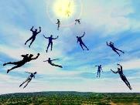
When Will the Rapture Take Place Relative to the Tribulation Period?
Pre-tribulation rapture theory
Mid-tribulation rapture theory
Post-tribulation rapture theory
Pre-wrath rapture theory
Partial rapture theory

Slide 5
When is the Rapture? 7 Arguments Favoring the Pre-Tribulation View
Tribulation's purpose concerns Israel (Jer 30:7; Dan 9:24)
No biblical reference to the church on earth during the Tribulation period (Rev 4-22)
Church is promised an exemption from divine wrath (1 Thess 1:10; 5:9; Rom 5:9; Rev 3:10; 6:17)
Rapture is imminent (1 Cor 15:51; 1 Thess 4:15)
Rapture is a comfort (1 Thess 4:18)
Antichrist cannot come to power until the restrainer is removed (2 Thess 2:6-7)
Symbolic parallels (2 Peter 2:5-9)

Slide 6
Luke 17:26-30
“²⁶ And just as it happened in the days of Noah, so it will be also in the days of the Son of Man: ²⁷ they were eating, they were drinking, they were marrying, they were being given in marriage, until the day that Noah entered the ark, and the flood came and destroyed them all. ²⁸ It was the same as happened in the days of Lot: they were eating, they were drinking, they were buying, they were selling, they were planting, they were building; ²⁹ but on the day that Lot went out from Sodom it rained fire and brimstone from heaven and destroyed them all. ³⁰ It will be just the same on the day that the Son of Man is revealed.”

Slide 7
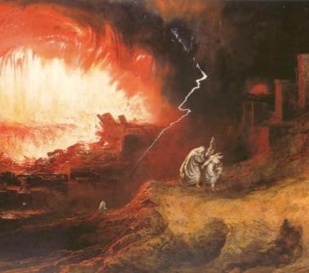
Symbolic Parallels
2 Peter 2:4-9
Enoch taken before the flood (Gen 5:24)
Noah protected before the flood (Gen 7:6-7)
Lot taken before judgment upon Sodom (2 Pet 2:7; Gen 19:22)

Slide 8
Symbolic Parallels
2 Peter 2:4-9
Enoch taken before the flood (Gen 5:24)
Noah protected before the flood (Gen 7:6-7)
Lot taken before judgment upon Sodom (2 Pet 2:7; Gen 19:22)

Slide 9
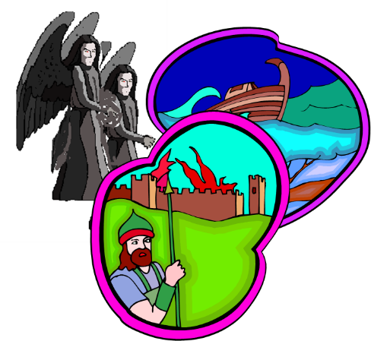
DOOM OF FALSE TEACHERS 2 Peter 2:4-9
Judgment of God (6-8) – 3 Historical Examples
Fallen angels (4)
Flood (5)
Sodom & Gomorrah (6-8)
Conclusion (9)

Slide 10
Genesis 6:1-4
“¹ Now it came about, when men began to multiply on the face of the land, and daughters were born to them, ² that the sons of God saw that the daughters of men were beautiful; and they took wives for themselves, whomever they chose. ³ Then the Lord said, ‘My Spirit shall not strive with man forever, because he also is flesh; nevertheless his days shall be one hundred and twenty years.’ . . .

Slide 11
Genesis 6:1-4
. . .⁴ The Nephilim were on the earth in those days, and also afterward, when the sons of God came in to the daughters of men, and they bore children to them. Those were the mighty men who were of old, men of renown.”

Slide 12
Genesis 6:5-7
“⁵ Then the Lord saw that the wickedness of man was great on the earth, and that every intent of the thoughts of his heart was only evil continually. ⁶ The Lord was sorry that He had made man on the earth, and He was grieved in His heart. ⁷ The Lord said, “I will blot out man whom I have created from the face of the land, from man to animals to creeping things and to birds of the sky; for I am sorry that I have made them.”

Slide 13
Genesis 6:11-13
“¹¹ Now the earth was corrupt in the sight of God, and the earth was filled with violence. ¹² God looked on the earth, and behold, it was corrupt; for all flesh had corrupted their way upon the earth. ¹³ Then God said to Noah, “The end of all flesh has come before Me; for the earth is filled with violence because of them; and behold, I am about to destroy them with the earth.”

Slide 14
Symbolic Parallels
2 Peter 2:4-9
Enoch taken before the flood (Gen 5:24)
Noah protected before the flood (Gen 7:6-7)
Lot taken before judgment upon Sodom (2 Pet 2:7; Gen 19:22)

Slide 15
Genesis 5:18-24
^{“18} Jared lived one hundred and sixty-two years, and became the father of Enoch. ¹⁹ Then Jared lived eight hundred years after he became the father of Enoch, and he had other sons and daughters. ²⁰ So all the days of Jared were nine hundred and sixty-two years, and he died. ²¹ Enoch lived sixty-five years, and became the father of Methuselah. ²² Then Enoch walked with God three hundred years after …

Slide 16
Genesis 5:18-24
. . .he became the father of Methuselah, and he had other sons and daughters. ²³ So all the days of Enoch were three hundred and sixty-five years. ²⁴ Enoch walked with God; and he was not, for God took him.”

Slide 17
Symbolic Parallels
2 Peter 2:4-9
Enoch taken before the flood (Gen 5:24)
Noah protected before the flood (Gen 7:6-7)
Lot taken before judgment upon Sodom (2 Pet 2:7; Gen 19:22)

Slide 18
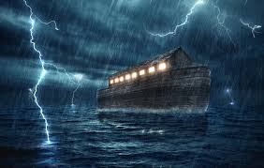
Genesis 7:6-7
“Now Noah was six hundred years old when the flood of water came upon the earth. ⁷ Then Noah and his sons and his wife and his sons’ wives with him entered the ark because of the water of the flood.”

Slide 19
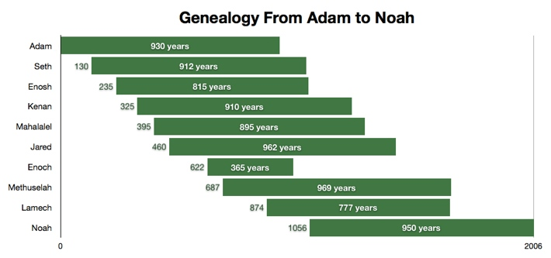

Slide 20
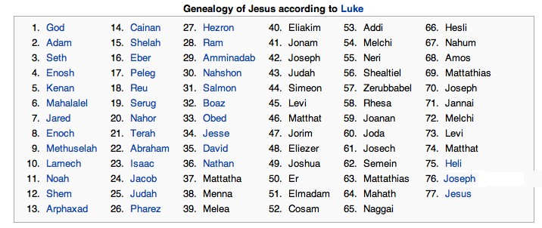

Slide 21
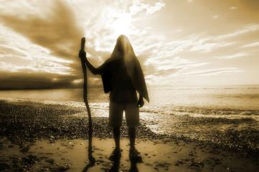
Similarities Between Enoch and Noah
Both ministered to the same era
Both stood out as lights to a corrupt generation
Both serve as positive examples for us
Both are removed / protected prior to divine judgment

Slide 22
Symbolic Parallels
2 Peter 2:4-9
Enoch taken before the flood (Gen 5:24)
Noah protected before the flood (Gen 7:6-7)
Lot taken before judgment upon Sodom (2 Pet 2:7; Gen 19:22)

Slide 23
2 Peter 2:7-9
“⁷ and if He rescued righteous Lot, oppressed by the sensual conduct of unprincipled men ⁸ (for by what he saw and heard that righteous man, while living among them, felt his righteous soul tormented day after day by their lawless deeds), ⁹ then the Lord knows how to rescue the godly from temptation, and to keep the unrighteous under punishment for the day of judgment.”

Slide 24
1 Corinthians 3:1-3 (NKJV)
¹ And I, brethren, could not speak to you as to spiritual people but as to carnal, as to babes in Christ. ² I fed you with milk and not with solid food; for until now you were not able to receive it, and even now you are still not able; ³ for you are still carnal. For where there are envy, strife, and divisions among you, are you not carnal and behaving like mere men?

Slide 25
Notes:
Ray Steadman – “1st Californians”
Unbelievers vs Categories of Believers
Unbelievers – ψυχικός psuchikós; Natural, pertaining to the natural as distinguished from the spiritual
Spiritual Believers – πνευματικός pneumatikós; of persons who are spiritual, enlightened by the Holy Spirit
Infant Believers – σάρκινος sárkinos; with propensities of the flesh unto sin; νήπιος nḗpios; an infant, child, baby without any definite limitation of age. (This relates to immaturity and lack of instruction)
Carnal Believers – σαρκικός sarkikós; tendency to satisfy the flesh, implying sinfulness, sinful propensity, carnal (This relates to disobedience and open rebellion)

Slide 26
1 Corinthians 3:15
“If any man’s work is burned up, he will suffer loss; but he himself will be saved, yet so as through fire.”

Slide 27
YIELDING TO THE OLD (SIN) NATURE
BELIEVER’S CONSEQUENCES | PASSAGE(S)
Lack of power | (Gal 5:16; 1 Thess. 5:19)
Grieving the Holy Spirit | (Eph 4:30-32)
Loss of joy | (Ps. 51:4, 12; Gal. 5:22-23)
Loss of spiritual sight | (2 Pet. 1:8-10; Luke 15:18-19)
Lack of growth | (1 Pet. 2:1-2)
Carnality | (1 Cor 3:1-3)
Unfruitfulness | (John 15:5, 8)
Lack of purpose | (Eccles. 1:2-3, 8; Mark 8:35)
Lack of stability | (Gal. 3:3; 2 Tim. 2:18; 2 Pet. 3:17)

Slide 28
YIELDING TO THE OLD (SIN) NATURE
BELIEVER’S CONSEQUENCES | PASSAGE(S)
Conviction | (2 Pet 2:7-8; Ps 32:1-5)
Divine discipline | (Heb. 12:5-11; Rev. 3:19)
Premature death | (Acts 5:1-11; 1 Cor 11:30; 1 John 5:16; Rev 2:22-23)
Loss of reward | (1 Cor. 3:15; 9:27; 2 John 8; Rev 3:11)
Loss of fellowship | (1 John 1:9)
Excommunication | (1 Cor 5:4-5; Matt 18:15-17)
Temporal consequences | (Gal 6:7-8)
Unanswered prayer | (Ps 66:18; 1 Pet 3:7)
Loss of testimony | (Gen 19:14)
Loss of leadership privileges | (1 Tim 3:1-13; 2 Sam. 12)

Slide 29
Genesis 19:22
“Hurry, escape there, for I cannot do anything until you arrive there.” Therefore the name of the town was called Zoar.”

Slide 30
1 Corinthians 15:50-51
“⁵⁰ Now I say this, brethren, that flesh and blood cannot inherit the kingdom of God; nor does the perishable inherit the imperishable. ⁵¹ Behold, I tell you a mystery; we will not all sleep, but we will all be changed.”

Slide 31
Conclusion

Slide 32
When is the Rapture? 7 Arguments Favoring the Pre-Tribulation View
Tribulation's purpose concerns Israel (Jer 30:7; Dan 9:24)
No biblical reference to the church on earth during the Tribulation period (Rev 4-22)
Church is promised an exemption from divine wrath (1 Thess 1:10; 5:9; Rom 5:9; Rev 3:10; 6:17)
Rapture is imminent (1 Cor 15:51; 1 Thess 4:15)
Rapture is a comfort (1 Thess 4:18)
Antichrist cannot come to power until the restrainer is removed (2 Thess 2:6-7)
Symbolic parallels (2 Peter 2:5-9)

