Slide 1
THE RAPTURE
What and When? – Part 9
Dr. Andy Woods
Senior Pastor – Sugar Land Bible Church
President – Chafer Theological Seminary

Slide 2
What is the Rapture?
An important doctrine
Distinct from the Second Advent
Catching away of all living believers (1 Thess 4:17)
Reunion (1 Thess 4:14-16)
Resurrection (1 Cor 15:50-54)
Exemption from death (1 Cor 15:51, 54-56)
Instantaneous (1 Cor 15:52)
Mystery (1 Cor 15:51)
Imminent (1 Cor 15:51; 1 Thess 4:15)
Traditional doctrine now being recovered

Slide 3
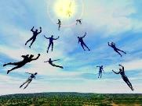
When Will the Rapture Take Place Relative to the Tribulation Period?
Pre-tribulation rapture theory
Mid-tribulation rapture theory
Post-tribulation rapture theory
Pre-wrath rapture theory
Partial rapture theory

Slide 5
When is the Rapture? 7 Arguments Favoring the Pre-Tribulation View
Tribulation's purpose concerns Israel (Jer 30:7; Dan 9:24)
No biblical reference to the church on earth during the Tribulation period (Rev 4-22)
Church is promised an exemption from divine wrath (1 Thess 1:10; 5:9; Rom 5:9; Rev 3:10; 6:17)
Rapture is imminent (1 Cor 15:51; 1 Thess 4:15)
Rapture is a comfort (1 Thess 4:18)
Antichrist cannot come to power until the restrainer is removed (2 Thess 2:6-7)
Symbolic parallels (2 Peter 2:5-9)

Slide 6
When is the Rapture? 7 Arguments Favoring the Pre-Tribulation View
Tribulation's purpose concerns Israel (Jer 30:7; Dan 9:24)
No biblical reference to the church on earth during the Tribulation period (Rev 4-22)
Church is promised an exemption from divine wrath (1 Thess 1:10; 5:9; Rom 5:9; Rev 3:10; 6:17)
Rapture is imminent (1 Cor 15:51; 1 Thess 4:15)
Rapture is a comfort (1 Thess 4:18)
Antichrist cannot come to power until the restrainer is removed (2 Thess 2:6-7)
Symbolic parallels (2 Peter 2:5-9)

Slide 7
When is the Rapture? 7 Arguments Favoring the Pre-Tribulation View
Tribulation's purpose concerns Israel (Jer 30:7; Dan 9:24)
No biblical reference to the church on earth during the Tribulation period (Rev 4-22)
Church is promised an exemption from divine wrath (1 Thess 1:10; 5:9; Rom 5:9; Rev 3:10; 6:17)
Rapture is imminent (1 Cor 15:51; 1 Thess 4:15)
Rapture is a comfort (1 Thess 4:18)
Antichrist cannot come to power until the restrainer is removed (2 Thess 2:6-7)
Symbolic parallels (2 Peter 2:5-9)

Slide 8
When is the Rapture? 7 Arguments Favoring the Pre-Tribulation View
Tribulation's purpose concerns Israel (Jer 30:7; Dan 9:24)
No biblical reference to the church on earth during the Tribulation period (Rev 4-22)
Church is promised an exemption from divine wrath (1 Thess 1:10; 5:9; Rom 5:9; Rev 3:10; 6:17)
Rapture is imminent (1 Cor 15:51; 1 Thess 4:15)
Rapture is a comfort (1 Thess 4:18)
Antichrist cannot come to power until the restrainer is removed (2 Thess 2:6-7)
Symbolic parallels (2 Peter 2:5-9)

Slide 9
When is the Rapture? 7 Arguments Favoring the Pre-Tribulation View
Tribulation's purpose concerns Israel (Jer 30:7; Dan 9:24)
No biblical reference to the church on earth during the Tribulation period (Rev 4-22)
Church is promised an exemption from divine wrath (1 Thess 1:10; 5:9; Rom 5:9; Rev 3:10; 6:17)
Rapture is imminent (1 Cor 15:51; 1 Thess 4:15)
Rapture is a comfort (1 Thess 4:18)
Antichrist cannot come to power until the restrainer is removed (2 Thess 2:6-7)
Symbolic parallels (2 Peter 2:5-9)

Slide 10
What is the Rapture?
An important doctrine
Distinct from the Second Advent
Catching away of all living believers (1 Thess 4:17)
Reunion (1 Thess 4:14-16)
Resurrection (1 Cor 15:50-54)
Exemption from death (1 Cor 15:51, 54-56)
Instantaneous (1 Cor 15:52)
Mystery (1 Cor 15:51)
Imminent (1 Cor 15:51; 1 Thess 4:15)
Traditional doctrine now being recovered

Slide 11
Wayne Brindle
"Biblical Evidence for the Imminence of the Rapture," Bibliotheca Sacra 158, no. 630 (April-June 2001): 138-51.
“Four criteria may be suggested, any one of which indicates imminence:
The passage speaks of Christ’s return as at any moment.
The passage speaks of Christ’s return as ‘near,’ without stating any signs that must precede His coming.
The passage speaks of Christ’s return as something that gives believers hope and encouragement, without indicating that these believers will suffer tribulation.
The passage speaks of Christ’s return as giving hope without relating it to God’s judgment of unbelievers.”

Slide 12
Imminent (1 Cor 15:51; 1 Thess 4:15)
Imminency definition
James 5:8; 1 Thess 1:10; 1 Cor 1:7; Philip 3:20
We are to be looking for Jesus Christ; not the Antichrist!
Motivator (Holiness, Evangelism)

Slide 13
1 Thessalonians 4:13-15
¹³ "But we do not want you to be uninformed, brethren, about those who are asleep, so that you will not grieve as do the rest who have no hope. ¹⁴ For if we believe that Jesus died and rose again, even so God will bring with Him those who have fallen asleep in Jesus. ¹⁵ For this we say to you by the word of the Lord, that we who are alive and remain until the coming of the Lord, will not precede those who have fallen asleep.

Slide 14
1 Corinthians 15:51
“Behold, I tell you a mystery; we will not all sleep, but we will all be changed.”

Slide 15
John 14:1–4
¹ “Do not let your heart be troubled; believe in God, believe also in Me. ² “In My Father’s house are many dwelling places; if it were not so, I would have told you; for I go to prepare a place for you. ³ “If I go and prepare a place for you, I will come again and receive you to Myself, that where I am, there you may be also. ⁴ “And you know the way where I am going.”

Slide 17
Robert Gundry
First the Antichrist: Why Christ Won't Come before the Antichrist Does (Grand Rapids: Baker, 1997).

Slide 18
When is the Rapture? 7 Arguments Favoring the Pre-Tribulation View
Tribulation's purpose concerns Israel (Jer 30:7; Dan 9:24)
No biblical reference to the church on earth during the Tribulation period (Rev 4-22)
Church is promised an exemption from divine wrath (1 Thess 1:10; 5:9; Rom 5:9; Rev 3:10; 6:17)
Rapture is imminent (1 Cor 15:51; 1 Thess 4:15)
Rapture is a comfort (1 Thess 4:18)
Antichrist cannot come to power until the restrainer is removed (2 Thess 2:6-7)
Symbolic parallels (2 Peter 2:5-9)

Slide 19
John 14:1–4
¹ “Do not let your heart be troubled; believe in God, believe also in Me. ² “In My Father’s house are many dwelling places; if it were not so, I would have told you; for I go to prepare a place for you. ³ “If I go and prepare a place for you, I will come again and receive you to Myself, that where I am, there you may be also. ⁴ “And you know the way where I am going.”

Slide 20
1 Thessalonians 4:13-18
¹³ "But we do not want you to be uninformed, brethren, about those who are asleep, so that you will not grieve as do the rest who have no hope. ¹⁴ For if we believe that Jesus died and rose again, even so God will bring with Him those who have fallen asleep in Jesus. ¹⁵ For this we say to you by the word of the Lord, that we who are alive and remain until the coming of the Lord, will not precede those who . . .

Slide 21
1 Thessalonians 4:13-18
. . . have fallen asleep. ¹⁶ For the Lord Himself will descend from heaven with a shout, with the voice of the archangel and with the trumpet of God, and the dead in Christ will rise first. ¹⁷ Then we who are alive and remain will be caught up together with them in the clouds to meet the Lord in the air, and so we shall always be with the Lord. ¹⁸ Therefore comfort one another with these words."

Slide 22
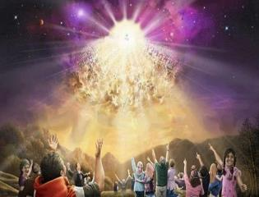
Titus 2:13
“Looking for the blessed hope and the appearing of the glory of our great God and Savior, Christ Jesus.”
22

Slide 23
Comfort
John 14:1; 1 Thess 4:18; Titus 2:13
Other rapture views are not comforting since they place the church into divine wrath

Slide 25
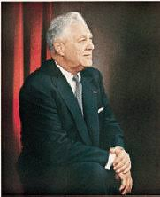
Donald Grey Barnhouse
Cited in Mark Hitchcock, “An Overview of Pretribulational arguments,” online: www.pre-trib.org, accessed 27 August 2013, 29-30.
“Jesus may come today, Glad day! Glad day! And I would see my friend; Dangers and troubles would end If Jesus should come today. Glad day! Glad day! Is it the crowning day? I’ll live for today, nor anxious be, Jesus, my Lord, I soon shall see; Glad day! Glad day! Is it the crowning day?”

Slide 26
Donald Grey Barnhouse
Cited in Mark Hitchcock, “An Overview of Pretribulational arguments,” online: www.pre-trib.org, accessed 27 August 2013, 29-30.
By way of parody, Dr. Barnhouse also pointed out that if the midtrib or posttrib advocates sang this song, it would instead have to say: “Jesus can’t come today, Sad day! Sad day! And I won't see my friend; Dangers and troubles won’t end Because Jesus can’t come today. Sad day! Sad day! Today is not the crowning day? I won’t live for today, and anxious I’ll be, The Beast and the False Prophet I soon shall see, Sad day! Sad day! Today is not the crowning day?”

Slide 27
When is the Rapture? 7 Arguments Favoring the Pre-Tribulation View
Tribulation's purpose concerns Israel (Jer 30:7; Dan 9:24)
No biblical reference to the church on earth during the Tribulation period (Rev 4-22)
Church is promised an exemption from divine wrath (1 Thess 1:10; 5:9; Rom 5:9; Rev 3:10; 6:17)
Rapture is imminent (1 Cor 15:51; 1 Thess 4:15)
Rapture is a comfort (1 Thess 4:18)
Antichrist cannot come to power until the restrainer is removed (2 Thess 2:6-7)
Symbolic parallels (2 Peter 2:5-9)

Slide 28
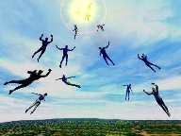
Restrainer Must First be Removed
Restrainer holds back the Antichrist (2 Thess 2:6-7)
Restrainer = the omnipotent Holy Spirit (2 Thess 2:9)
Holy Spirit permanently indwells all Christians (John 14:16; Rom 8:9)
Spirit indwelt Christians must first be removed prior to the Antichrist's advent

Slide 29
Restrainer Must First be Removed
Restrainer holds back the Antichrist (2 Thess 2:6-7)
Restrainer = the omnipotent Holy Spirit (2 Thess 2:9)
Holy Spirit permanently indwells all Christians (John 14:16; Rom 8:9)
Spirit indwelt Christians must first be removed prior to the Antichrist's advent

Slide 32
2 Thessalonians 2:6-7
⁶And you know what restrains [katechō; neuter] him now, so that in his time he will be revealed. ⁷For the mystery of lawlessness is already at work; only he who now restrains [katechō; masculine] will do so until he is taken out of the way.

Slide 33
Restrainer Must First be Removed
Restrainer holds back the Antichrist (2 Thess 2:6-7)
Restrainer = the omnipotent Holy Spirit (2 Thess 2:9)
Holy Spirit permanently indwells all Christians (John 14:16; Rom 8:9)
Spirit indwelt Christians must first be removed prior to the Antichrist's advent

Slide 34
Restrainer? (2:6-7)
Rome?
Satan?
Government?
Michael?
Spirit?

Slide 35
Restrainer? (2:6-7)
Rome?
Satan?
Government?
Michael?
Spirit?

Slide 36
Restrainer? (2:6-7)
Rome?
Satan?
Government?
Michael?
Spirit?

Slide 37
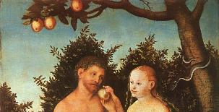
2 Thessalonians 2:9
“⁹ that is, the one whose coming is in accord with the activity of Satan, with all power and signs and false wonders.”

Slide 38
Matthew 12:24-26
“²⁴ But when the Pharisees heard this, they said, ‘This man casts out demons only by Beelzebul the ruler of the demons.’ ²⁵ And knowing their thoughts Jesus said to them, ‘Any kingdom divided against itself is laid waste; and any city or house divided against itself will not stand. ²⁶ If Satan casts out Satan, he is divided against himself; how then will his kingdom stand?”
38

Slide 39
Restrainer? (2:6-7)
Rome?
Satan?
Government?
Michael?
Spirit?

Slide 40
Genesis 9:6
“Whoever sheds man’s blood, By man his blood shall be shed, For in the image of God He made man.”

Slide 41
Romans 13:1-7
¹ Every person is to be in subjection to the governing authorities. For there is no authority except from God, and those which exist are established by God. ² Therefore whoever resists authority has opposed the ordinance of God; and they who have opposed will receive condemnation upon themselves. ³ For rulers are not a cause of fear for good behavior, but for evil. Do you want to have no fear of authority? Do what is good and you will have praise from the same; ⁴ for it is a minister of God to you for good. But if you do what is evil, be afraid; for it does not bear the sword for nothing; for it is a . . .

Slide 42
Romans 13:1-7
... ⁴ for it is a minister of God to you for good. But if you do what is evil, be afraid; for it does not bear the sword for nothing; for it is a minister of God, an avenger who brings wrath on the one who practices evil. ⁵ Therefore it is necessary to be in subjection, not only because of wrath, but also for conscience’ sake. ⁶ For because of this you also pay taxes, for rulers are servants of God, devoting themselves to this very thing. ⁷ Render to all what is due them: tax to whom tax is due; custom to whom custom; fear to whom fear; honor to whom honor.

Slide 43
Daniel 7:19, 23, 25
“Then I desired to know the exact meaning of the fourth beast, which was different from all the others, exceedingly dreadful, with its teeth of iron and its claws of bronze, and which devoured, crushed and trampled down the remainder with its feet…Thus he said: ‘The fourth beast will be a fourth kingdom on the earth, which will be different from all the other kingdoms and will devour the whole . . .
43

Slide 44
Daniel 7:19, 23, 25
. . .the whole earth and tread it down and crush it…He will speak out against the Most High and wear down the saints of the Highest One, and he will intend to make alterations in times and in law; and they will be given into his hand for a time, times, and half a time.”
44

Slide 45
Restrainer? (2:6-7)
Rome?
Satan?
Government?
Michael?
Spirit?

Slide 46
Daniel 12:1
“Now at that time Michael, the great prince who stands guard over the sons of your people, will arise. And there will be a time of distress such as never occurred since there was a nation until that time; and at that time your people, everyone who is found written in the book, will be rescued.”
46

Slide 47
2 Thessalonians 2:9
“⁹ that is, the one whose coming is in accord with the activity of Satan, with all power and signs and false wonders.”

Slide 48
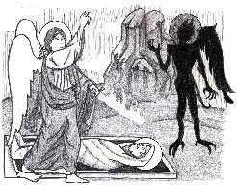
Jude 9
“But Michael the archangel, when he disputed with the devil and argued about the body of Moses, did not dare pronounce against him a railing judgment, but said, ‘The Lord rebuke you!’”
48

Slide 49
Restrainer? (2:6-7)
Rome?
Satan?
Government?
Michael?
Spirit?

Slide 50
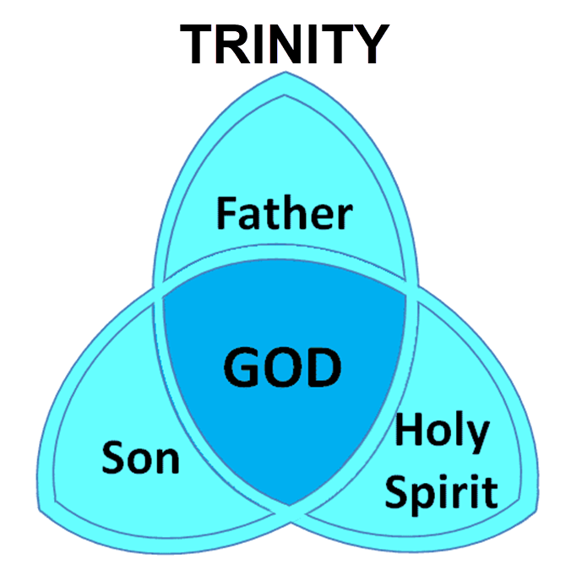

Slide 51
3 Reasons Why the Restrainer is the Holy Spirit (2 Thessalonians 2:6-7)
The Holy Spirit is omnipotent
The Holy Spirit view handles well the switch in gender from the neuter (vs. 6) to the masculine (vs. 7)
The Holy Spirit is active in the world (Gen. 6:3; John 16:7-11)

Slide 52
3 Reasons Why the Restrainer is the Holy Spirit (2 Thessalonians 2:6-7)
The Holy Spirit is omnipotent
The Holy Spirit view handles well the switch in gender from the neuter (vs. 6) to the masculine (vs. 7)
The Holy Spirit is active in the world (Gen. 6:3; John 16:7-11)

Slide 53
2 Thessalonians 2:9
“⁹ that is, the one whose coming is in accord with the activity of Satan, with all power and signs and false wonders.”

Slide 54
3 Reasons Why the Restrainer is the Holy Spirit (2 Thessalonians 2:6-7)
The Holy Spirit is omnipotent
The Holy Spirit view handles well the switch in gender from the neuter (vs. 6) to the masculine (vs. 7)
The Holy Spirit is active in the world (Gen. 6:3; John 16:7-11)

Slide 55
2 Thessalonians 2:6-7
⁶And you know what restrains [katechō; neuter] him now, so that in his time he will be revealed. ⁷For the mystery of lawlessness is already at work; only he who now restrains [katechō; masculine] will do so until he is taken out of the way.

Slide 56
John 14:16-17
¹⁶ I will ask the Father, and He will give you another Helper, that He may be with you forever; ¹⁷ that is the Spirit of truth, whom the world cannot receive, because it does not see Him or know Him, but you know Him because He abides with you and will be in you.

Slide 57
John 16:7-11
“⁷ But I tell you the truth, it is to your advantage that I go away; for if I do not go away, the Helper will not come to you; but if I go, I will send Him to you. ⁸ And He, when He comes, will convict the world concerning sin and righteousness and judgment; ⁹ concerning sin, because they do not believe in Me; ¹⁰ and concerning righteousness, because I go to the Father and you no longer see Me; ¹¹ and concerning judgment, because the ruler of this world has been judged.”

Slide 58
3 Reasons Why the Restrainer is the Holy Spirit (2 Thessalonians 2:6-7)
The Holy Spirit is omnipotent
The Holy Spirit view handles well the switch in gender from the neuter (vs. 6) to the masculine (vs. 7)
The Holy Spirit is active in the world (Gen. 6:3; John 16:7-11)

Slide 59
Genesis 6:1-4
“¹ Now it came about, when men began to multiply on the face of the land, and daughters were born to them, ² that the sons of God saw that the daughters of men were beautiful; and they took wives for themselves, whomever they chose. ³ Then the Lord said, ‘My Spirit shall not strive with man forever, because he also is flesh; nevertheless his days shall be one hundred and twenty years.’ . . .

Slide 60
Genesis 6:1-4
. . .⁴ The Nephilim were on the earth in those days, and also afterward, when the sons of God came in to the daughters of men, and they bore children to them. Those were the mighty men who were of old, men of renown.”

Slide 61
John 16:7-11
“⁷ But I tell you the truth, it is to your advantage that I go away; for if I do not go away, the Helper will not come to you; but if I go, I will send Him to you. ⁸ And He, when He comes, will convict the world concerning sin and righteousness and judgment; ⁹ concerning sin, because they do not believe in Me; ¹⁰ and concerning righteousness, because I go to the Father and you no longer see Me; ¹¹ and concerning judgment, because the ruler of this world has been judged.”

Slide 62
John 14:16-17
¹⁶ I will ask the Father, and He will give you another Helper, that He may be with you forever; ¹⁷ that is the Spirit of truth, whom the world cannot receive, because it does not see Him or know Him, but you know Him because He abides with you and will be in you.

Slide 63
Romans 8:5-6
^{5 “}For those who are according to the flesh set their minds on the things of the flesh, but those who are according to the Spirit, the things of the Spirit. ⁶ For the mind set on the flesh is death, but the mind set on the Spirit is life and peace.”

Slide 64
2 Thessalonians 2:5
“Do you not remember that while I was still with you, I was telling you these things?”

Slide 65
Restrainer Must First be Removed
Restrainer holds back the Antichrist (2 Thess 2:6-7)
Restrainer = the omnipotent Holy Spirit (2 Thess 2:9)
Holy Spirit permanently indwells all Christians (John 14:16; Rom 8:9)
Spirit indwelt Christians must first be removed prior to the Antichrist's advent

Slide 66
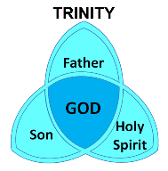
Romans 8:9
“However, you are not in the flesh but in the Spirit, if indeed the Spirit of God dwells in you. But if anyone does not have the Spirit of Christ, he does not belong to Him.”

Slide 67
1 Corinthians 6:19
“Or do you not know that your body is a temple of the Holy Spirit who is in you, whom you have from God, and that you are not your own?”

Slide 68
John 14:16-17
¹⁶ I will ask the Father, and He will give you another Helper, that He may be with you forever; ¹⁷ that is the Spirit of truth, whom the world cannot receive, because it does not see Him or know Him, but you know Him because He abides with you and will be in you.

Slide 69
Ephesians 4:30
“Do not grieve the Holy Spirit of God, by whom you were sealed for the day of redemption.”

Slide 70
Work of the Spirit in the OT vs. Church Age
 | OT/Gospels | Today
Reception of all of the Spirit at the moment of salvation? | Subsequent to salvation (Exod 31:3) | At moment of salvation (Rom 8:9)
How long is the indwelling? | Temporary indwelling (1 Sam 16:14; Ps 51:11) | Permanent indwelling (John 14:16)
Who is indwelt? | Selective indwelling (Joel 2:28) | Universal indwelling (1 Cor 12:13)

Slide 71
Restrainer Must First be Removed
Restrainer holds back the Antichrist (2 Thess 2:6-7)
Restrainer = the omnipotent Holy Spirit (2 Thess 2:9)
Holy Spirit permanently indwells all Christians (John 14:16; Rom 8:9)
Spirit indwelt Christians must first be removed prior to the Antichrist's advent

Slide 72
Psalm 139:7-8
“⁷ Where can I go from Your Spirit? Or where can I flee from Your presence? ⁸ If I ascend to heaven, You are there; If I make my bed in Sheol, behold, You are there..”

Slide 73
Distinctions Between 144,000 & Multitude
144,000 | MULTITUDE
Revelation 7:1-8 | Revelation 7:9-17
Numbered | Innumerable
Jews | All nations
Sealed | Slain
Sealed before the Tribulation | Converted out of the Tribulation
Hitchcock and Ice, The Truth Behind Left Behind, 77

Slide 74
Work of the Spirit in the OT vs. Church Age
 | OT/Gospels | Today
Reception of all of the Spirit at the moment of salvation? | Subsequent to salvation (Exod 31:3) | At moment of salvation (Rom 8:9)
How long is the indwelling? | Temporary indwelling (1 Sam 16:14; Ps 51:11) | Permanent indwelling (John 14:16)
Who is indwelt? | Selective indwelling (Joel 2:28) | Universal indwelling (1 Cor 12:13)

Slide 75
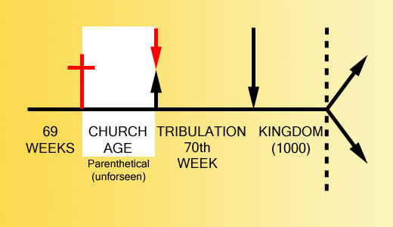

Slide 77
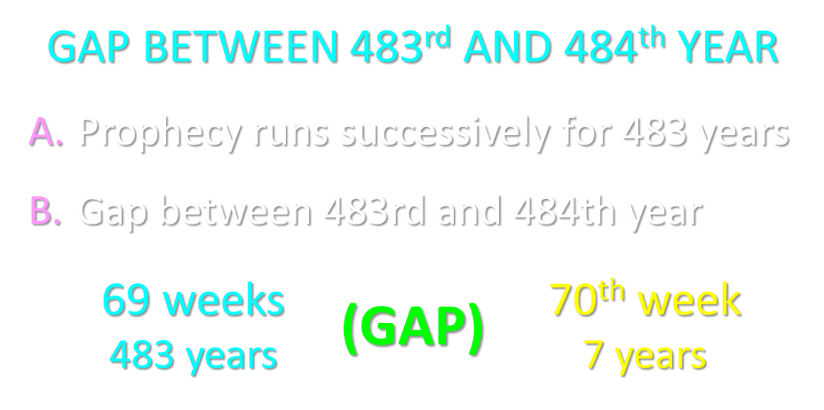

Slide 78
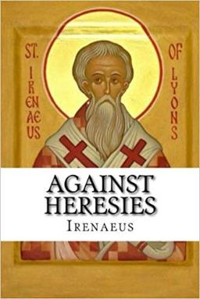
Late Date (A.D. 95) Irenaeus Against Heresies 5.30.3
“But if it had been necessary to announce his name plainly at the present time, it would have been spoken by him who saw the apocalypse. For it was not seen long ago, but almost in our own time, at the end of the reign of Domitian.”

Slide 79
Ezekiel 28:13, 15
“¹³ You were in Eden, the garden of God; Every precious stone was your covering: The ruby, the topaz and the diamond; The beryl, the onyx and the jasper; The lapis lazuli, the turquoise and the emerald; And the gold, the workmanship of your settings and sockets, Was in you. On the day that you were created They were prepared… ¹⁵ You were blameless in your ways From the day you were created Until unrighteousness was found in you.”

Slide 80
1 John 4:3
“and every spirit that does not confess Jesus is not from God; this is the spirit of the antichrist, of which you have heard that it is coming, and now it is already in the world.”

Slide 81
2 Thessalonians 2:7
“For the mystery of lawlessness is already at work; only he who now restrains will do so until he is taken out of the way.”

Slide 82
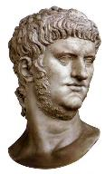

Slide 83
Conclusion

Slide 84
When is the Rapture? 7 Arguments Favoring the Pre-Tribulation View
Tribulation's purpose concerns Israel (Jer 30:7; Dan 9:24)
No biblical reference to the church on earth during the Tribulation period (Rev 4-22)
Church is promised an exemption from divine wrath (1 Thess 1:10; 5:9; Rom 5:9; Rev 3:10; 6:17)
Rapture is imminent (1 Cor 15:51; 1 Thess 4:15)
Rapture is a comfort (1 Thess 4:18)
Antichrist cannot come to power until the restrainer is removed (2 Thess 2:6-7)
Symbolic parallels (2 Peter 2:5-9)

