Slide 1
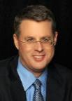
THE RAPTURE
What and When? – Part 5
Dr. Andy Woods
Senior Pastor – Sugar Land Bible Church
President – Chafer Theological Seminary

Slide 2
Joel Richardson
https://christinprophecy.org/sermons/jan-markell-on-the-mockery-of-bible-prophecy/
From 19:45 to 20:10
“What if the end of the world really isn’t as so many have portrayed it? What if the Church is not Raptured to heaven before the Great Tribulation as many are teaching? What if the Church has been left ill-prepared to face the Antichrist and the Mark of the Beast? What if Tim LaHaye’s claim that if the Pre-Tribulation Rapture is false then the Blessed Hope will become the blasted hope, actually comes true for millions of Pretribulationists? What if millions who have been led astray by the Pre-Trib teaching become part of the great falling away that Jesus warned would take place at that time? Left behind, or led astray?”

Slide 3
Joel Richardson
https://christinprophecy.org/sermons/jan-markell-on-the-mockery-of-bible-prophecy/
From 19:45 to 20:10
“The issue of the Pre-Tribulational versus the Post-Tribulational Rapture is one of the premier pastoral issues of our day. If you are a pastor that is not preparing your people to face potentially the Antichrist in the Great Tribulation in this hour simply because your denomination teaches it or whatever, personally I think you’re failing in your role as a shepherd and a pastor.”

Slide 4
What is the Rapture?
An important doctrine
Distinct from the Second Advent
Catching away of all living believers (1 Thess 4:17)
Reunion (1 Thess 4:14-16)
Resurrection (1 Cor 15:50-54)
Exemption from death (1 Cor 15:51, 54-56)
Instantaneous (1 Cor 15:52)
Mystery (1 Cor 15:51)
Imminent (1 Cor 15:51; 1 Thess 4:15)
Traditional doctrine now being recovered

Slide 5
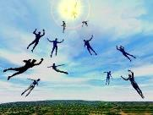
When Will the Rapture Take Place Relative to the Tribulation Period?
Pre-tribulation rapture theory
Mid-tribulation rapture theory
Post-tribulation rapture theory
Pre-wrath rapture theory
Partial rapture theory

Slide 7
When is the Rapture? 7 Arguments Favoring the Pre-Tribulation View
Tribulation's purpose concerns Israel (Jer 30:7; Dan 9:24)
No biblical reference to the church on earth during the Tribulation period (Rev 4-22)
Church is promised an exemption from divine wrath (1 Thess 1:10; 5:9; Rom 5:9; Rev 3:10; 6:17)
Rapture is imminent (1 Cor 15:51; 1 Thess 4:15)
Rapture is a comfort (1 Thess 4:18)
Antichrist cannot come to power until the restrainer is removed (2 Thess 2:6-7)
Symbolic parallels (2 Peter 2:5-9)

Slide 8
When is the Rapture? 7 Arguments Favoring the Pre-Tribulation View
Tribulation's purpose concerns Israel (Jer 30:7; Dan 9:24)
No biblical reference to the church on earth during the Tribulation period (Rev 4-22)
Church is promised an exemption from divine wrath (1 Thess 1:10; 5:9; Rom 5:9; Rev 3:10; 6:17)
Rapture is imminent (1 Cor 15:51; 1 Thess 4:15)
Rapture is a comfort (1 Thess 4:18)
Antichrist cannot come to power until the restrainer is removed (2 Thess 2:6-7)
Symbolic parallels (2 Peter 2:5-9)

Slide 9
When is the Rapture? 7 Arguments Favoring the Pre-Tribulation View
Tribulation's purpose concerns Israel (Jer 30:7; Dan 9:24)
No biblical reference to the church on earth during the Tribulation period (Rev 4-22)
Church is promised an exemption from divine wrath (1 Thess 1:10; 5:9; Rom 5:9; Rev 3:10; 6:17)
Rapture is imminent (1 Cor 15:51; 1 Thess 4:15)
Rapture is a comfort (1 Thess 4:18)
Antichrist cannot come to power until the restrainer is removed (2 Thess 2:6-7)
Symbolic parallels (2 Peter 2:5-9)

Slide 10
Revelation 1:19
“Therefore write the things which you have seen, and the things which are, and the things which will take place after these things [meta tauta].”

Slide 11
Revelation 1:19
Seen (1)
Are (2–3)
After these things (4–22)

Slide 12
Revelation 1:19
“Therefore write the things which you have seen, and the things which are, and the things which will take place after these things [meta tauta].”

Slide 13
God’s Work Through Israel
Revelation 7 – 144,000 Jews
Revelation 11 – Two Jewish witnesses
Revelation 12 – Israel flees

Slide 14
Revelation 1:20
“As for the mystery of the seven stars which you saw in My right hand, and the seven golden lampstands: the seven stars are the angels of the seven churches, and the seven lampstands are the seven churches.”

Slide 15
Revelation 4:5
“Out from the throne come flashes of lightning and sounds and peals of thunder. And there were seven lamps of fire burning before the throne, which are the seven Spirits of God.”

Slide 16
Revelation 4:4
“Around the throne were twenty-four thrones; and upon the thrones I saw twenty-four elders sitting, clothed in white garments, and golden crowns on their heads.”

Slide 17
Revelation 5:8-10
“⁸ When He had taken the book, the four living creatures and the twenty-four elders fell down before the Lamb, each one holding a harp and golden bowls full of incense, which are the prayers of the saints. ⁹ And they sang a new song, saying, ‘Worthy are You to take the book and to break its seals; for You were slain, and purchased for God with Your blood men from every tribe and tongue and people and nation. ¹⁰ You have made them to be a kingdom and priests to our God; and they will reign upon the earth.’”

Slide 18
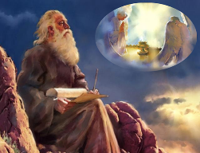
Twenty-Four Elders (Rev. 4:4; 5:8-10)
NOT
Israel
Redeemed of all ages
Angels

Slide 19
Twenty-Four Elders (Rev. 4:4; 5:8-10)
NOT
Israel
Redeemed of all ages
Angels

Slide 20
Revelation 4:4
“Around the throne were twenty-four thrones; and upon the thrones I saw twenty-four elders sitting, clothed in white garments, and golden crowns on their heads.”

Slide 22
Twenty-Four Elders (Rev. 4:4; 5:8-10)
NOT
Israel
Redeemed of all ages
Angels

Slide 23
Revelation 4:4
“Around the throne were twenty-four thrones; and upon the thrones I saw twenty-four elders sitting, clothed in white garments, and golden crowns on their heads.”

Slide 25
Twenty-Four Elders (Rev. 4:4; 5:8-10)
NOT
Israel
Redeemed of all ages
Angels

Slide 26
Revelation 4:4
“Around the throne were twenty-four thrones; and upon the thrones I saw twenty-four elders sitting, clothed in white garments, and golden crowns on their heads.”

Slide 27
Revelation 5:11
“Then I looked, and I heard the voice of many angels around the throne and the living creatures and the elders; and the number of them was myriads of myriads, and thousands of thousands.”

Slide 28
Revelation 7:11
“And all the angels were standing around the throne and around the elders and the four living creatures; and they fell on their faces before the throne and worshiped God.”

Slide 29
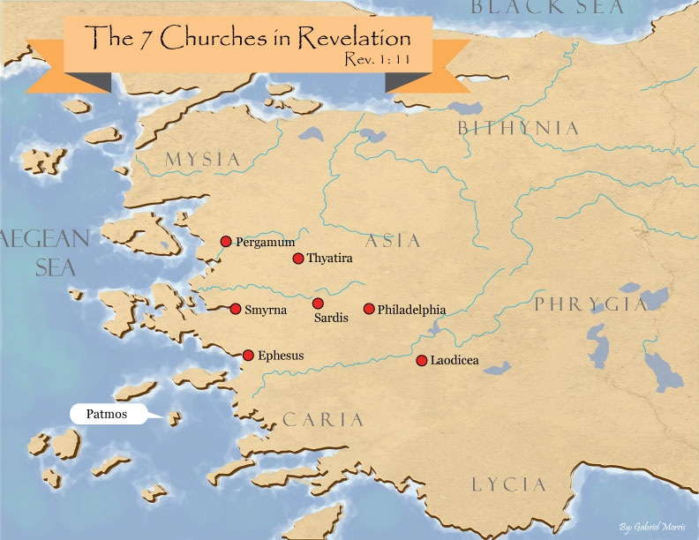

Slide 30
DESCRIPTION OF THE SEVEN CHURCHES REVELATION 2‒3
CHURCH | SCRIPTURE | DESCRIPTION
Ephesus | 2:1-7 | Loveless
Smyrna | 2:8-11 | Persecuted
Pergamum | 2:12-17 | Compromised
Thyatira | 2:18-29 | Corrupt
Sardis | 3:1-6 | Dead
Philadelphia | 3:7-13 | Missionary
Laodicea | 3:14-22 | Man-centered

Slide 31
Twenty-Four Elders (Rev. 4:4; 5:8-10)
CHURCH
Crowned (Rev. 2:10; 3:11)
Resurrected (Rev. 4:4)
Clothed in White (Rev. 3:5)
Redeemed (Rev. 5:8-10)
Global (Rev. 5:9; Matt. 28:19)
Enthroned (Rev. 3:21)
Elders (Rev. 1 Tim. 3:1-7)
Kingdom of Priests (Rev. 1:6)
Twenty-four (Rev. 1:6)

Slide 32
Twenty-Four Elders (Rev. 4:4; 5:8-10)
CHURCH
Crowned (Rev. 2:10; 3:11)
Resurrected (Rev. 4:4)
Clothed in White (Rev. 3:5)
Redeemed (Rev. 5:8-10)
Global (Rev. 5:9; Matt. 28:19)
Enthroned (Rev. 3:21)
Elders (Rev. 1 Tim. 3:1-7)
Kingdom of Priests (Rev. 1:6)
Twenty-four (Rev. 1:6)

Slide 33
Revelation 4:4
“Around the throne were twenty-four thrones; and upon the thrones I saw twenty-four elders sitting, clothed in white garments, and golden crowns on their heads.”

Slide 34
Scripture’s Five Crowns (Rev 4:10: 3:11; 2 John 8)
SCRIPTURE | CROWN | PURPOSE
1 Cor. 9:24-27 | Incorruptible | Gaining mastery over the flesh
1 Thess. 2:19-20 | Rejoicing | Soul winning
Jas. 1:12; Rev. 2:10 | Life | Enduring trials
1 Pet. 5:2-4 | Glory | Shepherding God’s people
2 Tim. 4:8 | Righteousness | Longing for His appearing

Slide 35
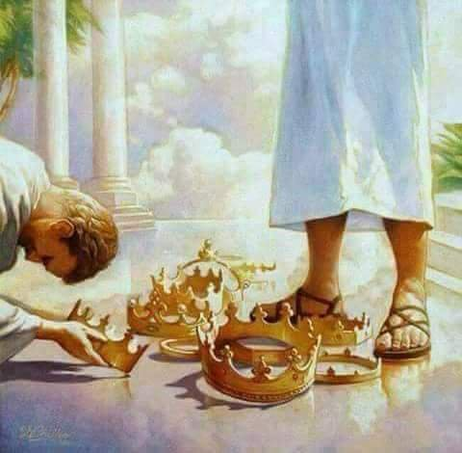

Slide 36
Twenty-Four Elders (Rev. 4:4; 5:8-10)
CHURCH
Crowned (Rev. 2:10; 3:11)
Resurrected (Rev. 4:4)
Clothed in White (Rev. 3:5)
Redeemed (Rev. 5:8-10)
Global (Rev. 5:9; Matt. 28:19)
Enthroned (Rev. 3:21)
Elders (Rev. 1 Tim. 3:1-7)
Kingdom of Priests (Rev. 1:6)
Twenty-four (Rev. 1:6)

Slide 37
Revelation 4:4
“Around the throne were twenty-four thrones; and upon the thrones I saw twenty-four elders sitting, clothed in white garments, and golden crowns on their heads.”

Slide 38
What is the Rapture?
An important doctrine
Distinct from the Second Advent
Catching away of all living believers (1 Thess 4:17)
Reunion (1 Thess 4:14-16)
Resurrection (1 Cor 15:50-54)
Exemption from death (1 Cor 15:51, 54-56)
Instantaneous (1 Cor 15:52)
Mystery (1 Cor 15:51)
Imminent (1 Cor 15:51; 1 Thess 4:15)
Traditional doctrine now being recovered

Slide 39
Twenty-Four Elders (Rev. 4:4; 5:8-10)
CHURCH
Crowned (Rev. 2:10; 3:11)
Resurrected (Rev. 4:4)
Clothed in White (Rev. 3:5)
Redeemed (Rev. 5:8-10)
Global (Rev. 5:9; Matt. 28:19)
Enthroned (Rev. 3:21)
Elders (Rev. 1 Tim. 3:1-7)
Kingdom of Priests (Rev. 1:6)
Twenty-four (Rev. 1:6)

Slide 40
Revelation 4:4
“Around the throne were twenty-four thrones; and upon the thrones I saw twenty-four elders sitting, clothed in white garments, and golden crowns on their heads.”

Slide 41
Twenty-Four Elders (Rev. 4:4; 5:8-10)
CHURCH
Crowned (Rev. 2:10; 3:11)
Resurrected (Rev. 4:4)
Clothed in White (Rev. 3:5)
Redeemed (Rev. 5:8-10)
Global (Rev. 5:9; Matt. 28:19)
Enthroned (Rev. 3:21)
Elders (Rev. 1 Tim. 3:1-7)
Kingdom of Priests (Rev. 1:6)
Twenty-four (Rev. 1:6)

Slide 42
Revelation 5:9-10
“ ⁹ And they sang a new song, saying, ‘Worthy are You to take the book and to break its seals; for You were slain, and purchased for God with Your blood men from every tribe and tongue and people and nation. ¹⁰ You have made them to be a kingdom and priests to our God; and they will reign upon the earth.’”

Slide 43
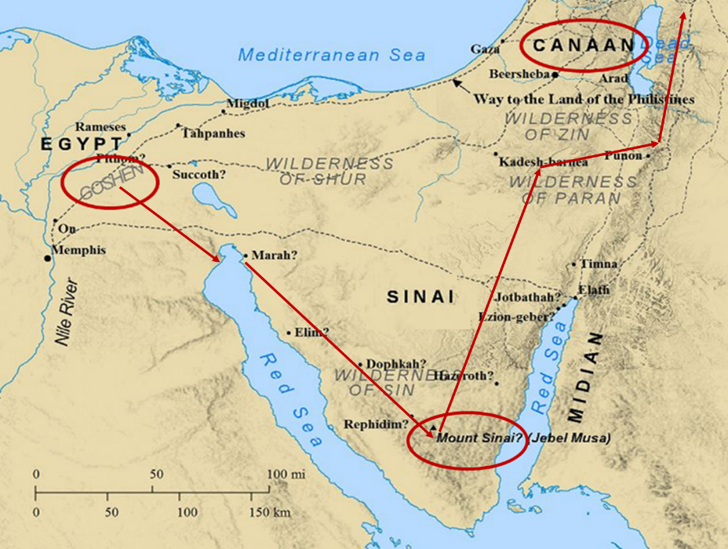

Slide 44
Exodus 15:13, 17
^{1 “}Then Moses and the sons of Israel sang this song to the Lord, and said…¹³ In Your lovingkindness You have led the people whom You have redeemed; In Your strength You have guided them to Your holy habitation…¹⁷ You will bring them and plant them in the mountain of Your inheritance, The place, O Lord, which You have made for Your dwelling, The sanctuary, O Lord, which Your hands have established.”

Slide 45
Revelation 5:9-10 (NKJV)
⁹ “And they sang a new song, saying: ‘You are worthy to take the scroll, And to open its seals; For You were slain, And have redeemed us to God by Your blood Out of every tribe and tongue and people and nation, ¹⁰ And have made us kings and priests to our God; And we shall reign on the earth.’”

Slide 46
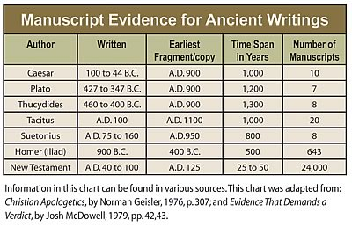

Slide 47
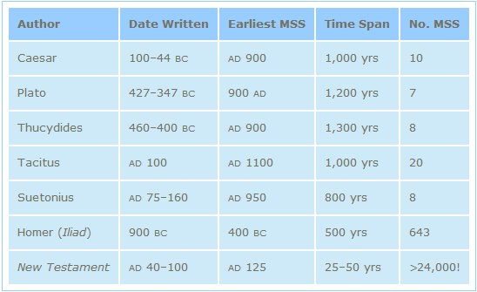
http://creationrevolution.com/2012/05/should-we-trust-the-bible/

Slide 48
J.A. Seiss
Seiss, J. A. (1901). The Apocalypse: A Series of Special Lectures on the Revelation of Jesus Christ with Revised Text (Eighth Edition, Vol. 1). New York: Charles C. Cook.
“Ηγὸρασας ἠμᾶς. Some critics and expositors have rejected this ἠμᾶς (us), for the reason that it is omitted in the Codex Alexandrinus, and in the Ethiopic verson; though the latter is not much more than a loose paraphrase. The Codex Sinaiticus, however, which was discovered in 1860, and which is of equal antiquity and authority with the Codex Alexandrinus, contains it. The Codex Basilianus, in the Vatican, contains it. The Latin, Coptic or Memphitic, and Arminian, which are of great value, contain it.”

Slide 49
J.A. Seiss
Seiss, J. A. (1901). The Apocalypse: A Series of Special Lectures on the Revelation of Jesus Christ with Revised Text (Eighth Edition, Vol. 1). New York: Charles C. Cook.
“And so do all other MSS. and versions. And to discredit it, simply and only because it does not appear in that one single Codex of Alexandria, is most unreasonable and unjust to the weight of authority for its retention. Dr. Tregelles, on full examination, was firmly convinced of its right to a place in the text, before the Codex Sinaiticus appeared; and the presence of this ἠμᾶς in that MS., ought to settle the question of its genuineness forever. The evidences from the context, also argue powerfully for a construction which necessarily embraces it, whether expressed or not. We regard it as indubitably genuine.”

Slide 50
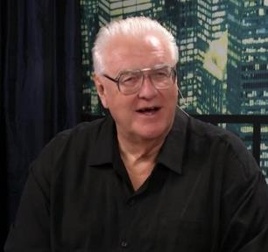
David Hocking
David Hocking, The Book of Revelation: Understanding the Future (Tustin, CA: Hope For Today Publications, 2014), 271.
“The Greek manuscripts (that we have today) of the passage in Revelation 5:9 are 24 in number, and 23 of them read “US” ‒ only Codex Alexandrinus differs in this regard.”

Slide 51
David Hocking
David Hocking, The Book of Revelation: Understanding the Future (Tustin, CA: Hope For Today Publications, 2014), 271.
“You maybe asking ‒ ‘what difference does it make, and why go to all the trouble that is listed above?’ The answer is quite important: The King James reading of the text clearly teaches that church-age believers (represented by the 24 elders in heaven) are singing a song about their own redemption, and since the 24 elders are in heaven all during the tribulation ‒ the correct view of Bible prophecy as to the rapture of the church-age believers (Jew and Gentile) is that they are removed BEFORE the tribulation begins! Our response is simple ‒ PRAISE THE LORD!”

Slide 52
Twenty-Four Elders (Rev. 4:4; 5:8-10)
CHURCH
Crowned (Rev. 2:10; 3:11)
Resurrected (Rev. 4:4)
Clothed in White (Rev. 3:5)
Redeemed (Rev. 5:8-10)
Global (Rev. 5:9; Matt. 28:19)
Enthroned (Rev. 3:21)
Elders (Rev. 1 Tim. 3:1-7)
Kingdom of Priests (Rev. 1:6)
Twenty-four (Rev. 1:6)

Slide 53
Revelation 5:8-10
“⁸ When He had taken the book, the four living creatures and the twenty-four elders fell down before the Lamb, each one holding a harp and golden bowls full of incense, which are the prayers of the saints. ⁹ And they sang a new song, saying, ‘Worthy are You to take the book and to break its seals; for You were slain, and purchased for God with Your blood men from every tribe and tongue and people and nation. ¹⁰ You have made them to be a kingdom and priests to our God; and they will reign upon the earth.’”

Slide 54
Twenty-Four Elders (Rev. 4:4; 5:8-10)
CHURCH
Crowned (Rev. 2:10; 3:11)
Resurrected (Rev. 4:4)
Clothed in White (Rev. 3:5)
Redeemed (Rev. 5:8-10)
Global (Rev. 5:9; Matt. 28:19)
Enthroned (Rev. 3:21)
Elders (Rev. 1 Tim. 3:1-7)
Kingdom of Priests (Rev. 1:6)
Twenty-four (Rev. 1:6)

Slide 55
Revelation 4:4
“Around the throne were twenty-four thrones; and upon the thrones I saw twenty-four elders sitting, clothed in white garments, and golden crowns on their heads.”

Slide 56
Rev 3:21
Promise to the Overcomers
“He who overcomes, I will grant to him to sit down with Me on My throne, as I also overcame and sat down with My Father on His throne.”

Slide 57
Twenty-Four Elders (Rev. 4:4; 5:8-10)
CHURCH
Crowned (Rev. 2:10; 3:11)
Resurrected (Rev. 4:4)
Clothed in White (Rev. 3:5)
Redeemed (Rev. 5:8-10)
Global (Rev. 5:9; Matt. 28:19)
Enthroned (Rev. 3:21)
Elders (Rev. 1 Tim. 3:1-7)
Kingdom of Priests (Rev. 1:6)
Twenty-four (Rev. 1:6)

Slide 58
Revelation 4:4
“Around the throne were twenty-four thrones; and upon the thrones I saw twenty-four elders sitting, clothed in white garments, and golden crowns on their heads.”

Slide 59
1 Peter 5:1, 5
“Therefore, I exhort the elders among you, as your fellow elder and witness of the sufferings of Christ, and a partaker also of the glory that is to be revealed…You younger men, likewise, be subject to your elders; and all of you, clothe yourselves with humility toward one another, for God is opposed to the proud, but gives grace to the humble.”

Slide 60
Twenty-Four Elders (Rev. 4:4; 5:8-10)
CHURCH
Crowned (Rev. 2:10; 3:11)
Resurrected (Rev. 4:4)
Clothed in White (Rev. 3:5)
Redeemed (Rev. 5:8-10)
Global (Rev. 5:9; Matt. 28:19)
Enthroned (Rev. 3:21)
Elders (Rev. 1 Tim. 3:1-7)
Kingdom of Priests (Rev. 1:6)
Twenty-four (Rev. 1:6)

Slide 61
Revelation 5:10
“You have made them to be a kingdom and priests to our God; and they will reign [basileuō] upon the earth [gē].”

Slide 62
Revelation 1:6
“and He has made us to be a kingdom, priests to His God and Father—to Him be the glory and the dominion forever and ever. Amen.”

Slide 63
Twenty-Four Elders (Rev. 4:4; 5:8-10)
CHURCH
Crowned (Rev. 2:10; 3:11)
Resurrected (Rev. 4:4)
Clothed in White (Rev. 3:5)
Redeemed (Rev. 5:8-10)
Global (Rev. 5:9; Matt. 28:19)
Enthroned (Rev. 3:21)
Elders (Rev. 1 Tim. 3:1-7)
Kingdom of Priests (Rev. 1:6)
Twenty-four (Rev. 1:6)

Slide 64
Revelation 4:4
“Around the throne were twenty-four thrones; and upon the thrones I saw twenty-four elders sitting, clothed in white garments, and golden crowns on their heads.”

Slide 65
Revelation 1:6
“and He has made us to be a kingdom, priests to His God and Father—to Him be the glory and the dominion forever and ever. Amen.”

Slide 66
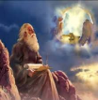
Twenty-Four Elders (Church) (Rev. 4:4; 5:8-10)
DESCRIPTION | SCRIPTURE
1. Crowned | (2:10)
2. Resurrected | (4:4)
3. Clothed in White | (3:5)
4. Redeemed | (5:8-10)
5. Global | (5:9; Matt. 28:19)
6. Enthroned | (3:21)
7. Elders | (1 Tim. 3:1-7; 1 Pet. 5:1, 5)
8. Kingdom of Priests | (Rev. 1:6)
9. Twenty-four | (Rev. 1:6)

Slide 67
Revelation 13:10
“If anyone is destined for captivity, to captivity he goes; if anyone kills with the sword, with the sword he must be killed. Here is the perseverance and the faith of the saints.”

Slide 68
Psalm 50:5 (NKJV)
“Gather My saints together to Me, Those who have made a covenant with Me by sacrifice.”

Slide 69
Psalm 149:1 (NKJV)
“Praise the Lord! Sing to the Lord a new song, And His praise in the assembly of saints.”

Slide 70
Matthew 16:18
“I also say to you that you are Peter, and upon this rock I will build [oikodomeō] My church; and the gates of Hades WILL NOT overpower it.”

Slide 71
Conclusion

Slide 72
When is the Rapture? 7 Arguments Favoring the Pre-Tribulation View
Tribulation's purpose concerns Israel (Jer 30:7; Dan 9:24)
No biblical reference to the church on earth during the Tribulation period (Rev 4-22)
Church is promised an exemption from divine wrath (1 Thess 1:10; 5:9; Rom 5:9; Rev 3:10; 6:17)
Rapture is imminent (1 Cor 15:51; 1 Thess 4:15)
Rapture is a comfort (1 Thess 4:18)
Antichrist cannot come to power until the restrainer is removed (2 Thess 2:6-7)
Symbolic parallels (2 Peter 2:5-9)

