Slide 1


HOW TO FIND JOY IN THE CHRISTIAN LIFE

Slide 2

Answering Ten Questions
Who wrote it? – Paul
To Whom was it written? – The Believers at Philippi
Where was it written from? – Rome
When was it written? – A.D. 62
What was the book’s occasion? – Five contacts
Who are the opponents? – Four opponents threatening joy
What is the book’s purpose? – To give joy during adversity
How is it organized (outline)? – Four- part outline
What is it about? – Joy during adverstiy
What makes the book different? – Personal & informal

Slide 3

Outline
Ch 1 – God can use negative circumstances to bring about positive results
Ch 2 – Christ’s example of servanthood
Ch 3 – Avoiding legalism
Ch 4 – Reliance upon Christ’s strength for daily life

Slide 4
Outline
Ch 1 – God can use negative circumstances to bring about positive results
Ch 2 – Christ’s example of servanthood
Ch 3 – Avoiding legalism
Ch 4 – Reliance upon Christ’s strength for daily life

Slide 5
Positive Results of Imprisonment
(Phil. 1:12-30)
Captive audience (Phil. 1:12-13)
Church’s boldness in preaching (Phil. 1:14-18)
Greater prayer (Phil. 1:19)
Protection from martyrdom (Phil. 1:20-26)

Slide 6
Outline
Ch 1 – God can use negative circumstances to bring about positive results
Ch 2 – Christ’s example of servanthood
Ch 3 – Avoiding legalism
Ch 4 – Reliance upon Christ’s strength for daily life

Slide 7

Examples of Humble Service
(Phil. 2)
Christ (Phil. 2:5-16)
Paul (Phil. 2:17-18)
Timothy (Phil. 2:19-24)
Epaphroditus (Phil. 2:25-30)

Slide 8
Outline
Ch 1 – God can use negative circumstances to bring about positive results
Ch 2 – Christ’s example of servanthood
Ch 3 – Avoiding legalism
Ch 4 – Reliance upon Christ’s strength for daily life

Slide 9

Genesis 2:16-17
“¹⁶ The Lord God commanded the man, saying, ‘From any tree of the garden you may eat freely; ¹⁷ but from the tree of the knowledge of good and evil you shall not eat, for in the day that you eat from it you will surely die.’”

Slide 10
Genesis 3:2-3
“² The woman said to the serpent, ‘From the fruit of the trees of the garden we may eat; ³ but from the fruit of the tree which is in the middle of the garden, God has said, ‘You shall not eat from it or touch it, or you will die.’”

Slide 11
Genesis 3:1, 4
“¹ Now the serpent was more crafty than any beast of the field which the Lord God had made. And he said to the woman, “Indeed, has God said, ‘You shall not eat from any tree of the garden’?” …⁴ The serpent said to the woman, ‘You surely will not die!’”

Slide 12

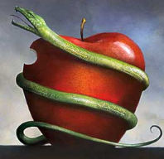
COMPLICATION OF THE SIMPLE
2 Cor. 11:3
“But I fear, lest somehow, as the serpent deceived Eve by his craftiness, so your minds may be corrupted by from the simplicity that is in Christ.” (Italics mine)

Slide 13


Galatians 3:3
“Are you so foolish? Having begun by the Spirit, are you now being perfected by the flesh?”

Slide 14

Avoid Legalism
(Phil. 3)
Legalists vs. true believers (Phil. 3:1-3)
Paul’s transition away from legalism (Phil. 3:4-14)
Other items to embrace in lieu of legalism (Phil. 3:15–4:3)

Slide 15
Avoid Legalism
(Phil. 3)
Legalists vs. true believers (Phil. 3:1-3)
Paul’s transition away from legalism (Phil. 3:4-14)
Other items to embrace in lieu of legalism (Phil. 3:15–4:3)

Slide 16
Legalists vs. True Believers
(Phil. 3:1-3)
Command to Rejoice (1)
Threat Posed by Legalists (2)
Characteristics of those walking by the Spirit (3)

Slide 17
Legalists vs. True Believers
(Phil. 3:1-3)
Command to Rejoice (1)
Threat Posed by Legalists (2)
Characteristics of those walking by the Spirit (3)

Slide 18
Three Tenses of Salvation
Phase | Justification | Sanctification | Glorification
Tense | Past | Present | Future
Saved from sin’s: | Penalty | Power | Presence
Scripture | Eph 2:8-9; Titus 3:5 | Philip 2:12 | Rom 5:10

Slide 19
Three Tenses of Salvation
Phase | Justification | Sanctification | Glorification
Tense | Past | Present | Future
Saved from sin’s: | Penalty | Power | Presence
Scripture | Eph 2:8-9; Titus 3:5 | Philip 2:12 | Rom 5:10

Slide 20
Order of Paul’s Letters
Galatians (A.D. 49)
1‒2 Thessalonians (A.D. 51)
1‒2 Corinthians (A.D. 56)
Romans (A.D. 57)
Ephesians, Colossians, Philemon, Philippians (A.D. 60‒62)
1 Timothy, Titus (A.D. 62‒66)
2 Timothy (A.D. 67)

Slide 21
Legalists vs. True Believers
(Phil. 3:1-3)
Command to Rejoice (1)
Threat Posed by Legalists (2)
Characteristics of those walking by the Spirit (3)

Slide 22
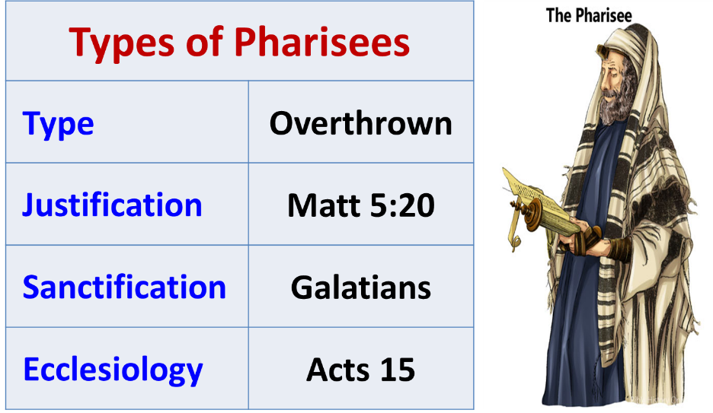

Slide 23
2. Threat Posed by Legalists
(Phil. 3:2)
Dogs
Evil workers
Circumcision

Slide 24
2. Threat Posed by Legalists
(Phil. 3:2)
Dogs
Evil workers
Circumcision

Slide 25
2. Threat Posed by Legalists
(Phil. 3:2)
Dogs
Evil workers
Circumcision

Slide 26
2. Threat Posed by Legalists
(Phil. 3:2)
Dogs
Evil workers
Circumcision

Slide 27
Legalists vs. True Believers
(Phil. 3:1-3)
Command to Rejoice (1)
Threat Posed by Legalists (2)
Characteristics of those walking by the Spirit (3)

Slide 28
3. Characteristics of those walking by the Spirit
(Phil. 3:3)
Genuinely circumcised
Spiritual worshippers
Glory in Christ
Put no confidence in the flesh

Slide 29
3. Characteristics of those walking by the Spirit
(Phil. 3:3)
Genuinely circumcised
Spiritual worshippers
Glory in Christ
Put no confidence in the flesh

Slide 30
3. Characteristics of those walking by the Spirit
(Phil. 3:3)
Genuinely circumcised
Spiritual worshippers
Glory in Christ
Put no confidence in the flesh

Slide 31
3. Characteristics of those walking by the Spirit
(Phil. 3:3)
Genuinely circumcised
Spiritual worshippers
Glory in Christ
Put no confidence in the flesh

Slide 32
3. Characteristics of those walking by the Spirit
(Phil. 3:3)
Genuinely circumcised
Spiritual worshippers
Glory in Christ
Put no confidence in the flesh

Slide 33
Avoid Legalism
(Phil. 3)
Legalists vs. true believers (Phil. 3:1-3)
Paul’s transition away from legalism (Phil. 3:4-14)
Other items to embrace in lieu of legalism (Phil. 3:15–4:3)

Slide 34
Paul’s Transition Away From Legalism
(Phil. 3:4-14)
A transitionary & general statement (Phil. 3:4)
Eight reasons for Paul’s fleshly confidence (Phil. 3:5-6)
Paul’s new spiritual priorities (Phil. 3:7-14)

Slide 35
Paul’s Transition Away From Legalism
(Phil. 3:4-14)
A transitionary & general statement (Phil. 3:4)
Eight reasons for Paul’s fleshly confidence (Phil. 3:5-6)
Paul’s new spiritual priorities (Phil. 3:7-14)

Slide 36
Paul’s Transition Away From Legalism
(Phil. 3:4-14)
A transitionary & general statement (Phil. 3:4)
Eight reasons for Paul’s fleshly confidence (Phil. 3:5-6)
Paul’s new spiritual priorities (Phil. 3:7-14)

Slide 37
Eight Reasons for Paul’s Fleshly Confidence
(Phil. 3:5-6)
Circumcision
Israeli
Benjaminite
Hebrew of Hebrews
Pharisee
Persecutor of the Church
Zeal
Blameless

Slide 38
Eight Reasons for Paul’s Fleshly Confidence
(Phil. 3:5-6)
Circumcision
Israeli
Benjaminite
Hebrew of Hebrews
Pharisee
Persecutor of the Church
Zeal
Blameless

Slide 39
Eight Reasons for Paul’s Fleshly Confidence
(Phil. 3:5-6)
Circumcision
Israeli
Benjaminite
Hebrew of Hebrews
Pharisee
Persecutor of the Church
Zeal
Blameless

Slide 40

Joshua 24:2-3

Slide 41

Genesis 12:3
“And I will bless those who bless you, And the one who curses you I will curse. And in you all the families of the earth will be blessed.”

Slide 42

Israel’s Three Blessings to the World
(Gen 12:3b)
Scripture (Rom 3:2)
Savior (John 4:22)
Kingdom (Isa 2:2-3)

Slide 43
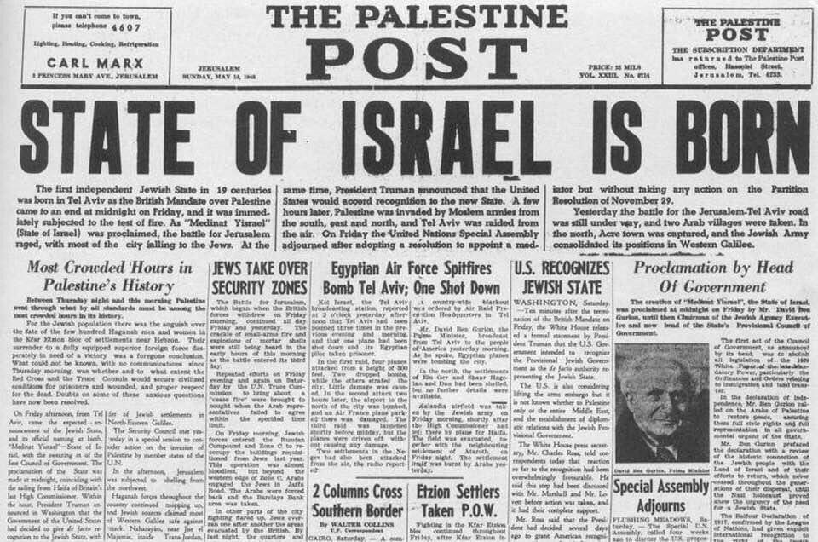

Slide 44
Eight Reasons for Paul’s Fleshly Confidence
(Phil. 3:5-6)
Circumcision
Israeli
Benjaminite
Hebrew of Hebrews
Pharisee
Persecutor of the Church
Zeal
Blameless

Slide 45
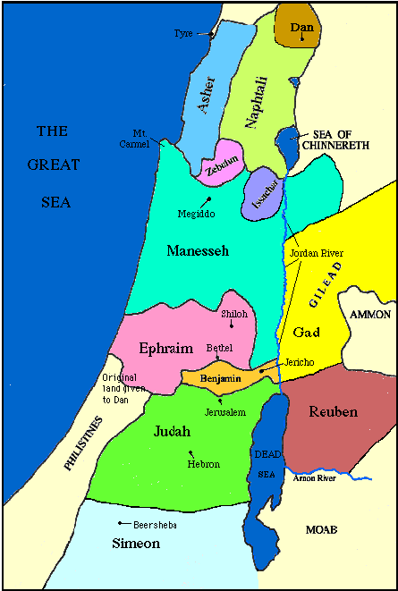

Slide 46
Eight Reasons for Paul’s Fleshly Confidence
(Phil. 3:5-6)
Circumcision
Israeli
Benjaminite
Hebrew of Hebrews
Pharisee
Persecutor of the Church
Zeal
Blameless

Slide 47
Eight Reasons for Paul’s Fleshly Confidence
(Phil. 3:5-6)
Circumcision
Israeli
Benjaminite
Hebrew of Hebrews
Pharisee
Persecutor of the Church
Zeal
Blameless

Slide 48

Mark 7:13
“thus invalidating the word of God by your tradition which you have handed down; and you do many things such as that.”

Slide 49
Eight Reasons for Paul’s Fleshly Confidence
(Phil. 3:5-6)
Circumcision
Israeli
Benjaminite
Hebrew of Hebrews
Pharisee
Persecutor of the Church
Zeal
Blameless

Slide 50
Eight Reasons for Paul’s Fleshly Confidence
(Phil. 3:5-6)
Circumcision
Israeli
Benjaminite
Hebrew of Hebrews
Pharisee
Persecutor of the Church
Zeal
Blameless

Slide 51
Eight Reasons for Paul’s Fleshly Confidence
(Phil. 3:5-6)
Circumcision
Israeli
Benjaminite
Hebrew of Hebrews
Pharisee
Persecutor of the Church
Zeal
Blameless

Slide 52
Paul’s Transition Away From Legalism
(Phil. 3:4-14)
A transitionary & general statement (Phil. 3:4)
Eight reasons for Paul’s fleshly confidence (Phil. 3:5-6)
Paul’s new spiritual priorities (Phil. 3:7-14)

Slide 53

Paul’s New Spiritual Priorities
(Phil. 3:7-14)
Rejection of fleshly things (7)
Embracing of spiritual things (8-14)
  Knowing Christ (8)
  Christ’s righteousness (9)
  Fellowship of His sufferings (10)
  Resurrection (11-12)
  Prize (13-14)

Slide 54
Paul’s New Spiritual Priorities
(Phil. 3:7-14)
Rejection of fleshly things (7)
Embracing of spiritual things (8-14)
  Knowing Christ (8)
  Christ’s righteousness (9)
  Fellowship of His sufferings (10)
  Resurrection (11-12)
  Prize (13-14)

Slide 55
Paul’s New Spiritual Priorities
(Phil. 3:7-14)
Rejection of fleshly things (7)
Embracing of spiritual things (8-14)
  Knowing Christ (8)
  Christ’s righteousness (9)
  Fellowship of His sufferings (10)
  Resurrection (11-12)
  Prize (13-14)

Slide 56
Paul’s New Spiritual Priorities
(Phil. 3:7-14)
Rejection of fleshly things (7)
Embracing of spiritual things (8-14)
  Knowing Christ (8)
  Christ’s righteousness (9)
  Fellowship of His sufferings (10)
  Resurrection (11-12)
  Prize (13-14)

Slide 57

Matthew 7:21-23
“Not everyone who says to Me, ‘Lord, Lord,’ will enter the kingdom of heaven, but he who does the will of My Father who is in heaven will enter. ²² Many will say to Me on that day, ‘Lord, Lord, did we not prophesy in Your name, and in Your name cast out demons, and in Your name perform many miracles?’ ²³ And then I will declare to them, ‘I never knew you; depart from Me, you who practice lawlessness.’”

Slide 58
Paul’s New Spiritual Priorities
(Phil. 3:7-14)
Rejection of fleshly things (7)
Embracing of spiritual things (8-14)
  Knowing Christ (8)
  Christ’s righteousness (9)
  Fellowship of His sufferings (10)
  Resurrection (11-12)
  Prize (13-14)

Slide 59

Three Transfers / Imputations
Adam’s Sin to All Humanity | Humanity’s Sin to Jesus Christ | Christ’s Righteousness to Believers
Hamartiology Rom. 5:12 | Christology 2 Cor. 5:21 | Soteriology Phil. 3:9

Slide 60
Paul’s New Spiritual Priorities
(Phil. 3:7-14)
Rejection of fleshly things (7)
Embracing of spiritual things (8-14)
  Knowing Christ (8)
  Christ’s righteousness (9)
  Fellowship of His sufferings (10)
  Resurrection (11-12)
  Prize (13-14)

Slide 61
Paul’s New Spiritual Priorities
(Phil. 3:7-14)
Rejection of fleshly things (7)
Embracing of spiritual things (8-14)
  Knowing Christ (8)
  Christ’s righteousness (9)
  Fellowship of His sufferings (10)
  Resurrection (11-12)
  Prize (13-14)

Slide 62

1 Corinthians 15:20-23
“²⁰ But now Christ has been raised from the dead, the first fruits of those who are asleep. ²¹-For since by a man came death, by a man also came the resurrection of the dead. ²² For as in Adam all die, so also in Christ all will be made alive. ²³ But each in his own order: Christ the first fruits, after that those who are Christ’s at His coming.”

Slide 63
Paul’s New Spiritual Priorities
(Phil. 3:7-14)
Rejection of fleshly things (7)
Embracing of spiritual things (8-14)
  Knowing Christ (8)
  Christ’s righteousness (9)
  Fellowship of His sufferings (10)
  Resurrection (11-12)
  Prize (13-14)

Slide 64

1 Corinthians 9:24-27
“Do you not know that those who run in a race all run, but only one receives the prize? Run in such a way that you may win. ²⁵ Everyone who competes in the games exercises self-control in all things. They then do it to receive a perishable wreath, but we an imperishable. ²⁶ Therefore I run in such a way, as not without aim; I box in such a way, as not beating the air; ²⁷ but I discipline my body and make it my slave, so that, after I have preached to others, I myself will not be disqualified.”

Slide 65
Avoid Legalism
(Phil. 3)
Legalists vs. true believers (Phil. 3:1-3)
Paul’s transition away from legalism (Phil. 3:4-14)
Other items to embrace in lieu of legalism (Phil. 3:15–4:3)

Slide 66
Other Items to Embrace in Lieu of Legalism
(Phil. 3:15–4:3)
Maturity (Phil. 3:15-16)
Avoiding license (Phil. 3:17-19)
Heavenly and eternal perspective (Phil. 3:20-21)
Unity (Phil. 4:1-3)

Slide 67
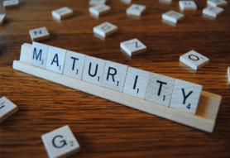
Other Items to Embrace in Lieu of Legalism
(Phil. 3:15–4:3)
Maturity (Phil. 3:15-16)
Avoiding license (Phil. 3:17-19)
Heavenly and eternal perspective (Phil. 3:20-21)
Unity (Phil. 4:1-3)

Slide 68
Ephesians 4:11-16
“¹¹ And He gave some as apostles, and some as prophets, and some as evangelists, and some as pastors and teachers, ¹² for the equipping of the saints for the work of service, to the building up of the body of Christ;” ¹³ until we all attain to the unity of the faith, and of the knowledge of the Son of God, to a mature man, to the measure of the stature which . . .

Slide 69
Ephesians 4:11-16
“... belongs to the fullness of Christ. ¹⁴ As a result, we are no longer to be children, tossed here and there by waves and carried about by every wind of doctrine, by the trickery of men, by craftiness in deceitful scheming; ¹⁵ but speaking the truth in love, we are to grow up in all aspects into Him who is the head, even . . .

Slide 70
Ephesians 4:11-16
“. . . Christ, ¹⁶ from whom the whole body, being fitted and held together by what every joint supplies, according to the proper working of each individual part, causes the growth of the body for the building up of itself in love.”

Slide 71

Charles Ryrie
The Ryrie Study Bible
“Philippians 3:15 (RSB:NASB1995U): 3:15 perfect = mature. In the latter half of the verse Paul says, in effect, ‘If you don’t agree, God will give you light on the subject.’”

Slide 72

Other Items to Embrace in Lieu of Legalism
(Phil. 3:15–4:3)
Maturity (Phil. 3:15-16)
Avoiding license (Phil. 3:17-19)
Heavenly and eternal perspective (Phil. 3:20-21)
Unity (Phil. 4:1-3)

Slide 73
Examples of Humble Service
(Phil. 2)
Christ (Phil. 2:5-16)
Paul (Phil. 2:17-18)
Timothy (Phil. 2:19-24)
Epaphroditus (Phil. 2:25-30)

Slide 74
Charles Ryrie
The Ryrie Study Bible
“Philippians 3:17 (RSB:NASB1995U): 3:17 Not many believers can exhort others to imitate them (the literal meaning of follow).”

Slide 75

Other Items to Embrace in Lieu of Legalism
(Phil. 3:15–4:3)
Maturity (Phil. 3:15-16)
Avoiding license (Phil. 3:17-19)
Heavenly and eternal perspective (Phil. 3:20-21)
Unity (Phil. 4:1-3)

Slide 76
RAPTURE DISTINCT FROM SECOND ADVENT
Rapture (1 Thess 4:13-17; 1 Cor 15:51-57) | Second Coming (Rev 19:11-16)
Christ comes in the air (1 Thess 4:16) | Christ comes to the earth (Zech 14:4)
For His saints (1 Thess 4:15-17) | With His saints (Rev 19:14)
Blessing (1 Thess 4:18) | Judgment (Rev 19:15)
Effects only believers (1 Thess 4:16) | Effects both believers and unbelievers (Rev 19:15)
Invisible (1 Thess 4:16) | Visible to all (Rev 1:7)
Announced only by an archangel (1 Thess 4:16) | Involves myriads of angels (Jude 14)
Resurrection (1 Cor15: 51) | No resurrection
Rescue of the church (1 Thess 1:10) | Rescue of Israel (Matt 23:37-39)

Slide 77


Slide 78
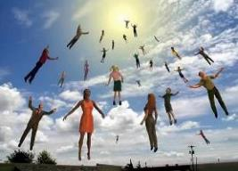
When Will the Rapture Take Place?
Pre-tribulation rapture theory
Mid-tribulation rapture theory
Post-tribulation rapture theory
Pre-wrath rapture theory
Partial rapture theory

Slide 79
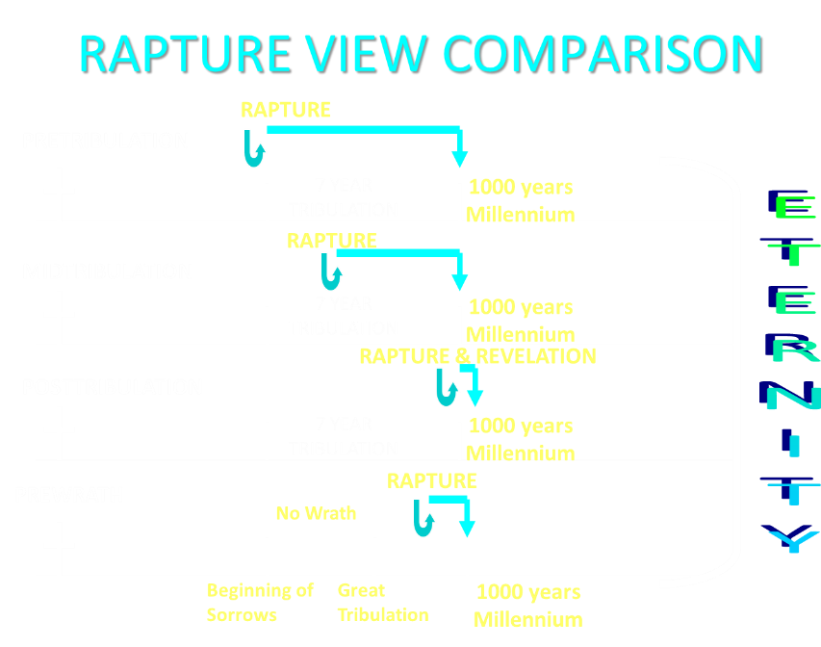

Slide 80

Pretribulationism is not Escapism
Trials (John 16:33)
Man’s wrath (2 Tim 3:12)
Satan’s wrath (Eph 6:11-12)
World’s wrath (John 15:18-19)

Slide 81

Romans 8:19-23
¹⁹ “For the anxious longing of the creation waits eagerly for the revealing of the sons of God. ²⁰ For the creation was subjected to futility, not willingly, but because of Him who subjected it, in hope ²¹ that the creation itself also will be set free from its slavery to corruption into the freedom of the glory of the children of God. ²² For we know that the whole creation groans and suffers the pains of childbirth together until now. ²³ And not only this, but also we ourselves, having the first fruits of the Spirit, even we ourselves groan within ourselves, waiting eagerly for our adoption as sons, the redemption of our body.”

Slide 82

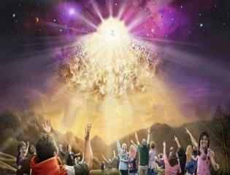
Titus 2:13
“Looking for the blessed hope and the appearing of the glory of our great God and Savior, Christ Jesus.”
82

Slide 83

Other Items to Embrace in Lieu of Legalism
(Phil. 3:15–4:3)
Maturity (Phil. 3:15-16)
Avoiding license (Phil. 3:17-19)
Heavenly and eternal perspective (Phil. 3:20-21)
Unity (Phil. 4:1-3)

Slide 84
1 Corinthians 3:1-3 (NKJV)
¹ And I, brethren, could not speak to you as to spiritual people but as to carnal, as to babes in Christ. ² I fed you with milk and not with solid food; for until now you were not able to receive it, and even now you are still not able; ³ for you are still carnal. For where there are envy, strife, and divisions among you, are you not carnal and behaving like mere men?

Slide 85

Notes:
Ray Steadman – “1st Californians”
Unbelievers vs Categories of Believers
Unbelievers – ψυχικός psuchikós; Natural, pertaining to the natural as distinguished from the spiritual
Spiritual Believers – πνευματικός pneumatikós; of persons who are spiritual, enlightened by the Holy Spirit
Infant Believers – σάρκινος sárkinos; with propensities of the flesh unto sin; νήπιος nḗpios; an infant, child, baby without any definite limitation of age. (This relates to immaturity and lack of instruction)
Carnal Believers – σαρκικός sarkikós; tendency to satisfy the flesh, implying sinfulness, sinful propensity, carnal (This relates to disobedience and open rebellion)

Slide 86
Conclusion

Slide 87
Avoid Legalism
(Phil. 3)
Legalists vs. true believers (Phil. 3:1-3)
Paul’s transition away from legalism (Phil. 3:4-14)
Other items to embrace in lieu of legalism (Phil. 3:15–4:3)

Slide 88

“The Lord bless you and keep you; the Lord make his face shine on you and be gracious to you; the Lord turn his face toward you and give you peace.” (NIV)

