Slide 1
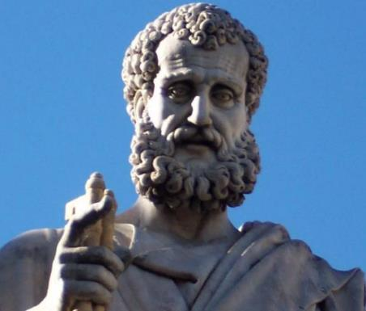

2 Peter
Dr. Andy Woods
Senior Pastor – Sugar Land Bible Church
President – Chafer Theological Seminary

Slide 2

INTRODUCTORY MATTERS
Authorship: Peter
Biography: Gospels & Acts
Date: A.D. 64
Recipients: Regenerated, Asia Minor, Hebrews
Place of writing: Babylon
Occasion for writing: Incipient Gnosticism
Purpose: Insulation from false teaching
Structure: 3 parts
Message: Protection from false teachers
Unique characteristics: Knowledge

Slide 3
STRUCTURE
2 Peter 1 – Call to maturity
2 Peter 2 – Characteristics of false teachers
2 Peter 3 – Doctrine of the false teachers (uniformitarianism)

Slide 4
STRUCTURE
2 Peter 1 – Call to maturity
2 Peter 2 – Characteristics of false teachers
2 Peter 3 – Doctrine of the false teachers (uniformitarianism)

Slide 5
2 PETER
Chapter 1
Introduction (1:1-2)
Call to Growth (1:3-11)
Purpose Statement (1:12-15)
Coming kingdom (1:16-21)

Slide 6
STRUCTURE
2 Peter 1 – Call to maturity
2 Peter 2 – Characteristics of false teachers
2 Peter 3 – Doctrine of the false teachers (uniformitarianism)

Slide 7

2 PETER 2 OUTLINE
Predicted arrival (2:1a)
Devices (2:1b-3)
Doom (2:4-9)
Depravity (2:10-16)
Emptiness (2:17-19)
Regression (2:20-22)

Slide 8
STRUCTURE
2 Peter 1 – Call to maturity
2 Peter 2 – Characteristics of false teachers
2 Peter 3 – Doctrine of the false teachers

Slide 9
OVERVIEW OF 2 PETER 3:3-15
Heresy of the false teachers (v3-4)
Motive of the false teachers (v3-4)
Peter’s rebuttal (v5-10)
Application (v11-15)

Slide 10
APPLICATION
V. 11-15
Holy Living (11b, 14)
Evangelism (12)
Hope (13)
Patience (15)

Slide 11

THREE CONCLUDING EXHORTATIONS
2 Peter 3:15-18

Slide 12
OVERVIEW 2 PETER 3:15-18
Regard the grace of God (v15)
Beware of false teachers (v16-17)
Grow in Christ (v18)

Slide 13
OVERVIEW 2 PETER 3:15-18
Regard the grace of God (v15)
Beware of false teachers (v16-17)
Grow in Christ (v18)

Slide 14
OVERVIEW 2 PETER 3:15-18
Regard the grace of God (v15)
Beware of false teachers (v16-17)
Grow in Christ (v18)

Slide 15

2 Peter 3:16-17
“as also in all his letters, speaking in them of these things, in which are some things hard to understand, which the untaught and unstable distort, as they do also the rest of the Scriptures, to their own destruction. ¹⁷ You therefore, beloved, knowing this beforehand, be on your guard so that you are not carried away by the error of unprincipled men and fall from your own steadfastness.”

Slide 16
BEWARE OF FALSE TEACHERS
(3:16-17)
Paul’s writings have given false teachers an opportunity
Rev 22:18-19
“Fall from your own steadfastness”?

Slide 17
2 Peter 3:16-17
“as also in all his letters, speaking in them of these things, in which are some things hard to understand, which the untaught and unstable distort, as they do also the rest of the Scriptures, to their own destruction. ¹⁷ You therefore, beloved, knowing this beforehand, be on your guard so that you are not carried away by the error of unprincipled men and fall from your own steadfastness.”

Slide 18
Revelation 22:18-19
“¹⁸ I testify to everyone who hears the words of the prophecy of this book: if anyone adds to them, God will add to him the plagues which are written in this book; ¹⁹ and if anyone takes away from the words of the book of this prophecy, God will take away his part [meros] from the tree of life and from the holy city, which are written in this book.”

Slide 19
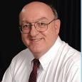
Dennis Rokser
Shall Never Perish Forever, p. 274
“To unbelievers who would add to God’s Word in this fashion, the Lord promises to ‘add to him the plagues that are written in this book.’ The plagues spoken of in the book of Revelation occur during that future period of God’s judgment on the earth known as the Tribulation. If anyone reading Revelation accepts the invitation of verse 17 and becomes a believer in Christ prior to the Tribulation, that person will experience the pretribulational Rapture of the saints (1 Thess. 4:13-18) rather than the plagues of the Tribulation (1 Thess. 5:1-3). Therefore, the warning of Revelation 22:18 applies only to unbelievers. This is not a warning to believers to stay saved or to be rewarded for their perseverance.”

Slide 20
Dennis Rokser
Shall Never Perish Forever, p. 273
“Verses 18-19 follow with a grave warning to unbelievers who would add to or subtract from the words of this book. Either adding to or taking away from the Word of God is characteristic of unbelievers who cannot simply accept by faith what God says in His Word. When God speaks, the response of the believing heart is simply ‘Amen.’ But the unbeliever does not accept what God says at face value, and so he must change the Word to suit himself.”

Slide 21
Dennis Rokser
Shall Never Perish Forever, p. 274
“A common characteristic of cults and religions that profess to be ‘Christian’ is that they invariably add other books, creeds, council decisions, or ‘inspired’ writings of their founder or leaders to the Bible, and they put these on a par with God’s Word.”

Slide 22
2 Peter 3:16-17
“¹⁶ as also in all his letters, speaking in them of these things, in which are some things hard to understand, which the untaught and unstable distort, as they do also the rest of the Scriptures, to their own destruction. ¹⁷ You therefore, beloved, knowing this beforehand, be on your guard so that you are not carried away by the error of unprincipled men and fall from your own steadfastness.”

Slide 23
2 Peter 1:1-2
“¹ Simon Peter, a bond-servant and apostle of Jesus Christ, To those who have received a faith of the same kind as ours, by the righteousness of our God and Savior, Jesus Christ: ² Grace and peace be multiplied to you in the knowledge of God and of Jesus our Lord.”

Slide 24
2 Peter 1:8-9
“⁸ For if these qualities are yours and are increasing, they render you neither useless nor unfruitful in the true knowledge of our Lord Jesus Christ. ⁹ For he who lacks these qualities is blind or short-sighted, having forgotten his purification from his former sins.”

Slide 25
Three Tenses of Salvation
Phase | Justification | Sanctification | Glorification
Tense | Past | Present | Future
Saved from sin’s: | Penalty | Power | Presence
Scripture | Eph 2:8-9; Titus 3:5 | Philip 2:12 | Rom 5:10

Slide 26
Three Tenses of Salvation
Phase | Justification | Sanctification | Glorification
Tense | Past | Present | Future
Saved from sin’s: | Penalty | Power | Presence
Scripture | Eph 2:8-9; Titus 3:5 | Philip 2:12 | Rom 5:10

Slide 27


Galatians 3:3
“Are you so foolish? Having begun by the Spirit, are you now being perfected by the flesh?”

Slide 28

Galatians 5:4
“You have been severed from Christ, you who are seeking to be justified by law; you have fallen from grace.”

Slide 29

1 Timothy 4:16
“Pay close attention to yourself and to your teaching; persevere in these things, for as you do this you will ensure salvation both for yourself and for those who hear you.”

Slide 30
OVERVIEW 2 PETER 3:15-18
Regard the grace of God (v15)
Beware of false teachers (v16-17)
Grow in Christ (v18)

Slide 31

2 Peter 3:18
“¹⁸ but grow in the grace and knowledge of our Lord and Savior Jesus Christ. To Him be the glory, both now and to the day of eternity. Amen.”

Slide 32
2 Peter 3:18
“¹⁸ but grow in the grace and knowledge of our Lord and Savior Jesus Christ. To Him be the glory, both now and to the day of eternity. Amen.”

Slide 33
GROW IN CHRIST
(3:18)
Maturity inoculates the believer against false teaching (Eph 4:11-16)
God’s glory is the ultimate motivation for maturity

Slide 34
GROW IN CHRIST
(3:18)
Maturity inoculates the believer against false teaching (Eph 4:11-16)
God’s glory is the ultimate motivation for maturity

Slide 35

Ephesians 4:11-16
“¹¹ And He gave some as apostles, and some as prophets, and some as evangelists, and some as pastors and teachers, ¹² for the equipping of the saints for the work of service, to the building up of the body of Christ;” ¹³ until we all attain to the unity of the faith, and of the knowledge of the Son of God, to a mature man, to the measure of the stature which . . .

Slide 36
Ephesians 4:11-16
“... belongs to the fullness of Christ. ¹⁴ As a result, we are no longer to be children, tossed here and there by waves and carried about by every wind of doctrine, by the trickery of men, by craftiness in deceitful scheming; ¹⁵ but speaking the truth in love, we are to grow up in all aspects into Him who is the head, even . . .

Slide 37
Ephesians 4:11-16
“. . . Christ, ¹⁶ from whom the whole body, being fitted and held together by what every joint supplies, according to the proper working of each individual part, causes the growth of the body for the building up of itself in love.”

Slide 38
2 Peter 3:18
“¹⁸ but grow in the grace and knowledge of our Lord and Savior Jesus Christ. To Him be the glory, both now and to the day of eternity. Amen.”

Slide 39
2 Peter 3:18
“¹⁸ but grow in the grace and knowledge of our Lord and Savior Jesus Christ. To Him be the glory, both now and to the day of eternity. Amen.”

Slide 40

Matt. 7:21-23
“Not everyone who says to Me, ‘Lord, Lord,’ will enter the kingdom of heaven, but he who does the will of My Father who is in heaven will enter. ²² Many will say to Me on that day, ‘Lord, Lord, did we not prophesy in Your name, and in Your name cast out demons, and in Your name perform many miracles?’ ²³ And then I will declare to them, ‘I never knew you; depart from Me, you who practice lawlessness.’”

Slide 41
2 Peter 3:18
“¹⁸ but grow in the grace and knowledge of our Lord and Savior Jesus Christ. To Him be the glory, both now and to the day of eternity. Amen.”

Slide 42
GROW IN CHRIST
(3:18)
Maturity inoculates the believer against false teaching (Eph 4:11-16)
God’s glory is the ultimate motivation for maturity

Slide 43
Dispensational Theology is a
System of Theology
Traditional-normative dispensational theology is a system that embodies three essential, fundamental concepts called the sine qua non (lit. “without which is not”):
The consistent use of a plain, normal, literal, grammatical-historical method of interpretation;
Which reveals that the Church is distinct from Israel;
God’s overall purpose is to bring glory to Himself (Eph. 1:6, 12, 14).
Dr. Charles Ryrie, Dispensationalism, pp. 38-41

Slide 44
Doxological Purpose
God’s ultimate purpose for the ages is to glorify Himself. Scripture is not human-centered, as though salvation were the principle point, but God-centered, because His glory is at the center.
The glory of God is the primary principle that unifies all dispensations, the program of salvation being just one of the means by which God glorifies Himself. Each successive revelation of God’s plan for the ages, as well as His dealing with the elect, non-elect, angels, and nations all manifest His glory.
Dictionary of Premillennial Theology, Charles Ryrie, p. 94

Slide 45
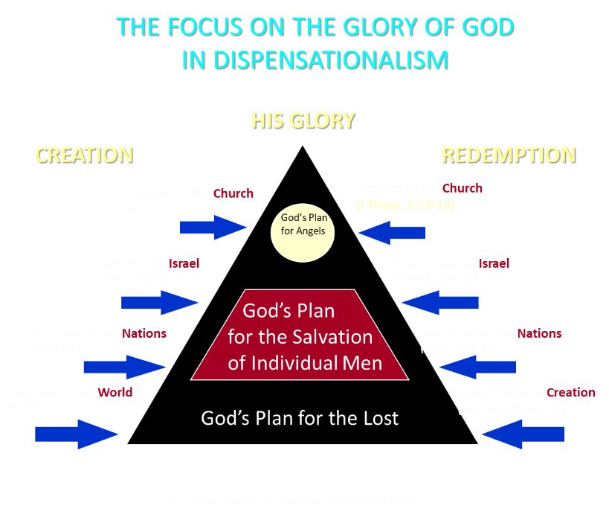

Slide 46

Westminster Shorter Catechism
Q. 1. What is the chief end of man?
A. Man’s chief end is to glorify God, and to enjoy Him forever.

Slide 47
OVERVIEW 2 PETER 3:15-18
Regard the grace of God (v15)
Beware of false teachers (v16-17)
Grow in Christ (v18)

Slide 48
CONCLUSION

Slide 49
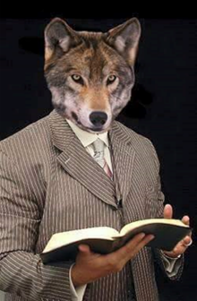
MESSAGE
Protection from the negative influence of the coming false teachers is accomplished through exhortation toward maturity and exposing the characteristics and doctrines of these coming false teachers

Slide 50
STRUCTURE
2 Peter 1 – Call to maturity
2 Peter 2 – Characteristics of false teachers
2 Peter 3 – Doctrine of the false teachers

