Slide 1
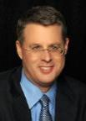
THE RAPTURE
What and When? – Part 5
Dr. Andy Woods
Senior Pastor – Sugar Land Bible Church
President – Chafer Theological Seminary

Slide 2
What is the Rapture?
An important doctrine
Distinct from the Second Advent
Catching away of all living believers (1 Thess 4:17)
Reunion (1 Thess 4:14-16)
Resurrection (1 Cor 15:50-54)
Exemption from death (1 Cor 15:51, 54-56)
Instantaneous (1 Cor 15:52)
Mystery (1 Cor 15:51)
Imminent (1 Cor 15:51; 1 Thess 4:15)
Traditional doctrine now being recovered

Slide 3
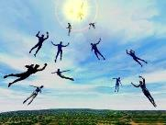
When Will the Rapture Take Place Relative to the Tribulation Period?
Pre-tribulation rapture theory
Mid-tribulation rapture theory
Post-tribulation rapture theory
Pre-wrath rapture theory
Partial rapture theory

Slide 5
When is the Rapture? 7 Arguments Favoring the Pre-Tribulation View
Tribulation's purpose concerns Israel (Jer 30:7; Dan 9:24)
No biblical reference to the church on earth during the Tribulation period (Rev 4-22)
Church is promised an exemption from divine wrath (1 Thess 1:10; 5:9; Rom 5:9; Rev 3:10; 6:17)
Rapture is imminent (1 Cor 15:51; 1 Thess 4:15)
Rapture is a comfort (1 Thess 4:18)
Antichrist cannot come to power until the restrainer is removed (2 Thess 2:6-7)
Symbolic parallels (2 Peter 2:5-9)

Slide 6
When is the Rapture? 7 Arguments Favoring the Pre-Tribulation View
Tribulation's purpose concerns Israel (Jer 30:7; Dan 9:24)
No biblical reference to the church on earth during the Tribulation period (Rev 4-22)
Church is promised an exemption from divine wrath (1 Thess 1:10; 5:9; Rom 5:9; Rev 3:10; 6:17)
Rapture is imminent (1 Cor 15:51; 1 Thess 4:15)
Rapture is a comfort (1 Thess 4:18)
Antichrist cannot come to power until the restrainer is removed (2 Thess 2:6-7)
Symbolic parallels (2 Peter 2:5-9)

Slide 7
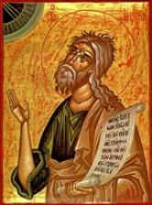
Jeremiah 30:7
“Alas! for that day is great, There is none like it; And it is the time of Jacob’s distress (Gen. 32:8; 35:10), But he will be saved from it.”

Slide 8
Daniel 9:24
Seventy weeks have been decreed for your people and your holy city, to finish the transgression, to make an end of sin, to make atonement for iniquity, to bring in everlasting righteousness, to seal up vision and prophecy and to anoint the most holy place.

Slide 9
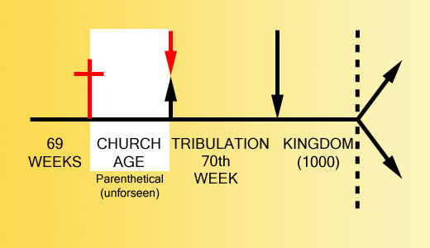

Slide 11
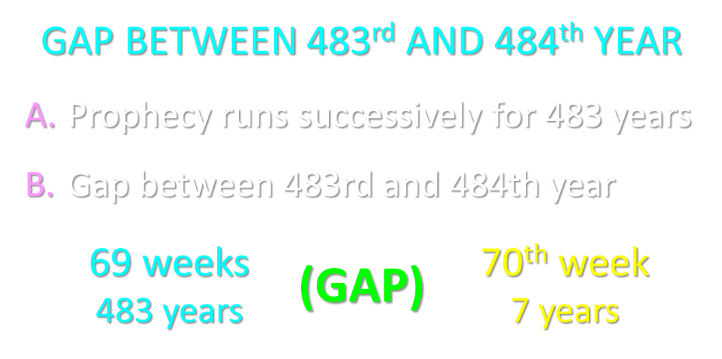

Slide 12
“Mystery” Defined
“In the N.T, it [mystērion] denotes, not the mysterious (as with the Eng. word), but that which, being outside the range of unassisted natural apprehension, can be made known only by Divine revelation, and is made known in a manner and at a time appointed by God, and to those who are illumined by His Spirit.”
W. E. Vine, Merrill F. Unger, and William White, Vine's Complete Expository Dictionary of the Old and New Testament Words (Nashville: Nelson, 1996), 424.

Slide 13
Ephesians 3:3-6
“³ that by revelation there was made known to me the mystery, as I wrote before in brief. ⁴ By referring to this, when you read you can understand my insight into the mystery of Christ, ⁵ which in other generations was not made known to the sons of men, as it has now been revealed to His holy apostles and prophets in the Spirit; ⁶ to be specific, that the Gentiles are fellow heirs and fellow members of the body, and fellow partakers of the promise in Christ Jesus through the gospel”.

Slide 14
Ephesians 3:9
“and to bring to light what is the administration of the mystery which for ages has been hidden in God who created all things.”

Slide 15
The Tribulation's Concerns Israel
Jer 30:7; Dan 9:24
God uses Israel and the church on a mutually exclusive basis

Slide 16
Daniel 12:7
I heard the man dressed in linen, who was above the waters of the river, as he raised his right hand and his left toward heaven, and swore by Him who lives forever that it would be for a time, times, and half a time; and as soon as they finish shattering the power of the holy people, all these events will be completed.

Slide 18
When is the Rapture? 7 Arguments Favoring the Pre-Tribulation View
Tribulation's purpose concerns Israel (Jer 30:7; Dan 9:24)
No biblical reference to the church on earth during the Tribulation period (Rev 4-22)
Church is promised an exemption from divine wrath (1 Thess 1:10; 5:9; Rom 5:9; Rev 3:10; 6:17)
Rapture is imminent (1 Cor 15:51; 1 Thess 4:15)
Rapture is a comfort (1 Thess 4:18)
Antichrist cannot come to power until the restrainer is removed (2 Thess 2:6-7)
Symbolic parallels (2 Peter 2:5-9)

Slide 19
Revelation 1:19
“Therefore write the things which you have seen, and the things which are, and the things which will take place after these things [meta tauta].”

Slide 20
Revelation 1:19
Seen (1)
Are (2–3)
After these things (4–22)

Slide 21
Revelation 1:19
Seen (1)
Are (2–3)
After these things (4–22)

Slide 22
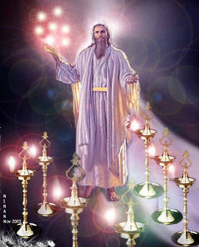

Slide 23
Revelation 1:19
Seen (1)
Are (2–3)
After these things (4–22)

Slide 24
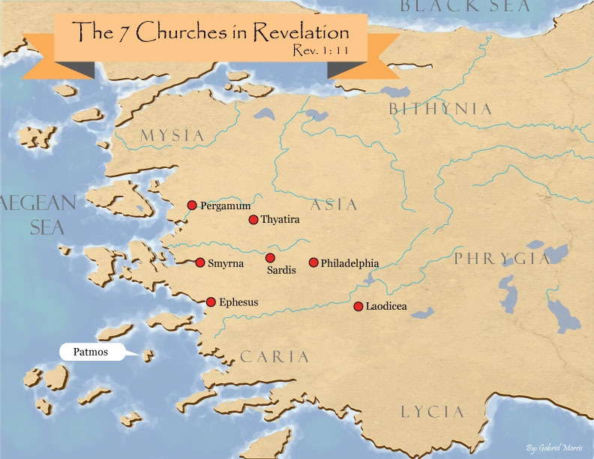

Slide 25
Revelation 1:19
Seen (1)
Are (2–3)
After these things (4–22)

Slide 26
Revelation 1:19
“Therefore write the things which you have seen, and the things which are, and the things which will take place after these things [meta tauta].”

Slide 27
Revelation 4:1
“After these things [meta tauta] I looked, and behold, a door standing open in heaven, and the first voice which I had heard, like the sound of a trumpet speaking with me, said, ‘Come up here, and I will show you what must take place after these things [meta tauta].’”

Slide 31
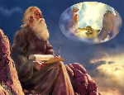
“After These Things” (Rev. 4‒22)
Before the Tribulation (4‒5)
During the Tribulation (6‒19)
After the Tribulation (20‒22)
Kingdom (20:1-10)
Great White Throne Judgment (20:11-15)
Destruction of the Earth (21:1)
New Heaven and New Earth (21‒22)

Slide 32
The Missing Church
Rev 4-19
Rev 13:9
Revelation’s Jewish nature

Slide 33
Romans 10:19
But I say, surely Israel did not know, did they? First Moses says, “I will make you jealous by that which is not a nation, By a nation without understanding will I anger you.”

Slide 34
Galatians 3:28
There is neither Jew nor Greek, there is neither slave nor free man, there is neither male nor female; for you are all one in Christ Jesus.

Slide 35
Ephesians 2:14
For He Himself is our peace, who made both groups into one and broke down the barrier of the dividing wall.

Slide 36
God’s Work Through Israel
Revelation 7-144,000 Jews
Revelation 11-Two Jewish witnesses
Revelation 12-Israel flees

Slide 37
Revelation 1:20
“As for the mystery of the seven stars which you saw in My right hand, and the seven golden lampstands: the seven stars are the angels of the seven churches, and the seven lampstands are the seven churches.”

Slide 38
Revelation 4:5
“Out from the throne come flashes of lightning and sounds and peals of thunder. And there were seven lamps of fire burning before the throne, which are the seven Spirits of God.”

Slide 39
Revelation 4:4
“Around the throne were twenty-four thrones; and upon the thrones I saw twenty-four elders sitting, clothed in white garments, and golden crowns on their heads.”

Slide 40
Revelation 5:8-10
“⁸ When He had taken the book, the four living creatures and the twenty-four elders fell down before the Lamb, each one holding a harp and golden bowls full of incense, which are the prayers of the saints. ⁹ And they sang a new song, saying, ‘Worthy are You to take the book and to break its seals; for You were slain, and purchased for God with Your blood men from every tribe and tongue and people and nation. ¹⁰ You have made them to be a kingdom and priests to our God; and they will reign upon the earth.’”

Slide 41
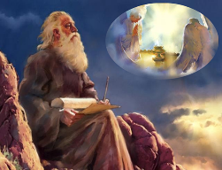
Twenty-Four Elders (Rev. 4:4; 5:8-10)
NOT
Israel
Redeemed of all ages
Angels

Slide 42
Twenty-Four Elders (Rev. 4:4; 5:8-10)
NOT
Israel
Redeemed of all ages
Angels

Slide 43
Revelation 4:4
“Around the throne were twenty-four thrones; and upon the thrones I saw twenty-four elders sitting, clothed in white garments, and golden crowns on their heads.”

Slide 45
Twenty-Four Elders (Rev. 4:4; 5:8-10)
NOT
Israel
Redeemed of all ages
Angels

Slide 46
Revelation 4:4
“Around the throne were twenty-four thrones; and upon the thrones I saw twenty-four elders sitting, clothed in white garments, and golden crowns on their heads.”

Slide 48
Twenty-Four Elders (Rev. 4:4; 5:8-10)
NOT
Israel
Redeemed of all ages
Angels

Slide 49
Revelation 4:4
“Around the throne were twenty-four thrones; and upon the thrones I saw twenty-four elders sitting, clothed in white garments, and golden crowns on their heads.”

Slide 50
Revelation 5:11
“Then I looked, and I heard the voice of many angels around the throne and the living creatures and the elders; and the number of them was myriads of myriads, and thousands of thousands.”

Slide 51
Revelation 7:11
“And all the angels were standing around the throne and around the elders and the four living creatures; and they fell on their faces before the throne and worshiped God.”

Slide 53
DESCRIPTION OF THE SEVEN CHURCHES Revelation 2‒3
CHURCH | SCRIPTURE | DESCRIPTION
Ephesus | 2:1-7 | Loveless
Smyrna | 2:8-11 | Persecuted
Pergamum | 2:12-17 | Compromised
Thyatira | 2:18-29 | Corrupt
Sardis | 3:1-6 | Dead
Philadelphia | 3:7-13 | Missionary
Laodicea | 3:14-22 | Man-centered

Slide 54
Twenty-Four Elders (Rev. 4:4; 5:8-10)
CHURCH
Crowned (Rev. 2:10; 3:11)
Resurrected (Rev. 4:4)
Clothed in White (Rev. 3:5)
Redeemed (Rev. 5:8-10)
Global (Rev. 5:9; Matt. 28:19)
Enthroned (Rev. 3:21)
Elders (Rev. 1 Tim. 3:1-7)
Kingdom of Priests (Rev. 1:6)
Twenty-four (Rev. 1:6)

Slide 55
Twenty-Four Elders (Rev. 4:4; 5:8-10)
CHURCH
Crowned (Rev. 2:10; 3:11)
Resurrected (Rev. 4:4)
Clothed in White (Rev. 3:5)
Redeemed (Rev. 5:8-10)
Global (Rev. 5:9; Matt. 28:19)
Enthroned (Rev. 3:21)
Elders (Rev. 1 Tim. 3:1-7)
Kingdom of Priests (Rev. 1:6)
Twenty-four (Rev. 1:6)

Slide 56
Revelation 4:4
“Around the throne were twenty-four thrones; and upon the thrones I saw twenty-four elders sitting, clothed in white garments, and golden crowns on their heads.”

Slide 57
Scripture’s Five Crowns (Rev 4:10: 3:11; 2 John 8)
SCRIPTURE | CROWN | PURPOSE
1 Cor. 9:24-27 | Incorruptible | Gaining mastery over the flesh
1 Thess. 2:19-20 | Rejoicing | Soul winning
Jas. 1:12; Rev. 2:10 | Life | Enduring trials
1 Pet. 5:2-4 | Glory | Shepherding God’s people
2 Tim. 4:8 | Righteousness | Longing for His appearing

Slide 58
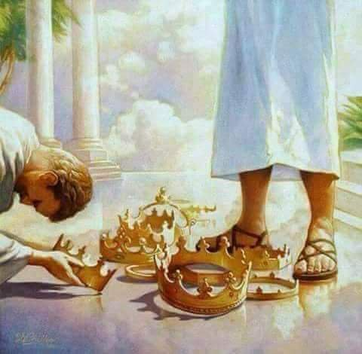

Slide 59
Twenty-Four Elders (Rev. 4:4; 5:8-10)
CHURCH
Crowned (Rev. 2:10; 3:11)
Resurrected (Rev. 4:4)
Clothed in White (Rev. 3:5)
Redeemed (Rev. 5:8-10)
Global (Rev. 5:9; Matt. 28:19)
Enthroned (Rev. 3:21)
Elders (Rev. 1 Tim. 3:1-7)
Kingdom of Priests (Rev. 1:6)
Twenty-four (Rev. 1:6)

Slide 60
Revelation 4:4
“Around the throne were twenty-four thrones; and upon the thrones I saw twenty-four elders sitting, clothed in white garments, and golden crowns on their heads.”

Slide 61
Twenty-Four Elders (Rev. 4:4; 5:8-10)
CHURCH
Crowned (Rev. 2:10; 3:11)
Resurrected (Rev. 4:4)
Clothed in White (Rev. 3:5)
Redeemed (Rev. 5:8-10)
Global (Rev. 5:9; Matt. 28:19)
Enthroned (Rev. 3:21)
Elders (Rev. 1 Tim. 3:1-7)
Kingdom of Priests (Rev. 1:6)
Twenty-four (Rev. 1:6)

Slide 62
Revelation 4:4
“Around the throne were twenty-four thrones; and upon the thrones I saw twenty-four elders sitting, clothed in white garments, and golden crowns on their heads.”

Slide 63
Twenty-Four Elders (Rev. 4:4; 5:8-10)
CHURCH
Crowned (Rev. 2:10; 3:11)
Resurrected (Rev. 4:4)
Clothed in White (Rev. 3:5)
Redeemed (Rev. 5:8-10)
Global (Rev. 5:9; Matt. 28:19)
Enthroned (Rev. 3:21)
Elders (Rev. 1 Tim. 3:1-7)
Kingdom of Priests (Rev. 1:6)
Twenty-four (Rev. 1:6)

Slide 64
Revelation 5:9-10
“ ⁹ And they sang a new song, saying, ‘Worthy are You to take the book and to break its seals; for You were slain, and purchased for God with Your blood men from every tribe and tongue and people and nation. ¹⁰ You have made them to be a kingdom and priests to our God; and they will reign upon the earth.’”

Slide 65
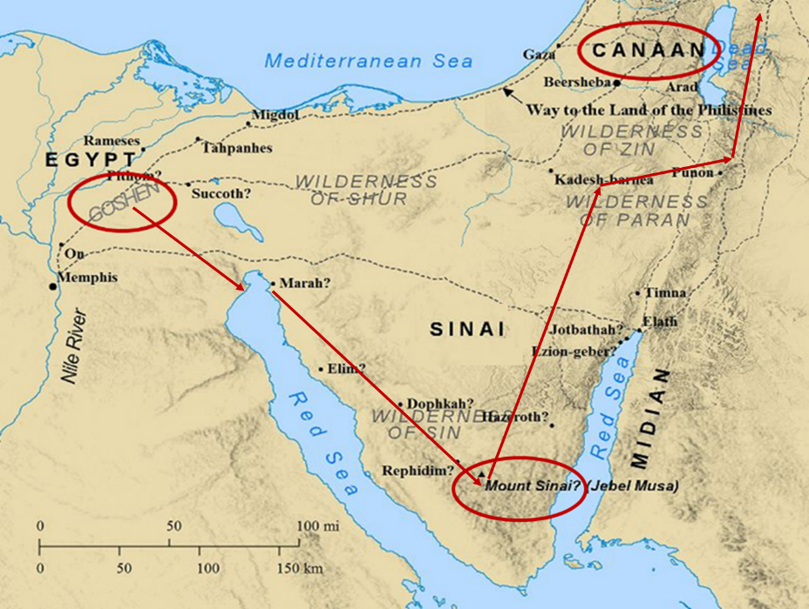

Slide 66
Exodus 15:13, 17
^{13 “}In Your lovingkindness You have led the people whom You have redeemed; In Your strength You have guided them to Your holy habitation…¹⁷ You will bring them and plant them in the mountain of Your inheritance, The place, O Lord, which You have made for Your dwelling, The sanctuary, O Lord, which Your hands have established.”

Slide 67
Revelation 5:9-10 (NKJV)
⁹ “And they sang a new song, saying: ‘You are worthy to take the scroll, And to open its seals; For You were slain, And have redeemed us to God by Your blood Out of every tribe and tongue and people and nation, ¹⁰ And have made us kings and priests to our God; And we shall reign on the earth.’”

Slide 68
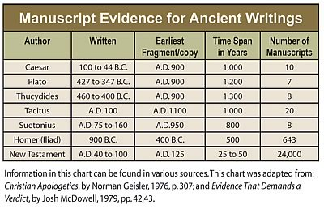

Slide 69
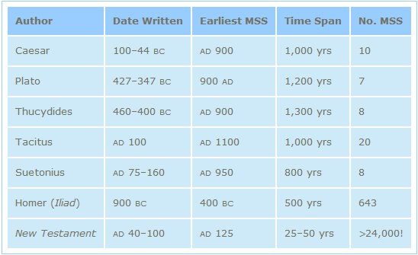
http://creationrevolution.com/2012/05/should-we-trust-the-bible/

Slide 70
J.A. Seiss
Seiss, J. A. (1901). The Apocalypse: A Series of Special Lectures on the Revelation of Jesus Christ with Revised Text (Eighth Edition, Vol. 1). New York: Charles C. Cook.
“Ηγὸρασας ἠμᾶς. Some critics and expositors have rejected this ἠμᾶς (us), for the reason that it is omitted in the Codex Alexandrinus, and in the Ethiopic verson; though the latter is not much more than a loose paraphrase. The Codex Sinaiticus, however, which was discovered in 1860, and which is of equal antiquity and authority with the Codex Alexandrinus, contains it. The Codex Basilianus, in the Vatican, contains it. The Latin, Coptic or Memphitic, and Arminian, which are of great value, contain it.”

Slide 71
J.A. Seiss
Seiss, J. A. (1901). The Apocalypse: A Series of Special Lectures on the Revelation of Jesus Christ with Revised Text (Eighth Edition, Vol. 1). New York: Charles C. Cook.
“And so do all other MSS. and versions. And to discredit it, simply and only because it does not appear in that one single Codex of Alexandria, is most unreasonable and unjust to the weight of authority for its retention. Dr. Tregelles, on full examination, was firmly convinced of its right to a place in the text, before the Codex Sinaiticus appeared; and the presence of this ἠμᾶς in that MS., ought to settle the question of its genuineness forever. The evidences from the context, also argue powerfully for a construction which necessarily embraces it, whether expressed or not. We regard it as indubitably genuine.”

Slide 72
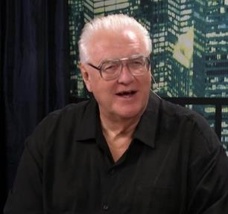
David Hocking
David Hocking, The Book of Revelation: Understanding the Future (Tustin, CA: Hope For Today Publications, 2014), 271.
“The Greek manuscripts (that we have today) of the passage in Revelation 5:9 are 24 in number, and 23 of them read “US” ‒ only Codex Alexandrinus differs in this regard.”

Slide 73
David Hocking
David Hocking, The Book of Revelation: Understanding the Future (Tustin, CA: Hope For Today Publications, 2014), 271.
“You maybe asking ‒ ‘what difference does it make, and why go to all the trouble that is listed above?’ The answer is quite important: The King James reading of the text clearly teaches that church-age believers (represented by the 24 elders in heaven) are singing a song about their own redemption, and since the 24 elders are in heaven all during the tribulation ‒ the correct view of Bible prophecy as to the rapture of the church-age believers (Jew and Gentile) is that they are removed BEFORE the tribulation begins! Our response is simple ‒ PRAISE THE LORD!”

Slide 74
Twenty-Four Elders (Rev. 4:4; 5:8-10)
CHURCH
Crowned (Rev. 2:10; 3:11)
Resurrected (Rev. 4:4)
Clothed in White (Rev. 3:5)
Redeemed (Rev. 5:8-10)
Global (Rev. 5:9; Matt. 28:19)
Enthroned (Rev. 3:21)
Elders (Rev. 1 Tim. 3:1-7)
Kingdom of Priests (Rev. 1:6)
Twenty-four (Rev. 1:6)

Slide 75
Revelation 5:8-10
“⁸ When He had taken the book, the four living creatures and the twenty-four elders fell down before the Lamb, each one holding a harp and golden bowls full of incense, which are the prayers of the saints. ⁹ And they sang a new song, saying, ‘Worthy are You to take the book and to break its seals; for You were slain, and purchased for God with Your blood men from every tribe and tongue and people and nation. ¹⁰ You have made them to be a kingdom and priests to our God; and they will reign upon the earth.’”

Slide 76
Twenty-Four Elders (Rev. 4:4; 5:8-10)
CHURCH
Crowned (Rev. 2:10; 3:11)
Resurrected (Rev. 4:4)
Clothed in White (Rev. 3:5)
Redeemed (Rev. 5:8-10)
Global (Rev. 5:9; Matt. 28:19)
Enthroned (Rev. 3:21)
Elders (Rev. 1 Tim. 3:1-7)
Kingdom of Priests (Rev. 1:6)
Twenty-four (Rev. 1:6)

Slide 77
Revelation 4:4
“Around the throne were twenty-four thrones; and upon the thrones I saw twenty-four elders sitting, clothed in white garments, and golden crowns on their heads.”

Slide 78
Rev 3:21
Promise to the Overcomers
“He who overcomes, I will grant to him to sit down with Me on My throne, as I also overcame and sat down with My Father on His throne.”

Slide 79
Twenty-Four Elders (Rev. 4:4; 5:8-10)
CHURCH
Crowned (Rev. 2:10; 3:11)
Resurrected (Rev. 4:4)
Clothed in White (Rev. 3:5)
Redeemed (Rev. 5:8-10)
Global (Rev. 5:9; Matt. 28:19)
Enthroned (Rev. 3:21)
Elders (Rev. 1 Tim. 3:1-7)
Kingdom of Priests (Rev. 1:6)
Twenty-four (Rev. 1:6)

Slide 80
Revelation 4:4
“Around the throne were twenty-four thrones; and upon the thrones I saw twenty-four elders sitting, clothed in white garments, and golden crowns on their heads.”

Slide 81
1 Peter 5:1, 5
“Therefore, I exhort the elders among you, as your fellow elder and witness of the sufferings of Christ, and a partaker also of the glory that is to be revealed…You younger men, likewise, be subject to your elders; and all of you, clothe yourselves with humility toward one another, for God is opposed to the proud, but gives grace to the humble.”

Slide 82
Twenty-Four Elders (Rev. 4:4; 5:8-10)
CHURCH
Crowned (Rev. 2:10; 3:11)
Resurrected (Rev. 4:4)
Clothed in White (Rev. 3:5)
Redeemed (Rev. 5:8-10)
Global (Rev. 5:9; Matt. 28:19)
Enthroned (Rev. 3:21)
Elders (Rev. 1 Tim. 3:1-7)
Kingdom of Priests (Rev. 1:6)
Twenty-four (Rev. 1:6)

Slide 83
Revelation 5:10
“You have made them to be a kingdom and priests to our God; and they will reign [basileuō] upon the earth [gē].”

Slide 84
Revelation 1:6
“and He has made us to be a kingdom, priests to His God and Father—to Him be the glory and the dominion forever and ever. Amen.”

Slide 85
Twenty-Four Elders (Rev. 4:4; 5:8-10)
CHURCH
Crowned (Rev. 2:10; 3:11)
Resurrected (Rev. 4:4)
Clothed in White (Rev. 3:5)
Redeemed (Rev. 5:8-10)
Global (Rev. 5:9; Matt. 28:19)
Enthroned (Rev. 3:21)
Elders (Rev. 1 Tim. 3:1-7)
Kingdom of Priests (Rev. 1:6)
Twenty-four (Rev. 1:6)

Slide 86
Revelation 4:4
“Around the throne were twenty-four thrones; and upon the thrones I saw twenty-four elders sitting, clothed in white garments, and golden crowns on their heads.”

Slide 87
Revelation 1:6
“and He has made us to be a kingdom, priests to His God and Father—to Him be the glory and the dominion forever and ever. Amen.”

Slide 88
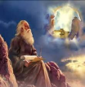
Twenty-Four Elders (Church) (Rev. 4:4; 5:8-10)
DESCRIPTION | SCRIPTURE
1. Crowned | (2:10)
2. Resurrected | (4:4)
3. Clothed in White | (3:5)
4. Redeemed | (5:8-10)
5. Global | (5:9; Matt. 28:19)
6. Enthroned | (3:21)
7. Elders | (1 Tim. 3:1-7; 1 Pet. 5:1, 5)
8. Kingdom of Priests | (Rev. 1:6)
9. Twenty-four | (Rev. 1:6)

Slide 89
Psalm 50:5 (NKJV)
“Gather My saints together to Me, Those who have made a covenant with Me by sacrifice.”

Slide 90
Psalm 149:1 (NKJV)
“Praise the Lord! Sing to the Lord a new song, And His praise in the assembly of saints.”

Slide 91
Matthew 16:18
“I also say to you that you are Peter, and upon this rock I will build [oikodomeō] My church; and the gates of Hades WILL NOT overpower it.”

Slide 92
Conclusion

Slide 93
When is the Rapture? 7 Arguments Favoring the Pre-Tribulation View
Tribulation's purpose concerns Israel (Jer 30:7; Dan 9:24)
No biblical reference to the church on earth during the Tribulation period (Rev 4-22)
Church is promised an exemption from divine wrath (1 Thess 1:10; 5:9; Rom 5:9; Rev 3:10; 6:17)
Rapture is imminent (1 Cor 15:51; 1 Thess 4:15)
Rapture is a comfort (1 Thess 4:18)
Antichrist cannot come to power until the restrainer is removed (2 Thess 2:6-7)
Symbolic parallels (2 Peter 2:5-9)

