Slide 1
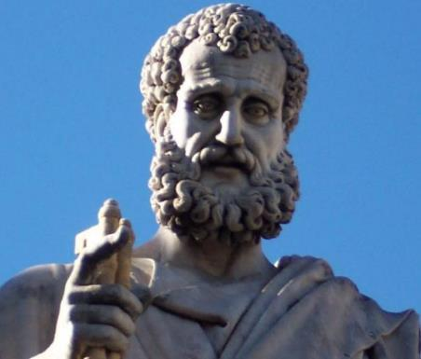

2 Peter
Dr. Andy Woods
Senior Pastor – Sugar Land Bible Church
President – Chafer Theological Seminary

Slide 2

INTRODUCTORY MATTERS
Authorship: Peter
Biography: Gospels & Acts
Date: A.D. 64
Recipients: Regenerated, Asia Minor, Hebrews
Place of writing: Babylon
Occasion for writing: Incipient Gnosticism
Purpose: Insulation from false teaching
Structure: 3 parts
Message: Protection from false teachers
Unique characteristics: Knowledge

Slide 3
STRUCTURE
2 Peter 1 – Call to maturity
2 Peter 2 – Characteristics of false teachers
2 Peter 3 – Doctrine of the false teachers (uniformitarianism)

Slide 4
STRUCTURE
2 Peter 1 – Call to maturity
2 Peter 2 – Characteristics of false teachers
2 Peter 3 – Doctrine of the false teachers (uniformitarianism)

Slide 5
2 PETER
Chapter 1
Introduction (1:1-2)
Call to Growth (1:3-11)
Purpose Statement (1:12-15)
Coming kingdom (1:16-21)

Slide 6
STRUCTURE
2 Peter 1 – Call to maturity
2 Peter 2 – Characteristics of false teachers
2 Peter 3 – Doctrine of the false teachers (uniformitarianism)

Slide 7

2 PETER 2 OUTLINE
Predicted arrival (2:1a)
Devices (2:1b-3)
Doom (2:4-9)
Depravity (2:10-16)
Emptiness (2:17-19)
Regression (2:20-22)

Slide 8
STRUCTURE
2 Peter 1 – Call to maturity
2 Peter 2 – Characteristics of false teachers
2 Peter 3 – Doctrine of the false teachers

Slide 9
OVERVIEW OF 2 PETER 3:3-15
Heresy of the false teachers (v3-4)
Motive of the false teachers (v3-4)
Peter’s rebuttal (v5-10)
Application (v11-15)

Slide 10
OVERVIEW OF 2 PETER 3:3-15
Heresy of the false teachers (v3-4)
Motive of the false teachers (v3-4)
Peter’s rebuttal (v5-10)
Application (v11-15)

Slide 11

DOCTRINE OF FALSE TEACHERS
V.3-4
Deny 2nd Coming
  Scoffing
  Future tense

Slide 12
OVERVIEW OF 2 PETER 3:3-15
Heresy of the false teachers (v3-4)
Motive of the false teachers (v3-4)
Peter’s rebuttal (v5-10)
Application (v11-15)

Slide 13
MOTIVE OF FALSE TEACHERS
V.3-4
Deny 2nd Coming
  Lust & denial of judgment
  Uniformitarianism/ naturalism

Slide 14
OVERVIEW OF 2 PETER 3:3-15
Heresy of the false teachers (v3-4)
Motive of the false teachers (v3-4)
Peter’s rebuttal (v5-10)
Application (v11-15)

Slide 15
PETER’S REBUTTAL
V.5-10
Arguments from:
History (5-7)
Scripture (8)
God’s character (9)
Divine promise (10)

Slide 16
OVERVIEW OF 2 PETER 3:3-15
Heresy of the false teachers (v3-4)
Motive of the false teachers (v3-4)
Peter’s rebuttal (v5-10)
Application (v11-15)

Slide 17
APPLICATION
V. 11-15
Holy Living (11b, 14)
Evangelism (12)
Hope (13)
Patience (15)

Slide 18

THREE CONCLUDING EXHORTATIONS
2 Peter 3:15-18

Slide 19
OVERVIEW 2 PETER 3:15-18
Regard the grace of God (v15)
Beware of false teachers (v16-17)
Grow in Christ (v18)

Slide 20
OVERVIEW 2 PETER 3:15-18
Regard the grace of God (v15)
Beware of false teachers (v16-17)
Grow in Christ (v18)

Slide 21
REGARD THE GRACE OF GOD
(3:15)
2 Pet 3:9
Paul as an example of God’s grace
God even used Paul to author Scripture

Slide 22
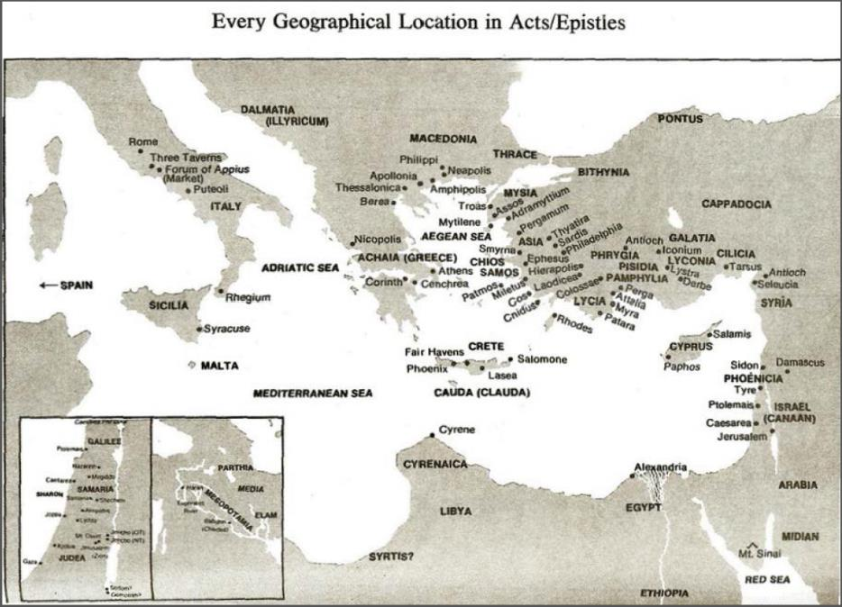

Slide 23

Acts 8:3-4; 11:19
“³ But Saul began ravaging the church, entering house after house, and dragging off men and women, he would put them in prison. ⁴ Therefore, those who had been scattered went about preaching the word…¹⁹ So then those who were scattered because of the persecution that occurred in connection with Stephen made their way to Phoenicia and Cyprus and Antioch, speaking the word to no one except to Jews alone.”

Slide 24
OVERVIEW 2 PETER 3:15-18
Regard the grace of God (v15)
Beware of false teachers (v16-17)
Grow in Christ (v18)

Slide 25

2 Peter 3:16-17
“as also in all his letters, speaking in them of these things, in which are some things hard to understand, which the untaught and unstable distort, as they do also the rest of the Scriptures, to their own destruction. ¹⁷ You therefore, beloved, knowing this beforehand, be on your guard so that you are not carried away by the error of unprincipled men and fall from your own steadfastness.”

Slide 26
BEWARE OF FALSE TEACHERS
(3:16-17)
Paul’s writings have given false teachers an opportunity
Rev 22:18-19
“Fall from your own steadfastness”?

Slide 27

Galatians 2:7-8
“⁷ But on the contrary, seeing that I had been entrusted with the gospel to the uncircumcised, just as Peter had been to the circumcised ⁸ (for He who effectually worked for Peter in his apostleship to the circumcised effectually worked for me also to the Gentiles).”

Slide 28

Ephesians 3:3-6
“that by revelation there was made known to me the mystery, as I wrote before in brief. ⁴ By referring to this, when you read you can understand my insight into the mystery of Christ, ⁵ which in other generations was not made known to the sons of men, as it has now been revealed to His holy apostles and prophets in the Spirit; ⁶ to be specific, that the Gentiles are fellow heirs and fellow members of the body, and fellow partakers of the promise in Christ Jesus through the gospel”.

Slide 29
Ephesians 3:9
“and to bring to light what is the administration of the mystery which for ages has been hidden in God who created all things.”

Slide 30

EMERGENT EPISTEMOLOGY
“I grew up thinking that we’ve figured out the Bible…that we know what it means. Now I have no idea what most of it means.”
Kristen Bell, wife of Rob Bell; quoted in Christianity Today, 11/1/04

Slide 31
2 Peter 3:16-17
“as also in all his letters, speaking in them of these things, in which are some things hard to understand, which the untaught and unstable distort, as they do also the rest of the Scriptures, to their own destruction. ¹⁷ You therefore, beloved, knowing this beforehand, be on your guard so that you are not carried away by the error of unprincipled men and fall from your own steadfastness.”

Slide 32
2 Peter 3:16-17
“as also in all his letters, speaking in them of these things, in which are some things hard to understand, which the untaught and unstable distort, as they do also the rest of the Scriptures, to their own destruction. ¹⁷ You therefore, beloved, knowing this beforehand, be on your guard so that you are not carried away by the error of unprincipled men and fall from your own steadfastness.”

Slide 33
Revelation 22:18-19
“¹⁸ I testify to everyone who hears the words of the prophecy of this book: if anyone adds to them, God will add to him the plagues which are written in this book; ¹⁹ and if anyone takes away from the words of the book of this prophecy, God will take away his part [meros] from the tree of life and from the holy city, which are written in this book.”

Slide 34
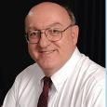
Dennis Rokser
Shall Never Perish Forever, p. 274
“To unbelievers who would add to God’s Word in this fashion, the Lord promises to ‘add to him the plagues that are written in this book.’ The plagues spoken of in the book of Revelation occur during that future period of God’s judgment on the earth known as the Tribulation. If anyone reading Revelation accepts the invitation of verse 17 and becomes a believer in Christ prior to the Tribulation, that person will experience the pretribulational Rapture of the saints (1 Thess. 4:13-18) rather than the plagues of the Tribulation (1 Thess. 5:1-3). Therefore, the warning of Revelation 22:18 applies only to unbelievers. This is not a warning to believers to stay saved or to be rewarded for their perseverance.”

Slide 35
Dennis Rokser
Shall Never Perish Forever, p. 273
“Verses 18-19 follow with a grave warning to unbelievers who would add to or subtract from the words of this book. Either adding to or taking away from the Word of God is characteristic of unbelievers who cannot simply accept by faith what God says in His Word. When God speaks, the response of the believing heart is simply ‘Amen.’ But the unbeliever does not accept what God says at face value, and so he must change the Word to suit himself.”

Slide 36
Dennis Rokser
Shall Never Perish Forever, p. 274
“A common characteristic of cults and religions that profess to be ‘Christian’ is that they invariably add other books, creeds, council decisions, or ‘inspired’ writings of their founder or leaders to the Bible, and they put these on a par with God’s Word.”

Slide 37
2 Peter 3:16-17
“as also in all his letters, speaking in them of these things, in which are some things hard to understand, which the untaught and unstable distort, as they do also the rest of the Scriptures, to their own destruction. ¹⁷ You therefore, beloved, knowing this beforehand, be on your guard so that you are not carried away by the error of unprincipled men and fall from your own steadfastness.”

Slide 38


Galatians 3:3
“Are you so foolish? Having begun by the Spirit, are you now being perfected by the flesh?”

Slide 39

Galatians 5:4
“You have been severed from Christ, you who are seeking to be justified by law; you have fallen from grace.”

Slide 40
Three Tenses of Salvation
Phase | Justification | Sanctification | Glorification
Tense | Past | Present | Future
Saved from sin’s: | Penalty | Power | Presence
Scripture | Eph 2:8-9; Titus 3:5 | Philip 2:12 | Rom 5:10

Slide 41
Three Tenses of Salvation
Phase | Justification | Sanctification | Glorification
Tense | Past | Present | Future
Saved from sin’s: | Penalty | Power | Presence
Scripture | Eph 2:8-9; Titus 3:5 | Philip 2:12 | Rom 5:10

Slide 42
OVERVIEW 2 PETER 3:15-18
Regard the grace of God (v15)
Beware of false teachers (v16-17)
Grow in Christ (v18)

Slide 43
GROW IN CHRIST
(3:18)
Maturity inoculates the believer against false teaching (Eph 4:11-16)
God’s glory is the ultimate motivation for maturity

Slide 44

Ephesians 4:11-16
“¹¹ And He gave some as apostles, and some as prophets, and some as evangelists, and some as pastors and teachers, ¹² for the equipping of the saints for the work of service, to the building up of the body of Christ;” ¹³ until we all attain to the unity of the faith, and of the knowledge of the Son of God, to a mature man, to the measure of the stature which . . .

Slide 45
Ephesians 4:11-16
“... belongs to the fullness of Christ. ¹⁴ As a result, we are no longer to be children, tossed here and there by waves and carried about by every wind of doctrine, by the trickery of men, by craftiness in deceitful scheming; ¹⁵ but speaking the truth in love, we are to grow up in all aspects into Him who is the head, even . . .

Slide 46
Ephesians 4:11-16
“. . . Christ, ¹⁶ from whom the whole body, being fitted and held together by what every joint supplies, according to the proper working of each individual part, causes the growth of the body for the building up of itself in love.”

Slide 47
GROW IN CHRIST
(3:18)
Maturity inoculates the believer against false teaching (Eph 4:11-16)
God’s glory is the ultimate motivation for maturity

Slide 48
Dispensational Theology is a
System of Theology
Traditional-normative dispensational theology is a system that embodies three essential, fundamental concepts called the sine qua non (lit. “without which is not”):
The consistent use of a plain, normal, literal, grammatical-historical method of interpretation;
Which reveals that the Church is distinct from Israel;
God’s overall purpose is to bring glory to Himself (Eph. 1:6, 12, 14).
Dr. Charles Ryrie, Dispensationalism, pp. 38-41

Slide 49
Doxological Purpose
God’s ultimate purpose for the ages is to glorify Himself. Scripture is not human-centered, as though salvation were the principle point, but God-centered, because His glory is at the center.
The glory of God is the primary principle that unifies all dispensations, the program of salvation being just one of the means by which God glorifies Himself. Each successive revelation of God’s plan for the ages, as well as His dealing with the elect, non-elect, angels, and nations all manifest His glory.
Dictionary of Premillennial Theology, Charles Ryrie, p. 94

Slide 50
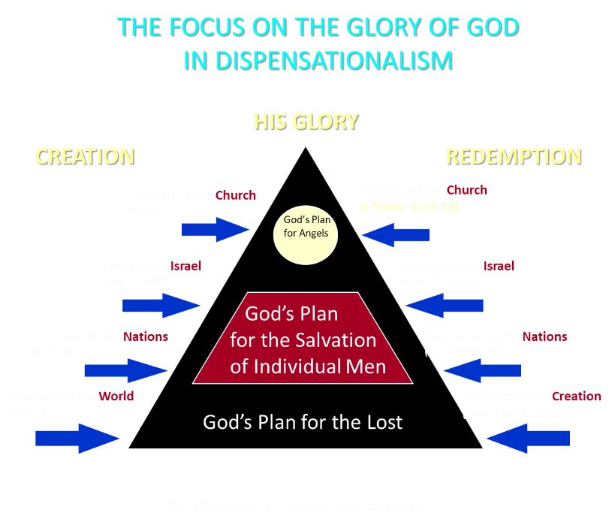

Slide 51
OVERVIEW 2 PETER 3:15-18
Regard the grace of God (v15)
Beware of false teachers (v16-17)
Grow in Christ (v18)

Slide 52
CONCLUSION

Slide 53
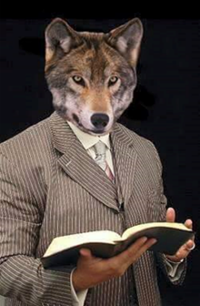
MESSAGE
Protection from the negative influence of the coming false teachers is accomplished through exhortation toward maturity and exposing the characteristics and doctrines of these coming false teachers

Slide 54
STRUCTURE
2 Peter 1 – Call to maturity
2 Peter 2 – Characteristics of false teachers
2 Peter 3 – Doctrine of the false teachers

