Slide 1
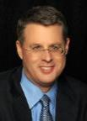
THE RAPTURE
What and When? – Part 5
Dr. Andy Woods
Senior Pastor – Sugar Land Bible Church
President – Chafer Theological Seminary

Slide 2
What is the Rapture?
An important doctrine
Distinct from the Second Advent
Catching away of all living believers (1 Thess 4:17)
Reunion (1 Thess 4:14-16)
Resurrection (1 Cor 15:50-54)
Exemption from death (1 Cor 15:51, 54-56)
Instantaneous (1 Cor 15:52)
Mystery (1 Cor 15:51)
Imminent (1 Cor 15:51; 1 Thess 4:15)
Traditional doctrine now being recovered

Slide 3
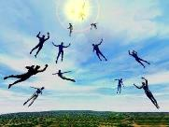
When Will the Rapture Take Place Relative to the Tribulation Period?
Pre-tribulation rapture theory
Mid-tribulation rapture theory
Post-tribulation rapture theory
Pre-wrath rapture theory
Partial rapture theory

Slide 5
When Will the Rapture Take Place Relative to the Tribulation Period?
Pre-tribulation rapture theory
Mid-tribulation rapture theory
Post-tribulation rapture theory
Pre-wrath rapture theory
Partial rapture theory

Slide 6
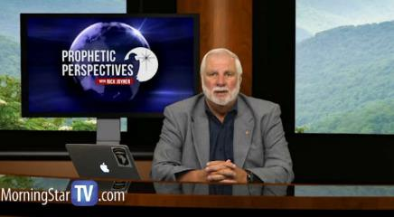
Rick Joyner
The Harvest, 1989-1990, revised booklet page 121.
“The doctrine of the rapture was a great and effective use of the enemy to implant in the church a retreat mentality. Already this yoke has been cast off by the majority of the advancing church and it will soon be cast off by all.” (italics added)

Slide 7
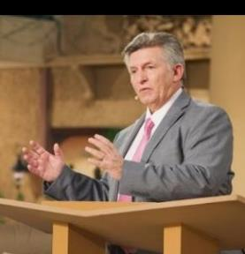
Rick Wiles
http://www.wnd.com/2015/08/is-everything-you-know-about-second-coming-wrong/
“I personally do not believe that by the year 2020, any credible person will be teaching the secret pre-trib. rapture doctrine. I think the events that are coming in the next five years will utterly destroy the doctrine.”

Slide 8
Rick Wiles
“Jan Markell on the Mockery of Bible Prophecy,” online: http://christinprophecy.org/sermons/jan-markell-on-the-mockery-of-bible-prophecy/, October 14 2018, accessed 19 November 2018.
Rick Wiles: The secret Pre-Trib Rapture story and Christian Zionism that is a two headed–
Doc Burkhart: Monster.
Rick Wiles: –monster. It is a two headed freak monster. Okay. They come together, both of them come together because they were started by the same people. The Christian Zionists started the Pre-Trib Rapture doctrine.
Doc Burkhart: And this was seed planted decades ago, but it came into full fruit in within the last 30 years.

Slide 9
Rick Wiles
“Jan Markell on the Mockery of Bible Prophecy,” online: http://christinprophecy.org/sermons/jan-markell-on-the-mockery-of-bible-prophecy/, October 14 2018, accessed 19 November 2018.
Rick Wiles: That’s right. They had to create the Pre-Trib Rapture doctrine to justify Christian Zionism. That’s where it all came from. But isn’t it interesting that in the recent decades where the American Evangelical Church has been taken over by Christian Zionism, that the American Evangelical Church has lost its flavor.
Doc Burkhart: Yes.
Rick Wiles: It has lost its saltiness. It is of no use anymore to God in this country.
Doc Burkhart: Right. In fact things are worse off now than they were 30 years ago.

Slide 10
Rick Wiles
“Jan Markell on the Mockery of Bible Prophecy,” online: http://christinprophecy.org/sermons/jan-markell-on-the-mockery-of-bible-prophecy/, October 14 2018, accessed 19 November 2018.
Rick Wiles: We’ve become a pagan nation.
Doc Burkhart: We’re Babylon.
Rick Wiles: We’re Babylon and it happened on the watch of the Christian Zionist. I’m laying it on your doorstep Christian Zionists. You are the cause of America’s decline.
Doc Burkhart: Those are strong words there.

Slide 11
Rick Wiles
“Jan Markell on the Mockery of Bible Prophecy,” online: http://christinprophecy.org/sermons/jan-markell-on-the-mockery-of-bible-prophecy/, October 14 2018, accessed 19 November 2018.
Rick Wiles: They are strong words, and I mean it. They took control of the churches in America, the Christian Zionist. They changed the Gospel. They took Jesus off the cross. They replaced the cross with the Star of David. They took the focus off God, and holiness. They put it all on a piece of land in the Middle East. And America has gone to hell. America has gone to hell. We’ve become a pagan, heathen nation because the Christian Zionists have taken our eyes off Jesus.

Slide 13
David Barton
“David Barton Is ‘Grateful’ That The Most Recent ‘Left Behind’ Movie Bombed,” online: http://www.rightwingwatch.org/post/david-barton-is-grateful-that-the-most-recent-left-behind-movie-bombed/, October 29 2014, accessed 15 February 2018.
“The movie is a complete bust,” Barton rejoiced. “It did really pathetic at the box office … and quite frankly I was somewhat happy the movie was a bust.” Barton said the “Left Behind” series has convinced too many Christians that “it is a waste of time to get involved.” Barton “was really grateful that the movie didn’t do well because I didn’t want that mentality going out there. It violates way too many things in the Bible. I think the movie not doing well is [a sign] that hopefully our eschatology is beginning to change for a more sound biblical direction in America,” he said. “Maybe we’re getting a little more mature and a little wiser over some things.”

Slide 14
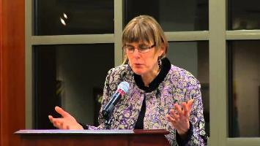
Barbara R. Rossing
The Rapture Exposed: The Message of Hope in the Book of Revelation (Boulder, CO: Westview Press, 2004), 1-2.
“The rapture is a racket. Whether prescribing a violent script for Israel or survivalism in the United States, this theology distorts God’s vision for the world…This theology is not biblical. We are not raptured off the earth, nor is God. No, God has come to live in the world through Jesus. God created the world, God loves the world, God will never leave the world behind!”

Slide 15
William Lane Craig
“No, Christians Should Not Believe in 'Left Behind's' Rapture Theology, Says Prominent Christian Philosopher,” online: https://www.christianpost.com/news/no-christians-should-not-believe-in-left-behinds-rapture-theology-says-prominent-apologist-124070/, July 30 2014, accessed 14 February 2018.
“This doctrine is not really found in the book of Revelation. If you read the book of Revelation, you won't find any mention of the rapture there. [The idea of the rapture comes from a] misinterpretation of 1 and 2 Thessalonians where Paul is describing the coming of the Lord and resurrection of the dead, which will occur at His coming. If you compare what Paul says there to what Jesus says about the End Times, Paul uses the same vocabulary, the same phraseology. I think it's very plausible that Paul is talking about the same event that Jesus predicted, namely the visible coming of the Son of Man at the end of human history to usher in his kingdom.”

Slide 16
William Lane Craig
“No, Christians Should Not Believe in 'Left Behind's' Rapture Theology, Says Prominent Christian Philosopher,” online: https://www.christianpost.com/news/no-christians-should-not-believe-in-left-behinds-rapture-theology-says-prominent-apologist-124070/, July 30 2014, accessed 14 February 2018.
“But proponents of the rapture view, say that Paul is not at all talking about the second coming of the Christ there. What he's really talking about is this invisible preliminary secret return of Christ to snatch believers out of the world before the great tribulation occurs. I think there's no textual warrant for that at all. A good many Bible-believing Christians absorbed this view as their mother's milk as it were and have never thought to question its Biblical credentials. It could be maybe good fiction. It would be say like reading science fiction or fantasy novels like The Lord of the Rings.”

Slide 17
William Lane Craig
“No, Christians Should Not Believe in 'Left Behind's' Rapture Theology, Says Prominent Christian Philosopher,” online: https://www.christianpost.com/news/no-christians-should-not-believe-in-left-behinds-rapture-theology-says-prominent-apologist-124070/, July 30 2014, accessed 14 February 2018.
“Just so long as you're not deceived into thinking that represents biblical eschatology. It is astonishing, if I'm correct about this, American evangelism is very widely misled, that it has departed from the historic Christian position about the second coming of Christ. That's really rather sobering, because if we're wrong about this, what other things might we have misinterpreted?”

Slide 18
NT Wright
“NT Wright Claims 'The Rapture' Does Not Appear Anywhere in Scripture, in New Podcast from Premier,” online: https://www.premier.org.uk/News/UK/NT-Wright-claims-the-rapture-does-not-appear-anywhere-in-scripture-in-new-podcast-from-Premier, November 15 2018, accessed 19 November 2018.
“When Paul wrote 1 Thessalonians people were worried that when Jesus returned, those who were dead would stay dead and miss out on the ‘new day.’ Some people have taken the verses that followed literally, but the problem is that that is not what this verse is about. Paul is awfully good at mixed metaphors. When Jesus comes back, it’s not to snatch people away from earth but rather to transform earth with the life of Heaven and to transform us as well. He doesn’t come back to take us away, but to heal the world and to heal and transform his people."

Slide 19
Hank Hanegraaff
“Jan Markell on the Mockery of Bible Prophecy,” online: http://christinprophecy.org/sermons/jan-markell-on-the-mockery-of-bible-prophecy/, October 14 2018, accessed 19 November 2018.
Caller: “What I am trying to understand is where do they get the teaching that the Church will be raptured out and will not have to go through Tribulation? Where is that found at?”
Hank Hanegraaff: ”It’s not found. That’s the whole point. The point is it’s something that is imposed on the Scripture. The notion is a very new notion in Church history; it is a 19th Century notion that was popularized by John Nelson Darby. And it comes with the presupposition that God has two distinct people; and therefore He has two distinct plans for the two distinct people...”

Slide 20
Hank Hanegraaff
“Jan Markell on the Mockery of Bible Prophecy,” online: http://christinprophecy.org/sermons/jan-markell-on-the-mockery-of-bible-prophecy/, October 14 2018, accessed 19 November 2018.
Hank Hanegraaff: “…And He has two distinct phases of the Second Coming, and two distinct destinies. This however, is an imposition on Scripture because the truth of it is God has only, always had one chosen people. One covenant community. Beautifully connected by the cross and illustrated by a cultivated olive tree in Paul’s letter to the Romans. So, the point here is that all those who are followers of Jesus Christ are the one chosen people. And this is prior to the cross as well because all that looked forward to Christ prior to the cross are God’s covenant chosen people. And the covenant chosen people are made up of people from every tongue, and language and nation and people. You are not a son of Abraham because of some genealogical construction. You are a son of Abraham because you believe in the God of Abraham.”

Slide 21
Joel Richardson
“Jan Markell on the Mockery of Bible Prophecy,” online: http://christinprophecy.org/sermons/jan-markell-on-the-mockery-of-bible-prophecy/, October 14 2018, accessed 19 November 2018.
“What if the end of the world really isn’t as so many have portrayed it? What if the Church is not Raptured to heaven before the Great Tribulation as many are teaching? What if the Church has been left ill-prepared to face the Antichrist and the Mark of the Beast? What if Tim LaHaye’s claim that if the Pre-Tribulation Rapture is false then the Blessed Hope will become the blasted hope, actually comes true for millions of Pretribulationists? What if millions who have been led astray by the Pre-Trib teaching become part of the great falling away that Jesus warned would take place at that time? Left behind, or led astray? The issue of the Pre-Tribulational versus . . .

Slide 22
Joel Richardson
“Jan Markell on the Mockery of Bible Prophecy,” online: http://christinprophecy.org/sermons/jan-markell-on-the-mockery-of-bible-prophecy/, October 14 2018, accessed 19 November 2018.
. . .versus the Post-Tribulational Rapture is one of the premier pastoral issues of our day. If you are a pastor that is not preparing your people to face potentially the Antichrist in the Great Tribulation in this hour simply because your denomination teaches it or whatever, personally I think you’re failing in your role as a shepherd and a pastor.”

Slide 23
Frank Schaeffer
“Jan Markell on the Mockery of Bible Prophecy,” online: http://christinprophecy.org/sermons/jan-markell-on-the-mockery-of-bible-prophecy/, October 14 2018, accessed 19 November 2018.
“The Evangelical Christian movement in America latched on to a 19th Century concept that was hatched by someone called John Nelson Darby, who said that Jesus could not come back until Israel had been restored as a nation, populated by Jews, with Jerusalem as its capital. This is not traditional Christian teaching in the Protestant Church. This was not a concern of Martin Luther or any Roman Catholic, or the Greek Orthodox or anyone else. When I was a kid, my parents had their ministry L’Abri. We had a number of Christian leaders come by. One of them, Hal Lindsey, had written a book called ‘The Late Great Planet Earth’ in which he predicted the end times . . .

Slide 24
Frank Schaeffer
“Jan Markell on the Mockery of Bible Prophecy,” online: http://christinprophecy.org/sermons/jan-markell-on-the-mockery-of-bible-prophecy/, October 14 2018, accessed 19 November 2018.
“. . . coming in 1980s. He said it is now possible because Israel has been restored. And then others came back and said, ‘No, no, Jesus can’t come back yet because Jerusalem is not restored.’ Fast forward to the 16 books and 4 films that you had that came out of the Left Behind series written by a friend of mine Jerry Jenkins, and his sidekick co-author Tim LaHaye, that (sic) wrote it with him. And you’ve got 60 million copies sold that essentially are total fiction. 'I am going to give you an analogy, this is as if the Twilight Zone had been taken as gospel by some religious group and they were going back through old episodes and basing an entire cultic kind of religion on it.”

Slide 25
John Piper
https://www.desiringgod.org/interviews/what-is-the-rapture
Question: “Pastor John, I know this is a huge debate, but I would love your thoughts. How many times is Jesus coming back? Is he coming back in the rapture (according to 1 Thessalonians 4:16–17) and then returning a second time to defeat Satan (according to Revelation 19:11–21)? Is Christ returning one more time, or two more times?”
Answer: “My understanding of the New Testament is that Jesus promised he would return, and that in this returning, he would do a final rescue for those who are trusting him and a final judgment for those who are not believing in him. I don’t think there are two comings of Christ in the future, but only one.”

Slide 26
When is the Rapture? 7 Arguments Favoring the Pre-Tribulation View
Tribulation's purpose concerns Israel (Jer 30:7; Dan 9:24)
No biblical reference to the church on earth during the Tribulation period (Rev 4-22)
Church is promised an exemption from divine wrath (1 Thess 1:10; 5:9; Rom 5:9; Rev 3:10; 6:17)
Rapture is imminent (1 Cor 15:51; 1 Thess 4:15)
Rapture is a comfort (1 Thess 4:18)
Antichrist cannot come to power until the restrainer is removed (2 Thess 2:6-7)
Symbolic parallels (2 Peter 2:5-9)

Slide 27
When is the Rapture? 7 Arguments Favoring the Pre-Tribulation View
Tribulation's purpose concerns Israel (Jer 30:7; Dan 9:24)
No biblical reference to the church on earth during the Tribulation period (Rev 4-22)
Church is promised an exemption from divine wrath (1 Thess 1:10; 5:9; Rom 5:9; Rev 3:10; 6:17)
Rapture is imminent (1 Cor 15:51; 1 Thess 4:15)
Rapture is a comfort (1 Thess 4:18)
Antichrist cannot come to power until the restrainer is removed (2 Thess 2:6-7)
Symbolic parallels (2 Peter 2:5-9)

Slide 28
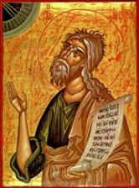
Jeremiah 30:7
“Alas! for that day is great, There is none like it; And it is the time of Jacob’s distress (Gen. 32:8; 35:10), But he will be saved from it.”

Slide 29
Daniel 9:24
Seventy weeks have been decreed for your people and your holy city, to finish the transgression, to make an end of sin, to make atonement for iniquity, to bring in everlasting righteousness, to seal up vision and prophecy and to anoint the most holy place.

Slide 30
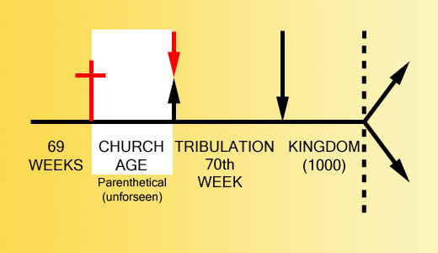

Slide 32
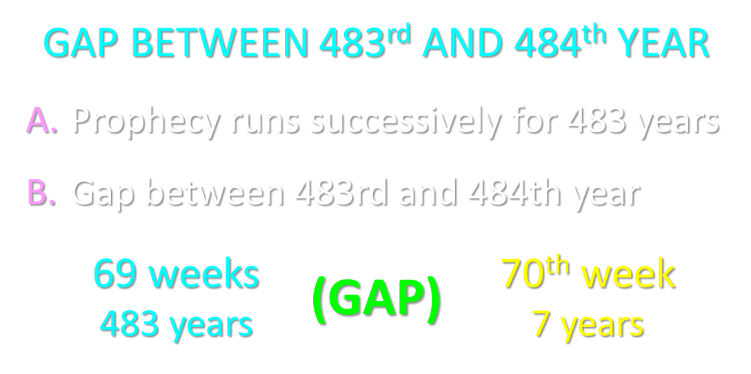

Slide 33
The Tribulation's Concerns Israel
Jer 30:7; Dan 9:24
God uses Israel and the church on a mutually exclusive basis

Slide 34
Daniel 12:7
I heard the man dressed in linen, who was above the waters of the river, as he raised his right hand and his left toward heaven, and swore by Him who lives forever that it would be for a time, times, and half a time; and as soon as they finish shattering the power of the holy people, all these events will be completed.

Slide 36
When is the Rapture? 7 Arguments Favoring the Pre-Tribulation View
Tribulation's purpose concerns Israel (Jer 30:7; Dan 9:24)
No biblical reference to the church on earth during the Tribulation period (Rev 4-22)
Church is promised an exemption from divine wrath (1 Thess 1:10; 5:9; Rom 5:9; Rev 3:10; 6:17)
Rapture is imminent (1 Cor 15:51; 1 Thess 4:15)
Rapture is a comfort (1 Thess 4:18)
Antichrist cannot come to power until the restrainer is removed (2 Thess 2:6-7)
Symbolic parallels (2 Peter 2:5-9)

Slide 37
Revelation 1:19
“Therefore write the things which you have seen, and the things which are, and the things which will take place after these things [meta tauta].”

Slide 38
Revelation 1:19
Seen (1)
Are (2–3)
After these things (4–22)

Slide 39
Revelation 1:19
Seen (1)
Are (2–3)
After these things (4–22)

Slide 40
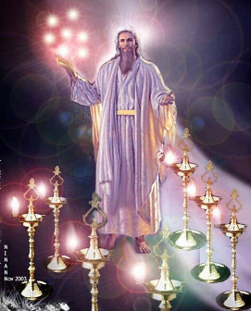

Slide 41
Revelation 1:19
Seen (1)
Are (2–3)
After these things (4–22)

Slide 42
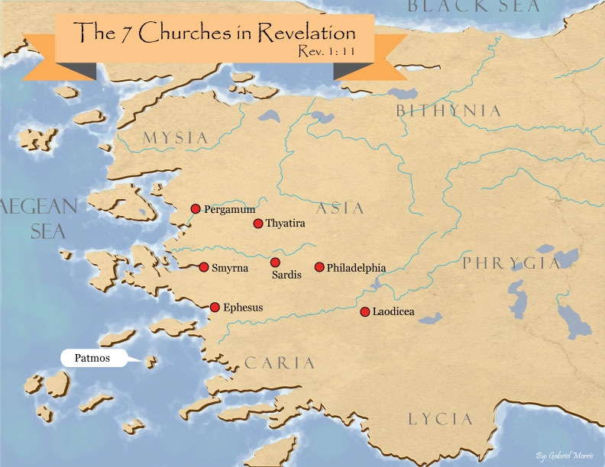

Slide 43
Revelation 1:19
Seen (1)
Are (2–3)
After these things (4–22)

Slide 44
Revelation 1:19
“Therefore write the things which you have seen, and the things which are, and the things which will take place after these things [meta tauta].”

Slide 45
Revelation 4:1
“After these things [meta tauta] I looked, and behold, a door standing open in heaven, and the first voice which I had heard, like the sound of a trumpet speaking with me, said, ‘Come up here, and I will show you what must take place after these things [meta tauta].’”

Slide 49
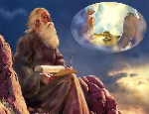
“After These Things” (Rev. 4‒22)
Before the Tribulation (4‒5)
During the Tribulation (6‒19)
After the Tribulation (20‒22)
Kingdom (20:1-10)
Great White Throne Judgment (20:11-15)
Destruction of the Earth (21:1)
New Heaven and New Earth (21‒22)

Slide 50
The Missing Church
Rev 4-19
Rev 13:9
Revelation’s Jewish nature

Slide 51
Romans 10:19
But I say, surely Israel did not know, did they? First Moses says, “I will make you jealous by that which is not a nation, By a nation without understanding will I anger you.”

Slide 52
Galatians 3:28
There is neither Jew nor Greek, there is neither slave nor free man, there is neither male nor female; for you are all one in Christ Jesus.

Slide 53
Ephesians 2:14
For He Himself is our peace, who made both groups into one and broke down the barrier of the dividing wall.

Slide 54
God’s Work Through Israel
Revelation 7-144,000 Jews
Revelation 11-Two Jewish witnesses
Revelation 12-Israel flees

Slide 55
Revelation 1:20
“As for the mystery of the seven stars which you saw in My right hand, and the seven golden lampstands: the seven stars are the angels of the seven churches, and the seven lampstands are the seven churches.”

Slide 56
Revelation 4:5
“Out from the throne come flashes of lightning and sounds and peals of thunder. And there were seven lamps of fire burning before the throne, which are the seven Spirits of God.”

Slide 57
Revelation 4:4
“Around the throne were twenty-four thrones; and upon the thrones I saw twenty-four elders sitting, clothed in white garments, and golden crowns on their heads.”

Slide 58
Revelation 5:8-10
“⁸ When He had taken the book, the four living creatures and the twenty-four elders fell down before the Lamb, each one holding a harp and golden bowls full of incense, which are the prayers of the saints. ⁹ And they sang a new song, saying, ‘Worthy are You to take the book and to break its seals; for You were slain, and purchased for God with Your blood men from every tribe and tongue and people and nation. ¹⁰ You have made them to be a kingdom and priests to our God; and they will reign upon the earth.’”

Slide 59
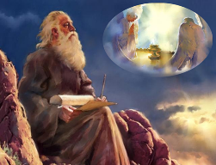
Twenty-Four Elders (Rev. 4:4; 5:8-10)
NOT
Israel
Redeemed of all ages
Angels

Slide 60
Twenty-Four Elders (Rev. 4:4; 5:8-10)
NOT
Israel
Redeemed of all ages
Angels

Slide 61
Revelation 4:4
“Around the throne were twenty-four thrones; and upon the thrones I saw twenty-four elders sitting, clothed in white garments, and golden crowns on their heads.”

Slide 63
Twenty-Four Elders (Rev. 4:4; 5:8-10)
NOT
Israel
Redeemed of all ages
Angels

Slide 64
Revelation 4:4
“Around the throne were twenty-four thrones; and upon the thrones I saw twenty-four elders sitting, clothed in white garments, and golden crowns on their heads.”

Slide 66
Twenty-Four Elders (Rev. 4:4; 5:8-10)
NOT
Israel
Redeemed of all ages
Angels

Slide 67
Revelation 4:4
“Around the throne were twenty-four thrones; and upon the thrones I saw twenty-four elders sitting, clothed in white garments, and golden crowns on their heads.”

Slide 68
Revelation 5:11
“Then I looked, and I heard the voice of many angels around the throne and the living creatures and the elders; and the number of them was myriads of myriads, and thousands of thousands.”

Slide 69
Revelation 7:11
“And all the angels were standing around the throne and around the elders and the four living creatures; and they fell on their faces before the throne and worshiped God.”

Slide 71
DESCRIPTION OF THE SEVEN CHURCHES Revelation 2‒3
CHURCH | SCRIPTURE | DESCRIPTION
Ephesus | 2:1-7 | Loveless
Smyrna | 2:8-11 | Persecuted
Pergamum | 2:12-17 | Compromised
Thyatira | 2:18-29 | Corrupt
Sardis | 3:1-6 | Dead
Philadelphia | 3:7-13 | Missionary
Laodicea | 3:14-22 | Man-centered

Slide 72
Twenty-Four Elders (Rev. 4:4; 5:8-10)
CHURCH
Crowned (Rev. 2:10; 3:11)
Resurrected (Rev. 4:4)
Clothed in White (Rev. 3:5)
Redeemed (Rev. 5:8-10)
Global (Rev. 5:9; Matt. 28:19)
Enthroned (Rev. 3:21)
Elders (Rev. 1 Tim. 3:1-7)
Kingdom of Priests (Rev. 1:6)
Twenty-four (Rev. 1:6)

Slide 73
Twenty-Four Elders (Rev. 4:4; 5:8-10)
CHURCH
Crowned (Rev. 2:10; 3:11)
Resurrected (Rev. 4:4)
Clothed in White (Rev. 3:5)
Redeemed (Rev. 5:8-10)
Global (Rev. 5:9; Matt. 28:19)
Enthroned (Rev. 3:21)
Elders (Rev. 1 Tim. 3:1-7)
Kingdom of Priests (Rev. 1:6)
Twenty-four (Rev. 1:6)

Slide 74
Revelation 4:4
“Around the throne were twenty-four thrones; and upon the thrones I saw twenty-four elders sitting, clothed in white garments, and golden crowns on their heads.”

Slide 75
Scripture’s Five Crowns (Rev 4:10: 3:11; 2 John 8)
SCRIPTURE | CROWN | PURPOSE
1 Cor. 9:24-27 | Incorruptible | Gaining mastery over the flesh
1 Thess. 2:19-20 | Rejoicing | Soul winning
Jas. 1:12; Rev. 2:10 | Life | Enduring trials
1 Pet. 5:2-4 | Glory | Shepherding God’s people
2 Tim. 4:8 | Righteousness | Longing for His appearing

Slide 76
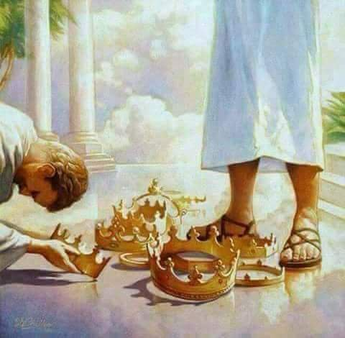

Slide 77
Twenty-Four Elders (Rev. 4:4; 5:8-10)
CHURCH
Crowned (Rev. 2:10; 3:11)
Resurrected (Rev. 4:4)
Clothed in White (Rev. 3:5)
Redeemed (Rev. 5:8-10)
Global (Rev. 5:9; Matt. 28:19)
Enthroned (Rev. 3:21)
Elders (Rev. 1 Tim. 3:1-7)
Kingdom of Priests (Rev. 1:6)
Twenty-four (Rev. 1:6)

Slide 78
Revelation 4:4
“Around the throne were twenty-four thrones; and upon the thrones I saw twenty-four elders sitting, clothed in white garments, and golden crowns on their heads.”

Slide 79
Twenty-Four Elders (Rev. 4:4; 5:8-10)
CHURCH
Crowned (Rev. 2:10; 3:11)
Resurrected (Rev. 4:4)
Clothed in White (Rev. 3:5)
Redeemed (Rev. 5:8-10)
Global (Rev. 5:9; Matt. 28:19)
Enthroned (Rev. 3:21)
Elders (Rev. 1 Tim. 3:1-7)
Kingdom of Priests (Rev. 1:6)
Twenty-four (Rev. 1:6)

Slide 80
Revelation 4:4
“Around the throne were twenty-four thrones; and upon the thrones I saw twenty-four elders sitting, clothed in white garments, and golden crowns on their heads.”

Slide 81
Twenty-Four Elders (Rev. 4:4; 5:8-10)
CHURCH
Crowned (Rev. 2:10; 3:11)
Resurrected (Rev. 4:4)
Clothed in White (Rev. 3:5)
Redeemed (Rev. 5:8-10)
Global (Rev. 5:9; Matt. 28:19)
Enthroned (Rev. 3:21)
Elders (Rev. 1 Tim. 3:1-7)
Kingdom of Priests (Rev. 1:6)
Twenty-four (Rev. 1:6)

Slide 82
Revelation 5:9-10
“ ⁹ And they sang a new song, saying, ‘Worthy are You to take the book and to break its seals; for You were slain, and purchased for God with Your blood men from every tribe and tongue and people and nation. ¹⁰ You have made them to be a kingdom and priests to our God; and they will reign upon the earth.’”

Slide 83
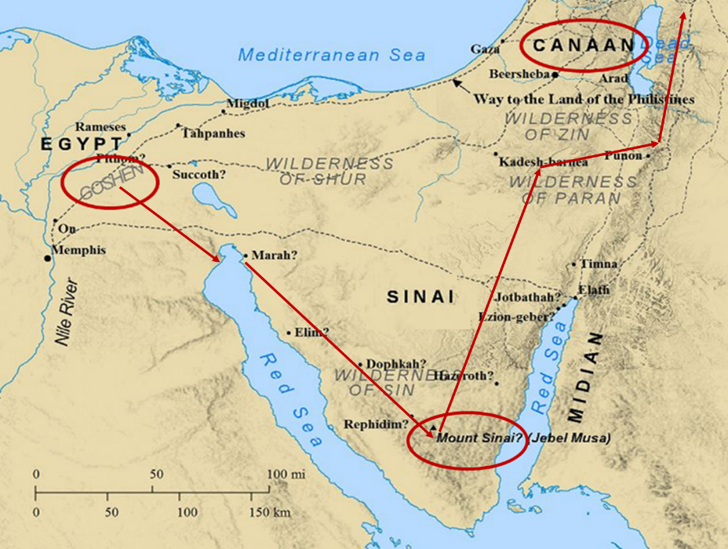

Slide 84
Exodus 15:13, 17
^{13 “}In Your lovingkindness You have led the people whom You have redeemed; In Your strength You have guided them to Your holy habitation…¹⁷ You will bring them and plant them in the mountain of Your inheritance, The place, O Lord, which You have made for Your dwelling, The sanctuary, O Lord, which Your hands have established.”

Slide 85
Revelation 5:9-10 (NKJV)
⁹ “And they sang a new song, saying: ‘You are worthy to take the scroll, And to open its seals; For You were slain, And have redeemed us to God by Your blood Out of every tribe and tongue and people and nation, ¹⁰ And have made us kings and priests to our God; And we shall reign on the earth.’”

Slide 86
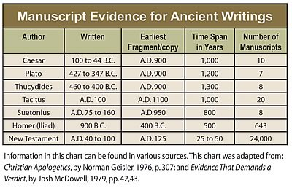

Slide 87
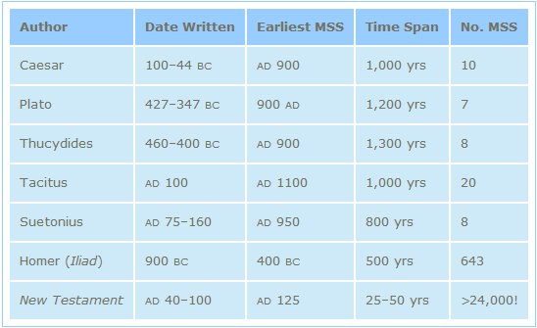
http://creationrevolution.com/2012/05/should-we-trust-the-bible/

Slide 88
J.A. Seiss
Seiss, J. A. (1901). The Apocalypse: A Series of Special Lectures on the Revelation of Jesus Christ with Revised Text (Eighth Edition, Vol. 1). New York: Charles C. Cook.
“Ηγὸρασας ἠμᾶς. Some critics and expositors have rejected this ἠμᾶς (us), for the reason that it is omitted in the Codex Alexandrinus, and in the Ethiopic verson; though the latter is not much more than a loose paraphrase. The Codex Sinaiticus, however, which was discovered in 1860, and which is of equal antiquity and authority with the Codex Alexandrinus, contains it. The Codex Basilianus, in the Vatican, contains it. The Latin, Coptic or Memphitic, and Arminian, which are of great value, contain it.”

Slide 89
J.A. Seiss
Seiss, J. A. (1901). The Apocalypse: A Series of Special Lectures on the Revelation of Jesus Christ with Revised Text (Eighth Edition, Vol. 1). New York: Charles C. Cook.
“And so do all other MSS. and versions. And to discredit it, simply and only because it does not appear in that one single Codex of Alexandria, is most unreasonable and unjust to the weight of authority for its retention. Dr. Tregelles, on full examination, was firmly convinced of its right to a place in the text, before the Codex Sinaiticus appeared; and the presence of this ἠμᾶς in that MS., ought to settle the question of its genuineness forever. The evidences from the context, also argue powerfully for a construction which necessarily embraces it, whether expressed or not. We regard it as indubitably genuine.”

Slide 90
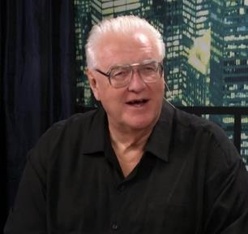
David Hocking
David Hocking, The Book of Revelation: Understanding the Future (Tustin, CA: Hope For Today Publications, 2014), 271.
“The Greek manuscripts (that we have today) of the passage in Revelation 5:9 are 24 in number, and 23 of them read “US” ‒ only Codex Alexandrinus differs in this regard.”

Slide 91
David Hocking
David Hocking, The Book of Revelation: Understanding the Future (Tustin, CA: Hope For Today Publications, 2014), 271.
“You maybe asking ‒ ‘what difference does it make, and why go to all the trouble that is listed above?’ The answer is quite important: The King James reading of the text clearly teaches that church-age believers (represented by the 24 elders in heaven) are singing a song about their own redemption, and since the 24 elders are in heaven all during the tribulation ‒ the correct view of Bible prophecy as to the rapture of the church-age believers (Jew and Gentile) is that they are removed BEFORE the tribulation begins! Our response is simple ‒ PRAISE THE LORD!”

Slide 92
Twenty-Four Elders (Rev. 4:4; 5:8-10)
CHURCH
Crowned (Rev. 2:10; 3:11)
Resurrected (Rev. 4:4)
Clothed in White (Rev. 3:5)
Redeemed (Rev. 5:8-10)
Global (Rev. 5:9; Matt. 28:19)
Enthroned (Rev. 3:21)
Elders (Rev. 1 Tim. 3:1-7)
Kingdom of Priests (Rev. 1:6)
Twenty-four (Rev. 1:6)

Slide 93
Revelation 5:8-10
“⁸ When He had taken the book, the four living creatures and the twenty-four elders fell down before the Lamb, each one holding a harp and golden bowls full of incense, which are the prayers of the saints. ⁹ And they sang a new song, saying, ‘Worthy are You to take the book and to break its seals; for You were slain, and purchased for God with Your blood men from every tribe and tongue and people and nation. ¹⁰ You have made them to be a kingdom and priests to our God; and they will reign upon the earth.’”

Slide 94
Twenty-Four Elders (Rev. 4:4; 5:8-10)
CHURCH
Crowned (Rev. 2:10; 3:11)
Resurrected (Rev. 4:4)
Clothed in White (Rev. 3:5)
Redeemed (Rev. 5:8-10)
Global (Rev. 5:9; Matt. 28:19)
Enthroned (Rev. 3:21)
Elders (Rev. 1 Tim. 3:1-7)
Kingdom of Priests (Rev. 1:6)
Twenty-four (Rev. 1:6)

Slide 95
Revelation 4:4
“Around the throne were twenty-four thrones; and upon the thrones I saw twenty-four elders sitting, clothed in white garments, and golden crowns on their heads.”

Slide 96
Rev 3:21
Promise to the Overcomers
“He who overcomes, I will grant to him to sit down with Me on My throne, as I also overcame and sat down with My Father on His throne.”

Slide 97
Twenty-Four Elders (Rev. 4:4; 5:8-10)
CHURCH
Crowned (Rev. 2:10; 3:11)
Resurrected (Rev. 4:4)
Clothed in White (Rev. 3:5)
Redeemed (Rev. 5:8-10)
Global (Rev. 5:9; Matt. 28:19)
Enthroned (Rev. 3:21)
Elders (Rev. 1 Tim. 3:1-7)
Kingdom of Priests (Rev. 1:6)
Twenty-four (Rev. 1:6)

Slide 98
Revelation 4:4
“Around the throne were twenty-four thrones; and upon the thrones I saw twenty-four elders sitting, clothed in white garments, and golden crowns on their heads.”

Slide 99
1 Peter 5:1, 5
“Therefore, I exhort the elders among you, as your fellow elder and witness of the sufferings of Christ, and a partaker also of the glory that is to be revealed…You younger men, likewise, be subject to your elders; and all of you, clothe yourselves with humility toward one another, for God is opposed to the proud, but gives grace to the humble.”

Slide 100
Twenty-Four Elders (Rev. 4:4; 5:8-10)
CHURCH
Crowned (Rev. 2:10; 3:11)
Resurrected (Rev. 4:4)
Clothed in White (Rev. 3:5)
Redeemed (Rev. 5:8-10)
Global (Rev. 5:9; Matt. 28:19)
Enthroned (Rev. 3:21)
Elders (Rev. 1 Tim. 3:1-7)
Kingdom of Priests (Rev. 1:6)
Twenty-four (Rev. 1:6)

Slide 101
Revelation 5:10
“You have made them to be a kingdom and priests to our God; and they will reign [basileuō] upon the earth [gē].”

Slide 102
Revelation 1:6
“and He has made us to be a kingdom, priests to His God and Father—to Him be the glory and the dominion forever and ever. Amen.”

Slide 103
Twenty-Four Elders (Rev. 4:4; 5:8-10)
CHURCH
Crowned (Rev. 2:10; 3:11)
Resurrected (Rev. 4:4)
Clothed in White (Rev. 3:5)
Redeemed (Rev. 5:8-10)
Global (Rev. 5:9; Matt. 28:19)
Enthroned (Rev. 3:21)
Elders (Rev. 1 Tim. 3:1-7)
Kingdom of Priests (Rev. 1:6)
Twenty-four (Rev. 1:6)

Slide 104
Revelation 4:4
“Around the throne were twenty-four thrones; and upon the thrones I saw twenty-four elders sitting, clothed in white garments, and golden crowns on their heads.”

Slide 105
Revelation 1:6
“and He has made us to be a kingdom, priests to His God and Father—to Him be the glory and the dominion forever and ever. Amen.”

Slide 106
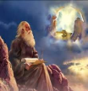
Twenty-Four Elders (Church) (Rev. 4:4; 5:8-10)
DESCRIPTION | SCRIPTURE
1. Crowned | (2:10)
2. Resurrected | (4:4)
3. Clothed in White | (3:5)
4. Redeemed | (5:8-10)
5. Global | (5:9; Matt. 28:19)
6. Enthroned | (3:21)
7. Elders | (1 Tim. 3:1-7; 1 Pet. 5:1, 5)
8. Kingdom of Priests | (Rev. 1:6)
9. Twenty-four | (Rev. 1:6)

Slide 107
Psalm 50:5 (NKJV)
“Gather My saints together to Me, Those who have made a covenant with Me by sacrifice.”

Slide 108
Psalm 149:1 (NKJV)
“Praise the Lord! Sing to the Lord a new song, And His praise in the assembly of saints.”

Slide 109
Matthew 16:18
“I also say to you that you are Peter, and upon this rock I will build [oikodomeō] My church; and the gates of Hades WILL NOT overpower it.”

Slide 110
Conclusion

Slide 111
When is the Rapture? 7 Arguments Favoring the Pre-Tribulation View
Tribulation's purpose concerns Israel (Jer 30:7; Dan 9:24)
No biblical reference to the church on earth during the Tribulation period (Rev 4-22)
Church is promised an exemption from divine wrath (1 Thess 1:10; 5:9; Rom 5:9; Rev 3:10; 6:17)
Rapture is imminent (1 Cor 15:51; 1 Thess 4:15)
Rapture is a comfort (1 Thess 4:18)
Antichrist cannot come to power until the restrainer is removed (2 Thess 2:6-7)
Symbolic parallels (2 Peter 2:5-9)

