Slide 1
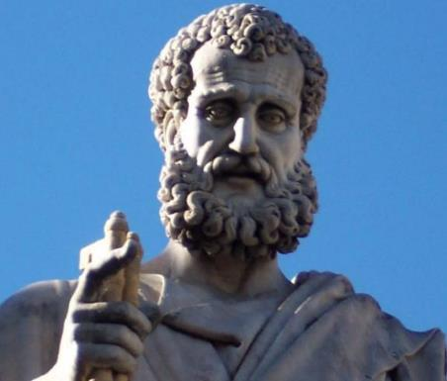

2 Peter
Dr. Andy Woods
Senior Pastor – Sugar Land Bible Church
President – Chafer Theological Seminary

Slide 2

INTRODUCTORY MATTERS
Authorship: Peter
Biography: Gospels & Acts
Date: A.D. 64
Recipients: Regenerated, Asia Minor, Hebrews
Place of writing: Babylon
Occasion for writing: Incipient Gnosticism
Purpose: Insulation from false teaching
Structure: 3 parts
Message: Protection from false teachers
Unique characteristics: Knowledge

Slide 3
STRUCTURE
2 Peter 1 – Call to maturity
2 Peter 2 – Characteristics of false teachers
2 Peter 3 – Doctrine of the false teachers (uniformitarianism)

Slide 4
STRUCTURE
2 Peter 1 – Call to maturity
2 Peter 2 – Characteristics of false teachers
2 Peter 3 – Doctrine of the false teachers (uniformitarianism)

Slide 5
2 PETER
Chapter 1
Introduction (1:1-2)
Call to Growth (1:3-11)
Purpose Statement (1:12-15)
Coming kingdom (1:16-21)

Slide 6
STRUCTURE
2 Peter 1 – Call to maturity
2 Peter 2 – Characteristics of false teachers
2 Peter 3 – Doctrine of the false teachers (uniformitarianism)

Slide 7

2 PETER 2 OUTLINE
Predicted arrival (2:1a)
Devices (2:1b-3)
Doom (2:4-9)
Depravity (2:10-16)
Emptiness (2:17-19)
Regression (2:20-22)

Slide 8
STRUCTURE
2 Peter 1 – Call to maturity
2 Peter 2 – Characteristics of false teachers
2 Peter 3 – Doctrine of the false teachers

Slide 9

RELEVANCE OF THE FUTURE
2 Peter 3:3-15

Slide 10
OVERVIEW OF 2 PETER 3:3-15
Heresy of the false teachers (v3-4)
Motive of the false teachers (v3-4)
Peter’s rebuttal (v5-10)
Application (v11-15)

Slide 11
OVERVIEW OF 2 PETER 3:3-15
Heresy of the false teachers (v3-4)
Motive of the false teachers (v3-4)
Peter’s rebuttal (v5-10)
Application (v11-15)

Slide 12
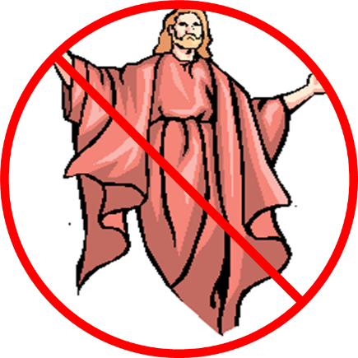
DOCTRINE OF FALSE TEACHERS
V.3-4
Deny 2nd Coming
  Scoffing
  Future tense

Slide 13
OVERVIEW OF 2 PETER 3:3-15
Heresy of the false teachers (v3-4)
Motive of the false teachers (v3-4)
Peter’s rebuttal (v5-10)
Application (v11-15)

Slide 14
MOTIVE OF FALSE TEACHERS
V.3-4
Deny 2nd Coming
  Lust & denial of judgment
  Uniformitarianism/ naturalism

Slide 15
OVERVIEW OF 2 PETER 3:3-15
Heresy of the false teachers (v3-4)
Motive of the false teachers (v3-4)
Peter’s rebuttal (v5-10)
Application (v11-15)

Slide 16
PETER’S REBUTTAL
V.5-10
Arguments from:
History (5-7)
Scripture (8)
God’s character (9)
Divine promise (10)

Slide 17
OVERVIEW OF 2 PETER 3:3-15
Heresy of the false teachers (v3-4)
Motive of the false teachers (v3-4)
Peter’s rebuttal (v5-10)
Application (v11-15)

Slide 18
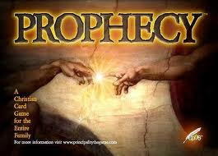
BIBLICAL PROPHECY: IMPORTANCE
27% of Scripture was prophetic at the time it was written
2 Pet 1:19

Slide 19

J. Dwight Pentecost
Prophecy For Today, Page 20
“A short time ago, I took occasion to go through the New Testament to mark each reference to the coming of the Lord Jesus Christ and to observe the use made of that teaching about His coming. I was struck a new with the fact that almost without exception, when the coming of Christ is mentioned in the New Testament, it is followed by an exhortation to godliness and holy living.”

Slide 20

2 Peter 1:19-21
“¹⁹ So we have the prophetic word made more sure, to which you do well to pay attention as to a lamp shining in a dark place, until the day dawns and the morning star arises in your hearts. ²⁰ But know this first of all, that no prophecy of Scripture is a matter of one’s own interpretation, ²¹ for no prophecy was ever made by an act of human will, but men moved by the Holy Spirit spoke from God.”

Slide 21
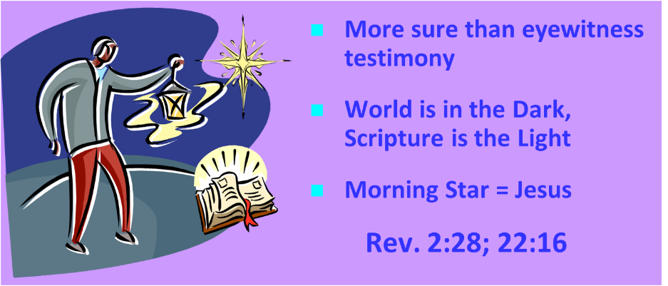
AUTHORITY OF SCRIPTURE
V. 19

Slide 22
APPLICATION
V. 11-15
Holy Living (11b, 14)
Evangelism (12)
Hope (13)
Patience (15)

Slide 23
APPLICATION
V. 11-15
Holy Living (11b, 14)
Evangelism (12)
Hope (13)
Patience (15)

Slide 24
APPLICATION
V. 11-15
Holy Living (11b, 14)
Evangelism (12)
Hope (13)
Patience (15)

Slide 25
2 Peter 3:12
“looking for and hastening [speudō] the coming of the day of God, because of which the heavens will be destroyed by burning, and the elements will melt with intense heat!.”

Slide 26
Romans 11:25
“For I do not want you, brethren, to be uninformed of this mystery—so that you will not be wise in your own estimation—that a partial hardening has happened to Israel until the fullness of the Gentiles has come in.”

Slide 27
APPLICATION
V. 11-15
Holy Living (11b, 14)
Evangelism (12)
Hope (13)
Patience (15)

Slide 28
APPLICATION
V. 11-15
Holy Living (11b, 14)
Evangelism (12)
Hope (13)
Patience (15)

Slide 29

THREE CONCLUDING EXHORTATIONS
2 Peter 3:15-18

Slide 30
OVERVIEW 2 PETER 3:15-18
Regard the grace of God (v15)
Beware of false teachers (v16-17)
Grow in Christ (v18)

Slide 31
OVERVIEW 2 PETER 3:15-18
Regard the grace of God (v15)
Beware of false teachers (v16-17)
Grow in Christ (v18)

Slide 32
REGARD THE GRACE OF GOD
(3:15)
2 Pet 3:9
Paul as an example of God’s grace
God even used Paul to author Scripture

Slide 33
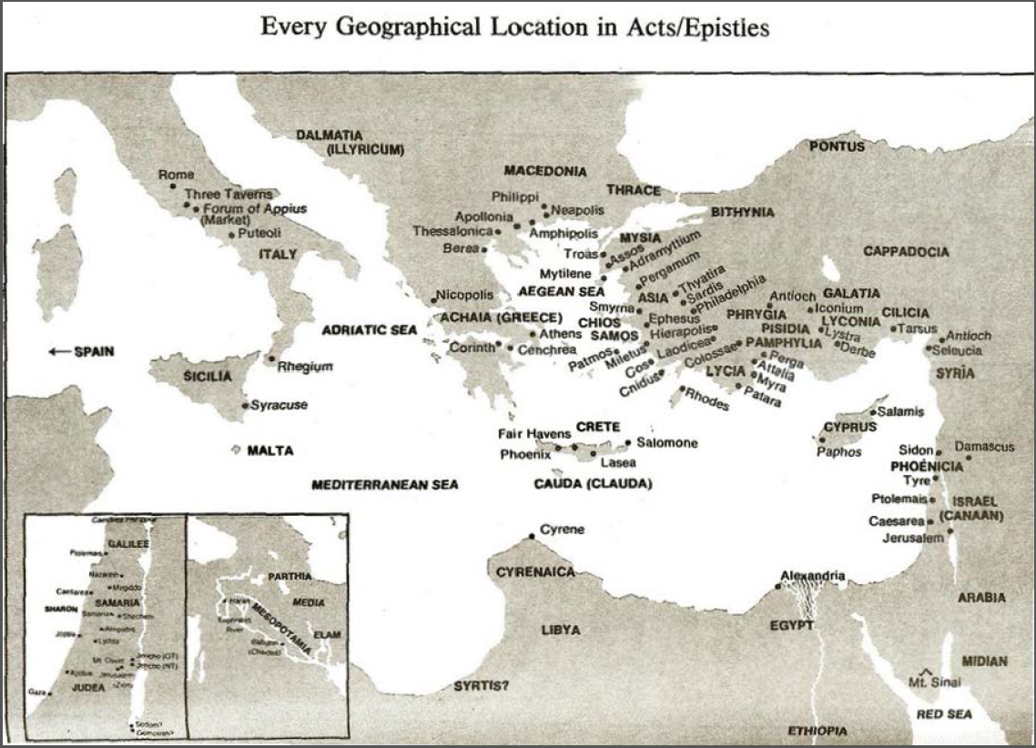

Slide 34

Acts 8:3-4; 11:19
“³ But Saul began ravaging the church, entering house after house, and dragging off men and women, he would put them in prison. ⁴ Therefore, those who had been scattered went about preaching the word…¹⁹ So then those who were scattered because of the persecution that occurred in connection with Stephen made their way to Phoenicia and Cyprus and Antioch, speaking the word to no one except to Jews alone.”

Slide 35
OVERVIEW 2 PETER 3:15-18
Regard the grace of God (v15)
Beware of false teachers (v16-17)
Grow in Christ (v18)

Slide 36

2 Peter 3:16-17
“as also in all his letters, speaking in them of these things, in which are some things hard to understand, which the untaught and unstable distort, as they do also the rest of the Scriptures, to their own destruction. ¹⁷ You therefore, beloved, knowing this beforehand, be on your guard so that you are not carried away by the error of unprincipled men and fall from your own steadfastness.”

Slide 37
BEWARE OF FALSE TEACHERS
(3:16-17)
Paul’s writings have given false teachers an opportunity
Rev 22:18-19
“Fall from your own steadfastness”?

Slide 38

Galatians 2:7-8
“⁷ But on the contrary, seeing that I had been entrusted with the gospel to the uncircumcised, just as Peter had been to the circumcised ⁸ (for He who effectually worked for Peter in his apostleship to the circumcised effectually worked for me also to the Gentiles).”

Slide 39
2 Peter 3:16-17
“as also in all his letters, speaking in them of these things, in which are some things hard to understand, which the untaught and unstable distort, as they do also the rest of the Scriptures, to their own destruction. ¹⁷ You therefore, beloved, knowing this beforehand, be on your guard so that you are not carried away by the error of unprincipled men and fall from your own steadfastness.”

Slide 40
2 Peter 3:16-17
“as also in all his letters, speaking in them of these things, in which are some things hard to understand, which the untaught and unstable distort, as they do also the rest of the Scriptures, to their own destruction. ¹⁷ You therefore, beloved, knowing this beforehand, be on your guard so that you are not carried away by the error of unprincipled men and fall from your own steadfastness.”

Slide 41
Revelation 22:18-19
“¹⁸ I testify to everyone who hears the words of the prophecy of this book: if anyone adds to them, God will add to him the plagues which are written in this book; ¹⁹ and if anyone takes away from the words of the book of this prophecy, God will take away his part [meros] from the tree of life and from the holy city, which are written in this book.”

Slide 42
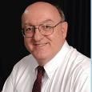
Dennis Rokser
Shall Never Perish Forever, p. 274
“To unbelievers who would add to God’s Word in this fashion, the Lord promises to ‘add to him the plagues that are written in this book.’ The plagues spoken of in the book of Revelation occur during that future period of God’s judgment on the earth known as the Tribulation. If anyone reading Revelation accepts the invitation of verse 17 and becomes a believer in Christ prior to the Tribulation, that person will experience the pretribulational Rapture of the saints (1 Thess. 4:13-18) rather than the plagues of the Tribulation (1 Thess. 5:1-3). Therefore, the warning of Revelation 22:18 applies only to unbelievers. This is not a warning to believers to stay saved or to be rewarded for their perseverance.”

Slide 43
Dennis Rokser
Shall Never Perish Forever, p. 273
“Verses 18-19 follow with a grave warning to unbelievers who would add to or subtract from the words of this book. Either adding to or taking away from the Word of God is characteristic of unbelievers who cannot simply accept by faith what God says in His Word. When God speaks, the response of the believing heart is simply ‘Amen.’ But the unbeliever does not accept what God says at face value, and so he must change the Word to suit himself.”

Slide 44
Dennis Rokser
Shall Never Perish Forever, p. 274
“A common characteristic of cults and religions that profess to be ‘Christian’ is that they invariably add other books, creeds, council decisions, or ‘inspired’ writings of their founder or leaders to the Bible, and they put these on a par with God’s Word.”

Slide 45
2 Peter 3:16-17
“as also in all his letters, speaking in them of these things, in which are some things hard to understand, which the untaught and unstable distort, as they do also the rest of the Scriptures, to their own destruction. ¹⁷ You therefore, beloved, knowing this beforehand, be on your guard so that you are not carried away by the error of unprincipled men and fall from your own steadfastness.”

Slide 46


Galatians 3:3
“Are you so foolish? Having begun by the Spirit, are you now being perfected by the flesh?”

Slide 47
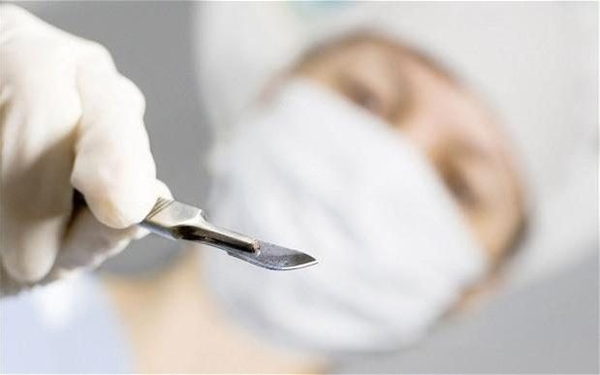
Galatians 5:4
“You have been severed from Christ, you who are seeking to be justified by law; you have fallen from grace.”

Slide 48
Three Tenses of Salvation
Phase | Justification | Sanctification | Glorification
Tense | Past | Present | Future
Saved from sin’s: | Penalty | Power | Presence
Scripture | Eph 2:8-9; Titus 3:5 | Philip 2:12 | Rom 5:10

Slide 49
Three Tenses of Salvation
Phase | Justification | Sanctification | Glorification
Tense | Past | Present | Future
Saved from sin’s: | Penalty | Power | Presence
Scripture | Eph 2:8-9; Titus 3:5 | Philip 2:12 | Rom 5:10

Slide 50
OVERVIEW 2 PETER 3:15-18
Regard the grace of God (v15)
Beware of false teachers (v16-17)
Grow in Christ (v18)

Slide 51
GROW IN CHRIST
(3:18)
Maturity inoculates the believer against false teaching (Eph 4:11-16)
God’s glory is the ultimate motivation for maturity

Slide 52

Ephesians 4:11-16
“¹¹ And He gave some as apostles, and some as prophets, and some as evangelists, and some as pastors and teachers, ¹² for the equipping of the saints for the work of service, to the building up of the body of Christ;” ¹³ until we all attain to the unity of the faith, and of the knowledge of the Son of God, to a mature man, to the measure of the stature which . . .

Slide 53
Ephesians 4:11-16
“... belongs to the fullness of Christ. ¹⁴ As a result, we are no longer to be children, tossed here and there by waves and carried about by every wind of doctrine, by the trickery of men, by craftiness in deceitful scheming; ¹⁵ but speaking the truth in love, we are to grow up in all aspects into Him who is the head, even . . .

Slide 54
Ephesians 4:11-16
“. . . Christ, ¹⁶ from whom the whole body, being fitted and held together by what every joint supplies, according to the proper working of each individual part, causes the growth of the body for the building up of itself in love.”

Slide 55
GROW IN CHRIST
(3:18)
Maturity inoculates the believer against false teaching (Eph 4:11-16)
God’s glory is the ultimate motivation for maturity

Slide 56
OVERVIEW 2 PETER 3:15-18
Regard the grace of God (v15)
Beware of false teachers (v16-17)
Grow in Christ (v18)

Slide 57
CONCLUSION

Slide 58
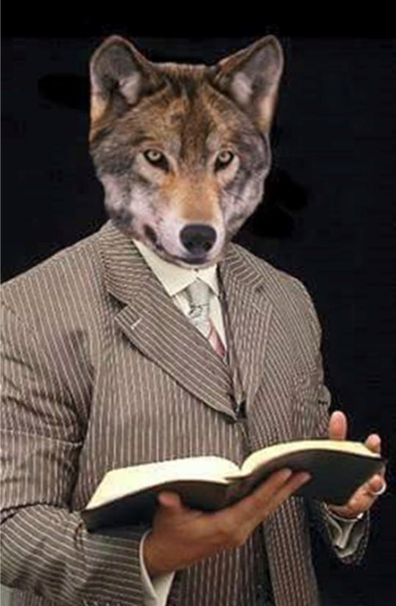
MESSAGE
Protection from the negative influence of the coming false teachers is accomplished through exhortation toward maturity and exposing the characteristics and doctrines of these coming false teachers

Slide 59
STRUCTURE
2 Peter 1 – Call to maturity
2 Peter 2 – Characteristics of false teachers
2 Peter 3 – Doctrine of the false teachers

