Slide 1
HOW TO FIND JOY IN THE CHRISTIAN LIFE

Slide 2
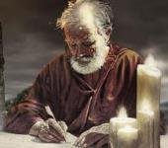
Answering Ten Questions
Who wrote it? – Paul
To Whom was it written? – The Believers at Philippi
Where was it written from? – Rome
When was it written? – A.D. 62
What was the book’s occasion? – Five contacts
Who are the opponents? – Four opponents threatening joy
What is the book’s purpose? – To give joy during adversity
How is it organized (outline)? – Four- part outline
What is it about? – Joy during adverstiy
What makes the book different? – Personal & informal

Slide 3
Introduction Phil. 1:1-11
Salutation (1:1-2)
Thanksgiving (1:3-8)
Prayer (1:9-11)

Slide 4
Outline
Ch 1 – God can use negative circumstances to bring about positive results
Ch 2 – Christ’s example of servanthood
Ch 3 – Avoiding legalism
Ch 4 – Reliance upon Christ’s strength for daily life

Slide 5
Outline
Ch 1 – God can use negative circumstances to bring about positive results
Ch 2 – Christ’s example of servanthood
Ch 3 – Avoiding legalism
Ch 4 – Reliance upon Christ’s strength for daily life

Slide 6
Positive Results of Imprisonment (Phil. 1:12-30)
Captive audience (Phil. 1:12-13)
Church’s boldness in preaching (Phil. 1:14-18)
Greater prayer (Phil. 1:19)
Protection from martyrdom (Phil. 1:20-26)

Slide 7
Applying Paul’s Paradigm (Phil. 1:27–30)
Walk worthy of your calling (Phil. 1:27)
Do not fear your persecutors (Phil. 1:28-29)
Suffering is normal (Phil. 1:30)

Slide 8
Outline
Ch 1 – God can use negative circumstances to bring about positive results
Ch 2 – Christ’s example of servanthood
Ch 3 – Avoiding legalism
Ch 4 – Reliance upon Christ’s strength for daily life

Slide 9
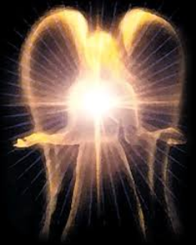
Original State and First Sin
Isaiah 14:12-15
5 “I will” statements
Ascend to heaven (13)
Raise my throne above the stars of God (13)
Sit enthroned on the Mt. of the Assembly (13)
Ascend above the tops of the clouds (14)
Make myself like the Most High (14)

Slide 10
Ezekiel 28:17
“Your heart was lifted up because of your beauty; You corrupted your wisdom by reason of your splendor.”

Slide 11
Examples of Humble Service
(Phil. 2)
Christ (Phil. 2:5-16)
Paul (Phil. 2:17-18)
Timothy (Phil. 2:19-24)
Epaphroditus (Phil. 2:25-30)

Slide 12
Examples of Humble Service
(Phil. 2)
Christ (Phil. 2:5-16)
Paul (Phil. 2:17-18)
Timothy (Phil. 2:19-24)
Epaphroditus (Phil. 2:25-30)

Slide 13
Philippians 2:7
“⁷ but emptied [kenoō] Himself, taking the form of a bond-servant, and being made in the likeness of men.”

Slide 14
John Walvoord
Jesus Christ Our Lord, 143-44
“The act of kenosis as stated in Philippians 2 may therefore be properly understood to mean that Christ surrendered no attribute of deity, but that He did voluntarily restrict their independent use in keeping with His purpose of living among men and their limitations.”

Slide 15
Charles Ryrie
The Ryrie Study Bible
“Philippians 2:7. emptied Himself. The kenosis (emptying) of Christ during His incarnation does not mean that He surrendered any attributes of deity, but that He took on the limitations of humanity. This involved a veiling of His preincarnate glory (John 17:5) and the voluntary nonuse of some of His divine prerogatives during the time He was on earth (Matt. 24:36). form. The same word as in verse 6. He was completely God and truly man. To deny either the deity or humanity of Christ requires denying the other.”

Slide 16
Emergent Preaching
“At Solomon’s porch, sermons are not primarily about my extracting truth from the Bible to apply to people’s lives…So our sermons are not lessons that precisely define belief so much as they are stories that welcome our hopes and ideas and participation” (Italics added).
Doug Pagitt, cited in Oakland, 41-42.

Slide 17
Emergent Preaching
“It isn’t about clever apologetics or careful exegetical or expository preaching…Emerging generations are hungering to experience God in worship” (Italics added).
Dan Kimball, The Emerging Church, 116

Slide 18
Emergent Preaching
“A spiritual Tsunami has hit postmodern culture. The wave will build without breaking for decades to come. The wave is this: People want to know God. They want less to know about God …they want new experiences, especially new experiences of the divine” (Italics added).
Leonard Sweet, Soul Tsunami, 420.

Slide 19
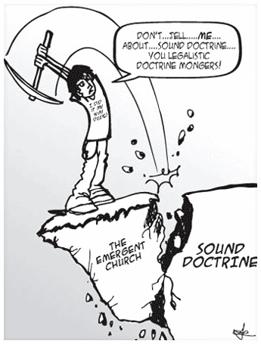
Emergent Doctrine
“…something beyond a belief system or doctrinal array or even a practice. I mean an attitude–an attitude toward God and our neighbor and our mission that is passionate.”
Brian McLaren, A Generous Orthodoxy, 117-18.

Slide 20
“Don’t give me doctrine, just give me Jesus.”
“What really matters is Christ not creed.”
“Devotion is important and not doctrine.”
“What counts is our behavior, and not our beliefs.”
Most of these slogans were originally accumulated in Henry Holloman, “Prolegomena, Bibliology, and Theology (Part 1)” (unpublished class notes in TTH511 Theology I, Talbot Theological Seminary, Spring 1998), 9.

Slide 21
Rick Warren Purpose Driven Life 34, 124, 183
“God won’t ask you about your religious background or doctrinal views.”
“Jesus said our love for each other - not our doctrinal beliefs - is our greatest witness to the world.”
“Today many assume that spiritual maturity is measured by the amount of biblical information and doctrine you know.”

Slide 22
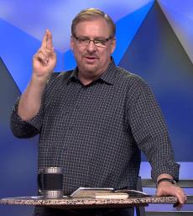
Rick Warren Purpose Driven Life 186, 231; Purpose Driven Church 300
“The Bible is far more than a doctrinal guidebook.”
“The last thing many believers need today is to go to another Bible study. They already know far more than they are putting into practice.”
“My pastor has been in Daniel’s seventy weeks longer than Daniel was!”

Slide 23
Acts 2:41-47
“…⁴² They were continually devoting themselves to the apostles’ teaching and to fellowship, to the breaking of bread and to prayer…”

Slide 24
Applying Paul’s Paradigm (Phil. 2:12–16)
Progress in practical sanctification (Phil. 2:12-13)
Do not grumble or dispute (Phil. 2:14)
Be blameless in the world (Phil. 2:15)
Remain loyal to Christ (Phil. 2:16)

Slide 25
Applying Paul’s Paradigm (Phil. 2:12–16)
Progress in practical sanctification (Phil. 2:12-13)
Do not grumble or dispute (Phil. 2:14)
Be blameless in the world (Phil. 2:15)
Remain loyal to Christ (Phil. 2:16)

Slide 26
Three Tenses of Salvation
Phase | Justification | Sanctification | Glorification
Tense | Past | Present | Future
Saved from sin’s: | Penalty | Power | Presence
Scripture | Eph 2:8-9; Titus 3:5 | Philip 2:12 | Rom 5:10

Slide 27
Three Tenses of Salvation
Phase | Justification | Sanctification | Glorification
Tense | Past | Present | Future
Saved from sin’s: | Penalty | Power | Presence
Scripture | Eph 2:8-9; Titus 3:5 | Philip 2:12 | Rom 5:10

Slide 28
Galatians 3:3
“Are you so foolish? Having begun by the Spirit, are you now being perfected by the flesh?”

Slide 29
Applying Paul’s Paradigm (Phil. 2:12–16)
Progress in practical sanctification (Phil. 2:12-13)
Do not grumble or dispute (Phil. 2:14)
Be blameless in the world (Phil. 2:15)
Remain loyal to Christ (Phil. 2:16)

Slide 30
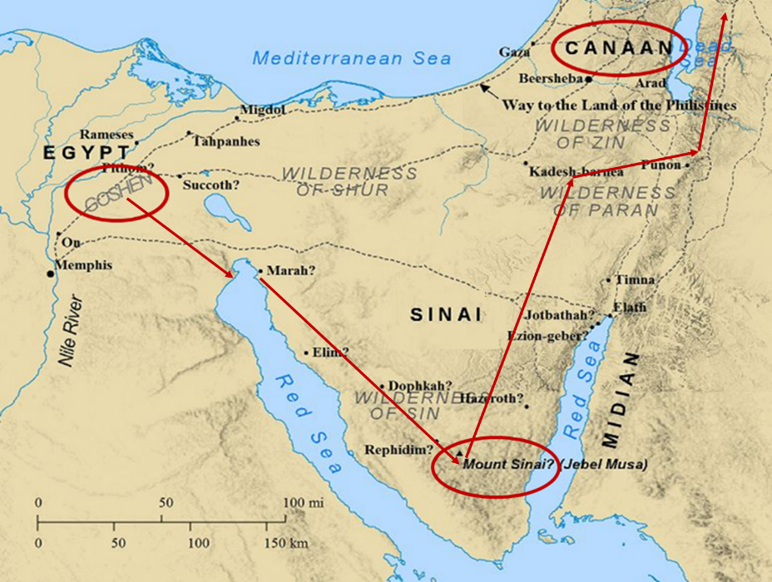

Slide 31
Applying Paul’s Paradigm (Phil. 2:12–16)
Progress in practical sanctification (Phil. 2:12-13)
Do not grumble or dispute (Phil. 2:14)
Be blameless in the world (Phil. 2:15)
Remain loyal to Christ (Phil. 2:16)

Slide 32
Applying Paul’s Paradigm (Phil. 2:12–16)
Progress in practical sanctification (Phil. 2:12-13)
Do not grumble or dispute (Phil. 2:14)
Be blameless in the world (Phil. 2:15)
Remain loyal to Christ (Phil. 2:16)

Slide 33
1 Corinthians 9:24-27
“Do you not know that those who run in a race all run, but only one receives the prize? Run in such a way that you may win. ²⁵ Everyone who competes in the games exercises self-control in all things. They then do it to receive a perishable wreath, but we an imperishable. ²⁶ Therefore I run in such a way, as not without aim; I box in such a way, as not beating the air; ²⁷ but I discipline my body and make it my slave, so that, after I have preached to others, I myself will not be disqualified.”

Slide 34
Examples of Humble Service
(Phil. 2)
Christ (Phil. 2:5-16)
Paul (Phil. 2:17-18)
Timothy (Phil. 2:19-24)
Epaphroditus (Phil. 2:25-30)

Slide 35
Examples of Humble Service
(Phil. 2)
Christ (Phil. 2:5-16)
Paul (Phil. 2:17-18)
Timothy (Phil. 2:19-24)
Epaphroditus (Phil. 2:25-30)

Slide 36
Examples of Humble Service
(Phil. 2)
Christ (Phil. 2:5-16)
Paul (Phil. 2:17-18)
Timothy (Phil. 2:19-24)
Epaphroditus (Phil. 2:25-30)

Slide 37
Galatians 4:13-14
“¹³ but you know that it was because of a bodily illness that I preached the gospel to you the first time; ¹⁴ and that which was a trial to you in my bodily condition you did not despise or loathe, but you received me as an angel of God, as Christ Jesus Himself.”

Slide 38
Romans 8:19-22
¹⁹ For the anxious longing of the creation waits eagerly for the revealing of the sons of God. ²⁰ For the creation was subjected to futility, not willingly, but because of Him who subjected it, in hope ²¹ that the creation itself also will be set free from its slavery to corruption into the freedom of the glory of the children of God. ²² For we know that the whole creation groans and suffers the pains of childbirth together until now.

Slide 39
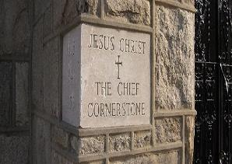
1 Timothy 5:23
“No longer drink water exclusively, but use a little wine for the sake of your stomach and your frequent ailments.”

Slide 40
2 Timothy 4:20
“Erastus remained at Corinth, but Trophimus I left sick at Miletus.”

Slide 41
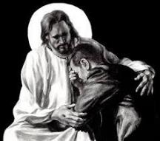
Revelation 21:4
“and He will wipe away every tear from their eyes; and there will no longer be any death; there will no longer be any mourning, or crying, or pain; the first things have passed away.”

Slide 42
Conclusion

Slide 43
Examples of Humble Service
(Phil. 2)
Christ (Phil. 2:5-16)
Paul (Phil. 2:17-18)
Timothy (Phil. 2:19-24)
Epaphroditus (Phil. 2:25-30)

Slide 44
“The Lord bless you and keep you; the Lord make his face shine on you and be gracious to you; the Lord turn his face toward you and give you peace.” (NIV)

