Slide 1
THE RAPTURE
What and When? – Part 4
Dr. Andy Woods
Senior Pastor – Sugar Land Bible Church
President – Chafer Theological Seminary

Slide 2
What is the Rapture?
An important doctrine
Distinct from the Second Advent
Catching away of all living believers (1 Thess 4:17)
Reunion (1 Thess 4:14-16)
Resurrection (1 Cor 15:50-54)
Exemption from death (1 Cor 15:51, 54-56)
Instantaneous (1 Cor 15:52)
Mystery (1 Cor 15:51)
Imminent (1 Cor 15:51; 1 Thess 4:15)
Traditional doctrine now being recovered

Slide 3
Michael L. Brown & Craig S. Keener Not Afraid of the Antichrist: Why We Don't Believe in a Pre-Tribulation Rapture (Bloomington, MINN: Chosen, 2019), 62.
“The view dominated many mid-twentieth-century U.S. evangelical circles, which also promoted it widely on mission fields that now flourish with tens or hundreds of millions of zealous Christians. Yet there is no record of anyone promoting a pre-Tribulational Rapture before about 1830; until that time virtually everyone, from any Christian or even semi-Christian tradition, expected that Jesus would resurrect the righteous and destroy the wicked at the same time.”

Slide 4
Gary DeMar End Times Fiction: A Biblical Consideration of the Left Behind Theology (Nashville, TN: Nelson, 2001), 19.
“…the doctrine was not discovered until the nineteenth century. All attempts to find a pretrib Rapture any earlier than around 1830 do not hold up to historical scrutiny…If it took nearly nineteen-hundred years to discover the pretrib Rapture, why didn’t it take that long to discover the many other doctrines that Christians believed and confessed…?”

Slide 5
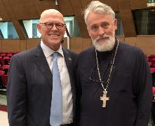
Hank Hanegraaff
The Apocalypse Code: Find Out What the Bible Really Says About the End Times and Why It Matters (Nashville, TN: Nelson, 2007), 17, 272.
“Prior to the nineteenth century, all Christians, futurists included, believed that a commonsense reading of Scripture inevitability led to the conclusion that the second coming / bodily return of Christ and the rapture / resurrection of believers are simultaneous events... Dispensationalism was first conceived by John Nelson Darby in the nineteenth century and popularized by prophecy pundits such as Hal Lindsey and Tim LaHaye in the twentieth century.”

Slide 6
“The Rapture” is a New Doctrine? Four Logical Fallacies
Recency fallacy
Ad-populum fallacy
Genetic fallacy
Ad-hominem fallacy

Slide 7
“The Rapture” a Traditional Doctrine Now Being Recovered
Sola scriptura
Negative influence of Augustine and Origen
Pseudo Ephraem (4th-6th century A.D.)
Progressive illumination

Slide 8
“The Rapture” a Traditional Doctrine Now Being Recovered
Sola scriptura
Negative influence of Augustine and Origen
Pseudo Ephraem (4th-6th century A.D.)
Progressive illumination

Slide 9
Acts 20:29-31
²⁹ “I know that after my departure savage wolves will come in among you, not sparing the flock; ³⁰ and from among your own selves men will arise, speaking perverse things, to draw away the disciples after them. ³¹ “Therefore be on the alert, remembering that night and day for a period of three years I did not cease to admonish each one with tears.

Slide 10
“The Rapture” a Traditional Doctrine Now Being Recovered
Sola scriptura
Negative influence of Augustine and Origen
Pseudo Ephraem (4th-6th century A.D.)
Progressive illumination

Slide 11
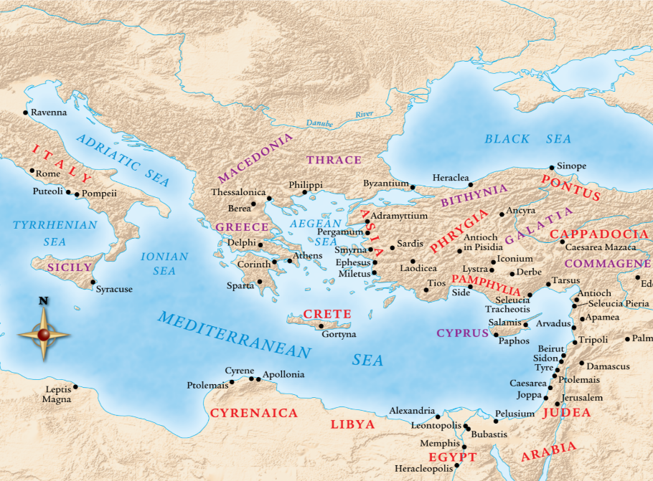

Slide 12
Jesse Forest Silver
The Lord’s Return: Seen in History and in Scripture as Premillennial and Imminent (NY: Revell, 1914), 62-64.
Silver says of the apostolic fathers that “they expected the return of the Lord in their day…They believed the time was imminent because the Lord had taught them to live in a watchful attitude.” Concerning the ante Nicene fathers, he says: “by tradition they knew the faith of the apostles. They taught the doctrine of the imminent and pre-millennial return of the Lord.”

Slide 13
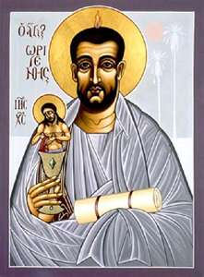
Ante-Nicene Fathers: “Heavenly and Eschatological" Interpretation of John 14:1-4
Papias (AD 110)
Irenaeus (AD 130-202)
Tertullian (AD 196-212)
Origen (AD 182-251)
Cyprian (AD 258)
George Gunn, “John 14:1-3: The Father's House: Are We There Yet?,” 7-11

Slide 14
Ante-Nicene Fathers: “Heavenly and Eschatological" Interpretation of John 14:1-4
“Interestingly, references to John 14:1-3 virtually disappear when perusing the writings of the Nicene and Post-Nicene fathers. This is a bit surprising, given the abundance of material in these later writers when compared with the Ante-Nicenes. I would assume that with the rise of Augustinian amillennialism and its optimistic interpretation regarding the present arrival of the Kingdom of God, the kind of hope held out in John 14:1-3 ceased to hold relevance.”
George A. Gunn, "Jesus and the Rapture: John 14," in Evidence for the Rapture: A Biblical Case for Pretribulationism, ed. John F. Hart (Chicago: Moody, 2015), 119, n. 22.

Slide 15
“The Rapture” a Traditional Doctrine Now Being Recovered
Sola scriptura
Negative influence of Augustine and Origen
Pseudo Ephraem (4th-6th century A.D.)
Progressive illumination

Slide 16
Pseudo Ephraem (4th-6th century A.D.)
“Why therefore do we not reject every care of earthly actions and prepare ourselves for the meeting of the Lord Christ, so that he may draw us from the confusion, which overwhelms all the world…For all the saints and the elect of God are gathered, prior to the tribulation that is to come, and are taken to the Lord lest they see the confusion that is to overwhelm the world because of our sins.”

Slide 17
“The Rapture” a Traditional Doctrine Now Being Recovered
Sola scriptura
Negative influence of Augustine and Origen
Pseudo Ephraem (4th-6th century A.D.)
Progressive illumination

Slide 18
Daniel 12:4, 9
“⁴ But as for you, Daniel, conceal these words and seal up the book until the end of time; many will go back and forth, and knowledge will increase...⁹ Go your way, Daniel, for these words are concealed and sealed up until the end time.”

Slide 19
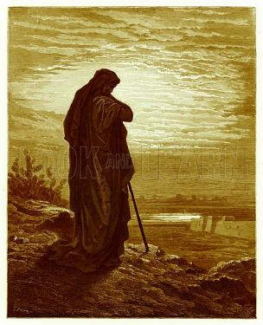
Amos 8:12
“People will stagger from sea to sea And from the north even to the east; They will go to and fro to seek the word of the Lord, But they will not find it.”

Slide 20
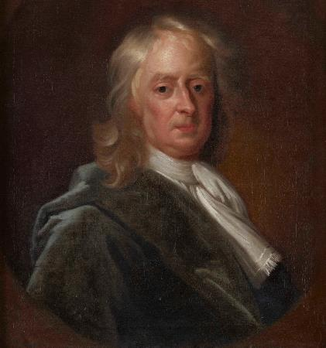
Sir Isaac Newton (1642–1727)
"About the time of the end, a body of men will be raised up who will turn their attention to the Prophecies, and insist upon their literal interpretation, in the midst of much clamor and opposition."
Isaac Newton cited in Nathaniel West, The Thousand Years in Both Testaments, 462.

Slide 21
History of Doctrine
Canon (A.D. 180)
Christology (A.D. 500)
Atonement (A.D. 1100)
Salvation (A.D. 1500)
Eschatology (A.D. 1800)

Slide 22
James Orr
The Progress of Dogma (Grand Rapids: Eerdmans, 1952), 21-31.
Orr outlines the progress of Christian dogma in a similar way. “The second century was the age of Apologetics. The doctrine of God and especially the Trinity then took center stage in the third and fourth centuries as the Church dealt with the Monarchian, Arian, and Macedonian controversies. Anthropology then became the Church's focus in the early fifth century during the Augustinian and Pelagian controversies...The late fifth and then sixth and seventh centuries were characterized by an ecclesiastical interest in Christological (Nestorian, Eutychian, Monphysite, Monothelite) matters. In the . . .

Slide 23
James Orr
The Progress of Dogma (Grand Rapids: Eerdmans, 1952), 21-31.
“. . .sixteenth century the reformers focused upon salvific or Soteriological concerns. Finally, the Church gave itself to correcting a Mythical and Mediaeval pre-reformation Eschatology.” Thus, Eschatology was the last of the branches of theology to be systematized since it was not designed to be progressively unsealed or illuminated by the Holy Spirit until just before the fulfillment of the predicted events (Dan. 12:4, 8-9).

Slide 24
What is the Rapture?
An important doctrine
Distinct from the Second Advent
Catching away of all living believers (1 Thess 4:17)
Reunion (1 Thess 4:14-16)
Resurrection (1 Cor 15:50-54)
Exemption from death (1 Cor 15:51, 54-56)
Instantaneous (1 Cor 15:52)
Mystery (1 Cor 15:51)
Imminent (1 Cor 15:51; 1 Thess 4:15)
Traditional doctrine now being recovered

Slide 25
THE RAPTURE
What and When?
Dr. Andy Woods
Senior Pastor – Sugar Land Bible Church
President – Chafer Theological Seminary

Slide 26
When Will the Rapture Take Place Relative to the Tribulation Period?
Pre-tribulation rapture theory
Mid-tribulation rapture theory
Post-tribulation rapture theory
Pre-wrath rapture theory
Partial rapture theory

Slide 28
When Will the Rapture Take Place Relative to the Tribulation Period?
Pre-tribulation rapture theory
Mid-tribulation rapture theory
Post-tribulation rapture theory
Pre-wrath rapture theory
Partial rapture theory

Slide 29
Rick Joyner
The Harvest, 1989-1990, revised booklet page 121.
“The doctrine of the rapture was a great and effective use of the enemy to implant in the church a retreat mentality. Already this yoke has been cast off by the majority of the advancing church and it will soon be cast off by all.” (italics added)

Slide 30
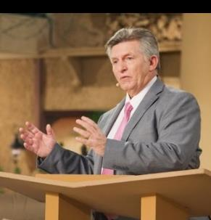
Rick Wiles
http://www.wnd.com/2015/08/is-everything-you-know-about-second-coming-wrong/
“I personally do not believe that by the year 2020, any credible person will be teaching the secret pre-trib. rapture doctrine. I think the events that are coming in the next five years will utterly destroy the doctrine.”

Slide 31
Rick Wiles
“Jan Markell on the Mockery of Bible Prophecy,” online: http://christinprophecy.org/sermons/jan-markell-on-the-mockery-of-bible-prophecy/, October 14 2018, accessed 19 November 2018.
Rick Wiles: The secret Pre-Trib Rapture story and Christian Zionism that is a two headed–
Doc Burkhart: Monster.
Rick Wiles: –monster. It is a two headed freak monster. Okay. They come together, both of them come together because they were started by the same people. The Christian Zionists started the Pre-Trib Rapture doctrine.
Doc Burkhart: And this was seed planted decades ago, but it came into full fruit in within the last 30 years.

Slide 32
Rick Wiles
“Jan Markell on the Mockery of Bible Prophecy,” online: http://christinprophecy.org/sermons/jan-markell-on-the-mockery-of-bible-prophecy/, October 14 2018, accessed 19 November 2018.
Rick Wiles: That’s right. They had to create the Pre-Trib Rapture doctrine to justify Christian Zionism. That’s where it all came from. But isn’t it interesting that in the recent decades where the American Evangelical Church has been taken over by Christian Zionism, that the American Evangelical Church has lost its flavor.
Doc Burkhart: Yes.
Rick Wiles: It has lost its saltiness. It is of no use anymore to God in this country.
Doc Burkhart: Right. In fact things are worse off now than they were 30 years ago.

Slide 33
Rick Wiles
“Jan Markell on the Mockery of Bible Prophecy,” online: http://christinprophecy.org/sermons/jan-markell-on-the-mockery-of-bible-prophecy/, October 14 2018, accessed 19 November 2018.
Rick Wiles: We’ve become a pagan nation.
Doc Burkhart: We’re Babylon.
Rick Wiles: We’re Babylon and it happened on the watch of the Christian Zionist. I’m laying it on your doorstep Christian Zionists. You are the cause of America’s decline.
Doc Burkhart: Those are strong words there.

Slide 34
Rick Wiles
“Jan Markell on the Mockery of Bible Prophecy,” online: http://christinprophecy.org/sermons/jan-markell-on-the-mockery-of-bible-prophecy/, October 14 2018, accessed 19 November 2018.
Rick Wiles: They are strong words, and I mean it. They took control of the churches in America, the Christian Zionist. They changed the Gospel. They took Jesus off the cross. They replaced the cross with the Star of David. They took the focus off God, and holiness. They put it all on a piece of land in the Middle East. And America has gone to hell. America has gone to hell. We’ve become a pagan, heathen nation because the Christian Zionists have taken our eyes off Jesus.

Slide 35
David Barton
“David Barton Is ‘Grateful’ That The Most Recent ‘Left Behind’ Movie Bombed,” online: http://www.rightwingwatch.org/post/david-barton-is-grateful-that-the-most-recent-left-behind-movie-bombed/, October 29 2014, accessed 15 February 2018.
“The movie is a complete bust,” Barton rejoiced. “It did really pathetic at the box office … and quite frankly I was somewhat happy the movie was a bust.” Barton said the “Left Behind” series has convinced too many Christians that “it is a waste of time to get involved.” Barton “was really grateful that the movie didn’t do well because I didn’t want that mentality going out there. It violates way too many things in the Bible. I think the movie not doing well is [a sign] that hopefully our eschatology is beginning to change for a more sound biblical direction in America,” he said. “Maybe we’re getting a little more mature and a little wiser over some things.”

Slide 36
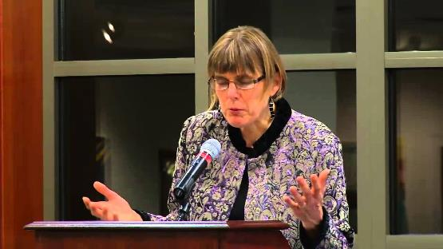
Barbara R. Rossing
The Rapture Exposed: The Message of Hope in the Book of Revelation (Boulder, CO: Westview Press, 2004), 1-2.
“The rapture is a racket. Whether prescribing a violent script for Israel or survivalism in the United States, this theology distorts God’s vision for the world…This theology is not biblical. We are not raptured off the earth, nor is God. No, God has come to live in the world through Jesus. God created the world, God loves the world, God will never leave the world behind!”

Slide 37
William Lane Craig
“No, Christians Should Not Believe in 'Left Behind's' Rapture Theology, Says Prominent Christian Philosopher,” online: https://www.christianpost.com/news/no-christians-should-not-believe-in-left-behinds-rapture-theology-says-prominent-apologist-124070/, July 30 2014, accessed 14 February 2018.
“This doctrine is not really found in the book of Revelation. If you read the book of Revelation, you won't find any mention of the rapture there. [The idea of the rapture comes from a] misinterpretation of 1 and 2 Thessalonians where Paul is describing the coming of the Lord and resurrection of the dead, which will occur at His coming. If you compare what Paul says there to what Jesus says about the End Times, Paul uses the same vocabulary, the same phraseology. I think it's very plausible that Paul is talking about the same event that Jesus predicted, namely the visible coming of the Son of Man at the end of human history to usher in his kingdom.”

Slide 38
William Lane Craig
“No, Christians Should Not Believe in 'Left Behind's' Rapture Theology, Says Prominent Christian Philosopher,” online: https://www.christianpost.com/news/no-christians-should-not-believe-in-left-behinds-rapture-theology-says-prominent-apologist-124070/, July 30 2014, accessed 14 February 2018.
“But proponents of the rapture view, say that Paul is not at all talking about the second coming of the Christ there. What he's really talking about is this invisible preliminary secret return of Christ to snatch believers out of the world before the great tribulation occurs. I think there's no textual warrant for that at all. A good many Bible-believing Christians absorbed this view as their mother's milk as it were and have never thought to question its Biblical credentials. It could be maybe good fiction. It would be say like reading science fiction or fantasy novels like The Lord of the Rings.”

Slide 39
William Lane Craig
“No, Christians Should Not Believe in 'Left Behind's' Rapture Theology, Says Prominent Christian Philosopher,” online: https://www.christianpost.com/news/no-christians-should-not-believe-in-left-behinds-rapture-theology-says-prominent-apologist-124070/, July 30 2014, accessed 14 February 2018.
“Just so long as you're not deceived into thinking that represents biblical eschatology. It is astonishing, if I'm correct about this, American evangelism is very widely misled, that it has departed from the historic Christian position about the second coming of Christ. That's really rather sobering, because if we're wrong about this, what other things might we have misinterpreted?”

Slide 40
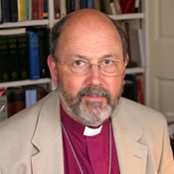
NT Wright
“NT Wright Claims 'The Rapture' Does Not Appear Anywhere in Scripture, in New Podcast from Premier,” online: https://www.premier.org.uk/News/UK/NT-Wright-claims-the-rapture-does-not-appear-anywhere-in-scripture-in-new-podcast-from-Premier, November 15 2018, accessed 19 November 2018.
“When Paul wrote 1 Thessalonians people were worried that when Jesus returned, those who were dead would stay dead and miss out on the ‘new day.’ Some people have taken the verses that followed literally, but the problem is that that is not what this verse is about. Paul is awfully good at mixed metaphors. When Jesus comes back, it’s not to snatch people away from earth but rather to transform earth with the life of Heaven and to transform us as well. He doesn’t come back to take us away, but to heal the world and to heal and transform his people."

Slide 41
Hank Hanegraaff
“Jan Markell on the Mockery of Bible Prophecy,” online: http://christinprophecy.org/sermons/jan-markell-on-the-mockery-of-bible-prophecy/, October 14 2018, accessed 19 November 2018.
Caller: “What I am trying to understand is where do they get the teaching that the Church will be raptured out and will not have to go through Tribulation? Where is that found at?”
Hank Hanegraaff: ”It’s not found. That’s the whole point. The point is it’s something that is imposed on the Scripture. The notion is a very new notion in Church history; it is a 19th Century notion that was popularized by John Nelson Darby. And it comes with the presupposition that God has two distinct people; and therefore He has two distinct plans for the two distinct people...”

Slide 42
Hank Hanegraaff
“Jan Markell on the Mockery of Bible Prophecy,” online: http://christinprophecy.org/sermons/jan-markell-on-the-mockery-of-bible-prophecy/, October 14 2018, accessed 19 November 2018.
Hank Hanegraaff: “…And He has two distinct phases of the Second Coming, and two distinct destinies. This however, is an imposition on Scripture because the truth of it is God has only, always had one chosen people. One covenant community. Beautifully connected by the cross and illustrated by a cultivated olive tree in Paul’s letter to the Romans. So, the point here is that all those who are followers of Jesus Christ are the one chosen people. And this is prior to the cross as well because all that looked forward to Christ prior to the cross are God’s covenant chosen people. And the covenant chosen people are made up of people from every tongue, and language and nation and people. You are not a son of Abraham because of some genealogical construction. You are a son of Abraham because you believe in the God of Abraham.”

Slide 43
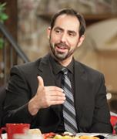
Joel Richardson
“Jan Markell on the Mockery of Bible Prophecy,” online: http://christinprophecy.org/sermons/jan-markell-on-the-mockery-of-bible-prophecy/, October 14 2018, accessed 19 November 2018.
“What if the end of the world really isn’t as so many have portrayed it? What if the Church is not Raptured to heaven before the Great Tribulation as many are teaching? What if the Church has been left ill-prepared to face the Antichrist and the Mark of the Beast? What if Tim LaHaye’s claim that if the Pre-Tribulation Rapture is false then the Blessed Hope will become the blasted hope, actually comes true for millions of Pretribulationists? What if millions who have been led astray by the Pre-Trib teaching become part of the great falling away that Jesus warned would take place at that time? Left behind, or led astray? The issue of the Pre-Tribulational versus . . .

Slide 44
Joel Richardson
“Jan Markell on the Mockery of Bible Prophecy,” online: http://christinprophecy.org/sermons/jan-markell-on-the-mockery-of-bible-prophecy/, October 14 2018, accessed 19 November 2018.
. . .versus the Post-Tribulational Rapture is one of the premier pastoral issues of our day. If you are a pastor that is not preparing your people to face potentially the Antichrist in the Great Tribulation in this hour simply because your denomination teaches it or whatever, personally I think you’re failing in your role as a shepherd and a pastor.”

Slide 45
Frank Schaeffer
“Jan Markell on the Mockery of Bible Prophecy,” online: http://christinprophecy.org/sermons/jan-markell-on-the-mockery-of-bible-prophecy/, October 14 2018, accessed 19 November 2018.
“The Evangelical Christian movement in America latched on to a 19th Century concept that was hatched by someone called John Nelson Darby, who said that Jesus could not come back until Israel had been restored as a nation, populated by Jews, with Jerusalem as its capital. This is not traditional Christian teaching in the Protestant Church. This was not a concern of Martin Luther or any Roman Catholic, or the Greek Orthodox or anyone else. When I was a kid, my parents had their ministry L’Abri. We had a number of Christian leaders come by. One of them, Hal Lindsey, had written a book called ‘The Late Great Planet Earth’ in which he predicted the end times . . .

Slide 46
Frank Schaeffer
“Jan Markell on the Mockery of Bible Prophecy,” online: http://christinprophecy.org/sermons/jan-markell-on-the-mockery-of-bible-prophecy/, October 14 2018, accessed 19 November 2018.
“. . . coming in 1980s. He said it is now possible because Israel has been restored. And then others came back and said, ‘No, no, Jesus can’t come back yet because Jerusalem is not restored.’ Fast forward to the 16 books and 4 films that you had that came out of the Left Behind series written by a friend of mine Jerry Jenkins, and his sidekick co-author Tim LaHaye, that (sic) wrote it with him. And you’ve got 60 million copies sold that essentially are total fiction. 'I am going to give you an analogy, this is as if the Twilight Zone had been taken as gospel by some religious group and they were going back through old episodes and basing an entire cultic kind of religion on it.”

Slide 47
Conclusion

Slide 48
When is the Rapture? 7 Arguments Favoring the Pre-Tribulation View
Tribulation's purpose concerns Israel (Jer 30:7; Dan 9:24)
No biblical reference to the church on earth during the Tribulation period (Rev 4-22)
Church is promised an exemption from divine wrath (1 Thess 1:10; 5:9; Rom 5:9; Rev 3:10; 6:17)
Rapture is imminent (1 Cor 15:51; 1 Thess 4:15)
Rapture is a comfort (1 Thess 4:18)
Antichrist cannot come to power until the restrainer is removed (2 Thess 2:6-7)
Symbolic parallels (2 Peter 2:5-9)

