Slide 1
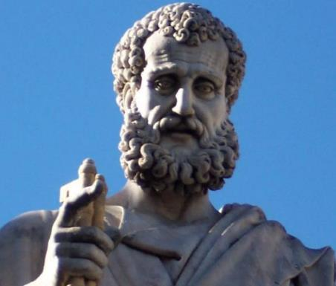

2 Peter
Dr. Andy Woods
Senior Pastor – Sugar Land Bible Church
President – Chafer Theological Seminary

Slide 2

INTRODUCTORY MATTERS
Authorship: Peter
Biography: Gospels & Acts
Date: A.D. 64
Recipients: Regenerated, Asia Minor, Hebrews
Place of writing: Babylon
Occasion for writing: Incipient Gnosticism
Purpose: Insulation from false teaching
Structure: 3 parts
Message: Protection from false teachers
Unique characteristics: Knowledge

Slide 3
STRUCTURE
2 Peter 1 – Call to maturity
2 Peter 2 – Characteristics of false teachers
2 Peter 3 – Doctrine of the false teachers (uniformitarianism)

Slide 4
STRUCTURE
2 Peter 1 – Call to maturity
2 Peter 2 – Characteristics of false teachers
2 Peter 3 – Doctrine of the false teachers (uniformitarianism)

Slide 5
2 PETER
Chapter 1
Introduction (1:1-2)
Call to Growth (1:3-11)
Purpose Statement (1:12-15)
Coming kingdom (1:16-21)

Slide 6
STRUCTURE
2 Peter 1 – Call to maturity
2 Peter 2 – Characteristics of false teachers
2 Peter 3 – Doctrine of the false teachers (uniformitarianism)

Slide 7

2 PETER 2 OUTLINE
Predicted arrival (2:1a)
Devices (2:1b-3)
Doom (2:4-9)
Depravity (2:10-16)
Emptiness (2:17-19)
Regression (2:20-22)

Slide 8
STRUCTURE
2 Peter 1 – Call to maturity
2 Peter 2 – Characteristics of false teachers
2 Peter 3 – Doctrine of the false teachers

Slide 9

RELEVANCE OF THE FUTURE
2 Peter 3:3-15

Slide 10
OVERVIEW OF 2 PETER 3:3-15
Heresy of the false teachers (v3-4)
Motive of the false teachers (v3-4)
Peter’s rebuttal (v5-10)
Application (v11-15)

Slide 11
OVERVIEW OF 2 PETER 3:3-15
Heresy of the false teachers (v3-4)
Motive of the false teachers (v3-4)
Peter’s rebuttal (v5-10)
Application (v11-15)

Slide 12
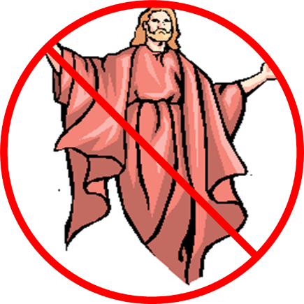
DOCTRINE OF FALSE TEACHERS
V.3-4
Deny 2nd Coming
  Scoffing
  Future tense

Slide 13
OVERVIEW OF 2 PETER 3:3-15
Heresy of the false teachers (v3-4)
Motive of the false teachers (v3-4)
Peter’s rebuttal (v5-10)
Application (v11-15)

Slide 14
MOTIVE OF FALSE TEACHERS
V.3-4
Deny 2nd Coming
  Lust & denial of judgment
  Uniformitarianism/ naturalism

Slide 15
OVERVIEW OF 2 PETER 3:3-15
Heresy of the false teachers (v3-4)
Motive of the false teachers (v3-4)
Peter’s rebuttal (v5-10)
Application (v11-15)

Slide 16
PETER’S REBUTTAL
V.5-10
Arguments from:
History (5-7)
Scripture (8)
God’s character (9)
Divine promise (10)

Slide 17
PETER’S REBUTTAL
V.5-10
Arguments from:
History (5-7)
Scripture (8)
God’s character (9)
Divine promise (10)

Slide 18
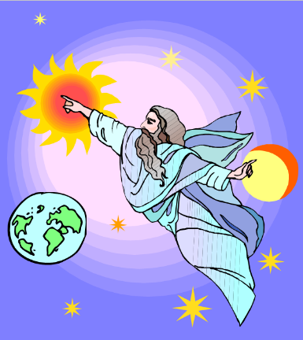
HISTORY
V. 5-7
Creation (5)
Flood (6-7)
  God will judge again via fire

Slide 19
PETER’S REBUTTAL
V.5-10
Arguments from:
History (5-7)
Scripture (8)
God’s character (9)
Divine promise (10)

Slide 20
SCRIPTURE
V. 8
God’s timing is not the same as ours

Slide 21
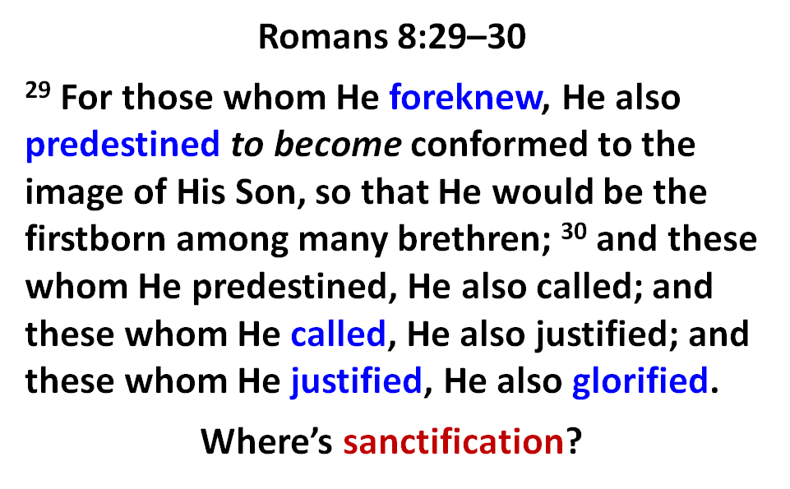

Slide 22

Jude 14–15
¹⁴ It was also about these men that Enoch, in the seventh generation from Adam, prophesied, saying, “Behold, the Lord came with many thousands of His holy ones, ¹⁵ to execute judgment upon all, and to convict all the ungodly of all their ungodly deeds which they have done in an ungodly way, and of all the harsh things which ungodly sinners have spoken against Him.”

Slide 23
PETER’S REBUTTAL
V.5-10
Arguments from:
History (5-7)
Scripture (8)
God’s character (9)
Divine promise (10)

Slide 24
GOD’S CHARACTER
V. 9
Delay ≠ no 2nd Coming
Delay = patience

Slide 25

Genesis 6:1-4
“¹ Now it came about, when men began to multiply on the face of the land, and daughters were born to them, ² that the sons of God saw that the daughters of men were beautiful; and they took wives for themselves, whomever they chose. ³ Then the Lord said, ‘My Spirit shall not strive with man forever, because he also is flesh; nevertheless his days shall be one hundred and twenty years.’ ⁴ The Nephilim were on the earth in those days, and also afterward, when the sons of God came in to the daughters of men, and they bore children to them. Those were the mighty men who were of old, men of renown.”

Slide 26

1 Peter 3:19-20
“¹⁹ in which also He went and made proclamation the spirits now in prison, ²⁰ who once were disobedient, when the patience of God kept waiting in the days of Noah, during the construction of the ark, in which a few, that is, eight persons, were brought safely through the water.”

Slide 27

Calvin said: “By predestination we mean the eternal decree of God, by which he determined with himself whatever he wished to happen with regard to every man. All are not created on equal terms, but some are preordained to eternal life, others to eternal damnation; and, accordingly, as each has been created for one or other of these ends, we say that he has been predestinated to life or to death.”
John Calvin
Institutes of the Christian Religion, Vol. 3, (Orlando, Signalman Publishing, from the 4th edition, 2009, Kindle edition), Chapter 21, section 5, Kindle location 17221.

Slide 28
Calvin said: “We say, then, that Scripture clearly proves this much, that God by his eternal and immutable counsel determined once for all those whom it was his pleasure one day to admit to salvation, and those whom, on the other hand, it was his pleasure to doom to destruction.”
John Calvin
Institutes of the Christian Religion, Vol. 3, Chapter 23, section 7.

Slide 29
Calvin said: “I say with Augustine, that the Lord has created those who, as he certainly foreknow, were to go to destruction, and he did so because he so willed. Why he willed it is not ours to ask, as we cannot comprehend, nor can it become us even to raise a controversy as to the justice of the divine will. Whenever we speak of it, we are speaking of the supreme standard of justice.”
John Calvin
Institutes of the Christian Religion, Vol. 3, Chapter 23, section 5.

Slide 30
Calvin wrote: “Now, since the arrangement of all things is in the hand of God, since to him belongs the disposal of life and death, he arranges all things by his sovereign counsel, in such a way that individuals are born, who are doomed from the womb to certain death, and are to glorify him by their destruction.”
John Calvin
Institutes of the Christian Religion, Vol. 3, Chapter 23, section 6.

Slide 31
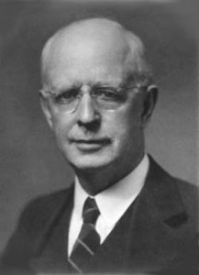

Slide 32

Lewis Sperry Chafer
vol. 7, Systematic Theology (Grand Rapids, MI: Kregel Publications, 1993), 265-66.
“This vital newness of mind is a part of believing, after all, and therefore it may be and is used as a synonym for believing at times (cf. Acts 17:30; 20:21; 26:20; Rom. 2:4; 2Tim. 2:25; 2 Pet. 3:9). Repentance nevertheless cannot be added to believing as a condition of salvation, because upwards of 150 passages of Scripture condition salvation upon believing only (cf. John 3:16; Acts 16:31).”

Slide 33

Acts 17:30-31
“³⁰ Therefore having overlooked the times of ignorance, God is now declaring to men that all people everywhere should repent [metanoeō], ³¹ because He has fixed a day in which He will judge the world in righteousness through a Man whom He has appointed, having furnished proof to all men by raising Him from the dead.”

Slide 34
Three Tenses of Salvation
Phase | Justification | Sanctification | Glorification
Tense | Past | Present | Future
Saved from sin’s: | Penalty | Power | Presence
Scripture | Eph 2:8-9; Titus 3:5 | Philip 2:12 | Rom 5:10

Slide 35
PETER’S REBUTTAL
V.5-10
Arguments from:
History (5-7)
Scripture (8)
God’s character (9)
Divine promise (10)

Slide 36
GOD’S PROMISE
V. 10
Despite delay,
  the day will come:
Like a thief
According to God’s promise

Slide 37
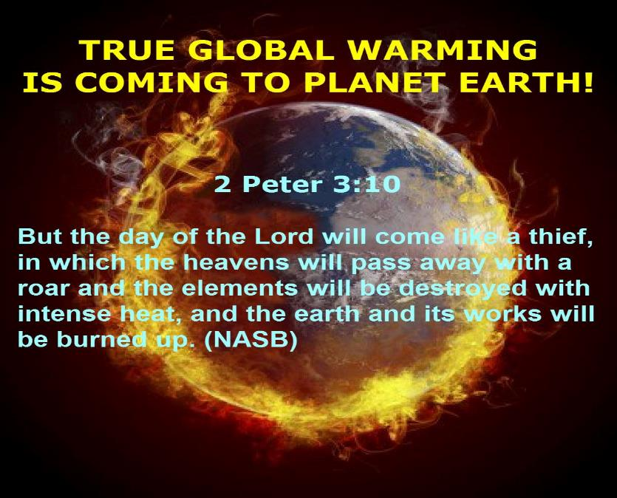

Slide 38

Genesis 1:1-3
“¹ In the beginning God created the heavens and the earth. ² The earth was formless and void, and darkness was over the surface of the deep, and the Spirit of God was moving over the surface of the waters. ³ Then God said, ‘Let there be light’; and there was light.”

Slide 39
Genesis 6:1-4
“¹ Now it came about, when men began to multiply on the face of the land, and daughters were born to them, ² that the sons of God saw that the daughters of men were beautiful; and they took wives for themselves, whomever they chose. ³ Then the Lord said, ‘My Spirit shall not strive with man forever, because he also is flesh; nevertheless his days shall be one hundred and twenty years.’ ⁴ The Nephilim were on the earth in those days, and also afterward, when the sons of God came in to the daughters of men, and they bore children to them. Those were the mighty men who were of old, men of renown.”

Slide 40

Revelation 21:1, 4
¹ Then I saw a new heaven and a new earth; for the first heaven and the first earth passed away [apérchomai], and there is no longer any sea…⁴ and He will wipe away every tear from their eyes; and there will no longer be any death; there will no longer be any mourning, or crying, or pain; the first things have passed away [apérchomai].

Slide 41

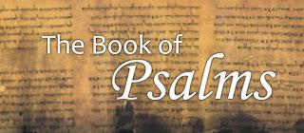
Psalm 90:2
“Before the mountains were born Or You gave birth to the earth and the world, Even from everlasting (olam) to everlasting (olam), You are God.”

Slide 42
GOD’S PROMISE
V. 10
Despite delay,
  the day will come:
Like a thief
According to God’s promise

Slide 43

1 Thessalonians 4:13-18
. . . have fallen asleep. ¹⁶ For the Lord Himself will descend from heaven with a shout, with the voice of the archangel and with the trumpet of God, and the dead in Christ will rise first. ¹⁷ Then we who are alive and remain will be caught up together with them in the clouds to meet the Lord in the air, and so we shall always be with the Lord. ¹⁸ Therefore comfort one another with these words."

Slide 44
PETER’S REBUTTAL
V.5-10
Arguments from:
History (5-7)
Scripture (8)
God’s character (9)
Divine promise (10)

Slide 45
OVERVIEW OF 2 PETER 3:3-15
Heresy of the false teachers (v3-4)
Motive of the false teachers (v3-4)
Peter’s rebuttal (v5-10)
Application (v11-15)

Slide 46
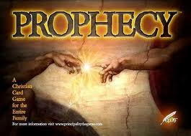
BIBLICAL PROPHECY: IMPORTANCE
27% of Scripture was prophetic at the time it was written
2 Pet 1:19

Slide 47

J. Dwight Pentecost
Prophecy For Today, Page 20
“A short time ago, I took occasion to go through the New Testament to mark each reference to the coming of the Lord Jesus Christ and to observe the use made of that teaching about His coming. I was struck a new with the fact that almost without exception, when the coming of Christ is mentioned in the New Testament, it is followed by an exhortation to godliness and holy living.”

Slide 48
2 Peter 1:19-21
“¹⁹ So we have the prophetic word made more sure, to which you do well to pay attention as to a lamp shining in a dark place, until the day dawns and the morning star arises in your hearts. ²⁰ But know this first of all, that no prophecy of Scripture is a matter of one’s own interpretation, ²¹ for no prophecy was ever made by an act of human will, but men moved by the Holy Spirit spoke from God.”

Slide 49
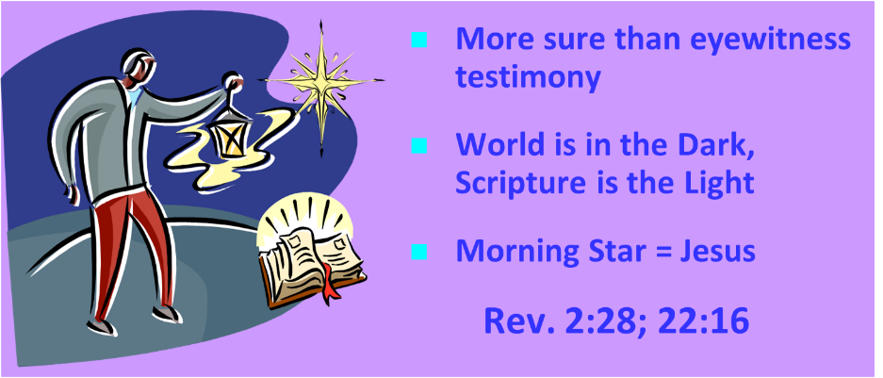
AUTHORITY OF SCRIPTURE
V. 19

Slide 50
APPLICATION
V. 11-15
Holy Living (11b, 14)
Evangelism (12)
Hope (13)
Patience (15)

Slide 51
APPLICATION
V. 11-15
Holy Living (11b, 14)
Evangelism (12)
Hope (13)
Patience (15)

Slide 52
APPLICATION
V. 11-15
Holy Living (11b, 14)
Evangelism (12)
Hope (13)
Patience (15)

Slide 53
Romans 11:25
“For I do not want you, brethren, to be uninformed of this mystery—so that you will not be wise in your own estimation—that a partial hardening has happened to Israel until the fullness of the Gentiles has come in.”

Slide 54
APPLICATION
V. 11-15
Holy Living (11b, 14)
Evangelism (12)
Hope (13)
Patience (15)

Slide 55
APPLICATION
V. 11-15
Holy Living (11b, 14)
Evangelism (12)
Hope (13)
Patience (15)

Slide 56
CONCLUSION

Slide 57
OVERVIEW OF 2 PETER 3:3-15
Heresy of the false teachers (v3-4)
Motive of the false teachers (v3-4)
Peter’s rebuttal (v5-10)
Application (v11-15)

