Slide 1
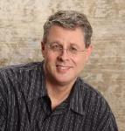
HOW TO FIND JOY IN THE CHRISTIAN LIFE
Dr. Andy Woods
Senior Pastor – Sugar Land Bible Church
President – Chafer Theological Seminary

Slide 2
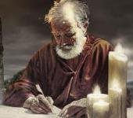
Answering Ten Questions
Who wrote it? – Paul
To Whom was it written? – The Believers at Philippi
Where was it written from? – Rome
When was it written? – A.D. 62
What was the book’s occasion? – Five contacts
Who are the opponents? – Four opponents threatening joy
What is the book’s purpose? – To give joy during adversity
How is it organized (outline)? – Four- part outline
What is it about? – Joy during adverstiy
What makes the book different? – Personal & informal

Slide 3
Introduction Philippians 1:1-11
Salutation (1:1-2)
Thanksgiving (1:3-8)
Prayer (1:9-11)

Slide 4
Outline
Ch 1 – God can use negative circumstances to bring about positive results
Ch 2 – Christ’s example of servanthood
Ch 3 – Avoiding legalism
Ch 4 – Reliance upon Christ’s strength for daily life

Slide 5
Outline
Ch 1 – God can use negative circumstances to bring about positive results
Ch 2 – Christ’s example of servanthood
Ch 3 – Avoiding legalism
Ch 4 – Reliance upon Christ’s strength for daily life

Slide 6
Positive Results of Imprisonment (Phil. 1:12-30)
Captive audience (Phil. 1:12-13)
Church’s boldness in preaching (Phil. 1:14-18)
Greater prayer (Phil. 1:19)
Protection from martyrdom (Phil. 1:20-26)

Slide 7
Positive Results of Imprisonment (Phil. 1:12-30)
Captive audience (Phil. 1:12-13)
Church’s boldness in preaching (Phil. 1:14-18)
Greater prayer (Phil. 1:19)
Protection from martyrdom (Phil. 1:20-26)

Slide 8
Positive Results of Imprisonment (Phil. 1:12-30)
Captive audience (Phil. 1:12-13)
Church’s boldness in preaching (Phil. 1:14-18)
Greater prayer (Phil. 1:19)
Protection from martyrdom (Phil. 1:20-26)

Slide 9
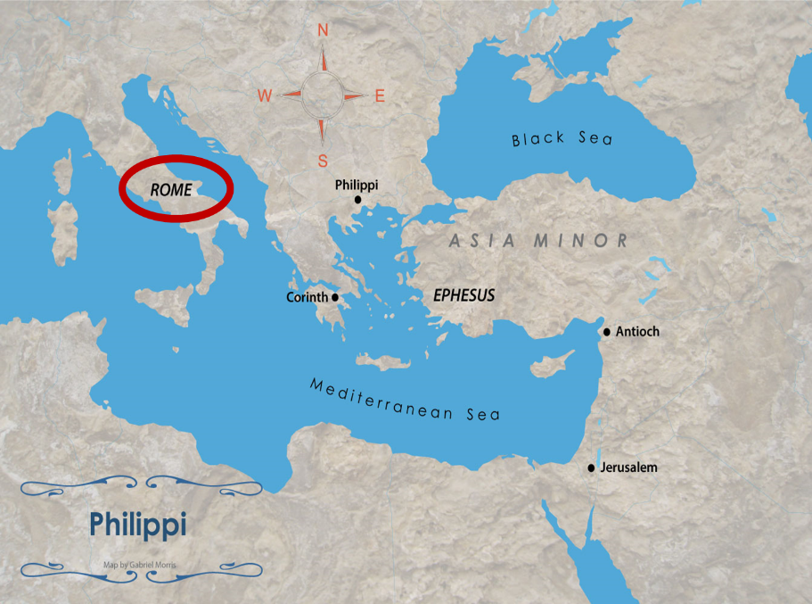

Slide 11
1 Corinthians 4:5
“ Therefore do not go on passing judgment before the time, but wait until the Lord comes who will both bring to light the things hidden in the darkness and disclose the motives of men’s hearts; and then each man’s praise will come to him from God.”

Slide 12
Positive Results of Imprisonment (Phil. 1:12-30)
Captive audience (Phil. 1:12-13)
Church’s boldness in preaching (Phil. 1:14-18)
Greater prayer (Phil. 1:19)
Protection from martyrdom (Phil. 1:20-26)

Slide 13
Positive Results of Imprisonment (Phil. 1:12-30)
Captive audience (Phil. 1:12-13)
Church’s boldness in preaching (Phil. 1:14-18)
Greater prayer (Phil. 1:19)
Protection from martyrdom (Phil. 1:20-26)

Slide 14
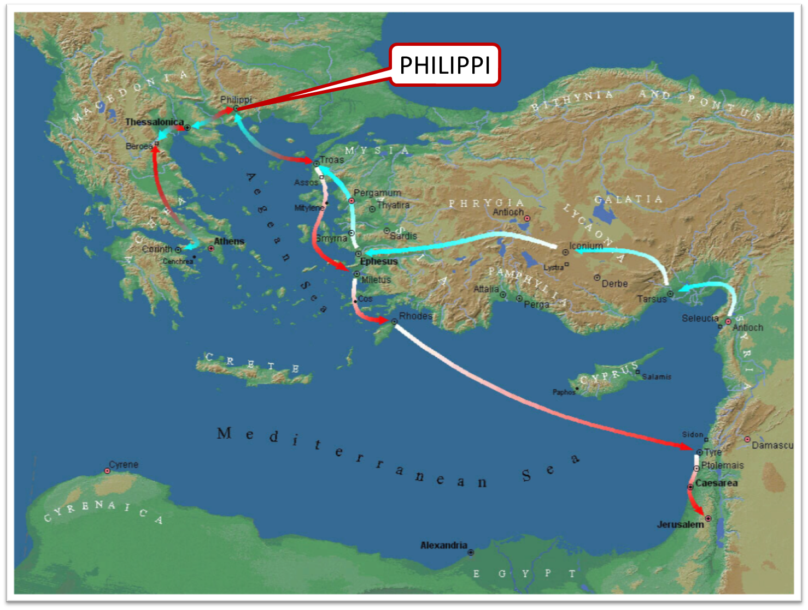

Slide 15
Positive Results of Imprisonment (Phil. 1:12-30)
Captive audience (Phil. 1:12-13)
Church’s boldness in preaching (Phil. 1:14-18)
Greater prayer (Phil. 1:19)
Protection from martyrdom (Phil. 1:20-26)

Slide 16
Applying Paul’s Paradigm (Phil. 1:27–30)
Walk worthy of your calling (Phil. 1:27)
Do not fear your persecutors (Phil. 1:28-29)
Suffering is normal (Phil. 1:30)

Slide 17
Applying Paul’s Paradigm (Phil. 1:27–30)
Walk worthy of your calling (Phil. 1:27)
Do not fear your persecutors (Phil. 1:28-29)
Suffering is normal (Phil. 1:30)

Slide 18
Applying Paul’s Paradigm (Phil. 1:27–30)
Walk worthy of your calling (Phil. 1:27)
Do not fear your persecutors (Phil. 1:28-29)
Suffering is normal (Phil. 1:30)

Slide 19
Applying Paul’s Paradigm (Phil. 1:27–30)
Walk worthy of your calling (Phil. 1:27)
Do not fear your persecutors (Phil. 1:28-29)
Suffering is normal (Phil. 1:30)

Slide 20
Conclusion

Slide 21
Positive Results of Imprisonment (Phil. 1:12-30)
Captive audience (Phil. 1:12-13)
Church’s boldness in preaching (Phil. 1:14-18)
Greater prayer (Phil. 1:19)
Protection from martyrdom (Phil. 1:20-26)

Slide 22
“The Lord bless you and keep you; the Lord make his face shine on you and be gracious to you; the Lord turn his face toward you and give you peace.” (NIV)

