Slide 1
THE RAPTURE
What and When? – Part 3
Dr. Andy Woods
Senior Pastor – Sugar Land Bible Church
President – Chafer Theological Seminary

Slide 2
What is the Rapture?
An important doctrine
Distinct from the Second Advent
Catching away of all living believers (1 Thess 4:17)
Reunion (1 Thess 4:14-16)
Resurrection (1 Cor 15:50-54)
Exemption from death (1 Cor 15:51, 54-56)
Instantaneous (1 Cor 15:52)
Mystery (1 Cor 15:51)
Imminent (1 Cor 15:51; 1 Thess 4:15)
Traditional doctrine now being recovered

Slide 3
Imminent (1 Cor 15:51; 1 Thess 4:15)
Imminency definition
James 5:8; 1 Thess 1:10; 1 Cor 1:7; Philip 3:20
We are to be looking for Jesus Christ and not the Antichrist!
Motivator (Holiness, Evangelism)
Feast of Trumpets?

Slide 4
Imminent (1 Cor 15:51; 1 Thess 4:15)
Imminency definition
James 5:8; 1 Thess 1:10; 1 Cor 1:7; Philip 3:20
We are to be looking for Jesus Christ and not the Antichrist!
Motivator (Holiness, Evangelism)
Feast of Trumpets?

Slide 5
1 Thessalonians 4:13-18
¹³ "But we do not want you to be uninformed, brethren, about those who are asleep, so that you will not grieve as do the rest who have no hope. ¹⁴ For if we believe that Jesus died and rose again, even so God will bring with Him those who have fallen asleep in Jesus. ¹⁵ For this we say to you by the word of the Lord, that we who are alive and remain until the coming of the Lord, will not precede those who . . .

Slide 6
1 Corinthians 15:51
“Behold, I tell you a mystery; we will not all sleep, but we will all be changed.”

Slide 7
Wayne Brindle
"Biblical Evidence for the Imminence of the Rapture," Bibliotheca Sacra 158, no. 630 (April-June 2001): 138-51.
“Four criteria may be suggested, any one of which indicates imminence: (1) The passage speaks of Christ’s return as at any moment. (2) The passage speaks of Christ’s return as ‘near,’ without stating any signs that must precede His coming. (3) The passage speaks of Christ’s return as something that gives believers hope and encouragement, without indicating that these believers will suffer tribulation. (4) The passage speaks of Christ’s return as giving hope without relating it to God’s judgment of unbelievers.”

Slide 8
Imminent (1 Cor 15:51; 1 Thess 4:15)
Imminency definition
James 5:8; 1 Thess 1:10; 1 Cor 1:7; Philip 3:20
We are to be looking for Jesus Christ and not the Antichrist!
Motivator (Holiness, Evangelism)
Feast of Trumpets?

Slide 9
John 14:1–4
¹ “Do not let your heart be troubled; believe in God, believe also in Me. ² “In My Father’s house are many dwelling places; if it were not so, I would have told you; for I go to prepare a place for you. ³ “If I go and prepare a place for you, I will come again and receive you to Myself, that where I am, there you may be also. ⁴ “And you know the way where I am going.”

Slide 10
Imminent (1 Cor 15:51; 1 Thess 4:15)
Imminency definition
James 5:8; 1 Thess 1:10; 1 Cor 1:7; Philip 3:20
We are to be looking for Jesus Christ and not the Antichrist!
Motivator (Holiness, Evangelism)
Feast of Trumpets?

Slide 12
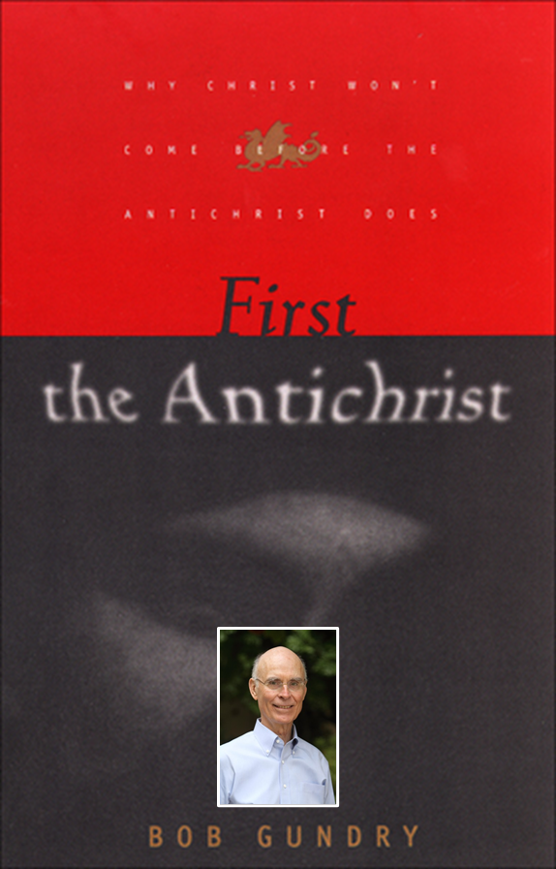
Robert H. Gundry, The Church and the Tribulation: Why Christ Won't Come Before the Antichrist Does (Grand Rapids: Zondervan, 1973).

Slide 15
Imminent (1 Cor 15:51; 1 Thess 4:15)
Imminency definition
James 5:8; 1 Thess 1:10; 1 Cor 1:7; Philip 3:20
We are to be looking for Jesus Christ and not the Antichrist!
Motivator (Holiness, Evangelism)
Feast of Trumpets?

Slide 16
J. Dwight Pentecost
Prophecy For Today, Page 20
“A short time ago, I took occasion to go through the New Testament to mark each reference to the coming of the Lord Jesus Christ and to observe the use made of that teaching about His coming. I was struck a new with the fact that almost without exception, when the coming of Christ is mentioned in the New Testament, it is followed by an exhortation to godliness and holy living.”

Slide 17
Imminent (1 Cor 15:51; 1 Thess 4:15)
Imminency definition
James 5:8; 1 Thess 1:10; 1 Cor 1:7; Philip 3:20
We are to be looking for Jesus Christ and not the Antichrist!
Motivator (Holiness, Evangelism)
Feast of Trumpets?

Slide 18
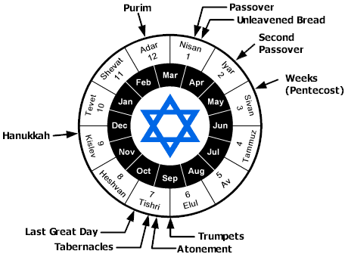

Slide 19
Levitical Feasts (Lev. 23)
Feast | Season | Purpose | Type
Passover | Spring | Redemption | 1 Cor 5:7
Unleavened Bread | Spring | Separation | John 6:35
1st fruits | Spring | Praise | 1 Cor 15:20
Pentecost | Spring | Praise | Acts 2:1-4
Trumpets | Fall | New Year | Matt 24:31
Atonement | Fall | Lev 16 | Zech 12:10
Booths | Fall | Wilderness provision | Zech 14:16-18

Slide 20
Ephesians 2:14-16
¹⁴ “For He Himself is our peace, who made both groups into one and broke down the barrier of the dividing wall, ¹⁵ by abolishing in His flesh the enmity, which is the Law of commandments contained in ordinances, so that in Himself He might make the two into one new man, thus establishing peace, ¹⁶ and might reconcile them both in one body to God through the cross, by it having put to death the enmity.”

Slide 21
1 Corinthians 10:32
“Give no offense, either to the Jews or to the Greeks or to the church of God.”

Slide 22
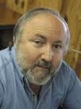
Arnold G. Fruchtenbaum “Israel and the Church,” in Issues in Dispensationalism, ed. Wesley R. Willis and John R. Master (Chicago: Moody, 1994), 118.
“In the book of Acts, both Israel and the church exist simultaneously. The term Israel is used twenty times and ekklēsia (church) nineteen times, yet the two groups are always kept distinct.”
ISRAEL ≠ CHURCH

Slide 23
Levitical Feasts (Lev. 23)
Feast | Season | Purpose | Type
Passover | Spring | Redemption | 1 Cor 5:7
Unleavened Bread | Spring | Separation | John 6:35
1st fruits | Spring | Praise | 1 Cor 15:20
Pentecost | Spring | Praise | Acts 2:1-4
Trumpets | Fall | New Year | Matt 24:31
Atonement | Fall | Lev 16 | Zech 12:10
Booths | Fall | Wilderness provision | Zech 14:16-18

Slide 24
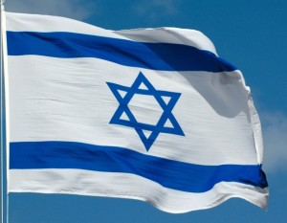
Matthew 24:31
³¹ “And He will send His angels with a great sound of a trumpet, and they will gather together His elect from the four winds, from one end of heaven to the other.”

Slide 25
What is the Rapture?
An important doctrine
Distinct from the Second Advent
Catching away of all living believers (1 Thess 4:17)
Reunion (1 Thess 4:14-16)
Resurrection (1 Cor 15:50-54)
Exemption from death (1 Cor 15:51, 54-56)
Instantaneous (1 Cor 15:52)
Mystery (1 Cor 15:51)
Imminent (1 Cor 15:51; 1 Thess 4:15)
Traditional doctrine now being recovered

Slide 26
Gary DeMar End Times Fiction: A Biblical Consideration of the Left Behind Theology (Nashville, TN: Nelson, 2001), 19.
“…the doctrine was not discovered until the nineteenth century. All attempts to find a pretrib Rapture any earlier than around 1830 do not hold up to historical scrutiny…If it took nearly nineteen-hundred years to discover the pretrib Rapture, why didn’t it take that long to discover the many other doctrines that Christians believed and confessed…?”

Slide 27
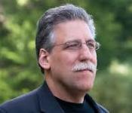
Michael L. Brown & Craig S. Keener Not Afraid of the Antichrist: Why We Don't Believe in a Pre-Tribulation Rapture (Bloomington, MINN: Chosen, 2019), 62.
“The view dominated many mid-twentieth-century U.S. evangelical circles, which also promoted it widely on mission fields that now flourish with tens or hundreds of millions of zealous Christians. Yet there is no record of anyone promoting a pre-Tribulational Rapture before about 1830; until that time virtually everyone, from any Christian or even semi-Christian tradition, expected that Jesus would resurrect the righteous and destroy the wicked at the same time.”

Slide 28
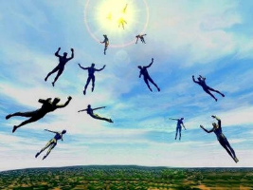
“The Rapture” is a New Doctrine? Four Logical Fallacies
Recency fallacy
Ad-populum fallacy
Genetic fallacy
Ad-hominem fallacy

Slide 29
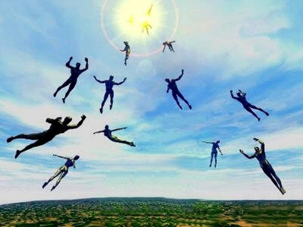
“The Rapture” a Traditional Doctrine Now Being Recovered
Sola scriptura
Negative influence of Augustine and Origen
Pseudo Ephraem (4th-6th century A.D.)
Progressive illumination

Slide 30
“The Rapture” a Traditional Doctrine Now Being Recovered
Sola scriptura
Negative influence of Augustine and Origen
Pseudo Ephraem (4th-6th century A.D.)
Progressive illumination

Slide 31
Acts 20:29-31
²⁹ “I know that after my departure savage wolves will come in among you, not sparing the flock; ³⁰ and from among your own selves men will arise, speaking perverse things, to draw away the disciples after them. ³¹ “Therefore be on the alert, remembering that night and day for a period of three years I did not cease to admonish each one with tears.

Slide 32
“The Rapture” a Traditional Doctrine Now Being Recovered
Sola scriptura
Negative influence of Augustine and Origen
Pseudo Ephraem (4th-6th century A.D.)
Progressive illumination

Slide 33
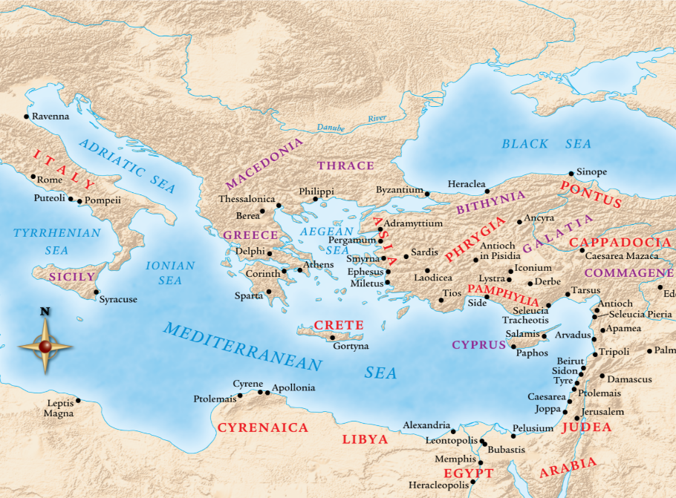

Slide 34
Jesse Forest Silver
The Lord’s Return: Seen in History and in Scripture as Premillennial and Imminent (NY: Revell, 1914), 62-64.
Silver says of the apostolic fathers that “they expected the return of the Lord in their day…They believed the time was imminent because the Lord had taught them to live in a watchful attitude.” Concerning the ante Nicene fathers, he says: “by tradition they knew the faith of the apostles. They taught the doctrine of the imminent and pre-millennial return of the Lord.”

Slide 35
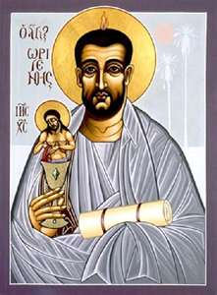
Ante-Nicene Fathers: “Heavenly and Eschatological" Interpretation of John 14:1-4
Papias (AD 110)
Irenaeus (AD 130-202)
Tertullian (AD 196-212)
Origen (AD 182-251)
Cyprian (AD 258)
George Gunn, “John 14:1-3: The Father's House: Are We There Yet?,” 7-11

Slide 36
Ante-Nicene Fathers: “Heavenly and Eschatological" Interpretation of John 14:1-4
“Interestingly, references to John 14:1-3 virtually disappear when perusing the writings of the Nicene and Post-Nicene fathers. This is a bit surprising, given the abundance of material in these later writers when compared with the Ante-Nicenes. I would assume that with the rise of Augustinian amillennialism and its optimistic interpretation regarding the present arrival of the Kingdom of God, the kind of hope held out in John 14:1-3 ceased to hold relevance.”
George A. Gunn, "Jesus and the Rapture: John 14," in Evidence for the Rapture: A Biblical Case for Pretribulationism, ed. John F. Hart (Chicago: Moody, 2015), 119, n. 22.

Slide 37
“The Rapture” a Traditional Doctrine Now Being Recovered
Sola scriptura
Negative influence of Augustine and Origen
Pseudo Ephraem (4th-6th century A.D.)
Progressive illumination

Slide 38
Pseudo Ephraem (4th-6th century A.D.)
“Why therefore do we not reject every care of earthly actions and prepare ourselves for the meeting of the Lord Christ, so that he may draw us from the confusion, which overwhelms all the world…For all the saints and the elect of God are gathered, prior to the tribulation that is to come, and are taken to the Lord lest they see the confusion that is to overwhelm the world because of our sins.”

Slide 39
“The Rapture” a Traditional Doctrine Now Being Recovered
Sola scriptura
Negative influence of Augustine and Origen
Pseudo Ephraem (4th-6th century A.D.)
Progressive illumination

Slide 40
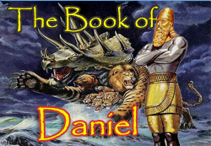
Daniel 12:4, 9
“⁴ But as for you, Daniel, conceal these words and seal up the book until the end of time; many will go back and forth, and knowledge will increase...⁹ Go your way, Daniel, for these words are concealed and sealed up until the end time.”

Slide 41
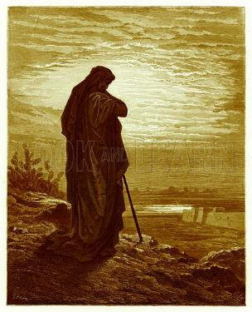
Amos 8:12
“People will stagger from sea to sea And from the north even to the east; They will go to and fro to seek the word of the Lord, But they will not find it.”

Slide 42
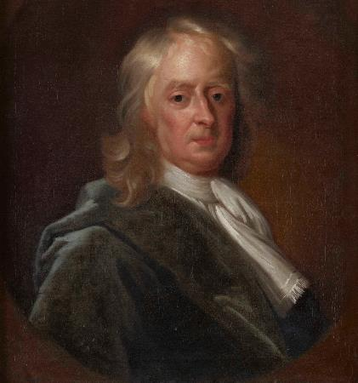
Sir Isaac Newton (1642–1727)
"About the time of the end, a body of men will be raised up who will turn their attention to the Prophecies, and insist upon their literal interpretation, in the midst of much clamor and opposition."
Isaac Newton cited in Nathaniel West, The Thousand Years in Both Testaments, 462.

Slide 43
History of Doctrine
Canon (A.D. 180)
Christology (A.D. 500)
Atonement (A.D. 1100)
Salvation (A.D. 1500)
Eschatology (A.D. 1800)

Slide 44
James Orr
The Progress of Dogma (Grand Rapids: Eerdmans, 1952), 21-31.
Orr outlines the progress of Christian dogma in a similar way. “The second century was the age of Apologetics. The doctrine of God and especially the Trinity then took center stage in the third and fourth centuries as the Church dealt with the Monarchian, Arian, and Macedonian controversies. Anthropology then became the Church's focus in the early fifth century during the Augustinian and Pelagian controversies...The late fifth and then sixth and seventh centuries were characterized by an ecclesiastical interest in Christological (Nestorian, Eutychian, Monphysite, Monothelite) matters. In the . . .

Slide 45
James Orr
The Progress of Dogma (Grand Rapids: Eerdmans, 1952), 21-31.
“. . .sixteenth century the reformers focused upon salvific or Soteriological concerns. Finally, the Church gave itself to correcting a Mythical and Mediaeval pre-reformation Eschatology.” Thus, Eschatology was the last of the branches of theology to be systematized since it was not designed to be progressively unsealed or illuminated by the Holy Spirit until just before the fulfillment of the predicted events (Dan. 12:4, 8-9).

Slide 46
Conclusion

Slide 47
What is the Rapture?
An important doctrine
Distinct from the Second Advent
Catching away of all living believers (1 Thess 4:17)
Reunion (1 Thess 4:14-16)
Resurrection (1 Cor 15:50-54)
Exemption from death (1 Cor 15:51, 54-56)
Instantaneous (1 Cor 15:52)
Mystery (1 Cor 15:51)
Imminent (1 Cor 15:51; 1 Thess 4:15)
Traditional doctrine now being recovered

