Slide 1
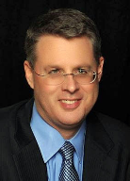
THE RAPTURE
What and When? – Part 1
Dr. Andy Woods
Senior Pastor – Sugar Land Bible Church
President – Chafer Theological Seminary

Slide 2
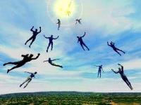
What is the Rapture?
An important doctrine
Distinct from the Second Advent
Catching away of all living believers (1 Thess 4:17)
Reunion (1 Thess 4:14-16)
Resurrection (1 Cor 15:50-54)
Exemption from death (1 Cor 15:51, 54-56)
Instantaneous (1 Cor 15:52)
Mystery (1 Cor 15:51)
Imminent (1 Cor 15:51; 1 Thess 4:15)
Traditional doctrine now being recovered

Slide 3
What is the Rapture?
An important doctrine
Distinct from the Second Advent
Catching away of all living believers (1 Thess 4:17)
Reunion (1 Thess 4:14-16)
Resurrection (1 Cor 15:50-54)
Exemption from death (1 Cor 15:51, 54-56)
Instantaneous (1 Cor 15:52)
Mystery (1 Cor 15:51)
Imminent (1 Cor 15:51; 1 Thess 4:15)
Traditional doctrine now being recovered

Slide 4
What is the Rapture?
An important doctrine
Distinct from the Second Advent
Catching away of all living believers (1 Thess 4:17)
Reunion (1 Thess 4:14-16)
Resurrection (1 Cor 15:50-54)
Exemption from death (1 Cor 15:51, 54-56)
Instantaneous (1 Cor 15:52)
Mystery (1 Cor 15:51)
Imminent (1 Cor 15:51; 1 Thess 4:15)
Traditional doctrine now being recovered

Slide 5
What is the Rapture?
An important doctrine
Distinct from the Second Advent
Catching away of all living believers (1 Thess 4:17)
Reunion (1 Thess 4:14-16)
Resurrection (1 Cor 15:50-54)
Exemption from death (1 Cor 15:51, 54-56)
Instantaneous (1 Cor 15:52)
Mystery (1 Cor 15:51)
Imminent (1 Cor 15:51; 1 Thess 4:15)
Traditional doctrine now being recovered

Slide 6
1 Thessalonians 4:13-18
. . . have fallen asleep. ¹⁶ For the Lord Himself will descend from heaven with a shout, with the voice of the archangel and with the trumpet of God, and the dead in Christ will rise first. ¹⁷ Then we who are alive and remain will be caught up [harpazō] together with them in the clouds to meet the Lord in the air, and so we shall always be with the Lord. ¹⁸ Therefore comfort one another with these words."

Slide 7
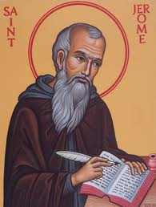
Latin Vulgate Translation (1 Thess. 4:17)
“Deinde nos, qui vivimus, qui relinquimur, simul rapiemur cum illis in nubibus obviam Christo in aëra, et sic semper cum Domino erimus.”
Andrew Curtis and Isaiah Hoogendyk, The Lexham Latin-English Interlinear Vulgate (Bellingham, WA: Lexham Press, 2016), 1 Th 4:17.

Slide 8
What is the Rapture?
An important doctrine
Distinct from the Second Advent
Catching away of all living believers (1 Thess 4:17)
Reunion (1 Thess 4:14-16)
Resurrection (1 Cor 15:50-54)
Exemption from death (1 Cor 15:51, 54-56)
Instantaneous (1 Cor 15:52)
Mystery (1 Cor 15:51)
Imminent (1 Cor 15:51; 1 Thess 4:15)
Traditional doctrine now being recovered

Slide 9
What is the Rapture?
An important doctrine
Distinct from the Second Advent
Catching away of all living believers (1 Thess 4:17)
Reunion (1 Thess 4:14-16)
Resurrection (1 Cor 15:50-54)
Exemption from death (1 Cor 15:51, 54-56)
Instantaneous (1 Cor 15:52)
Mystery (1 Cor 15:51)
Imminent (1 Cor 15:51; 1 Thess 4:15)
Traditional doctrine now being recovered

Slide 10
1 Corinthians 15:50-51
“⁵⁰ Now I say this, brethren, that flesh and blood cannot inherit the kingdom of God; nor does the perishable inherit the imperishable. ⁵¹ Behold, I tell you a mystery; we will not all sleep, but we will all be changed.”

Slide 11
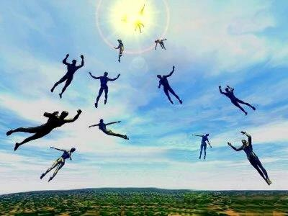
Resurrection (1 Cor 15:50-52)
Resurrection definition
Resurrection importance (1 Cor 15:50, 53-54)
Resurrection of living believers (1 Cor 15:51)
Resurrection of deceased believers (1 Cor 15:52)

Slide 12
Romans 8:19-23
¹⁹ “For the anxious longing of the creation waits eagerly for the revealing of the sons of God. ²⁰ For the creation was subjected to futility, not willingly, but because of Him who subjected it, in hope ²¹ that the creation itself also will be set free from its slavery to corruption into the freedom of the glory of the children of God. ²² For we know that the whole creation groans and suffers the pains of childbirth together until now. ²³ And not only this, but also we ourselves, having the first fruits of the Spirit, even we ourselves groan within ourselves, waiting eagerly for our adoption as sons, the redemption of our body.”

Slide 13
1 Corinthians 15:50-51
“⁵⁰ Now I say this, brethren, that flesh and blood cannot inherit the kingdom of God; nor does the perishable inherit the imperishable. ⁵¹ Behold, I tell you a mystery; we will not all sleep, but we will all be changed.”

Slide 14
Resurrection (1 Cor 15:50-52)
Resurrection definition
Resurrection importance (1 Cor 15:50, 53-54)
Resurrection of living believers (1 Cor 15:51)
Resurrection of deceased believers (1 Cor 15:52)

Slide 15
What is the Rapture?
An important doctrine
Distinct from the Second Advent
Catching away of all living believers (1 Thess 4:17)
Reunion (1 Thess 4:14-16)
Resurrection (1 Cor 15:50-54)
Exemption from death (1 Cor 15:51, 54-56)
Instantaneous (1 Cor 15:52)
Mystery (1 Cor 15:51)
Imminent (1 Cor 15:51; 1 Thess 4:15)
Traditional doctrine now being recovered

Slide 16
1 Corinthians 15:50-51
“⁵⁰ Now I say this, brethren, that flesh and blood cannot inherit the kingdom of God; nor does the perishable inherit the imperishable. ⁵¹ Behold, I tell you a mystery; we will not all sleep, but we will all be changed.”

Slide 17
Exemption from Death (1 Cor 15:54-56)
Enoch (Gen 5)
Elijah (2 Kings 2)
Christ (Acts 1:11; Rev 12:5)
Philip (Acts 8:39)
Paul (2 Cor 12:2, 4)
John (Rev 4:1-2)
Two witnesses (Rev 11)

Slide 18
Exemption from Death (1 Cor 15:54-56)
Enoch (Gen 5)
Elijah (2 Kings 2)
Christ (Acts 1:11; Rev 12:5)
Philip (Acts 8:39)
Paul (2 Cor 12:2, 4)
John (Rev 4:1-2)
Two witnesses (Rev 11)

Slide 19
What is the Rapture?
An important doctrine
Distinct from the Second Advent
Catching away of all living believers (1 Thess 4:17)
Reunion (1 Thess 4:14-16)
Resurrection (1 Cor 15:50-54)
Exemption from death (1 Cor 15:51, 54-56)
Instantaneous (1 Cor 15:52)
Mystery (1 Cor 15:51)
Imminent (1 Cor 15:51; 1 Thess 4:15)
Traditional doctrine now being recovered

Slide 20
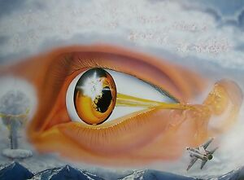
1 Corinthians 15:52
“in a moment, in the twinkling of an eye, at the last trumpet; for the trumpet will sound, and the dead will be raised imperishable, and we will be changed.”

Slide 21
1 Corinthians 15:52
“in a moment [atomos], in the twinkling of an eye, at the last trumpet; for the trumpet will sound, and the dead will be raised imperishable, and we will be changed.”

Slide 22
Instantaneous (1 Cor 15:52)
Twinkling of an eye
Flash or moment
Split second
Atomos (Greek) = atom (English)

Slide 23
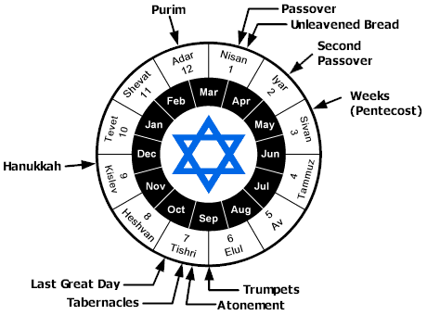

Slide 24
What is the Rapture?
An important doctrine
Distinct from the Second Advent
Catching away of all living believers (1 Thess 4:17)
Reunion (1 Thess 4:14-16)
Resurrection (1 Cor 15:50-54)
Exemption from death (1 Cor 15:51, 54-56)
Instantaneous (1 Cor 15:52)
Mystery (1 Cor 15:51)
Imminent (1 Cor 15:51; 1 Thess 4:15)
Traditional doctrine now being recovered

Slide 25
1 Corinthians 15:51
“Behold, I tell you a mystery [mystērion]; we will not all sleep, but we will all be changed.”

Slide 26
Mystery (1 Cor 15:51)
Mystery definition
Paul’s assignment
How church age will end
Second coming taught in both the Old and New Testaments
Rapture taught only in the New Testament

Slide 27
Mystery (1 Cor 15:51)
Mystery definition
Paul’s assignment
How church age will end
Second coming taught in both the Old and New Testaments
Rapture taught only in the New Testament

Slide 28
“Mystery” Defined
“In the N.T, it [mystērion] denotes, not the mysterious (as with the Eng. word), but that which, being outside the range of unassisted natural apprehension, can be made known only by Divine revelation, and is made known in a manner and at a time appointed by God, and to those who are illumined by His Spirit.”
W. E. Vine, Merrill F. Unger, and William White, Vine's Complete Expository Dictionary of the Old and New Testament Words (Nashville: Nelson, 1996), 424.

Slide 29
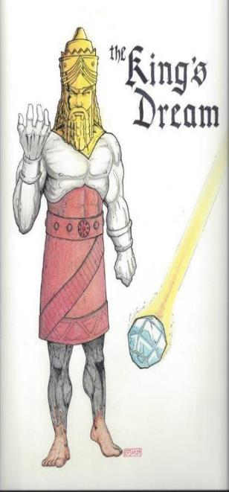
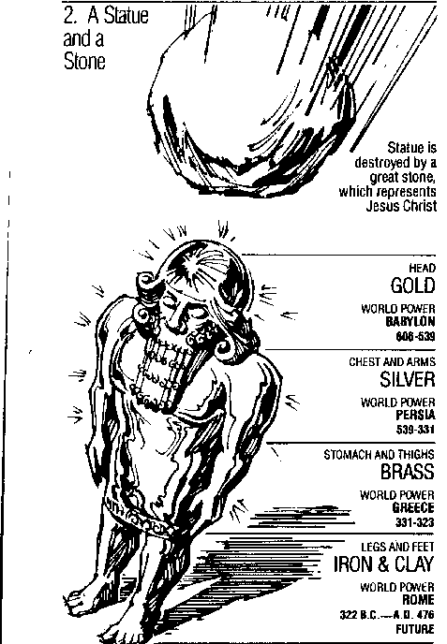
Statue
&
Stone

Slide 30
Daniel 2:18-19, 27-30
“¹⁸ so that they might request compassion from the God of heaven concerning this mystery, so that Daniel and his friends would not be destroyed with the rest of the wise men of Babylon. ¹⁹ Then the mystery was revealed to Daniel in a night vision. Then Daniel blessed the God of heaven;…²⁷ Daniel answered before the king and said, “As for the mystery about which the king has inquired, neither wise men, conjurers, magicians nor diviners are able to declare it to the king. ²⁸ However, there is a God in heaven who mysteries, and He...

Slide 31
Daniel 2:18-19, 27-30
...has made known to King Nebuchadnezzar what will take place in the latter days. This was your dream and the visions in your mind while on your bed. ²⁹ As for you, O king, while on your bed your thoughts turned to what would take place in the future; and He who reveals mysteries has made known to you what will take place. ³⁰ But as for me, this mystery has not been revealed to me for any wisdom residing in me more than in any other living man, but for the purpose of making the interpretation known to the king, and that you may understand the thoughts of your mind.”

Slide 32
Colossians 1:26
“that is, the mystery which has been hidden from the past ages and generations, but has now been manifested to His.”

Slide 33
Mystery (1 Cor 15:51)
Mystery definition
Paul’s assignment
How church age will end
Second coming taught in both the Old and New Testaments
Rapture taught only in the New Testament

Slide 34
Ephesians 2:14-16
¹⁴ “For He Himself is our peace, who made both groups into one and broke down the barrier of the dividing wall, ¹⁵ by abolishing in His flesh the enmity, which is the Law of commandments contained in ordinances, so that in Himself He might make the two into one new man, thus establishing peace, ¹⁶ and might reconcile them both in one body to God through the cross, by it having put to death the enmity.”

Slide 35
Ephesians 3:3-6
“³ that by revelation there was made known to me the mystery, as I wrote before in brief. ⁴ By referring to this, when you read you can understand my insight into the mystery of Christ, ⁵ which in other generations was not made known to the sons of men, as it has now been revealed to His holy apostles and prophets in the Spirit; ⁶ to be specific, that the Gentiles are fellow heirs and fellow members of the body, and fellow partakers of the promise in Christ Jesus through the gospel”.

Slide 36
Ruth 1:16
“But Ruth said, “Do not urge me to leave you or turn back from following you; for where you go, I will go, and where you lodge, I will lodge. Your people shall be my people, and your God, my God.”

Slide 37
Ephesians 3:9
“and to bring to light what is the administration of the mystery which for ages has been hidden in God who created all things.”

Slide 38
Mystery (1 Cor 15:51)
Mystery definition
Paul’s assignment
How church age will end
Second coming taught in both the Old and New Testaments
Rapture taught only in the New Testament

Slide 40
Mystery (1 Cor 15:51)
Mystery definition
Paul’s assignment
How church age will end
Part of Inter-Advent Age
Second coming taught in both the Old and New Testaments
Rapture taught only in the New Testament

Slide 41
Matthew 13 Parables
Public parables (13:1-2)
Sower (13:1-9, 18-23)
Wheat and tares (13:24-30, 36-43)
Mustard seed (13:31-32)
Leaven (13:33)
Private parables (13:36)
Earthen treasure (13:44)
Pearl of great price (13:45-46)
Dragnet (13:47-50)
Householder (13:51-52)

Slide 42
Matthew 13:11
Jesus answered them, “To you it has been granted to know the mysteries of the kingdom of heaven, but to them it has not been granted.”

Slide 43
Matthew 13:16-17
“¹⁶ But blessed are your eyes, because they see; and your ears, because they hear. ¹⁷ For truly I say to you that many prophets and righteous men desired to see what you see, and did not see it, and to hear what you hear, and did not hear it.”

Slide 44
Matthew 13:35
“This was to fulfill what was spoken through the prophet: ‘I will open My mouth in parables; I will utter things hidden since the foundation of the world.’”

Slide 46
Zechariah 9:9-10
⁹ Rejoice greatly, O daughter of Zion! Shout in triumph, O daughter of Jerusalem! Behold, your king is coming to you; He is just and endowed with salvation, Humble, and mounted on a donkey, Even on a colt, the foal of a donkey.¹⁰ I will cut off the chariot from Ephraim And the horse from Jerusalem; And the bow of war will be cut off. And He will speak peace to the nations; And His dominion will be from sea to sea, And from the River to the ends of the earth.

Slide 47
Isaiah 9:6-7
⁶ For a child will be born to us, a son will be given to us; And the government will rest on His shoulders; And His name will be called Wonderful Counselor, Mighty God, Eternal Father, Prince of Peace.⁷ There will be no end to the increase of His government or of peace, On the throne of David and over his kingdom, To establish it and to uphold it with justice and righteousness From then on and forevermore. The zeal of the Lord of hosts will accomplish this.

Slide 48
1 Peter 1:10-11
¹⁰ As to this salvation, the prophets who prophesied of the grace that would come to you made careful searches and inquiries, ¹¹ seeking to know what person or time the Spirit of Christ within them was indicating as He predicted the sufferings of Christ and the glories to follow.

Slide 49
Isaiah 26:19-20
“¹⁹ Your dead will live; Their corpses will rise. You who lie in the dust, awake and shout for joy, For your dew is as the dew of the dawn, And the earth will give birth to the departed spirits. ²⁰ Come, my people, enter into your rooms And close your doors behind you; Hide for a little while Until indignation runs its course.”

Slide 51
Mystery (1 Cor 15:51)
Mystery definition
Paul’s assignment
How church age will end
Second coming taught in both the Old and New Testaments
Rapture taught only in the New Testament

Slide 52
Mystery (1 Cor 15:51)
Mystery definition
Paul’s assignment
How church age will end
Second coming taught in both the Old and New Testaments
Rapture taught only in the New Testament

Slide 53
John 14:1–4
¹ “Do not let your heart be troubled; believe in God, believe also in Me. ² “In My Father’s house are many dwelling places; if it were not so, I would have told you; for I go to prepare a place for you. ³ “If I go and prepare a place for you, I will come again and receive you to Myself, that where I am, there you may be also. ⁴ “And you know the way where I am going.”

Slide 54
New Mystery Truth
“But here in John 14 the Lord gives a new and unique revelation; He speaks of something which no prophet had promised, or even could promise. Where is it written that this Messiah would come and instead of gathering His saints into an earthly Jerusalem, would take them to the Father's house, to the very place where He is? It is something new.”
Arno C. Gaebelein, The Gospel of John, 268.

Slide 55
What is the Rapture?
An important doctrine
Distinct from the Second Advent
Catching away of all living believers (1 Thess 4:17)
Reunion (1 Thess 4:14-16)
Resurrection (1 Cor 15:50-54)
Exemption from death (1 Cor 15:51, 54-56)
Instantaneous (1 Cor 15:52)
Mystery (1 Cor 15:51)
Imminent (1 Cor 15:51; 1 Thess 4:15)
Traditional doctrine now being recovered

Slide 56
Imminent (1 Cor 15:51; 1 Thess 4:15)
Imminency definition
James 5:8; 1 Thess 1:10; 1 Cor 1:7; Philip 3:20
We are to be looking for Jesus Christ and not the Antichrist!
Motivator (Holiness, Evangelism)

Slide 57
Imminent (1 Cor 15:51; 1 Thess 4:15)
Imminency definition
James 5:8; 1 Thess 1:10; 1 Cor 1:7; Philip 3:20
We are to be looking for Jesus Christ and not the Antichrist!
Motivator (Holiness, Evangelism)

Slide 58
1 Thessalonians 4:13-18
¹³ "But we do not want you to be uninformed, brethren, about those who are asleep, so that you will not grieve as do the rest who have no hope. ¹⁴ For if we believe that Jesus died and rose again, even so God will bring with Him those who have fallen asleep in Jesus. ¹⁵ For this we say to you by the word of the Lord, that we who are alive and remain until the coming of the Lord, will not precede those who . . .

Slide 59
1 Corinthians 15:51
“Behold, I tell you a mystery; we will not all sleep, but we will all be changed.”

Slide 60
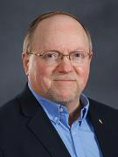
Wayne Brindle
"Biblical Evidence for the Imminence of the Rapture," Bibliotheca Sacra 158, no. 630 (April-June 2001): 138-51.
“Four criteria may be suggested, any one of which indicates imminence: (1) The passage speaks of Christ’s return as at any moment. (2) The passage speaks of Christ’s return as ‘near,’ without stating any signs that must precede His coming. (3) The passage speaks of Christ’s return as something that gives believers hope and encouragement, without indicating that these believers will suffer tribulation. (4) The passage speaks of Christ’s return as giving hope without relating it to God’s judgment of unbelievers.”

Slide 61
Imminent (1 Cor 15:51; 1 Thess 4:15)
Imminency definition
James 5:8; 1 Thess 1:10; 1 Cor 1:7; Philip 3:20
We are to be looking for Jesus Christ and not the Antichrist!
Motivator (Holiness, Evangelism)

Slide 62
John 14:1–4
¹ “Do not let your heart be troubled; believe in God, believe also in Me. ² “In My Father’s house are many dwelling places; if it were not so, I would have told you; for I go to prepare a place for you. ³ “If I go and prepare a place for you, I will come again and receive you to Myself, that where I am, there you may be also. ⁴ “And you know the way where I am going.”

Slide 63
Imminent (1 Cor 15:51; 1 Thess 4:15)
Imminency definition
James 5:8; 1 Thess 1:10; 1 Cor 1:7; Philip 3:20
We are to be looking for Jesus Christ and not the Antichrist!
Motivator (Holiness, Evangelism)

Slide 65
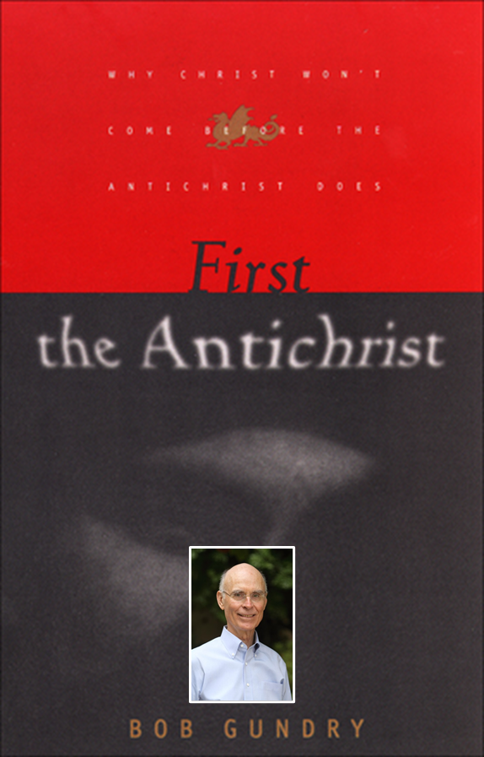
Robert H. Gundry, The Church and the Tribulation: Why Christ Won't Come Before the Antichrist Does (Grand Rapids: Zondervan, 1973).

Slide 68
Imminent (1 Cor 15:51; 1 Thess 4:15)
Imminency definition
James 5:8; 1 Thess 1:10; 1 Cor 1:7; Philip 3:20
We are to be looking for Jesus Christ and not the Antichrist!
Motivator (Holiness, Evangelism)

Slide 69
What is the Rapture?
An important doctrine
Distinct from the Second Advent
Catching away of all living believers (1 Thess 4:17)
Reunion (1 Thess 4:14-16)
Resurrection (1 Cor 15:50-54)
Exemption from death (1 Cor 15:51, 54-56)
Instantaneous (1 Cor 15:52)
Mystery (1 Cor 15:51)
Imminent (1 Cor 15:51; 1 Thess 4:15)
Traditional doctrine now being recovered

Slide 70
“The Rapture” is a New Doctrine? Three Logical Fallacies
Recency fallacy
Ad-populum fallacy
Genetic fallacy

Slide 71
“The Rapture” a Traditional Doctrine Now Being Recovered
Sola scriptura
Negative influence of Augustine and Origen
Pseudo Ephraem (4th-6th century A.D.)
Progressive illumination

Slide 72
“The Rapture” a Traditional Doctrine Now Being Recovered
Sola scriptura
Negative influence of Augustine and Origen
Pseudo Ephraem (4th-6th century A.D.)
Progressive illumination

Slide 73
Acts 20:29-31
²⁹ “I know that after my departure savage wolves will come in among you, not sparing the flock; ³⁰ and from among your own selves men will arise, speaking perverse things, to draw away the disciples after them. ³¹ “Therefore be on the alert, remembering that night and day for a period of three years I did not cease to admonish each one with tears.

Slide 74
“The Rapture” a Traditional Doctrine Now Being Recovered
Sola scriptura
Negative influence of Augustine and Origen
Pseudo Ephraem (4th-6th century A.D.)
Progressive illumination

Slide 75
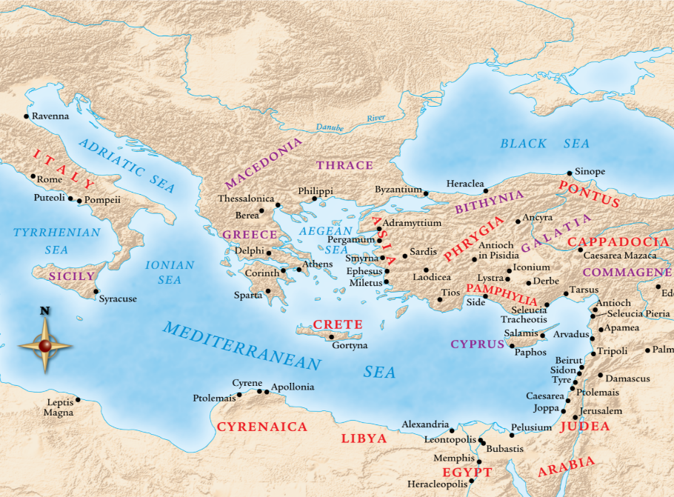

Slide 76
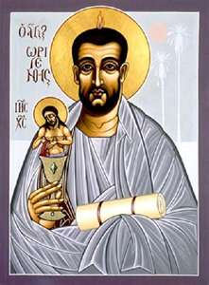
Ante-Nicene Fathers: “Heavenly and Eschatological" Interpretation of John 14:1-4
Papias (AD 110)
Irenaeus (AD 130-202)
Tertullian (AD 196-212)
Origen (AD 182-251)
Cyprian (AD 258)
George Gunn, “John 14:1-3: The Father's House: Are We There Yet?,” 7-11

Slide 77
Ante-Nicene Fathers: “Heavenly and Eschatological" Interpretation of John 14:1-4
“Interestingly, references to John 14:1-3 virtually disappear when perusing the writings of the Nicene and Post-Nicene fathers. This is a bit surprising, given the abundance of material in these later writers when compared with the Ante-Nicenes. I would assume that with the rise of Augustinian amillennialism and its optimistic interpretation regarding the present arrival of the Kingdom of God, the kind of hope held out in John 14:1-3 ceased to hold relevance.”
George Gunn, “John 14:1-3: The Father's House: Are We There Yet?,” 30, n. 24.

Slide 78
“The Rapture” a Traditional Doctrine Now Being Recovered
Sola scriptura
Negative influence of Augustine and Origen
Pseudo Ephraem (4th-6th century A.D.)
Progressive illumination

Slide 79
Pseudo Ephraem (4th-6th century A.D.)
“Why therefore do we not reject every care of earthly actions and prepare ourselves for the meeting of the Lord Christ, so that he may draw us from the confusion, which overwhelms all the world…For all the saints and the elect of God are gathered, prior to the tribulation that is to come, and are taken to the Lord lest they see the confusion that is to overwhelm the world because of our sins.”

Slide 80
Jesse Forest Silver
The Lord’s Return: Seen in History and in Scripture as Premillennial and Imminent (NY: Revell, 1914), 62-64.
Silver says of the apostolic fathers that “they expected the return of the Lord in their day…They believed the time was imminent because the Lord had taught them to live in a watchful attitude.” Concerning the ante Nicene fathers, he says: “by tradition they knew the faith of the apostles. They taught the doctrine of the imminent and pre-millennial return of the Lord.”

Slide 81
“The Rapture” a Traditional Doctrine Now Being Recovered
Sola scriptura
Negative influence of Augustine and Origen
Pseudo Ephraem (4th-6th century A.D.)
Progressive illumination

Slide 82
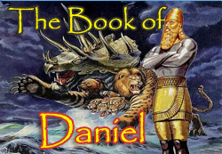
Daniel 12:4, 9
“⁴ But as for you, Daniel, conceal these words and seal up the book until the end of time; many will go back and forth, and knowledge will increase...⁹ Go your way, Daniel, for these words are concealed and sealed up until the end time.”

Slide 83
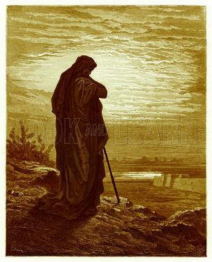
Amos 8:12
“People will stagger from sea to sea And from the north even to the east; They will go to and fro to seek the word of the Lord, But they will not find it.”

Slide 84
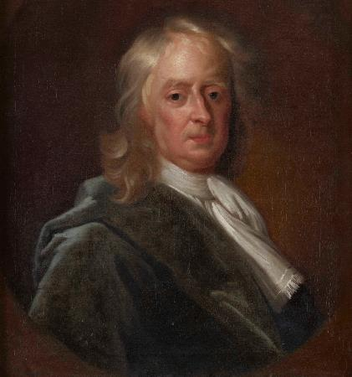
Sir Isaac Newton (1642–1727)
"About the time of the end, a body of men will be raised up who will turn their attention to the Prophecies, and insist upon their literal interpretation, in the midst of much clamor and opposition."
Isaac Newton cited in Nathaniel West, The Thousand Years in Both Testaments, 462.

Slide 85
History of Doctrine
Canon (A.D. 180)
Christology (A.D. 500)
Atonement (A.D. 1100)
Salvation (A.D. 1500)
Eschatology (A.D. 1800)

Slide 86
James Orr
The Progress of Dogma (Grand Rapids: Eerdmans, 1952), 21-31.
Orr outlines the progress of Christian dogma in a similar way. “The second century was the age of Apologetics. The doctrine of God and especially the Trinity then took center stage in the third and fourth centuries as the Church dealt with the Monarchian, Arian, and Macedonian controversies. Anthropology then became the Church's focus in the early fifth century during the Augustinian and Pelagian controversies...The late fifth and then sixth and seventh centuries were characterized by an ecclesiastical interest in Christological (Nestorian, Eutychian, Monphysite, Monothelite) matters. In the . . .

Slide 87
James Orr
The Progress of Dogma (Grand Rapids: Eerdmans, 1952), 21-31.
“. . .sixteenth century the reformers focused upon salvific or Soteriological concerns. Finally, the Church gave itself to correcting a Mythical and Mediaeval pre-reformation Eschatology.” Thus, Eschatology was the last of the branches of theology to be systematized since it was not designed to be progressively unsealed or illuminated by the Holy Spirit until just before the fulfillment of the predicted events (Dan. 12:4, 8-9).

Slide 88
Conclusion

Slide 89
What is the Rapture?
An important doctrine
Distinct from the Second Advent
Catching away of all living believers (1 Thess 4:17)
Reunion (1 Thess 4:14-16)
Resurrection (1 Cor 15:50-54)
Exemption from death (1 Cor 15:51, 54-56)
Instantaneous (1 Cor 15:52)
Mystery (1 Cor 15:51)
Imminent (1 Cor 15:51; 1 Thess 4:15)
Traditional doctrine now being recovered

