Slide 1
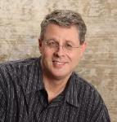
HOW TO FIND JOY IN THE CHRISTIAN LIFE
Dr. Andy Woods
Senior Pastor – Sugar Land Bible Church
President – Chafer Theological Seminary

Slide 2
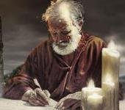
Answering Ten Questions
Who wrote it? – Paul
To Whom was it written? – The Believers at Philippi
Where was it written from? – Rome
When was it written? – A.D. 62
What was the book’s occasion? – Five contacts
Who are the opponents? – Four opponents threatening joy
What is the book’s purpose? – To give joy during adversity
How is it organized (outline)? – Four- part outline
What is it about? – Joy during adverstiy
What makes the book different? – Personal & informal

Slide 3
Introduction Philippians 1:1-11
Salutation (1:1-2)
Thanksgiving (1:3-8)
Prayer (1:9-11)

Slide 4
Introduction Philippians 1:1-11
Salutation (1:1-2)
Thanksgiving (1:3-8)
Prayer (1:9-11)

Slide 5
Philippians 1:1-2
“¹ Paul and Timothy, bond-servants of Christ Jesus, To all the saints in Christ Jesus who are in Philippi, including the overseers and deacons: ² Grace to you and peace from God our Father and the Lord Jesus Christ.”

Slide 6
Philippians 1:1-2
“¹ Paul and Timothy, bond-servants of Christ Jesus, To all the saints in Christ Jesus who are in Philippi, including the overseers and deacons: ² Grace to you and peace from God our Father and the Lord Jesus Christ.”

Slide 7
Philippians 1:1-2
“¹ Paul and Timothy, bond-servants of Christ Jesus, To all the saints in Christ Jesus who are in Philippi, including the overseers and deacons: ² Grace to you and peace from God our Father and the Lord Jesus Christ.”

Slide 8
Philippians 1:1-2
“¹ Paul and Timothy, bond-servants [doulos] of Christ Jesus, To all the saints in Christ Jesus who are in Philippi, including the overseers and deacons: ² Grace to you and peace from God our Father and the Lord Jesus Christ.”

Slide 9
Philippians 1:1-2
“¹ Paul and Timothy, bond-servants of Christ Jesus, To all the saints in Christ Jesus who are in Philippi, including the overseers and deacons: ² Grace to you and peace from God our Father and the Lord Jesus Christ.”

Slide 10
Three Tenses of Salvation
Phase | Justification | SANCTIFICATION | Glorification
Tense | Past | Present | Future
Saved from sin’s: | Penalty | Power | Presence
Scripture | Eph 2:8-9; Titus 3:5 | Philip 2:12 | Rom 5:10

Slide 11
Philippians 1:1-2
“¹ Paul and Timothy, bond-servants of Christ Jesus, To all the saints in Christ Jesus who are in Philippi, including the overseers and deacons: ² Grace to you and peace from God our Father and the Lord Jesus Christ.”

Slide 12
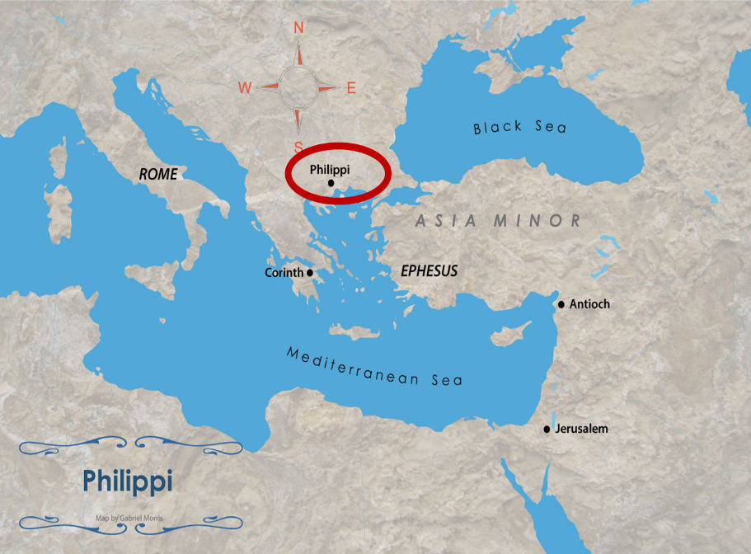

Slide 13
Philippians 1:1-2
“¹ Paul and Timothy, bond-servants of Christ Jesus, To all the saints in Christ Jesus who are in Philippi, including the overseers [episkopos] and deacons [diakonos]: ² Grace to you and peace from God our Father and the Lord Jesus Christ.”

Slide 14
Philippians 1:1-2
“¹ Paul and Timothy, bond-servants of Christ Jesus, To all the saints in Christ Jesus who are in Philippi, including the overseers and deacons: ² Grace to you and peace from God our Father and the Lord Jesus Christ.”

Slide 15
Philippians 1:1-2
“¹ Paul and Timothy, bond-servants of Christ Jesus, To all the saints in Christ Jesus who are in Philippi, including the overseers and deacons: ² Grace to you and peace from God our Father and the Lord Jesus Christ.”

Slide 16
Philippians 1:1-2
“¹ Paul and Timothy, bond-servants of Christ Jesus, To all the saints in Christ Jesus who are in Philippi, including the overseers and deacons: ² Grace to you and peace from God our Father and the Lord Jesus Christ.”

Slide 17
Introduction Philippians 1:1-11
Salutation (1:1-2)
Thanksgiving (1:3-8)
Prayer (1:9-11)

Slide 18
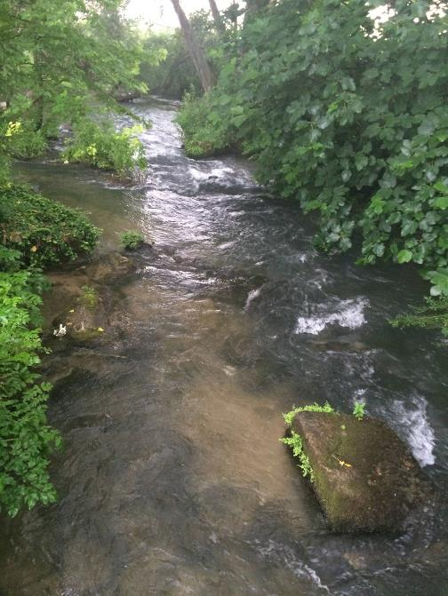

Slide 19
Spiritual Sacrifices
Body – Rom. 12:1
Praise – Heb. 13:15
Good works – Philip. 2:17
Financial giving – Heb. 13:16
Prayer – Philip. 1:4

Slide 20
2 John 7-11
“⁷ For many deceivers have gone out into the world, those who do not acknowledge Jesus Christ as coming in the flesh. This is the deceiver and the antichrist. ⁸ Watch yourselves, that you do not lose what we have accomplished, but that you may receive a full reward. ⁹ Anyone who goes too far and does . . .

Slide 21
2 John 7-11
… not abide in the teaching of Christ, does not have God; the one who abides in the teaching, he has both the Father and the Son. ¹⁰ If anyone comes to you and does not bring this teaching, do not receive him into your house, and do not give him a greeting; ¹¹ for the one who gives him a greeting participates in his evil deeds.”

Slide 22
Charles Ryrie
The Ryrie Study Bible
Philippians 1:6. “God who began. God will continue His work of grace in them until the consummation at the day of Christ Jesus (the day when Christ returns).”

Slide 23
Thomas L. Constable “Notes on Philippians,” online: www.soniclight.com, accessed 04 April 2020, 18.
“What was the ‘good work’ to which Paul referred? If he had in mind only the generosity of his original readers, he may have meant that good work. However, as I have suggested, he seems to have had a much broader concept in mind, namely, what the work of the gospel produces: salvation…In the New Testament, God has revealed that salvation is a process. It involves justification, when a sinner trusts Jesus Christ as his or her Savior.”

Slide 24
Thomas L. Constable “Notes on Philippians,” online: www.soniclight.com, accessed 04 April 2020, 18.
“It also includes progressive sanctification, that occurs continuously from the time of justification until the Christian's death or the Rapture. And it culminates in glorification, when the redeemed sinner finally sees Jesus Christ and experiences transformation into His image. Paul was confident that, just as surely as God had justified the Philippians, He would also continue to sanctify, and eventually glorify, them. Whereas we have a hand in the process of sanctification, and can affect it by our obedience or disobedience, God alone justifies us. Regardless of our carnality or spirituality, He will also glorify us (1 Cor. 15:1-7).”

Slide 25
Three Tenses of Salvation
Phase | Justification | Sanctification | Glorification
Tense | Past | Present | Future
Saved from sin’s: | Penalty | Power | Presence
Scripture | Eph 2:8-9; Titus 3:5 | Philip 2:12 | Rom 5:10

Slide 26
Three Tenses of Salvation
Phase | Justification | Sanctification | GLORIFICATION
Tense | Past | Present | FUTURE
Saved from sin’s: | Penalty | Power | PRESENCE
Scripture | Eph 2:8-9; Titus 3:5 | Philip 2:12 | ROM 5:10

Slide 27
Romans 8:29–30
²⁹ For those whom He foreknew, He also predestined to become conformed to the image of His Son, so that He would be the firstborn among many brethren; ³⁰ and these whom He predestined, He also called; and these whom He called, He also justified; and these whom He justified, He also glorified.

Slide 28
Introduction Philippians 1:1-11
Salutation (1:1-2)
Thanksgiving (1:3-8)
Prayer (1:9-11)

Slide 29
III. Prayer Philippians 1:9-11
Progressive sanctification (1:9a)
Knowledge (1:9b)
Discernment (1:9c)
Approve what is excellent (1:10a)
Favorable ruling at the Bema Seat (1:10b)
Fruit of the Spirit (1:11)

Slide 30
III. Prayer Philippians 1:9-11
Progressive sanctification (1:9a)
Knowledge (1:9b)
Discernment (1:9c)
Approve what is excellent (1:10a)
Favorable ruling at the Bema Seat (1:10b)
Fruit of the Spirit (1:11)

Slide 31
III. Prayer Philippians 1:9-11
Progressive sanctification (1:9a)
Knowledge (1:9b)
Discernment (1:9c)
Approve what is excellent (1:10a)
Favorable ruling at the Bema Seat (1:10b)
Fruit of the Spirit (1:11)

Slide 32
III. Prayer Philippians 1:9-11
Progressive sanctification (1:9a)
Knowledge (1:9b)
Discernment (1:9c)
Approve what is excellent (1:10a)
Favorable ruling at the Bema Seat (1:10b)
Fruit of the Spirit (1:11)

Slide 33
III. Prayer Philippians 1:9-11
Progressive sanctification (1:9a)
Knowledge (1:9b)
Discernment (1:9c)
Approve what is excellent (1:10a)
Favorable ruling at the Bema Seat (1:10b)
Fruit of the Spirit (1:11)

Slide 34
III. Prayer Philippians 1:9-11
Progressive sanctification (1:9a)
Knowledge (1:9b)
Discernment (1:9c)
Approve what is excellent (1:10a)
Favorable ruling at the Bema Seat (1:10b)
Fruit of the Spirit (1:11)

Slide 35
1 Corinthians 3:15
“If any man’s work is burned up, he will suffer loss; but he himself will be saved, yet so as through fire.”

Slide 36
1 Corinthians 9:24-27
“Do you not know that those who run in a race all run, but only one receives the prize? Run in such a way that you may win. ²⁵ Everyone who competes in the games exercises self-control in all things. They then do it to receive a perishable wreath, but we an imperishable. ²⁶ Therefore I run in such a way, as not without aim; I box in such a way, as not beating the air; ²⁷ but I discipline my body and make it my slave, so that, after I have preached to others, I myself will not be disqualified.”

Slide 37
III. Prayer Philippians 1:9-11
Progressive sanctification (1:9a)
Knowledge (1:9b)
Discernment (1:9c)
Approve what is excellent (1:10a)
Favorable ruling at the Bema Seat (1:10b)
Fruit of the Spirit (1:11)

Slide 38
Conclusion

Slide 39
Introduction Philippians 1:1-11
Salutation (1:1-2)
Thanksgiving (1:3-8)
Prayer (1:9-11)

Slide 40
“The Lord bless you and keep you; the Lord make his face shine on you and be gracious to you; the Lord turn his face toward you and give you peace.” (NIV)

