Slide 1
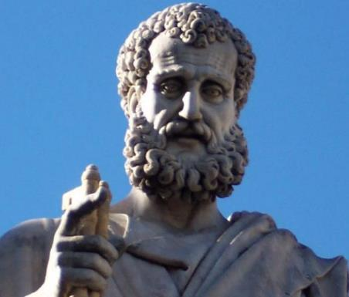

2 Peter
Dr. Andy Woods
Senior Pastor – Sugar Land Bible Church
President – Chafer Theological Seminary

Slide 2

INTRODUCTORY MATTERS
Authorship: Peter
Biography: Gospels & Acts
Date: A.D. 64
Recipients: Regenerated, Asia Minor, Hebrews
Place of writing: Babylon
Occasion for writing: Incipient Gnosticism
Purpose: Insulation from false teaching
Structure: 3 parts
Message: Protection from false teachers
Unique characteristics: Knowledge

Slide 3
STRUCTURE
2 Peter 1 – Call to maturity
2 Peter 2 – Characteristics of false teachers
2 Peter 3 – Doctrine of the false teachers (uniformitarianism)

Slide 4
STRUCTURE
2 Peter 1 – Call to maturity
2 Peter 2 – Characteristics of false teachers
2 Peter 3 – Doctrine of the false teachers (uniformitarianism)

Slide 5
2 PETER
Chapter 1
Introduction (1:1-2)
Call to Growth (1:3-11)
Purpose Statement (1:12-15)
Coming kingdom (1:16-21)

Slide 6
STRUCTURE
2 Peter 1 – Call to maturity
2 Peter 2 – Characteristics of false teachers
2 Peter 3 – Doctrine of the false teachers (uniformitarianism)

Slide 7

2 PETER 2 OUTLINE
Predicted arrival (2:1a)
Devices (2:1b-3)
Doom (2:4-9)
Depravity (2:10-16)
Emptiness (2:17-19)
Regression (2:20-22)

Slide 8
2 PETER 2 OUTLINE
Predicted arrival (2:1a)
Devices (2:1b-3)
Doom (2:4-9)
Depravity (2:10-16)
Emptiness (2:17-19)
Regression (2:20-22)

Slide 9
DEPRAVITY OF FALSE TEACHERS
V.10-16
Licentious (10a)
Lawless (10b-11)
Animalistic (12)
Shameless pleasure seekers (13)
Eyes full of adultery (14a)
Entice unstable souls (14b)
Greedy (14c-16)

Slide 10
2 PETER 2 OUTLINE
Predicted arrival (2:1a)
Devices (2:1b-3)
Doom (2:4-9)
Depravity (2:10-16)
Emptiness (2:17-19)
Regression (2:20-22)

Slide 11
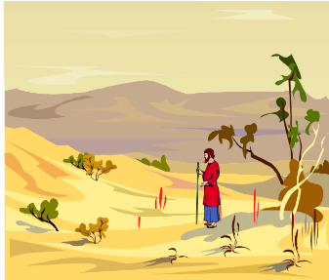
EMPTINESS OF FALSE TEACHERS
V. 17-19
Offer Nothing that is Permanently Satisfying
  Spring w/o water
  Mist

Slide 12

Mark 7:20-23
“²⁰ And He was saying, ‘That which proceeds out of the man, that is what defiles the man. ²¹ For from within, out of the heart of men, proceed the evil thoughts, fornications, thefts, murders, adulteries, ²² deeds of coveting and wickedness, as well as deceit, sensuality, envy, slander, pride and foolishness. ²³ All these evil things proceed from within and defile the man.’”

Slide 13
STRUCTURE
2 Peter 1 – Call to maturity
2 Peter 2 – Characteristics of false teachers
2 Peter 3 – Doctrine of the false teachers (uniformitarianism)

Slide 14

Ephesians 4:11-16
“¹¹ And He gave some as apostles, and some as prophets, and some as evangelists, and some as pastors and teachers, ¹² for the equipping of the saints for the work of service, to the building up of the body of Christ;” ¹³ until we all attain to the unity of the faith, and of the knowledge of the Son of God, to a mature man, to the measure of the stature which . . .

Slide 15
Ephesians 4:11-16
“... belongs to the fullness of Christ. ¹⁴ As a result, we are no longer to be children, tossed here and there by waves and carried about by every wind of doctrine, by the trickery of men, by craftiness in deceitful scheming; ¹⁵ but speaking the truth in love, we are to grow up in all aspects into Him who is the head, even . . .

Slide 16
Ephesians 4:11-16
“. . . Christ, ¹⁶ from whom the whole body, being fitted and held together by what every joint supplies, according to the proper working of each individual part, causes the growth of the body for the building up of itself in love.”

Slide 17

2 Timothy 3:16-17; 4:2
“All Scripture is inspired by God [theopneustos] and profitable for teaching, for reproof, for correction, for training in righteousness; so that the man of God may be adequate, equipped for every good work…preach the word; be ready in season and out of season; reprove, rebuke, exhort, with great patience and instruction.”

Slide 18
2 PETER 2 OUTLINE
Predicted arrival (2:1a)
Devices (2:1b-3)
Doom (2:4-9)
Depravity (2:10-16)
Emptiness (2:17-19)
Regression (2:20-22)

Slide 19
REGRESSION OF FALSE TEACHERS
V. 20-22
Return (20)
Accountability to God is Greater (21)
Two illustrations (22)

Slide 20
REGRESSION OF FALSE TEACHERS
V. 20-22
Return (20)
Accountability to God is Greater (21)
Two illustrations (22)

Slide 21
REGRESSION OF FALSE TEACHERS
V. 20-22
Return (20)
Accountability to God is Greater (21)
Two illustrations (22)

Slide 22
Matthew 11:20-24
²⁰ “Then He began to denounce the cities in which most of His miracles were done, because they did not repent. ^{21 ’}Woe to you, Chorazin! Woe to you, Bethsaida! For if the miracles had occurred in Tyre and Sidon which occurred in you, they would have repented long ago in sackcloth and ashes. ²² Nevertheless I say to you, it will be more tolerable for Tyre and Sidon in the day of judgment than for…

Slide 23
Matthew 11:20-24
…you.’” “²³And you, Capernaum, will not be exalted to heaven, will you? You will descend to Hades; for if the miracles had occurred in Sodom which occurred in you, it would have remained to this day. ²⁴Nevertheless I say to you that it will be more tolerable for the land of Sodom in the day of judgment, than for you.”

Slide 24
REGRESSION OF FALSE TEACHERS
V. 20-22
Return (20)
Accountability to God is Greater (21)
Two illustrations (22)

Slide 25

TWO ILLUSTRATIONS
V. 22
A dog returning to its own vomit (22a)
A pig returning to the mud (22b)

Slide 26
TWO ILLUSTRATIONS
V. 22
A dog returning to its own vomit (22a)
A pig returning to the mud (22b)

Slide 27
TWO ILLUSTRATIONS
V. 22
A dog returning to its own vomit (22a)
A pig returning to the mud (22b)

Slide 28
BELIEVER OR UNBELIEVER?
BELIEVER | UNBELIEVER
Purchased (1) | Dogs/pigs (22)
Knowledge of Christ (20) | Overcome (20)
Believers can sin (1:8-10) | Other unbelievers (4-6)
Example of Lot (7-8) | Last state worse than the first (20)
Examples of Balaam (15-16) | Darkness reserved (17)

Slide 29
CONCLUSION

Slide 30
2 PETER 2 OUTLINE
Predicted arrival (2:1a)
Devices (2:1b-3)
Doom (2:4-9)
Depravity (2:10-16)
Emptiness (2:17-19)
Regression (2:20-22)

